Slide 1

Automating Financial Budget Reports
by
Manali Gawde
November 2024

Slide 2
Agenda
Introduction
The Challenge
Project Goals
Implementation Steps
Technology used
Results and Impact
Lesson Learned
Q&A

Slide 3
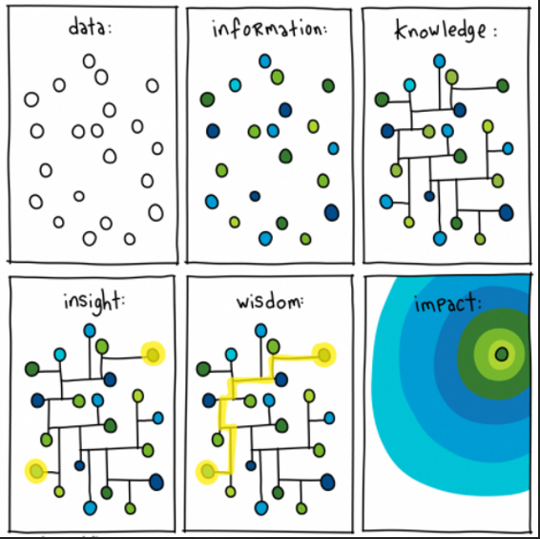
Introduction

Slide 4
“Our ambition is to lead the energy transition by leveraging cutting-edge technologies and data-driven solutions to deliver cleaner and more efficient energy to our customers.”
- Luc Rémont CEO of EDF

Slide 5
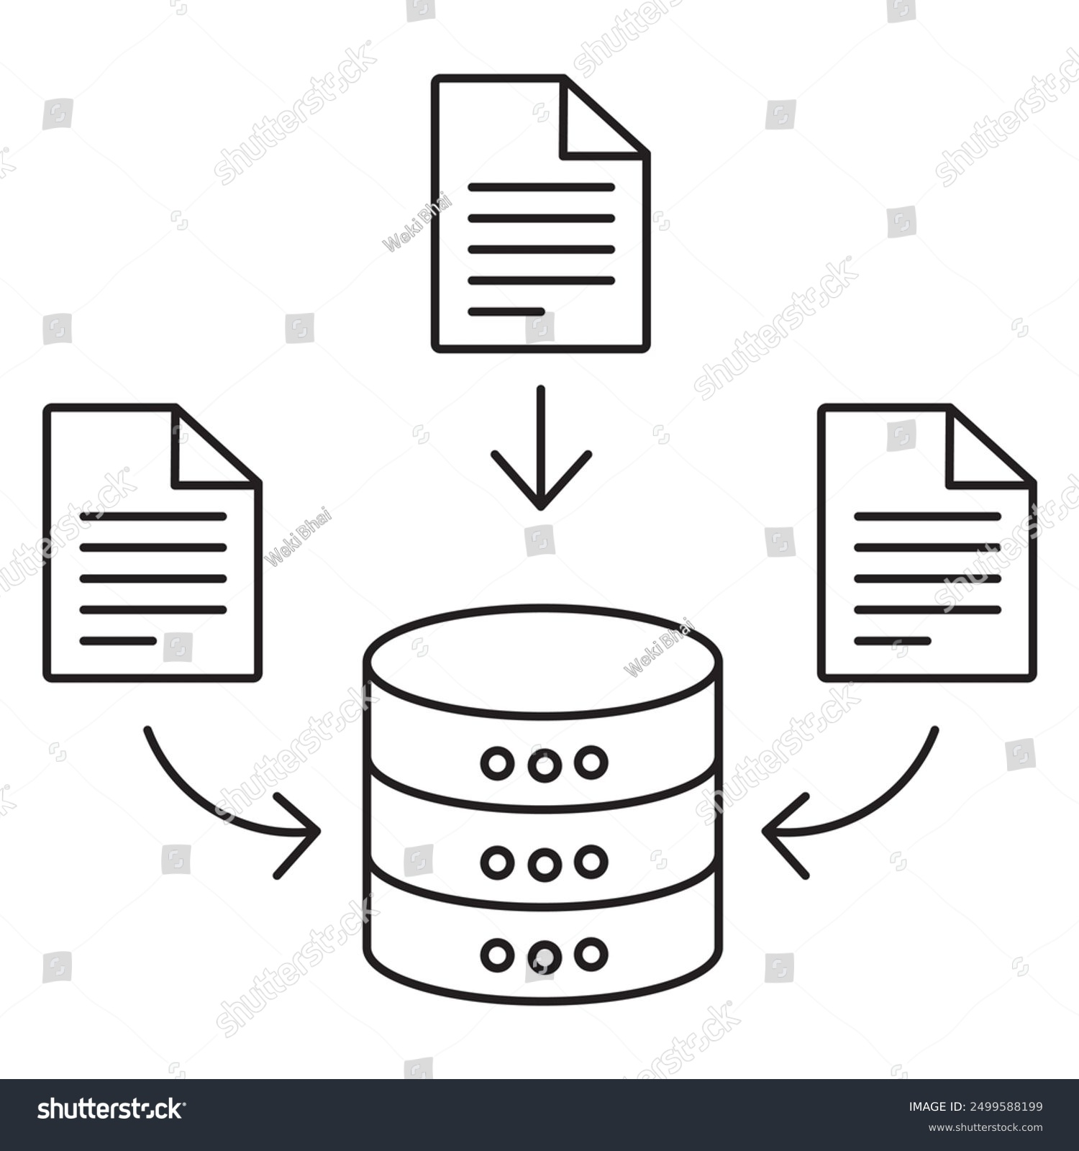


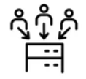
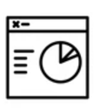

The Challenge
Data Collection
Day 0
Requesting additional/ validation
Data Cleaning
0 – 7 days
7 – 14 days
Manual calculation on Excel
Pivot tables
14 –15 days
15 – 17 days
Submitting to Finance
Day 20

Slide 6
The Project Objective
Unify Data Sources: Integrate all necessary data into a coherent financial schema to simplify access and manipulation.
Automate Report Generation: Develop a system to automate the entire process from data extraction to report generation.
Enhance Decision Making: Provide our finance team with timely, accurate financial reports every quarterly by triggering the DAG.

Slide 7
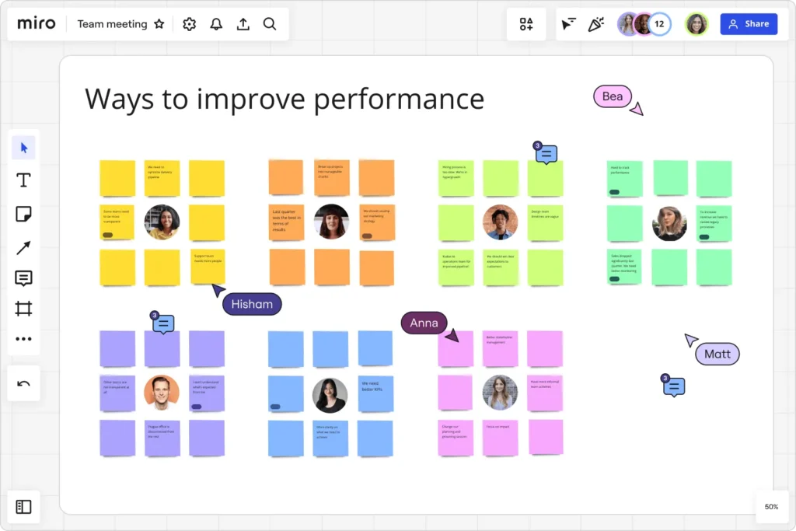
Solution Design
I initiated the project by conducting detailed discussions with key stakeholders to identify their specific needs.
This led to the design of a new financial schema that would incorporate essential fields from existing databases and introduce several new fields to fill data gaps.

Slide 8
Implementation Strategy
Database Restructuring: I restructured our existing database schema to create new dimensional and fact tables that better reflected our reporting needs.
Data Migration: I then migrated all relevant data to a new, cloud-based PostgreSQL database, ensuring enhanced accessibility and scalability.
Scripting and Automation: I wrote scripts that automatically pull data from the new schema, apply necessary financial calculations, and generate budget reports without manual intervention

Slide 9
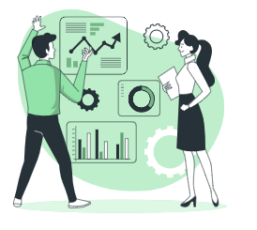
Process Flow
Workshop for requirement gathering
Build new financial schema
Build the data model on cloud based PostgresSQL DB
Migration of data with validation and mapping
Automation script to calculate budget
Storing the output data as summary tables in BigQuery
Scheduling the DAG every quarterly.
Connecting the DB to Grafana for dashboarding and monitoring.

Slide 10


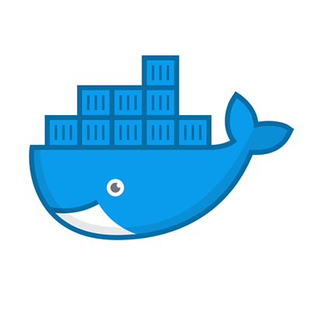

Project Flow
Git push
GitLab CI/CD pipeline
Docker image on Google Registry
Triggering DAG on Airflow

Slide 11
Technologies Used
Database Technology: PostgresSQL, BigQuery
Scripting Languages: Python, SQL,
Version Control: Git, Gitlab
Cloud services: Google Cloud Platform
Cloud services: Google Artifacts, Google composer, GKE, BigQuery
Devops: GitLab CI, docker
Visualization Tools: Grafana

Slide 12
Results Achieved
The automation of the budget reporting process led to a 70% reduction in time spent generating reports.
Error rates in financial data have decreased, ensuring more reliable data for decision-making.
Adapted by wider team within the organization.

Slide 13
Through iterative testing and continuous stakeholder feedback, we refined our database schema to ensure all data elements were accurately represented.
Lessons Learned
Best practices that emerged from this project include thorough stakeholder engagement during the requirement gathering phase and the adoption of agile methodologies for continuous improvement.

Slide 14
Thank You

