Slide 1

Optimizing Profit Cost Calculation
by
Manali Gawde
September 2024

Slide 2
Agenda
Introduction
Overview of the Dataset
Data Transformation and Cleaning
Insights and Additional Analysis
Challenges and Learnings
Q&A

Slide 3
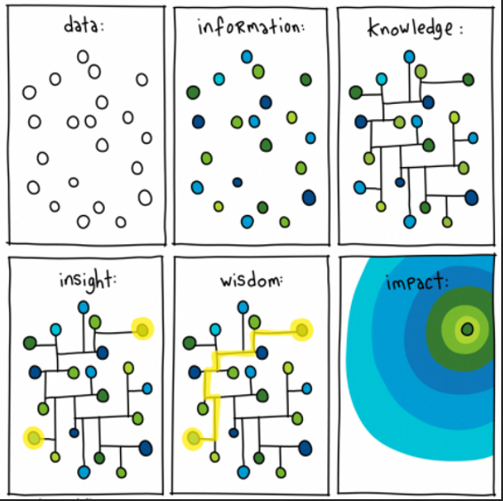
Introduction

Slide 4
“If we are to reimagine the Jaguar Land Rover business, and the automotive sector, we need to create this new data-first mindset”
Clive Benford, Ex-Data Office Director at Jaguar Land Rover
Source: Tableau

Slide 5

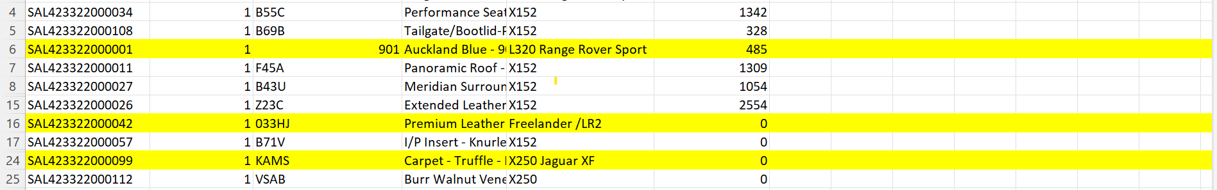
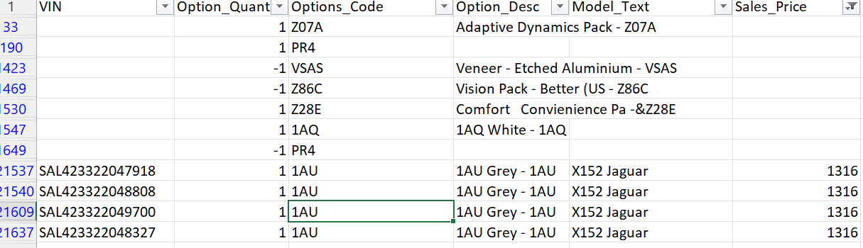
Overview of Dataset
Dataset 1 – Base_Data.csv
Dataset 2 – options_data.csv
Dataset 2 – vehicle_line_mapping.csv
Connection ? Link?
Missing Data and Presumed quality
Removal of Duplicates ,Name mismatch scenario, Finding Anomaly

Slide 6

Development
Ingest CSV into GCS
Load Data GCS to BigQuery
Read Data from GCS
Data Cleaning
Merging the data sets
Applying logic by Analyst
Profit Calculation
Saving the output in BigQuery tables

Slide 7
Dataset 1 :Base Data
Created a new column for Model_code from Model_Text
Removed null values from Sales_Price
Data Transformation

Slide 8
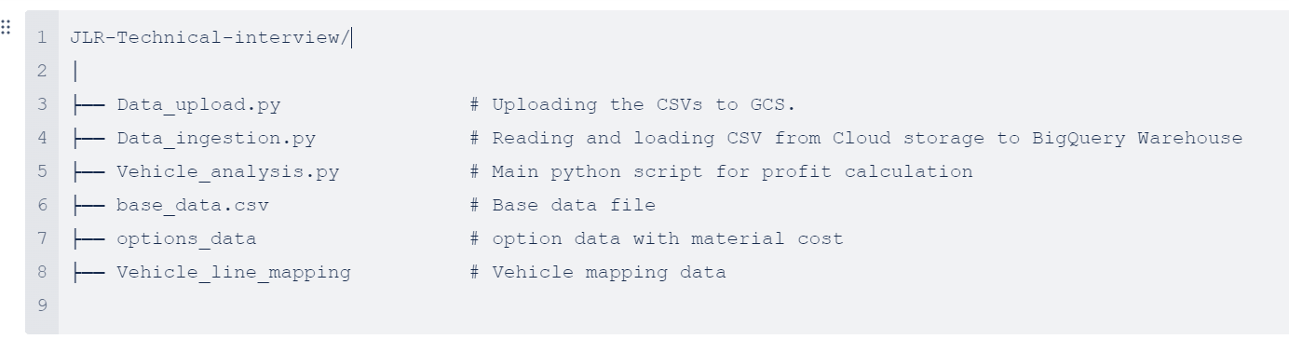
Project Hierarchy

Slide 9
Python Script

Slide 10
Thank You

