Slide 1

Optimizing Profit Cost Calculation
by
Manali Gawde

Slide 2
Agenda
Introduction
Overview of the Dataset
ERD
Data Transformation
Development
Python script
Q&A

Slide 3
Introduction

Slide 4
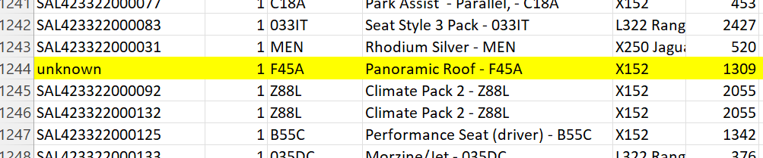
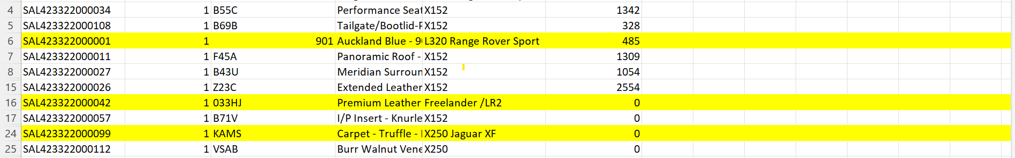
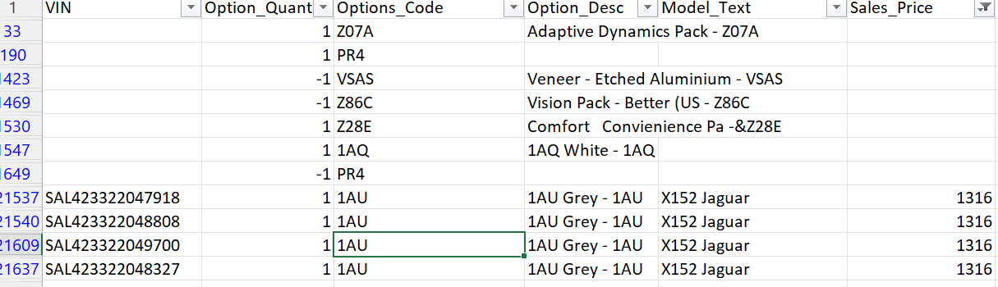
Dataset Overview
Dataset 1 – Base_Data.csv
Dataset 2 – options_data.csv
Dataset 2 – vehicle_line_mapping.csv
Notes:
Formatting issue: option_code column
Inconsistent pattern: text(mainly model names of car) after the pattern in model_text
null values: observed in VIN, sales_data, option_desc columns
Difficult to assume: option_quality .

Slide 5
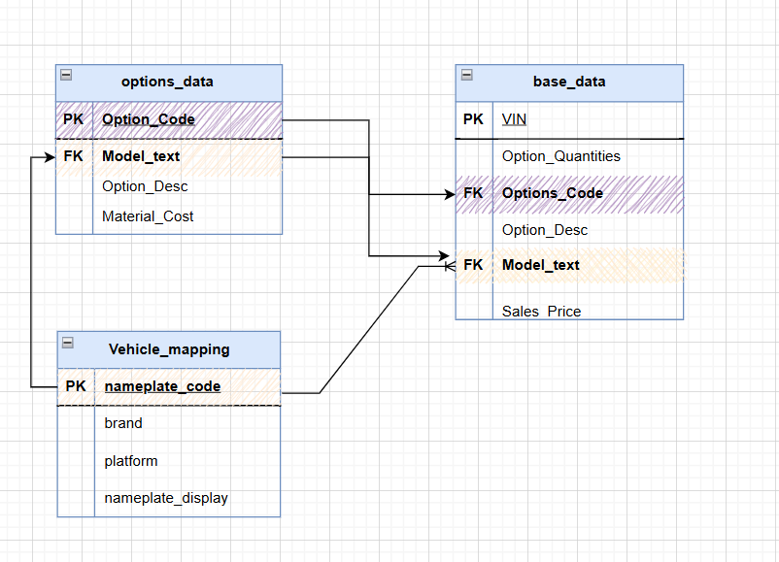
Entity Relation Diagram

Slide 6
ETL PIPELINE
Ingest CSV into GCS(Staging area)
Read Data from GCS
Data Cleaning
Merging the datasets
Applying logic by Analyst
Profit Calculation
Saving the output in BigQuery tables
Data Visualization using BigQuery
Notes:
Load Data GCS to BigQuery

Slide 7




END TO END CICD PIPELINE
Push code
Github CI/CD pipeline
Docker image on Artifact registry
Triggering DAG on Airflow

Slide 8
Dataset 1 :Base Data
Created a new column for Model_code from Model_Text
Removed null values from Sales_Price
Removed null values from VIN
Removed Duplicates
Applied Regex for model_text column.
Data Transformation

Slide 9
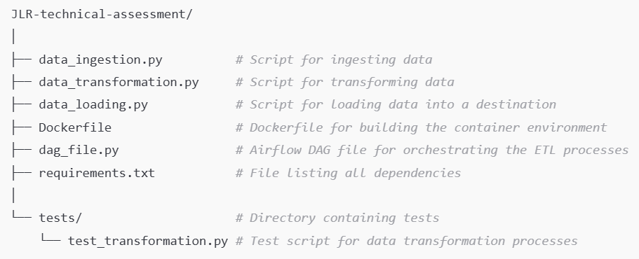
Project Hierarchy

Slide 10
Cloud Storage

Slide 11
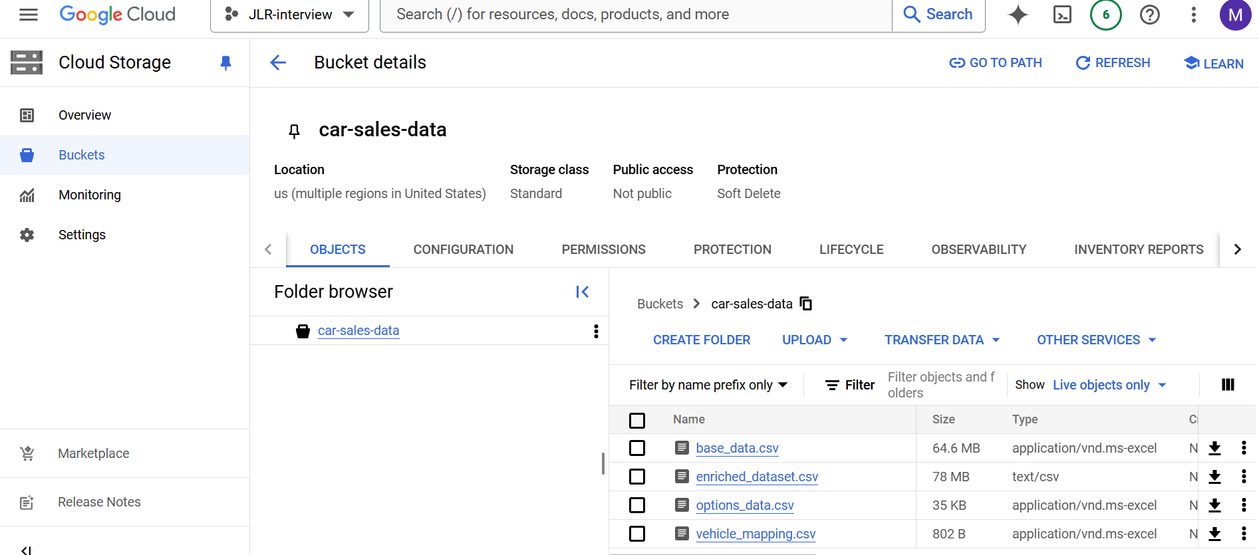
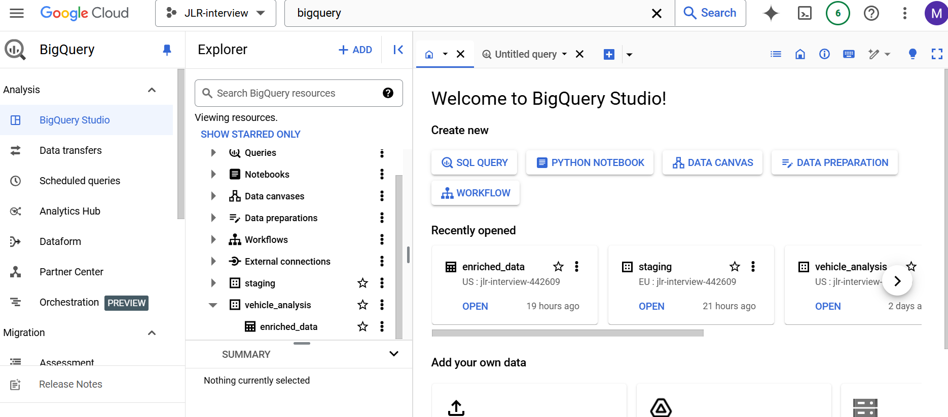



Slide 12
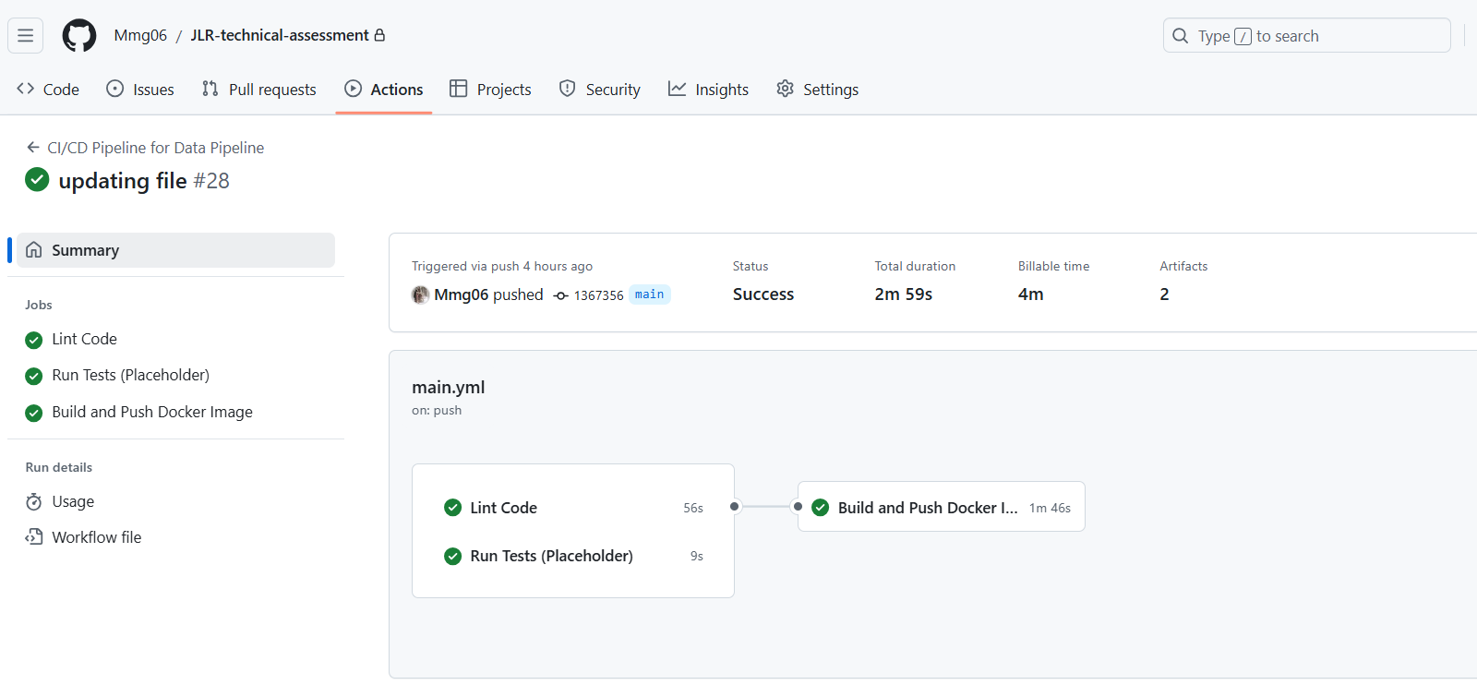
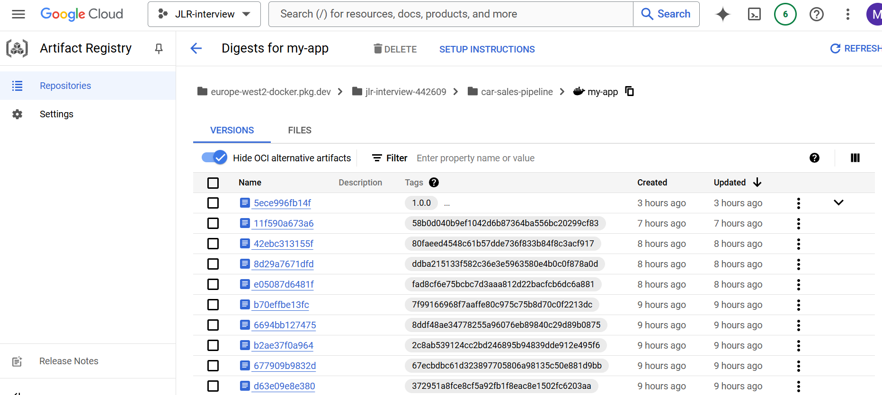
CICD pipeline

Slide 13
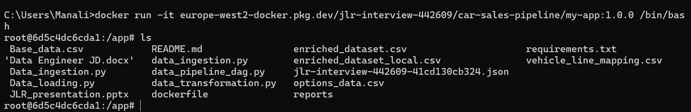
Docker Container

Slide 14
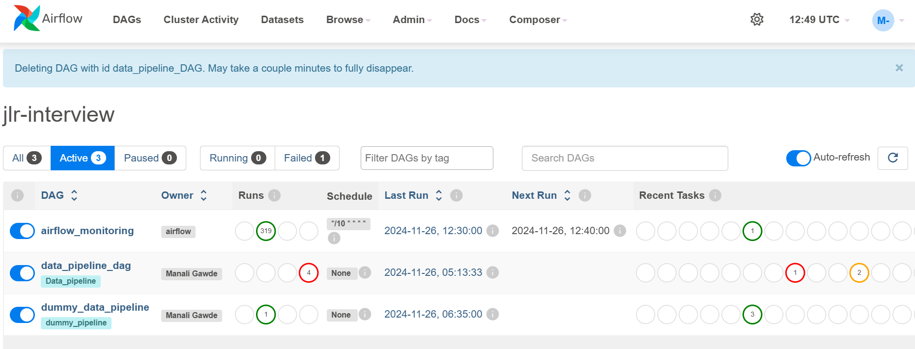
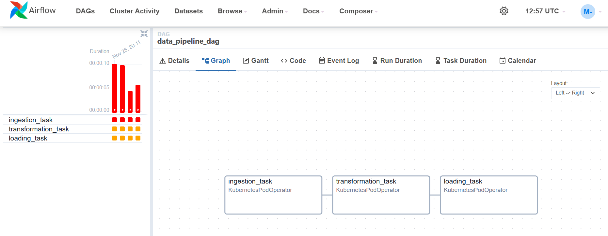
Airflow

Slide 15
Thank You

