Slide 1
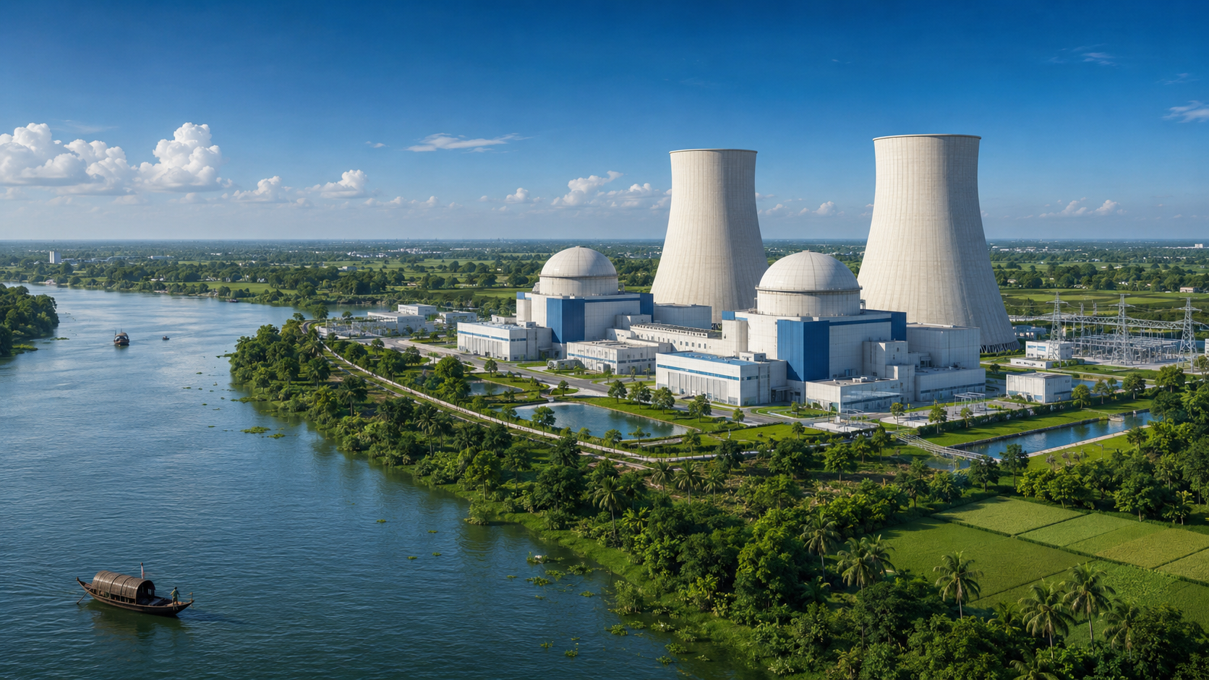
Environmental Impact Assessment (EIA) of Rooppur Nuclear Power Plant
Rooppur Nuclear Power Plant (RNPP), Bangladesh | 10-presenter academic seminar
Rooppur Nuclear Power Plant
Environmental benefits, risks, safety systems and sustainability governance
University Seminar
30–35 minutes
10 presenters
01
Notes:
Presenter 1: Open with the title and explain that the deck evaluates RNPP through environmental benefits, environmental challenges and management strategies.

Slide 2
Presentation Outline
Presenter allocation and flow of discussion
Context
Technology
Introduction, energy crisis, history, site selection
Reactor type, PWR, core, coolant, turbine systems
EIA Focus
Management
Population, land use, earthquake risk, disasters
Waste, safety, recommendations, conclusion
35 slides | 10 presenters | Dark blue + white + green academic theme
02
Notes:
Presenter 1: Briefly describe the flow. Do not spend long here. Tell the audience each presenter covers a specific thematic block.

Slide 3
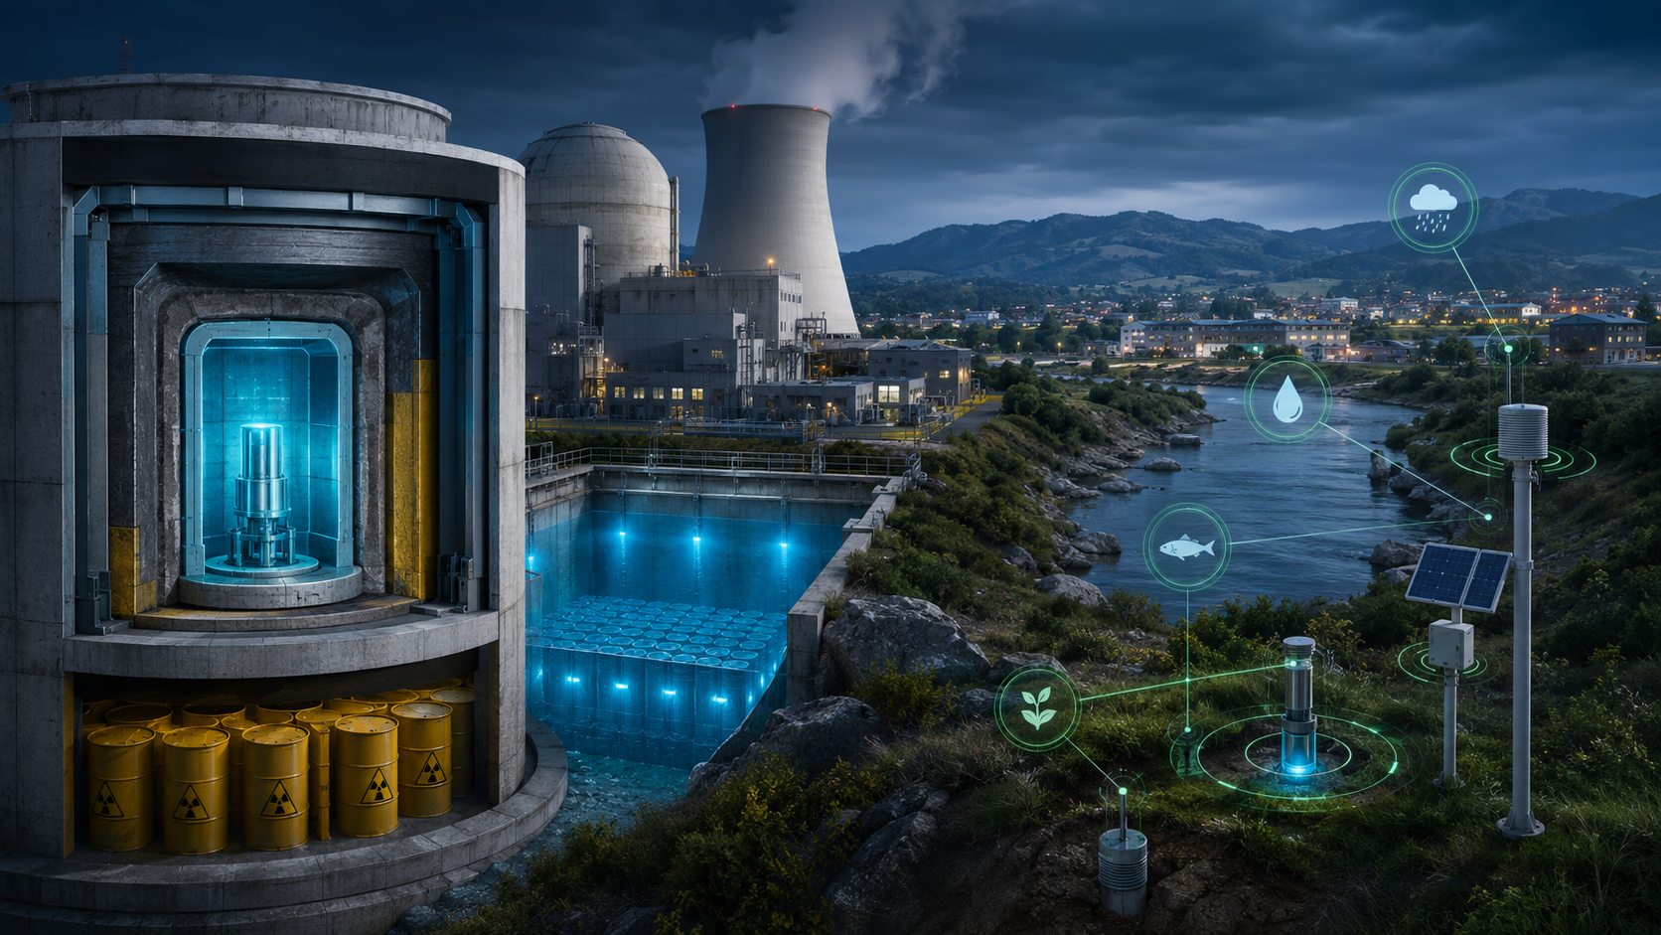
Introduction
RNPP as a national energy mega-project
RNPP is presented as Bangladesh’s premier mega-project for long-term energy independence.
The source deck describes two advanced reactor units with a combined 2.4 GW generation capacity.
The project is framed as a bridge between rapid economic growth and cleaner electricity generation.
EIA is essential because nuclear projects combine energy benefits with long-term environmental responsibilities.
2.4 GW
2
10%
Combined generation capacity
Advanced units
Approx. demand coverage
03
Notes:
Presenter 1: Explain RNPP as a major energy intervention. Stress that nuclear power can produce large baseload electricity but requires rigorous EIA and safety governance.

Slide 4
Bangladesh Energy Crisis
Why RNPP is framed as a strategic response
Energy
Need
Power
Shortage
Nuclear
Energy
RNPP
Electricity
Generation
Economic
Development
Demand pressure
RNPP response
Rapid industrialisation and urbanisation increase electricity demand, while domestic gas reserves and fuel imports create uncertainty.
The source deck positions 2,400 MW of constant baseload nuclear electricity as a stabilising contribution to the national grid.
Development logic
Stable electricity supports industry, households, economic zones and regional development in the western grid zone.
04
Notes:
Presenter 1: Use the flowchart to explain how energy demand leads to interest in nuclear power and how RNPP is linked to electricity generation and development.

Slide 5
History of Rooppur Nuclear Power Plant
Long-term nuclear ambition realised through RNPP
Early energy planning
Historical significance
Strategic continuity
RNPP represents Bangladesh’s transition from long-term nuclear planning to physical nuclear infrastructure and future grid integration.
The source content frames RNPP as a landmark initiative for long-term energy independence and national technological advancement.
Nuclear project revival
International partnership
Seminar framing
Construction and installation
Discuss history as a development storyline rather than only a construction chronology: energy ambition, partnership and safety capacity.
Operational readiness
05
Notes:
Presenter 2: Explain that RNPP is historically important because it turns Bangladesh’s nuclear energy ambition into a concrete power project.

Slide 6
Project Timeline
Planning to long-term operational management
Planning
Site
Development
Reactor
Installation
Testing
Operation
Monitoring
Timeline interpretation
The project timeline should be understood as a life-cycle process. It extends from planning and construction to operation, waste management, decommissioning and continuous environmental monitoring.
60 yr
80 yr
EMP
Operational baseline
Possible lifecycle extension
Continuous management
06
Notes:
Presenter 2: Present the timeline as life-cycle thinking. Emphasise that EIA is not finished after construction; it must continue during operation.

Slide 7
Site Selection
Rooppur site characteristics and environmental relevance
Location: Rooppur in Ishwardi Upazila, Pabna District.
Distance: approximately 160 km northwest of Dhaka according to the source deck.
Hydrological setting: eastern bank of the Padma River, important for cooling-water access.
Industrial footprint: approximately 1,062 acres, requiring planning-zone management.
Rooppur
Schematic location: Padma River edge
07
Notes:
Presenter 2: Explain why site selection matters for EIA: river cooling water, land footprint, settlement context and environmental safeguards.

Slide 8
Reactor Type
VVER-1200 Generation III+ nuclear reactor
Reactor family
The source deck states that RNPP uses Russian VVER‑1200 reactors. VVER reactors are pressurized water reactors.
Generation III+
The deck describes the plant as using advanced Generation III+ technology with modern safety standards.
Operational design
The facility is engineered for a 60-year baseline with the possibility of extending the lifecycle to around 80 years.
08
Notes:
Presenter 3: Define the VVER-1200 as the central technical feature. Link reactor type to safety and environmental management.

Slide 9
Pressurized Water Reactor (PWR)
Core logic of the RNPP reactor system
Uranium
Fuel
Reactor
Core
Heat
Generation
Steam
Generator
Steam
Turbine
Generator
Electricity
PWR principle
EIA relevance
In a pressurized water reactor, heat generated in the reactor core is transferred through a closed water system to produce steam for the turbine-generator cycle.
Understanding the reactor system helps identify heat pathways, cooling-water requirements, radioactive inventory and engineered safety barriers.
Heat
Steam
Electricity
Main energy transfer
Turbine driver
Grid output
09
Notes:
Presenter 3: Walk through the PWR flow from uranium fuel to electricity. Explain that this diagram connects engineering with EIA.

Slide 10
Fuel Assemblies and Reactor Core
Where nuclear heat is produced
Fuel assemblies
Fuel assemblies hold uranium fuel in an organised reactor-core geometry. This arrangement supports controlled fission and heat production.
Core safety focus
Core control, cooling availability and containment are central because the reactor core contains the main radioactive inventory.
Reactor core schematic
Environmental importance
Fuel integrity and cooling-system performance are directly linked to accident prevention and radiological environmental protection.
10
Notes:
Presenter 3: Explain the reactor core in simple terms: fuel assemblies produce heat and must be cooled and controlled safely.

Slide 11
Methodology
EIA-based analytical framework for RNPP
Baseline
assessment
Assessment scope
The assessment considers energy benefits, site conditions, water use, thermal discharge, waste management, radiation safety, biodiversity and community impact.
Impact
identification
Impact
prediction
Evidence basis
The deck is structured around the uploaded RNPP content: capacity, technology, environmental benefits, potential risks, mitigation and governance.
Impact
evaluation
Mitigation
Management logic
Monitoring
and review
EIA is treated as a decision-support process: identify impacts, reduce negative effects, monitor outcomes and adjust management.
11
Notes:
Presenter 4: Introduce the EIA methodology. Emphasise that EIA is a structured process, not only a list of impacts.

Slide 12
Reactor Coolant System
Cooling, heat transfer and river protection
Environmental concern
The source deck identifies thermal pollution in the Padma River as an important environmental issue requiring continuous monitoring.
Reactor
Steam
Generator
Safeguard
Cooling systems should dissipate heat before discharge to keep final water temperatures within safe environmental limits.
Cooling-water protection logic
Monitoring parameter
Important parameters include river temperature, discharge temperature, dissolved oxygen and fish-response indicators.
12
Notes:
Presenter 4: Explain coolant system relevance. Focus on how cooling water connects nuclear technology to Padma River environmental monitoring.

Slide 13
Fuel Handling Process
From fresh fuel to spent fuel management
Fresh
Fuel
Fuel
Loading
Core
Operation
Spent
Fuel
Cooling
Pool
Secure
Storage
Fresh fuel handling
Spent fuel risk
Source-deck strategy
Fresh nuclear fuel requires strict control, security and technical protocols before reactor loading.
Spent fuel contains high radioactivity and heat, so it requires cooling, shielding and long-term controlled storage.
The uploaded deck states that spent nuclear fuel is transported back to Russia under a management agreement.
EIA link
Fuel handling is central to nuclear EIA because it affects accident prevention, waste planning, emergency response and public trust.
13
Notes:
Presenter 4: Explain the fuel handling chain. Stress spent fuel as the most important long-term waste concern.

Slide 14
Turbine Generator
Mechanical conversion of steam energy into electricity
Steam
Turbine
rotation
Generator
Transformer
National
Grid
Turbine function
Generator function
Steam produced through heat exchange rotates turbine blades, converting thermal energy into mechanical energy.
The generator converts mechanical rotation into electrical energy for transmission through the national grid.
Environmental connection
The turbine island is not radioactive like the reactor core, but it is linked with cooling water, condenser operation and thermal discharge management.
14
Notes:
Presenter 5: Explain the turbine-generator simply: steam to rotation to electricity. Link it to cooling and heat discharge.

Slide 15
Feed Water System
Water circulation and condenser support
Purpose
Condenser
The feed water system returns condensed water to the steam generator, helping maintain continuous electricity generation.
Feed water pump
Steam generator
Environmental relevance
Feed-water and condenser performance influence cooling-water demand, discharge temperature and plant efficiency.
Steam to turbine
Condensation return
Monitoring relevance
EIA should treat water circulation, temperature control and river-interface performance as operational monitoring priorities.
Closed steam-water cycle
15
Notes:
Presenter 5: Explain the feed-water cycle and why it matters for cooling, efficiency and environmental monitoring.

Slide 16
Electricity Generation Process
Uranium fuel to grid supply
Uranium
Fuel
Reactor
Core
Heat
Steam
Generator
Turbine
Generator
Electricity
Nuclear fission in the reactor core produces heat rather than combustion gases.
Heat is transferred to generate steam, which drives the turbine-generator system.
Electricity is transmitted through high-voltage lines into the national grid.
Environmental attention focuses on heat control, coolant integrity, radiation safety and waste management.
16
Notes:
Presenter 5: Summarise the complete electricity generation process and connect technical steps with environmental concerns.

Slide 17
Environmental Impact Assessment
Impact framework for RNPP
Project
activities
Baseline environment
EIA begins by understanding the Padma River, local ecology, land use, population, water quality and background radiation context.
Impact
identification
Impact
prediction
Impact pathways
Project activities may affect air quality, water temperature, aquatic ecology, radioactive waste handling, land use and community perception.
Impact
evaluation
Mitigation
Management response
Monitoring
Mitigation and monitoring convert environmental risks into manageable operational responsibilities through EMP implementation.
Review
17
Notes:
Presenter 6: Explain EIA as a structured cycle. Relate each step to RNPP environmental issues.

Slide 18
Population Density
Community exposure and planning relevance
Why population matters
Population density determines emergency-planning needs, public communication strategy, exposure assessment and evacuation planning zones.
EIA relevance
RNPP EIA should evaluate settlements, sensitive receptors, schools, healthcare centres, farms and transport access in the planning zone.
Schematic population-density field
Visual interpretation
This slide uses a schematic density graphic; exact population mapping would require census and GIS data.
18
Notes:
Presenter 6: Clarify that population density is important for safety planning, emergency communication and exposure assessment.

Slide 19
Land Use and Planning Zone
Spatial planning around the nuclear facility
Project footprint
The source deck notes an industrial structural footprint of about 1,062 acres, requiring land-use control.
RNPP
Planning zone
Planning zones help manage incompatible land uses, emergency access, security, monitoring stations and community interfaces.
EIA focus
Planning-zone schematic
Land-use assessment should consider agriculture, settlements, riverbank activities, transport corridors and industrial support facilities.
19
Notes:
Presenter 6: Describe planning-zone importance for safety, monitoring, infrastructure and land-use control.

Slide 20
Earthquake Risk
Hazard resistance as a safety requirement
Source-deck safety claim
The uploaded deck states that RNPP is designed to survive earthquakes, extreme internal pressure and external impacts.
EIA perspective
Earthquake risk matters because ground shaking could affect containment, cooling-water systems, power supply and emergency response functions.
Management priority
Earthquake hazard schematic
Seismic design verification, inspection, emergency drills and redundant safety systems are essential in nuclear project governance.
20
Notes:
Presenter 7: Discuss earthquake risk as a design and emergency-planning issue. Avoid unsupported numbers and focus on the safety design statement in the source deck.

Slide 21
Natural Disasters
Multi-hazard considerations for RNPP operation
Flood / river dynamics
Earthquake / structural stress
The Padma River setting creates hydrological relevance: riverbank stability, sedimentation, water intake and flood-season management.
Nuclear infrastructure must maintain containment, cooling and power functions during extreme external events.
Extreme weather
Operational resilience
Emergency power, access roads, logistics and monitoring systems should remain functional during severe weather conditions.
A resilient nuclear EIA must connect hazard assessment with defense-in-depth, emergency response and periodic safety review.
Spent
fuel
Thermal
discharge
Likelihood ↑
Siltation
Biodiversity
Air
emissions
21
Consequence →
Notes:
Presenter 7: Explain natural disasters as multi-hazard stressors that require resilience planning and monitoring.

Slide 22
Fukushima Lessons
Why defense, redundancy and emergency response matter
Lesson 1: cooling continuity
Lesson 2: emergency power
Severe nuclear accidents highlight the importance of maintaining cooling capacity even during extreme external hazards.
Backup power, redundancy and rapid response procedures are essential for preventing cascading failures.
Lesson 3: communication
RNPP connection
Transparent public communication and evacuation planning are central to risk governance and trust.
The source deck emphasises passive containment, core catcher, double containment and extreme-hazard resistance as key safety features.
External
Hazard
Loss of
Function
Safety
System
Emergency
Response
Environmental
Protection
22
Notes:
Presenter 7: Frame Fukushima as a lesson for safety culture. Do not overgeneralise; connect the lesson to cooling continuity, emergency power and defense-in-depth.

Slide 23
Radioactive Waste
Long-term environmental responsibility of nuclear power
Waste type | Examples | Environmental concern
LLW | Tools, clothing, minor contaminated materials | Volume management and controlled disposal
ILW | Filters, resins, contaminated components | Shielding and solidification needs
HLW | Spent fuel | High radioactivity, heat and long-term isolation
Spent fuel | Used fuel assemblies | Cooling, storage and secure transfer
Source-deck position
The source deck states that all hazardous spent nuclear fuel is securely managed and transported back to Russia under oversight.
23
Notes:
Presenter 8: Explain the waste categories and why spent fuel is the most sensitive long-term environmental issue.

Slide 24
Waste Management
From waste generation to control pathway
Waste
generation
Low and intermediate waste
Tools, clothing, filters and resins are compressed, sealed or solidified depending on waste category and radiation level.
Classification
Treatment
High-level waste
Used fuel is stored in cooled pools and then managed under strict arrangements; the source deck identifies return to Russia as a key strategy.
Temporary
storage
Transport /
return
Governance need
Waste management requires traceability, security, radiation monitoring, regulatory inspection and transparent reporting.
Final
disposal
24
Notes:
Presenter 8: Explain waste management as a chain of control: classify, treat, store, transport and monitor.

Slide 25
Spent Fuel Storage
Cooling pool and secure temporary storage
Spent
Fuel
Cooling
Pool
Temporary
Storage
Treatment
Final
Disposal
Why cooling is required
Spent fuel remains thermally hot and highly radioactive after removal from the reactor core. Cooling pools remove decay heat and provide radiation shielding.
EIA focus
Cooling pool schematic
Spent fuel storage requires water quality control, pool integrity, security, emergency backup and regulatory inspection.
25
Notes:
Presenter 8: Explain why spent fuel goes to cooling pools and why this is one of the most important nuclear EIA issues.

Slide 26
Safety Management
Institutional and technical control system
Technical safety
Operational safety
VVER‑1200 technology, double containment, core catcher and passive safety systems are presented as major engineering controls.
Safety management depends on trained staff, maintenance culture, monitoring, reporting, emergency drills and regulatory compliance.
Environmental safety
Public safety
Water, waste, biodiversity, radiation and thermal monitoring translate technical safety into environmental protection.
Community awareness, emergency preparedness and transparent communication improve trust and preparedness.
Design
Operation
Monitoring
Regulation
Emergency
Response
26
Notes:
Presenter 9: Explain safety management as a combination of technology, people, institutions and monitoring.

Slide 27
Defense in Depth
Five-layer protective philosophy
Layer 5: External hazard resistance
Layer 4: Double containment dome
Layer 3: Engineered safety systems
Layer 2: Core catcher and cooling
Layer 1: Operational control
Source-deck claim
The uploaded deck explicitly mentions five-layer containment, double concrete domes and a core catcher as core safety measures.
27
Notes:
Presenter 9: Use the layered figure to explain the idea of defense in depth: multiple barriers, not a single safety feature.

Slide 28
Passive Safety System
Safety features designed to function under stress
Passive safety idea
Core catcher
Passive safety refers to systems designed to protect the reactor with minimal dependence on active human intervention or external power.
The source deck describes the core catcher as a cooling trap below the vessel to catch and cool molten fuel in a severe meltdown scenario.
Double containment
Environmental relevance
Heavy inner and outer concrete containment domes limit release pathways and strengthen the plant’s external resistance.
Passive systems reduce the probability of severe accident progression and therefore reduce radiological environmental risk.
Core
Double
Passive
Catcher
Containment
Barriers
28
Notes:
Presenter 9: Explain core catcher and containment in simple terms. Connect passive safety with environmental protection.

Slide 29
Advantages
Positive contributions of RNPP
Advantage | Explanation
Clean-air operation | No routine coal-smoke, SO2, NOx or PM emissions during generation
Stable baseload power | Large continuous electricity source that supports grid reliability
Energy diversification | Reduces dependence on fossil-fuel imports and gas availability
Economic development | Supports jobs, infrastructure and industrial development
Technological capacity | Builds nuclear engineering and regulatory skills in Bangladesh
29
Notes:
Presenter 10: Summarise advantages using the table. Emphasise clean air, stable baseload power and energy diversification.

Slide 30
Environmental Challenges
Risks that require careful management
Challenge | Potential environmental implication | Required response
Thermal discharge | River temperature change and aquatic stress | Cooling towers and discharge monitoring
Radioactive waste | Long-term contamination risk if mismanaged | Secure storage, tracking and international oversight
Water dependence | Operational vulnerability to river changes | Hydrological monitoring and contingency planning
Biodiversity | Fish migration and habitat stress | Intake screens and ecological auditing
Siltation | Intake blockage and maintenance pressure | Dredging and sediment management
30
Notes:
Presenter 10: Explain that challenges do not mean the project cannot proceed, but they require strict mitigation and monitoring.

Slide 31
Recommendations
Strengthening sustainability and governance
Build local capacity by training Bangladeshi engineers, technicians and environmental monitoring specialists.
Maintain transparent monitoring of Padma River temperature, dissolved oxygen, aquatic ecology and intake conditions.
Keep radioactive waste and spent fuel transport under strict chain-of-custody and regulatory oversight.
Strengthen emergency preparedness through drills, communication protocols and community awareness programmes.
Publish periodic EMP implementation reports to improve accountability and public trust.
Training
Monitoring
Waste
Control
Emergency
Planning
Transparency
31
Notes:
Presenter 10: Present recommendations as practical actions for safer and more sustainable RNPP operation.

Slide 32
Conclusion
Balanced EIA interpretation of RNPP
Opportunity
Responsibility
RNPP provides large-scale baseload electricity and is framed as a cleaner alternative to fossil-fuel thermal generation.
Nuclear power requires high institutional capacity because environmental risks can be long-term and highly sensitive.
Core trade-off
Final message
The strongest environmental benefit is clean-air operation; the strongest challenge is radioactive waste and thermal-water management.
RNPP sustainability depends on technology, monitoring, regulation, public trust and adaptive environmental management.
EIA is not only approval; it is continuous environmental governance.
32
Notes:
Presenter 10: Conclude by balancing benefits and risks. Emphasise continuous governance.

Slide 33
Future Research
Gaps that should be studied in detail
Detailed Padma River thermal plume modelling under seasonal low-flow and high-flow conditions.
Long-term aquatic biodiversity monitoring with emphasis on fish migration and intake-system effects.
Independent population exposure and emergency-response mapping for the surrounding planning zones.
Life-cycle waste management assessment, including storage, transport, return and final-disposal accountability.
Social perception and risk communication research among communities living near the RNPP site.
Water
Waste
People
Ecology
Thermal plume study
Life-cycle audit
Risk perception
Fish + habitat
33
Notes:
Presenter 10: Explain future research gaps and show how they extend the EIA agenda.

Slide 34
References
Source basis for the presentation
Primary uploaded source
Ruppur 222222(1).pptx, uploaded in this conversation. Content includes RNPP location, capacity, VVER‑1200 technology, safety, waste, biodiversity, thermal pollution and recommendations.
Requested paper
The requested paper title was: Environmental Impact of Nuclear Power Plant (Rooppur Nuclear Power Plant) on Third World Country like Bangladesh by Md. Nesar Ali et al. The searchable uploaded files did not contain the actual PDF paper.
Visual note
Maps, diagrams, risk matrices and flowcharts are presentation visuals created from the available RNPP source content and generic EIA structure.
34
Notes:
Presenter 10: Mention the source limitation honestly if asked. The provided deck content was used as the available source.

Slide 35
Thank You
Questions and Discussion
Thank You
Environmental Impact Assessment of Rooppur Nuclear Power Plant
35
Notes:
Presenter 10: Close the seminar and invite questions from the audience.

