Slide 1

Project: Analysing Movie Ratings
Intro to R Workshop
SCAN THIS FOR THE RESOURCES

Slide 2
TODAY
What we'll cover
01
04
Why R?
Data cleaning
What makes R useful for data work
Handling messy real-world data with dplyr
02
05
Setup
Visualisation
R, RStudio & the packages we need
Plotting with ggplot2
03
06
The project
Wrap-up
Scraping IMDb with rvest
Key takeaways

Slide 3
WHY R?
R is a language built for data
📊
Statistics-first
📦
Rich ecosystem
Designed by statisticians. Probability, regression & tests are built in.
CRAN hosts 20,000+ packages. tidyverse, ggplot2, rvest — all free.
🖼️
Beautiful charts
🌐
Community
ggplot2 produces publication-quality graphics with minimal code.
Active forums, R-Ladies, TidyTuesday — beginners are welcome.

Slide 4
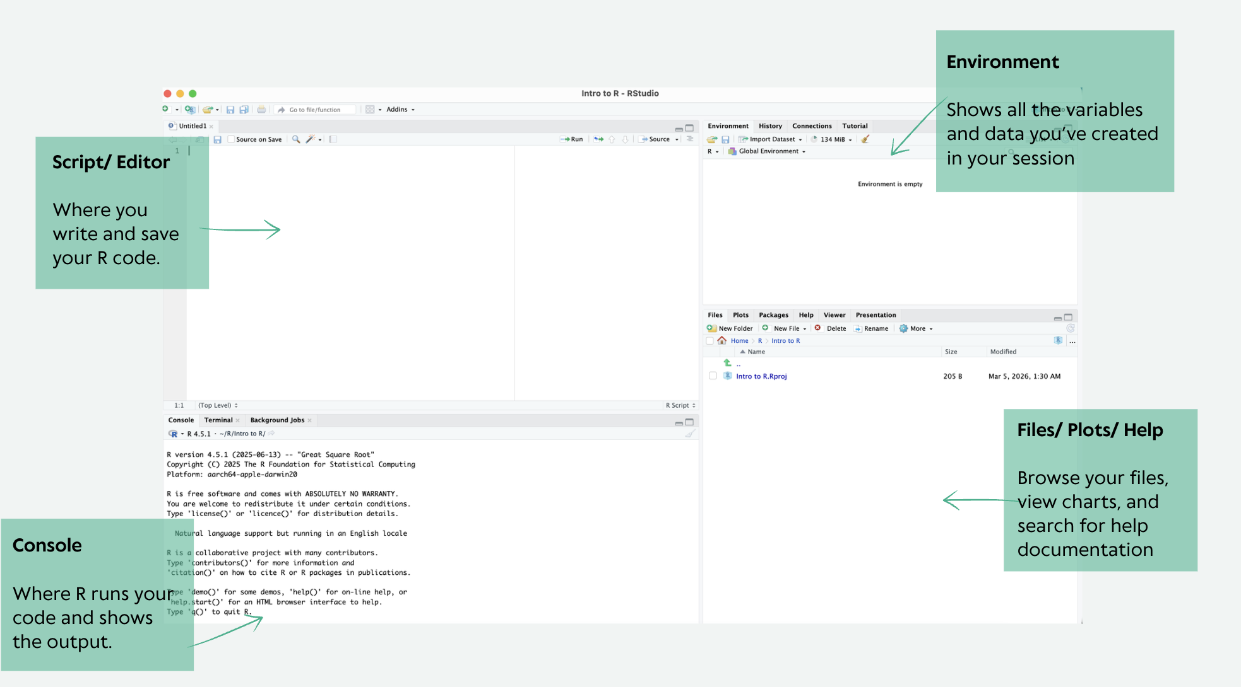
SETUP
Before we start
1
Install R
cran.r-project.org — the language itself
2
Install RStudio
posit.co — the editor we'll use today
3
Set Working Directory
New Project → New Directory → Navigate to
Desktop → Name the project Project_1
4
Install packages
Run this once in the console (below)
On a pc, you would set the working directory like this:
setwd("C:/Desktop/Project_1")
On a mac, you would set the working directory like this:
setwd("~/Desktop/Project_1")
install.packages(c("rvest", "dplyr", "ggplot2"))
library(rvest)
library(dplyr)
library(ggplot2)

Slide 5
THE PROJECT
What we're building
1
2
3
4
Scrape
Clean
Analyse
Visualise
Pull the top 50 IMDb
movies (Jan–March 2026)
Handle missing values,
fix data types
Explore ratings, and votes
Plot ratings vs votes
with ggplot2
#Dataset: IMDb top 50 films, Jan–March 2026 · Variables: title, year, runtime,
#rating, votes
#Source: web-scraped via rvest · Skills: CSS selectors, data frames, ggplot2 scatter plots

Slide 6
WEB SCRAPING
Getting data from the web
Websites are built with HTML. rvest lets R read that HTML and pull out the bits we want.
🌐
🔍
📋
Request
Parse HTML
Extract
rvest reads the page
and builds a tree
CSS selectors pull out
specific elements
R sends an HTTP request
to the IMDb URL. However, some sites like IMDb, Amazon or LinkedIn block automated access. Save the relevant IMDb page as an HTML file in your working directory.
CSS selectors
html_nodes() takes a CSS selector — the same syntax used in web styling. Your browser's Dev Tools (F12) let you inspect any element to find its selector.
html_text()
Extracts the visible text from each matched node.
# URL to save the file (Format: Web Page, Complete): https://www.imdb.com/search/title/?title_type=feature&release_date=2026-01-01,2026-03-31&sort=num_votes,desc
# Save it in your working directory.
page <- read_html("imdb.html")

Slide 7
WEB SCRAPING
Extracting all variables
# Extract each field
# Titles (will include rank prefix e.g. "1. Project Hail Mary")
titles <- page %>% html_nodes("h3.ipc-title__text") %>% html_text()
titles <- titles[1:48]
# we have trimmed to 48 films as 2 of the films are missing their metadata entirely (you can check using the length(), head() and tail() functions)
# Rating and votes
rating <- page %>% html_nodes(".ipc-rating-star--rating") %>% html_text()
rating <- rating[1:48]
votes <- page %>% html_nodes(".ipc-rating-star--voteCount") %>% html_text()
votes <- votes[1:48]
# Year, runtime, certificate — all in the same repeating list
meta <- page %>% html_nodes(".ipc-inline-list__item") %>% html_text()
year <- meta[seq(1, 144, 3)]
runtime_raw <- meta[seq(2, 144, 3)]
certificate <- meta[seq(3, 144, 3)]
movies_df <- data.frame(titles, year, runtime_raw,
certificate, rating, votes,
stringsAsFactors = FALSE)
data.frame()
Think of it like a spreadsheet in R. Each argument becomes a column. All columns must be the same length.
stringsAsFactors = FALSE
Keeps text as plain characters.
Pipe operator %>%
Passes the result on the left into the function on the right. Read it as "then".

Slide 8
DATA CLEANING
Cleaning the data with dplyr
⚠️
Wrong types
🕳️
mutate()
Creates or overwrites a column. Here we overwrite the same column with a cleaned version.
gsub()
Removes all matches of a pattern. gsub(",", "", x) strips commas from x.
filter()
Keeps only rows meeting the condition. !is.na() means "not missing".
glimpse()
Prints column names, types, and sample values — a quick sanity check.
Missing values
🔢
Formatted numbers
Rating and votes come back as character strings. We need numbers to calculate or plot.
Not every movie has all fields. NA values will break maths unless we handle them.
Vote counts are formatted with “(249K)" which is not a number R can use.
movies_clean <- movies_df %>%
mutate(rating = as.numeric(rating)) %>%
mutate(votes = as.numeric(gsub("[^0-9.]", "", votes)) *
ifelse(grepl("K", votes), 1000, 1)) %>%
mutate(titles = sub("^[0-9]+\\. ", "", titles)) %>%
filter(!is.na(rating), !is.na(votes))
glimpse(movies_clean)

Slide 9
VISUALISATION
Understanding graphics
ggplot2 builds every chart from the same three ingredients:
1
Data
ggplot(data = movies_clean, ...)
The data frame you want to plot
2
Aesthetics (aes)
aes(x = votes, y = rating)
Which columns map to x, y, colour, size…
3
Geometry (geom)
geom_point()
The shape to draw — points, bars, lines…
These layers are added together with the + operator.

Slide 10
VISUALISATION
Building the scatter plot
ggplot(data = movies_clean,
aes(x = votes, y = rating)) +
geom_point(colour = "#D64045", alpha = 0.7) +
geom_smooth(method = "lm", se = FALSE, colour = "grey40") +
labs(
title = "Do more-voted films rate higher?",
x = "Number of votes (log scale)",
y = "IMDb rating”
) +
scale_x_log10() +
theme_minimal()
ggsave("imdb_plot.png", width = 10, height = 6, dpi = 300)
alpha = 0.7
Controls point transparency (0 = invisible, 1 = solid). Useful when points overlap.
geom_smooth(method = "lm")
Adds a linear regression line. se = FALSE hides the confidence band.
scale_x_log10()
Transforms the x-axis to log base 10. Useful when data spans several orders of magnitude.
theme_minimal()
Removes chart clutter. Other options: theme_classic(), theme_bw().

Slide 11
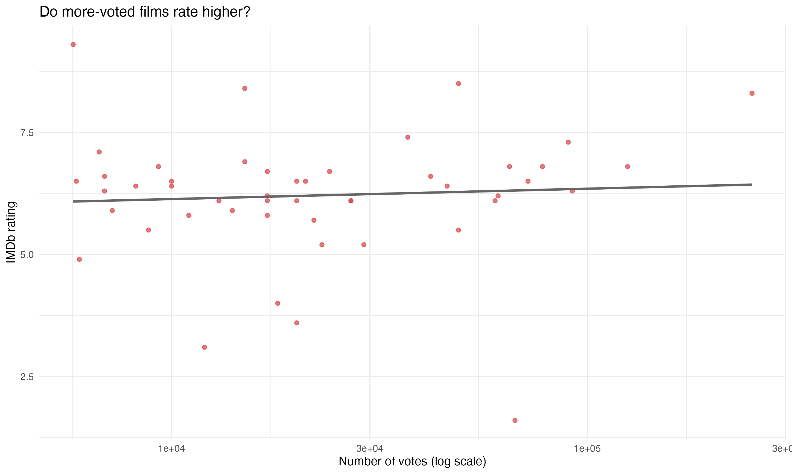
VISUALISATION
Reading your output
Spread
High variation throughout. A small sample makes individual films have an outsized effect on the pattern.
Trend line
The line is nearly flat — vote count and rating are not strongly correlated here. Films released Jan–March 2026 are very recent, so vote counts are still growing.
Outliers
Few films sit well below the trend with a very low rating. In a small sample, outliers can shift the trend line significantly.

Slide 12
GOING FURTHER
Extra questions to explore
The flat trend raises questions. Try these extensions to dig deeper:
1. Does certificate rating (PG, R, etc.) affect IMDb score?
movies_clean %>% group_by(certificate) %>% summarise(avg = mean(rating))
2. Does a longer runtime mean a higher rating?
ggplot(movies_clean, aes(x = runtime, y = rating)) + geom_point() + geom_smooth(method = "lm")
3. What happens if you widen the date range to all of 2025–2026?
Save a new page with release_date=2025-01-01,2026-03-31 and re-run. Does the trend change with more data?
4. Which film is the low-rating outlier, and how many votes does it have?
movies_clean %>% arrange(rating) %>% select(titles, rating, votes) %>% head(3)

Slide 13
REFERENCE
R concepts from today
<-
Assignment operator. x <- 5 stores the value 5 in x.
%>%
Pipe: passes the left-side result into the right-side function.
data.frame()
A table of data. Columns can have different types.
mutate()
dplyr: add or modify a column.
filter()
dplyr: keep rows matching a condition.
ggplot()
Start a plot. Add layers with +.
aes()
Map data columns to visual properties (x, y, colour, size).
geom_point()
Draw a scatter plot.

Slide 14

What you've covered today
Fetched real data from IMDb using rvest
Cleaned messy scraped data with dplyr
Visualised a pattern with ggplot2
Practised reading and writing R code
For more R projects, you can check out:
https://www.dataquest.io/blog/r-projects-for-beginners-with-source-code
PLEASE TAKE 2 MINS TO FILL OUT
THE FEEDBACK FORM

