Slide 1
Chapter4 Lists, Stacks, and Queues
1. Lists
2. Stacks
3. Queues

Slide 2
1. lists
1.1 Definition of lists
1.2 ADT of lists
1.3 Basic Implementation of Lists
  1.3.1 Array-based List
  1.3.2 Linked List
  1.3.3 Comparison
1.4 Free list
1.5 Double Linked List

Slide 3
Example of lists
Digital Library - List of books
001 | 高等数学 | 樊映川 | 机械工业出版社 | …
002 | 理论力学 | 罗远祥 | 电子工业出版社 | …
003 | 高等数学 | 华罗庚 | 高等教育出版社 | …
004 | 线性代数 | 栾汝书 | 高等教育出版社 | …
… | … | … | … | …
More example?
List of
students / airlines / songs / numbers / words...

Slide 4
Definition of lists (1)
A list is a finite, ordered sequence of data items called elements.
Notation of list: ( a₀, a₁, …,a_{n-1} )

Slide 5
Definition of lists (2)
The empty list contains no elements.
The length of the list is the number of elements currently stored.
The beginning of the list is called the head, the end of the list is called the tail.
Sorted lists and unsorted lists

Slide 6
Operation of List (1)
Operations on list:
  Add/delete element anywhere,
  search
  next
  previous
  ... ....

Slide 7
Operation of List (2)
The position of a list to execute operations is defined as a fence_{栅栏.}
For example:
<12, 22 | 32, 15,29>
fence

Slide 8
Operation of List (3)
Ex: <12 | 32, 15>
insert (99)
Result: <12 | 99, 32, 15>
remove( )
Result: <12 | 32, 15>
read( )
Get 32.

Slide 9
1. lists
1.1 Definition of lists
1.2 ADT of lists
1.3 Basic Implementation of Lists
  1.3.1 Array-based List
  1.3.2 Linked List
  1.3.3 Comparison
1.4 Free list
1.5 Double Linked List

Slide 10
List ADT
template <class Elem> class List {
public:
virtual void clear() = 0;
virtual bool setPos(int pos) = 0;
virtual bool insert(const Elem&) = 0;
virtual bool append(const Elem&) = 0;
virtual bool remove(Elem&) = 0;
virtual bool getValue(Elem&) const = 0;
virtual void setStart() = 0;
virtual void setEnd() = 0;
virtual void prev() = 0;
virtual void next() = 0;
virtual int leftLength() const = 0;
virtual int rightLength() const = 0;
virtual void print() const = 0;
};

Slide 11
List ADT Examples （1）
Insert /remove/getvalue:
MyList: <12 | 32, 15>
MyList.insert(99);
Result: <12 | 99, 32, 15>
MyList.remove(element);
Result: <12 | 32, 15>
element = 99.
MyList.getvalue(element);
element = 32.

Slide 12
List ADT Examples （2）
setStart / setEnd/next / prev
MyList: <12 | 32, 15>
MyList.setStart();
Result: < | 12, 32, 15>
MyList.setEnd();
Result: < 12, 32, 15 | >
MyList.prev();
Result: < 12, 32 | 15 >
MyList.next();
Result: < 12, 32 ,15 | >

Slide 13
List ADT Examples （3）
Iterate through the whole list:
for (MyList.setStart();MyList.getValue(it);
MyList.next())
DoSomething(it);
< | 12, 32, 15>
it =12
< 12 | 32, 15>
it =32
< 12, 32 | 15>
it =15
< 12, 32, 15 | >
over

Slide 14
List ADT Examples (4)
Search for an element
// Return true iff K is in list
bool find(List<int>& L, int K) {
int it;
for (L.setStart(); L.getValue(it); L.next())
if (K == it) return true; // Found it
return false; // Not found
}

Slide 15
1. lists
1.1 Definition of lists
1.2 ADT of lists
1.3 Basic Implementation of Lists
  1.3.1 Array-based List
  1.3.2 Linked List
  1.3.3 Comparison
1.4 Free list
1.5 Double Linked List

Slide 16
Data Storage of a List
List : (e1, e2,e3, e4, e5)
e1
e2
e3
e4
e5
e1
e2
e3
e4
e5
array based list
linked list

Slide 17
1. lists
1.1 Definition of lists
1.2 ADT of lists
1.3 Basic Implementation of Lists
  1.3.1 Array-based List
  1.3.2 Linked List
  1.3.3 Comparison
1.4 Free list
1.5 Double Linked List

Slide 18
Array-Based List Class (1)
template <class Elem> // Array-based list
class AList : public List<Elem> {
private:
Elem* listArray; // Array holding list
int maxSize; // Maximum size of list
int listSize; // Actual elem count
int fence; // Position of fence
listArray
fence
listsize
maxsize

Slide 19
Array-Based List Class (2)
listArray
fence
listSize
public:
AList(int size=DefaultListSize) {
maxSize = size;
listSize = fence = 0;
listArray = new Elem[maxSize];
}
~AList() { delete [] listArray; }
void clear() {
delete [] listArray;
listSize = fence = 0;
listArray = new Elem[maxSize];
}
maxsize

Slide 20
Array-Based List Class (3)
void setStart() { fence = 0; }
void setEnd() { fence = listSize; }
void prev() { if (fence != 0) fence--; }
void next() { if (fence <= listSize-1)
fence++; }
int leftLength() const { return fence; }
int rightLength() const
{ return listSize - fence; }
Θ(1)
listArray
fence
listsize

Slide 21
Array-Based List Class (4)
//set the position of the fence
bool setPos(int pos) {
if ((pos >= 0) && (pos <= listSize))
fence = pos;
return (pos >= 0) && (pos <= listSize);
}
//get the first element after the fence
bool getValue(Elem& it) const {
if (rightLength() == 0) return false;
else {
it = listArray[fence];
return true;
}
}
Θ(1)
listArray
fence
listsize

Slide 22
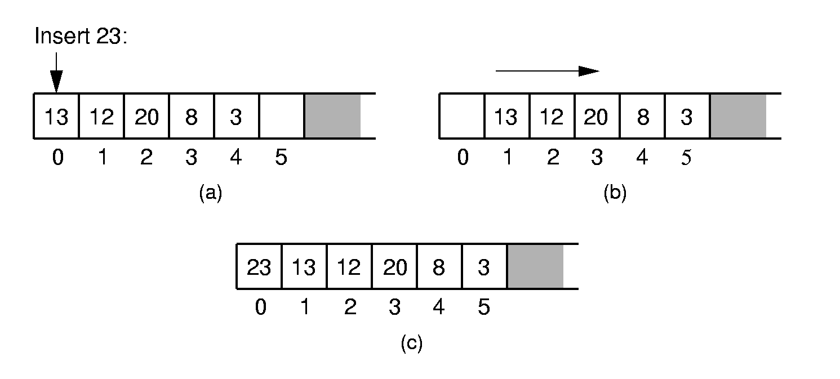
Array-Based List Class (5) - Insert

Slide 23
Array-Based List Class (6) - Insert
// Insert at front of right partition
template <class Elem>
bool AList<Elem>::insert(const Elem& item) {
if (listSize == maxSize) return false;
// Shift Elems up to make room
for(int i=listSize; i>fence; i--)
listArray[i] = listArray[i-1];
}
Insert item
0
1
2
3
4
5
listArray
fence
listSize
maxsize

Slide 24
Array-Based List Class (6) - Insert
// Insert at front of right partition
template <class Elem>
bool AList<Elem>::insert(const Elem& item) {
if (listSize == maxSize) return false;
// Shift Elems up to make room
for(int i=listSize; i>fence; i--)
listArray[i] = listArray[i-1];
listArray[fence] = item;
listSize++; // Increment list size
return true;
}
Θ(n)
Insert item
0
1
item
2
3
4
5
listArray
fence
listSize
maxsize

Slide 25
Array-Based List Class (7) - append
// Append Elem to end of the list
template <class Elem>
bool AList<Elem>::append(const Elem& item) {
if (listSize == maxSize) return false;
listArray[listSize++] = item;
return true;
}
append item
listArray
listSize
fence
maxsize

Slide 26
Array-Based List Class (8) - remove
// Remove and return first Elem in right
// partition
template <class Elem>
bool AList<Elem>::remove(Elem& it) {
if (rightLength() == 0) return false;
it = listArray[fence]; // Copy Elem
for(int i=fence; i<listSize-1; i++)
listArray[i] = listArray[i+1];
}
remove
1
2
3
4
5
6
listArray
fence
listSize
maxsize

Slide 27
Array-Based List Class (8) - remove
// Remove and return first Elem in right
// partition
template <class Elem>
bool AList<Elem>::remove(Elem& it) {
if (rightLength() == 0) return false;
it = listArray[fence]; // Copy Elem
for(int i=fence; i<listSize-1; i++)
listArray[i] = listArray[i+1];
listSize--; // Decrement size
return true;
}
Θ(n)
remove
1
2
4
5
6
listArray
fence
listSize
maxsize

Slide 28
1. lists
1.1 Definition of lists
1.2 ADT of lists
1.3 Basic Implementation of Lists
  1.3.1 Array-based List
  1.3.2 Linked List
  1.3.3 Comparison
1.4 Free list
1.5 Double Linked List

Slide 29
Linked List Node
// Singly-linked list node
template <class Elem> class Link {
public:
Elem element; // Value for this node
Link *next; // Pointer to next node
Link(const Elem& elemval,
Link* nextval =NULL)
{ element = elemval; next = nextval; }
};
element next

Slide 30
Linked List Class (1)
// Linked list implementation
template <class Elem>
class LList:public List<Elem> {
private:
Link<Elem>* head; //Point to list header
Link<Elem>* tail; //Pointer to last Elem
Link<Elem>* fence;//Last element on left
int leftcnt; //Size of left
int rightcnt; //Size of right
tail
head
fence

Slide 31
Linked List Class (2)
LList(int size=DefaultListSize)
{ init(); }
void init() { //Initialization routine
fence = tail = head = new Link<Elem>;
leftcnt = rightcnt = 0;
}
tail
head
The head node is a special node to
indicate the beginning of the list.
fence

Slide 32
Linked List Class (3)
public:
~LList() { removeall(); } // Destructor
void clear() { removeall(); init(); }
void removeall() {
while(head != NULL) {
fence = head;
head = head->next;
delete fence;
}
}
tail
head
NULL
fence

Slide 33
Linked List Class (4)
void setStart() {
fence = head; rightcnt += leftcnt;
leftcnt = 0; }
tail
head
fence

Slide 34
Linked List Class (4)
void setStart() {
fence = head; rightcnt += leftcnt;
leftcnt = 0; }
void setEnd() {
fence = tail; leftcnt += rightcnt;
rightcnt = 0; }
tail
head
fence

Slide 35
Linked List Class (4)
void setStart() {
fence = head; rightcnt += leftcnt;
leftcnt = 0; }
void setEnd() {
fence = tail; leftcnt += rightcnt;
rightcnt = 0; }
void next() {
// Don't move fence if right empty
if (fence != tail) {
fence = fence->next; rightcnt--;
leftcnt++; }
}
tail
head
fence

Slide 36
Linked List Class (5) - Prev
// Move fence one step left;
// no change if left is empty
template <class Elem>
Void LList<Elem>::prev() {
Link<Elem>* temp = head;
if (fence == head) return; // No prev Elem
while (temp->next!=fence)
temp=temp->next;
fence = temp;
leftcnt--;
rightcnt++;
}
Θ(n)
tail
temp
head
fence

Slide 37
Linked List Class (6)
int leftLength() const { return leftcnt; }
int rightLength() const { return rightcnt; }
bool getValue (Elem& it) const {
if(rightLength() == 0) return false;
it = fence->next->element;
return true; }
tail
head
fence

Slide 38
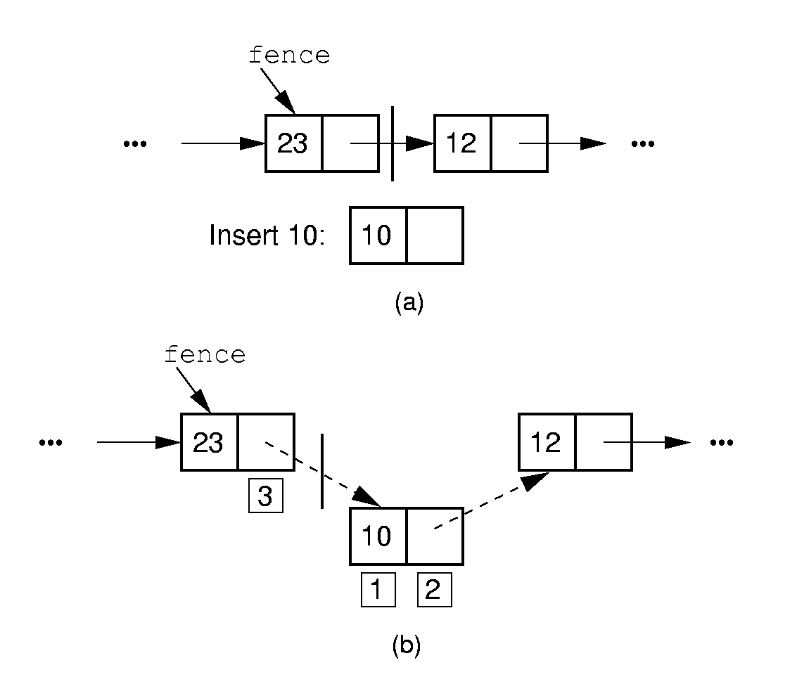
Insert

Slide 39
Insert
// Insert at front of right partition
template <class Elem>
bool LList<Elem>::insert(const Elem& item) {
fence->next =
new Link<Elem>(item, fence->next);
rightcnt++;
return true;}
tail
head
fence
item

Slide 40
Insert
// Insert at front of right partition
template <class Elem>
bool LList<Elem>::insert(const Elem& item) {
fence->next =
new Link<Elem>(item, fence->next);
if (tail == fence) tail = fence->next;
rightcnt++;
return true;}
Θ(1)
tail
head
item
fence

Slide 41
Append
// Append Elem to end of the list
template <class Elem>
bool LList<Elem>::append(const Elem& item) {
tail = tail->next =
new Link<Elem>(item, NULL);
rightcnt++;
return true;}
tail
head
item
fence

Slide 42
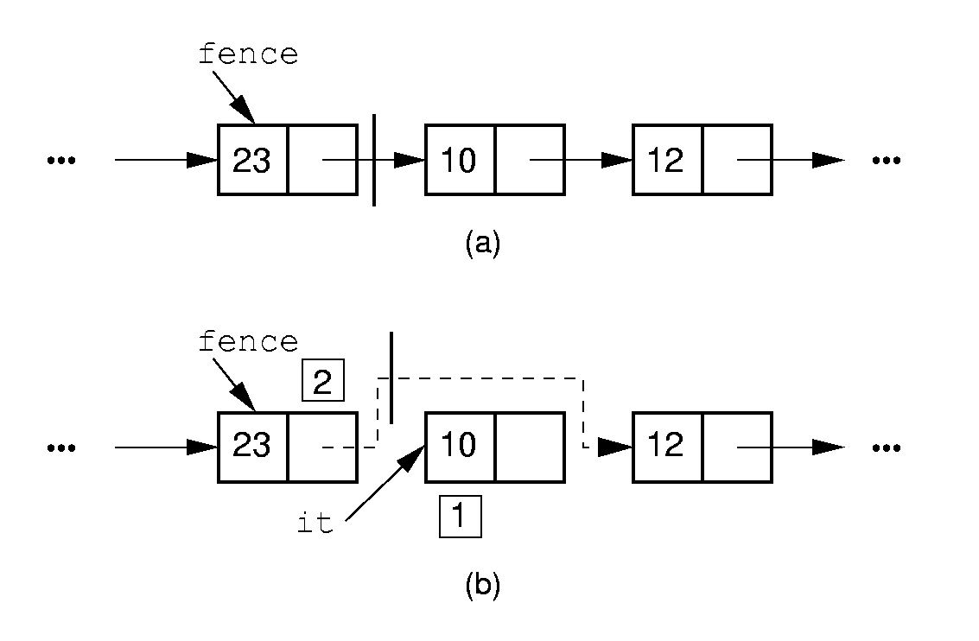
Remove

Slide 43
Remove
// Remove and return first Elem in right
// partition
template <class Elem>
bool LList<Elem>::remove(Elem& it) {
if (fence->next == NULL) return false;
it = fence->next->element; // Remember val
// Remember link node
Link<Elem>* ltemp = fence->next;
fence->next = ltemp->next; // Remove
delete ltemp; // Reclaim space
rightcnt--;
return true;
}
tail
fence
head
ltemp

Slide 44
Remove
// Remove and return first Elem in right
// partition
template <class Elem>
bool LList<Elem>::remove(Elem& it) {
if (fence->next == NULL) return false;
it = fence->next->element; // Remember val
// Remember link node
Link<Elem>* ltemp = fence->next;
fence->next = ltemp->next; // Remove
if (tail == ltemp) // Reset tail
tail = fence;
delete ltemp; // Reclaim space
rightcnt--;
return true;
}
Θ(1)
tail
fence
head
ltemp

Slide 45
Setpos
// Set the size of left partition to pos
template <class Elem>
bool LList<Elem>::setPos(int pos) {
if ((pos < 0) || (pos > rightcnt+leftcnt))
return false;
fence = head;
for(int i=0; i<pos; i++)
fence = fence->next;
rightcnt = rightcnt+leftcnt-pos;
leftcnt = pos;
return true;
}
Θ(n)
tail
head
fence

Slide 46
1. lists
1.1 Definition of lists
1.2 ADT of lists
1.3 Basic Implementation of Lists
  1.3.1 Array-based List
  1.3.2 Linked List
  1.3.3 Comparison
1.4 Free list
1.5 Double Linked List

Slide 47
Comparison of Implementations
Array-Based Lists:
Insertion and deletion are Θ(n).
Prev and direct access are Θ(1).
Array must be allocated in advance.
No overhead if all array positions are full.
Linked Lists:
Insertion and deletion are Θ(1).
Prev and direct access are Θ(n).
Space grows with number of elements.
Every element requires overhead.

Slide 48
Space Comparison
Array-Based Lists Linked Lists
DE vs. n(P + E)
E: Space for data value.
P: Space for pointer.
D: Maximum Number of elements in array.
n: current number of elements

Slide 49
1. lists
1.1 Definition of lists
1.2 ADT of lists
1.3 Basic Implementation of Lists
  1.3.1 Array-based List
  1.3.2 Linked List
  1.3.3 Comparison
1.4 Free list
1.5 Double Linked List

Slide 50
Freelists (1)
System new and delete are slow.
Organize the freed nodes as a list call ‘freelist’
freelist
freelist
delete

Slide 51
Freelists (2)
System new and delete are slow.
Organize the freed nodes as a list call ‘freelist’
freelist
new

Slide 52
Freelists (3)
// Singly-linked list node with freelist
template <class Elem> class Link {
private:
static Link<Elem>* freelist; // Head
public:
Elem element; // Value for this node
Link* next; // Point to next node
… …
void* operator new(size_t); // Overload
void operator delete(void*); // Overload
};
element next
freelist

Slide 53
Freelists (4)
template <class Elem>
Link<Elem>* Link<Elem>::freelist = NULL;
template <class Elem> // Overload for new
void* Link<Elem>::operator new(size_t) {
if (freelist == NULL) return ::new Link;
Link<Elem>* temp = freelist; // Reuse
freelist = freelist->next;
return temp; // Return the link
}
temp
freelist

Slide 54
Freelists (5)
template <class Elem> // Overload delete
void Link<Elem>::operator delete(void* ptr){
((Link<Elem>*)ptr)->next = freelist;
freelist = (Link<Elem>*)ptr;
}
ptr
freelist

Slide 55
1. lists
1.1 Definition of lists
1.2 ADT of lists
1.3 Basic Implementation of Lists
  1.3.1 Array-based List
  1.3.2 Linked List
  1.3.3 Comparison
1.4 Free list
1.5 Double Linked List

Slide 56
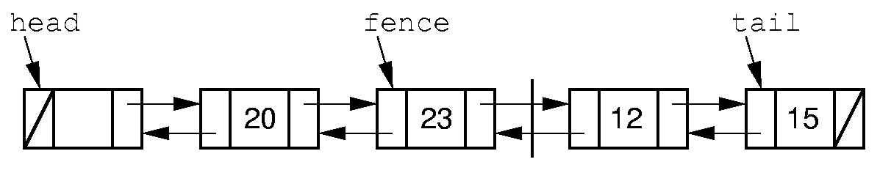
Doubly Linked Lists (1)
Simplify the prev() operation: Add a pointer pointing to
the previous node.

Slide 57
Doubly Linked Lists (2)
// Doubly-linked list link node
template <class Elem> class Link {
public:
Elem element; // Value for this node
Link *next; // Pointer to next node
Link *prev; // Pointer to previous node
Link(const Elem& e, Link* prevp =NULL,
Link* nextp =NULL)
{ element=e; prev=prevp; next=nextp; }
Link(Link* prevp =NULL, Link* nextp =NULL)
{ prev = prevp; next = nextp; }
};
prev element next

Slide 58
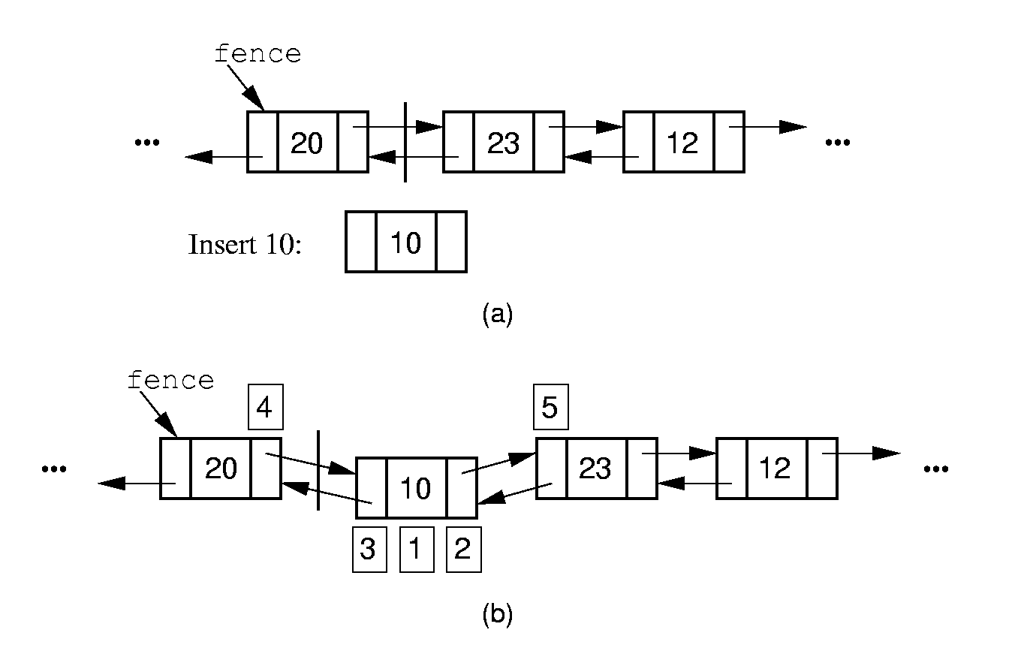
Doubly Linked List - Insert (3)

Slide 59
Doubly Linked List – Insert (4)
// Insert at front of right partition
template <class Elem>
bool LList<Elem>::insert(const Elem& item) {
fence->next =
new Link<Elem>(item, fence, fence->next);
if (fence->next->next != NULL)
fence->next->next->prev = fence->next;
if (tail == fence) // Appending new Elem
tail = fence->next; // so set tail
rightcnt++; // Added to right
return true;
}
tail
fence

Slide 60
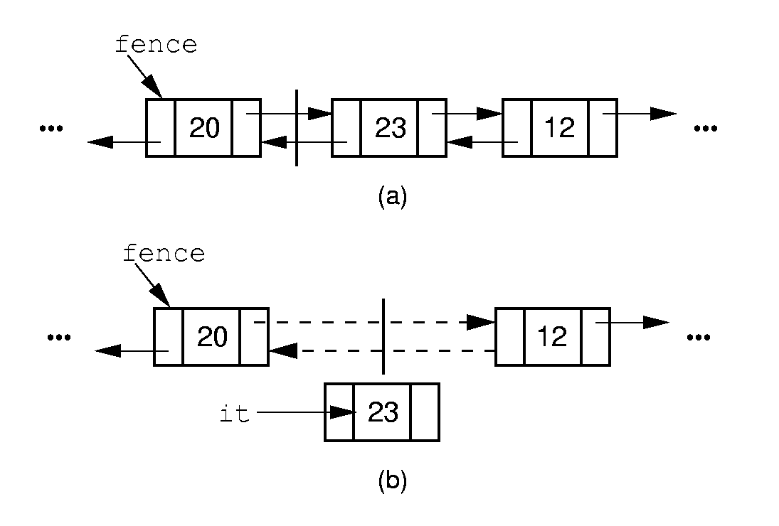
Doubly Linked List – Remove (5)

Slide 61
Doubly Linked List – Remove (6)
// Remove, return first Elem in right part
template <class Elem>
bool LList<Elem>::remove(Elem& it) {
if (fence->next == NULL) return false;
it = fence->next->element;
Link<Elem>* ltemp = fence->next;
if (ltemp->next != NULL)
ltemp->next->prev = fence;
else tail = fence; // Reset tail
fence->next = ltemp->next; // Remove
delete ltemp; // Reclaim space
rightcnt--; // Removed from right
return true;
}
tail
fence
ltemp

Slide 62
Chapter4 Lists, Stacks, and Queues
1. Lists
2. Stacks
3. Queues

Slide 63
2. Stacks
2.1 Definition of Stacks
2.2 ADT of Stacks
2.3 Basic Implementation of Stacks
  2.3.1 Array-based Stack
  2.3.2 Linked Stack
2.4 Application of stacks

Slide 64
Definition of Stacks
Stack: A restricted form of list: Insert and
remove only at front of list.
LIFO property: Last In, First Out.
Notation:
Insert: PUSH
Remove: POP
The accessible element is called the TOP element.
push
pop
TOP

Slide 65
2. Stacks
2.1 Definition of Stacks
2.2 ADT of Stacks
2.3 Basic Implementation of Stacks
  2.3.1 Array-based Stack
  2.3.2 Linked Stack
2.4 Application of stacks

Slide 66
Stack ADT
// Stack abtract class
template <class Elem> class Stack {
public:
// Reinitialize the stack
virtual void clear() = 0;
// Push an element onto the top of the stack.
virtual bool push(const Elem&) = 0;
// Remove the element at the top of the stack.
virtual bool pop(Elem&) = 0;
// Get a copy of the top element in the stack
virtual bool topValue(Elem&) const = 0;
// Return the number of elements in the stack.
virtual int length () const = 0;
};

Slide 67
2. Stacks
2.1 Definition of Stacks
2.2 ADT of Stacks
2.3 Basic Implementation of Stacks
  2.3.1 Array-based Stack
  2.3.2 Linked Stack
2.4 Application of stacks

Slide 68
Array-Based Stack (1)
// Array-based stack implementation
template <class Elem> class AStack: public Stack<Elem>
{
private:
Elem *listArray; //Array holding stack elements
int size; // Maximum size of stack
int top; // The position to insert the new element
push
listArray
pop
top
size

Slide 69
Array-Based Stack (2)
public:
AStack(int sz =DefaultListSize)
{ size = sz; top = 0;
listArray = new Elem[sz]; }
~AStack() { delete [] listArray;
void clear() { top = 0; }
listArray
top
size

Slide 70
Array-Based Stack (3)
bool push(const Elem& item) {
if (top == size) return false;//Stack is full
else { listArray[top++] = item; return true;}
}
item
listArray
top
size

Slide 71
Array-Based Stack (4)
// Pop top element
bool pop(Elem& it) {
if (top == 0)
return false;
else { it = listArray[--top]; return true; }
}
it
listArray
top
size

Slide 72
Array-Based Stack (5)
// Return top element
bool topValue(Elem& it) const {
if (top == 0) return false;
else { it = listArray[top-1]; return true; }
}
int length() const { return top; }
};
it
listArray
top
size

Slide 73
2. Stacks
2.1 Definition of Stacks
2.2 ADT of Stacks
2.3 Basic Implementation of Stacks
  2.3.1 Array-based Stack
  2.3.2 Linked Stack
2.4 Application of stacks

Slide 74
Linked Stack (1)
// Linked stack implementation
template <class Elem> class LStack: public Stack<Elem>
{
private:
Link<Elem>* top; // Pointer to first elem
int size; // Count number of elems
top

Slide 75
Linked Stack (2)
public:
LStack(int sz =DefaultListSize)
{ top = NULL; size = 0;}
top
NULL
size = 0
Stack is empty
top
size = 1
After push 1 element
top
size = 2
After push 2 elements

Slide 76
Linked Stack (3)
~LStack() {clear();}
void clear() {
while(top != NULL){
LINK<Elem>* temp = top;
top = top->next;
delete temp;
}
Size = 0;
}
top
NULL
temp

Slide 77
Linked Stack (4)
bool push(const Elem& item) {
top = new Link<Elem> (item, top);
size ++;
return true;
}
item
top

Slide 78
Linked Stack (5)
// Pop top element
bool pop(Elem& it) {
if(size == 0) return false;
it = top->element;
Link<Elem>* ltemp = top->next;
delete top;
top = ltemp;
size--;
return true;
}
top
ltemp

Slide 79
Linked Stack (6)
// Return top element
bool topValue(Elem& it) const {
if(size == 0) return false;
it = top->element;
return true;
}
int length() const {return size;}
};
top

Slide 80
2. Stacks
2.1 Definition of Stacks
2.2 ADT of Stacks
2.3 Basic Implementation of Stacks
  2.3.1 Array-based Stack
  2.3.2 Linked Stack
2.4 Application of stacks
  Make use of the LIFO property: Last In, First Out.

Slide 81
Example – Verify the Balance of Parentheses
Eg. The string “((())())” contains balanced parentheses. The string“(()” are not balanced.
Problem: Write a program to check if a string contains properly nested and balanced parentheses.
Stack
Last In First Out
( ( ( ) ) ( ) )
(
(
(
(
(
(
(
)
)
(
)
)
( ( )
(
(
(
(
)

Slide 82
Application of stack(2) – Subroutine Call
Subroutine call.
  Before calling a subroutine, the context (return address, parameters, local variables) is stored into the a stack.
4000
int a = 0;
int b =1;
Dosomething (a,b);
a = a + b;
Stack
4001
4003,0,1
4002
4003
Dosomthing(int x, int y)
{
… … }
context
context

Slide 83
Application of stack(2) – Subroutine Call (cont.)
Implementation of Recursion
// The recursion version to compute n!
long fact(int n)
{
if (n <= 1) return 1; // Base case: return base solution
return n * fact(n-1); // Recursive call for n > 1
}
300
301
fact(4)
fact(3)
fact(2)
fact(1)
fact(2)
fact(3)
fact(4)
return 1
return 2
301,4
301,3
301,2
return 6
return 24

Slide 84
1. Lists
2. Stacks
3. Queues

Slide 85
3. Queues
3.1 Definition of Queues
3.2 ADT of Queues
3.3 Basic Implementation of Queues
  3.3.1 Array-based Queues
  3.3.2 Linked Queues
3.4 Application of Queues

Slide 86

FIFO property: First In, First Out

Slide 87
Definition of Queues
Queue: A restricted form of list - Insert at one end, remove from the other.
FIFO property: First in, First Out
Notation:
Insert: enqueue （入队）
Delete: dequeue （出队）
First element: front
Last element: rear
enqueue
dequeue
front
rear

Slide 88
3. Queues
3.1 Definition of Queues
3.2 ADT of Queues
3.3 Basic Implementation of Queues
  3.3.1 Array-based Queues
  3.3.2 Linked Queues
3.4 Application of Queues

Slide 89
ADT of Queues
template <class Elem> class Queue {
public:
virtual void clear() = 0;
virtual bool enqueue(const Elem&) = 0;
virtual bool dequeue(Elem&) = 0;
virtual bool frontValue(Elem&) const = 0;
virtual int length() const = 0;
};

Slide 90
3. Queues
3.1 Definition of Queues
3.2 ADT of Queues
3.3 Basic Implementation of Queues
  3.3.1 Array-based Queues
  3.3.2 Linked Queues
3.4 Application of Queues

Slide 91
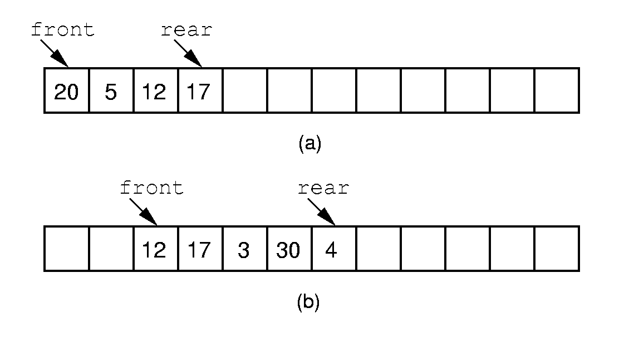
Array-based Queue Implementation (1)
Length of the queue
= rear – front + 1
front
rear
10
12
42
(c)
How to insert one more element?

Slide 92
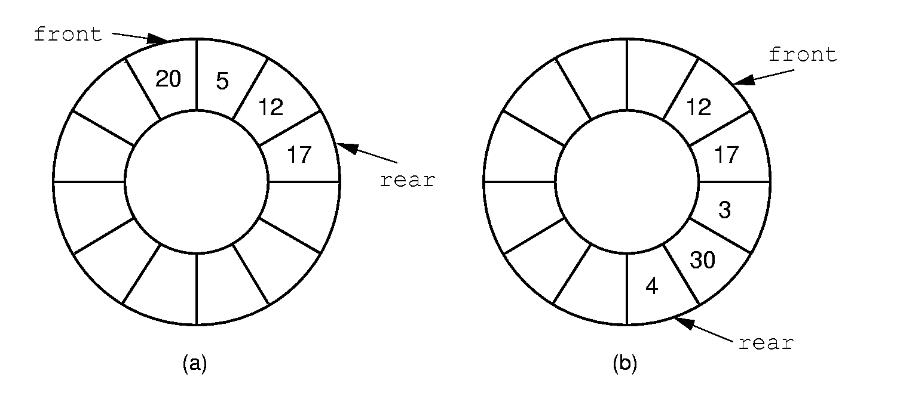
Array-based Queue Implementation (2)
Circular queue

Slide 93





Array-based Circular Queue
5
Array base
base
4
0
0
J6
1
J7
rear=1
2
3
1
3
J3
front=3
front
4
J4
2
5
J5
size =6
rear
The position of the element next
to the No. i element it is:
(i+1)% size
The length of the queue is:
Length = (rear - front + 1) ?
Length = (rear+size - front + 1) % size

Slide 94


The state of a circular queue
rear
front
rear
rear
front
5
4
5
0
4
0
4
5
0
3
1
3
2
1
2
3
2
1
front
rear
5
front
4
0
3
2
1
5
4
0
front
3
2
1
rear
full
front = = (rear+1)%size
empty
How to distinguish?

Slide 95
Distinguish full and empty
4
5
0
4
5
0
3
1
3
1
2
2
front
front
rear
rear
(a) Empty
(b) Full
Only store n – 1 elements in a Circular queue with the length n.
Empty： front = = (rear+1)%size
Full： front = = (rear+2)%size

Slide 96
Implementation of the Array-Based Circular Queue(1)
template <class Elem> class AQueue: public Queue<Elem>
{
private:
int size; // Maximum size of queue
int front; // Index of front element
int rear; // Index of rear element
Elem *listArray; // Array holding queue elements
Size = 6
5
listArray
listArray
4
0
0
J6
1
J7
rear=1
2
3
1
3
J3
front=3
front
4
J4
2
5
J5
rear

Slide 97
Implementation of the Array-Based Circular Queue(2)
virtual int length() const
{ return (rear+size - front + 1) % size; }
bool frontValue(Elem& it) const {
if (length() == 0) return false; // Empty
it = listArray[front];
return true;
}
rear
4
5
0
3
2
1
front
it = J₃

Slide 98
Implementation of the Array-Based Circular Queue(3)
void clear() { front = (rear+1)%size; }
rear
4
5
0
5
3
2
1
4
0
3
2
1
front
clear
front
rear
Empty

Slide 99

Implementation of the Array-Based Circular Queue(4)
bool enqueue(const Elem& it) {
if (((rear+2) % size) == front) return false; // Full
rear = (rear+1) % size; // Circular increment
listArray[rear] = it;
return true;
}
rear
4
5
0
4
5
0
3
1
2
3
2
1
front
front
rear
Full
enqueue

Slide 100
Implementation of the Array-Based Circular Queue(5)
bool dequeue(Elem& it) {
if (length() == 0) return false; // Empty
it = listArray[front];
front = (front+1) % size; // Circular increment
return true;
}
rear
4
5
0
5
3
2
1
4
0
3
2
1
front
front
it = J₃
rear
Empty
dequeue

Slide 101
3. Queues
3.1 Definition of Queues
3.2 ADT of Queues
3.3 Basic Implementation of Queues
  3.3.1 Array-based Queues
  3.3.2 Linked Queues
3.4 Application of Queues

Slide 102
Linked Queues
tail
head
tail
head
dequeue
tail
head
enqueue

Slide 103
3. Queues
3.1 Definition of Queues
3.2 ADT of Queues
3.3 Basic Implementation of Queues
  3.3.1 Array-based Queues
  3.3.2 Linked Queues
3.4 Application of Queues

Slide 104
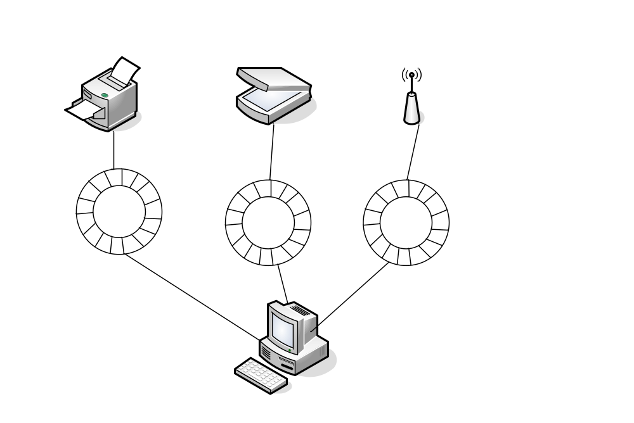
Application of Queue(1)- Buffer
Low speed devices
Queues for data buffer
High speed processor

Slide 105
Application of Queue(2)-Message Queue
Asynchronous collaboration between different
components.
Eg. Message Queue in Windows.
Message consumer
Message producer
dequeue
enqueue

Slide 106
Thanks!
Questions?

