Slide 1
Chapter 10. Indexing
Why indexing
Linear Indexing
Tree indexing
  2-3 Trees
  B Trees

Slide 2
Why Indexing
Goals:
  Organize a large collection of records stored on disk.
  Support efficient insert, delete, and range queries
  Support multiple search keys.

Slide 3
Index File
Support : insert, delete, and range queries
Index file on different keys
index
index
index
index
Records on disk

Slide 4
Indexing
Why indexing
Linear Indexing
Tree indexing
  2-3 Trees
  B Trees

Slide 5
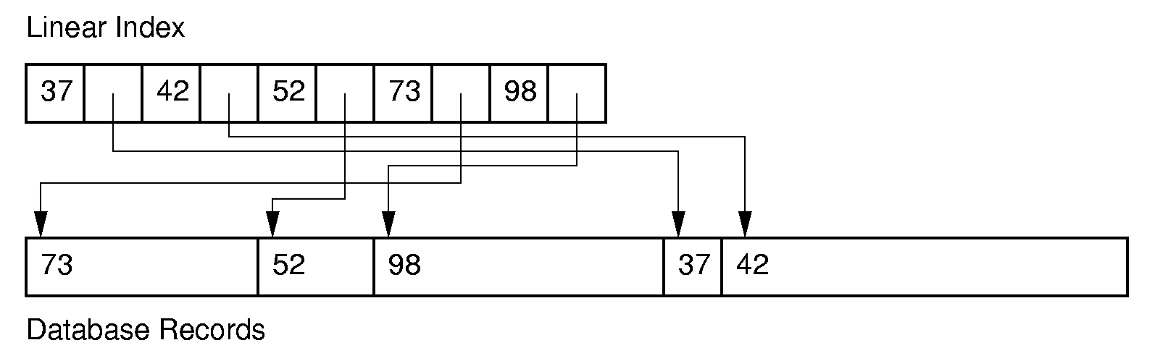
Linear Indexing (1)
Linear index: Index file organized as a simple sequence of (key, record pointer)
Key values are sorted.
How to search?

Slide 6
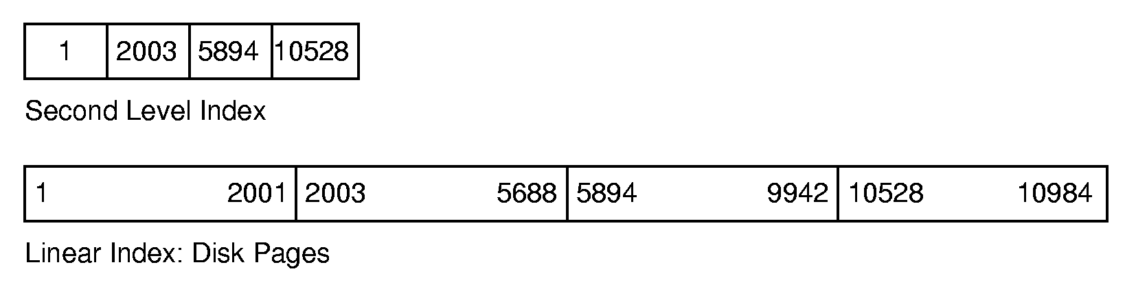
Linear Indexing (2)
If the index is too large to fit in main memory, a second-level index might be used.

Slide 7
What to improve?
Insertion and deletion operation can cause massive update of the index file ( Θ(n))

Slide 8
Indexing
Why indexing
Linear Indexing
Tree indexing
  2-3 Trees
  B Trees

Slide 9
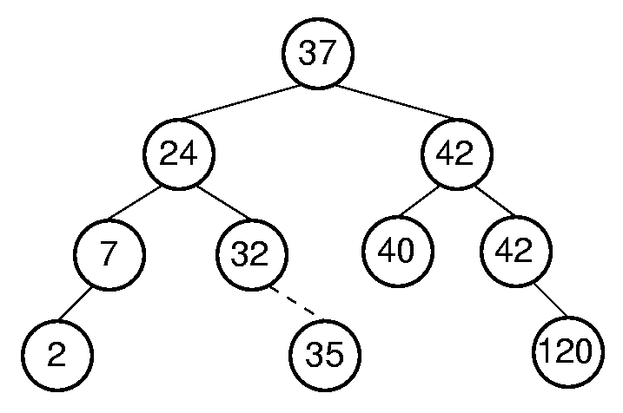
Tree Indexing
Tree index can efficiently support insertion/deletion operations
Search/insert/delete on BST: Θ(log n) in average case when the tree is balanced.
.

Slide 10
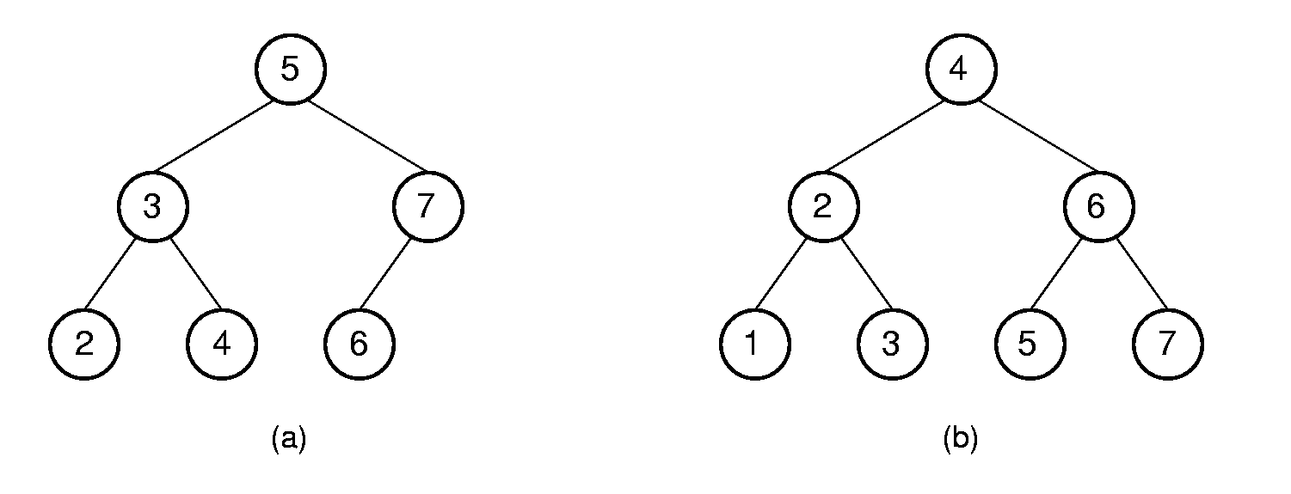
Tree Indexing (2)
BST is not so good :
  It is expensive to keep BST balanced.
Insert 1
To keep the BST as a complete binary tree after inserting 1,
many records required to refresh.

Slide 11
Indexing
Why indexing
Linear Indexing
Tree indexing
  2-3 Trees
  B Trees

Slide 12
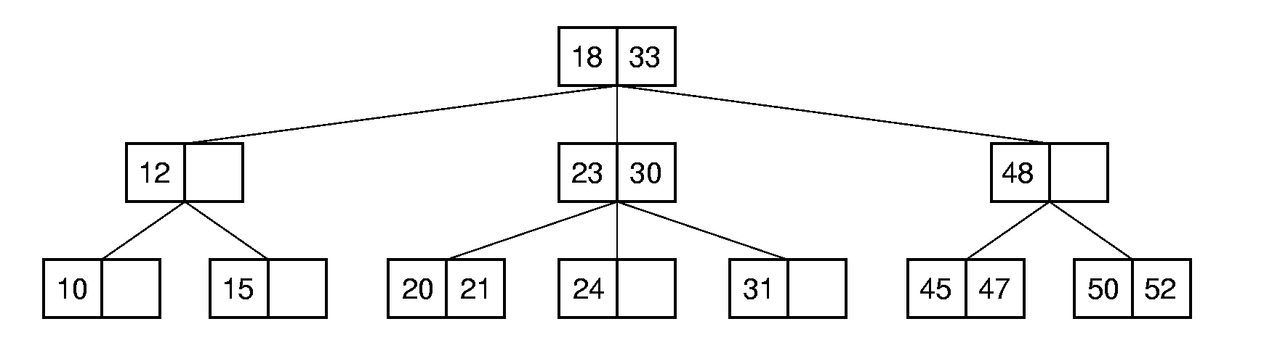
2-3 Tree (1)
The search procedure is similar with BST.
Low update cost.

Slide 13
2-3 Tree (2)
A 2-3 Tree has the following properties:
  A node contains one or two keys
  Every internal node has either two children (if it contains one key) or three children (if it contains two keys).
  All leaves are at the same level in the tree, so the tree is always height balanced.

Slide 14
2-3 Tree Searching
Search 21
Θ(log n)

Slide 15
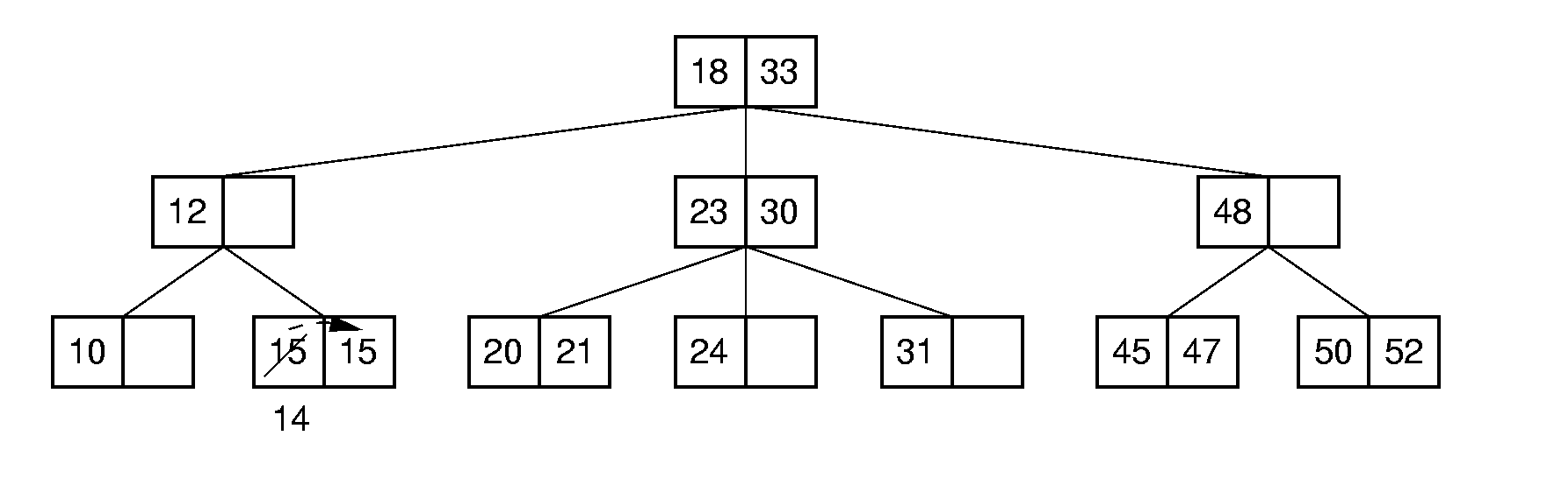
Insertion - Simple Case
Case 1:
Insert 14

Slide 16
Insertion - Split
Case 2:
Split the node.
23
23
19
21
24
20
21
24
split
20
20
23
Insert 19
19
21
24

Slide 17
Insertion - Continuous Split
Case 3:
18
18
split
23
30
23
30
20
21
24
31
19
21
24
31
20
18
Insert 19
20
23
30
19
21
24
31

Slide 18
2-3 Tree Insertion (3)
18
20
23
30
19
21
24
31
split
18
23
20
30
19
21
24
31

Slide 19
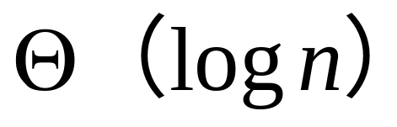
2-3 Tree Insertion (3)
18
23
20
30
19
21
24
31
18
23
20
30
19
21
24
31

Slide 20
Implementation of 2-3 Tree
template <class Elem>
class TTNode { // 2-3 tree node structure
public:
Elem lkey;
Elem rkey;
TTNode* left;
TTNode* center;
TTNode* right;
TTNode()
{ center = left = right = NULL; lkey = rkey = EMPTY; }
~TTNode() { }
bool isLeaf() { return left = = NULL; }
};
lkey
rkey
left
center
right

Slide 21
Implementation of 2-3 Tree searching
template <class Key, class Elem >
bool TTTree<Key, Elem>::
findhelp(TTNode<Elem>* subroot, const Key& K, Elem& e) const {
if (subroot = = NULL) return false;
if (K == getkey(subroot->lkey))
{ e = subroot->lkey; return true; }
if (subroot->rkey != EMPTY &&
K==getkey(subroot->rkey))
{ e = subroot->rkey; return true; }
if (K < getkey(subroot->lkey))
return findhelp(subroot->left, K, e);
else if (subroot->rkey = = EMPTY)
return findhelp(subroot->center, K, e);
else if (K < getkey(subroot->rkey))
return findhelp(subroot->center, K, e);
else return findhelp(subroot->right, K, e);
}
subroot
lkey
rkey
left
center
right

Slide 22
Implementation of 2-3 Tree insertion -- inserthelp
template <class Key, class Elem>
bool TTTree<Key, Elem>::
inserthelp(TTNode<Elem>*& subroot, const Elem& e,
Elem& retval, TTNode<Elem>*& retptr) {
subroot
subroot
retptr
retval
Insert e

Slide 23
template <class Key, class Elem>
bool TTTree<Key, Elem>::
inserthelp(TTNode<Elem>*& subroot, const Elem& e,
Elem& retval, TTNode<Elem>*& retptr)
{
Elem myretv;
TTNode<Elem>* myretp = NULL;
if (subroot = = NULL) // Empty tree: make new node
{ subroot = new TTNode<Elem>( ); subroot->lkey = e; }
subroot
e
NULL
NULL
NULL

Slide 24
template <class Key, class Elem>
bool TTTree<Key, Elem>::
inserthelp(TTNode<Elem>*& subroot, const Elem& e,
Elem& retval, TTNode<Elem>*& retptr) {
Elem myretv; TTNode<Elem>* myretp = NULL;
if (subroot = = NULL) // Empty tree: make new node
{ subroot = new TTNode<Elem>( ); subroot->lkey = e; }
else if (subroot->isLeaf( )) // At leaf node: insert here
if (subroot->rkey = = EMPTY) { // Easy case: not full
if (subroot->lkey < e)
subroot->rkey = e;
else {subroot->rkey = subroot->lkey;
subroot->lkey = e; }
}
else splitnode(subroot, e, NULL, retval, retptr);
lkey
e
NULL
NULL
NULL

Slide 25
template <class Key, class Elem>
bool TTTree<Key, Elem>::
inserthelp(TTNode<Elem>*& subroot, const Elem& e,
Elem& retval, TTNode<Elem>*& retptr) {
Elem myretv; TTNode<Elem>* myretp = NULL;
if (subroot = = NULL) // Empty tree: make new node
{ subroot = new TTNode<Elem>( ); subroot->lkey = e; }
else if (subroot->isLeaf( )) // At leaf node: insert here
if (subroot->rkey = = EMPTY) { // Easy case: not full
if (subroot->lkey < e)
subroot->rkey = e;
else {subroot->rkey = subroot->lkey;
subroot->lkey = e; }
}
else splitnode(subroot, e, NULL, retval, retptr);
lkey
NULL
NULL
NULL

Slide 26
template <class Key, class Elem>
bool TTTree<Key, Elem>::
inserthelp(TTNode<Elem>*& subroot, const Elem& e,
Elem& retval, TTNode<Elem>*& retptr) {
Elem myretv; TTNode<Elem>* myretp = NULL;
if (subroot = = NULL) // Empty tree: make new node
{ subroot = new TTNode<Elem>( ); subroot->lkey = e; }
else if (subroot->isLeaf( )) // At leaf node: insert here
if (subroot->rkey = = EMPTY) { // Easy case: not full
if (subroot->lkey < e)
subroot->rkey = e;
else {subroot->rkey = subroot->lkey;
subroot->lkey = e; }
}
else splitnode(subroot, e, NULL, retval, retptr);
e
lkey
NULL
NULL
NULL

Slide 27
template <class Key, class Elem>
bool TTTree<Key, Elem>::
inserthelp(TTNode<Elem>*& subroot, const Elem& e,
Elem& retval, TTNode<Elem>*& retptr) {
Elem myretv; TTNode<Elem>* myretp = NULL;
if (subroot = = NULL) // Empty tree: make new node
{ subroot = new TTNode<Elem>( ); subroot->lkey = e; }
else if (subroot->isLeaf( )) // At leaf node: insert here
if (subroot->rkey = = EMPTY) { // Easy case: not full
if (subroot->lkey < e)
subroot->rkey = e;
else {subroot->rkey = subroot->lkey;
subroot->lkey = e; }
}
else splitnode(subroot, e, NULL, retval, retptr);
lkey
rkey
NULL
NULL
NULL

Slide 28
template <class Key, class Elem>
bool TTTree<Key, Elem>::
inserthelp(TTNode<Elem>*& subroot, const Elem& e,
Elem& retval, TTNode<Elem>*& retptr) {
Elem myretv; TTNode<Elem>* myretp = NULL;
… … …
else if (e < subroot->lkey) // Insert in left child
inserthelp(subroot->left, e, myretv, myretp);
subroot
// insert e to an internode
lkey
rkey
left
center
right
Insert e

Slide 29
template <class Key, class Elem>
bool TTTree<Key, Elem>::
inserthelp(TTNode<Elem>*& subroot, const Elem& e,
Elem& retval, TTNode<Elem>*& retptr) {
Elem myretv; TTNode<Elem>* myretp = NULL;
… … …
else if (e < subroot->lkey) // Insert in left child
inserthelp(subroot->left, e, myretv, myretp);
subroot
// insert e to an internode
lkey
rkey
left
center
right
myretv
myretp

Slide 30
template <class Key, class Elem>
bool TTTree<Key, Elem>::
inserthelp(TTNode<Elem>*& subroot, const Elem& e,
Elem& retval, TTNode<Elem>*& retptr) {
Elem myretv; TTNode<Elem>* myretp = NULL;
… … …
else if ((subroot->rkey = = EMPTY) ||
(e < subroot->rkey ))
inserthelp(subroot->center, e, myretv, myretp);
else inserthelp(subroot->right, e, myretv, myretp);
subroot
// insert e to an internode
lkey
left
center
Insert e

Slide 31
template <class Key, class Elem>
bool TTTree<Key, Elem>::
inserthelp(TTNode<Elem>*& subroot, const Elem& e,
Elem& retval, TTNode<Elem>*& retptr) {
Elem myretv; TTNode<Elem>* myretp = NULL;
… … …
else if ((subroot->rkey = = EMPTY) ||
(e < subroot->rkey ))
inserthelp(subroot->center, e, myretv, myretp);
else inserthelp(subroot->right, e, myretv, myretp);
subroot
// insert e to an internode
lkey
rkey
left
center
Insert e

Slide 32
template <class Key, class Elem>
bool TTTree<Key, Elem>::
inserthelp(TTNode<Elem>*& subroot, const Elem& e,
Elem& retval, TTNode<Elem>*& retptr) {
Elem myretv; TTNode<Elem>* myretp = NULL;
… … …
else if ((subroot->rkey = = EMPTY) ||
(e < subroot->rkey ))
inserthelp(subroot->center, e, myretv, myretp);
else inserthelp(subroot->right, e, myretv, myretp);
subroot
// insert e to an internode
lkey
rkey
left
center
myretv
myretp

Slide 33
template <class Key, class Elem>
bool TTTree<Key, Elem>::
inserthelp(TTNode<Elem>*& subroot, const Elem& e,
Elem& retval, TTNode<Elem>*& retptr) {
Elem myretv; TTNode<Elem>* myretp = NULL;
… … …
else if ((subroot->rkey = = EMPTY) ||
(subroot->rkey > getkey(e)))
inserthelp(subroot->center, e, myretv, myretp);
else inserthelp(subroot->right, e, myretv, myretp);
subroot
// insert e to an internode
lkey
rkey
right
left
center
Insert e

Slide 34
template <class Key, class Elem>
bool TTTree<Key, Elem>::
inserthelp(TTNode<Elem>*& subroot, const Elem& e,
Elem& retval, TTNode<Elem>*& retptr) {
Elem myretv; TTNode<Elem>* myretp = NULL;
… … …
else if ((subroot->rkey = = EMPTY) ||
(subroot->rkey > getkey(e)))
inserthelp(subroot->center, e, myretv, myretp);
else inserthelp(subroot->right, e, myretv, myretp);
subroot
// insert e to an internode
lkey
rkey
right
left
center
myretv
myretp

Slide 35
//If myretp is not NULL，insert myretv into subroot
if (myretp != NULL)
if (subroot->rkey != EMPTY) // Full: split node
splitnode(subroot, myretv, myretp, retval, retptr);
subroot
lkey
rkey
right
left
center
myretv
myretp

Slide 36
if (myretp != NULL) // Child split: receive promoted value
… … … …
else { // Not full: add to this node
if (myretv < subroot->lkey)) {
subroot->rkey = subroot->lkey;
subroot->lkey = myretv;
subroot->right = subroot->center;
subroot->center = myretp;
}
subroot
lkey
left
center
myretv
myretp

Slide 37
if (myretp != NULL) // Child split: receive promoted value
… … … …
else { // Not full: add to this node
if (myretv < subroot->lkey)) {
subroot->rkey = subroot->lkey;
subroot->lkey = myretv;
subroot->right = subroot->center;
subroot->center = myretp;
}
subroot
myretv
lkey
left
center
right
myretv
myretp

Slide 38
if (myretp != NULL) // Child split: receive promoted value
… … … …
else { // Not full: add to this node
if (myretv < subroot->lkey)) {
subroot->rkey = subroot->lkey;
subroot->lkey = myretv;
subroot->right = subroot->center;
subroot->center = myretp;
}
else
{ subroot->rkey = myretv; subroot->right = myretp; }
}
return true;
}
subroot
lkey
left
center
myretv
myretp

Slide 39
if (myretp != NULL) // Child split: receive promoted value
… … … …
else { // Not full: add to this node
if (myretv < subroot->lkey)) {
subroot->rkey = subroot->lkey;
subroot->lkey = myretv;
subroot->right = subroot->center;
subroot->center = myretp;
}
else
{ subroot->rkey = myretv; subroot->right = myretp; }
}
return true;
}
subroot
lkey
myretv
left
center
right
myretv
myretp

Slide 40
Implementation of 2-3 tree insertion– splitnode (1)
template <class Key, class Elem>
bool TTTree<Key, Elem>::
splitnode(TTNode<Elem>* subroot, const Elem& inval,
TTNode<Elem>*inptr, Elem& retval, TTNode<Elem>*& retptr){

Slide 41
template <class Key, class Elem>
bool TTTree<Key, Elem>::
splitnode(TTNode<Elem>* subroot, const Elem& inval,
TTNode<Elem>*inptr, Elem& retval, TTNode<Elem>*& retptr){
18
分裂的节点是中间节点的情况
subroot
23
30
retval
19
21
24
31
18
retptr
23
20
split
inptr
20
30
inval
19
21
24
31

Slide 42
Implementation of 2-3 tree insertion– splitnode(2)
template <class Key, class Elem>
bool TTTree<Key, Elem>::
splitnode(TTNode<Elem>* subroot, const Elem& inval,
TTNode<Elem>*inptr, Elem& retval, TTNode<Elem>*& retptr){
23
split
23
subroot
19
20
24
19
21
24
NULL
NULL
NULL
NULL
NULL
NULL
20
retptr
NULL
NULL
21
retval
inptr
分裂的节点是叶子节点的情况
inval
Splitnode( subroot, 21, NULL, retval, retptr)

Slide 43
template <class Key, class Elem>
splitnode(TTNode<Elem>* subroot, const Elem& inval,
TTNode<Elem>*inptr, Elem& retval, TTNode<Elem>*& retptr){
retptr = new TTNode<Elem>( ); // Node created by split
if (inval < subroot->lkey)) { // Add at left
retval = subroot->lkey; subroot->lkey = inval;
retptr->lkey = subroot->rkey; retptr->left = subroot->center;
retptr->center = subroot->right; subroot->center = inptr; }
subroot
23
30
retval
19
21
24
31
subroot
retptr
23
20
split
inptr
20
30
inval
19
21
24
31

Slide 44
template <class Key, class Elem>
splitnode(TTNode<Elem>* subroot, const Elem& inval,
TTNode<Elem>*inptr, Elem& retval, TTNode<Elem>*& retptr){
… … … …
else if (inval < subroot->rkey)) { // Center
retval = inval; retptr->lkey = subroot->rkey;
retptr->left = inptr; retptr->center = subroot->right; }
subroot
23
30
retval
19
24
28
31
subroot
retptr
25
25
inptr
23
30
split
inval
19
24
28
31

Slide 45
template <class Key, class Elem>
splitnode(TTNode<Elem>* subroot, const Elem& inval,
TTNode<Elem>*inptr, Elem& retval, TTNode<Elem>*& retptr){
… … … …
else { // Add at right
retval = subroot->rkey; retptr->lkey = inval;
retptr->left = subroot->right; retptr->center = inptr; }
subroot->rkey = EMPTY;
}
subroot
23
30
retval
19
24
31
35
subroot
retptr
30
33
inptr
inval
23
33
split
19
24
31
35

Slide 46
Implementation of 2-3 Tree insertion --- insert
bool insert(const Elem& e) { // Insert node with value val
Elem retval; // Smallest value in newly created node
TTNode<Elem>* retptr = NULL; // Newly created node
bool issucc = inserthelp(root, e, retval, retptr);
i f (retptr != NULL) { // Root overflowed: make new root
TTNode<Elem>* temp = new TTNode<Elem>; temp->lkey = retval;
temp->left = root; temp->center = retptr;
root = temp;
}
return issucc;
}
23
retval
root
root
23
30
20
30
retptr
20
21
24
26
40
42
24
26
40
42
19
21
Insert 19

Slide 47
Implementation of 2-3 Tree insertion --- insert (续）
bool insert(const Elem& e) { // Insert node with value val
Elem retval; // Smallest value in newly created node
TTNode<Elem>* retptr = NULL; // Newly created node
bool issucc = inserthelp(root, e, retval, retptr);
i f (retptr != NULL) { // Root overflowed: make new root
TTNode<Elem>* temp = new TTNode<Elem>; temp->lkey = retval;
temp->left = root; temp->center = retptr;
root = temp;
}
return issucc;
}
23
retval
root
retptr
20
30
23
temp
root
retptr
19
21
24
26
40
42
20
30
19
21
24
26
40
42

Slide 48
How to improve 2-3 tree
How to implement the 2-3 tree on the disk.
Reduce the height of the tree to reduce the disk I/O operations when searching and updating the tree.
硬盘读写单元

Slide 49
Indexing
Why indexing
Linear Indexing
Tree indexing
  2-3 Trees
  B Trees

Slide 50
B-Trees (1)
The B-Tree is an extension of the 2-3 Tree to reduce the height of the tree.
The B-Tree is now the standard file organization for applications requiring insertion, deletion, and key range searches.

Slide 51
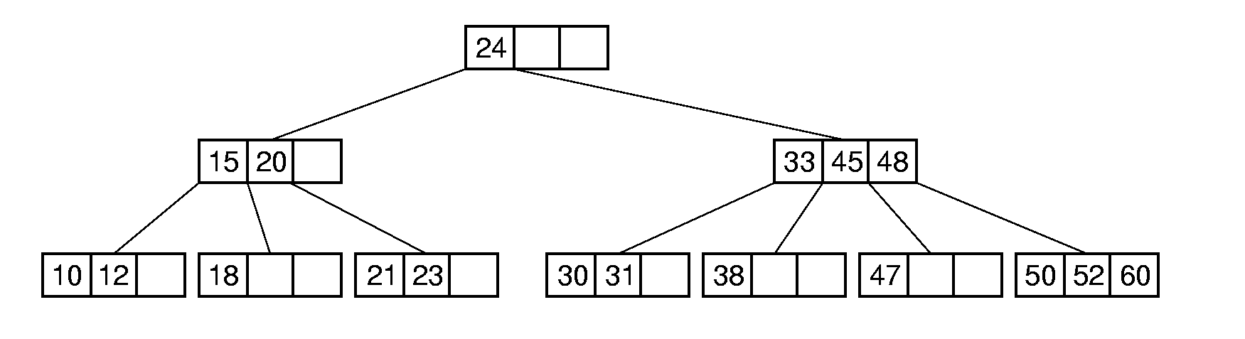
B-Tree Definition (1)
A B-Tree of order m (m阶B树) has these properties:
  The root is either a leaf or has at least two children.
  Each node, except for the root and the leaves, has between ⎡m/2⎤ and m children.
  All leaves are at the same level in the tree, so the tree is always height balanced.
B-tree of order 4

Slide 52
B-Tree Definition (2)
A B-Tree node is usually selected to match the size of a disk block to reduce the disk I/O operations
  A B-Tree node could have hundreds of children.

Slide 53
B-Tree Search
Search in a B-Tree is a generalization of search in a 2-3 Tree.
B-tree of order 4
Search 47
Not efficient to support range query
such as searching the keys in[30,50]!

Slide 54
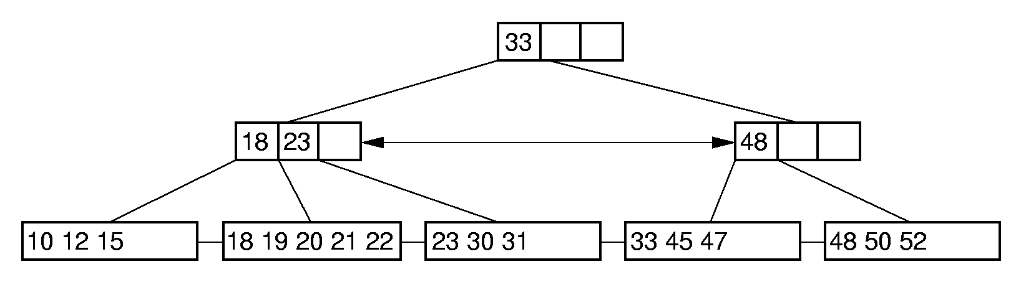
B⁺-Trees for Range Query
The most commonly implemented form of the B-Tree is the B⁺-Tree.
Internal nodes of the B⁺-Tree only store key values to guide the search.
Leaf nodes store records or pointers to records.
All of the nodes in the same level are linked together.
Support Range query well

Slide 55
Property of B⁺-Trees
The root is either a leaf or has at least two children.
Each node, except for the root and the leaves, has
⎡m/2⎤ ~ m children, and has ⎡m/2⎤ - 1 ~ m – 1 keys
If each leaf can store n records at most , it must store ⎡n/2 ⎤ records at least. (except the root as a leaf)
Example: B⁺ tree of order 4. Each internal nodes have 2~4 children.
Assume that each leaf can store 5 records at most. At least 3 records
should be contained in a leaf.

Slide 56
B⁺-Tree Insertion (1)
18 33
Case 1:
10 12 15
18 20 21
33 47 50
Insert 45
18 33
10 12 15
18 20 21
33 45 47 50
B+ tree of order 4. Each leaf contains 5 records at most.

Slide 57
B⁺-Tree Insertion (2)
18 33
10 12 15
18 20 21 24 30
33 45 47
Case 2:
Insert 26
18 33
10 12 15
18 20 21
24 26 30
33 45 47
split
B+ tree of order 4. Each leaf contains 5 records at most.

Slide 58
B⁺-Tree Insertion (2)
18 33
10 12 15
18 20 21
24 26 30
33 45 47
18 24 33
10 12 15
18 20 21
24 26 30
33 45 47
B+ tree of order 4. Each leaf contains 5 records at most.

Slide 59
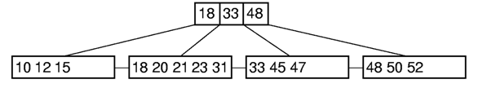
B⁺-Tree Insertion (3)
Case 3:
Insert 30
18 33 48
Split
10 12 15
18 20 21
23 30 31
33 45 47
48 50 52
18 23 33 48
10 12 15
18 20 21
23 30 31
33 45 47
48 50 52
B+ tree of order 4. Each leaf contains 5 records at most.

Slide 60
B⁺-Tree Insertion (3)
18 23 33 48
Split again
10 12 15
18 20 21
23 30 31
33 45 47
48 50 52
18 23
48
10 12 15
18 20 21
23 30 31
33 45 47
48 50 52
33
Θ(log n)
18 23
48
10 12 15
18 20 21
23 30 31
33 45 47
48 50 52
B+ tree of order 4. Each leaf contains 5 records at most.

Slide 61
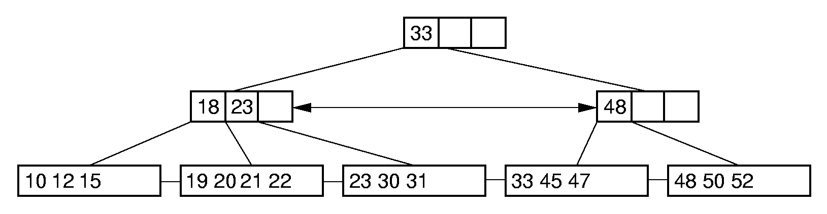
B⁺-Tree Deletion (1)
Case 1:
↓delete 18
B+ tree of order 4. Each leaf contains 5 records at most.

Slide 62
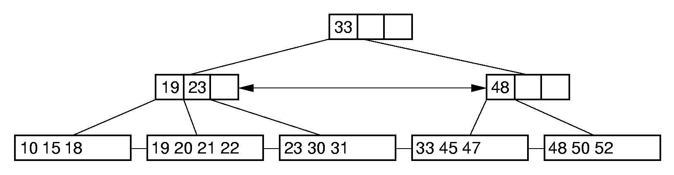
B⁺-Tree Deletion (2)
Case 2:
↓delete 12
Rich brother can help
B+ tree of order 4. Each leaf contains 5 records at most.

Slide 63
B⁺-Tree Deletion (3)
Case 3:
Merge with poor brother
↓delete 33
33
18 23
10 12 15
18 19 20 21 22
23 30 31
45 47 48 50 52
B+ tree of order 4. Each leaf contains 5 records at most.

Slide 64
B⁺-Tree Deletion (3)
33
Rich brother can help
18 23
10 12 15
18 19 20 21 22
23 30 31
45 47 48 50 52
23
Θ(log n)
18
33
10 12 15
18 19 20 21 22
23 30 31
45 47 48 50 52
B+ tree of order 4. Each leaf contains 5 records at most.

Slide 65
B⁺-Tree Deletion (4)
23
Case 4:
33
18
10 12 15
18 19 20 21 22
23 30 31
45 47 48
Merge with poor brother
↓delete 47
23
18
10 12 15
18 19 20 21 22
23 30 31 45 48
B+ tree of order 4. Each leaf contains 5 records at most.

Slide 66
B⁺-Tree Deletion (4)
Merge with poor brother
23
18
10 12 15
18 19 20 21 22
23 30 31 45 48
↓
18 23
10 12 15
18 19 20 21 22
23 30 31 45 48

Slide 67
B⁺-Tree Deletion (4)
18 23
10 12 15
18 19 20 21 22
23 30 31 45 48
↓
18 23
10 12 15
18 19 20 21 22
23 30 31 45 48
Collaps of the tree

Slide 68
Cost Analysis (1)
Asymptotic cost of search, insertion, and deletion of nodes from B-Trees is Θ(log_{r} n).
  r is the (average) branching factor of the tree.
  If the base is big enough, the B-tree is very efficient to index a large collection of records.

Slide 69
Cost Analysis (2)
Example: Consider a nonempty B⁺-Tree of order 100 with leaf nodes containing 100 records at most.
1 level B⁺-tree:
Min 1, Max 100
2 level B⁺-tree:
Min: 2 leaves of 50 for 2×50 =100 records.
Max: 100 leaves with 100 for 100×100=10,000 records.
3 level B⁺-tree:
Min: 2 x 50 leaves, for 2 x 50×50= 5000 records.
Max: 100³ = 1,000,000 records.
4 level B⁺-tree:
Min: 250,000 records (2 x 50 x 50 x 50).
Max: 100⁴ = 100 million records.

Slide 70
Cost Analysis (3)
Exercise: Consider a B⁺-Tree of order 40 with leaf nodes containing 100 records at most。
1 level B⁺-tree :
Min 1, Max 100
2 level B⁺-tree :
Min : 2 leaves of 50 for 2×50 =100 records
Max : 40 leaves with 100 for 40×100=4,000 records
3 level B⁺-tree :
Min : 2 x 20 leaves, for 2 x 20×50= 2000 records.
Max : 40×40×100 = 160,000 records.
4 level B⁺-tree :
Min : 40,000 records (2 × 20 × 20 × 50).
Max : 40×40×40×100 = 6,400,000 records .

Slide 71
Summary
B⁺- Trees are always balanced.
B⁺- Trees supports range query .
The height of B⁺- Trees is relatively low, which can reduce the disk I/O operations.

Slide 72
Thanks!

