Slide 1

ARTIFICIAL NEURAL NETWORK APPROACH ON DETECTING EARLY GESTATIONAL DIABETES MELLITUS
Presented By
Name: Tanzina Rahman Hera
Roll No: BKH-1311034F
Session: 2012-13
Year: IV, Term: II

Slide 2
Supervised By
Dr. Md Ashikur Rahman Khan
Professor & Chairman
Department of Information and Communication Engineering.
Noakhali Science & Technology University.

Slide 3
Contents
1. Introduction
1.1. Gestational Diabetes Mellitus (GDM)
1.2. Symptoms Of GDM
1.3. Risks on having GDM
1.4. Necessity of early diagnosis
1.5. Conventional Techniques
1.6. Disadvantages of conventional techniques
1.7. Problem Statement
2. Objectives
3. Methodology
3.1. Different Artificial Neural Network (ANN) Structures
3.2 Working procedure by a schematic diagram
4. Result and discussions
4.1 Comparative analysis
5. Conclusion
6.References

Slide 4

1. Introduction
1.1. Gestational Diabetes Mellitus (GDM)
Is a temporary condition that occurs during pregnancy.
3 to 25%of pregnant women develop gestational diabetes.
More than 50% of women who had gestational diabetes will develop type 2 diabetes.

Slide 5
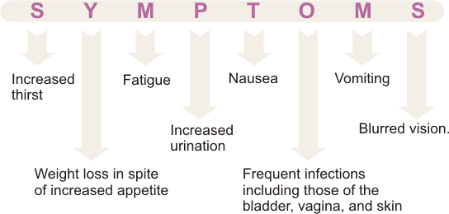
1.2 Symptoms of GDM

Slide 6
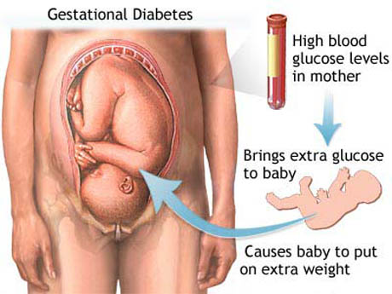
1.3 Risks on having GDM
For Mother
For Baby

Slide 7
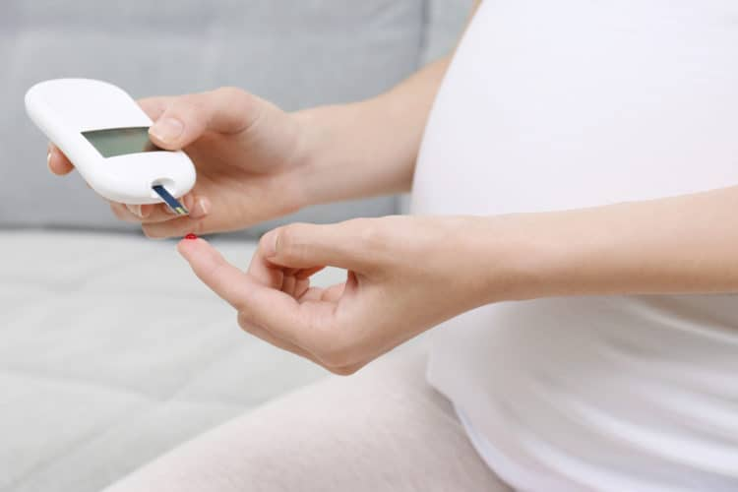
1.4 Necessity of early Diagnosis of GDM
Pregnancy complications.
Risk of miscarriage.
The mother can develop type 2 diabetes as she gets older.

Slide 8
1.5 Conventional diagnosis techniques of GDM
Non-challenge blood glucose tests
Screening glucose challenge test
Oral glucose tolerance test

Slide 9
1.6 Disadvantages of Conventional diagnosis techniques of GDM
Time consuming
Labored
Costly

Slide 10
1.7 Problem statement
An early detection model of GDM with high accuracy, less complex and with efﬁcient performance is urgently needed.
Cost-effective screening and diagnostic methods of gestational diabetes to reduce maternal and fetal complications is necessary.
Artificial Neural Network (ANN) models are becoming more popular in detecting various diseases so that the risk of the specific disease decreases.

Slide 11
2. Objectives
The objectives of the research are as follows:
To develop a cost-effective screening and diagnostic method of detecting gestational
diabetes mellitus (GDM) to reduce maternal and fetal complications.
To develop different Artificial Neural Network (ANN) models or structures for the early detection of GDM.
To study the performance of these network models by applying the same dataset of the patients.
To make a comparison among this ANN structures on the basis of finding the best network that shows the more accurate result.
To explore the efficient and better ANN structure for predicting the GDM.

Slide 12
3. Methodology
Artificial Intelligence (AI)
Artificial Neural Network (ANN)

Slide 13
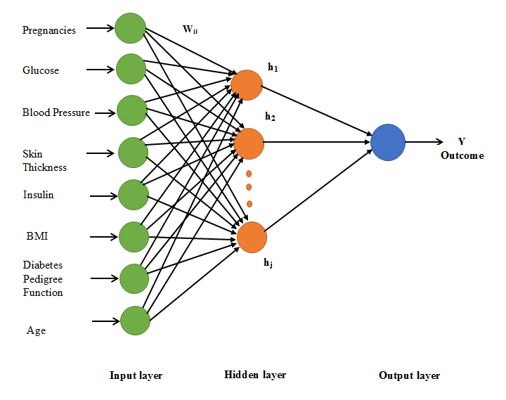
Figure 2. A simple structure of Artificial neural network

Slide 14
3.1 Different Artificial Neural Network (ANN) Structures
Multilayer Perceptron Neural Network (MLPNN)
Radial Basis Function Neural Network (RBFNN)
Self-organizing feature map (SOM) network
Recurrent network
Support vector machine (SVM) Neural Network
fuzzy logic network

Slide 15
3.2 Working procedure by a schematic diagram
Collection of the patient data
Build a network
Train the network
Test the network
Apply validation testing to compute the accuracy of the network model

Slide 16
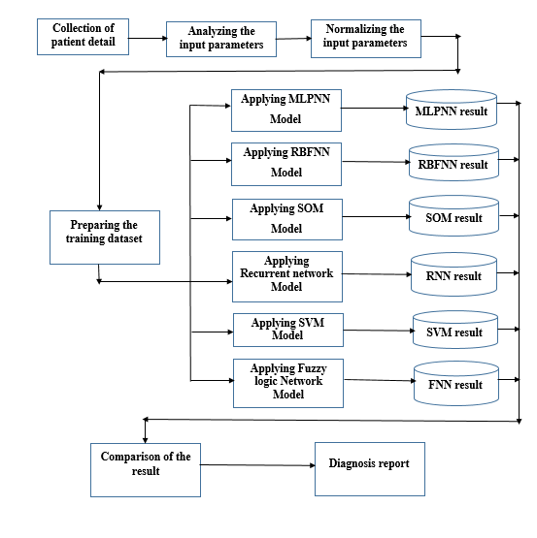
Figure 2. A Schematic diagram of working procedure

Slide 17
4. Result and Discussions
By the values of Mean square error and linear correlation coefficient of different ANN models
By the accuracy values from validation test
By the figure of validation result

Slide 18
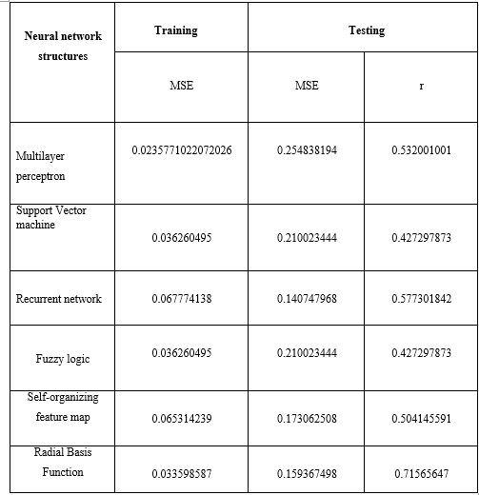
Fig. Comparison of the neural network structures by training and testing result

Slide 19
Neural network structure | Accuracy
Multilayer perceptron | 64%
Support Vector machine | 76.37%
Recurrent network | 83.64%
Fuzzy logic | 74.6%
Self-organizing feature map | 83.64%
Radial Basis Function | 87.3%
Fig. Comparison of the neural network structures by validation result

Slide 20
Fig. Validation result of MLPNN

Slide 21
Fig. Validation result of RBFNN

Slide 22
Fig. Validation result of SOM network

Slide 23
Fig. Validation result of Recurrent neural network

Slide 24
Fig. Validation result of SVM neural network

Slide 25
Fig. Validation result of fuzzy neural network

Slide 26
4.1 Comparative analysis
Fig. Statistical view of the comparison of different neural network structures

Slide 27
5. Conclusion
Future work

Slide 28
5. References
[1] Andries P. Engelbrecht, “Computational Intelligence: An Introduction”, Second Edition, John Wiley & Sons Ltd., (2007).
[2] Caipo Zhang, Jinjie Song, Zhilong Wu, “Fuzzy Integral be Applied to the Diagnosis of Gestational Diabetes Mellitus” Sixth International Conference on Fuzzy Systems and Knowledge Discovery, vol. 4, pp 296-300, (Nov 2009).
[3] J. K. Olarinoye, A. E. Ohwovoriole, G. O. Ajayi, “Diagnosis of Gestational Diabetes Mellitus in Nigerian pregnant women - comparison between 75g and 100g Oral Glucose Tolerance Tests”,
[4] Lohse N, Marseille E, Kahn JG, “Development of a model to assess the cost-effectiveness of gestational diabetes mellitus screening and lifestyle change for the prevention of type 2 diabetes mellitus”, International Journal of Gynaecology and Obstetrics, vol. 115, Supplement 1,pp S20-S25, (Nov 2011).
[5] Okeh U. M and Oyeka I. C. A “Receiver Operating Characteristic Curve Analysis Of Diagnostic Tests Results For Gestational Diabetic Mellitus”, Journal of Mathematics, vol. 8 (1), pp 11-17, (Sept - Oct 2013).
[6] Ozcimen EE, Uckuyu A, Ciftci FC, Yanik FF, Bakar C, “Diagnosis of gestational diabetes mellitus by use of the homeostasis model assessment-insulin resistance index in the first trimester”, The official Journal of the International Society of Gynaecological Endocrinology, vol. 24 (4), pp 224-229, (April 2008).

Slide 29
[7] Priya ShirleyMuller, S. Meenakshi Sundaram, M. Nirmala “An unconventional Approach for
Early Detection of Gestational Diabetes Mellitus using Influential Parameters” International Conference on Computational Intelligence and Advanced Manufacturing Research, vol. 1, pp 144-148, (May 2014).
[8] Sreedevi E, Vijaya Lakshmi K, Chaitanya Krishna E, Padmavathamma M., “Modelling effective diagnosis of risk complications in gestational diabetes mellitus: an e-diabetic expert system for pregnant women” SPIE Proceedings, Fourth International Conference on Digital Image Processing (ICDIP 2012), vol. 8334, (May 2012).
[9] Surabhi Nanda, Mina Savvidou, Argyro Syngelaki, Ranjit Akolekar and Kypros H. Nicolaides, “Prediction of Gestational Diabetes Mellitus by maternal factors and biomarkers at 11 to 13 weeks”, Prenatal Diagnosis, Published in Wiley Online Library, vol. 31 (2), pp 135-141, (Jan 2011).
[10] Thach S.Tran, Jane E. Hirst, My An T. Do, Jonathan M. Morris, Heather E. Jeffery, “Early Prediction of Gestational Diabetes Mellitus in Vietnam”: Clinical impact of currently recommended diagnostic criteria, Diabetes Care, Volume 36, pp 618–624, (2013).
[11] M.A. Kennelly, F.M. McAuliffe, Prediction and prevention of Gestational Diabetes: an update of recent literature, European Journal of Obstetrics & Gynecology and Reproductive biology (2016).
[12] Ahlam A. Sharief, Alaa Sheta, (IJARAI) International Journal of Advanced Research in Artificial Intelligence, Vol. 3, No.10, 2014.
[13] Sung Hee Yang, Changsoo Kim, Hyun Sook An, Hyun An and Jin Soo Lee, Prediction of Gestational Diabetes Mellitus in Pregnant Korean Women Based on Abdominal Subcutaneous Fat Thickness as Measured by Ultrasonography, Diabetes & Metabolism journal, (Mar. 6, 2017).

Slide 30
Thank You !

