Slide 1
Distributive Frequency of Energy Classification Using Deep Boltzmann Machine
Submitted By
Abir Hosen
Exam Roll: ASH1511033M
Information And Communication Engineering
Noakhali Science & Technology University
Thesis Supervisor
Saifur Rahman
Assistant Professor,
Information And Communication Engineering
Noakhali Science & Technology University

Slide 2
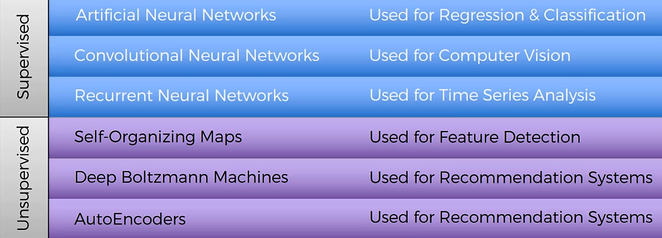
Introduction

Slide 3
Introduction
Quantum Mechanics rules over every atom & tiny particle in every piece of matter. Photons can be viewed in some sense as energy wave-packets of arbitrary spatiotemporal(belonging to both space and time or to space–time) amplitude, moving at the speed of light.
The photonic frequency identification according to it’s information is the main obstruct that will be tried to solve beside the huge data storage in minimal form with the purpose of easy learning process of Deep Boltzmann Machine.

Slide 4
Purpose
Here to build an algorithm following Deep Boltzmann Machine, in purpose of ionize frequency detection and classification.
The outcome will help auto detection of any existence around us, thus every existence contain radioactive as well as electromagnetic frequency.

Slide 5
objective
General Boltzmann Machine, Restricted Boltzmann Machine, Deep Belief Network will be discussed at a glance.
Brief discussion of Deep Boltzmann Machine & Energy based model will implement the complete ideology of the paper.

Slide 6
Methods
Sensors for radioactive frequency detection.
Ionize radiation measurement for data identification.
Deep Boltzmann Machine comparing Deep Belief Network.
Constructive Divergence.

Slide 7
Methods
The following equipment can be used to detect ionizing radiation (radioactivity):
Ionization chambers (the simplest of all gas-filled radiation detectors)
Gaseous ionization detectors (used in particle physics to detect the presence of ionizing particles)
Geiger counters (detects ionizing radiation such as alpha particles, beta particles, and gamma rays using the ionization effect produced in a Geiger–Müller tube)
Scintillation counters (for detecting and measuring ionizing radiation by using the excitation effect of incident radiation on a scintillating material, and detecting the resultant light pulses)

Slide 8
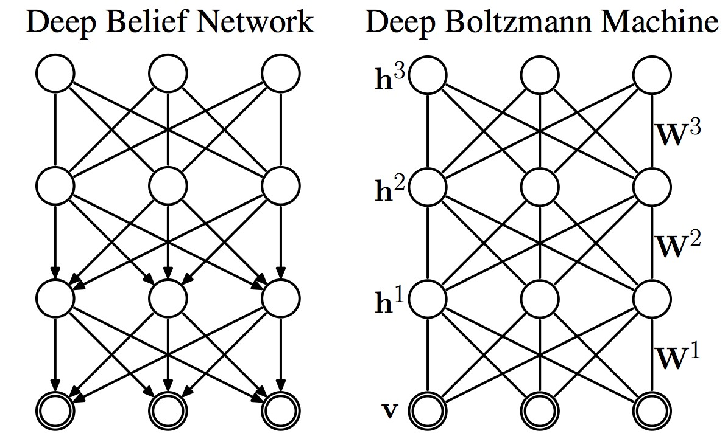
Methods
When used in unsupervised learning, it is common practice to model the joint distribution between a set of observable variables, called the visible units and auxiliary variables called the hidden units.

Slide 9
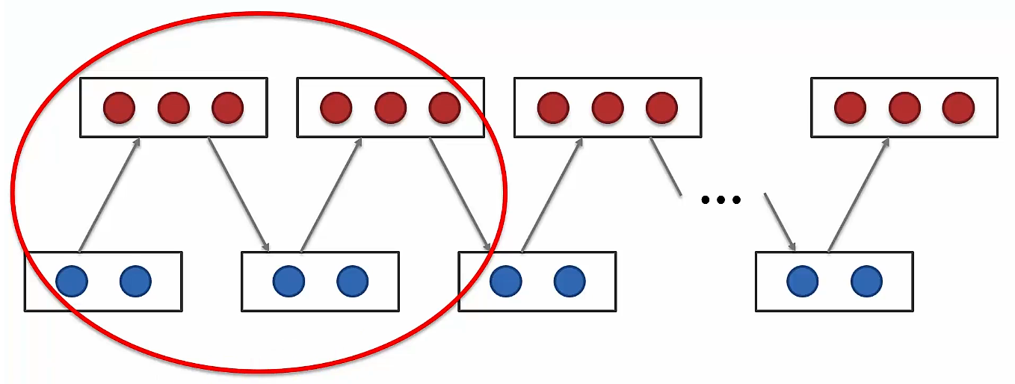
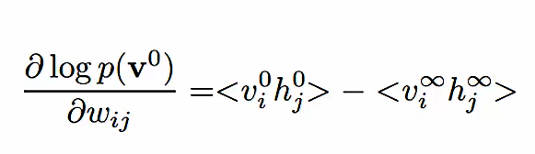
Methods

Slide 10
Expected result
AI based detection & identification of objects through the radiation pattern of it’s own.

Slide 11
references
Gas Classification Using Deep Convolutional Neural Networks, Pai Peng 1,3, Xiaojin Zhao 1, Xiaofang Pan 2 and Wenbin Ye 1. Published: 8 January 2018 https://www.mdpi.com/1424-8220/18/1/157/pdf
The wake-sleep algorithm for unsupervised neural networks, Geoffrey Hinton, 1995. http://www.cs.toronto.edu/~fritz/absps/ws.pdf
Deep Boltzmann Machines, RuslanSalakhutdinov, 2009 http://proceedings.mlr.press/v5/salakhutdinov09a/salakhutdinov09a.pdf
SINGLE PHOTONS FOR QUANTUM INFORMATION PROCESSING, , David Fattal, September 2010 https://web.stanford.edu/group/yamamotogroup/Thesis/DFthesis.pdf

Slide 12
references
Contrastive Divergence, Oliver Woodford, 2012 http://www.robots.ox.ac.uk/~ojw/files/NotesOnCD.pdf
A fast learning algorithm for deep belief nets. Hinton GE¹, Osindero S, Teh YW. https://www.cs.toronto.edu/~hinton/absps/fastnc.pdf
Energy based models, YannLeCun, 2006, http://yann.lecun.com/exdb/publis/pdf/lecun-06.pdf
Effects of ionizing radiation on nanomaterials and III-V semiconductor devices. by Cory Cress
http://scholarworks.rit.edu/cgi/viewcontent.cgi?article=5671&context=theses

