Slide 1


Slide 2


elcome
W

Slide 3
Thesis Title
Social Network Site (SNS) - Facebook and Bangladesh: A study of data analysis over Bangladeshi Facebook users with personality-traits, emotions and preferences to explore the opportunities.

Slide 4
Presented By
MD. MAHBUBUL ALAM
ID: ASH1311047M
Session: 2012-2013

Slide 5
Supervised By
MD. SAIFUR RAHMAN Assistant Professor
Department of Information and Communication Engineering (ICE) Noakhali Science and Technology University (NSTU)
Noakhali-3843, Bangladesh

Slide 6

Facebook
Most popular online social network
Launched on February 04, 2004
Founded by Mark Zuckerberg
Active Facebook users : Two billion

Slide 7

BANGLADESH
Area: 147,570 km²
Population: 166,368,149
Active Facebook users : 22 million

Slide 8
Why Facebook as Research tool?
Demographic profile
User-generated content
Social network structure
User preferences and activities
Information about user’s friends

Slide 9
Personality-traits
Creativity and Curiousness
Conscientiousness
Extroversion
Agreeableness
Emotional Stability

Slide 10
Emotions
Positive
Negative
Anger
Anticipation
Disgust
Fear
Joy
Sadness
Surprise
Trust

Slide 11
Preferences
Attributes / Parameters
Gender
Age
Geographic Region
Marital Status

Slide 12
Preferences
BOOKS
MOVIES
PLACES
NEWSPAPES
GAMES

Slide 13
Preferences
SPORTS
LANGUAGES
FOOD
TV CHANNELS
SEASONS

Slide 14
Requirement
Data: Facebook data, Online information
Hardware Requirement: Computer, Calculator.
Software Requirement: Microsoft Excel, MATLAB, Notepad++, Browser
Programming Languages: PHP, MATLAB
Algorithms: APRIORI and Filtering algorithm

Slide 15
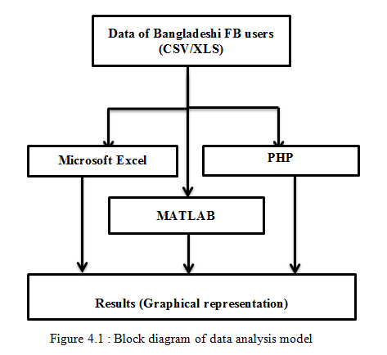
Methodology

Slide 16
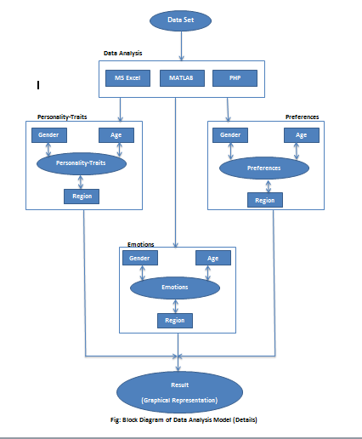

Slide 17
Result and Representation

Slide 18
Personality-Traits
Personality | Percentage
Creative and Curious | 52.22%
Conscious | 44.09%
Extrovert | 23.65%
Friendly and Co-operative | 60.93%
Emotional | 34.63%
Table : Personality-Traits of Bangladeshi Facebook users

Slide 19
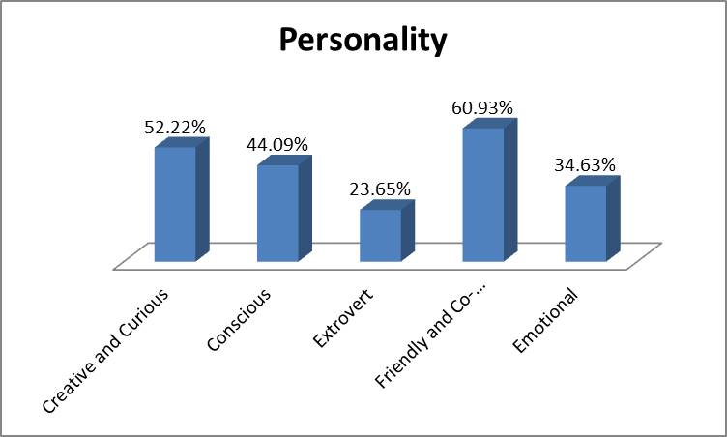
Personality-Traits
Fig: Personality-Traits of Bangladeshi Facebook users

Slide 20
Relationship between Gender and Emotions
Fig: Relationship between gender and Emotions

Slide 21
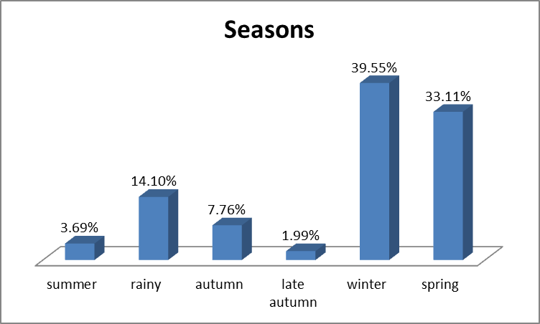
Seasons
Fig: Seasons preferences of Bangladeshi Facebook users

Slide 22
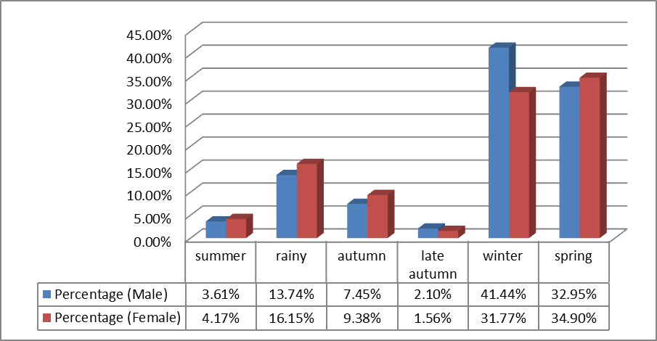
Relationship between Gender and Seasons
Fig: Seasons preferences and Gender

Slide 23
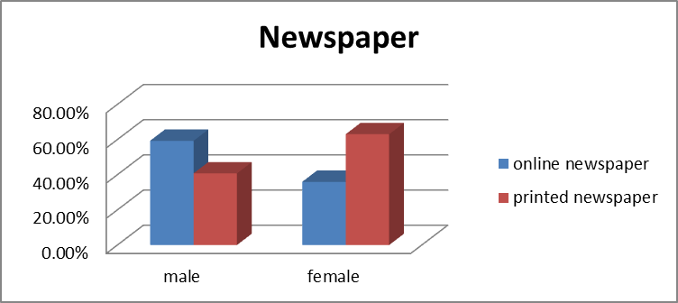
Newspapers
Newspaper | Percentage (Male) | Percentage (Female)
online newspaper | 59.25% | 35.94%
printed newspaper | 40.75% | 63.02%
Fig: Newspapers preferences and Gender

Slide 24
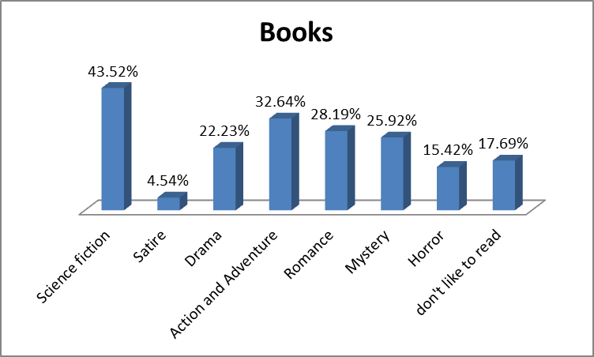
Books Preferences
Fig: Books preferences of Bangladeshi Facebook users

Slide 25
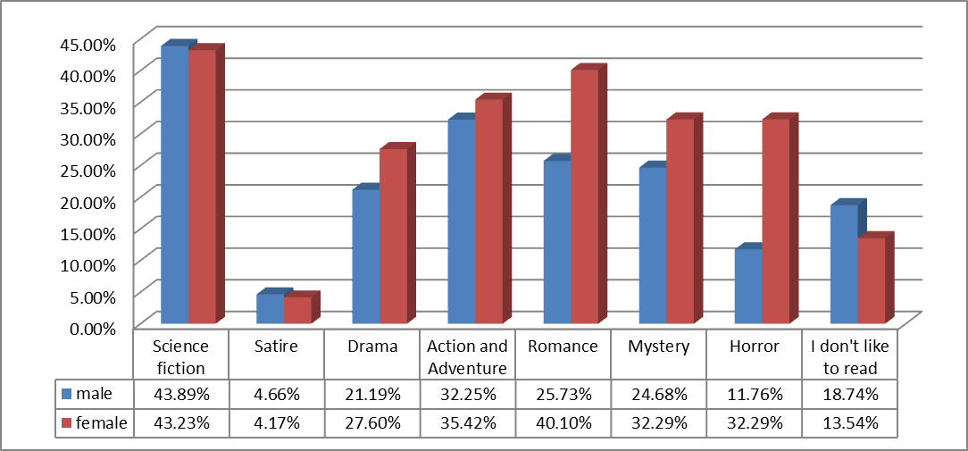
Relationship between Gender and Books preference
Fig: Books preferences and Gender

Slide 26
Books Preferences and Age
 | Age
Books | <15 | 16-20 | 21-25 | 26-30 | >31
Science fiction | 30.43% | 48.00% | 44.68% | 37.20% | 17.86%
Satire | 0.00% | 3.08% | 4.26% | 9.76% | 0.00%
Drama | 21.74% | 20.00% | 25.34% | 18.29% | 14.29%
Action and Adventure | 13.04% | 36.62% | 33.66% | 28.66% | 7.14%
Romance | 30.43% | 30.15% | 30.17% | 21.95% | 3.57%
Mystery | 4.35% | 26.77% | 27.66% | 25.00% | 7.14%
Horror | 13.04% | 22.15% | 14.31% | 8.54% | 0.00%
I don't like to read | 8.70% | 15.08% | 11.80% | 35.37% | 60.71%
Fig: Books preferences and Age

Slide 27
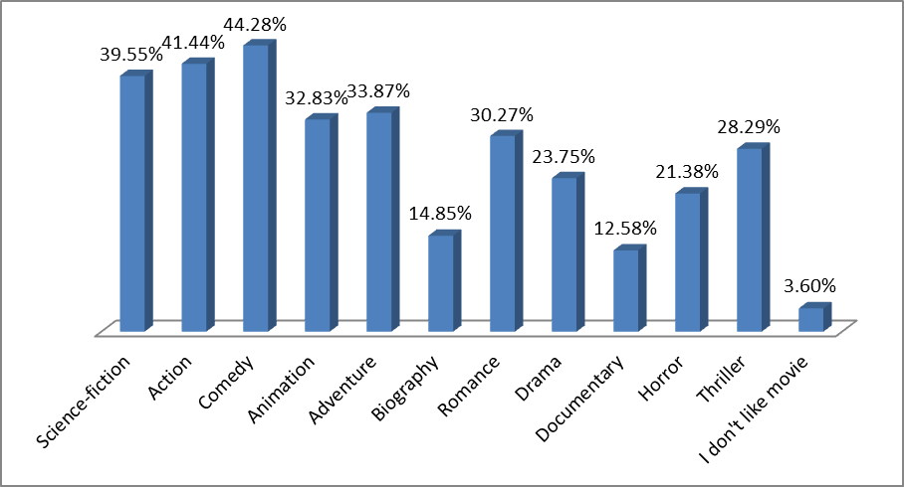
Movies Preferences
Fig: Movies preferences of Bangladeshi Facebook users

Slide 28
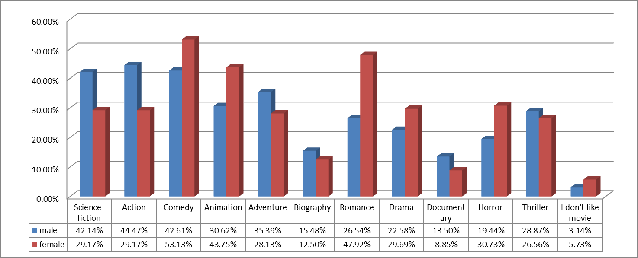
Relationship between Gender and Movies preference
Fig: Movies preferences and Gender

Slide 29
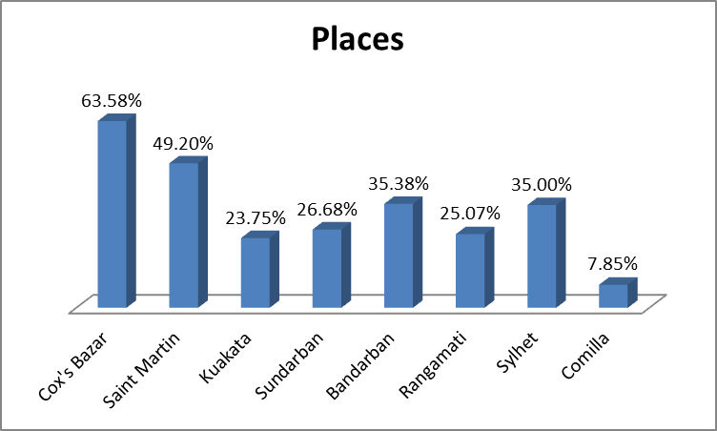
Places Preferences
Fig: Places preferences of Bangladeshi Facebook users

Slide 30
Places Preferences and Gender
Fig: Places preferences and Gender

Slide 31
Places Preferences and Age
 | Age
Places | <15 | 16-20 | 21-25 | 26-30 | >31
Cox's Bazar | 60.87% | 62.77% | 59.19% | 75.00% | 89.29%
Saint Martin | 60.87% | 44.62% | 48.16% | 59.76% | 50.00%
Kuakata | 26.09% | 29.85% | 20.50% | 21.34% | 25.00%
Sundarban | 30.43% | 25.54% | 26.31% | 29.27% | 28.57%
Bandarban | 21.74% | 36.92% | 31.91% | 46.95% | 25.00%
Rangamati | 4.35% | 29.23% | 24.18% | 23.17% | 21.43%
Sylhet | 8.70% | 37.85% | 37.14% | 29.27% | 17.86%
Comilla | 0.00% | 9.23% | 9.09% | 3.05% | 3.57%
Fig: Places preferences and Age

Slide 32
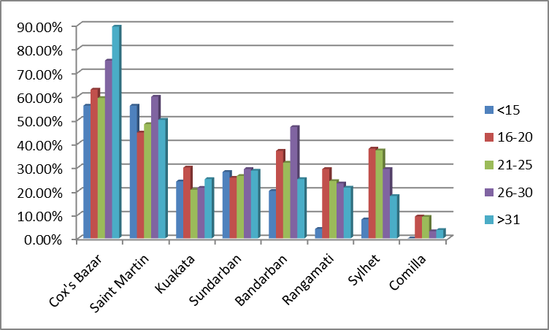
Places Preferences and Age
Fig: Places preferences and Age

Slide 33
Places Preferences and Area
 | Dhaka | Chittagong | Sylhet | Barisal | Khulna | Rajshahi | Mymensingh
Cox's Bazar | 74.19% | 59.82% | 68.66% | 47.73% | 76.62% | 57.43% | 80.00%
Saint Martin | 63.59% | 41.41% | 56.72% | 44.32% | 67.53% | 36.63% | 65.33%
Kuakata | 25.35% | 18.40% | 23.88% | 47.73% | 36.36% | 22.77% | 10.67%
Sundarban | 33.64% | 19.02% | 34.33% | 28.41% | 55.84% | 14.85% | 30.67%
Bandarban | 47.93% | 31.60% | 55.22% | 25.00% | 44.16% | 20.79% | 34.67%
Rangamati | 39.63% | 24.54% | 28.36% | 20.45% | 23.38% | 15.84% | 13.33%
Sylhet | 22.12% | 32.21% | 68.66% | 27.27% | 61.04% | 17.82% | 14.67%
Comilla | 4.61% | 14.11% | 1.49% | 5.68% | 0.00% | 0.99% | 6.67%
Fig: Places preferences and Area

Slide 34
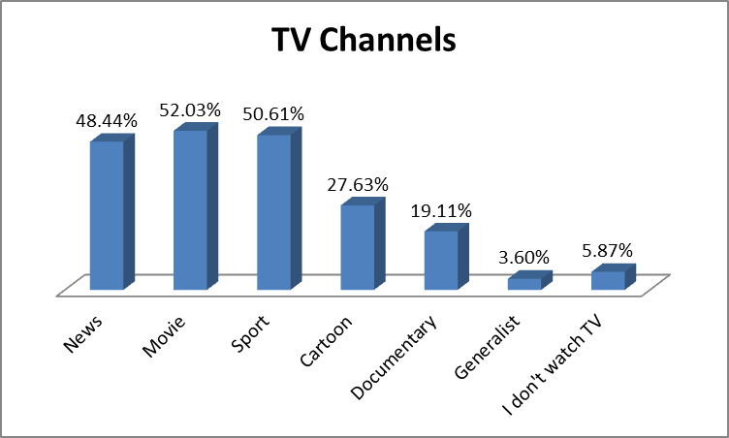
TV Channels Preferences
Fig: TV Channels preferences of Bangladeshi Facebook users

Slide 35
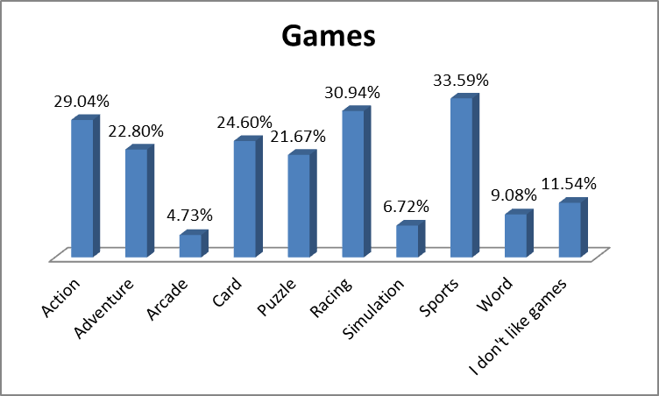
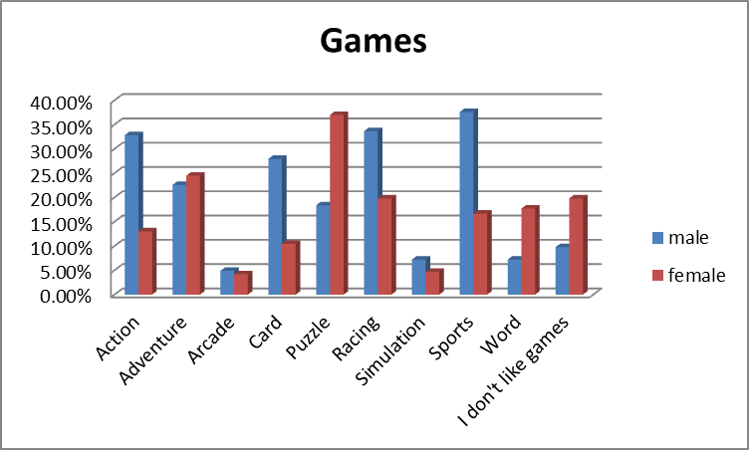
Games Preferences
Fig: Games preferences of Bangladeshi Facebook users

Slide 36
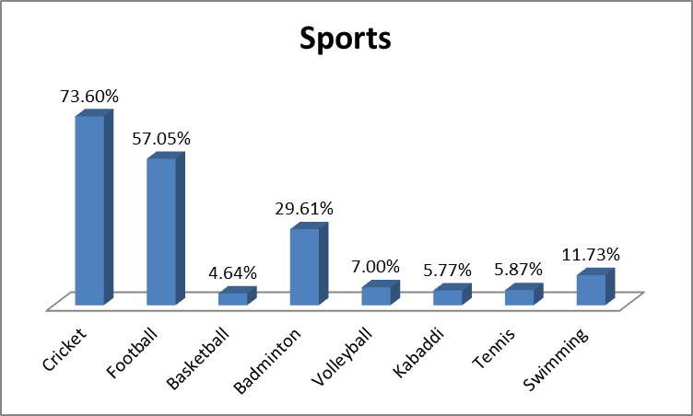
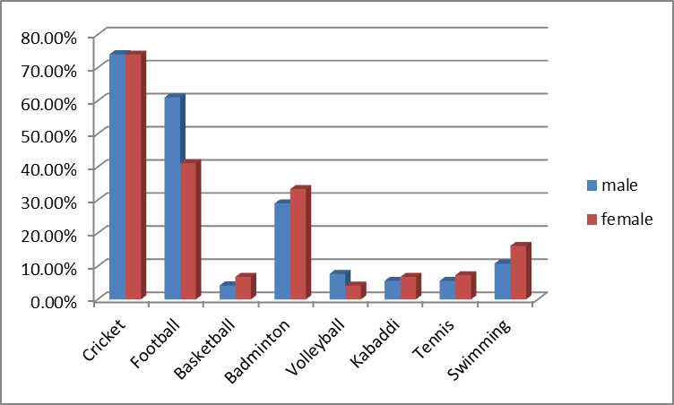
Sports Preferences
Fig: Sports preferences of Bangladeshi Facebook users

Slide 37
Language Association (APRIORI)
Language Association | Confidence
English => Bangla | 98.25%
Bangla => English | 75.38%
Hindi => Bangla | 99.53%
Hindi => English | 96.46%
Arabic => Bangla | 92.00%
Arabic => English | 92.00%
Spanish => Bangla | 85.71%
Korean => Bangla | 100.00%
Korean => English | 100.00%
French => Bangla | 75.00%
French => Spanish | 75.00%

Slide 38
Future Scope
Automatic Prediction
Making Decision
Prediction On The Personal Choices
Business Decision Accuracy

