Slide 1



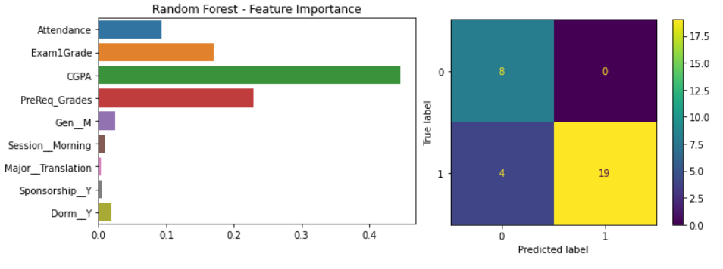
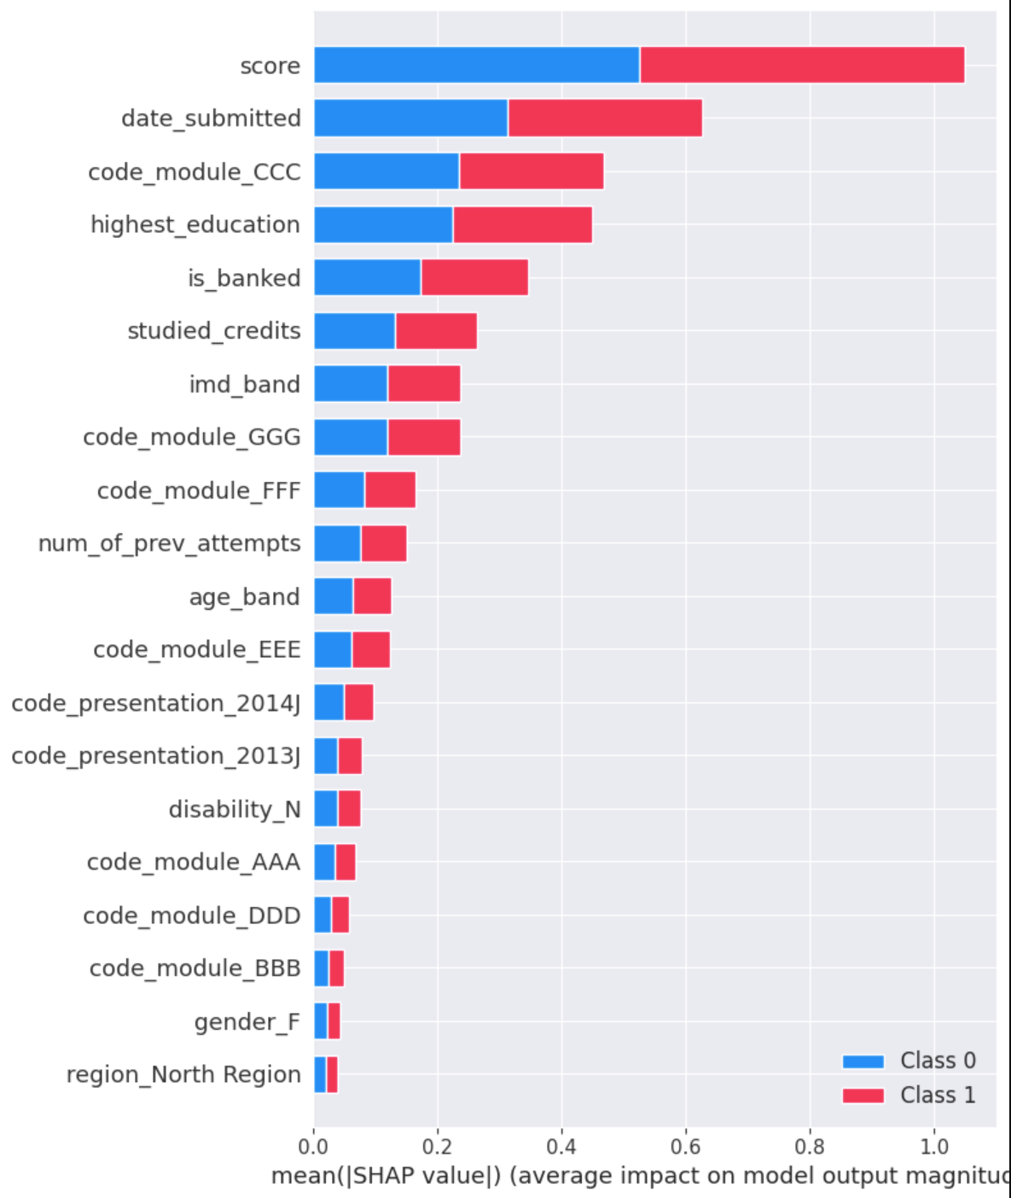
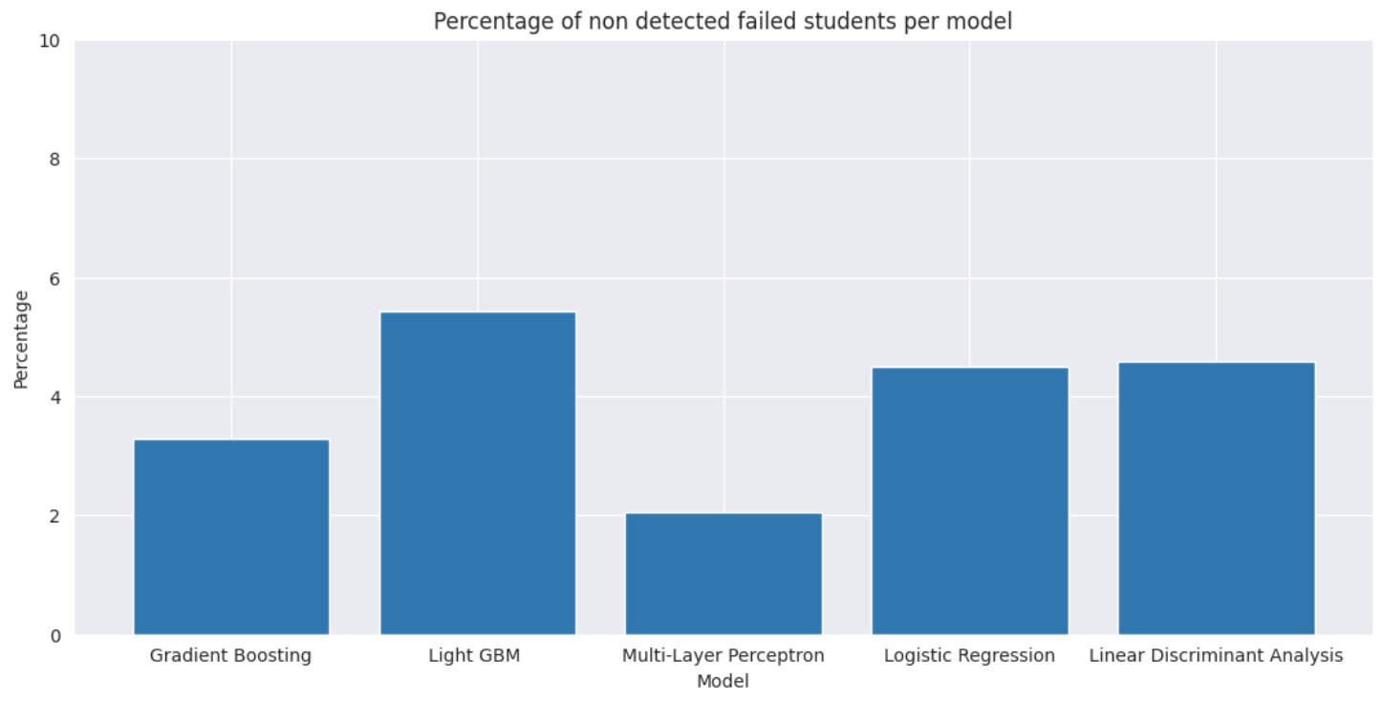
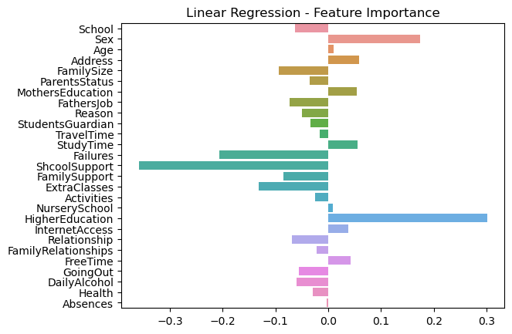
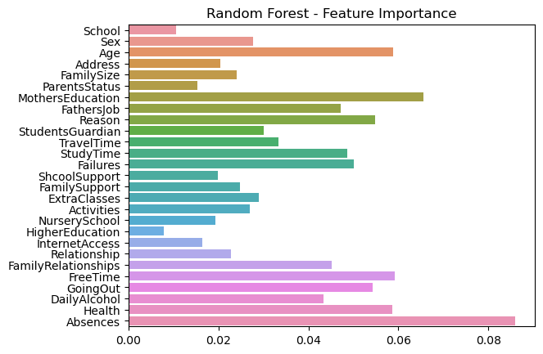
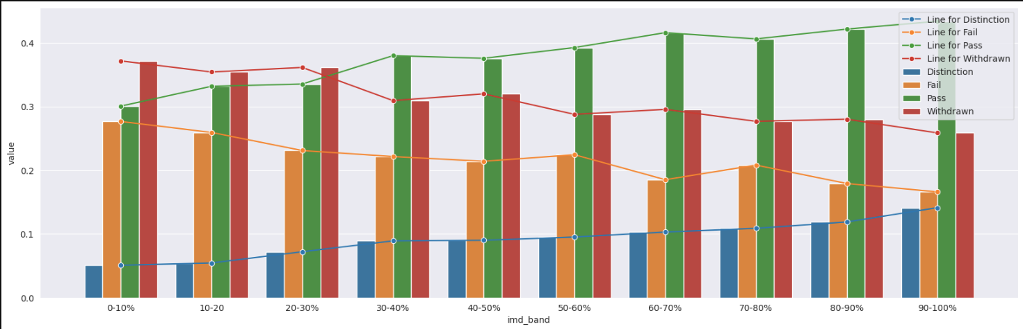
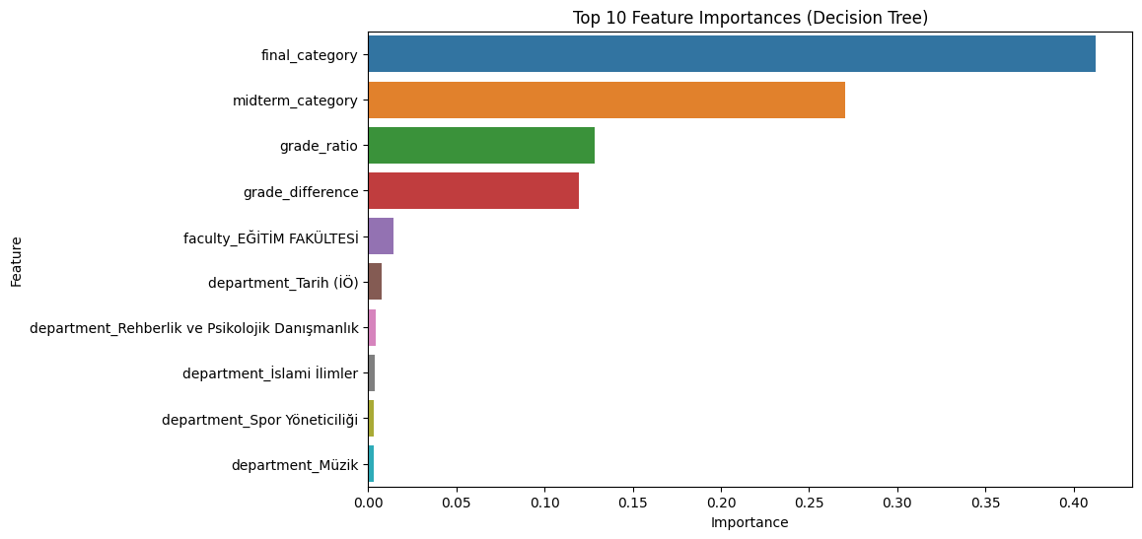
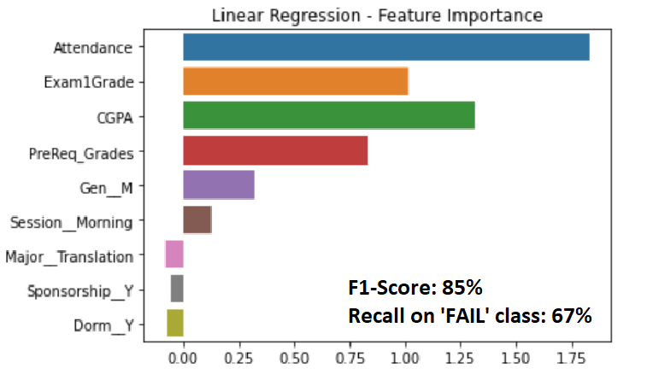
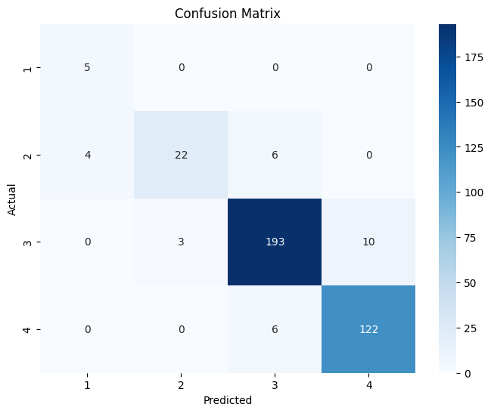



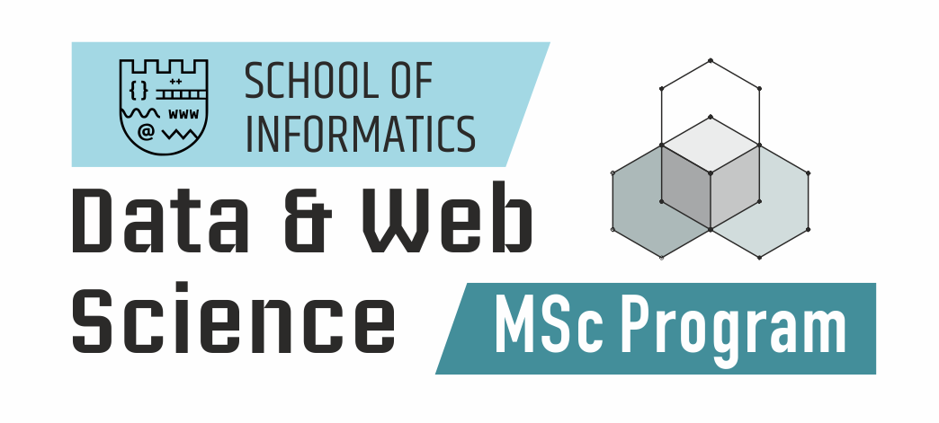
Exploring Feature Importance for Predicting Students' Academic Performance with Machine Learning Algorithms
Ntaoulas Vasileios, Kalyvas Emmanouil, Malamatinos Marios-Christos, Papanikolaou Stefanos
School of Informatics, Aristotle University of Thessaloniki, Thessaloniki, GR
Introduction
Motivation
Predicting students‘ academic performance through experimentation with various Machine Learning Models which can provide valuable insights for educators and institutes.
Feature Engineering: Experimented with impact of generated features from existing ones and also encoding them to highlight relationships in the data.
Model Interpretability: Applied interpretability techniques to extract valuable information as to how the models are affected by the data.
Cost Focused Approach: By applying cost matrices, we managed to achieve very low non-detected failure rates.
Enhanced Personalized Learning
Early Intervention and Support
Resource Allocation Optimization
Equity and Inclusion
Datasets
Dataset
Records x Features
Open University Learning Analytics dataset
UCI dataset
Buraimi University College dataset
Kırşehir Ahi Evran University dataset
26715 x 37
(649 & 395) x 33
151 x
1854 x 5
OULAD Dataset
UCI Dataset
KAEU Dataset
BUC Dataset
Conclusions
References
Most Important Features: First/Mid-Term Exam Scores, CGPA, Date of Submission, Attendance, Department, Educational Background, Wealth/Relationship Status, Age.
Data Availability: Shortage of student performance data and very few features to make use of.
Cost Importance: According to resources available, appropriate cost function can be set to decide on which students, educators should focus on and radically reduce failure rates.
Yağcı, M. Educational data mining: prediction of students' academic performance using machine learning algorithms. Smart Learn. Environ. 9, 11 (2022). https://doi.org/10.1186/s40561-022-00192-z
Amirah Mohamed Shahiri, Wahidah Husain, Nur’aini Abdul Rashid, A Review on Predicting Student's Performance Using Data Mining Techniques, Procedia Computer Science, Volume 72, 2015, Pages 414-422, ISSN 1877-0509, https://doi.org/10.1016/j.procs.2015.12.157
T. Mishra, D. Kumar and S. Gupta, "Mining Students' Data for Prediction Performance," 2014 Fourth International Conference on Advanced Computing & Communication Technologies, Rohtak, India, 2014, pp. 255-262, doi: 10.1109/ACCT.2014.105
Khan, I., Ahmad, A.R., Jabeur, N. et al. An artificial intelligence approach to monitor student performance and devise preventive measures. Smart Learn. Environ. 8, 17 (2021). https://doi.org/10.1186/s40561-021-00161-y

