Slide 1

PROJECT PRESENTATION ON DIABETES DISEASE PREDICTION USING MACHINE LEARNING
DEPT. OF INFORMATION TECHNOLOGY CENTRAL INSTITUTE OF TECHNOLOGY, KOKRAJHAR
By-
DAFFODIL KR. BRAHMA(GAU-C-15/226)
RUPAM DAS(GAU-C-15/228)
ANKUR ZOARDER(GAU-C-15/237)
MWNTHAI NARZARY(GAU-C-15/249)
Under the Guidence of-
Dr. Amitava Nag.
HOD, Associate Prefessor
Dept. of IT
Dec,23 2018
Daffo,Rupam,Ankur,Mwnthai(CITK)

Slide 2
CONTENTS
Machine Learning
Parts of machine Learning
Flow Chart(machine learning)
Decision Tree
5. Random forest
6. Working Process
7. Output
Dec,23 2018
Daffo,Rupam,Ankur,Mwnthai(CITK)

Slide 3
Machine Learning[1]
Machine learning is an application of artificial intelligence (AI) that provides systems the ability to learn automatically.
Dec,23 2018
Daffo,Rupam,Ankur,Mwnthai(CITK)

Slide 4
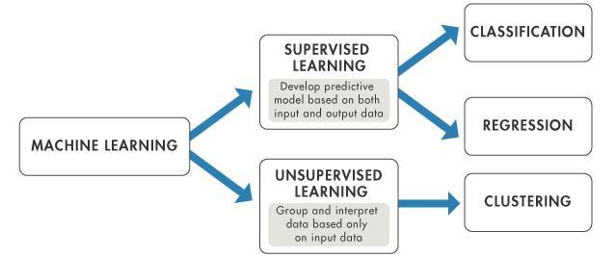
Parts Of Machine Learning
Dec,23 2018
Daffo,Rupam,Ankur,Mwnthai(CITK)

Slide 5
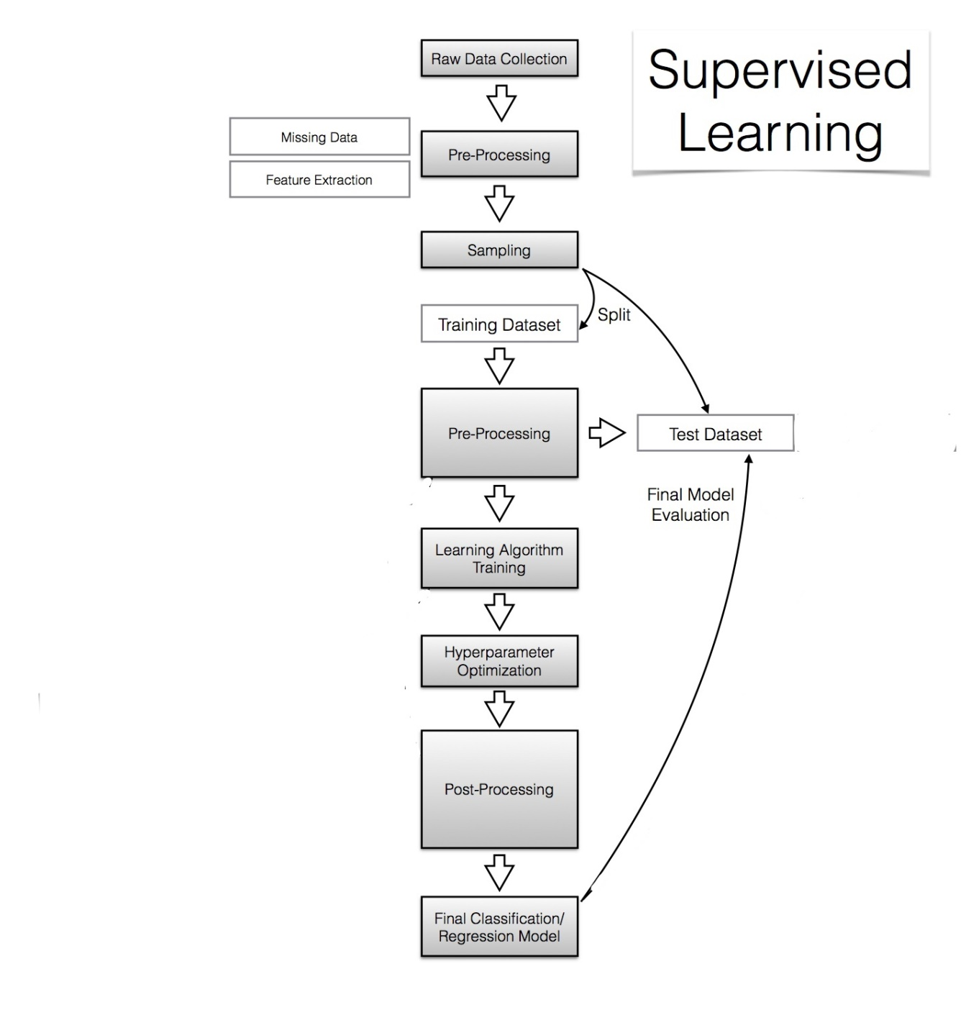
(Flow Chart)Machine Learning
Dec,23 2018
Daffo,Rupam,Ankur,Mwnthai(CITK)

Slide 6
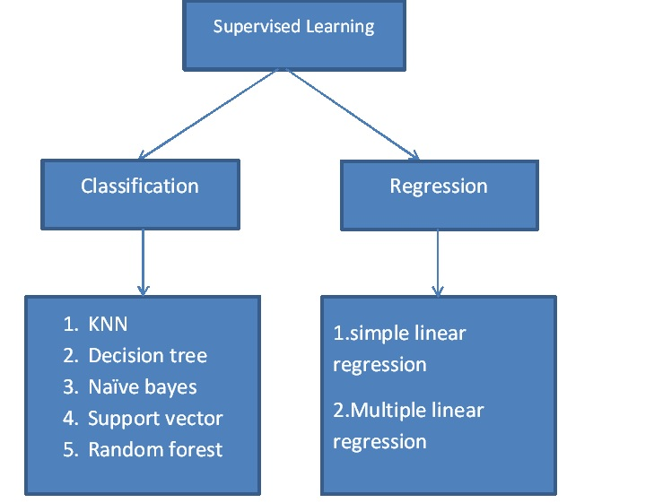
Continues…
Dec,23 2018
Daffo,Rupam,Ankur,Mwnthai(CITK)

Slide 7
Decision Tree
Decision tree is a simplest algorithm in machine learning.
It is powerful and perhaps most widely used algorithm of all.
Decision tree classified instances by sorting them down the tree from the root node, which provide classification of instances.
Dec,23 2018
Daffo,Rupam,Ankur,Mwnthai(CITK)

Slide 8
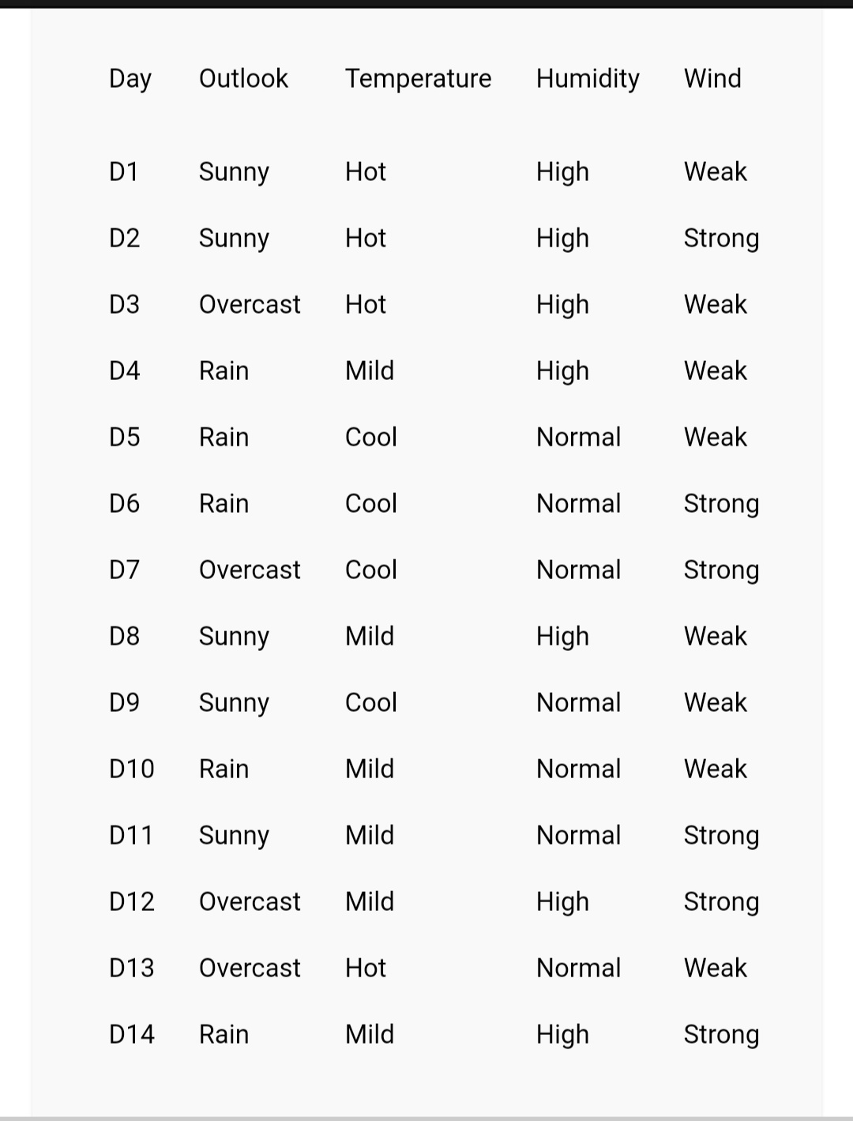
Example(decision tree).
Dec,23 2018
Daffo,Rupam,Ankur,Mwnthai(CITK)

Slide 9
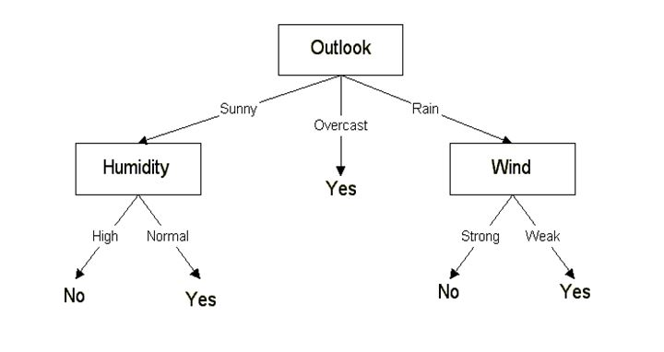
Example(decision tree).
Dec,23 2018
Daffo,Rupam,Ankur,Mwnthai(CITK)

Slide 10
Terms In Decision Tree[2]
Entropy
Let p_{i} be the probability that an arbitrary tuple in Dataset(D)-
Information
(after using A to split D into v partitions) to classify D:
Dec,23 2018
Daffo,Rupam,Ankur,Mwnthai(CITK)

Slide 11
Terms In Decision Tree(continue)
Gain-
branching on attribute A
Gini index-
If a data set D contains examples from n classes, gini index, gini(D) is defined as
Dec,23 2018
Daffo,Rupam,Ankur,Mwnthai(CITK)

Slide 12
Problem Of Decision Tree[3]
Overfitting is occur in Decision forest
Cannot handle missing data
It has low performance due to overfitting
Dec,23 2018
Daffo,Rupam,Ankur,Mwnthai(CITK)

Slide 13
Random Forest[4]
An collections of classifier using many decision tree algorithm.
Can be use for classifier.
Accuracy and variable importance information is provided with the result.
Dec,23 2018
Daffo,Rupam,Ankur,Mwnthai(CITK)

Slide 14
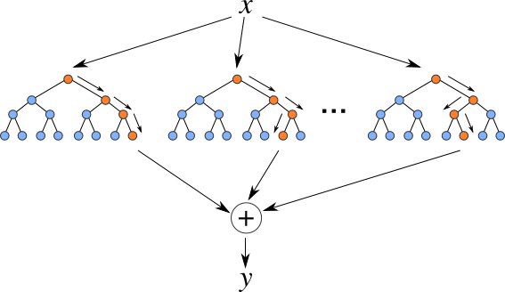
Random Forest Block Diagram
Dec,23 2018
Daffo,Rupam,Ankur,Mwnthai(CITK)

Slide 15
Advantage of random forest
It Reduce the problem of overfitting.
Handle missing data.
It is fast and easy to use.
Dec,23 2018
Daffo,Rupam,Ankur,Mwnthai(CITK)

Slide 16
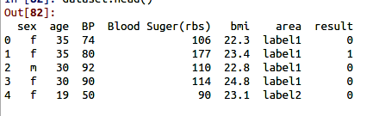
working process
Dataset
Dec,23 2018
Daffo,Rupam,Ankur,Mwnthai(CITK)

Slide 17

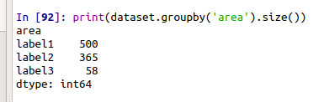
Working Process(continue..)
Dataset(male/female)
Dataset(area)
Label1= Rural
Label2= Semi Urban
Label3= Urban
Dec,23 2018
Daffo,Rupam,Ankur,Mwnthai(CITK)

Slide 18
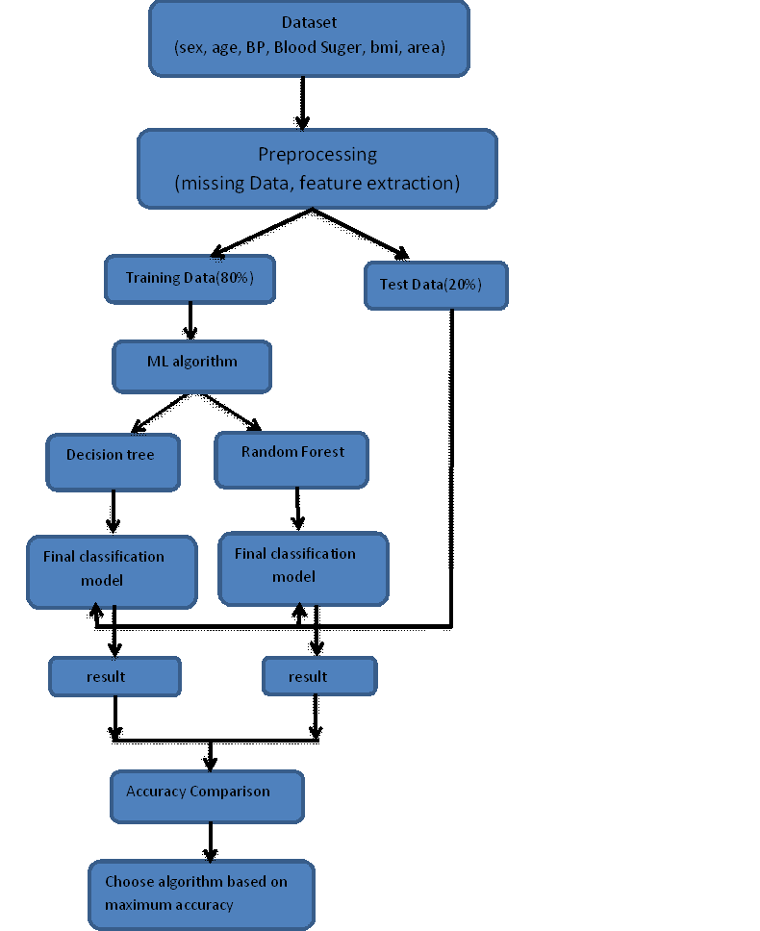
Working Process(continue..)
Flow Chart(working Process)
Dec,23 2018
Daffo,Rupam,Ankur,Mwnthai(CITK)

Slide 19
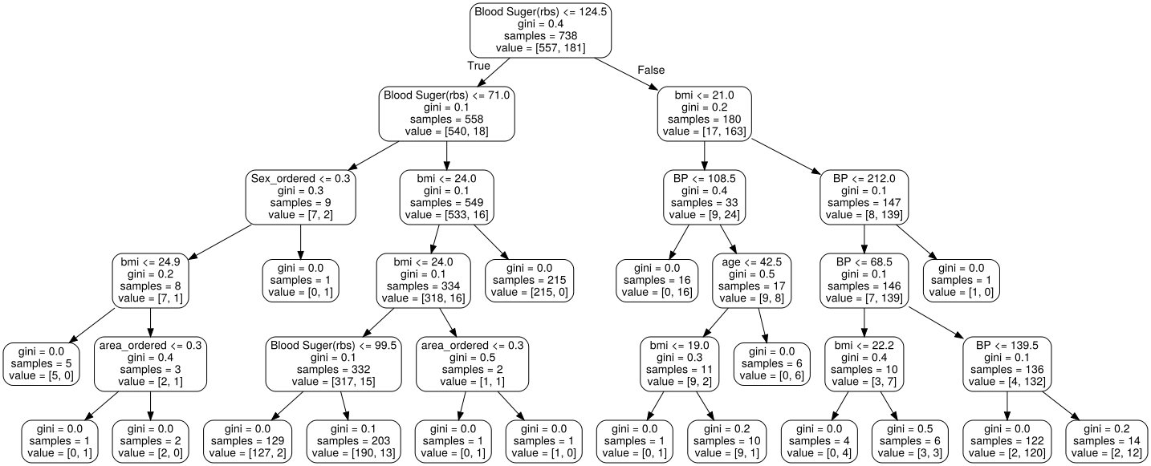
Output
Decision tree
Dec,23 2018
Daffo,Rupam,Ankur,Mwnthai(CITK)

Slide 20
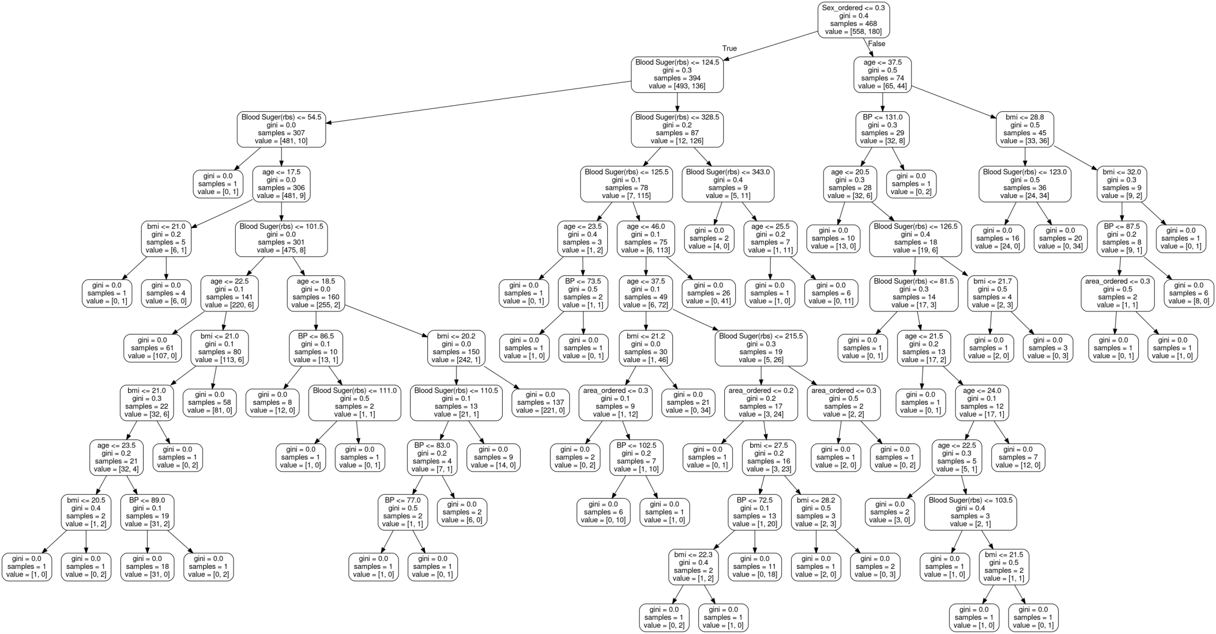
Output
Random forest
Dec,23 2018
Daffo,Rupam,Ankur,Mwnthai(CITK)

Slide 21

Output
Prediction Result
Dec,23 2018
Daffo,Rupam,Ankur,Mwnthai(CITK)

Slide 22
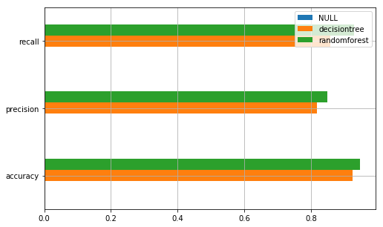
Output
Prediction Result(graph)
Dec,23 2018
Daffo,Rupam,Ankur,Mwnthai(CITK)

Slide 23
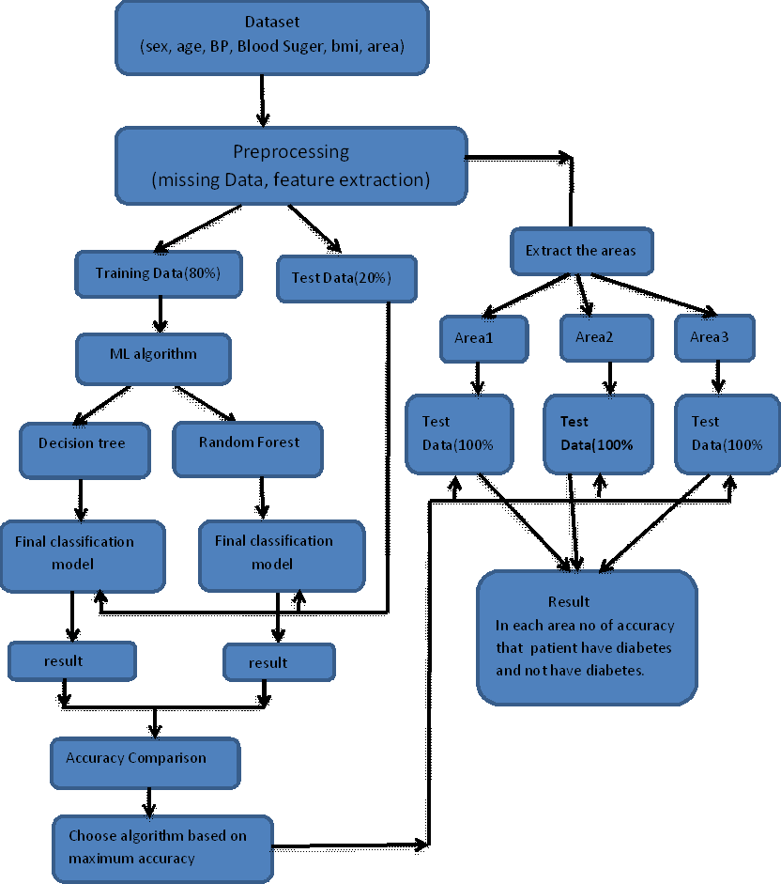
Output
Working process(flow chart)
Dec,23 2018
Daffo,Rupam,Ankur,Mwnthai(CITK)

Slide 24
Output
Working process(dataset)
Label1= Rural
Label2= Semi Urban
Label3= Urban
Dec,23 2018
Daffo,Rupam,Ankur,Mwnthai(CITK)

Slide 25
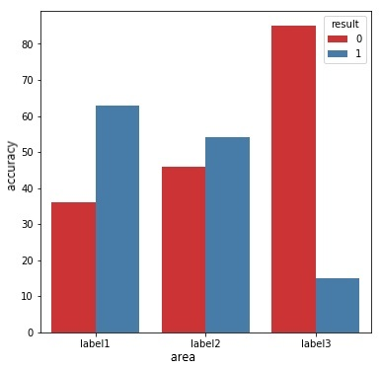
Output
Accuracy Result(area)
Dec,23 2018
Daffo,Rupam,Ankur,Mwnthai(CITK)

Slide 26
Output
Conclusion
Decision Tree has problem of overfitting.
We can overcome this problem with random forest
Performance of Random forest is more as compare to decision tree.
We come to know that in village area the level of diabetes is more then the semi-urban and urban area.
Dec,23 2018
Daffo,Rupam,Ankur,Mwnthai(CITK)

Slide 27
Output
Future Work
Include more data and more areas.
Use neural network and deep learning over the data.
Dec,23 2018
Daffo,Rupam,Ankur,Mwnthai(CITK)

Slide 28
Output
References
[1] Asir Antony Gnana Singh Danasingh, “Diabetes Prediction Using Medical Data” January 2017.
[2] Nasir Islam Sujan “What is Entropy and why Information gain matter in Decision Trees” Jun 29
[3] DeeptiSisodia,Dilip SinghSisodia "Prediction of Diabetes using Classification Algorithms"2018.05.12
[4] Punnee Sittidech,Nongyao Nai-arun "Random Forest Analysis on Diabetes Complication Data"January 2014
Dec,23 2018
Daffo,Rupam,Ankur,Mwnthai(CITK)

