Slide 1
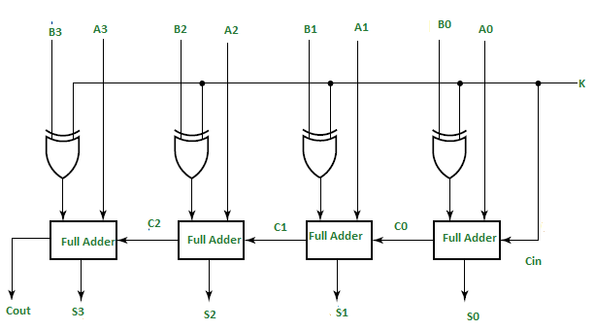
Take last 4 digits of your roll number. For each digit if its >= 5 write 1, otherwise write 0 for example 0647 -> 0101=B Perform addition and subtraction of your binary number with A=1111 using given circuit and fill below table
 | FA 0 | FA 1 | FA 2 | FA 3
Xi
Yi
Zi
Si
Ci
Z3
Y3
Z2
Y2
Z1
Y1
Z0
Y0
3
X3
2
X2
1
X1
0
X0

