Slide 1

cPU vs gpu on quantized transformer inference
Kabeer Ali
Muneeb Lone

Slide 2

Presented to
Ma’am Saira Qamar
Sir Adil Majeed
Sir Shahbaz Hassan

Slide 3

Introduction
Transformer models (BERT, DistilBERT) are widely used for NLP classification tasks
Moving from research to production requires optimal hardware-precision combinations
INT8 quantization is commonly recommended to reduce memory and increase speed
Problem: Theory doesn't match reality — hardware specs, batch sizes, and quantization overhead impact performance unpredictably
Users lack empirical guidance on when/where INT8 actually improves performance on accessible hardware

Slide 4
Literature Review
Reference | Core Contribution | Hardware / Deployment | Limitation Addressed by Your Paper
Vaswani et al. (2017) [3] | Introduced Transformer architecture Enabled parallelized sequence modeling | NVIDIA P100s (Training focus) Ignored inference deployment | Misses memory-bandwidth limits for small-batch inference Theoretical FLOPs don't reflect real throughput
Zafrir et al. (2019) [4] | Symmetric INT8 quantization for BERT Proved 8-bit inference feasibility | Single high-end GPU Did not measure batch size effects | Lacks latency penalty analysis for small batches Ignores mixed-precision outlier overhead
Gholami et al. (2021) [5] | Broad survey of quantization methods (PTQ, QAT, mixed-precision) | Broad hardware coverage Abstract bandwidth constraints | Lacks empirical throughput vs. batch size crossover data Misses outlier overhead vs. batch size interactions

Slide 5
Literature Review
Reference | Core Contribution | Hardware / Deployment | Limitation Addressed by Your Paper
Dettmers et al. (2022) [6] | Introduced LLM.int8() Separated outliers (FP16) from the rest (INT8) | High-bandwidth datacenter GPUs Evaluated large generative models only | Focuses on generative model memory/accuracy Misses throughput costs for encoder-only inference
Sheng et al. (2023) [7] | Analyzed memory/compute tradeoffs Proposed FlexGen for single-GPU offloading | High-end single-GPU setups Autoregressive inference focus | Limited strictly to autoregressive decoding Misses bandwidth characterization for encoder-only tasks

Slide 6
Research objectives

Slide 7
rEsearch objectives
Benchmark INT8 post-training quantization on accessible hardware (Kaggle GPUs, consumer CPU)
Measure latency, throughput, memory usage, and accuracy across 5 configurations Determine when INT8 improves vs degrades performance based on batch size
Compare memory bandwidth (HBM2 vs GDDR6) impact on throughput
Evaluate multi-GPU scaling behavior for encoder-only inference
Provide deployment guidance for researchers with limited compute budgets

Slide 8

Proposed solution
Models:
BERT-base (110M params, 12 layers) and DistilBERT (66M params, 6 layers)
Fine-tuned on GLUE SST-2 sentiment classification
Hardware Tested:
AMD Ryzen 5 5600 CPU (1, 6, 12 threads)
NVIDIA Tesla P100 GPU (732 GB/s HBM2)
NVIDIA Tesla T4 GPU (300 GB/s GDDR6)
Dual T4 GPUs (DataParallel)

Slide 9
Proposed solution
Quantization Methods:
GPU (T4): bitsandbytes LLM.int8() with outlier detection
GPU (P100): Fallback to weight-only quantization (no INT8 compute)
CPU: PyTorch dynamic quantization via FBGEMM backend
Measurement Protocols:
30 iterations + 5 warmup runs per configuration
Batch sizes: 1, 8, 16, 32, 64
Metrics: latency, throughput, peak memory, GLUE SST-2 accuracy
Fixed seed (42) for reproducibility

Slide 10
Challenges
Base Paper: Dettmers et al., "LLM.int8(): 8-bit Matrix Multiplication for Transformers at Scale" (NeurIPS 2022)
Introduces mixed-precision decomposition with outlier detection for transformer quantization
Preserves high-magnitude activations in FP16, quantizes remaining weights to INT8
Gap identified: Prior work focuses on datacenter GPUs and generative models
Missing: Encoder-only models on edge-tier hardware (T4, P100) across real-world batch sizes
No controlled study on memory bandwidth vs compute capability tradeoffs

Slide 11

Changes from baseline paper
P100 (HBM2) vs T4 (GDDR6) — FP32:
P100 outperforms T4 by 1.76× (BERT) to 1.96× (DistilBERT) at batch 64
Memory bandwidth (2.44× advantage) predicts throughput better than peak TOPs
T4 INT8 vs FP32:
Batch 1: INT8 is 4.8× slower
Batch 16+: INT8 begins outperforming FP32
Batch 64: INT8 achieves 1.38× speedup with 2.29× memory savings
CPU INT8 vs FP32:
Consistent 1.65×–1.84× speedup at 6 threads across all batch sizes.
Accuracy drop: 0.8–1.2 percentage points
Dual T4 vs Single P100:
DataParallel degrades throughput at batch <16
Single P100 matches/exceeds dual T4 at all batch sizes (BERT-base)

Slide 12
Graphs

Slide 13
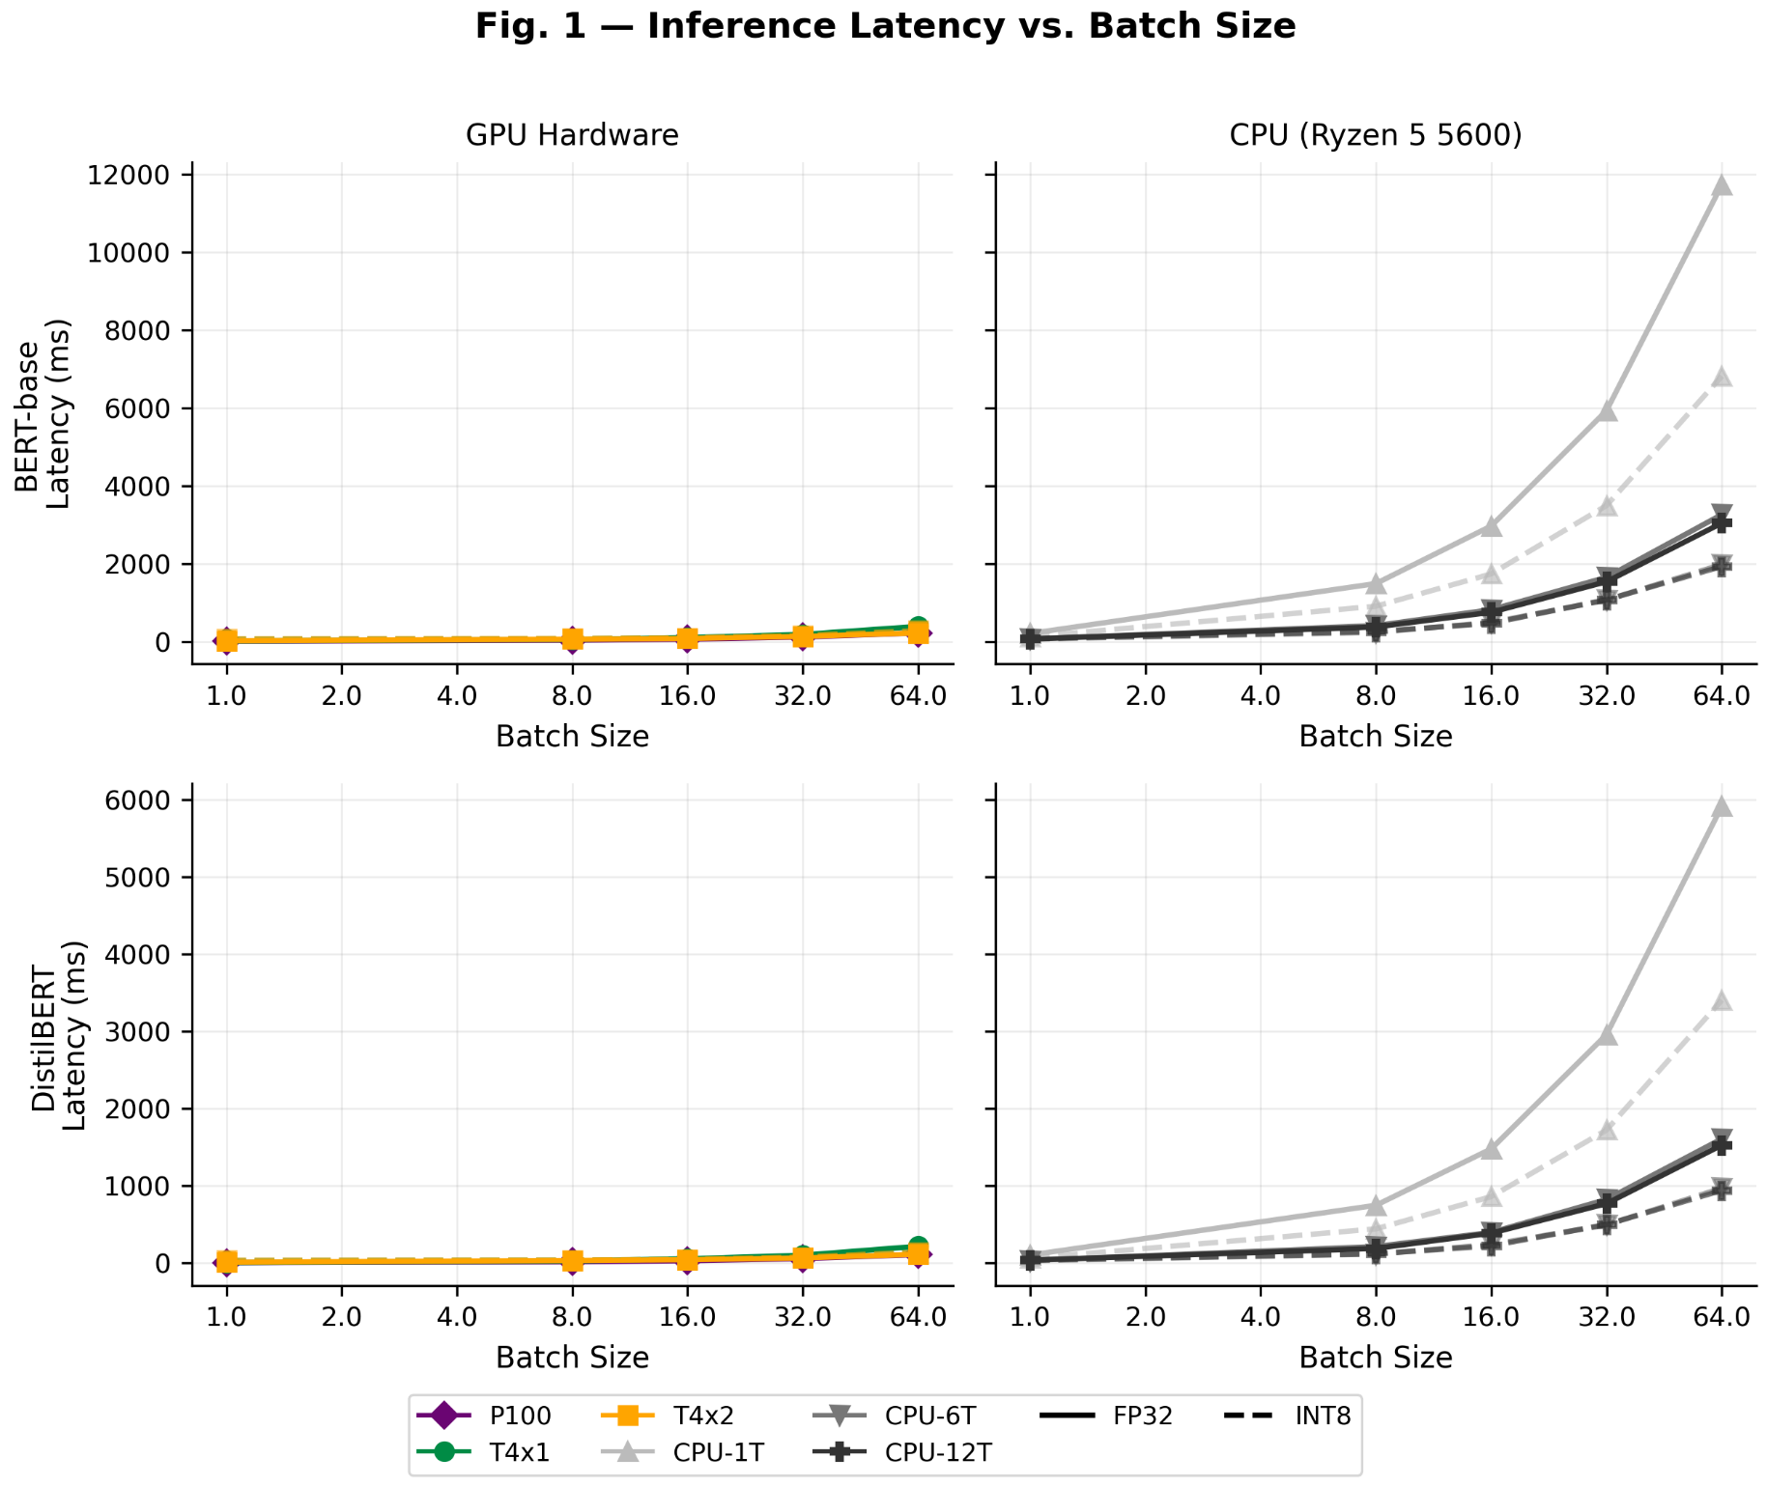

Slide 14
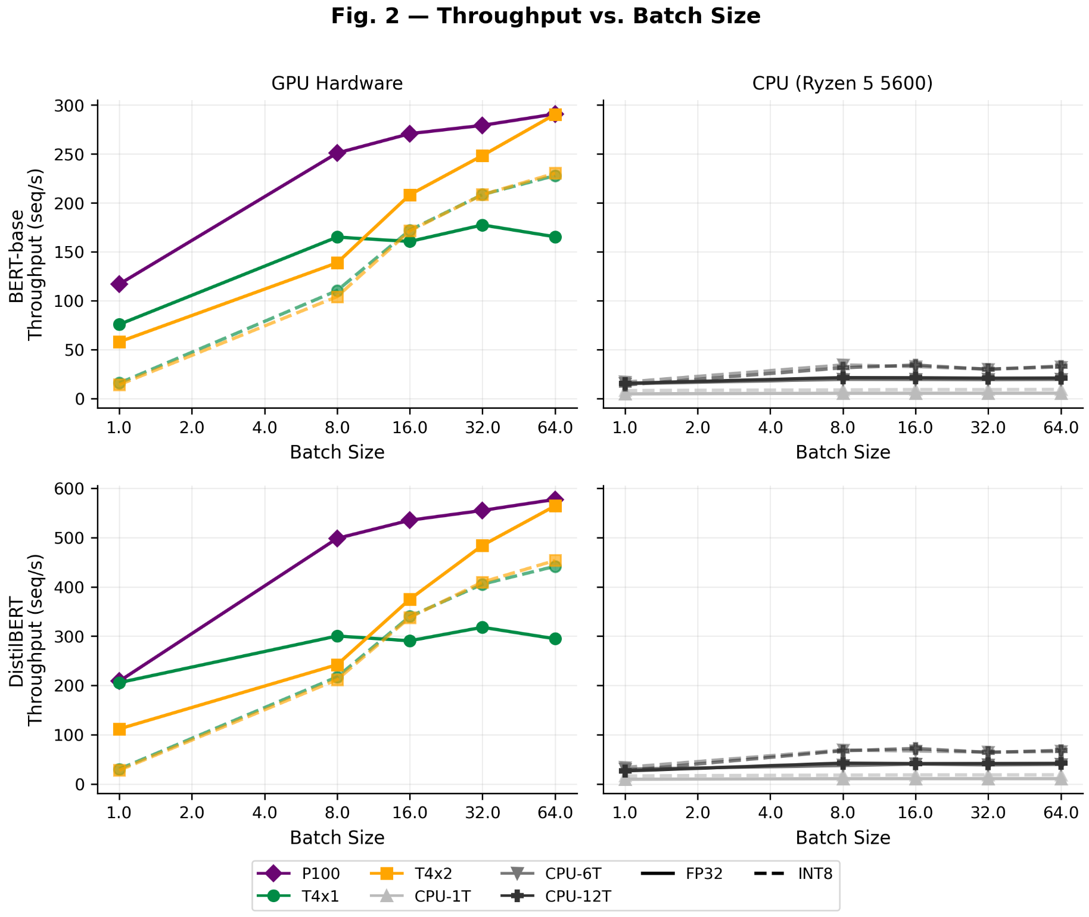

Slide 15
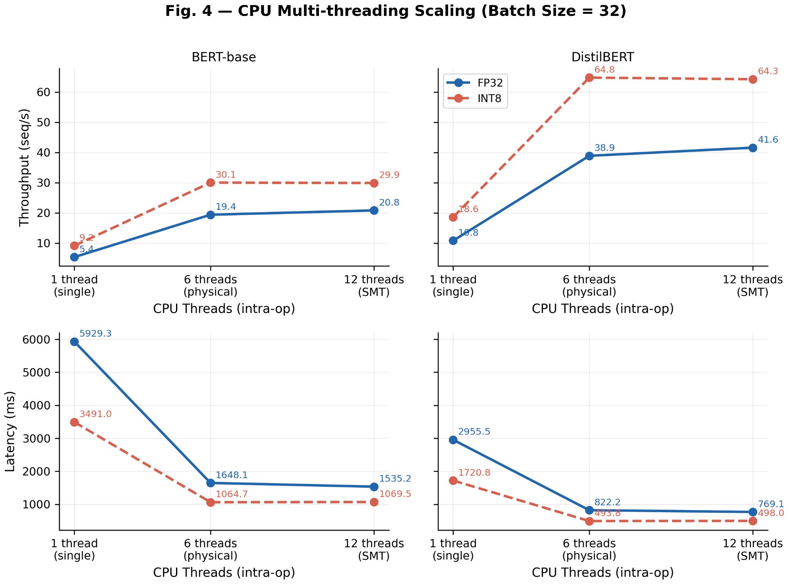

Slide 16
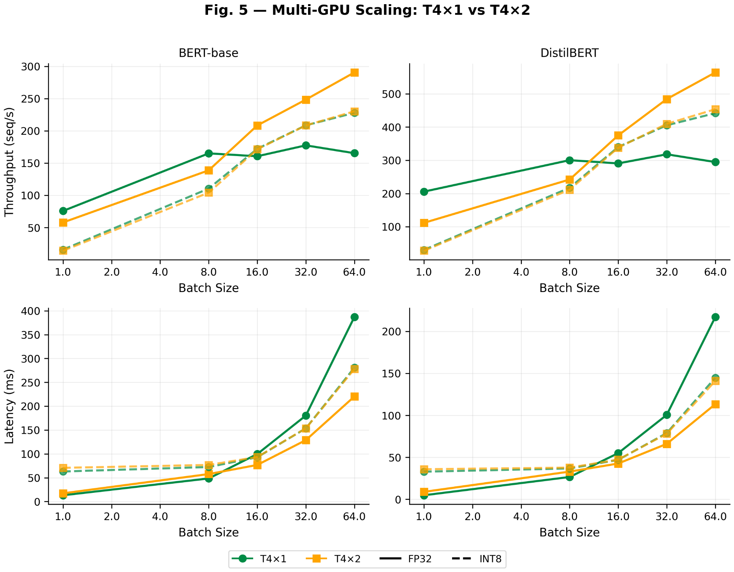

Slide 17
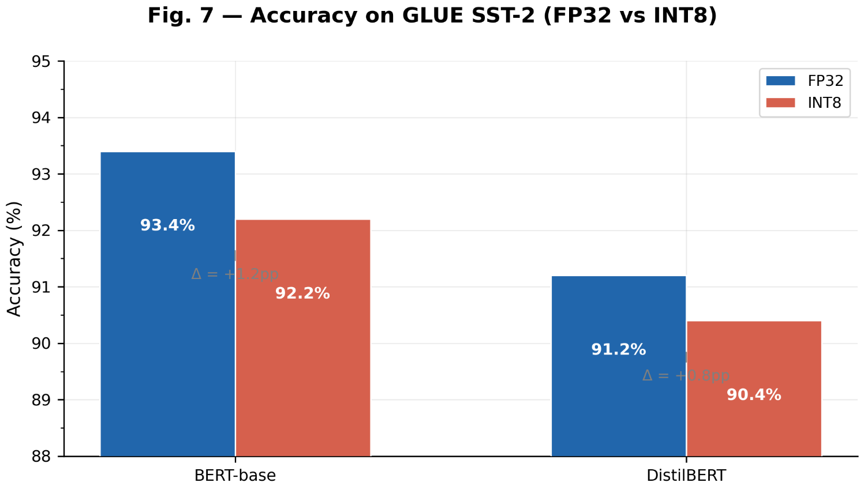

Slide 18
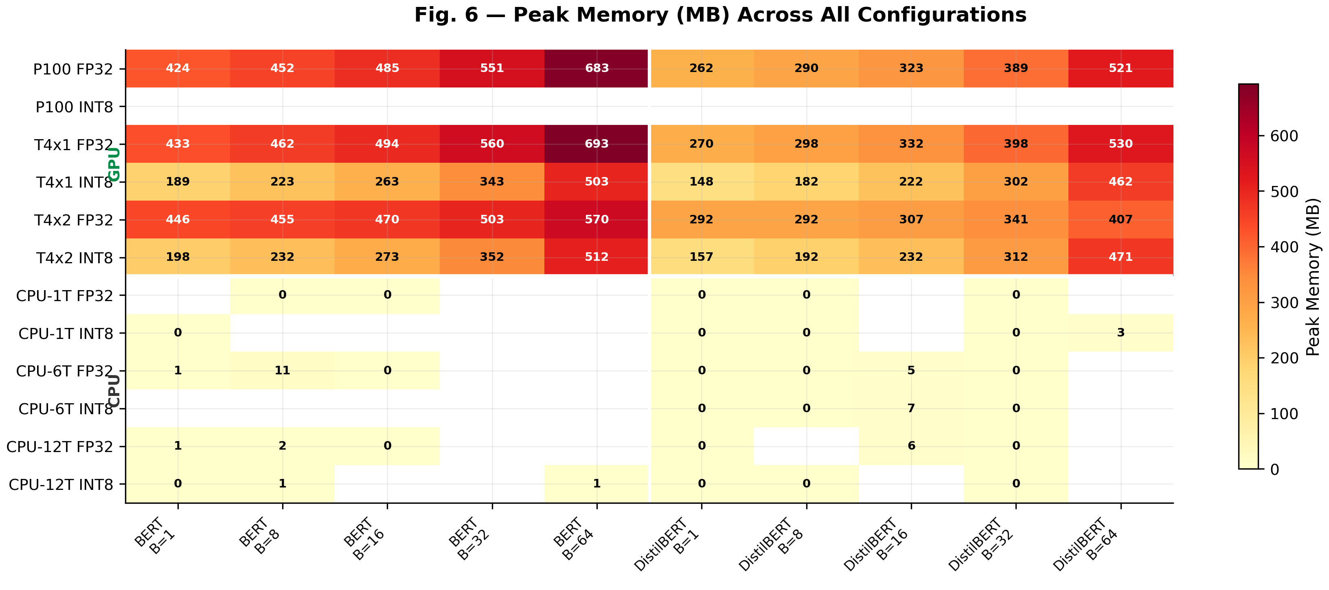

Slide 19
Conclusion
Hardware | Model | Prec. | Latency (ms) | Throughput (s/s) | Batch | Peak Mem (MB) | Accuracy
P100 x1 | BERT | FP32 | 114.58 | 279.29 | 32 | 550.81 | 93.4%
T4 x1 | BERT | FP32 | 180.29 | 177.49 | 32 | 560.42 | 93.4%
T4 x1 | BERT | INT8 | 153.46 | 208.53 | 32 | 343.36 | 93.2%
T4 x2 | BERT | FP32 | 128.80 | 248.44 | 32 | 503.30 | 93.4%
CPU 6T | BERT | FP32 | 1648.11 | 19.42 | 32 | N/A | 93.4%
CPU 6T | BERT | INT8 | 1064.74 | 30.05 | 32 | N/A | 92.2%
P100 x1 | DistilBERT | FP32 | 57.66 | 555.02 | 32 | 388.56 | 91.2%
T4 x1 | DistilBERT | INT8 | 78.94 | 405.35 | 32 | 301.95 | 91.4%
CPU 6T | DistilBERT | INT8 | 493.82 | 64.80 | 32 | N/A | 90.4%

Slide 20

Q&A

