Slide 1
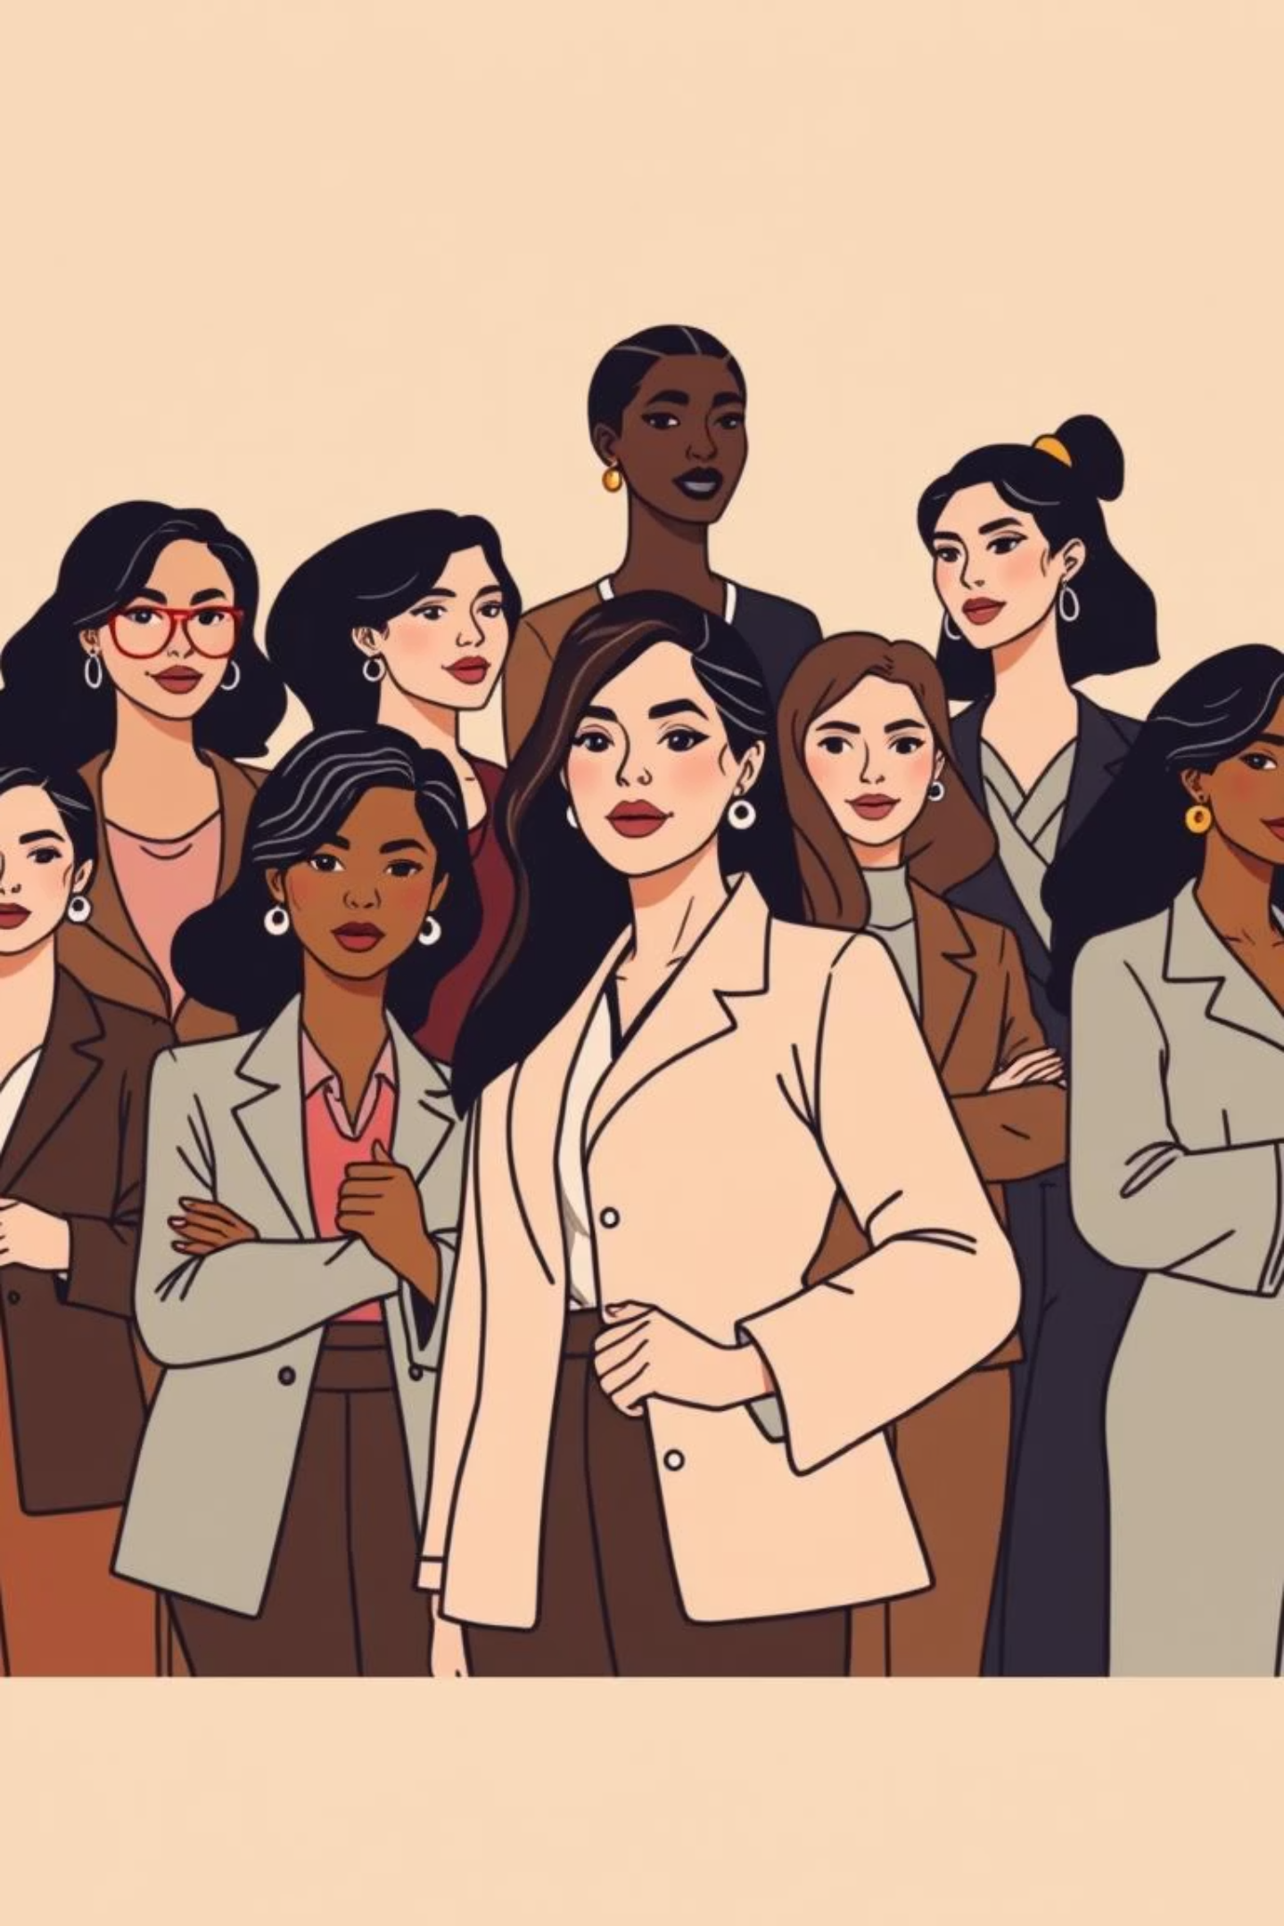
Junk Science: Strict Gender Roles are Natural
This report examines the claim that strict gender roles are biologically determined, often presented as scientific truths but relying on selective evidence and outdated anthropology.

Slide 2
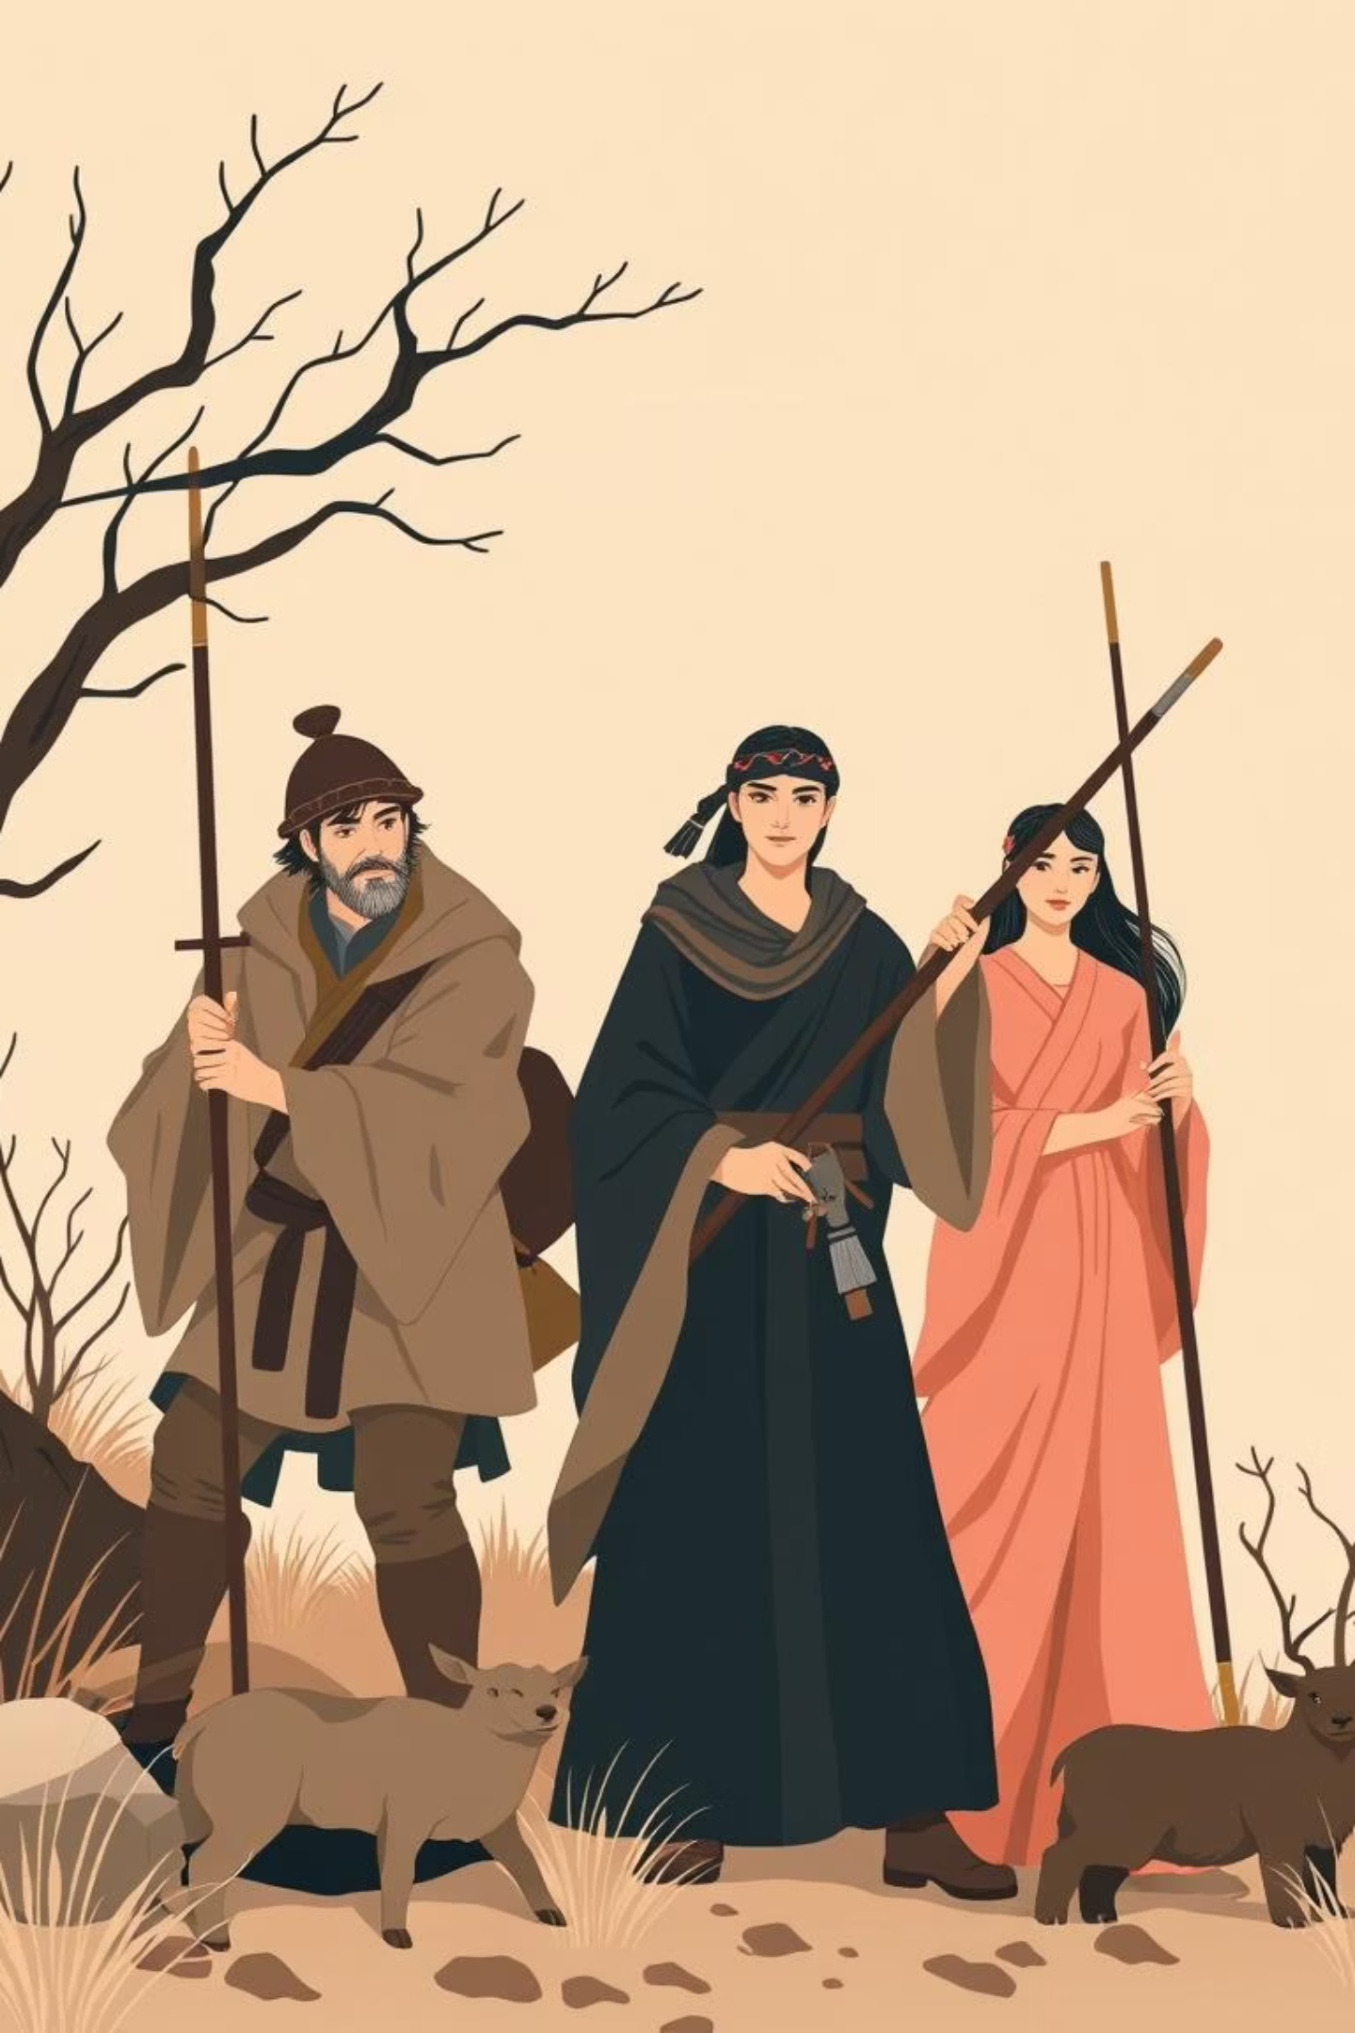
Background of the Claim
Claims of "natural gender roles" have persisted for centuries, portraying men as competitive and dominant, and women as nurturing and passive. This narrative was reinforced by the "man the hunter" model in historical anthropology and speculative evolutionary psychology.
It is maintained by conservative movements, religious institutions, and online communities to justify wage gaps and underrepresentation, not due to scientific validity but ideological usefulness.

Slide 3

Analysis of Evidence
Junk Science Claims
Credible Research
Men are natural hunters; women are caregivers (Washburn & Lancaster, 1968).
Archaeological evidence shows female hunters (Haas et al., 2020).
Labor roles are context-dependent in cross-cultural forager studies.
Gender inequality reflects biology (Popular Manosphere articles).
Neuroscience reveals no consistent biological basis for leadership interest (Hyde, 2014).
Women are less interested in leadership (Evolutionary psychology claims).
The "natural roles" claim relies on outdated models, speculative reasoning, and selective amplification, qualifying as junk science.

Slide 4
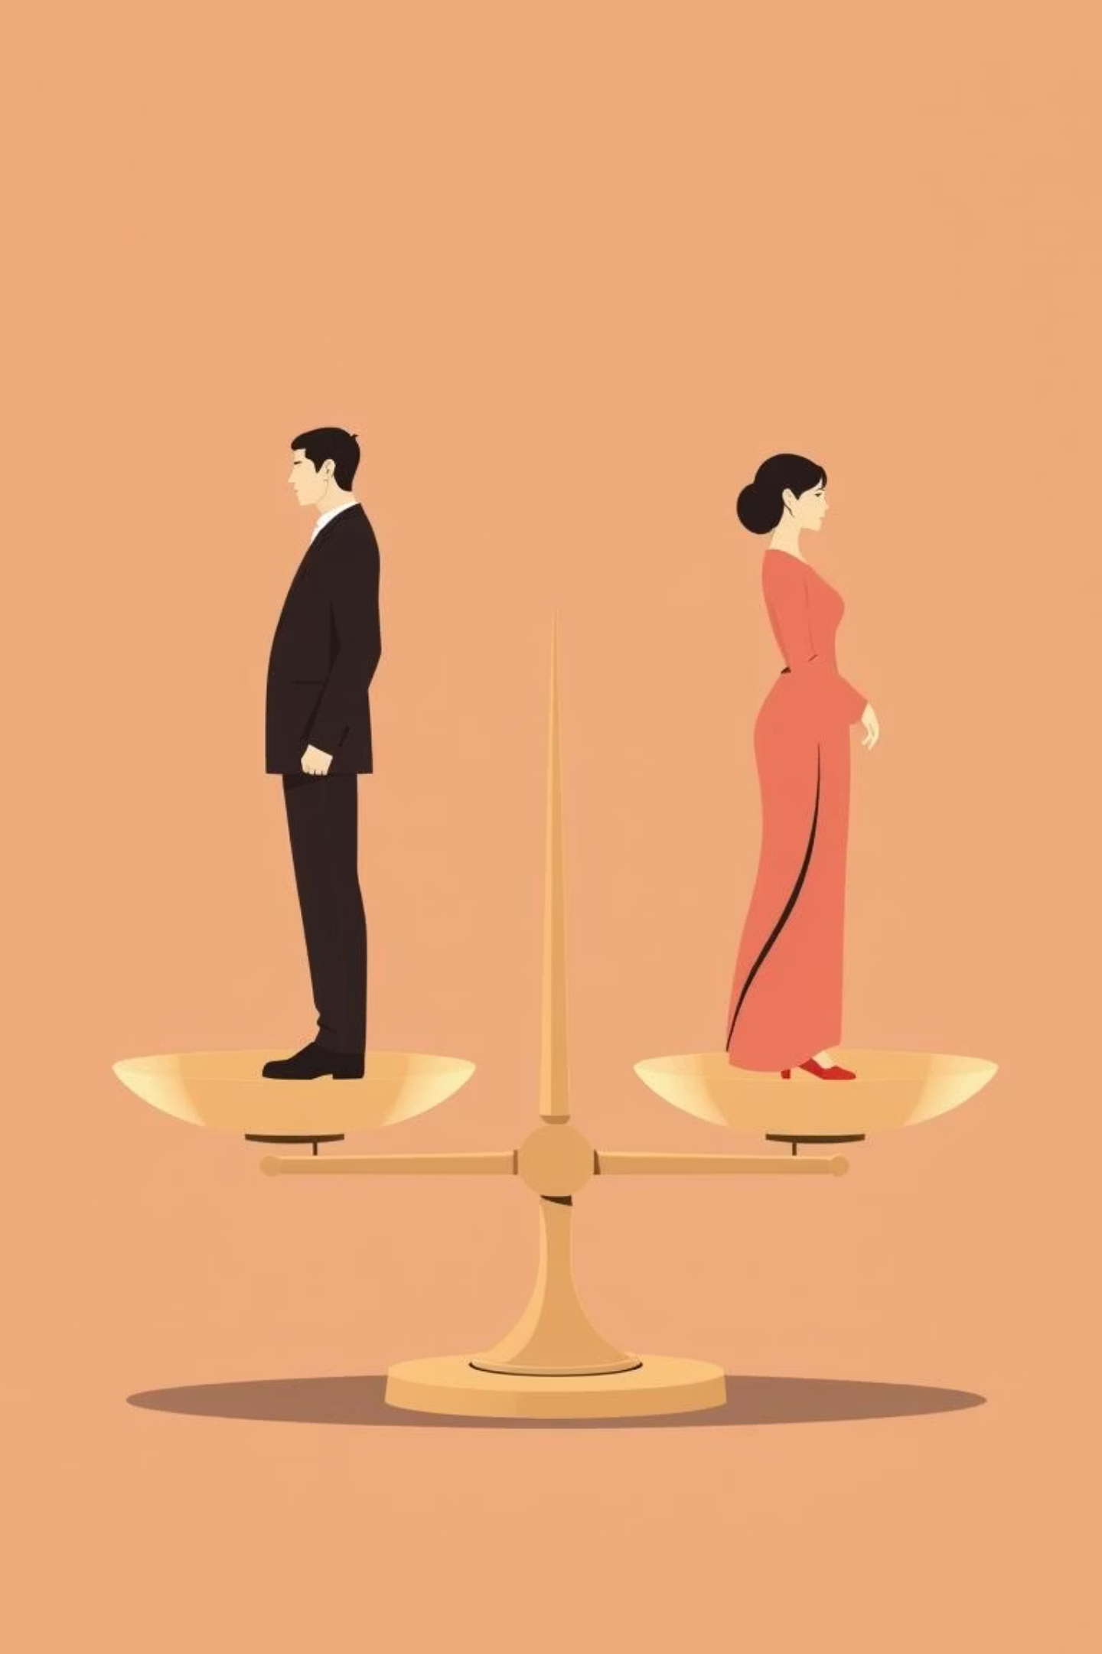
Who Benefits and Who is Harmed
Beneficiaries
Patriarchal institutions, corporations, and ideological movements justify male dominance, wage gaps, and resist parental leave.
Harms
Women face restricted access to education, leadership, and economic mobility. Men are discouraged from caregiving roles. Society loses productivity and resilience.
Framing inequality as biologically inevitable protects those in power while disadvantaging everyone else.

Slide 5
Conclusion & References
Strict gender roles are a clear example of junk science, relying on selective evidence and cultural bias. Exposing these claims enables evidence-based policies that promote fairness and equitable institutions.
References
Haas, R., et al. (2020). Female Big-Game Hunters in the Andes. Science Advances, 6(12), eaay2615.
Hyde, J. S. (2014). Gender Similarities and Differences in Cognitive Abilities. Current Directions in Psychological Science, 23(3), 171–176.

