Slide 1
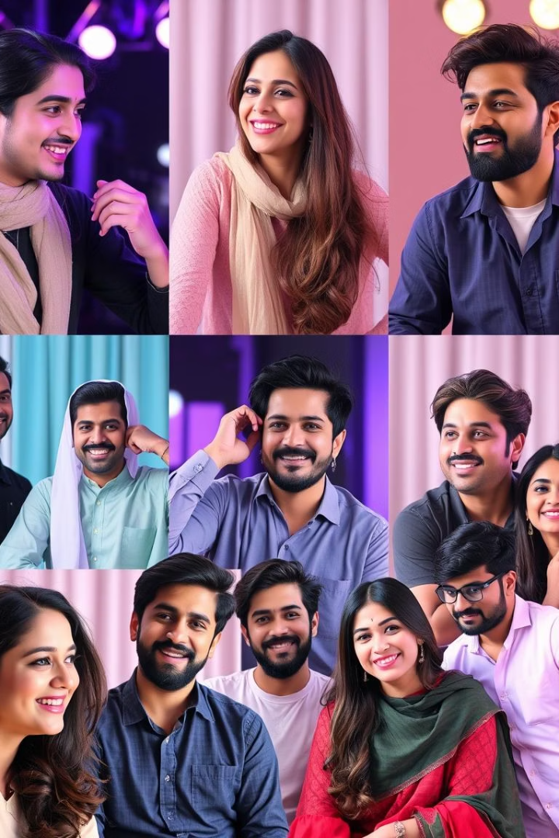
Parasocial Relationships in Pakistan: Beyond the Screen
Ever felt a deep connection with someone you've never met? Parasocial relationships connect fans to celebrities who feel like friends.
This phenomenon is growing rapidly in Pakistan's digital age and shapes social and emotional lives.
Targeted at university psychology students, we explore causes, impacts, and solutions.

Slide 2

Psychological Drivers: Filling the Void
Loneliness
Attachment Theory
Social isolation in Pakistan rose 40% post-COVID (Gallup).
Celebrities act as secure bases offering emotional security (Bowlby).
Social Surrogacy
Fans feel 'understood' by drama characters fulfilling unmet social needs.
Example: Pakistani drama fans often relate deeply to characters, feeling companionship.

Slide 3
Social & Cultural Drivers: Idol Worship and Escapism
Celebrity Worship
Escapism
Media & Social Amplification
Pakistan Example
75% of Pakistani youth admire celebrities (local survey).
Dramas provide a relaxing escape from daily pressures (Dawn Newspaper).
Obsessive fandom for Turkish drama actors is widespread in Pakistan.
Fan communities and viral trends amplify this connection.

Slide 4
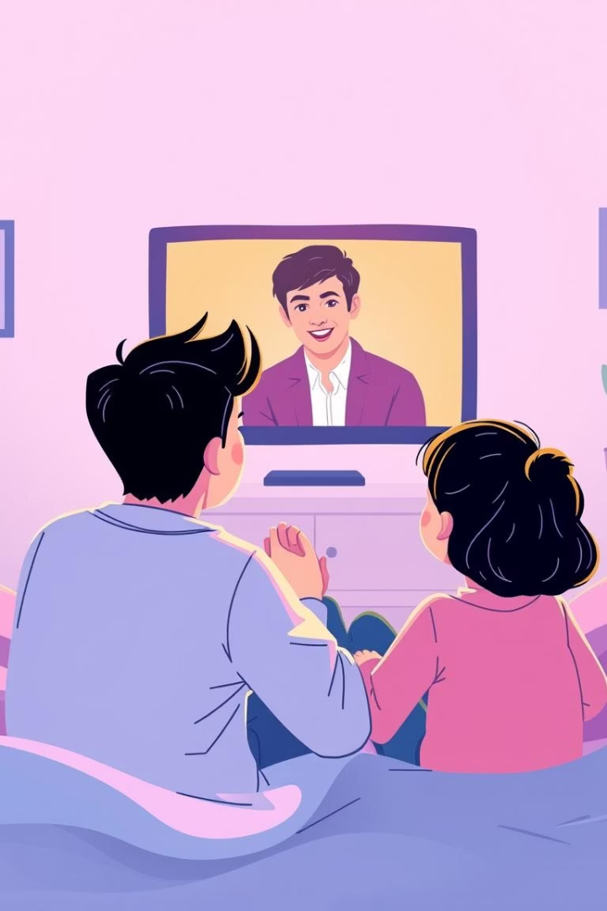
Emotional Impact: The Illusion of Intimacy
Unrealistic Expectations
Emotional Investment
Strong feelings triggered by celebrity deaths or scandals.
Relationships often idealized “like a drama”, influencing beliefs (local expert).
Pakistan Example
Public outrage over celebrity divorce news reflects deep parasocial bonds.

Slide 5

Societal Impact: Shifting Norms and Values
Media Influence
Shaping ideals of beauty, success, and relationships.
Changing Gender Roles
Media often portrays modern roles contrasting with societal reality.
Pakistan Example
Dramas impact marriage expectations, sometimes unrealistic.
Relationship Erosion
Parasocial bonds may reduce investment in real-life relationships.

Slide 6

Solutions: Media Literacy - Decoding the Message
Critical Thinking
Encourage questioning media stories and motives.
Healthy Boundaries
Balance online fandom with offline social connections.
Pakistan Example
School workshops raise awareness about media influence.

Slide 7

Solutions: Cognitive Behavioral Therapy (CBT) for Healthy Relationships
Identify Unhealthy Patterns
Recognize distorted beliefs fueling parasocial attachment.
Develop Coping Skills
Manage loneliness through effective methods.
Build Genuine Bonds
Foster real-life social connections.
Pakistan Example
Counseling centers incorporate CBT for media-related issues.

Slide 8
Key Takeaways: Navigating the Digital Age
Parasocial relationships are complex and widespread in Pakistan.
Encourage healthy connections in a digitally connected world.
Understanding their causes guides effective interventions.
Empower audiences to engage wisely with media figures.
Emotional and societal impacts reshape norms and values.
Media literacy and CBT promote balanced media engagement.

