Slide 1
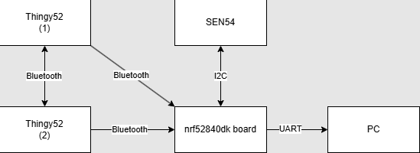
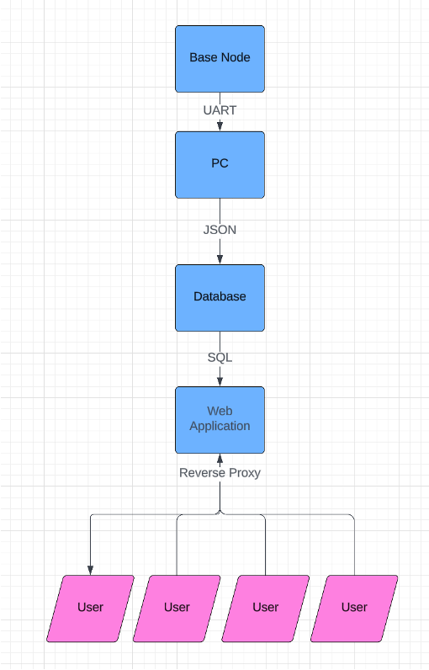
OUTDOOR WEATHER STATION NETWORK
Vulcan-Yellow (Ty Behnke 47069374, Marcus Nguyen)
AIMS(KPI)
Mesh Network Connectivity
Uses Bluetooth Mesh Connection.
All stations are interconnected.
Data Transmission Reliability
Reliable data transmission within the network.
Accurately transmits data without significant delays or loss.
Real-Time Visualization
Ensure the responsiveness and accuracy of the web dashboard viewer.
Display real-time air quality and weather from all stations.
Node Health Monitoring
Monitors individual node health.
Tracks battery level, sensor functionality, and connectivity status.
User Engagement and Feedback
Assesses the engagement and satisfaction of users with the web dashboard viewer
Metrics include, user interaction, feedback submissions, and feature request.
SYSTEM OVERVIEW
Hardware Architecture
Top Level Flowchart of Software Implementation
RESULTS
Mesh Network Connectivity:
Able to transmit sensor data with all the nodes
Each node can relay information received from the other nodes.
Base node automatically connects to mobile nodes
Data Transmission and Reliability
Reliable and quicker data transmissions
All the information for a sensor is received in a single packet
Real-Time Visualisation
Dashboard gets updated every minute
Visually displays all data points it pictographic and tabular form
Allows users to access entire database with sorting functionality
Node Health Monitoring
Time synchronisation ensures accurate record keeping of sensors over extended periods of operation
Disconnection from base node does not negatively impact database, components easily accessible and replaced easily.
User Engagement and Feedback
•Presenting prototype to stakeholders (audience) to actively engage feedback and criticisms to the project to make future improvements.
CONCLUSION
In terms of functionality, it is able to work with both the average user and experienced.
Allows for extended ranging, and more reliable transmissions between nodes and to the base.
The dashboard is easy to read and understand, added CSS style sheets provides a more enjoyable consumer experience
The system’s ability to monitor individual node health, including sensor functionality and connectivity status, ensures sustained operation and maintenance of the network. Time synchronization supports accurate long-term data records, and the ease of component replacement minimizes downtime in the event of node disconnection.

Slide 2
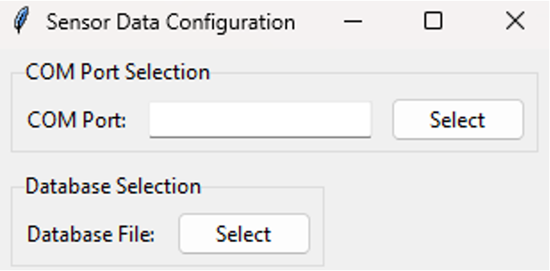
OUTDOOR WEATHER STATION NETWORK
Vulcan-Yellow (Ty Behnke 47069374, Marcus Nguyen)
Field Deployment Plan:
Configurability:
Software
Python listener script has an easy
setup with only two controls, with
added support to select different
databases, to expand the WeCast dashboard to view multiple cities.
Hardware
Both the Thingy52’s and Sen54 will simply plug into a power supply and will automatically begin transmissions to the base node, connected to a PC with a USB connection.
Firmware
Packets bytes are allocated to certain information, such as:
Sensor Type ID
Original Signal ID
Current Signal ID
The user can configure their own ID to allow different sensor information or allow more nodes to be used.
Future Steps:
Environment Setup:
Server Infrastructure: To deploy the weather dashboard, online, a dedicated server needs to be selected to host the Flask application (Google Cloud). Didn’t do this because I’m poor and didn’t want to pay.
Database Server: The current prototype is running on a file-based database (SQLlite). In order to allow external users to access the weather data, a database server host must be utilized (Microsoft SQL).
Web Server: To allow users to access the application, Apache can be to act as a reverse proxy to forward requests to the flask App.
Testing and Quality Assurance:
Functional Testing: Thorough testing will be performed to ensure that the deployed application behaves as expected in the production environment.
Load Testing: Conduct load testing to assess how the application performs under heavy traffic.

