Slide 1
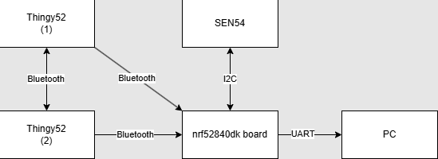
OUTDOOR WEATHER STATION NETWORK
Ty Behnke, Marcus Nguyen (Team A))
AIMS(KPI)
Mesh Network Connectivity
Uses Bluetooth Mesh Connection.
All stations are interconnected.
Data Transmission Reliability
Reliable data transmission within the network.
Accurately transmits data without significant delays or loss.
Real-Time Visualization
Ensure the responsiveness and accuracy of the web dashboard viewer.
Display real-time air quality and weather from all stations.
Node Health Monitoring
Monitors individual node health.
Tracks battery level, sensor functionality, and connectivity status.
User Engagement and Feedback
Assesses the engagement and satisfaction of users with the web dashboard viewer
Metrics include, user interaction, feedback submissions, and feature request.
SYSTEM OVERVIEW
Hardware Architecture
Top Level Flowchart of Software Implementation
RESULTS
Mesh Network Connectivity:
Able to transmit sensor data with all the nodes
Each node can relay information received from the other nodes.
Base node automatically connects to mobile nodes
Data Transmission and Reliability
Reliable and quicker data transmissions
All the information for a sensor is received in a single packet
Real-Time Visualisation
Visually displays all data points
Node Health Monitoring
Ds
User Engagement and Feedback
dsa
PROJECT CONFIGURABILITY AND FIELD DEPLOYING PLAN
Bluetooth Packets:
Packets bytes are allocated to certain information, such as:
Sensor Type ID
Original Signal ID
Current Signal ID
The user can configure their own ID to allow different sensor information or allow more nodes to be used.
CONCLUSION (Success of achieving KPI)

Slide 2
OUTDOOR WEATHER STATION NETWORK
Ty Behnke, Marcus Nguyen (Team A))
MAIN HEADINGS – BODONI MT 18PT ALL CAPS
Subheadings – Helvetica Neue Bold 14pt
Body Text – Helvetica Neue 14pt (min 12pt)
Don’t have the above fonts installed?
Substitutes for Bodoni MT:
Didot on Apple
or Times New Roman (Apple & Windows)
Substitutes for Helvetica Neue:
Helvetica (Apple)
or Arial (Apple & Windows)
General Hints & Tips
Do not change the colour/size/logos/positioning of the Slide Master.
This is a standard format across all Innovation Expo posters.
Do not add other corporate logos. This is an infringement of copyright, unless you have express permission to do so.
Do use this space as creatively as you wish.
Avoid using large background colours – doesn’t print well.
Stick to the basic fonts & sizes (left) – these read clearly. If you need to reduce the text size, you are trying to put too much on your poster.
As a check, print “scaled to fit” onto A4 and read at arms length.
Save your poster as you work on it.
You shouldn’t need to change the sizing of this file, it should already be landscape format with width: 41cm and height: 28.7 cm (A3 with 5 mm borders all around).
The title may look to close to the top edge – don’t be tempted to change it. It allows for the extra 5mm from the printing.
AIMS(KPI)
Mesh Work Networking
Data Transmission Reliability
Real-Time Visualisation
Node Health Monitoring
User Engagement and Feedback
SYSTEM OVERVIEW
Hardware Architecture
Top Level Flowchart of Software Implementation
RESULTS
Top Level Flowchart of Software Implementation
KEY PERFORMANCE INDICATORS
PROJECT CONFIGURABILITY AND FIELD DEPLOYING PLAN
CONCLUSION (Success of achieiving KPI)

