Slide 1
PAPER REVIEW & REPLICATION
ETF effects: the role of primary versus secondary market activities
Carole Comerton-Forde & Thomas Marta · Journal of Financial Markets 75 (2025) 100983
Who really moves ETF constituent stocks: authorized participants doing arbitrage, or high-frequency traders on the exchange?
Notes:
This talk reviews Comerton-Forde and Marta (2025) and presents our replication notebook. The paper separates the two ways ETFs touch the stocks they hold: arbitrage by authorized participants on the primary market, and high-frequency trading on the secondary market.

Slide 2
ETFs are now a $24 trillion market
$24.0trn
15×
≈30%
global ETF assets, end-Aug 2026
growth of ETF assets: $1trn (2009) → $15trn (2024)
of all US trading volume is in ETFs
ETFGI, Sep 2026
paper, §1
paper, citing Brogaard et al. (2024)
The worry: do ETFs import volatility, illiquidity and fragility into the stocks they hold (Ben-David et al., 2018)? Or do they make those stocks easier to trade?
The paper's answer: it depends on which ETF market you look at.
Notes:
ETFs passed 24 trillion dollars of assets in August 2026, up from 15 trillion at the end of 2024 cited in the paper. Regulators worry that ETF arbitrage transmits shocks to the underlying stocks. The paper's contribution is to separate the primary-market and secondary-market channels.

Slide 3
One ETF, two markets
SECONDARY MARKET (exchange)
Investors
buy & sell ETF units
Exchange order book
HFTs ≈ 74% of ETF volume
ETF price P
continuous quotes
APs create units when P > NAV and redeem when P < NAV — but only if the gap beats the cost.
Mispricing
(P − NAV) / NAV
PRIMARY MARKET (issuer)
Authorized Participants
dealers with creation rights
Creation / redemption
units ⇄ basket, in kind
Basket of stocks
value per unit = NAV
Notes:
The secondary market is the exchange, where investors trade ETF units and HFTs provide most of the volume. The primary market is where authorized participants create or redeem units against the basket. When the ETF price deviates from NAV by more than the arbitrage cost, APs step in and enforce the law of one price.

Slide 4


Two channels, opposite predictions
Arbitrage channel
Information linkage
APs on the primary market
HFTs on the secondary market
Basket trades pass non-fundamental demand shocks to the stocks
Inventory and adverse-selection costs for liquidity providers
ETF quotes aggregate information about the whole basket
Stock prices adjust through quotes, without heavy trading
Volatility ↑ Spreads ↑ Efficiency ↓
Spreads ↓ Efficiency ↑
Malamud (2015); Ben-David et al. (2018); Foucault et al. (2017)
Fremault (1991); Grossman (1992); Madhavan (1996)
Notes:
Two theories make opposite predictions. Under the arbitrage channel, AP basket trades push noise and inventory risk into stocks, so volatility and spreads rise. Under the information-linkage channel, HFT quoting in the ETF spreads information to the basket, so spreads fall and prices become more efficient. The paper's point is that both can be true at once, because different traders drive them.

Slide 5



Three questions, three datasets
Q1 What drives primary vs. secondary ETF activity?
Euronext Paris, 2015 · 34 large ETFs (93% of ETF volume) · trade-level HFT flag (AMF / BEDOFIH)
Q2 How does each relate to the constituents' market quality?
Lyxor CAC 40 ETF + 38 CAC 40 stocks · 5-minute quotes (LSEG) · volatility, spread, depth, resiliency, efficiency
Q3 Is the primary-market effect causal?
Japan, Sep 2010 – Sep 2016 · 2,173 TOPIX & Nikkei 225 stocks · Bank of Japan ETF purchases as the shock
Notes:
Q1 and Q2 use French data, where Euronext flags HFTs at the trade level. That is rare and is the paper's data advantage. Q3 needs exogenous variation, which comes from the Bank of Japan's ETF purchases. The authors cannot share any of these data, which is why our notebook rebuilds the mechanisms in simulation and on open data.

Slide 6
Measures and estimation
Key measures
Estimation
PMActivity = Δ units outstanding / units(t−1)
HFTActivity = log(1 + units traded by HFTs)
ETFMispricing = (P − NAV) / NAV
ETFOwn = ETF holdings / stock market value
PMStockActivity = Σ BoJ purchases × weight / market value(t−22)
Panel OLS with entity (ETF or stock) and day fixed effects
Standard errors double-clustered by entity and day
Stock tests: Y = β₁ ETFOwn×|PMActivity| + β₂ ETFOwn×HFTActivity + controls
Japan: BoJ purchase days only; placebo on other days; Z-test of the difference
All variables winsorised at 1% / 99%
In our notebook: the same estimator in ~40 lines of numpy (within transformation + Cameron–Gelbach–Miller two-way clustering). It matches linearmodels.PanelOLS and runs ~1,000× faster on the 600k-row Japanese panel.
Notes:
Primary-market activity is the daily percentage change in units outstanding. HFT activity is log volume with an HFT counterparty. For stocks, the ETF-level activity is interacted with ETF ownership of each stock, so identification comes from cross-sectional differences in exposure. All regressions use two-way fixed effects and double-clustered standard errors. Our notebook implements exactly this estimator.

Slide 7
HFTs dominate trading; APs rarely act
32%
13%
74%
of ETF-days have any creation or redemption
primary-market volume relative to secondary-market volume
of ETF volume involves an HFT (vs. ≈50% in CAC 40 stocks)
Implication: the activity regulators worry about (arbitrage) is infrequent and small; the activity that is everywhere (HFT) is not arbitrage at all. Euronext 2015; mispricing averages 0.005% with a 0.37% standard deviation.
Notes:
Descriptives from Table 2 and Figure 1. Creations or redemptions happen on only a third of days and amount to 13 percent of exchange volume. HFTs are counterparties in about three quarters of ETF volume, much more than in the underlying stocks.

Slide 8
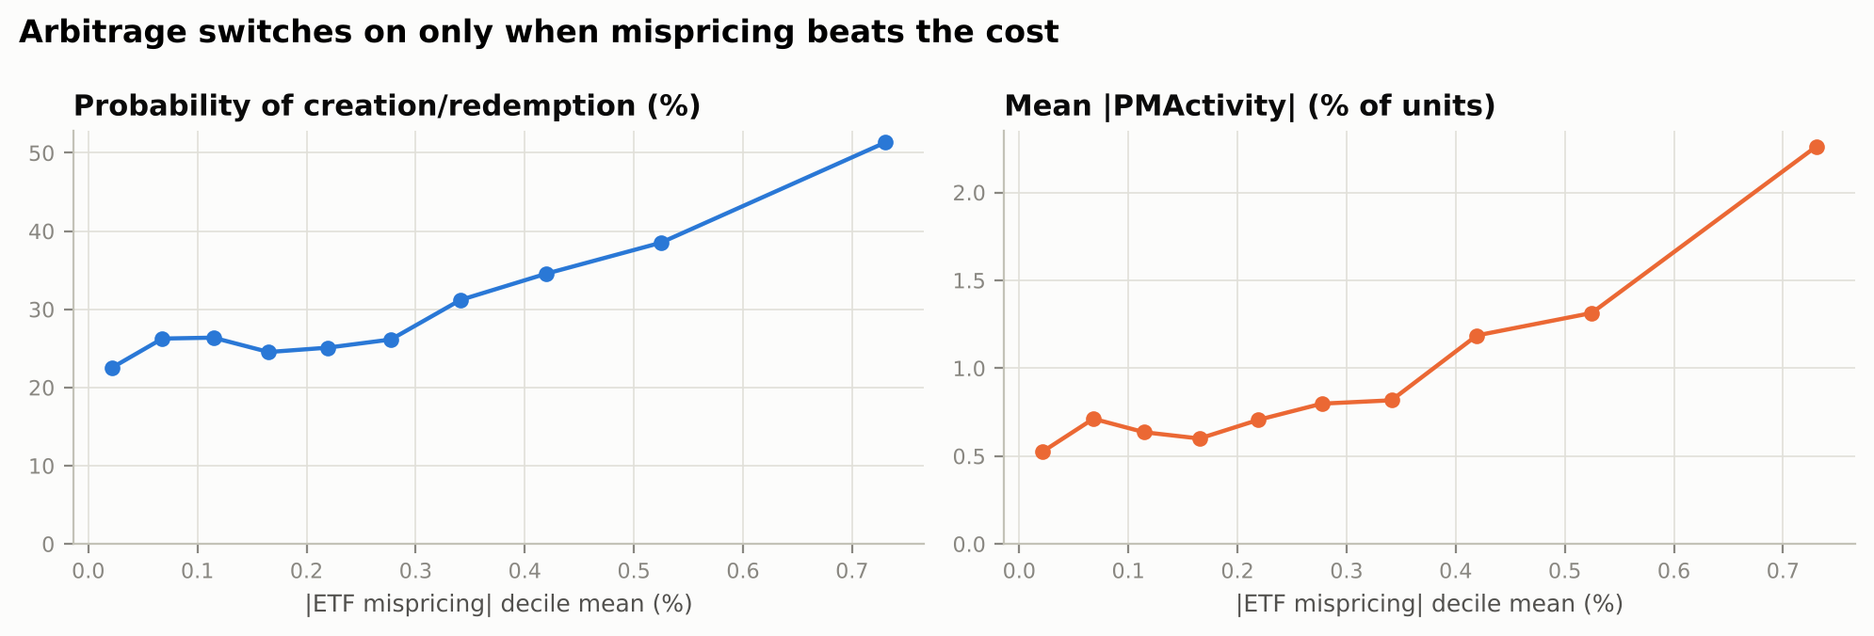
Mispricing, not HFTs, drives creations
+1 pp |mispricing| → +0.079 pp |PMActivity|** and +2.5 pp probability of creation/redemption
Threshold: above-median mispricing +0.143***, top tercile +0.121*** — limits to arbitrage
Direction: premium → creations, discount → redemptions (0.21–0.28)
HFTActivity: insignificant in every specification, both ways (Tables 3–4)
Our simulation (notebook §2): creation probability and size rise once mispricing beats the arbitrage cost.
Notes:
Table 3 regresses primary-market activity on mispricing and HFT activity with ETF and day fixed effects. Mispricing matters for magnitude, frequency and sign, with a jump for large mispricing, consistent with limits to arbitrage. HFT activity never matters. The chart is from our simulation, where arbitrage switches on above a cost threshold, and reproduces the same pattern.

Slide 9
Arbitrage hurts stocks; HFT trading helps
Outcome (CAC 40 stocks) | ETFOwn × |PMActivity| (APs) | ETFOwn × HFTActivity (HFTs)
Volatility | +0.029** | +0.013
Quoted spread | +0.004** | −0.006***
Depth | +0.017 | +0.004
Resiliency | −0.098** | −0.068
Inefficiency | +0.038** | −0.027*
Reading
Days with heavy AP arbitrage coincide with more volatile, less liquid, less efficient stocks — the arbitrage channel.
Heavy HFT trading in the ETF coincides with tighter stock spreads — the information-linkage channel.
Paper Table 5 · stock & day FE · double-clustered SEs · orange = worse market quality, blue = better
Notes:
Table 5 uses the Lyxor CAC 40 ETF and its 38 constituent stocks. The primary-market interaction is positive for volatility, spreads and inefficiency and negative for resiliency, so arbitrage days are bad days for market quality. The HFT interaction lowers spreads and inefficiency. Both are associations, because the French data cannot separate cause and effect.

Slide 10
The ETF is more liquid than its basket
2.17 bps
average spread gap: basket minus ETF
0.306***
more HFT activity → larger gap (ETF relatively more liquid)
0.511***
ETF spread → constituent spreads: liquidity spills over
Notes:
Table 6. The ETF's spread is about half the index-weighted spread of its constituents. The gap widens with HFT activity, not with primary-market activity, and the ETF spread predicts the constituents' spreads. The authors read this as liquidity spilling over from the ETF to the stocks through HFTs.

Slide 11
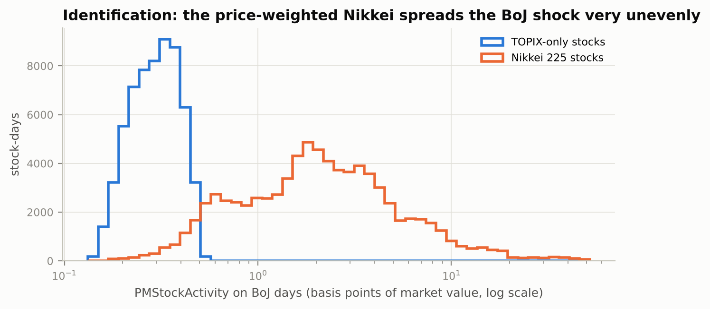
Japan: a quasi-natural experiment
The shock: the BoJ bought ETFs on 349 of 1,481 days, ≈ ¥70bn per day vs. ≈ ¥25bn normal ETF turnover; APs must create units and buy the stocks
The twist: the Nikkei 225 is price-weighted, so the purchase per stock relative to its size ∝ PAF / shares outstanding
Result: high-price, low-share-count stocks get demand unrelated to fundamentals; TOPIX demand is ≈ equal for all and is absorbed by day fixed effects
Our simulation (notebook §4): BoJ-driven demand is tightly clustered for TOPIX-only stocks but spread over two orders of magnitude for Nikkei 225 stocks.
Notes:
This is the identification idea. Because the Nikkei is price-weighted, a stock's Nikkei weight depends on its price, not its market value. Relative to market value, BoJ-driven demand is proportional to the price adjustment factor divided by shares outstanding, so a handful of stocks get very large shocks. The paper restricts the sample to BoJ purchase days and uses stock and day fixed effects.

Slide 12
BoJ-driven creations cause the damage
Paper Table 8
Return 0.239*** · Volatility 1.901***
Spread 0.011** · Depth −0.943***
Placebo test: the same regression on non-purchase days gives much smaller slopes (Z = 2.2, 1.7, 4.0, −3.2).
Conservative size: return +4%, volatility +1%, spread +3%, depth −5%.
Notes:
On BoJ purchase days, stocks receiving more AP buying have higher returns, higher volatility, wider spreads and less depth. Scaled by the average purchase of 0.33, these are the percentages on the chart, relative to sample means. Comparing with non-purchase days through a Z-test gives a conservative lower bound. This is the paper's causal evidence for the arbitrage channel.

Slide 13
Long run: the benefits seem to dominate
↑ ETF ownership
↓ Volatility
slope +0.19 per year, R² = 0.96
−1.48 points per year
↓ Quoted spread
↑ Resiliency, ↓ autocorrelation
−0.03 pp (3 bps) per year
both improve
Paper Table 9, Japan 2010–2016: ownership surged while market quality improved, so arbitrage harm is local and transitory. Caveat: this is a time-trend correlation (see critique).
Notes:
To ask which effect dominates, the authors regress cap-weighted market quality on a time trend. ETF ownership rose steadily while volatility and spreads fell. They conclude that the benefits dominate, but this part is descriptive, and we come back to its weaknesses in the critique.

Slide 14
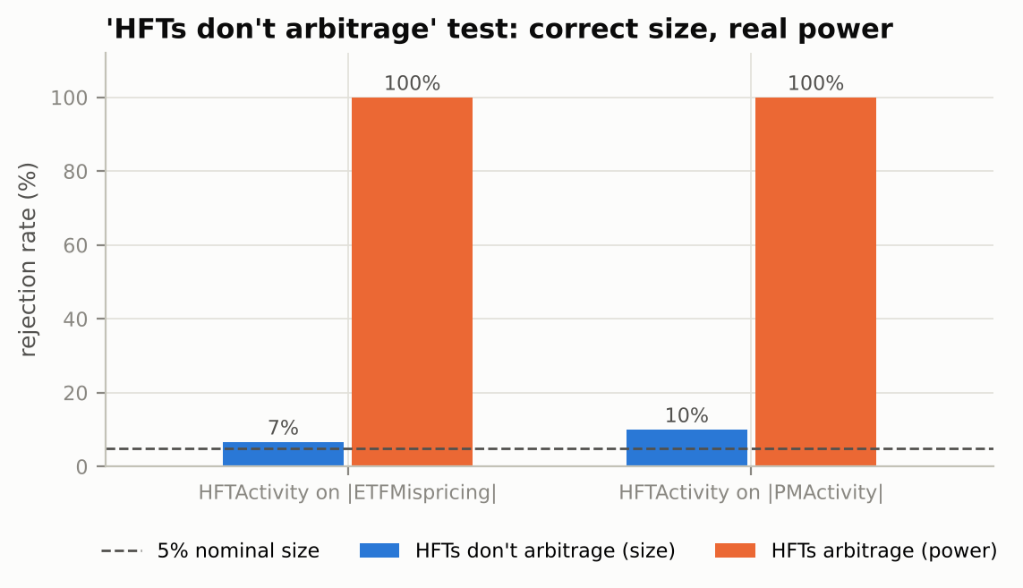
Our lab I: the HFT test has real power
Simulated Euronext-like market, calibrated to Table 2
Moment | Paper | Sim
PM days | 32% | 31%
s.d. mispricing | 0.37% | 0.36%
HFT share | 74% | 70%
PM / secondary volume | 13% | 10%
When HFTs truly ignore mispricing, the paper's regression rejects about as often as it should (7–10%); when they arbitrage, it rejects in 100% of samples. The paper's null result for HFTs is informative.
Notes:
Because the paper's data are proprietary, we simulated a market with authorized participants who arbitrage only above a cost threshold, investor flows, and HFTs. The calibration matches the paper's key moments. Across 30 simulated markets, the HFT regression has about the right size under the null and full power when HFTs do arbitrage, so a null result in the paper's sample is meaningful.

Slide 15
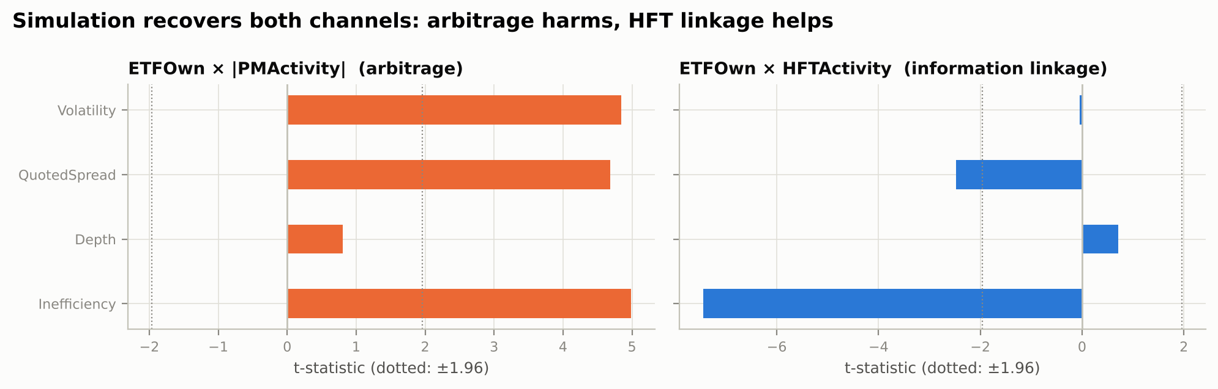
Our lab II: both channels are identifiable
Built in: AP basket trades raise volatility, spreads and inefficiency in proportion to ETFOwn × |PMActivity|; HFT quotes lower spreads
Recovered: the paper's equation (10), with stock and day FE, finds both channels with the right signs and significance
Caveat: a simulation proves the method can see the channels, not that they exist; that needs data (notebook §5–6)
Notes:
Here we simulate 38 stocks held by a large tracker ETF, building in both channels, and run the paper's equation 10. The arbitrage interaction is significantly positive for volatility, spreads and inefficiency, and the HFT interaction is significantly negative for spreads and inefficiency. This shows the design can separate the channels; it is not evidence that they exist.

Slide 16
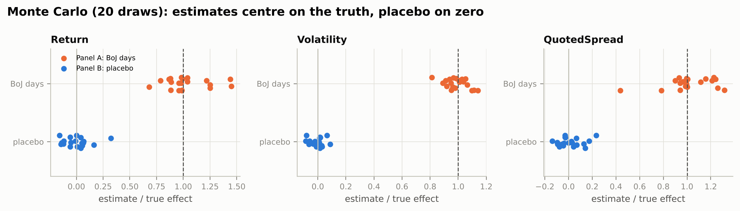
Our lab III: the BoJ design works, with care
Monte Carlo, 20 paper-sized markets: BoJ-day estimates centre on the true effect, placebo estimates on zero, so Panels A–C of Table 8 behave as intended.
Pitfall we found: same-day Nikkei weights contain the same-day price; on random data they produced a spurious return effect (t ≈ 5). Weights must come from the previous close.
Notes:
We built a paper-sized Japanese market: 225 Nikkei and 175 TOPIX-only stocks over 1,481 days, with purchases on weak mornings. Across 20 draws, the estimator recovers the true effects and the placebo is centred on zero. While testing the real-data module on random prices, we also found that day-t Nikkei weights create a mechanical correlation with day-t returns, so the notebook uses previous-close weights.

Slide 17






Critical assessment
Narrow French sample
Noisy proxies
Creations only
One year (2015); stock tests rest on a single ETF; Table 6 has 255 observations
Units outstanding settle with lags (up to 5 days in the US); the HFT flag excludes bank desks
The BoJ only bought, so redemptions — the fragility scenario — are untested
Selected days, extreme dose
Trend ≠ causality
Units & consistency
Purchases followed weak mornings; ¥70bn per day is far from routine arbitrage
TSE cut tick sizes for TOPIX100 in 2014–15, mechanically narrowing spreads; trend regressions need Newey–West SEs
PMStockActivity mean 0.33% vs. ≈0.01–0.02% implied by ¥70bn on ¥300–600trn; text vs. Table 9 slopes differ
Notes:
Six concerns. First, the French evidence is one year and, for stocks, one ETF. Second, both activity measures are proxies. Third, the Japanese shock only covers creations, so the redemption and fire-sale case remains open. Fourth, BoJ days are selected and the doses are extreme. Fifth, the long-run argument is a trend regression confounded by the 2014–2015 tick-size reform. Sixth, some reported magnitudes are hard to reconcile and should be clarified.

Slide 18
Since publication: the BoJ is now selling
Mar 2024
Sep 2025
Jan 2026
Aug 2026
BoJ ends new ETF purchases
Decides to sell ≈ ¥330bn a year (book value), ≈0.05% of turnover
Sales begin; full exit would take over a century
Global ETF assets reach a record $24.0trn
Why it matters for the paper: the redemption side it could not test is now live, but at ≈0.05% of turnover the paper's logic predicts negligible effects on stocks.
In our notebook: real-data modules for Colab (a dose–response test across BoJ regimes, with a 2021–24 placebo, and a tick-size-controlled trend) ready to run on BoJ statistics and Yahoo Finance data.
Notes:
Since the paper was written, the BoJ stopped buying ETFs in March 2024, decided in September 2025 to sell about 330 billion yen a year, and started selling in January 2026. That is the redemption experiment the paper lacked, though the pace is tiny. Our notebook includes real-data modules that extend the BoJ test across policy regimes and re-run the trend analysis with tick-size controls.

Slide 19
Takeaways
1
ETF arbitrage is rare (32% of days) and small (13% of volume); HFTs carry the trading and do not arbitrage
2
Arbitrage goes with worse market quality in overweighted stocks; HFT activity goes with narrower spreads
3
The BoJ experiment shows the arbitrage damage is causal, but local and transitory
4
Our simulations confirm the design can detect both channels; the long-run claim still needs a cleaner test
Notebook: github.com/Mnntn/Finances → ETF_effects_The_role_of_primary_versus_secondary_market_activities/etf_effects.ipynb
Notes:
Four takeaways. Arbitrage is infrequent and small. The two markets have opposite associations with stock market quality. The Japanese evidence makes the arbitrage harm causal but bounded. Our replication lab shows the methods work, while flagging that the claim that benefits dominate rests on the weakest evidence.

Slide 20
References
Comerton-Forde, C., Marta, T. (2025). ETF effects: The role of primary versus secondary market activities. Journal of Financial Markets 75, 100983.
Ben-David, I., Franzoni, F., Moussawi, R. (2018). Do ETFs increase volatility? Journal of Finance 73, 2471–2535.
Malamud, S. (2015). A dynamic equilibrium model of ETFs. Swiss Finance Institute Research Paper 15-37.
Charoenwong, B., Morck, R., Wiwattanakantang, Y. (2021). Bank of Japan equity purchases: The (non-)effects of extreme quantitative easing. Review of Finance 25, 713–743.
Shleifer, A., Vishny, R. (1997). The limits of arbitrage. Journal of Finance 52, 35–55.
Ardia, D., Guidotti, E., Kroencke, T. (2024). Efficient estimation of bid–ask spreads from open, high, low, and close prices. Journal of Financial Economics 161, 103916.
Cameron, A.C., Gelbach, J., Miller, D. (2011). Robust inference with multiway clustering. Journal of Business & Economic Statistics 29, 238–249.
ETFGI (Sep 2026), global ETF industry assets; Bank of Japan, statement on monetary policy (19 Sep 2025).
Notes:
Main references. Market data used in the notebook come from Yahoo Finance and Bank of Japan statistics.

