Slide 1
MICROCONTROLLERS AND INTERFACING TECHNIQUES TERM PROJECT
COURSE CODE : 19CCE281 SEMESTER : 3 BRANCH : CCE GROUP : 18
Temperature Controlled DC – Fan
Kogoor Sai Hrithik | CB.EN.U4CCE20027
Mohan V | CB.EN.U4CCE20033
V.Parthiv | CB.EN.U4CCE20041
Varun S | CB.EN.U4CCE20069

Slide 2
Abstract :
Generally, electronic devices produce more heat. So this heat should be reduced in order to protect the device.
The aim of this project is to design a Temperature Controlled DC Fan which automatically turns on a DC Fan when the temperature increases above a certain limit and also the temperature limit can be changed anytime using input from UART .
If the temperature exceeds 35 degree Celsius (ambient temperature limit of laptop)
The microcontroller will turn on the relay. Now, 12V DC source is connected which starts the fan.
If the temperature drops below 35 degree Celsius
The microcontroller will turn off the relay , but the fan speed will slow down gradually which further reduces the temperature.

Slide 3
2. Introduction :
LPC2148 is a single-chip 16 bit or 32 bit ARM7 family based RISC Microcontroller.
Components used :
LM35(Temperature Sensor)
Single Pole Double throw(SPDT) Relay
12V DC Fan
Virtual terminal
LM016L (16 X 2 LCD Display)
Push Button

Slide 4
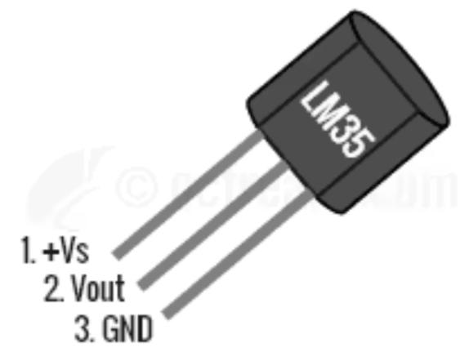
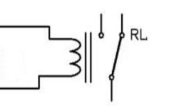
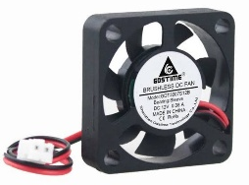
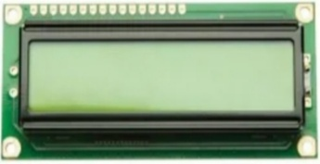
The LM35 is an integrated circuit sensor that can be used to measure temperature with an output voltage that is proportional to temperature (in °C).
Relay is an electromagnetic switch which allow low power circuits to switch to a relatively high Voltage.
DC fans are basically cooling fans engineered to meet requirements such as higher air flows.
A 16x2 LCD display is alphanumeric dot matrix display is capable of displaying it can display 16 characters per line and there are 2 such lines.

Slide 5
Configuration Steps:
Pin 2 is the data pin of LM35 which is connected to the analog input pin P0.27 i.e. ADC 0.
The last 4 data pins of the LCD are connected to P0.12 to P0.15 of the microcontroller.
A Single Pole Double throw(SPDT) relay is connected to P0.20 pin. The single pole is connected to 12V DC Source and Normally Open(NO) throw is connected to 12V DC Fan.
The Rx of Virtual terminal is connected to P0.1(TX) pin and TX of Virtual terminal is connected to P0.2 (RX) pin.
The push button with DC supply is connected to P0.16 pin, which is used to change the temperature limit based on the input from the UART.

Slide 6
3. Algorithm :
Configure PINSEL0 pins as GPIO
Configure P0.20 as Output which is used as input to RELAY
Configure P0.16 as Input for getting input from switch
Set temperature limit
Make ADC and LCD initialisation
While (1)
Get Temperature value from ADC
If P0.16 is high
Get input from UART(PC)
End
If previous value is not equal to current value
Convert Temperature into Fahrenheit
Display temperature in Celsius and Fahrenheit
If temperature is greater than temperature limit
Set P0.20 so that relay is on, in-turn, the connection to fan is on
Display “Overheat” in LCD
Else
Clear P0.20 so that relay is off, in-turn, the connection to fan is off
Display “Normal” in LCD
End
End
End

Slide 7
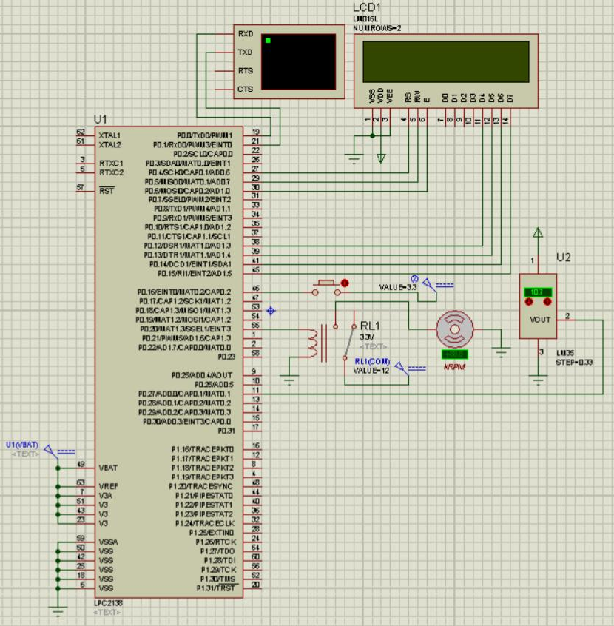
5. Simulation results :
Design :

Slide 8
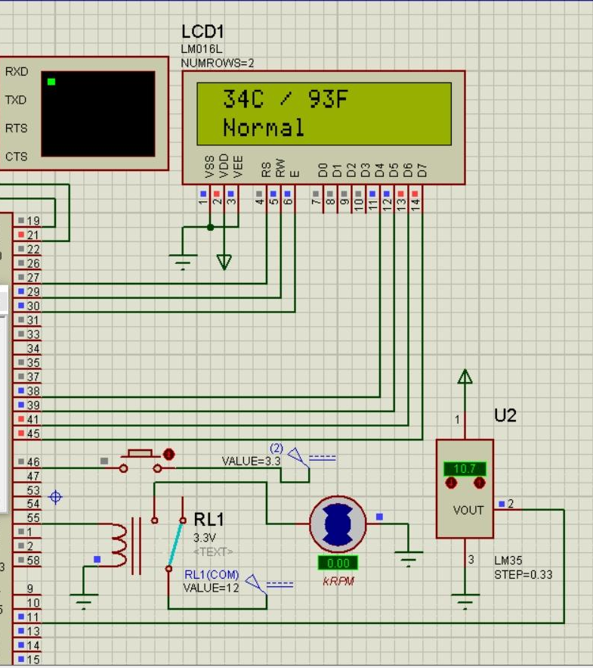

Initially, temperature is 34°C , Fan is off. The temperature became 35°C , Fan is on. The LCD display shows “Normal” The LCD display shows “Overheat”

Slide 9

With temperature unchanged , switch is pressed and “37,” is entered in the virtual terminal. Now, the LCD display shows “Normal” because the TEMP_LIMIT is 37 now but the current temperature is 35.

Slide 10

With temperature unchanged , again switch is pressed and “32,” is entered in the virtual terminal. Now, the LCD display shows “Overheat” because the TEMP_LIMIT is 32 now but the current temperature is 34.

Slide 11
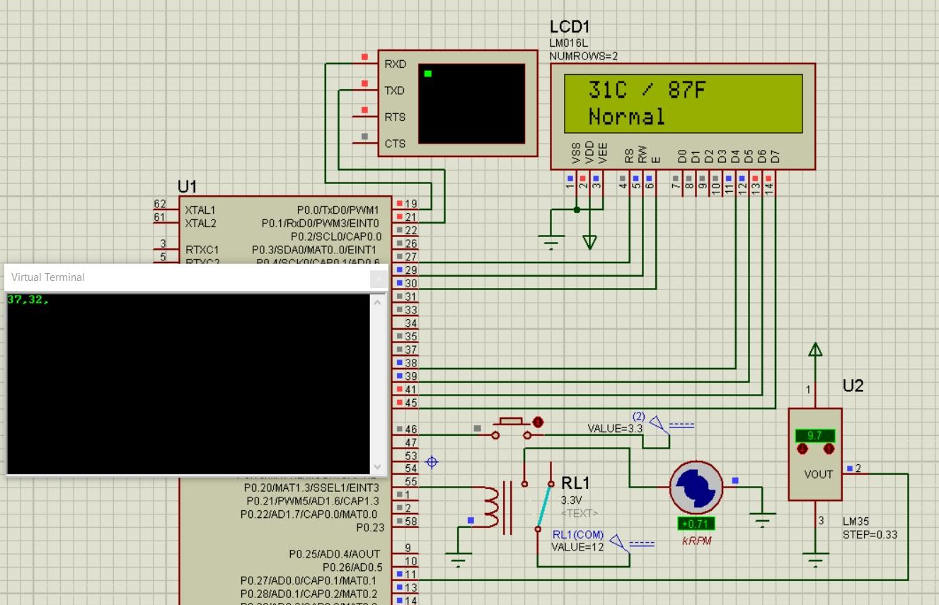
The TEMP_LIMIT with 32 as unchanged , temperature changes to 31. Now, the LCD display shows “Normal” because the TEMP_LIMIT is 32 now but the current temperature is 31.

Slide 12
Thank You

