Slide 1

Negation

Slide 2
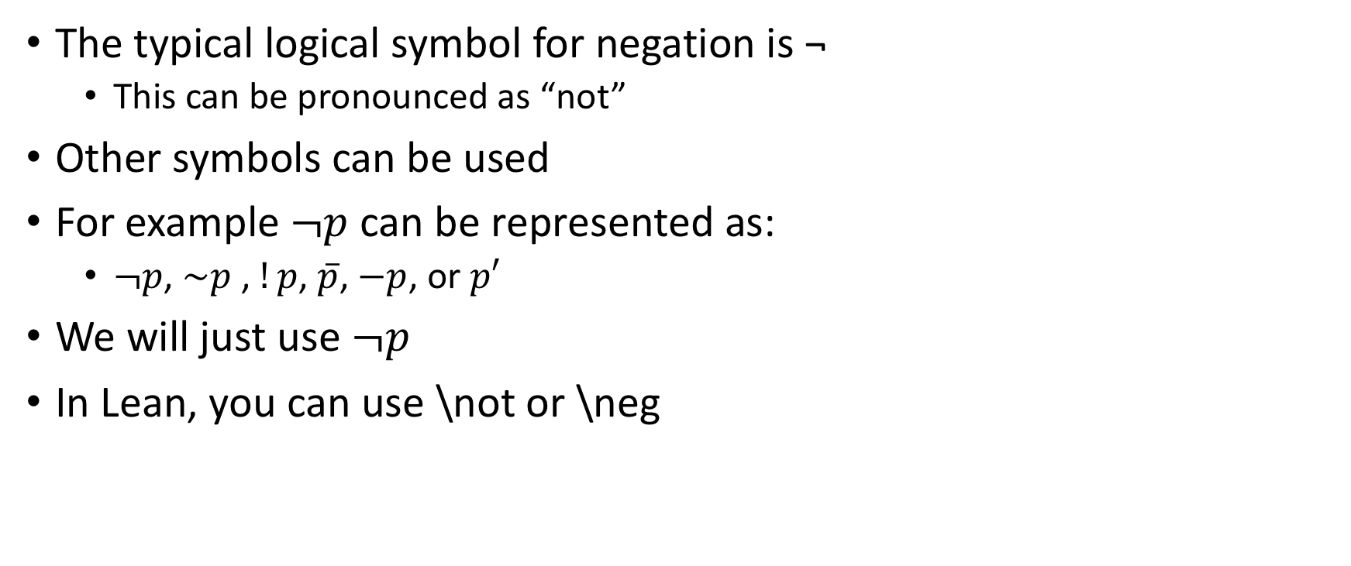
Terminology
The typical logical symbol for negation is ¬
This can be pronounced as “not”
Other symbols can be used
For example $¬p$ can be represented as:
$¬p$, $\sim p$ , $!p$, $\overline{p}$, $−p$, or $p′$
We will just use $¬p$
In Lean, you can use \not or \neg

Slide 3
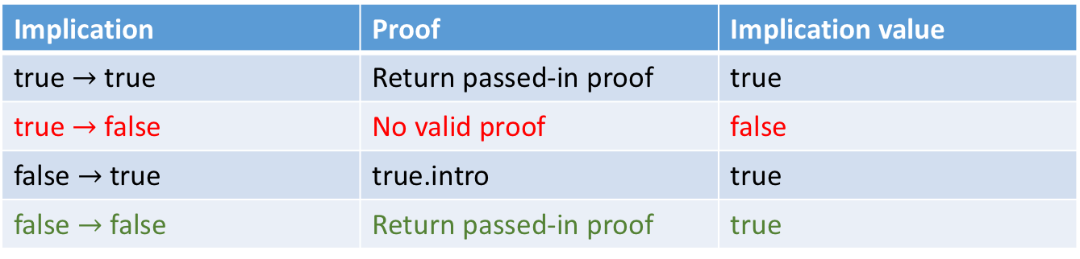
Stating a negation
Propositions can be true or false
So far, we have been interested in proving that propositions are true
One way to prove a proposition is false, is to prove its negation is true
¬P is thus shorthand for P → false — remember this!!
Remember our implication truth table:
Implication | Proof | Implication value
true $→$ true | Return passed-in proof | true
true $→$ false | No valid proof | false
false $→$ true | true.intro | true
false $→$ false | Return passed-in proof | true

Slide 4
Proof of negation
Proof that the proposition 1=0 is false:
theorem t1 : ¬ 1 = 0 :=
begin
by contradiction,
end
Note: in Lean, “=“ binds more tightly than “¬”
Also note: this is not a proof by contradiction
contradiction is a tactic that exploits the fact that terms built by different constructors (0 vs succ(0)) are never equal
See also https://leanprover.github.io/theorem_proving_in_lean/tactics.html#more-tactics

Slide 5
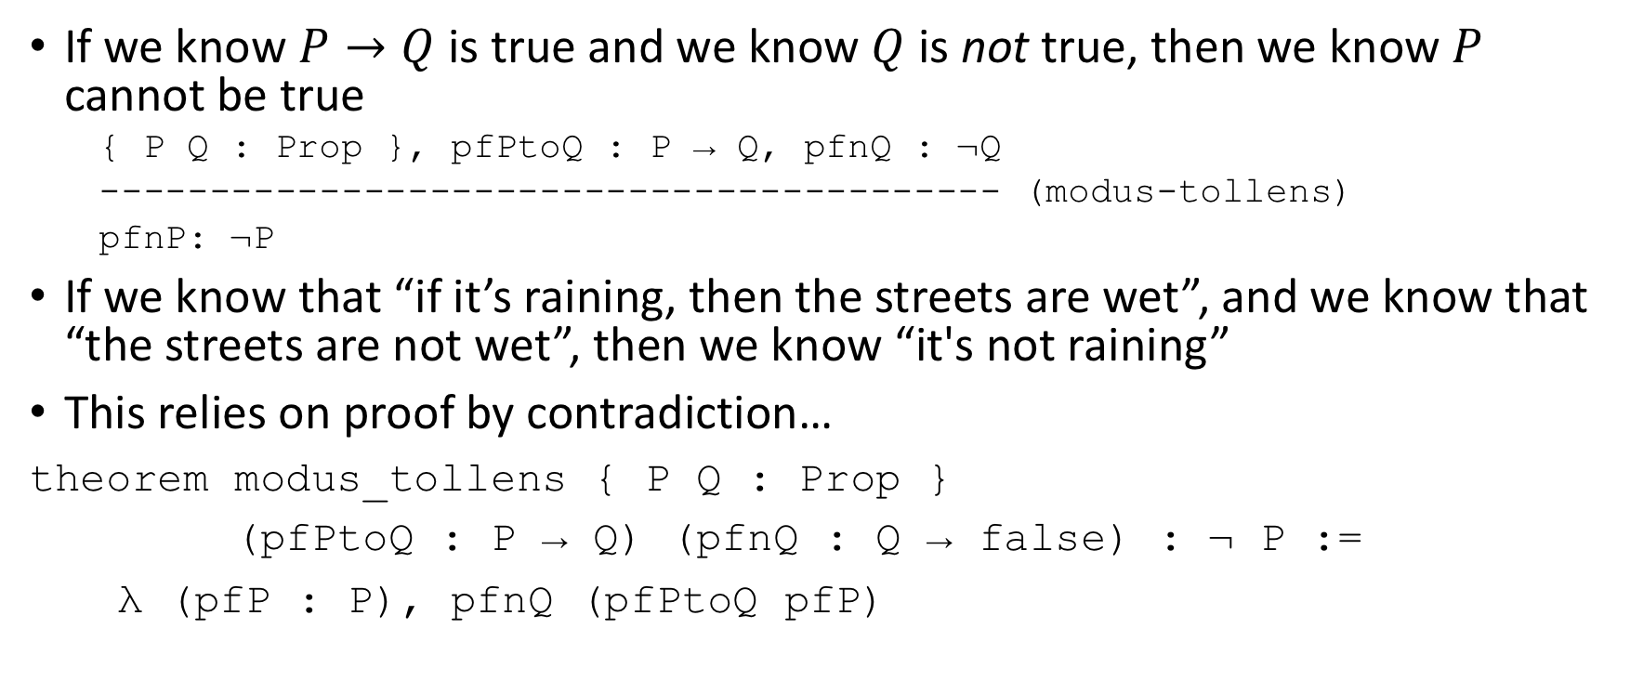
Modus Tollens (update!)
If we know $P→Q$ is true and we know $Q$ is not true, then we know $P$ cannot be true
{ P Q : Prop }, pfPtoQ : P → Q, pfnQ : ¬Q
----------------------------------------- (modus-tollens)
pfnP: ¬P
If we know that “if it’s raining, then the streets are wet”, and we know that “the streets are not wet”, then we know “it's not raining”
This relies on proof by contradiction…
theorem modus_tollens { P Q : Prop }
(pfPtoQ : P → Q) (pfnQ : Q → false) : ¬ P :=
λ (pfP : P), pfnQ (pfPtoQ pfP)

Slide 6
Unpacking modus tollens
theorem modus_tollens { P Q : Prop }
(pfPtoQ : P → Q) (pfnQ : Q → false) : ¬ P :=
λ (pfP : P), pfnQ (pfPtoQ pfP)
Given a proof of P implies Q and a proof that Q is false, we can prove that P is false
Steps:
Provide a function that takes a proof of P,
apply that to our implication that P implies Q to get a proof of Q,
apply that to our implication that Q implies false to get a proof that P implies false, hence
Recall that ¬P is actually synonymous with P implies false

Slide 7
Proving Q and not Q is false
Something cannot be both true and not true
theorem qAndNotQfalse { P Q: Prop }
(pf: Q ∧ ¬Q) : false :=
pf.2 pf.1
pf.1 takes the left side of the conjunction, pf.2 takes the right
Exercise: explain how this theorem works
¬Q is an implication that Q → false
What do we get when we apply that implication to Q?

Slide 8
Proving the negation
Now consider the proof of the negation:
theorem notQAndNotQ: ∀ Q : Prop, ¬ (Q ∧ ¬ Q) :=
λ (Q : Prop) (qanq : Q ∧ ¬ Q),
qanq.2 qanq.1
Exercise discuss how this proof works

Slide 9
Proof by contradiction
Imagine we want to prove the following theorem:
theorem proof_by_contra_1 { P Q : Prop }
(pfNotPImpQNotQ: ¬ P → (Q ∧ ¬ Q)) : P := sorry
I.e., given a proof that “not P” implies “Q and not Q”, we want to prove that P is true
Proof by contradiction has us assume the opposite of what we want to prove and show that it is false
I.e., assume “not P” and show it has a false truth judgment

Slide 10
Proof by contradiction (2)
def qAndNotQimpf { Q: Prop } (pf: Q ∧ ¬ Q) : false :=
pf.2 pf.1
#check qAndNotQimpf
open classical -- requires classical logic!
theorem proof_by_contra_1 { P Q : Prop }
(pfNotPImpQNotQ: ¬ P → (Q ∧ ¬ Q)) : P :=
by_contradiction (assume h: ¬P, show false,
from (qAndNotQimpf (pfNotPImpQNotQ h)))
#check proof_by_contra_1
Note that in order to use proof by contradiction we have to abandon purely constructive logic and employ classical logic.

Slide 11

Fin

