Slide 1
SAILY (NORD SECURITY) | SENIOR DATA ANALYST CASE STUDY
Unlocking Android Conversion Parity, Stopping Hardware CAC Bleed & Capturing Multi-Country Demand
End-to-End PACE Framework Synthesis (Plan -> Analyze -> Construct -> Execute)
Observation Window: Aug 1 – Aug 27, 2024 | 241,548 Deduplicated Sessions | 25,133 Paid Orders | $358,625.85 Gross Billings
• Part I — Core Executive Deck (Slides 1–7): Direct Answers to the 5 Case Study Questions & P0–P2 Action Roadmap
• Part II — Technical Deep-Dive Appendix (Slides 8–12): H1–H8 Registry, Simpson's Paradox, Behavioral Topology, Quota Matrix & Telemetry v2
Candidate: Mantas Normantas | Role Applied: Data Analyst (Saily) | Data Engine: Google Cloud BigQuery

Slide 2
PART I: CORE EXECUTIVE DECK | EXECUTIVE SUMMARY — DIRECT ANSWERS TO THE 5 CASE STUDY QUESTIONS
True Deduplicated Session CR is 10.12% (+0.97 pp vs Naive); Closing Android Gaps Unlocks +$297k to +$1.40M/yr
1. TRUE SESSION CONVERSION
10.12% Strict CR
24,456 buyers / 241,548 sessions
(vs 9.15% naive row CR; 10.40% order ratio)
2. iOS vs ANDROID COMPAT (H1)
+2.84 pp iOS Lead
iOS 12.48% vs And. Compat 9.65%
(Z = 20.28, p < 0.0001; S1->S2 & S2->S3)
3. AUG 27 MOROCCO SURGE (H3)
11.36% Ex-MA CR
5,134 MA iOS sessions (0.10% CR)
diluted global iOS CR to 5.64%
4. INCOMPATIBLE ANDROID (H2/H4)
+$35.8k / -$39.4k
+$35,752 27d hardware ceiling (~$483k/yr)
-$39,371 27d Paid CAC bleed (-$532k/yr)
Case Study Question | Verified Empirical Finding (BigQuery Reconciled) | Primary Root Cause | Priority Action & Annualized P&L Impact
1. Overall CR & Data Hygiene | Strict Session CR = 10.12% (24,456 / 241,548) Order Ratio = 10.40% (25,133 orders; $358,625.85) Naive Row CR = 9.15% (25,133 / 274,695 raw rows) | 30,836 duplicate session IDs generate 33,147 surplus rows; 677 multi-plan orders occur in same session. | Deploy mart_saily_sessions_deduped in dbt & split fct_sessions / fct_orders (Telemetry v2).
2. Cohort Funnel Comparison (H1) | iOS = 12.48% CR (16,088 / 128,872) Android Compat = 9.65% CR (8,258 / 85,603) Android Incompat = 0.41% CR (110 / 27,073) | Android Compat wins S0->S1 (52.18% vs 48.52%), but suffers 43.42% drop at S1->S2 & 67.32% at S2->S3. | P1-1: Redesign Android S1->S2 config UX, surface $/GB badges & promo parity (+$39k to +$134k/yr).
3. Incompatible Drop-Off (H2) | 70.78% (19,162) bounce at S0; 7,889 reach S1; 4,735 reach S2 (97.68% drop); 110 sessions ($1,238.19) pay. | Missing pre-checkout EuiccManager hardware gate allows 4,735 incompatible phones into checkout. | P0-2: Hard-block S2 on incompatible Android & show S0 modal (eliminates ~1,500 defective orders/yr).
4. Anomalies & Cyclicality (H3) | Aug 27 iOS CR = 5.64% observed vs 11.36% Ex-Morocco. Aug 16 Peak = 1,130 orders ($16,240.64; 14.83% iOS CR). | Aug 27: 5,134 Moroccan iOS sessions (97.8% domestic MA search). Fri (1.083x) & Sat (1.074x) weekend peaks. | P1-3 & P2-2: Paid UA geo-anomaly circuit-breaker + shift ad pacing +15% to Thu PM–Sat AM (+$61k–$101k/yr).
5. Opportunity vs CAC Bleed (H4) | Upper-Bound Revenue Ceiling: +$35,751.65 / 27d. Real-World Paid CAC Bleed: -$39,371.31 / 27d (@ $1.50 CAC). | Saily cannot remotely upgrade user hardware; acquiring 27,073 incompatible sessions burns paid UA budget. | P0-1: Enable Play Console euicc catalog filter + Paid UA OEM exclusion (saves +$258k to +$1.26M/yr).
Saily (Nord Security) Case Study | Candidate: Mantas Normantas | Part I: Core Executive Deck | Slide 2 of 12
Notes:
Speaker Notes: 1) Always distinguish between Naive Row CR (9.15%), Strict Session CR (10.12% = 24,456/241,548), and Order-to-Session Ratio (10.40% = 25,133/241,548). 2) iOS beats Compatible Android by +2.84 pp (Z=20.28). 3) Aug 27 iOS crash was a 5,134-session Moroccan domestic viral spike (Ex-MA CR = 11.36%).

Slide 3
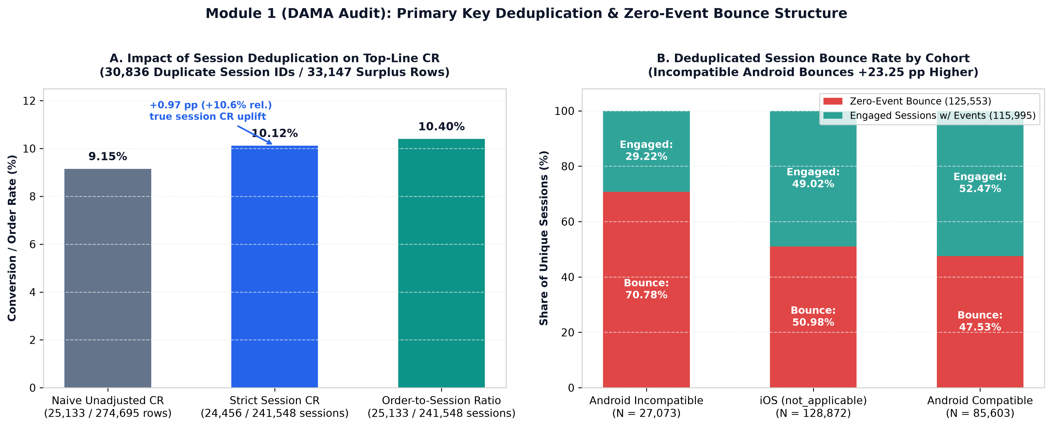
PART I: CORE EXECUTIVE DECK | QUESTION 1: DATA GOVERNANCE & PRIMARY KEY DEDUPLICATION (SQL/01_DATA_AUDIT.SQL)
Collapsing 33,147 Duplicate Session Rows Lifts True Session CR +0.97 pp to 10.12% While Preserving All 25,133 Orders
PRIMARY KEY DEDUPLICATION
241,548 Sessions
274,695 raw rows contain 30,836 duplicate IDs
(33,147 surplus rows; +20.9% JOIN inflation risk)
MULTI-ORDER PRESERVATION
25,133 Paid Orders
$358,625.85 billings ($14.27 AOV) across
24,456 buyers (677 multi-plan orders; $14.66 ARPPU)
ZERO-EVENT BOUNCE GAP
70.78% Incompat Bounce
125,553 bounced sessions (51.98% global):
70.78% And. Incompat vs 47.53% And. Compat
TAG SYNC & CLIENT LOOPS
99.88% Tag Sync
24,427 / 24,456 buyers logged events (29 dark);
250 sessions fired >15 identical taps (max 167)
Saily (Nord Security) Case Study | Candidate: Mantas Normantas | Part I: Core Executive Deck | Slide 3 of 12
Notes:
Speaker Notes: Full-width visualization of our DAMA audit. Notice the 4 bottom cards: 1) 30,836 duplicate session IDs (33,147 surplus rows), 2) 677 multi-plan orders inside 24,456 converting sessions, 3) 70.78% Android Incompatible zero-event bounce, 4) 99.88% tag sync & 250 client loop sessions.

Slide 4
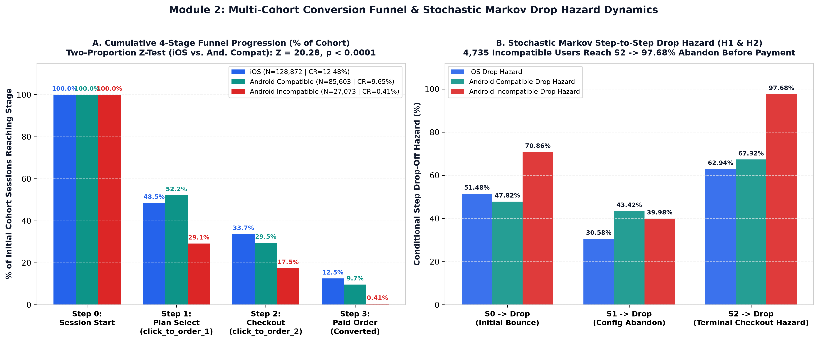
PART I: CORE EXECUTIVE DECK | QUESTIONS 2 & 3: FUNNEL COMPARISON (H1) & INCOMPATIBLE DROP-OFF (H2) (SQL/02_FUNNEL_AND_MARKOV.SQL)
Android Compat Wins S0->S1 (52.2% vs 48.5%), Drops at S1->S2 (43.4%) & S2->S3 (67.3%); 97.7% Incompat Wall
Device & Compatibility Cohort | S0: Unique Sessions | S1: Plan Select (click_to_order_1) | S2: Checkout (click_to_order_2) | S3: Buyers (Paid Orders) | S0->S1 Reach | S1->S2 Drop Hazard | S2->S3 Drop Hazard | Strict CR (Order Ratio)
iOS (not_applicable) | 128,872 | 62,532 | 43,411 | 16,088 (16,527) | 48.52% | 30.58% | 62.94% | 12.48% (12.82%)
Android Compatible (true) | 85,603 | 44,666 | 25,273 | 8,258 (8,495) | 52.18% | 43.42% | 67.32% | 9.65% (9.92%)
Android Incompatible (false) | 27,073 | 7,889 | 4,735 | 110 (111) | 29.14% | 39.98% | 97.68% | 0.41% (0.41%)
Global Total (Deduplicated) | 241,548 | 115,087 | 73,419 | 24,456 (25,133) | 47.65% | 36.21% | 66.69% | 10.12% (10.40%)
Saily (Nord Security) Case Study | Candidate: Mantas Normantas | Part I: Core Executive Deck | Slide 4 of 12
Notes:
Speaker Notes: Full-width funnel and Markov hazard chart on top, paired with the exact 4-stage cohort table below. Highlight that Compatible Android beats iOS at S0->S1 (+3.66 pp), so the 2.84 pp CR deficit is 100% in S1->S2 (+12.84 pp excess drop) and S2->S3 (+4.38 pp excess drop).

Slide 5
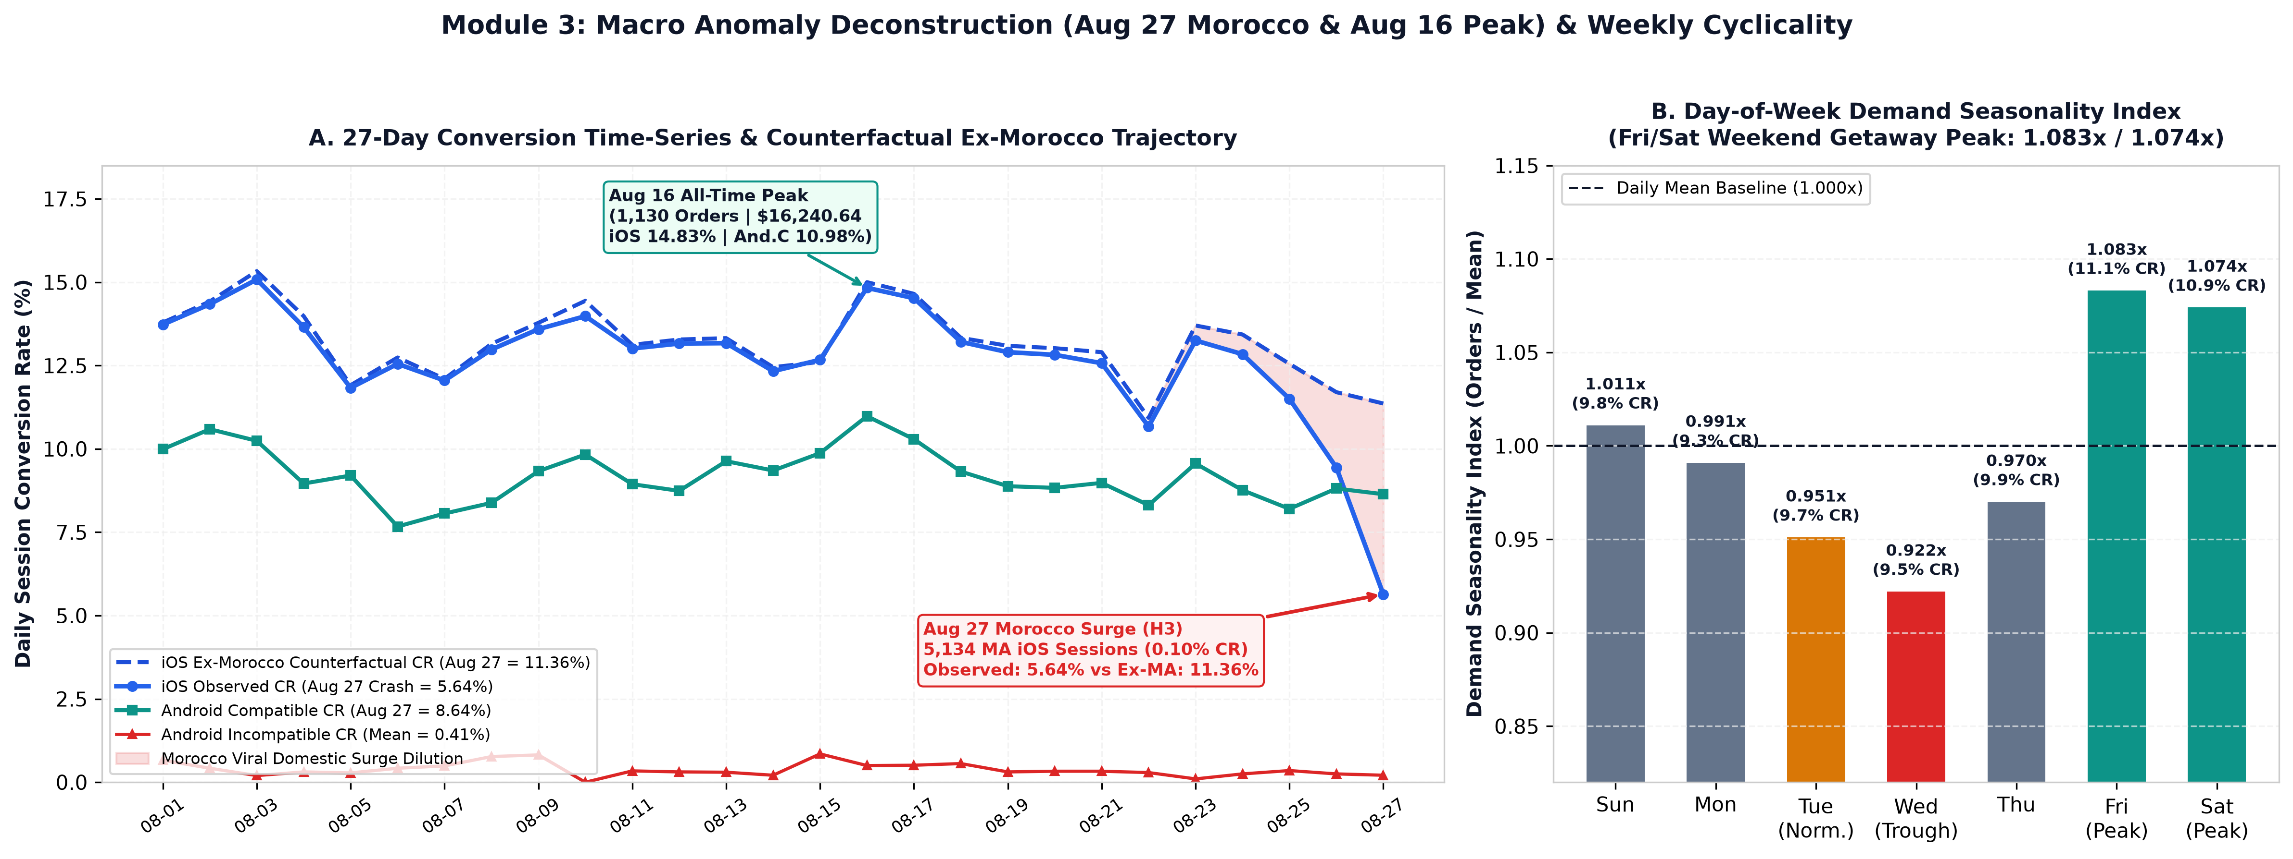
PART I: CORE EXECUTIVE DECK | QUESTION 4: MACRO ANOMALIES (H3: AUG 27 CRASH & AUG 16 PEAK) & WEEKLY CYCLICALITY
Aug 27 iOS Crash (5.64%) Was Driven by 5,134 Moroccan Domestic Sessions (0.10% CR); Ex-Morocco iOS CR Was 11.36%
AUG 27 MOROCCO SURGE (H3)
5,134 MA iOS Sessions
50.79% of Aug 27 iOS traffic (10,109 total);
converted at 0.10% (5 buyers) on $3.99 tourist rate
DOMESTIC MA SEARCH INTENT
97.8% Local MA Search
Across all 5,787 MA sessions on Aug 27, 5,019 of
5,134 logged event pairs searched destination = MA
COUNTERFACTUAL EX-MA CR
11.36% Ex-MA iOS CR
Excluding Morocco restores Aug 27 iOS CR from
5.64% to 11.36% (565 / 4,975) — zero app bug
AUG 16 PEAK & CYCLICALITY
1.083x Fri / 1.074x Sat
Aug 16 peak: 1,130 orders ($16,240.64; 14.83% iOS CR).
Fri (11.10% CR) & Sat (10.89% CR) vs Wed (0.922x)
Saily (Nord Security) Case Study | Candidate: Mantas Normantas | Part I: Core Executive Deck | Slide 5 of 12
Notes:
Speaker Notes: Explain both anomalies clearly: 1) Aug 27 iOS crash to 5.64% was an external composition shock (5,134 Moroccan iOS sessions converting at 0.10%, with 97.8% searching for local MA data). Removing Morocco restores Aug 27 iOS CR to 11.36%. 2) Friday Aug 16 is the global peak (1,130 orders / $16,240.64).

Slide 6
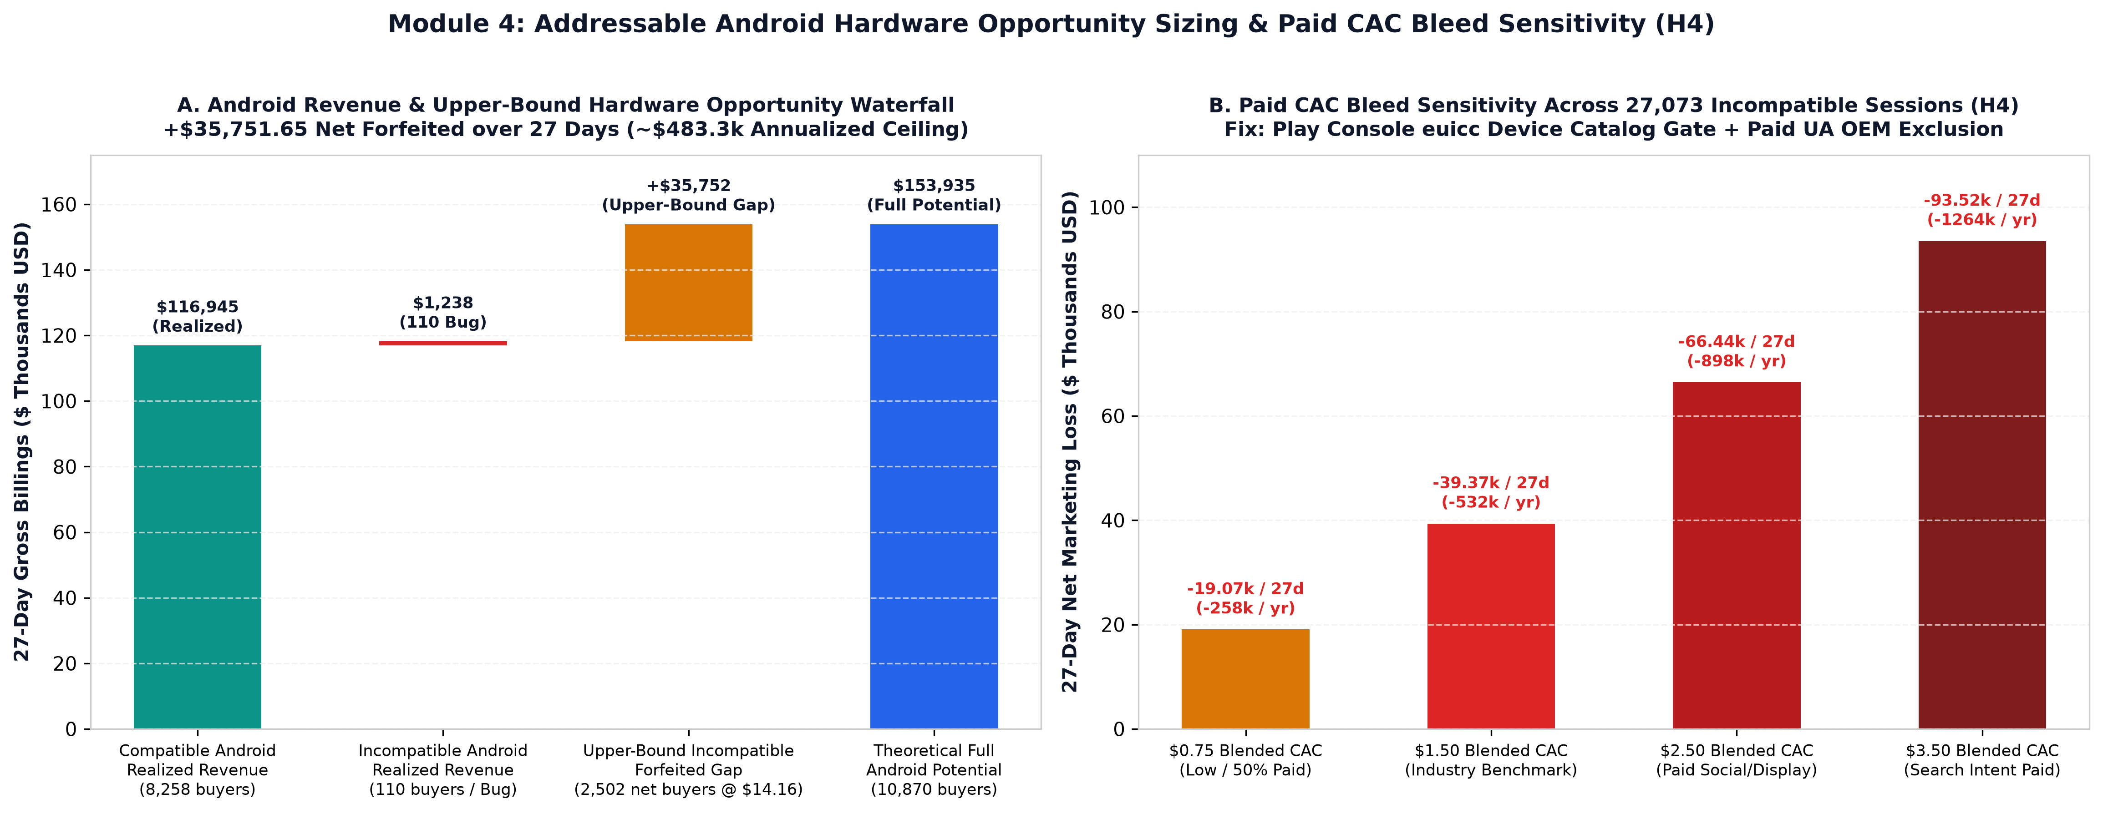
PART I: CORE EXECUTIVE DECK | QUESTION 5: ADDRESSABLE HARDWARE OPPORTUNITY CEILING VS. PAID CAC BLEED (H4)
Upper-Bound Hardware Parity Equals +$35,752/27d (~$483k/yr), But Real-World Paid CAC Bleed Destroys -$532k/yr
Valuation / Sensitivity Scenario | Session / Buyer Volume (27 Days) | Gross Revenue / Spend Formula | Net 27-Day P&L Impact | Annualized Impact (365/27)
Upper-Bound Hardware Revenue Ceiling (H2) | 27,073 sessions -> 2,612 buyers (2,502 net) | 2,612 x $14.1615 ARPPU ($36,989.84) - $1,238.19 actual | +$35,751.65 forfeited | +$483,310 / yr ceiling
Paid CAC Bleed — Low ($0.75 Blended CAC) | 27,073 incompat sessions (110 bug buyers) | $20,304.75 ad spend vs $1,238.19 defective revenue | -$19,066.56 net loss | -$257,752 / yr bleed
Paid CAC Bleed — Base ($1.50 Blended CAC) | 27,073 incompat sessions (110 bug buyers) | $40,609.50 ad spend vs $1,238.19 defective revenue | -$39,371.31 net loss | -$532,240.64 / yr bleed
Paid CAC Bleed — Mid/High ($2.50–$3.50 CAC) | 27,073 incompat sessions (110 bug buyers) | $67,682.50–$94,755.50 spend vs $1,238.19 revenue | -$66.4k to -$93.5k loss | -$898k to -$1.26M / yr
Saily (Nord Security) Case Study | Candidate: Mantas Normantas | Part I: Core Executive Deck | Slide 6 of 12
Notes:
Speaker Notes: Contrast the theoretical upper-bound revenue ceiling (+$35,751.65 over 27d if 27,073 incompatible users had eSIM phones converting at 9.65% and $14.16 ARPPU) with the real-world marketing bleed (-$39,371.31 net over 27d / -$532k/yr at $1.50 blended CAC).

Slide 7
PART I: CORE EXECUTIVE DECK | PRIORITIZED 7-INITIATIVE ACTION ROADMAP (P0–P2) & TELEMETRY V2 SUMMARY
Executing P0–P2 Initiatives Delivers +$258k–$1.26M/yr in CAC Savings & +$262k–$486k/yr in Incremental Gross Billings
P0-1: STOP PAID CAC BLEED
+$532k/yr Base Saved
Play Console euicc catalog gate + Paid UA
non-eSIM OEM exclusion (+$258k–$1.26M/yr)
P0-2: BLOCK DEFECTIVE ORDERS
~1,500 Orders/yr Blocked
In-app EuiccManager S0 modal & S2 hard-block
eliminates 110 bug buyers ($1,238 / 27d)
P1: ANDROID UX, PROMO & RETRY
+$128k–$262k/yr Lift
P1-1 Android S1->S2 UX & promo parity (+$39k–$134k)
+ P1-2 Checkout retry fallback (+$89k–$128k)
P2: BUNDLES & PEAK PACING
+$134k–$224k/yr Lift
P2-1 EU<->AT regional smart card (+$73k–$123k)
+ P2-2 Thu–Sat pacing & 10GB anchor (+$61k–$101k)
Priority | Strategic Initiative | Target Gap / Root Cause | Concrete Engineering / Growth Action | Annualized Impact (365/27) | Owner & Timeline
P0-1 | Pre-Install Paid UA & Play Store Gate | 27,073 incompat sessions (0.41% CR, 70.78% bounce) | Enable android.hardware.telephony.euicc in Play Console + exclude non-eSIM OEMs in Paid UA. | +$258k to +$1.26M/yr saved (+$532k base) | Perf. Mktg & Android Eng (Wk 1)
P0-2 | In-App EuiccManager Gate (S0 + S2) | 4,735 incompat reach S2; 110 sessions ($1,238.19) pay | Check EuiccManager.isEnabled() at S0; hard-block S2 checkout unless buying for companion device. | Eliminates ~1,500 defective orders & CS tickets/yr | Android Mobile Eng (Wk 1–2)
P1-1 | Android S1->S2 UX & Promo Parity | 43.42% Android S1->S2 drop; -4.43 pp promo gap | Sticky S1->S2 bottom sheet, $/GB savings badges (-39% to -56%), and Android promo deeplink parity. | +$39k to +$134k/yr net incremental billings | Product Growth & UX (Sprint 2–3)
P1-2 | Checkout Retry Loop Fallback Sheet | iOS 3+ click_to_order_2 retries plunge -52.2% to 17.92% | Auto-trigger 1-Tap Payment Fallback Sheet (Apple/Google Pay <-> Card/PayPal) on 2nd S2 tap. | +$89k to +$128k/yr recovered checkouts | Payments Eng (Sprint 2–3)
P1-3 | Paid UA Geo-Anomaly Circuit-Breaker | Aug 27 Morocco viral spike (5,134 iOS sessions, 0.10% CR) | Auto-pause ad sets when any country spikes >3x 7d volume at <1% CR; report Ex-Anomaly CR in BI. | Protects Paid UA ROAS & KPI integrity | Mktg Analytics & BI (Sprint 2)
P2-1 | Regional vs Single-Country Smart Card | 3+ countries = -72.3% CR drop; EU<->AT #1 pair (693) | Show 'Visiting 2+ EU Countries? Compare EU ($16.65) vs Single-Country ($9.79)' in 2–3 event window. | +$73k to +$123k/yr rescued multi-country orders | Search & Discovery (Sprint 4)
P2-2 | Thu–Sat Peak Pacing & 10 GB Anchor | Fri (1.083x) / Sat (1.074x) peak; Transatlantic $17.28 AOV | Shift Paid UA budget +15% to Thu PM–Sat AM; default-select 10 GB anchor on US/CA -> EU corridors. | +$61k to +$101k/yr AOV & ROAS expansion | Growth Mktg & Pricing (Sprint 3)
ENG-v2 | Telemetry v2 & dbt Warehouse Spec | 33,147 dup rows, 125.5k 0-event bounces, no timestamps | Split fct_sessions / fct_orders; add user_id, event_timestamp, app_open, promo_code_id & 500ms debounce. | Eliminates -0.97 pp CR distortion & 52% blind spot | Data Eng & Mobile SDK (Q1)
Saily (Nord Security) Case Study | Candidate: Mantas Normantas | Part I: Core Executive Deck | Slide 7 of 12
Notes:
Speaker Notes: Conclude the Core Executive Deck with our prioritized P0-P2 decision matrix. Every initiative is tied to a specific SQL finding, owner, effort level, and annualized dollar impact.

Slide 8
PART II: TECHNICAL DEEP-DIVE APPENDIX | APPENDIX A1: INFERENTIAL HYPOTHESIS REGISTRY (H1–H8)
6 of 8 Hypotheses Empirically Confirmed; H5 (Quota Down-Selling) & H6 (Simpson's Paradox) Formally Rejected
ID | Hypothesis Statement | Statistical / SQL Test Method | Verified Empirical Evidence | Verdict
H1 | iOS converts significantly higher than Compatible Android | Two-Proportion Z-Test (Deduplicated Sessions) | 12.48% (16,088/128,872) vs 9.65% (8,258/85,603); Diff = +2.84 pp (Z = 20.28, p < 0.0001) | CONFIRMED
H2 | Incompatible Android users reach payment before dropping | 4-Stage Markov Transition Matrix (sql/02) | 7,889 reach S1; 4,735 reach S2 (97.68% drop hazard); 110 sessions ($1,238.19) pay | CONFIRMED
H3 | Aug 27 iOS crash was an external geo-composition shock | Country Decomposition & Counterfactual CR | 5,134 Moroccan iOS sessions (0.10% CR; 97.8% domestic MA search); Ex-MA CR = 11.36% | CONFIRMED
H4 | Paid UA on incompatible Android destroys net marketing margin | Blended CAC Sensitivity Matrix ($0.75–$3.50) | 27,073 incompat sessions burn -$19.07k to -$93.52k net over 27d (-$39.37k / -$532k/yr base) | CONFIRMED
H5 | Checkout drop-off is driven by mid-session quota down-selling | Timestamp-Free Quota Exploration Matrix (N=24,426) | 92.16% (22,512) view 1 quota; 4.96% (1,211) view multiple & buy largest (97.12% diagonal) | REJECTED
H6 | Global iOS CR lead is a Simpson's Paradox country mix artifact | Within-Country OS Stratification (Top 11 Markets) | iOS beats Compatible Android in 10 of 11 top markets (US +3.07 pp, CA +5.93 pp, RO +7.02 pp) | REJECTED
H7 | iOS benefits from higher promotional discount penetration | Modal SKU Anchor Price Decomposition (N=24,782) | 25.50% of iOS orders discounted ($1.29/order) vs 21.07% on Android ($1.14/order; +4.43 pp gap) | CONFIRMED
H8 | Multi-country browsing & search loops trigger fatigue decay | Event Depth & Deterministic Cross-Shop Matrix | 92.57% convert in 2–3 events (30.37% CR); 3+ countries = -72.3% CR drop; EU<->AT #1 pair (693) | CONFIRMED
Saily (Nord Security) Case Study | Candidate: Mantas Normantas | Part II: Technical Deep-Dive Appendix | Slide 8 of 12
Notes:
Speaker Notes: This appendix slide summarizes all 8 formal hypotheses tested in Phase A across SQL Modules 01-04, including exact statistical test results and commercial implications.

Slide 9
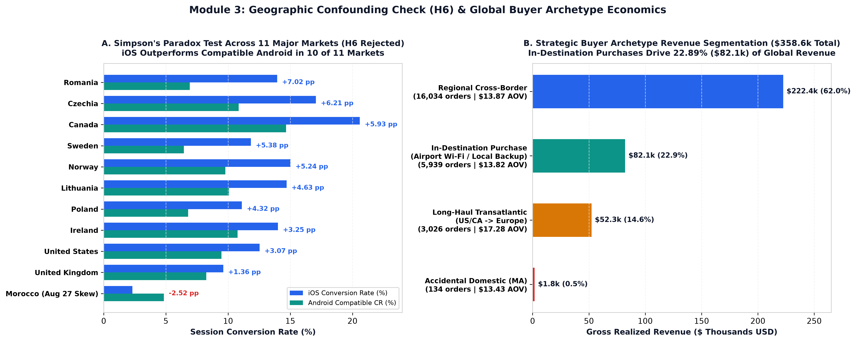
PART II: TECHNICAL DEEP-DIVE APPENDIX | APPENDIX A2: SIMPSON'S PARADOX CHECK (H6) & BUYER ARCHETYPES (SQL/03)
iOS Beats Compatible Android in 10 of 11 Top Markets; In-Destination Purchases Drive 22.89% ($82.1k) of Billings
H6 REJECTED: 10 OF 11 MARKETS
iOS Leads Across Geos
US (+3.07 pp), UK (+1.36 pp), CA (+5.93 pp),
PL (+4.32 pp), RO (+7.02 pp), CZ (+6.21 pp)
1. REGIONAL CROSS-BORDER
62.03% of Revenue
16,034 orders ($222,439.80, $13.87 AOV)
Core intra-European & regional travel
2. IN-DESTINATION PURCHASE
22.89% ($82,100.94)
5,939 orders ($13.82 AOV; US->US $27.9k, GB->GB $13k)
Airport Wi-Fi arrival & local backup SIMs
3. LONG-HAUL TRANSATLANTIC
$17.28 AOV (+25.0%)
3,026 orders ($52,285.60 / 14.58% share)
Led by US->EU ($19.29 AOV) & US->GB ($16.43)
Saily (Nord Security) Case Study | Candidate: Mantas Normantas | Part II: Technical Deep-Dive Appendix | Slide 9 of 12
Notes:
Speaker Notes: Deep dive into Module 3 geographic confounding and buyer archetypes. Point out that In-Destination Purchases (geo_country = destination) represent 5,939 orders ($82,100.94 / 22.89% of revenue) from travelers buying on arrival via Airport/Hotel Wi-Fi or dual-SIM locals.

Slide 10
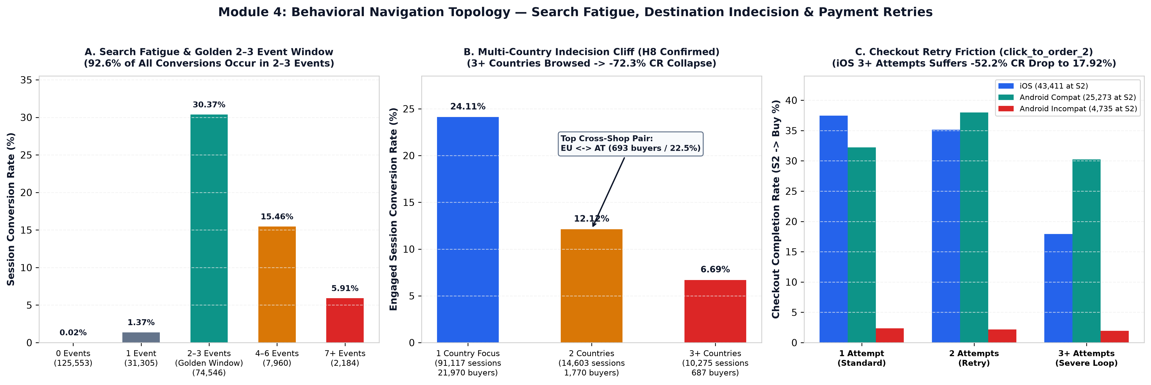
PART II: TECHNICAL DEEP-DIVE APPENDIX | APPENDIX A3: BEHAVIORAL NAVIGATION, CROSS-SHOPPING (H8) & RETRIES (SQL/04)
92.57% of Buyers Convert in 2–3 Events (30.37% CR); 3,078 Buyers Cross-Shopped Destinations (EU <-> AT #1 at 22.51%)
Behavioral Dimension | Segment / Tier Breakdown | Unique Sessions | Converting Buyers | Conversion Rate / Share | Product Engineering Action
Event Depth (Golden Window) | 2–3 Events vs 7+ Events | 74,546 vs 2,184 | 22,638 vs 129 | 30.37% CR (92.57% of buyers) vs 5.91% | Keep path to purchase strictly within 2–3 taps
Multi-Country Indecision (H8) | 1 Country vs 2 vs 3+ Countries | 91,117 / 14,603 / 10,275 | 21,970 / 1,770 / 687 | 24.11% -> 12.12% -> 6.69% (-72.3% drop) | Trigger Regional Bundle Card on 2nd country search
Destination Cross-Shopping | Viewed Alternative vs Single Dest. | 3,078 vs 21,349 buyers | 693 in EU <-> AT pair | 12.59% cross-shop (#1 EU<->AT = 22.51%) | Compare EU ($16.65/5GB) vs AT ($9.79/5GB) inline
Checkout Retry Loops (S2) | iOS 1 Attempt vs 3+ Attempts | 39,998 vs 736 at S2 | 14,987 vs 132 buyers | 37.47% -> 17.92% CR (-52.18% drop) | Auto-open 1-Tap Payment Fallback on 2nd S2 tap
Saily (Nord Security) Case Study | Candidate: Mantas Normantas | Part II: Technical Deep-Dive Appendix | Slide 10 of 12
Notes:
Speaker Notes: Full-width 3-panel behavioral topology chart paired with the exact breakdown table below.

Slide 11
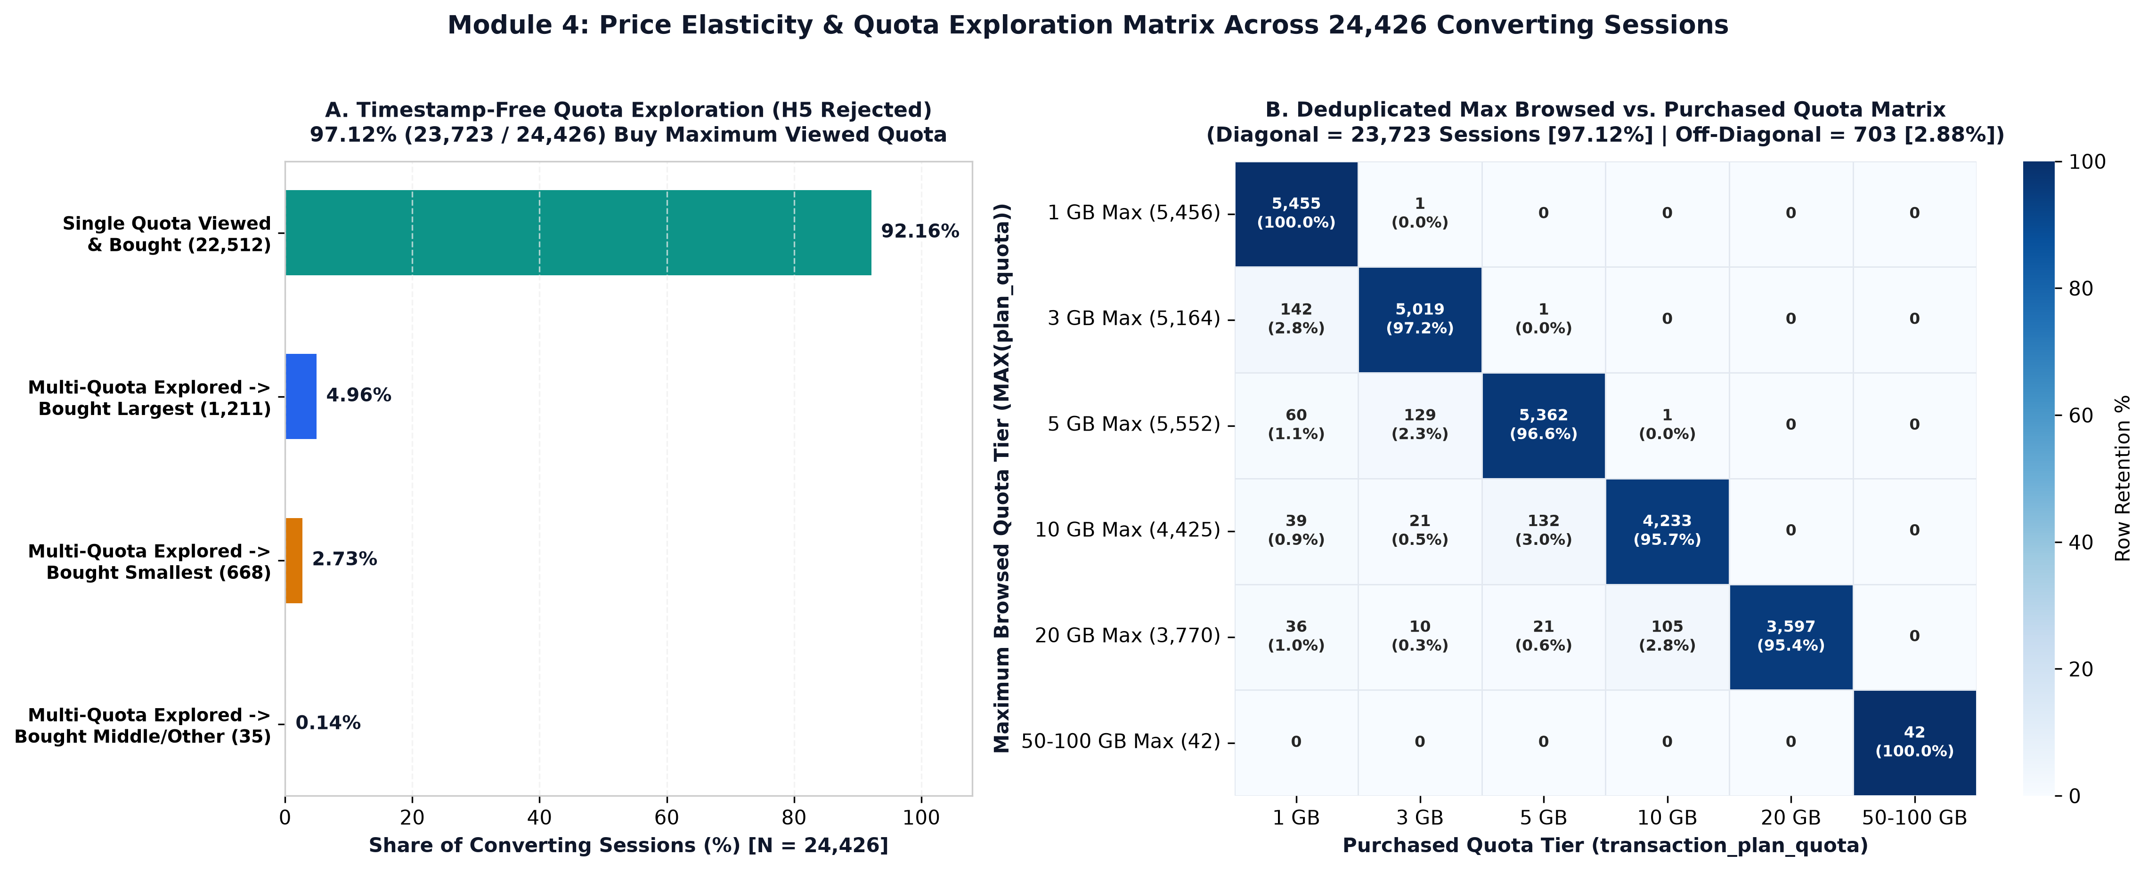
PART II: TECHNICAL DEEP-DIVE APPENDIX | APPENDIX A4: TIMESTAMP-FREE QUOTA EXPLORATION MATRIX (H5 REJECTED)
97.12% (23,723 / 24,426) Buy Their Maximum Browsed Quota (92.16% Single-Quota + 4.96% Multi-Quota Largest)
1. SINGLE QUOTA VIEWED
92.16% (22,512 Buyers)
Viewed exactly 1 quota tier and bought it;
zero mid-session quota switching
2. MULTI-QUOTA -> LARGEST
4.96% (1,211 Buyers)
Explored 2+ quota tiers and purchased
the largest quota viewed (up-tier lock-in)
TOTAL DIAGONAL RETENTION
97.12% (23,723 Buyers)
22,512 single-quota + 1,211 multi-quota largest
= 97.12% buy MAX(plan_quota)
OFF-DIAGONAL DOWN-SELL
Only 2.88% (703 Buyers)
668 (2.73%) bought smallest viewed; 30 (0.12%)
middle; 5 (0.02%) other -> H5 Rejected
Saily (Nord Security) Case Study | Candidate: Mantas Normantas | Part II: Technical Deep-Dive Appendix | Slide 11 of 12
Notes:
Speaker Notes: Because events has no intra-session timestamp, we classify converting sessions into 4 timestamp-free behavioral categories and cross-tabulate MAX(plan_quota) against transaction_plan_quota.

Slide 12
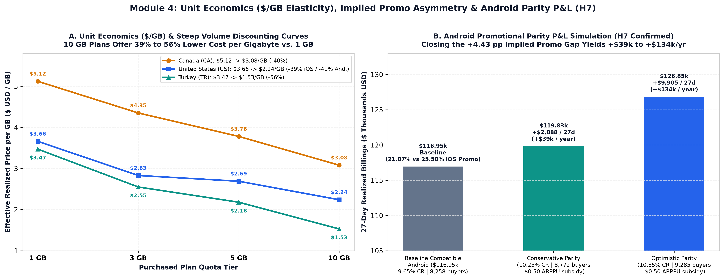
PART II: TECHNICAL DEEP-DIVE APPENDIX | APPENDIX A5: UNIT ECONOMICS ($/GB), PROMO PARITY (H7) & TELEMETRY V2 SPEC
10 GB Cuts $/GB by 39%–56%; Closing the +4.43 pp Promo Gap Yields +$39k–$134k/yr; Telemetry v2 Fixes 6 Schema Gaps
Telemetry v2 / Economic Pillar | Current v1 Schema / Baseline State | Proposed v2 Engineering / Growth Specification | Quantified Impact / Governance Value
1. Promo Asymmetry (H7 Confirmed) | 25.50% iOS orders discounted ($1.29) vs 21.07% Android ($1.14) | Equalize Android promo deeplink parity (+0.60 to +1.20 pp CR lift) | +$2,888 to +$9,905 / 27d (+$39k to +$134k/yr)
2. Split fct_sessions & fct_orders | 30,836 duplicate session IDs (33,147 surplus rows) in sessions | Enforce 1 row/unique_session_id in fct_sessions & 1 row/transaction_id in fct_orders | Eliminates -0.97 pp CR distortion (9.15% vs 10.12%)
3. Top-of-Funnel & Timestamp SDK | 125,553 bounced sessions (51.98%) log 0 events; no timestamps | Add event_timestamp, app_open, compatibility_modal_shown, destination_search | Illuminates 70.78% Android Incompat bounce & path order
4. User Identity, Promo & Debounce | No user_id, no list_price_usd / promo_code_id, 250 tap loops | Add hashed user_id, list_price_usd, ad_cost_usd & 500ms client tap debounce | Enables multi-session LTV, exact ROAS & retry root cause
Saily (Nord Security) Case Study | Candidate: Mantas Normantas | Part II: Technical Deep-Dive Appendix | Slide 12 of 12
Notes:
Speaker Notes: Final appendix slide combining Unit Economics ($/GB), Implied Promotional Asymmetry (H7), and our 6-point Telemetry v2 Engineering Specification.

