Slide 1
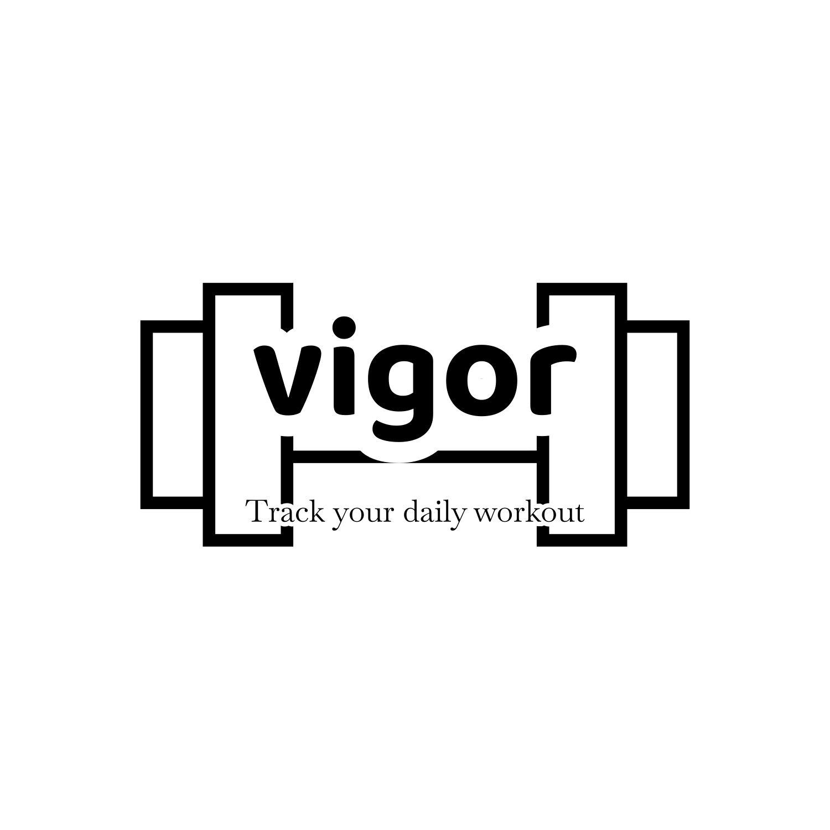
SWE212 PROJECT: Mobile Workout Plan Sharing App
Students Names&Surnames:
1- Student-developer-role: MANSOOR GABALI
2- Student-user-role: RAGHAD AL HADDAD
3- Student-customer-role: ELHAMUDDIN ANDARABI
Track your daily workout plans with Vigor

Slide 2
Main Points :
1- Project Overview
2- Gantt Chart
3- Use Case Diagram
4- UML Class Diagram
5- Sequence Diagram
6- Activity Diagram
7- State Machine Diagram
8 – Component or Deployment Diagram

Slide 3
Overview of the Mobile Workout Plan Sharing App
Project Name: Mobile Workout Plan Sharing App
Objective: To create a platform where users can develop, share, and discover workout plans.
Key Features:
User Functionalities:
Create custom workout plans
Share plans with the community
Like, comment on, and share others' workout plans
Admin Functionalities:
Review and manage reported content
Perform system maintenance tasks
Technologies Used for Mockup:
Frontend: React Native
Backend: Node.js, Express.js
Design Approach:
Used UML diagrams (Class, Use Case, Sequence, State Machine, Activity) for a clear and organized design process.
Ensured the app is accessible to all users.

Slide 4
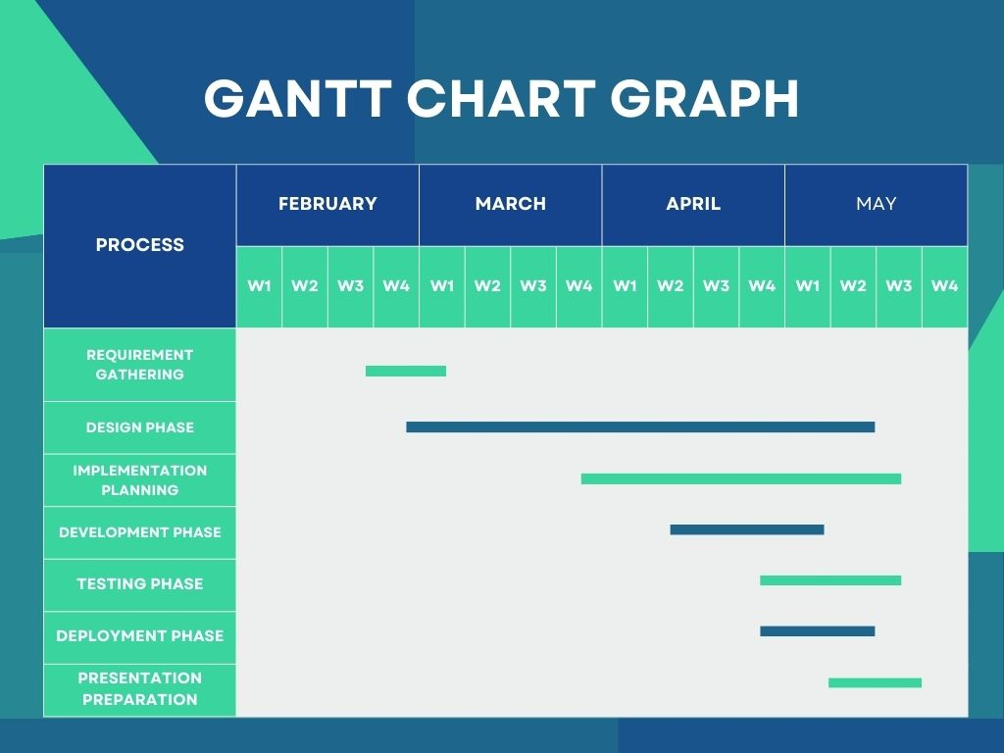

Slide 5
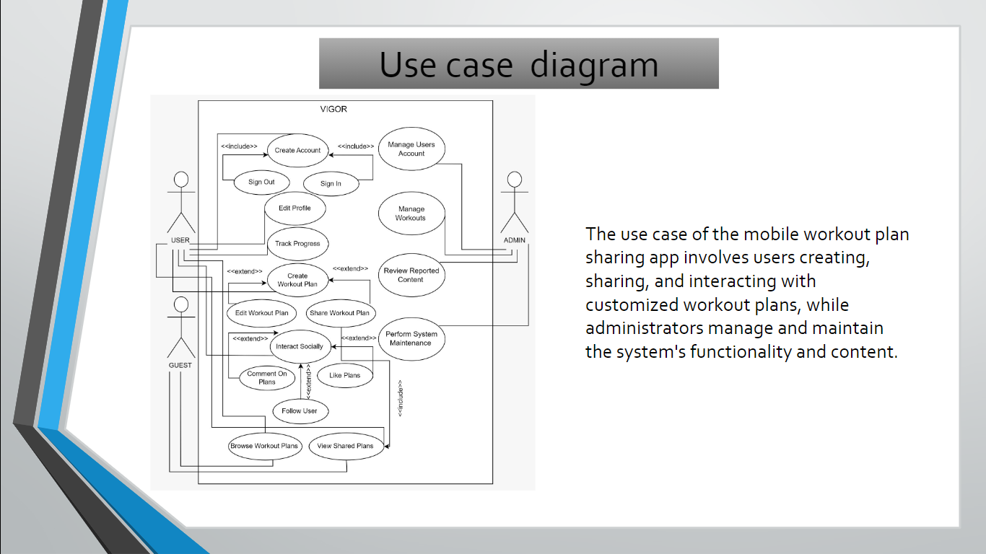
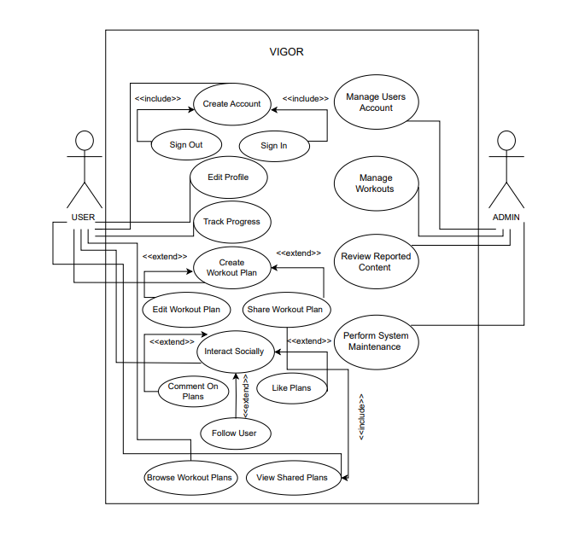

Slide 6
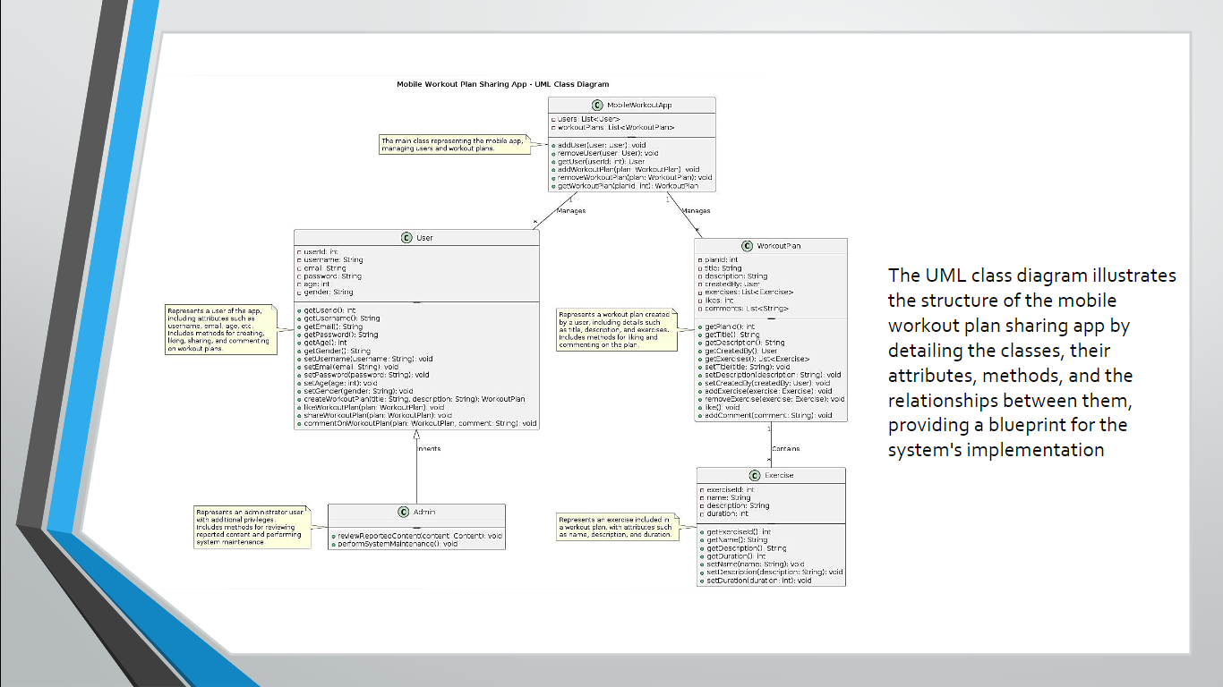
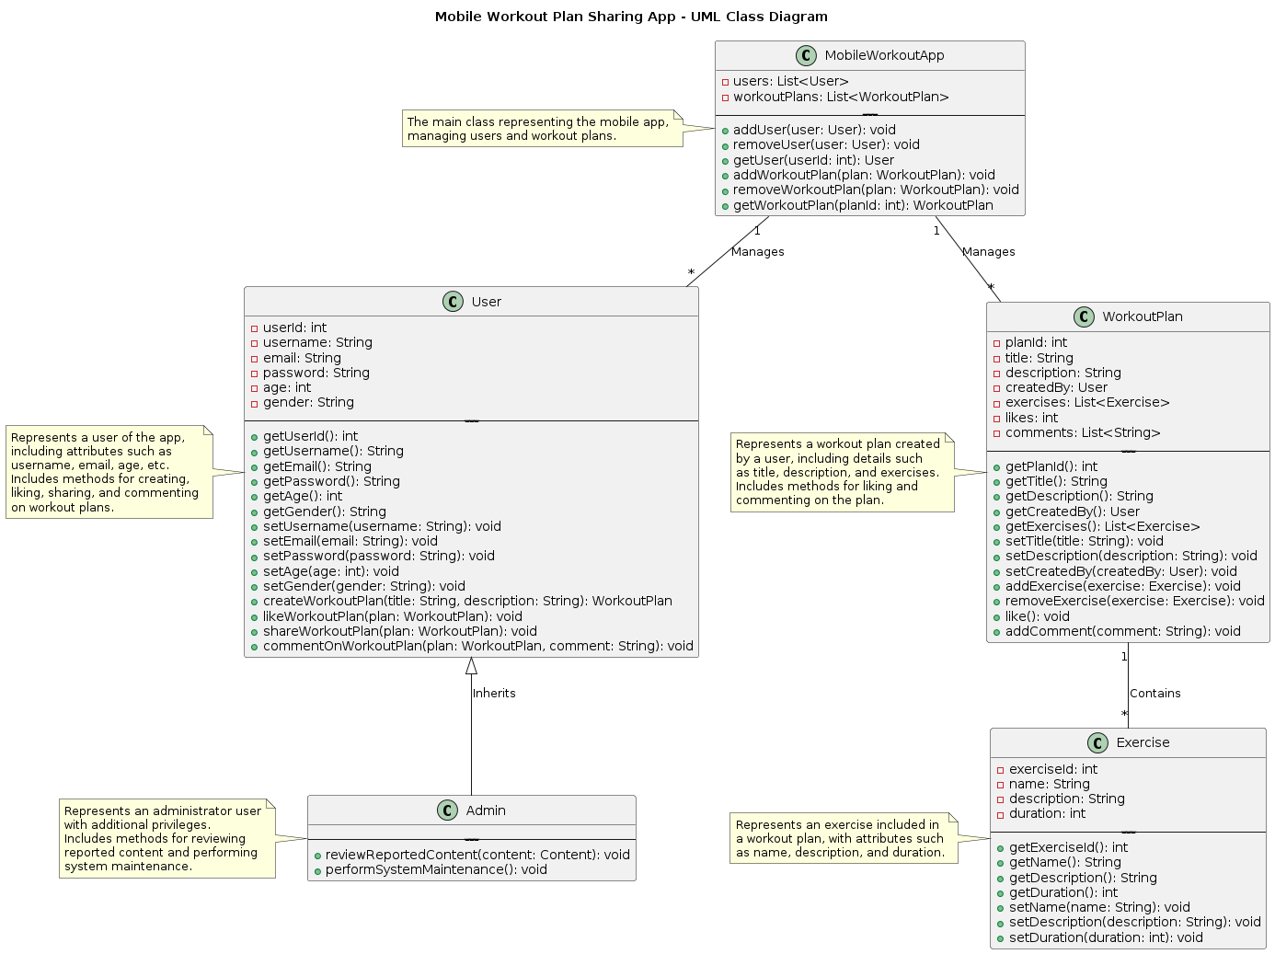
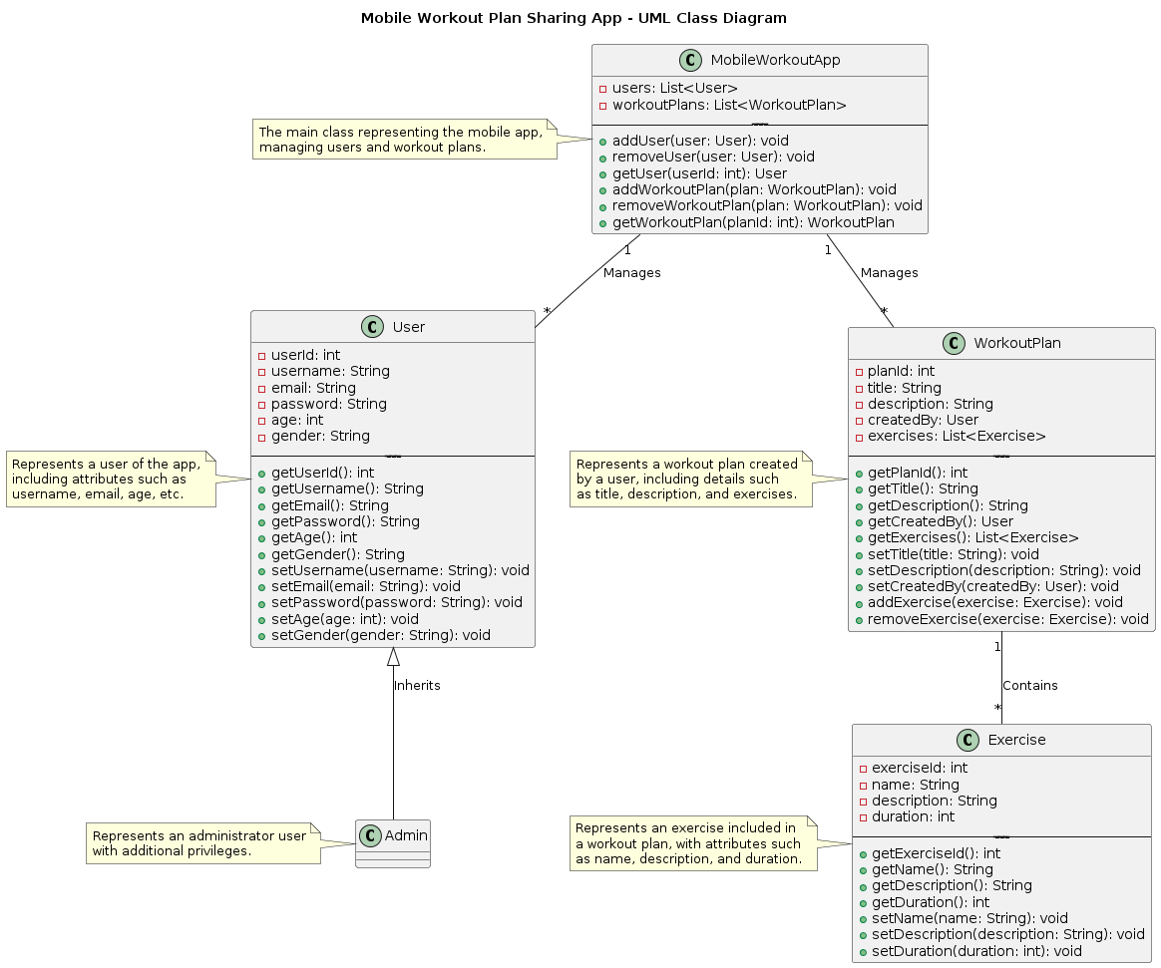

Slide 7
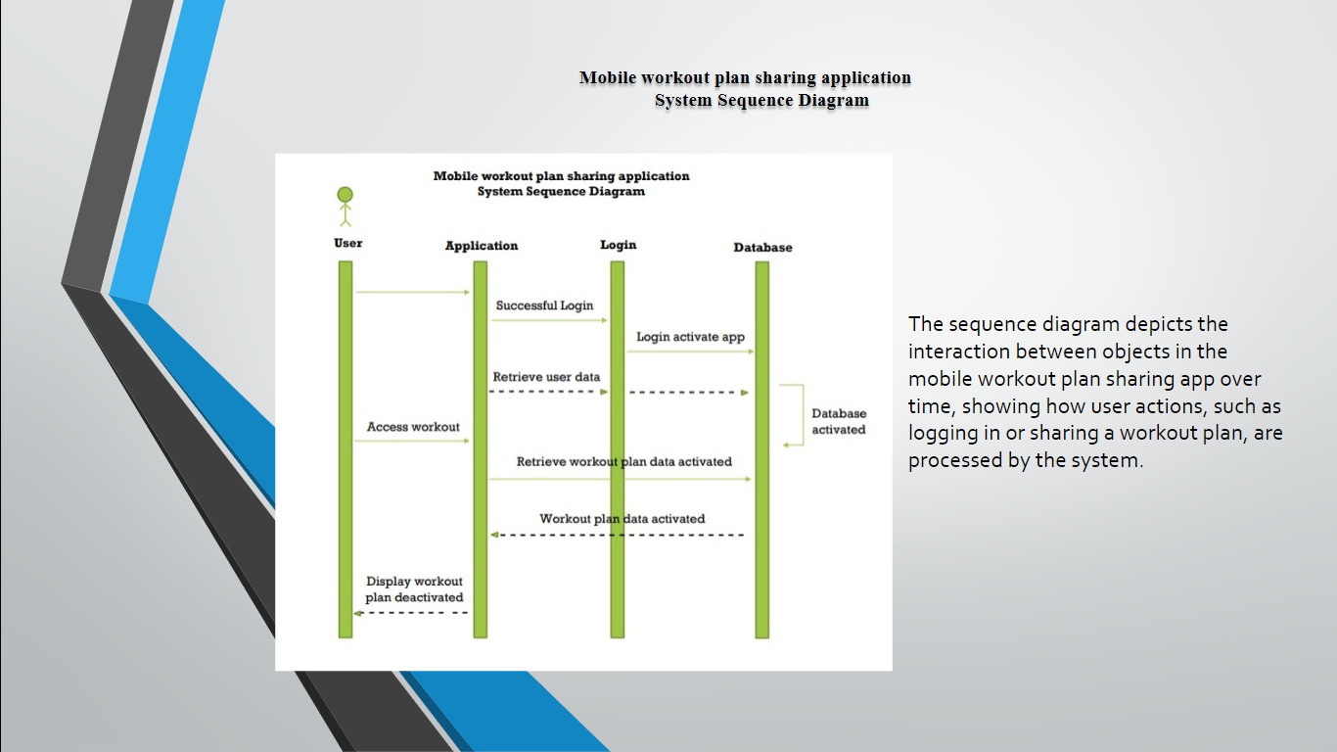

Slide 8
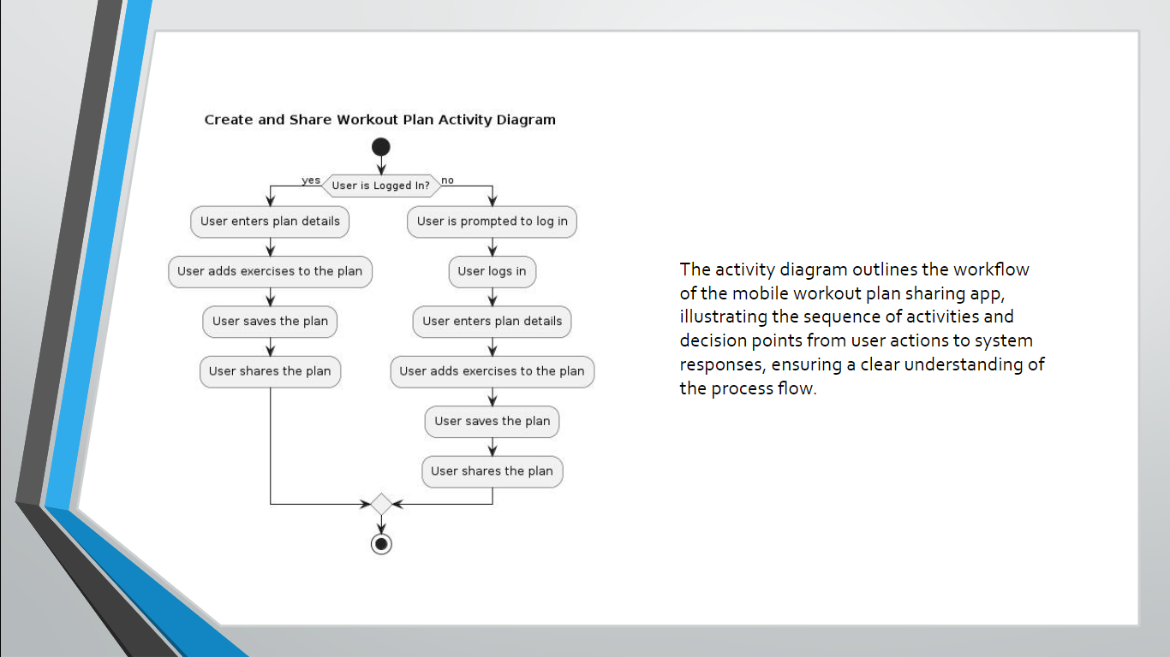

Slide 9

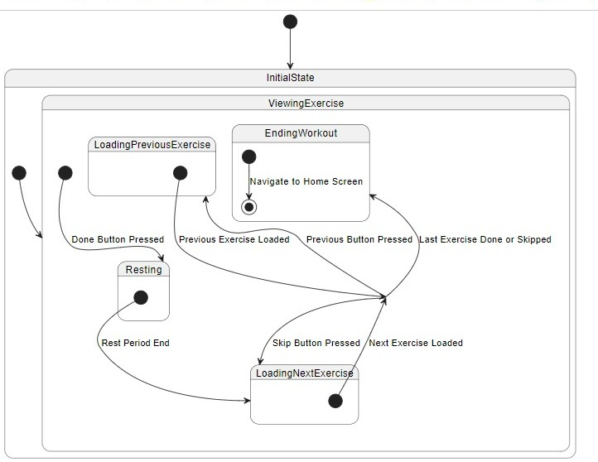
The state machine diagram
The state machine diagram models the dynamic behavior of a single object within the mobile workout plan sharing app, detailing the various states it can be in and the transitions triggered by user actions or events.

Slide 10
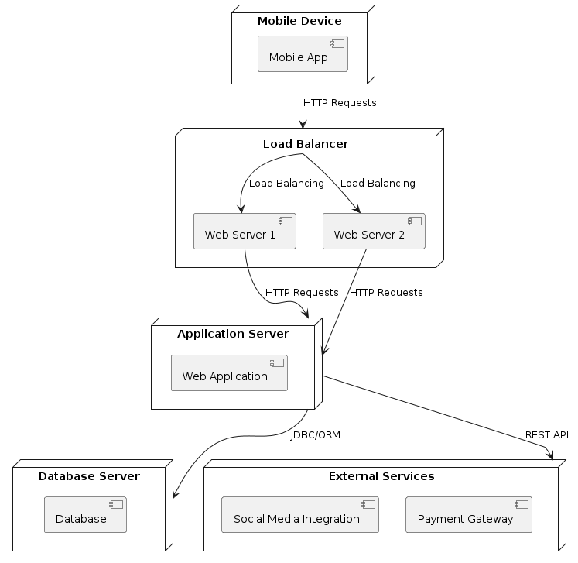
Deployment diagram
The "Mobile Device" node represents the devices running the mobile app.
The "Web Server" node represents the server hosting the web application.
The "Database Server" node represents the server hosting the database.
The "External Services" node represents external services or APIs integrated with the app, such as social media integration and payment gateway services.
Arrows represent communication between nodes, indicating the flow of data or requests.
The mobile app communicates with the web application hosted on the web server using HTTP requests.

Slide 11
Summary
Summary:
Project Overview: Developed a mobile workout plan sharing app that allows users to create, share, and engage with workout plans.
UML Diagrams: Used UML class, use case, sequence, state machine, and activity diagrams to visualize and design the app's structure, interactions, and behaviors.
Key Features:
User functionalities: Create, share, like, and comment on workout plans.
Admin functionalities: Review reported content and perform system maintenance.
Accessibility: Ensured the app is accessible to all users.

Slide 12


