Slide 1
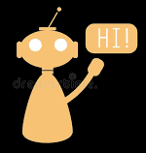
peach
Dressup To Impress-up
PREPARED BY:-
ASHMEET KAUR (21103311)
ANANYA MITTAL (21103305)
MANYA JAIN (21103313)
JUHI SHARMA (21103294)
VAISHNAVI AGRAWAL (21103320)
DEV PRATAP SINGH (21103209)

Slide 2
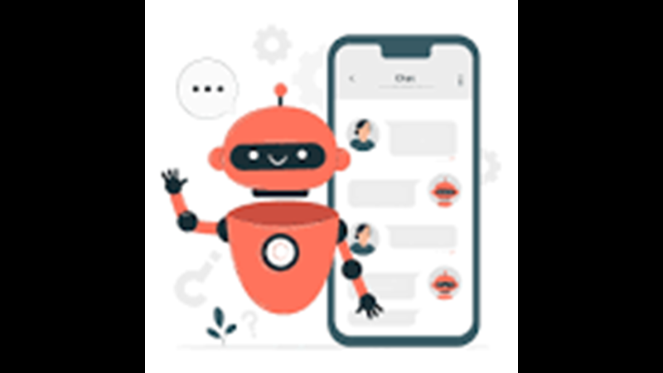
DEFINITION OF PROJECT
At the most basic level, a chatbot is a computer program that simulates and processes human conversation (either written or spoken), allowing humans to interact with digital devices as if they were communicating with a real person. They may answer basic questions, make product recommendations, and provide customer support. It is using nltk and flask. We have developed the project on python any where.

Slide 3
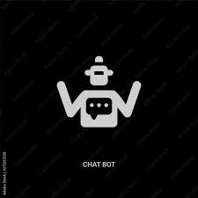
PROJECT DESCRIPTION
A chatbot is a piece of software that conducts conversation with users via auditory or textual methods. Fashion chatbots are also called intelligent assistants or AI stylists. They are computer programs that conduct and manage a dialogue through the exchange of text messages.
Through machine learning, these conversations can be seamless and natural enough that if the chatbot didn’t identify itself as a bot, you might never be the wiser.
It provide helpful information instantly, especially in times where every second is important. For example, if a customer wants to buy a clothes on basis of there skin tone, body structure this chatbot can play an important role. On basis of data a chatbot has it can give you suggestions according to your requirements.

Slide 4
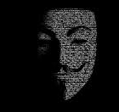
MOTIVATION
The motivation for creating this chatbot is to provide an easier and convenient alternative way of giving appropriate fashion choices on the basis of your skin tone, face shape, body shape, body structure etc. This chatbot is introduced to focus on giving service to all people to help them in making critical decisions about there clothing sense.
Nowadays AI is being used everywhere and that is where we got our motivation from.
AI refers to the capability of a machine to identify, leverage, and make use of language and related elements to emotionally engage individuals and activate behavior and that’s what we aim to do.

Slide 5
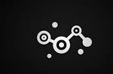
DEVELPOMENT ENVIRONMENT
Python Library Requirements :
Flask for web application.
Tensorflow for fast numerical computing.
Keras is a deep learning API.
Numpy for array handling.
Random for generating random
sequences.
Pickle for serializing and de-serializing.
Json for storage and data exchange.

Slide 6

DEVELOPMENT REQUIREMENTS
HARDWARE REQUIREMENTS:
For this project we need high configurations system because such tasks in this project requires more CPU computation and high graphic support to train dataset. We have used intel core i7 processor. The Intel Core i7 has more processing power and is better for high-performance gaming, content creation, multimedia editing, and specialized applications.
Once the dataset and network models are trained then we can run python code on normal machine also

Slide 7

references
Wikipedia (2019). Chatbot. Retrieved March 9, 2019 from: https://en.wikipedia.org/wiki/Chatbot
Wikipedia (2019). Siri. Retrieved March 9, 2019 from: https://en.wikipedia.org/wiki/Siri#Features_and_options

