Slide 1
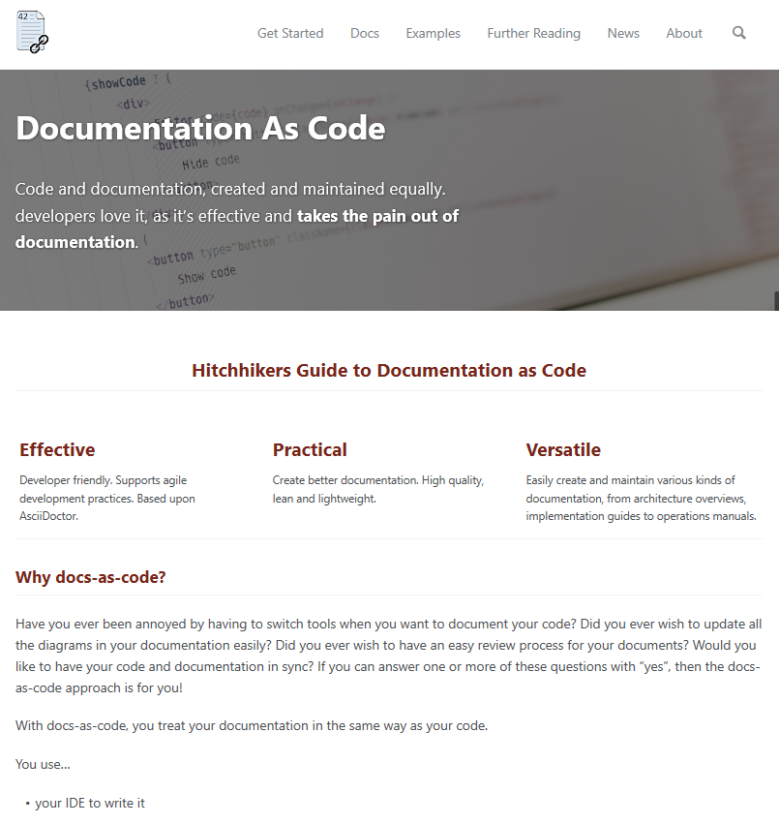
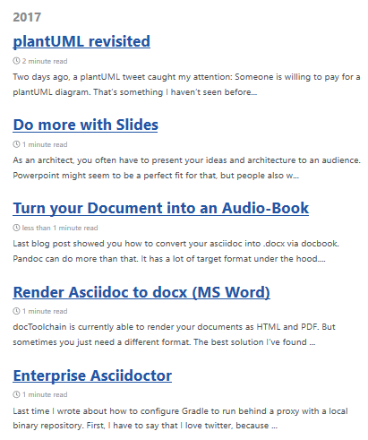

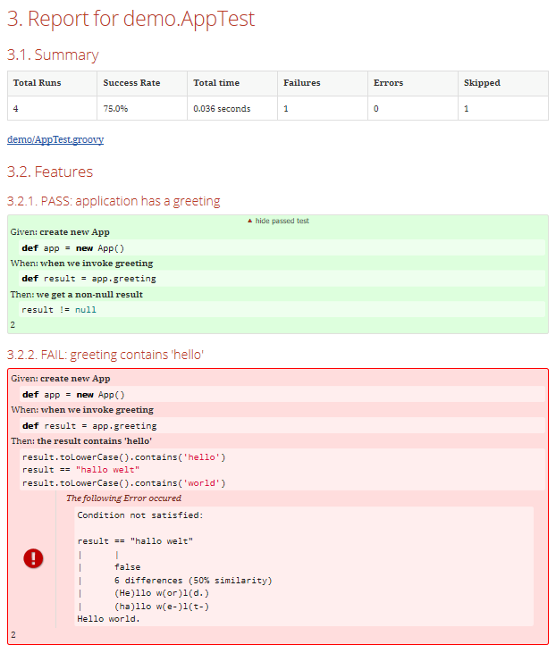
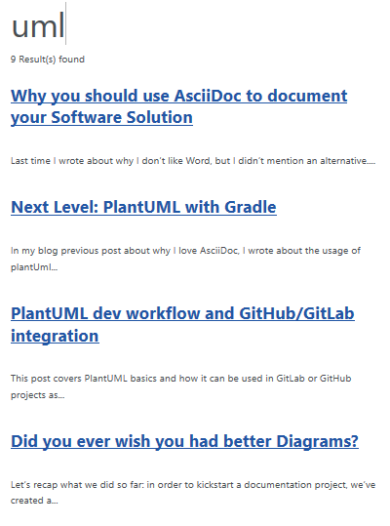

Landing-Page
Blog
arc42
Dokumentation
Test-Reports
Suche
User-Manual
Notes:
//tag::components[]
{slide}
//end::components[]

Slide 2




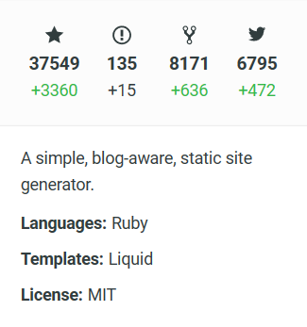
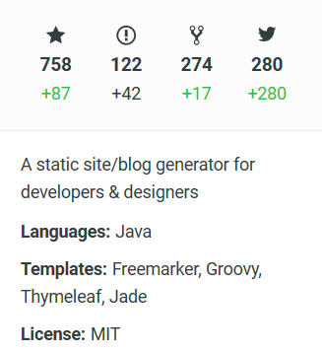
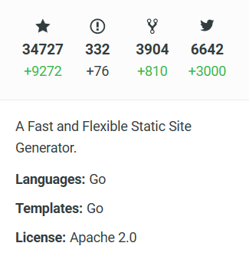
Quelle: www.staticgen.com
Notes:
//tag::overview[]
{slide}
//end::overview[]

