Slide 1
Detecting primate vocalizations in long field recordings
VGG19 transfer learning on mel-spectrograms
[Your name] · [Your affiliation] · [Date]
Notes:
(0:10) Hi, I'm [name]. Today I'm going to show you how we used deep learning to automatically detect primate vocalizations in multi-hour field recordings from Makokou, Gabon.

Slide 2
The problem
• Bioacoustic monitoring: leave microphones in the forest, non-invasive wildlife monitoring, runs 24 / 7 for weeks.
• The bottleneck is analysis — a week of continuous recording can produce hundreds of hours of audio, far more than a human can listen to.
• Goal: automatically find and classify vocalizations of three forest primates — Cercopithecus nictitans, Colobus guereza, and Pan troglodytes — in multi-hour Makokou recordings.
Notes:
(0:40) Bioacoustic monitoring — leaving microphones in the forest — is one of the most powerful tools we have for non-invasive wildlife monitoring. The problem is scale: a week of continuous recording produces hundreds of hours of audio, and a human analyst can listen to maybe one or two hours a day. Our goal is to automate the task: given a long field recording, find every time one of three forest primates — Cercopithecus nictitans, Colobus guereza, and Pan troglodytes — vocalizes, and classify which species it is.

Slide 3
Training data + augmentation
[ drop in: 06_counts_with_augmentation.png ] (raw vs ×7 augmented)
[ drop in: 07_augmentation_examples.png ] (one clip, every aug applied)
~870 species clips × 7-variant augmentation + ~1800 background clips = ~6 000 effective training samples
Short alarm calls (pyow ~0.1 s, hack ~0.07 s, kek ~0.04 s) are padded with real ambient noise at a random position, or 2–3 calls are concatenated with 1.5–3 s gaps.
Call-type durations: Mehon & Stephan (2021), R. Soc. Open Sci. 8(3).
Notes:
(1:10) Our training set is about 870 pre-extracted species clips and 1,800 background clips of forest ambient noise and non-target primates. A note on preprocessing: the alarm calls we target are very short — pyow around 0.1 second, hack around 0.07 second, kek around 0.04 second (Mehon & Stephan 2021). Rather than zero-pad them to the 5-second input length, we either place each call at a random position inside a 5-second window padded with real ambient noise (different noise each time, so the model doesn't learn a silence tell), or concatenate 2–3 calls of the same type with 1.5–3 second gaps, which also mirrors the natural alarm-call sequences described in the literature. On top of that, augmentation gives a ×7 multiplier: original, three background mixes at random SNR between −5 and +10 dB, time chop, frequency chop, frequency shift. That brings us to about 6,000 effective species training samples. The left panel shows raw vs augmented counts; the right panel shows what one clip looks like after each augmentation op — that's what the model actually trains on.

Slide 4
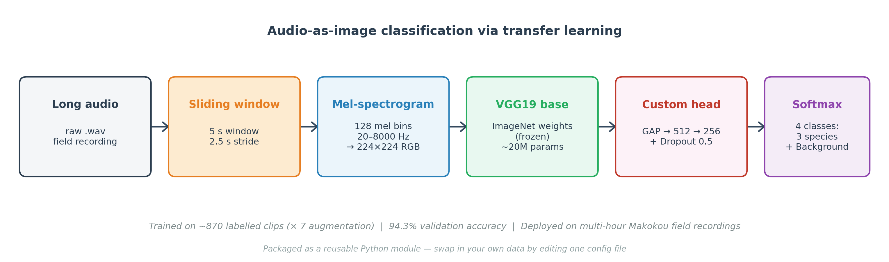
Audio-as-image classification via transfer learning
• 5 s sliding window → 128-bin mel-spectrogram → 224×224 RGB
• VGG19 ImageNet backbone (frozen) + custom classifier head
• Custom head: GAP → Dense 512 → Dense 256 → 4-way softmax
Notes:
(0:50) The core idea is simple: treat audio classification as image classification. We take a 5-second sliding window, convert it to a mel-spectrogram, resize to 224x224, and feed it to a VGG19 network pre-trained on ImageNet. The low-level features VGG19 learned on natural images — edges, textures — are exactly what distinguishes spectrograms of different calls. We freeze the backbone and train only a small custom head: global average pooling, 512-unit dense, 256-unit dense, 4-way softmax.

Slide 5
94.3% validation accuracy
[ drop in: 02_confusion_matrix.png ]
Per-class F1 > 0.9 for all three species; hardest class is background ↔ Cercopithecus (distant calls).
Notes:
(1:00) On a held-out validation set the model reaches 94.3% accuracy across the four classes. The confusion matrix tells a more nuanced story — look at the diagonal: Cercopithecus and Colobus recall is above 90%. The hardest class is the background class, where some samples get mis-labelled as Cercopithecus — which makes sense because many background clips contain distantly calling monkeys.

Slide 6
Deployed on 13 real recordings from Makokou
[ drop in: 05_detections_by_hour.png ]
• 13 recordings, June 9 2022, morning → night
• Default threshold 0.7 → 18 detections (over-strict)
• Threshold sweep → 0.4 = knee of curve
• Final: 44 detections, balanced across species
• Diurnal activity patterns recovered from filename timestamps
(Play one of the extracted clips from outputs/detected_clips/ if the room has audio.)
Notes:
(1:10) Validation accuracy on clean clips is not what matters — what matters is whether it works on real multi-hour field audio. We ran the model on 13 recordings from Makokou on June 9 2022, morning to night. Practical surprise: the default confidence threshold of 0.7 was way too strict. A threshold sweep showed the confidence distribution is bimodal — the model is either very sure or it assigns the window to background — so we settled on 0.4, below which the detection count saturates. That gave us 44 detections across the 13 files. Parsing the timestamp out of each filename lets us plot detections by hour of day, which recovers meaningful diurnal activity patterns. (Play a detected clip if the room has audio.)

Slide 7
Takeaways
• VGG19 transfer learning works for primate vocal classification — 94.3% validation accuracy.
• Deployed end-to-end on real 2022 Makokou recordings, recovers meaningful diurnal vocal activity patterns.
• Released as a reusable Python package — any researcher with their own primate recordings can run it by editing one config file.
Open challenge: Pan troglodytes recall. Next steps: more field data · per-call-type classification · temporal context.
Thank you — questions welcome.
Notes:
(0:20) Three takeaways: VGG19 transfer learning works well for primate vocal classification (94% on clean clips); deployed end-to-end on real 2022 field recordings it recovers meaningful diurnal activity patterns; and the whole pipeline is released as a reusable Python package — any researcher with their own primate recordings can run it by editing one config file. Main open challenge: Pan troglodytes recall. Next steps: more field data, per-call-type classification, temporal context. Thank you — happy to take questions.

Slide 8
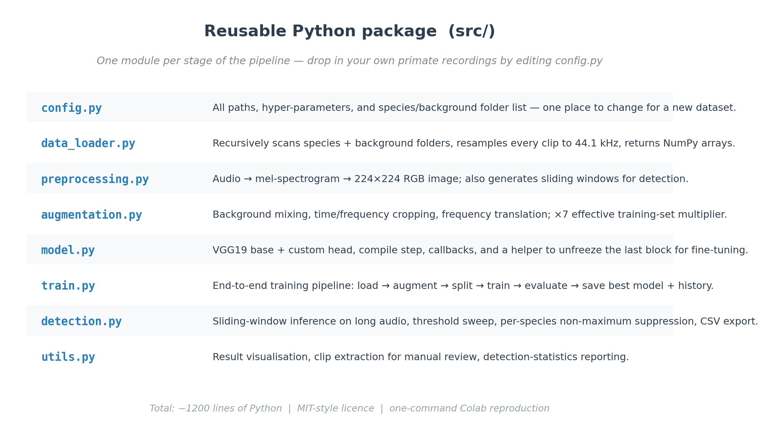
Backup — package structure
Hidden from normal flow. Pull up only if a question asks about code / reproducibility.
Notes:
(backup, only if asked) The whole pipeline lives in src/ as 8 Python modules — one per pipeline stage. config.py is the entry point: all paths, hyper-parameters, and the list of species folders live there. To run this on a new dataset the only file you edit is config.py — everything else is dataset-agnostic. Don't read the table row by row; let the audience read it.

