Slide 1
Data Preprocessing
Presented by Ahmed Attia and Mokhtar Mami

Slide 2
Plan
01
Introduction
02
Dealing with missing values
03
Encoding categorical features
04
Scaling numerical features
05
Train test split

Slide 3
Introduction

Slide 4
What is data preprocessing
At the heart of Machine Learning is to process data.
Your machine learning tools are as good as the quality of your data

Slide 5

Course method
In this course, we will be working on the Titanic: Machine Learning from Disaster competition in kaggle in order to make examples of data preprocessing more concrete

Slide 6
Dataset Description
Variable | Definition | Key
survival | Survival | 0 = No, 1 = Yes
pclass | Ticket class | 1 = 1st, 2 = 2nd, 3 = 3rd
sex | Sex
Age | Age in years
sibsp | # of siblings / spouses aboard the Titanic
parch | # of parents / children aboard the Titanic
ticket | Ticket number
fare | Passenger fare
cabin | Cabin number
embarked | Port of Embarkation | C = Cherbourg, Q = Queenstown, S = Southampton
Add Skills – 70%
Add Skills – 80%
Add Skills – 60%
Name Here
Add Skills – 90%

Slide 7
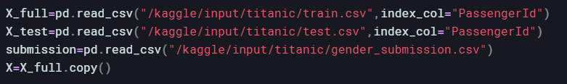
Variable definition
X_full : The training set backup.
X_test : The testing set (we are going to work only with the training set).
Submission : An exemple of the a submission.
X : The training set with the changes we make.
num_feat : array with numerical features column’s name
cat_feat : array with categorical features column’s name
num_nan : array with numerical features with missing values
cat_nan : array with categorical features with missing values

Slide 8
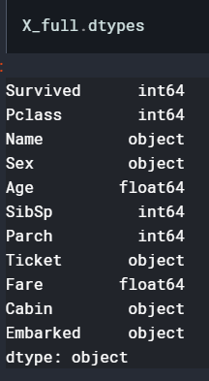
Features type
Numerical | Categorical
Survived | Name
Pclass | Sex
Age | Ticket
SibSp | Cabin
Parch | Embarked
Fare

Slide 9
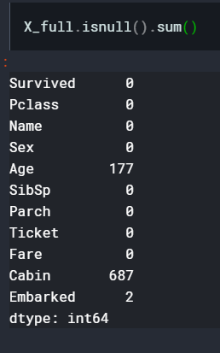
Features with missing values
Numerical features with missing values | Categorical features with missing values
Age | Cabin
 | Embarked

Slide 10
Dealing with missing values

Slide 11
Missing values in Data ?
SLIDE
The concept of missing values is important to understand in order to successfully manage data. If the missing values are not handled properly by the researcher, then he/she may end up drawing an inaccurate inference about the data. Due to improper handling, the result obtained by the researcher will differ from ones where the missing values are present.0
We Create Quality Professional
PPT Presentation

Slide 12
Why data is missing ?
SLIDE
Missing at Random (MAR): Missing at random means that the propensity for a data point to be missing is not related to the missing data, but it is related to some of the observed data
Missing Completely at Random (MCAR): The fact that a certain value is missing has nothing to do with its hypothetical value and with the values of other variables.
Missing not at Random (MNAR): The missing value depends on the hypothetical value (e.g. People with high salaries generally do not want to reveal their incomes in surveys)
We Create Quality Professional
PPT Presentation

Slide 13
Methods to deal with missing values
SLIDE
BUY
SLL
Dropping the missing data
Imputing the data

Slide 14
Dropping the data
SLIDE

Slide 15
Methods to drop the data
SLIDE
BUY
SLL
Dropping rows (numerical and categorical)
Dropping features (numerical and categorical)

Slide 16
Dropping rows
Small number of observation
Data rarely missing randomly
For a small number of observation, dropping rows is usually beneficial
Assumptions of MCAR (Missing Completely at Random) are typically rare to support.
Biased parameters
Dropping rows produce biased parameters and estimates.
Dropping rows removes all data for an observation that has one or more missing values.
Pros
Cons

Slide 17
Dropping features
Certain cases
Data rarely missing randomly
If the number of missing values in a feature is high (above 75%) and feature seems irrelevant, it might be beneficial
Assumptions of MCAR (Missing Completely at Random) are typically rare to support.
Biased parameters
Dropping columns produce biased parameters and estimates.
Dropping features removes a feature that has one or more missing values.
Pros
Cons

Slide 18
Dropping the missing data
Dropping rows
Dropping features

Slide 19
Imputing the data
SLIDE

Slide 20
Methods to impute the missing values
SLIDE
Fill with mean , median (numerical)
BUY
SLL
Fill with Mice (numerical)
Fill with 0 , -9999 (numerical)
Fill with mode (numerical and categorical)

Slide 21
Dealing with missing numerical values

Slide 22
Filling with -9999,0
Certain cases
Biased
If the number of missing values in a feature is high (above 60%) and feature seems irrelevant, it might be beneficial
Sometimes missing values represent 0
Filling with such number is biased and can change results
Replace missing values with a constant
Pros
Cons

Slide 23
Filling with median
Small datasets
Distribution shape
Works well with small numerical datasets
it completely disregards how the data is distributed
Dealing with outliers
It is insensitive to extreme values.
Filling missing values with median/mean
Pros
Cons

Slide 24
Filling with mean
Small datasets
Dealing with outliers
Works well with small numerical datasets
the mean is greatly affected by outliers in our data
Every element matters
It makes use of every element in the dataset
Filling missing values with median/mean
Pros
Cons

Slide 25
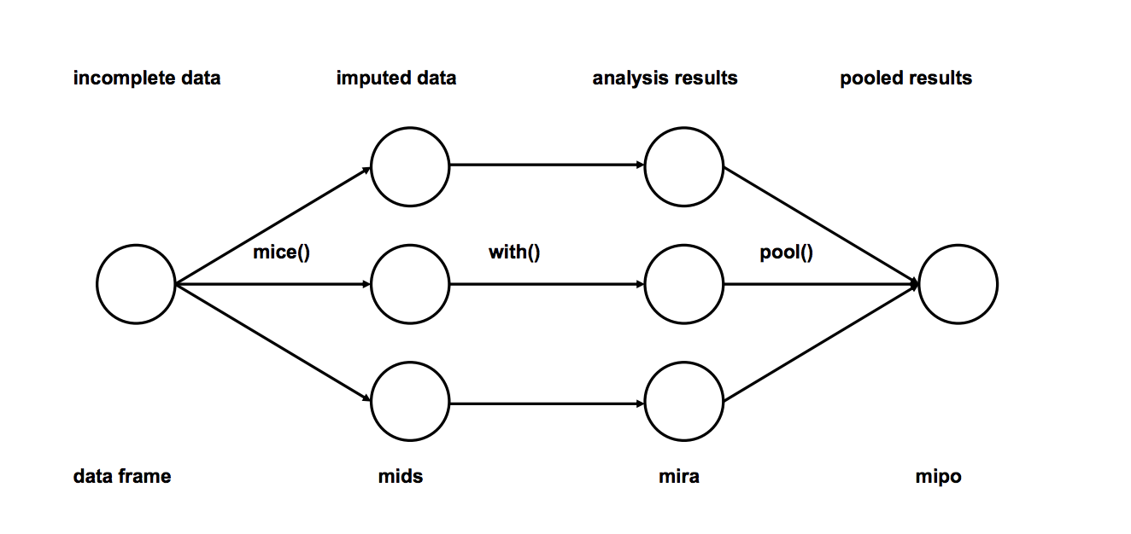
What is MICE ?

Slide 26
MICE phases
Imputation: Impute the missing entries of the incomplete data sets m times (m=3 in the figure). Note that imputed values are drawn from a distribution. Simulating random draws doesn’t include uncertainty in model parameters. Better approach is to use Markov Chain Monte Carlo (MCMC) simulation. This step results in m complete data sets.
Analysis: Analyze each of the m completed data sets.
Pooling: Integrate the m analysis results into a final result

Slide 27
Filling with MICE
Harder task
Accounts for uncertainty
MICE takes in consideration many imputations which eliminates uncertainty
Have to think about imputation model in addition to analysis model.
Easy to use
MICE is an easy method to use (already implemented)
Creating multiple imputations, as opposed to single imputations to “complete” datasets that accounts for the statistical uncertainty in the imputations.
Pros
Cons

Slide 28
Dealing with missing numerical and categorical values

Slide 29
Fill with mode
Irrelevance
mode is relative
The data set may have more than one modes or no mode at all
Filling with mode doesn’t change the result too much. It keeps data intact.
Biased
Filling with such number is biased and can change
Filling with mode replace all missing values with the most frequent value
Pros
Cons

Slide 30
Imputing the data
numerical values
numerical and categorical values
Filling with -9999,0
Filling with median
Filling with mean
Filling with MICE
Fill with mode

Slide 31
Dealing with missing values
Imputing the data
Dropping the missing data
Dropping rows
Dropping features
numerical values
numerical and categorical values
Filling with -9999,0
Filling with median
Filling with mean
Filling with median
Fill with mode

Slide 32
General vs specific
methods ?

Slide 33
Encoding categorical features

Slide 34
Encoding categorical features ?
SLIDE
It is very common to see categorical features in a dataset. However, our machine learning algorithm can only read numerical values. It is essential to encoding categorical features into numerical values.
We Create Quality Professional
PPT Presentation

Slide 35
Methods to encode categorical features
SLIDE
One hot encoder
Label encoder
BUY
SLL
Target encoder

Slide 36
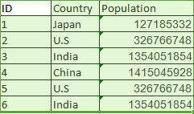
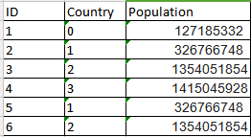
Label Encoder

Slide 37
Label Encoder
The order
The order
If there is an order between values label encoder will preserve it
the model will misunderstand the data to be in some kind of order if there isn’t one.
Encode labels with value between 0 and n_classes-1.
Pros
Cons

Slide 38
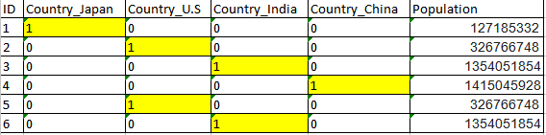
One Hot Encoder

Slide 39
One Hot Encoder
Doesn’t assume order
High cardinality
This approach works well with non ordinal features (Example color,…)
Columns with many unique values will create huge datasets
Encode categorical integer features as a one-hot numeric array.One hot encoder creates new columns indicating the presence (or absence) of each possible value in the original data
Pros
Cons

Slide 40
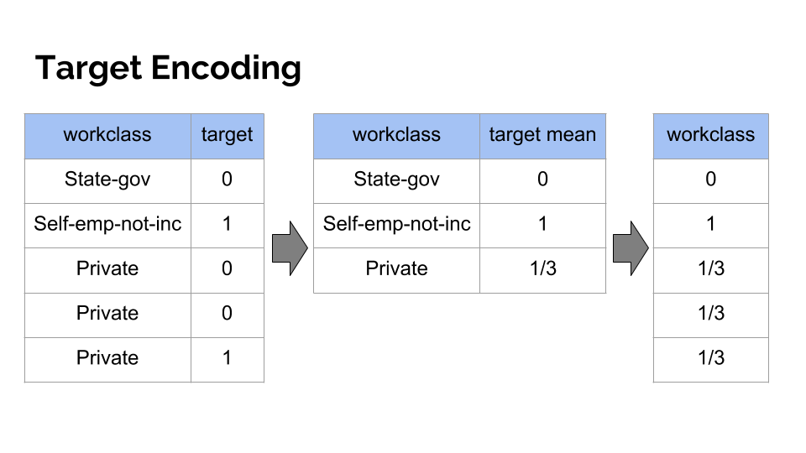
Target Encoder

Slide 41
Target Encoder
Great help for the model
Overfit
Target encoding is good because it picks up values that can explain the target
Due to the usage of the average value,values are bad when the number of values used in average is low
Target Encoded features are replaced with a blend of posterior probability of the target given particular categorical value and the prior probability of the target over all the training data.
Pros
Cons

Slide 42
Encoding categorical features
Target Encoder
One Hot Encoder
Label Encoder

Slide 43
Scaling numerical features

Slide 44
Scaling numerical features ?
SLIDE
Feature scaling is a method used to normalize the range of variables or features of data. In data processing, it is also known as data normalization.
We Create Quality Professional
PPT Presentation

Slide 45
Methods to Scaling numerical features
Standard Scaler
BUY
SLL
Min Max Scaler

Slide 46
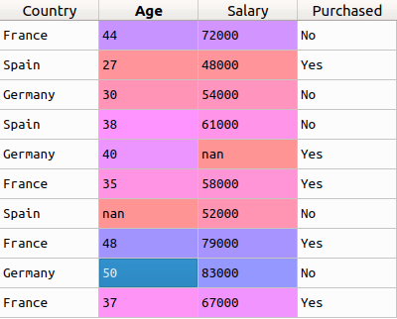
Why Scaling ?

Slide 47
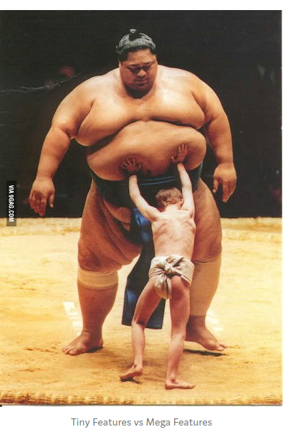

Slide 48
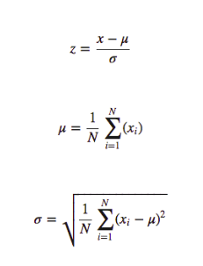
Standard Scaler

Slide 49
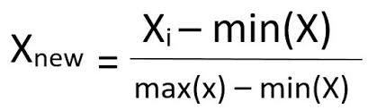
Min Max Scaler

Slide 50
Scaling numerical features
Standard Scaler
Min Max Scaler

Slide 51
Train Test Split

Slide 52
Train Test Split ?
SLIDE
The data we use is usually split into training data and test data. The training set contains a known output and the model learns on this data in order to be generalized to other data later on. We have the test dataset (or subset) in order to test our model’s prediction on this subset.
We Create Quality Professional
PPT Presentation

Slide 53
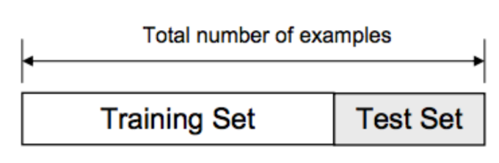

Slide 54
Splitting Strategies
Randomly
BUY
SLL
Based on time

Slide 55
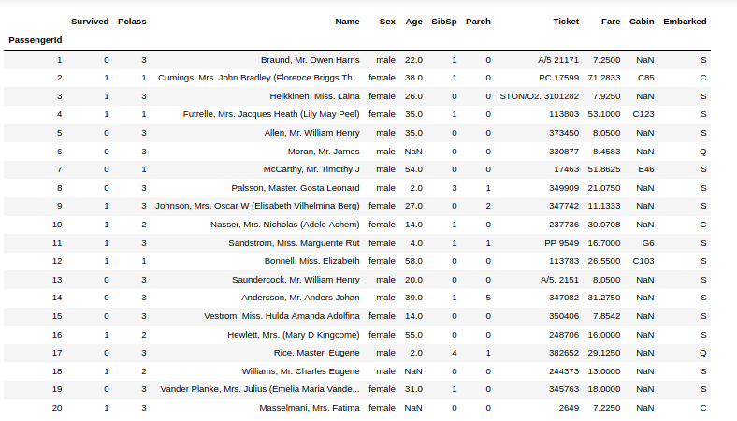
Random splitting
Train
Test

Slide 56
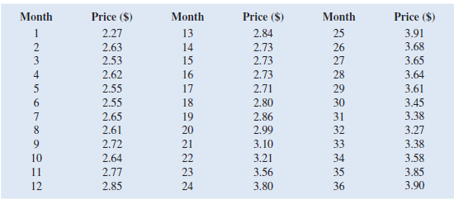
Based on time
Train
Test

Slide 57
Train/Test split
Based on time
Random splitting

Slide 58
Data Preprocessing
numerical
categorical
numerical & categorical
Scaling features
Encoding features
Train/Test split
Dealing with missing values
Based on time
Random splitting
Imputing the data
Dropping the missing data
Standard Scaler
Min Max Scaler
Target Encoder
One Hot Encoder
Label Encoder
numerical
numerical & categorical
Dropping rows
Dropping features
Filling with -9999,0
Filling with median
Filling with mean
Filling with mice
Fill with mode

