Slide 1
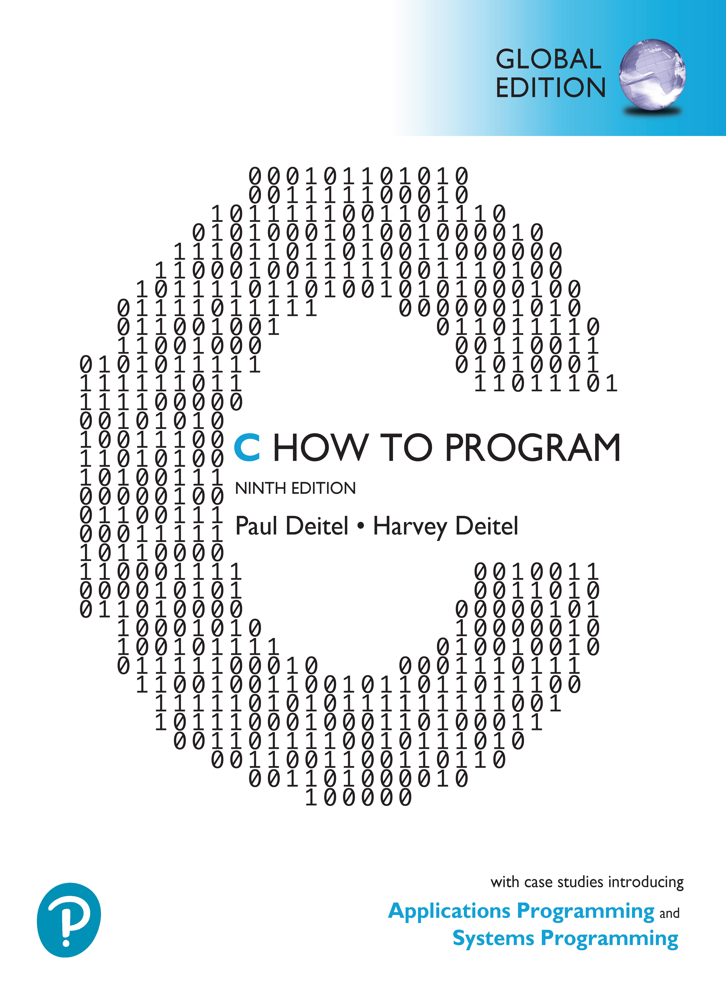

C How to Program
Ninth Edition, Global Edition
Chapter 2
Intro to C Programming
Copyright © 2023 Pearson Education Ltd. All Rights Reserved.
Notes:
If this PowerPoint presentation contains mathematical equations, you may need to check that your computer has the following installed:
1) MathType Plugin
2) Math Player (free versions available)
3) NVDA Reader (free versions available)

Slide 2
Objectives
Write simple C programs.
Use simple input and output statements.
Use the fundamental data types.
Learn computer memory concepts.
Use arithmetic operators.
Learn the precedence of arithmetic operators.
Write simple decision-making statements.
Begin focusing on secure C programming practices.

Slide 3
Outline
2.1 Introduction
2.2 A Simple C Program: Printing a Line of Text
2.3 Another Simple C Program: Adding Two Integers
2.4 Memory Concepts
2.5 Arithmetic in C
2.6 Decision Making: Equality and Relational Operators
2.7 Secure C Programming

Slide 4
2.1 Introduction
Introduce C programming
Presents several examples illustrating fundamental C features

Slide 5
2.2 A Simple C Program: Printing a Line of Text (1 of 15)
// fig02_01.c
// A first program in C.
#include <stdio.h>
// function main begins program execution
int main(void) {
printf("Welcome to C!\n");
} // end function main
OUTPUT:
Welcome to C!

Slide 6
2.2 A Simple C Program: Printing a Line of Text (2 of 15)
Comments
Begin with //
Insert comments to document programs and improve program readability
Comments do not cause the computer to perform actions
Help other people read and understand your program
Can also use /*…*/ multi-line comments
Everything between /* and */ is a comment

Slide 7
2.2 A Simple C Program: Printing a Line of Text (3 of 15)
#include Preprocessor Directive
#include <stdio.h>
C preprocessor directive
Preprocessor handles lines beginning with # before compilation
This directive includes the contents of the standard input/output header (<stdio.h>)
Contains information the compiler uses to ensure that you correctly use standard input/output library functions such as printf

Slide 8
2.2 A Simple C Program: Printing a Line of Text (4 of 15)
Blank Lines and White Space
Blank lines, space characters and tab characters make programs easier to read
Together, these are known as white space
Generally ignored by the compiler

Slide 9
2.2 A Simple C Program: Printing a Line of Text (5 of 15)
The main Function
Begins execution of every C program
Parentheses after main indicate that main is a function
C programs consist of functions, one of which must be main
Precede every function by a comment stating its purpose
Functions can return information
The keyword int to the left of main indicates that main “returns” an integer (whole number) value – for now simply mimic this

Slide 10
2.2 A Simple C Program: Printing a Line of Text (6 of 15)
The main Function
Functions can receive information
void in parentheses means main does not receive any information
A left brace, {, begins each function’s body
A corresponding right brace, }, ends each function’s body
A program terminates upon reaching main’s closing right brace
The braces form a block

Slide 11
2.2 A Simple C Program: Printing a Line of Text (7 of 15)
An Output Statement
printf("Welcome to C!\n");
“f” in printf stands for “formatted”
Performs an action—displays the string in the quotes
A string is also called a character string, a message or a literal
The entire line is called a statement
Every statement ends with a semicolon statement terminator
Characters usually print as they appear between
Notice the characters \n were not displayed.

Slide 12
2.2 A Simple C Program: Printing a Line of Text (8 of 15)
Escape Sequences
In a string, backslash (\) is an escape character
Compiler combines a backslash with the next character to form an escape sequence
\n means newline
When printf encounters a newline in a string, it positions the output cursor to the beginning of the next line

Slide 13
2.2 A Simple C Program: Printing a Line of Text (9 of 15)
Escape Sequence | Description
\n | Moves the cursor to the beginning of the next line.
\t | Moves the cursor to the next horizontal tab stop.
\a | Produces a sound or visible alert without changing the current cursor position.
\\ | Because the backslash has special meaning in a string, \\ is required to insert a backslash character in a string.
\” | Because strings are enclosed in double quotes, \” is required to insert a double-quote character in a string.

Slide 14
2.2 A Simple C Program: Printing a Line of Text (10 of 15)
The Linker and Executables
When compiling a printf statement, the compiler merely provides space in the object program for a “call” to the function
The compiler does not know where the library functions are—the linker does
When the linker runs, it locates the library functions and inserts the proper calls to these functions in the object program
Now the object program is complete and ready to execute
The linked program is called an executable

Slide 15
2.2 A Simple C Program: Printing a Line of Text (11 of 15)
Indentation Conventions
Indent the entire body of each function one level of indentation within the braces that define the function’s body
Emphasizes a program’s functional structure and helps make them easier to read
Set an indentation convention and uniformly apply that convention
Style guides often recommend using spaces rather than tabs

Slide 16
2.2 A Simple C Program: Printing a Line of Text (12 of 15)
Using Multiple printfs
Fig. 2.2 uses two statements to produce the same output as Fig. 2.1
Works because each printf resumes printing where the previous one finished
Line 7 displays Welcome followed by a space (but no newline)
Line 8’s printf begins printing immediately following the space

Slide 17
2.2 A Simple C Program: Printing a Line of Text (13 of 15)
// fig02_02.c
// Printing on one line with two printf statements.
#include <stdio.h>
// function main begins program execution
int main(void) {
printf("Welcome ");
printf("to C!\n");
} // end function main
OUTPUT:
Welcome to C!

Slide 18
2.2 A Simple C Program: Printing a Line of Text (14 of 15)
Displaying Multiple Lines with a Single printf
One printf can display several lines
Each \n moves the output cursor to the beginning of the next line

Slide 19
2.2 A Simple C Program: Printing a Line of Text (15 of 15)
// fig02_03.c
// Printing multiple lines with a single printf.
#include <stdio.h>
// function main begins program execution
int main(void) {
printf("Welcome\nto\nC!\n");
} // end function main
OUTPUT:
Welcome to C!

Slide 20
2.3 Another Simple C Program: Adding Two Integers (1 of 16)
scanf standard library function obtains information from the user at the keyboard
Next program obtains two integers, then computes their sum and displays the result

Slide 21
2.3 Another Simple C Program: Adding Two Integers (2 of 16)
// fig02_04.c
// Addition program.
#include <stdio.h>
// function main begins program execution
int main(void) {
int integer1 = 0; // will hold first number user enters
int integer2 = 0; // will hold second number user enters
printf("Enter first integer: "); // prompt
scanf("%d", &integer1); // read an integer

Slide 22
2.3 Another Simple C Program: Adding Two Integers (3 of 16)
printf("Enter second integer: "); // prompt
scanf("%d", &integer2); // read an integer
int sum = 0; // variable in which sum will be stored
sum = integer1 + integer2; // assign total to sum
printf("Sum is %d\n", sum); // print sum
} // end function main

Slide 23
2.3 Another Simple C Program: Adding Two Integers (4 of 16)
OUTPUT:
Enter first integer: 45 Enter second integer: 72 Sum is 117

Slide 24
2.3 Another Simple C Program: Adding Two Integers (5 of 16)
Variables and Variable Definitions
Lines 7 and 8 are definitions.
The names integer1 and integer2 are variables—locations in memory where the program can store values for later use
integer1 and integer2 have type int—they’ll hold whole-number integer values
Lines 7 and 8 initialize each variable to 0

Slide 25
2.3 Another Simple C Program: Adding Two Integers (6 of 16)
Define Variables Before They Are Used
All variables must be defined with a name and a type before they can be used in a program
You can place each variable definition anywhere in main before that variable’s first use in the code
In general, you should define variables close to their first use

Slide 26
2.3 Another Simple C Program: Adding Two Integers (7 of 16)
Identifiers and Case Sensitivity
A variable name can be any valid identifier
Each identifier may consist of letters, digits and underscores (_), but may not begin with a digit
C is case sensitive, so a1 and A1 are different identifiers
A variable name should start with a lowercase letter
Choosing meaningful variable names helps make a program self-documenting
Multiple-word variable names can make programs more readable
separate the words with underscores, as in total_commissions, or
run the words together and begin each subsequent word with a capital letter as in totalCommissions.

Slide 27
2.3 Another Simple C Program: Adding Two Integers (8 of 16)
Prompting Messages
Line 10 displays "Enter first integer: "
This message is called a prompt
tells user to take a specific action

Slide 28
2.3 Another Simple C Program: Adding Two Integers (9 of 16)
The scanf Function and Formatted Inputs
Line 11 uses scanf to obtain a value from the user
Reads from the standard input, usually the keyboard
The "%d" is the format control string — indicates the type of data the user should enter (an integer)
Second argument begins with an ampersand (&) followed by the variable name
Tells scanf the location (or address) in memory of the variable
scanf stores the value the user enters at that memory location

Slide 29
2.3 Another Simple C Program: Adding Two Integers (10 of 16)
Prompting for and Inputting the Second Integer
Line 13 prompts the user to enter the second integer
Line 14 obtains a value for variable integer2 from the user.

Slide 30
2.3 Another Simple C Program: Adding Two Integers (11 of 16)
Defining the sum Variable
Line 16 defines the int variable sum and initializes it to 0 before we use sum in line 17.

Slide 31
2.3 Another Simple C Program: Adding Two Integers (12 of 16)
Assignment Statement
The assignment statement in line 17 calculates the total of integer1 and integer2, then assigns the result to variable sum using the assignment operator (=)
Read as, “sum gets the value of the expression integer1 + integer2.”
Most calculations are performed in assignments

Slide 32
2.3 Another Simple C Program: Adding Two Integers (13 of 16)
Binary Operators
The = operator and the + operator are binary operators—each has two operands
Place spaces on either side of a binary operator to make the operator stand out and make the program more readable

Slide 33
2.3 Another Simple C Program: Adding Two Integers (14 of 16)
Printing with a Format Control String
The format control string "Sum is %d\n" in line 19 contains some literal characters to display ("Sum is ") and the conversion specification %d, which is a placeholder for an integer
The sum is the value to insert in place of %d

Slide 34
2.3 Another Simple C Program: Adding Two Integers (15 of 16)
Combining a Variable Definition and Assignment Statement
You can initialize a variable in its definition
For example, lines 16 and 17 can add the variables integer1 and integer2, then initialize the variable sum with the result:
int sum = integer1 + integer2; // assign total to sum

Slide 35
2.3 Another Simple C Program: Adding Two Integers (16 of 16)
Calculations in printf Statements
Actually, we do not need the variable sum, because we can perform the calculation in the printf statement
Lines 16–19 can be replaced with
printf("Sum is %d\n", integer1 + integer2);

Slide 36

2.4 Memory Concepts (1 of 3)
Every variable has a name, a type, a value and a location in the computer’s memory
After placing 45 in integer1
When a value is placed in a memory location, it replaces the location’s previous value which is lost

Slide 37
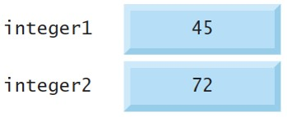
2.4 Memory Concepts (2 of 3)
After placing 72 in integer2
These locations are not necessarily adjacent in memory.

Slide 38
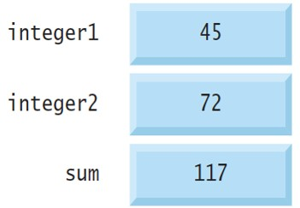
2.4 Memory Concepts (3 of 3)
After calculating sum of integer1 and integer2
Notes:
Three memory blocks depicted by boxes one below the other are labeled integer 1, integer 2, and sum from top to bottom that store the values 45, 72, and 117, respectively.

Slide 39
2.5 Arithmetic in C (1 of 9)
Binary arithmetic operators
C operation | Arithmetic operator | Algebraic expression | C expression
Addition | + | f + 7 | f + 7
Subtraction | Minus | p minus c | p minus c
Multiplication | * | b m | b asterisk m
Division | / | x slash y or start fraction x over y end fraction | x forward slash y
Remainder | % | r mod s | r percent sign s

Slide 40
2.5 Arithmetic in C (2 of 9)
Integer Division and the Remainder Operator
Integer division yields an integer result
evaluates to 1
evaluates to 3
Integer-only remainder operator, %, yields the remainder after integer division
yields 3
yields 2
An attempt to divide by zero usually is undefined
Generally, a fatal error
Nonfatal errors allow programs to run to completion, often with incorrect results

Slide 41
2.5 Arithmetic in C (3 of 9)
Parentheses for Grouping Subexpressions
Parentheses are used in C expressions in the same manner as in algebraic expressions
Rules of Operator Precedence
Generally the same as in algebra
Expressions grouped in parentheses evaluate first
In nested parentheses, operators in the innermost pair of parentheses are applied first
*, / and % are applied next left-to-right
+ and
are evaluated next left-to-right
The assignment operator (=) is evaluated last.

Slide 42
2.5 Arithmetic in C (4 of 9)
Algebra:
C:
Parentheses are required above

Slide 43
2.5 Arithmetic in C (5 of 9)
Algebra:
C:

Slide 44
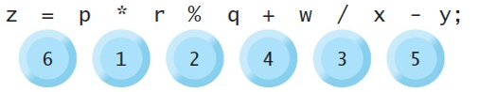
2.5 Arithmetic in C (6 of 9)
Algebra:
C:
Notes:
An expression with operators is as follows: z equals p asterisk r percentage q plus w forward slash x minus y semicolon. The order of precedence from 1 to 6 is asterisk, percentage, forward slash, plus, minus, and equals, respectively.

Slide 45

2.5 Arithmetic in C (7 of 9)
Second degree polynomial
Notes:
An expression with operators is as follows: y equals “a” asterisk x asterisk x plus b asterisk x plus c semicolon. The order of precedence from 1 to 6 is first asterisk, second asterisk, third asterisk, plus, plus, equals, respectively.

Slide 46
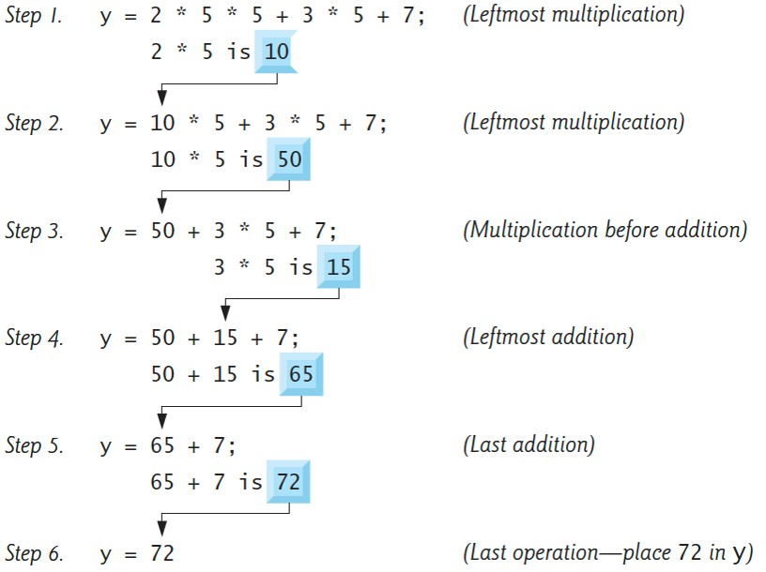
2.5 Arithmetic in C (8 of 9)
In the second-degree polynomial, suppose a = 2, b = 3, c = 7 and x = 5
Notes:
The diagram contains six steps and steps 1 to 5 contain two lines each. Step 1: Line 1: An expression with operators is as follows: y equals 2 asterisk 5 asterisk 5 plus 3 asterisk 5 plus 7 semicolon. Line 2: 2 asterisk 5 is 10. A label reads "Leftmost multiplication". Step 2: Line 1: The expression with operators is as follows: y equals 10 asterisk 5 plus 3 asterisk 5 plus 7 semicolon. An arrow from 10 in step 1 line 2 points to the 10 in step 2 line 1. Line 2: 10 asterisk 5 is 50. A label reads "Leftmost multiplication". Step 3: Line 1: The expression with operators is as follows: y equals 50 plus 3 asterisk 5 plus 7 semicolon. An arrow from 50 in step 2 line 2 points to the 50 in step 3 line 1. Line 2: 3 asterisk 5 is 15. A label reads "multiplication before addition". Step 4: Line 1: The expression with operators is as follows: y equals 50 plus 15 plus 7 semicolon. An arrow from 15 in step 3 line 2 points to the 15 in step 4 line 1. Line 2: 50 plus 15 is 65. A label reads "Leftmost addition". Step 5: Line 1: The expression with an operator is as follows: y equals 65 plus 7 semicolon. An arrow from 65 in step 4 line 2 points to the 65 in step 5 line 1. Line 2: 65 plus 7 is 72. A label reads "Last addition". Step 6: An expression is as follows: y equals 72. An arrow from 72 in step 5 line 2 points to the 72 in step 6. A label reads “Last operation hyphen place 72 in y”.

Slide 47
2.5 Arithmetic in C (9 of 9)
Using Parentheses for Clarity
Redundant parentheses can make an expression clearer

Slide 48
2.6 Decision Making: Equality and Relational Operators (1 of 13)
Executable statements perform actions like calculations, input and output, or make decisions
A condition is an expression that can be true or false
This section introduces the if statement
Makes a decision based on a condition’s value
If true, the statement in the if statement’s body executes
Otherwise, it does not

Slide 49
2.6 Decision Making: Equality and Relational Operators (2 of 13)
Equality and Relational Operators
Conditions are formed using the equality and relational operators

Slide 50
2.6 Decision Making: Equality and Relational Operators (3 of 13)
Relational operators
Algebraic equality or relational operator | C equality or relational operator | Sample C condition | Meaning of C condition
> | > | x > y | x is greater than y
< | < | x < y | x is less than y
greater than or equal to, right angle bracket with underscore | right angle bracket equals | x right angle bracket equals y | x is greater than or equal to y
less than or equal to, left angle bracket with underscore | left angle bracket equals | x left angle bracket equals y | x is less than or equal to y
Equality operators
Algebraic equality or relational operator | C equality or relational operator | Sample C condition | Meaning of C condition
= | equals equals | x equals equals y | x is equal to y
does not equal, equal sign with a slash through | exclamation point equals | x exclamation point equals | x is not equal to y

Slide 51
2.6 Decision Making: Equality and Relational Operators (4 of 13)
Confusing the Equality Operator
with the Assignment Operator
Common programming error
Read the equality operator as “double equals” and the assignment operator as “gets” or “is assigned the value of”
Confusing these operators can cause difficult-to-find logic errors rather than compilation errors

Slide 52
2.6 Decision Making: Equality and Relational Operators (5 of 13)
// fig02_05.c
// Using if statements, relational
// operators, and equality operators.
#include <stdio.h>
// function main begins program execution
int main(void) {
printf("Enter two integers, and I will tell you\n");
printf("the relationships they satisfy: ");
int number1 = 0; // first number to be read from user
int number2 = 0; // second number to be read from user
scanf("%d %d", &number1, &number2); // read two integers

Slide 53
2.6 Decision Making: Equality and Relational Operators (6 of 13)
if (number1 == number2) {
printf("%d is equal to %d\n", number1, number2);
} // end if
if (number1 != number2) {
printf("%d is not equal to %d\n", number1, number2);
} // end if
if (number1 < number2) {
printf("%d is less than %d\n", number1, number2);
} // end if

Slide 54
2.6 Decision Making: Equality and Relational Operators (7 of 13)
if (number1 > number2) {
printf("%d is greater than %d\n", number1, number2);
} // end if
if (number1 <= number2) {
printf("%d is less than or equal to %d\n", number1, number2);
} // end if
if (number1 >= number2) {
printf("%d is greater than or equal to %d\n", number1, number2);
} // end if
} // end function main

Slide 55
2.6 Decision Making: Equality and Relational Operators (8 of 13)
OUTPUT 1:
Enter two integers, and I will tell you the relationships they satisfy: 3 7 3 is not equal to 7 3 is less than 7 3 is less than or equal to 7

Slide 56
2.6 Decision Making: Equality and Relational Operators (9 of 13)
OUTPUT 2:
Enter two integers, and I will tell you the relationships they satisfy: 22 12 22 is not equal to 12 22 is greater than 12 22 is greater than or equal to 12

Slide 57
2.6 Decision Making: Equality and Relational Operators (10 of 13)
OUTPUT 3:
Enter two integers, and I will tell you the relationships they satisfy: 7 7 7 is equal to 7 7 is less than or equal to 7 7 is greater than or equal to 7

Slide 58
2.6 Decision Making: Equality and Relational Operators (11 of 13)
Comparing Numbers
Lines 16–18 compare number1’s and number2’s values for equality
If the values are equal, line 17 displays a line of text indicating that
Indenting each if statement’s body and placing blank lines above and below each if statement enhances program readability
{ begins the body of each if statement
} ends each if statement’s body
Any number of statements can be placed in an if statement’s body.
Placing a semicolon immediately to the right of the right parenthesis after an if statement’s condition is a common error
The semicolon is treated as an empty statement that does not perform a task

Slide 59
2.6 Decision Making: Equality and Relational Operators (12 of 13)
Keywords
Some words, such as int, if and void, are keywords or reserved words of the language and have special meaning to the compiler
The following table contains the C keywords
Do not use them as identifiers

Slide 60
2.6 Decision Making: Equality and Relational Operators (13 of 13)
Keywords
auto
break
case
char
const
continue
default
do
double
else
enum
extern
float
for
goto
if
int
long
register
return
short
signed
sizeof
static
struct
switch
typedef
union
unsigned
void
volatile
while
Keywords added in the C99 standard
_Bool _Complex _Imaginary inline restrict
Keywords added in the C11 standard
_Alignas _Alignof _Atomic _Generic _Noreturn _Static_assert _Thread_local

Slide 61
2.7 Secure C Programming (1 of 2)
Avoid Single-Argument printfs
printf’s first argument is a format string, which it inspects for conversion specifications
It then replaces each conversion specification with a subsequent argument’s value
It tries to do this regardless of whether there is a subsequent argument to use
Though the first printf argument typically is a string literal, it could be a variable containing a string that was input from a user
In such cases, an attacker can craft a user-input format string with more conversion specifications than there are additional printf arguments.
This exploit has been used by attackers to read memory that they should not be able to access.

Slide 62
2.7 Secure C Programming (2 of 2)
Preventative measures
Use puts to output a string with a terminating \n
To display a string without a terminating newline character, use printf with two arguments—a "%s" format control string and the string to display.

