Slide 1
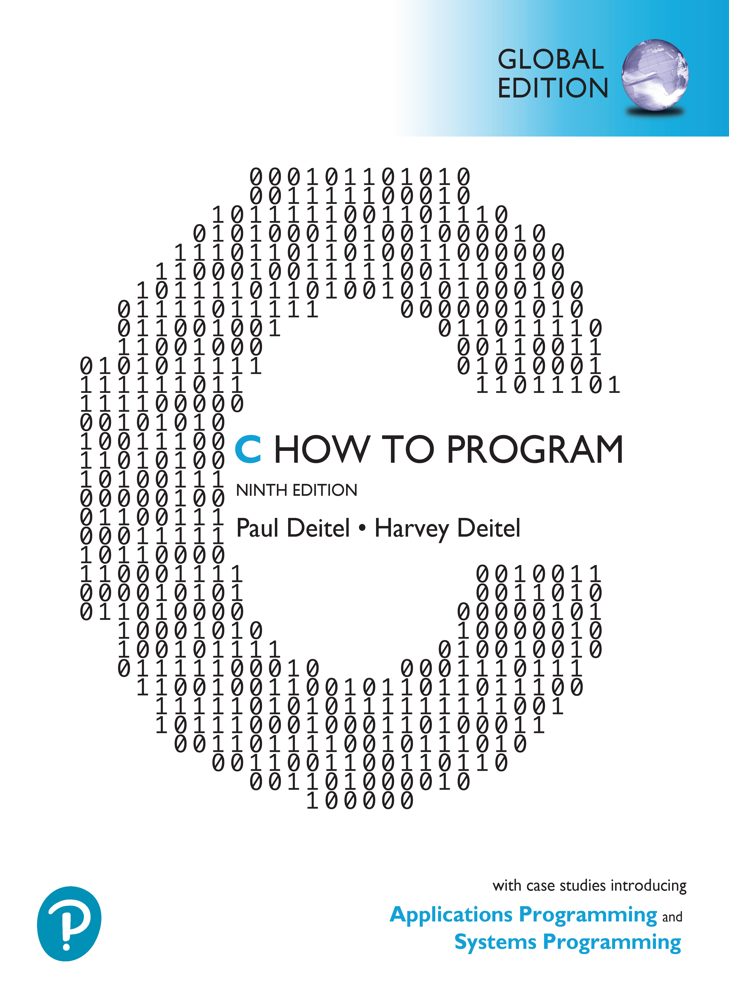

C How to Program
Ninth Edition, Global Edition
Chapter 3
Intro to C Programming
Copyright © 2023 Pearson Education Ltd. All Rights Reserved.
Notes:
If this PowerPoint presentation contains mathematical equations, you may need to check that your computer has the following installed:
1) MathType Plugin
2) Math Player (free versions available)
3) NVDA Reader (free versions available)

Slide 2
Objectives
Use basic problem-solving techniques.
Develop algorithms using top-down, stepwise refinement.
Select actions to execute based on a condition using the if and if…else selection statements.
Execute statements in a program repeatedly using the while iteration statement.
Use counter-controlled iteration and sentinel-controlled iteration.
Use structured programming techniques.
Use increment, decrement and assignment operators.

Slide 3
Outline
3.1 Introduction
3.2 Algorithms
3.3 Pseudocode
3.4 Control Structures
3.5 The if Selection Statement
3.6 The if…else Selection Statement
3.7 The while Iteration Statement
3.8 Formulating Algorithms Case Study 1: Counter-Controlled Iteration
3.9 Formulating Algorithms with Top-Down, Stepwise Refinement Case Study 2: Sentinel-Controlled Iteration
3.10 Formulating Algorithms with Top-Down, Stepwise Refinement Case Study 3: Nested Control Statements
3.11 Assignment Operators
3.12 Increment and Decrement Operators
3.13 Secure C Programming

Slide 4
3.1 Introduction
Before writing a program to solve a problem, you must have a thorough understanding of the problem and a carefully planned solution approach

Slide 5
3.2 Algorithms (1 of 3)
The solution to any computing problem involves executing a series of actions in a specific order
An algorithm is a procedure for solving a problem in terms of
the actions to execute
the order in which these actions should execute

Slide 6
3.2 Algorithms (2 of 3)
Correctly specifying the order in which the actions should execute is important
Consider the “rise-and-shine algorithm” followed by one junior executive for getting out of bed and going to work:
Get out of bed,
take off pajamas,
take a shower,
get dressed,
eat breakfast, and
carpool to work.
This gets the executive to work well prepared to make critical decisions

Slide 7
3.2 Algorithms (3 of 3)
Suppose the steps are performed in a slightly different order
Get out of bed,
take off pajamas,
get dressed,
take a shower,
eat breakfast,
carpool to work.
In this case, our junior executive shows up for work soaking wet
Specifying the order in which statements should execute in a computer program is called program control

Slide 8
3.3 Pseudocode (1 of 2)
Pseudocode is an informal artificial language
Helps you develop algorithms before converting them to C
Helps you “think out” a program before writing it in a programming language
Computers do not execute pseudocode
You may type it in any text editor
Often converting carefully prepared pseudocode to C is as simple as replacing a pseudocode statement with its C equivalent

Slide 9
3.3 Pseudocode (2 of 2)
Pseudocode describes the actions and decisions
Definitions are not executable statements—they’re simply messages to the compiler
int i = 0;
tells the compiler variable i’s type, instructs the compiler to reserve space in memory for the variable and initializes it to 0
Does not perform an action when the program executes, such as input, output, a calculation or a comparison
Some programmers do not include definitions in their pseudocode

Slide 10
3.4 Control Structures (1 of 8)
Normally, statements in a program execute one after the other in the order in which you write them
Called sequential execution
Some C statements enable you to specify that the next statement to execute may be other than the next one in sequence
Called transfer of control

Slide 11
3.4 Control Structures (2 of 8)
The research of Böhm and Jacopini demonstrated that programs could be written without in terms of three control structures
the sequence structure,
the selection structure
the iteration structure
The sequence structure is simple
The computer executes C statements one after the other in the order in which they’re written

Slide 12
3.4 Control Structures (3 of 8)
A flowchart is a graphical representation of an algorithm or of a portion of an algorithm
Flowcharts help you develop and represent algorithms
Flowcharts clearly show how control structures operate
Consider the following flowchart for a sequence structure in a portion of an algorithm that calculates the class average on a quiz

Slide 13
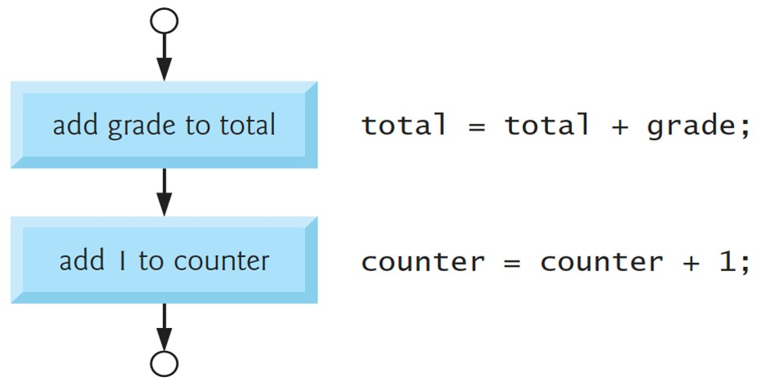
3.4 Control Structures (4 of 8)
Notes:
The flow begins with an input arrow from a small circle indicating the entry point of the statement. The arrow from the circle points to a rectangle labeled "add grade to total". This indicates total equals total plus grade semicolon. The arrow from this rectangle points to another rectangle labeled "add 1 to counter". This indicates counter equals counter plus one semicolon. An arrow from the second rectangle points to another small circle indicating the single exit point of the statement.

Slide 14
3.4 Control Structures (5 of 8)
The rectangle (or action) symbol indicates any action
Calculation, input or output
The flowlines indicate the order in which to perform the actions
When drawing a flowchart for a complete algorithm, the first symbol is a rounded rectangle symbol containing “Begin”, and the last is a rounded rectangle containing “End”
When drawing only a portion of an algorithm, we omit the rounded rectangle symbols in favor of using small circles called connector symbols

Slide 15
3.4 Control Structures (6 of 8)
Selection Statements in C
The if single-selection statement selects (performs) an action (or group of actions) only if a condition is true
The if…else double-selection statement performs one action (or group of actions) if a condition is true and a different action (or group of actions) if the condition is false.
The switch multiple-selection statement performs one of many different actions, depending on the value of an expression.

Slide 16
3.4 Control Structures (7 of 8)
Iteration Statements in C
while
do…while
for
These statements perform tasks repeatedly

Slide 17
3.4 Control Structures (8 of 8)
Summary of Control Statements
You form each program by combining as many of each type of control statement as is appropriate for the algorithm the program implements.
Each control statement has one entry point and one exit point
Single-entry/single-exit control statements make it easy to build clear programs
Can attach the control-statement flowchart segments to one another by connecting the exit point of one to the entry point of the next
control-statement stacking
Only other way to connect control statements is via nesting

Slide 18
3.5 The if Selection Statement (1 of 4)
Selection statements choose among alternative courses of action
If student’s grade is greater than or equal to 60
Print “Passed”
If true, then “Passed” is printed
If false, the printing is ignored
Written in C as
if (grade >= 60) { // grade must be declared before this puts("Passed"); } // end if
The C if statement code corresponds closely to the pseudocode

Slide 19
3.5 The if Selection Statement (2 of 4)
Indentation in the if Statement
The indentation in the second line is optional but highly recommended
Emphasizes the inherent structure of structured programs
The compiler ignores white-space characters used for indentation and vertical spacing
blanks, tabs and newlines

Slide 20
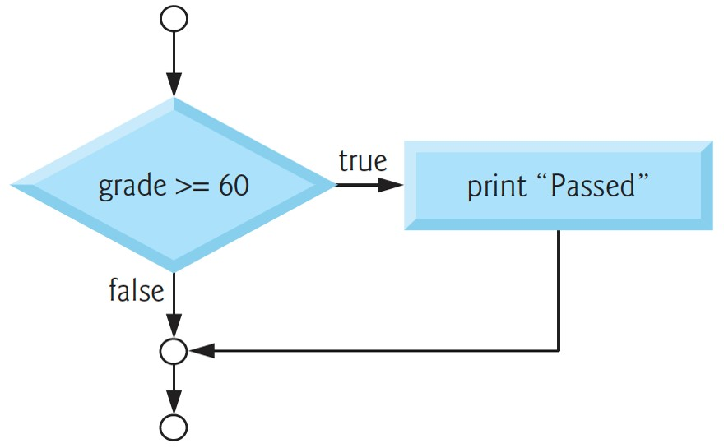
3.5 The if Selection Statement (3 of 4)
if Statement Flowchart
Notes:
The flow begins with an input arrow from a small circle indicating the entry point of the statement. The arrow from the circle points to a rhombus labeled "grade greater than equals to 60". If True, an arrow points to a display statement in a rectangle labeled "print open double quotes Passed close double quotes". If False, an arrow from the rhombus points downward to a second small circle indicating the single exit point of the statement. An arrow from the rectangle points to this single exit point of the statement. An arrow from this small circle points to another small circle.

Slide 21
3.5 The if Selection Statement (4 of 4)
if Statement Flowchart
Contains perhaps the most important flowchart symbol
The diamond (or decision) symbol indicates a decision is to be made
The symbol’s expression typically is a condition that can be true or false
Two flowlines emerging from it indicate the paths to take when the expression is true or false

Slide 22
3.6 The if…else Selection Statement (1 of 3)
Specifies different actions to perform when the condition is true or false
If student’s grade is greater than or equal to 60
Print “Passed” else Print “Failed”
Prints “Passed” if the student’s grade is greater than or equal to 60
Otherwise, it prints “Failed”
The else’s body also is indented

Slide 23
3.6 The if…else Selection Statement (2 of 3)
Written in C as
if (grade >= 60) { puts("Passed"); } // end if else { puts("Failed"); } // end else

Slide 24
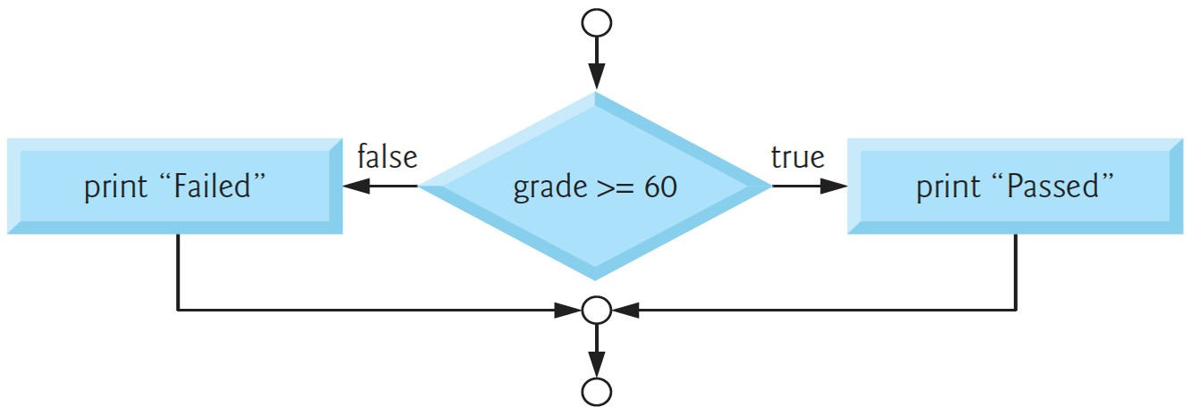
3.6 The if…else Selection Statement (3 of 3)
if…else Statement Flowchart
Notes:
The flow begins with an input arrow from a small circle indicating the entry point of the statement. The arrow from the circle points to a rhombus labeled "grade greater than equals 60". If True, an arrow from the rhombus points to a display statement in a rectangle on the right labeled "print open double quotes Passed close double quotes". If False, an arrow from the rhombus points to a display statement in a rectangle on the left labeled "print open double quotes Failed close double quotes". An arrow from each of the rectangles point to another small circle indicating the single exit point of the statement.

Slide 25
3.6 The if…else Selection Statement: Conditional Expressions
The conditional operator
is C’s only ternary operator (3 operands)
and its three operands form a conditional expression
First operand is a condition
Second is the conditional expression’s value if the condition is true
Third is the conditional expression’s value if the condition is false
Display "Passed" if grade
is true; otherwise, print "Failed":
puts((grade >= 60) ? "Passed" : "Failed");
Use expressions of the same type for the second and third operands
of the conditional operator
to avoid subtle errors.

Slide 26
3.6 The if…else Selection Statement: Nested if…else Statements (1 of 4)
Test for multiple cases by placing if…else statements inside if…else statements
For example, the following pseudocode prints:
A for grades greater than or equal to 90
B for grades greater than or equal to 80 (but less than 90)
C for grades greater than or equal to 70 (but less than 80)
D for grades greater than or equal to 60 (but less than 70)
F for all other grades.

Slide 27
3.6 The if…else Selection Statement: Nested if…else Statements (2 of 4)
If student’s grade is greater than or equal to 90
Print “A” else If student’s grade is greater than or equal to 80 Print “B” else If student’s grade is greater than or equal to 70 Print “C” else If student’s grade is greater than or equal to 60 Print “D” else Print “F”

Slide 28
3.6 The if…else Selection Statement: Nested if…else Statements (3 of 4)
Written in C as
if (grade >= 90) { puts("A"); } // end if else { if (grade >= 80) { puts("B"); } // end if else { if (grade >= 70) { puts("C"); } // end if else { if (grade >= 60) { puts("D"); } // end if else { puts("F"); } // end else } // end else } // end else } // end else

Slide 29
3.6 The if…else Selection Statement: Nested if…else Statements (4 of 4)
Most programmers write the preceding if statement as
if (grade >= 90) { puts("A"); } // end if else if (grade >= 80) { puts("B"); } // end else if else if (grade >= 70) { puts("C"); } // end else if else if (grade >= 60) { puts("D"); } // end else if else { puts("F"); } // end else

Slide 30
3.6 The if…else Selection Statement: Blocks and Compound Statements (1 of 2)
To include several statements in an if, enclose them in braces ({ and })
Braces form a compound statement or a block
Can be placed anywhere a single statement can be placed
The following if…else statement’s else part includes a compound statement containing two statements:
if (grade >= 60) { puts("Passed."); } // end if else { puts("Failed."); puts("You must take this course again."); } // end else

Slide 31
3.6 The if…else Selection Statement: Blocks and Compound Statements (2 of 2)
The braces surrounding the two statements in the else clause are important; otherwise, the second statement would be outside the else’s body and would execute regardless of whether the grade was less than 60
Always include your control statements’ bodies in braces

Slide 32
3.7 The while Iteration Statement
An iteration statement repeats an action while a condition remains true
Consider the following pseudocode
While there are more items on my shopping list
Purchase next item and cross it off my list
“there are more items on my shopping list” may be true or false
The shopper performs the action “Purchase next item and cross it off my list” repeatedly while the condition remains true
Eventually, the condition will become false (when the last item on the shopping list has been purchased and crossed off the list)
At this point, the iteration terminates

Slide 33
3.7 The while Iteration Statement: Calculating the First Power of 3 Greater Than 100
Find the first power of 3 larger than 100—product is initialized to 3
int product = 3; while (product <= 100) { product = 3 * product; }
Repeatedly multiplies product by 3
So it takes on the values 9, 27 and 81 successively
When product becomes 243, product
becomes false,
terminating the iteration
An action in the while statement’s body must eventually cause the condition to become false
Otherwise, the loop will never terminate—called an infinite loop

Slide 34
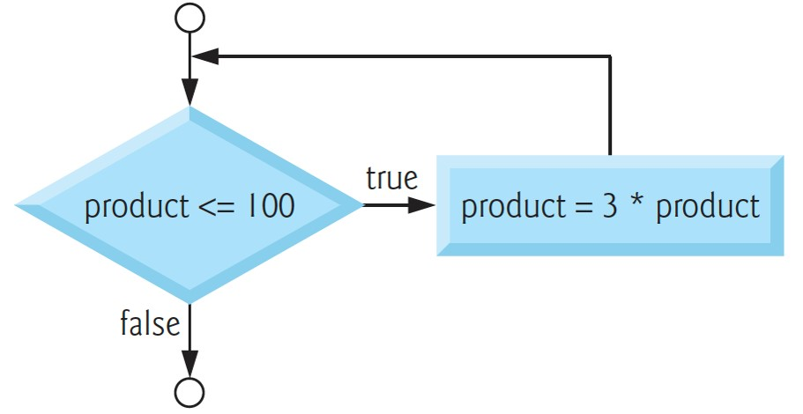
3.7 The while Iteration Statement: while Statement Flowchart (1 of 2)
Notes:
The flow begins with an input arrow from a small circle indicating the entry point of the statement. The arrow from the circle points to a rhombus labeled "product lesser than equals 100". If True, an arrow points to a display statement in a rectangle on the right labeled "product equals three asterisk product". An arrow from the rectangle points to the input arrow from the small circle indicating the entry point of the statement. If False, an arrow from the rhombus points downward to a small circle indicating the single exit point of the statement.

Slide 35
3.7 The while Iteration Statement: while Statement Flowchart (2 of 2)
The flowchart clearly shows the iteration
The flowline emerging from the rectangle points back to the flowline entering the decision
The loop tests the condition in the diamond during each iteration until the condition eventually becomes false
At this point, the while statement exits

Slide 36
3.8 Formulating Algorithms Case Study 1: Counter-Controlled Iteration
Consider the following problem statement:
A class of ten students took a quiz. The grades (integers in the range 0 to 100) for this quiz are available to you. Determine the class average on the quiz.
The class average is the sum of the grades divided by the number of students
The algorithm to solve this problem must input the grades, then calculate and display the class average

Slide 37
3.8 Formulating Algorithms Case Study 1: Counter-Controlled Iteration—Pseudocode for the Class-Average Problem (1 of 2)
Let’s use pseudocode to list the actions to execute and specify the order in which they should execute
We use counter-controlled iteration to input the grades one at a time
This technique uses a variable called a counter to specify the number of times a set of statements should execute
We know that ten students took a quiz, so we need to input 10 grades
Iteration terminates when the counter exceeds 10
Counter-controlled iteration is often called definite iteration because the number of iterations is known before the loop begins executing

Slide 38
3.8 Formulating Algorithms Case Study 1: Counter-Controlled Iteration—Pseudocode for the Class-Average Problem (2 of 2)
Set total to zero
Set grade counter to one
While grade counter is less than or equal to ten
Input the next grade
Add the grade into the total
Add one to the grade counter
Set the class average to the total divided by ten
Print the class average

Slide 39
3.8 Formulating Algorithms Case Study 1: Counter-Controlled Iteration (1 of 4)
// fig03_02.c
// Class average program with counter-controlled iteration.
#include <stdio.h>
// function main begins program execution
int main(void) {
// initialization phase
int total = 0; // initialize total of grades to 0
int counter = 1; // number of the grade to be entered next

Slide 40
3.8 Formulating Algorithms Case Study 1: Counter-Controlled Iteration (2 of 4)
// processing phase
while (counter <= 10) { // loop 10 times
printf("%s", "Enter grade: "); // prompt for input
int grade = 0; // grade value
scanf("%d", &grade); // read grade from user
total = total + grade; // add grade to total
counter = counter + 1; // increment counter
} // end while
// termination phase
int average = total / 10; // integer division
printf("Class average is %d\n", average); // display result
} // end function main

Slide 41
3.8 Formulating Algorithms Case Study 1: Counter-Controlled Iteration (3 of 4)
Output:
Enter grade: 98
Enter grade: 76
Enter grade: 71
Enter grade: 87
Enter grade: 83
Enter grade: 90
Enter grade: 57
Enter grade: 79
Enter grade: 82
Enter grade: 94
Class average is 81

Slide 42
3.8 Formulating Algorithms Case Study 1: Counter-Controlled Iteration (4 of 4)
A total is a variable used to accumulate the sum of a series of values
A counter is a variable used to count
Variables for totals should be initialized to zero
You should initialize all counters and totals
Counters typically are initialized to zero or one, depending on their use
An uninitialized variable contains a “garbage” value

Slide 43
3.9 Formulating Algorithms with Top-Down, Stepwise Refinement Case Study 2: Sentinel-Controlled Iteration
Let’s generalize the class-average problem
Consider the following problem:
Develop a class-averaging program that will process an arbitrary number of grades each time the program is run.
No indication is given of how many grades the user might input
The program must process an arbitrary number of grades

Slide 44
3.9 Formulating Algorithms with Top-Down, Stepwise Refinement Case Study 2: Sentinel-Controlled Iteration—Sentinel Values
Use a sentinel value to indicate “end of data entry”
Also is called a signal value, a dummy value, or a flag value
The user types grades until all legitimate grades have been entered
The user then types the sentinel value
Sentinel-controlled iteration is often called indefinite iteration because the number of iterations isn’t known before the loop begins executing
Choose a sentinel value that’s not an acceptable input value
Grades on a quiz are non-negative integers, so
is an acceptable
sentinel
The sentinel value
should not enter into the averaging calculation

Slide 45
3.9 Formulating Algorithms with Top-Down, Stepwise Refinement Case Study 2: Sentinel-Controlled Iteration—Top-Down, Stepwise Refinement (1 of 2)
Essential to developing well-structured programs
Begin with a pseudocode representation of the top:
Determine the class average for the quiz
The top is a single statement that conveys the program’s overall function
Rarely conveys a sufficient amount of detail for writing the C program
So we begin the refinement process

Slide 46
3.9 Formulating Algorithms with Top-Down, Stepwise Refinement Case Study 2: Sentinel-Controlled Iteration—Top-Down, Stepwise Refinement (2 of 2)
Divide the top into smaller tasks listed in the order in which they need to be performed
This results in the following first refinement:
Initialize variables
Input, sum, and count the quiz grades
Calculate and print the class average
Here, only the sequence structure has been used
Each refinement is a complete specification of the algorithm
Only the level of detail varies.

Slide 47
3.9 Formulating Algorithms with Top-Down, Stepwise Refinement Case Study 2: Sentinel-Controlled Iteration—Second Refinement (1 of 3)
Next, we commit to specific variables
a running total of the grades,
a count of how many grades have been processed,
a variable to receive the value of each grade as it is input and
a variable to hold the calculated average.
The pseudocode statement
Initialize variables
can be refined as
Initialize total to zero
Initialize counter to zero
Only the total and counter need to be initialized
Others are calculated or input

Slide 48
3.9 Formulating Algorithms with Top-Down, Stepwise Refinement Case Study 2: Sentinel-Controlled Iteration—Second Refinement (2 of 3)
The following pseudocode statement requires an iteration structure
Input, sum, and count the quiz grades
We do not know how many grades are to be processed, so we’ll use sentinel-controlled iteration
The refinement of the preceding pseudocode statement is
Input the first grade (possibly the sentinel)
While the user has not as yet entered the sentinel Add this grade into the running total Add one to the grade counter Input the next grade (possibly the sentinel)

Slide 49
3.9 Formulating Algorithms with Top-Down, Stepwise Refinement Case Study 2: Sentinel-Controlled Iteration—Second Refinement (3 of 3)
The pseudocode statement
Calculate and print the class average
may be refined as follows:
If the counter is not equal to zero
Set the average to the total divided by the counter Print the average
else Print “No grades were entered”
Test for the possibility of division by zero
A fatal error that, if undetected, would cause the program to crash

Slide 50
3.9 Formulating Algorithms with Top-Down, Stepwise Refinement Case Study 2: Sentinel-Controlled Iteration—Complete Second Refinement
Initialize total to zero
Initialize counter to zero
Input the first grade (possibly the sentinel)
While the user has not as yet entered the sentinel Add this grade into the running total Add one to the grade counter Input the next grade (possibly the sentinel)
If the counter is not equal to zero Set the average to the total divided by the counter Print the average
else Print “No grades were entered”

Slide 51
3.9 Formulating Algorithms with Top-Down, Stepwise Refinement Case Study 2: Sentinel-Controlled Iteration—Phases in a Basic Program
Many programs can be divided logically into three phases:
an initialization phase that initializes the program variables,
a processing phase that inputs data values and adjusts program variables accordingly, and
a termination phase that calculates and prints the final results.

Slide 52
3.9 Formulating Algorithms with Top-Down, Stepwise Refinement Case Study 2: Sentinel-Controlled Iteration—Number of Pseudocode Refinements
The pseudocode algorithm in Figure 3.3 was developed after only two levels of refinement
Sometimes more levels are necessary
You terminate the top-down, stepwise refinement process when the pseudocode algorithm provides sufficient detail for you to convert the pseudocode to C
The most challenging part of solving a problem on a computer is developing the algorithm for the solution
Once a correct algorithm has been specified, producing a working C program usually is straightforward

Slide 53
3.9 Formulating Algorithms with Top-Down, Stepwise Refinement Case Study 2: Sentinel-Controlled Iteration—Class-Average Program for an Arbitrary Number of Grades (1 of 9)
Figure 3.4 shows the C program and two sample executions
Although only integer grades are entered, the averaging calculation is likely to produce a number with a decimal point
Type int cannot represent such a number
This program introduces the data type double to handle numbers with decimal points—floating-point numbers
Note that lines 13 and 23 both include the sentinel value in the prompts requesting data entry
This is a good practice in a sentinel-controlled loop

Slide 54
3.9 Formulating Algorithms with Top-Down, Stepwise Refinement Case Study 2: Sentinel-Controlled Iteration—Class-Average Program for an Arbitrary Number of Grades (2 of 9)
// fig03_04.c
// Class-average program with sentinel-controlled iteration.
#include <stdio.h>
// function main begins program execution
int main(void) {
// initialization phase
int total = 0; // initialize total
int counter = 0; // initialize loop counter
// processing phase
// get first grade from user
printf("%s", "Enter grade, -1 to end: "); // prompt for input
int grade = 0; // grade value
scanf("%d", &grade); // read grade from user

Slide 55
3.9 Formulating Algorithms with Top-Down, Stepwise Refinement Case Study 2: Sentinel-Controlled Iteration—Class-Average Program for an Arbitrary Number of Grades (3 of 9)
// loop while sentinel value not yet read from user
while (grade != -1) {
total = total + grade; // add grade to total
counter = counter + 1; // increment counter
// get next grade from user
printf("%s", "Enter grade, -1 to end: "); // prompt for input
scanf("%d", &grade); // read next grade
} // end while

Slide 56
3.9 Formulating Algorithms with Top-Down, Stepwise Refinement Case Study 2: Sentinel-Controlled Iteration—Class-Average Program for an Arbitrary Number of Grades (4 of 9)
// termination phase
// if user entered at least one grade
if (counter != 0) {
// calculate average of all grades entered
double average = (double) total / counter; // avoid truncation
// display average with two digits of precision
printf("Class average is %.2f\n", average);
} // end if
else { // if no grades were entered, output message
puts("No grades were entered");
} // end else
} // end function main

Slide 57
3.9 Formulating Algorithms with Top-Down, Stepwise Refinement Case Study 2: Sentinel-Controlled Iteration—Class-Average Program for an Arbitrary Number of Grades (5 of 9)
Output 1:
Enter grade, −1 to end: 75
Enter grade, −1 to end: 94
Enter grade, −1 to end: 97
Enter grade, −1 to end: 88
Enter grade, −1 to end: 70
Enter grade, −1 to end: 64
Enter grade, −1 to end: 83
Enter grade, −1 to end: 89
Enter grade, −1 to end: −1
Class average is 82.50
Output 2:
Enter grade, −1 to end: −1
No grades were entered

Slide 58
3.9 Formulating Algorithms with Top-Down, Stepwise Refinement Case Study 2: Sentinel-Controlled Iteration—Class-Average Program for an Arbitrary Number of Grades (6 of 9)
Always Use Braces in a while Statement
Without this while loop’s braces (lines 18 and 25), only the statement on line 19 would be in the loop’s body
The code would be incorrectly interpreted as
while (grade != −1) total = total + grade; // add grade to total counter = counter + 1; // increment counter // get next grade from user printf("%s", "Enter grade, −1 to end: "); // prompt for input scanf("%d", &grade); // read next grade
This would cause an infinite loop if the user did not input
as the first grade

Slide 59
3.9 Formulating Algorithms with Top-Down, Stepwise Refinement Case Study 2: Sentinel-Controlled Iteration—Class-Average Program for an Arbitrary Number of Grades (7 of 9)
Converting Between Types Explicitly and Implicitly
Floating-point numbers can be represented by type double
Normally, the result of the calculation total / counter (line 32) is an integer because total and counter are both int variables
Dividing two ints results in integer division
Any fractional part of the calculation is truncated
You can produce a floating-point by creating temporary floating-point numbers
C provides the unary cast operator to accomplish this task
double average = (double) total / counter;
uses the cast operator (double) to create a temporary floating-point copy of total
The value stored in total is still an integer

Slide 60
3.9 Formulating Algorithms with Top-Down, Stepwise Refinement Case Study 2: Sentinel-Controlled Iteration—Class-Average Program for an Arbitrary Number of Grades (8 of 9)
Converting Between Types Explicitly and Implicitly
In mixed-type expressions, the compiler implicitly converts operands to ensure that they’re of the same type
In an expression containing the data types int and double, copies of int operands are made and implicitly converted to type double
Cast operators are formed by placing parentheses around a type name
A cast is a unary operator that takes only one operand
Cast operators group right-to-left and have the same precedence as other unary operators

Slide 61
3.9 Formulating Algorithms with Top-Down, Stepwise Refinement Case Study 2: Sentinel-Controlled Iteration—Class-Average Program for an Arbitrary Number of Grades (9 of 9)
Formatting Floating-Point Numbers
printf conversion specification %.2f
f specifies that a floating-point value will be printed
.2 is the precision—the value will have two (2) digits to the right of the decimal point
If %f is used without specifying the precision, the default precision is 6 digits to the right of the decimal point
When floating-point values are printed with precision, the printed value is rounded to the indicated number of decimal positions

Slide 62
3.10 Formulating Algorithms with Top-Down, Stepwise Refinement Case Study 3: Nested Control Statements (1 of 9)
We’ve seen that control statements may be stacked on top of one another (in sequence) just as a child stacks building blocks.
In this case study, we’ll see the only other structured way control statements may be connected in C, namely by nesting one control statement within another.

Slide 63
3.10 Formulating Algorithms with Top-Down, Stepwise Refinement Case Study 3: Nested Control Statements (2 of 9)
Consider the following problem statement:
A college offers a course that prepares students for the state licensing exam for real estate brokers. Last year, 10 of the students who completed this course took the licensing examination. Naturally, the college wants to know how well its students did on the exam. You’ve been asked to write a program to summarize the results. You’ve been given a list of these 10 students. Next to each name is a 1 if the student passed the exam or a 2 if the student failed.
Your program should analyze the results of the exam as follows:
Input each test result (i.e., a 1 or a 2). Display the prompting message “Enter result” each time the program requests another test result.
Count the number of test results of each type.
Display a summary of the test results indicating the number of students who passed and the number who failed.
If more than eight students passed the exam, print the message “Bonus to instructor!”

Slide 64
3.10 Formulating Algorithms with Top-Down, Stepwise Refinement Case Study 3: Nested Control Statements (3 of 9)
After reading the problem statement carefully, we make the following observations:
The program must process 10 test results. We’ll use a counter-controlled loop.
Each test result is a number—either a 1 or a 2. Each time the program reads a test result, it must determine whether the result is a 1 or a 2. We’ll test for a 1 in our algorithm. If the number is not a 1, we’ll assume that it’s a 2. Exercise 3.27 asks you to ensure that every test result is a 1 or a 2.
Two counters are used—one to count the number of students who passed the exam and one to count the number of students who failed the exam.
After the program has processed all the results, it must decide whether more than 8 students passed the exam and, if so, print "Bonus to Instructor!".

Slide 65
3.10 Formulating Algorithms with Top-Down, Stepwise Refinement Case Study 3: Nested Control Statements (4 of 9)
Pseudocode Representation of the Top
Analyze exam results and decide whether instructor should receive a bonus

Slide 66
3.10 Formulating Algorithms with Top-Down, Stepwise Refinement Case Study 3: Nested Control Statements (5 of 9)
First Refinement
Initialize variables
Input the ten quiz grades and count passes and failures
Print an exam-results summary and decide whether to bonus the instructor
Further refinement is necessary.

Slide 67
3.10 Formulating Algorithms with Top-Down, Stepwise Refinement Case Study 3: Nested Control Statements (6 of 9)
Second Refinement
Commit to specific variables
We need counters to record the passes and failures, a counter to control the looping process, and a variable to store the user input.
The pseudocode statement
Initialize variables
can be refined as follows:
Initialize passes to zero
Initialize failures to zero
Initialize student to one
Only the counter and totals are initialized.

Slide 68
3.10 Formulating Algorithms with Top-Down, Stepwise Refinement Case Study 3: Nested Control Statements (7 of 9)
Second Refinement
The following pseudocode statement requires a loop
Input the ten quiz grades and count passes and failures
We know there are ten exam results, so we use counter-controlled looping
Inside the loop (that is, nested within the loop), a double-selection statement will determine whether each exam result is a pass or a failure and will increment the appropriate counter
The refinement of the preceding pseudocode statement is then
While student counter is less than or equal to ten
Input the next exam result If the student passed Add one to passes else Add one to failures Add one to student counter

Slide 69
3.10 Formulating Algorithms with Top-Down, Stepwise Refinement Case Study 3: Nested Control Statements (8 of 9)
Second Refinement
The pseudocode statement
Print an exam-results summary and decide whether to bonus the instructor
may be refined as follows:
Print the number of passes
Print the number of failures
If more than eight students passed Print “Bonus to instructor!”

Slide 70
3.10 Formulating Algorithms with Top-Down, Stepwise Refinement Case Study 3: Nested Control Statements (9 of 9)
Complete second refinement
Initialize passes to zero Initialize failures to zero Initialize student to one While student counter is less than or equal to ten Input the next exam result
If the student passed Add one to passes else Add one to failures Add one to student counter Print the number of passes Print the number of failures If more than eight students passed Print “Bonus to instructor!”

Slide 71
3.10 Formulating Algorithms with Top-Down, Stepwise Refinement Case Study 3: Nested Control Statements—Implementing the Algorithm (1 of 5)
// fig03_06.c
// Analysis of examination results.
#include <stdio.h>
// function main begins program execution
int main(void) {
// initialize variables in definitions
int passes = 0;
int failures = 0;
int student = 1;

Slide 72
3.10 Formulating Algorithms with Top-Down, Stepwise Refinement Case Study 3: Nested Control Statements—Implementing the Algorithm (2 of 5)
// process 10 students using counter-controlled loop
while (student <= 10) {
// prompt user for input and obtain value from user
printf("%s", "Enter result (1=pass,2=fail): ");
int result = 0; // one exam result
scanf("%d", &result);
// if result 1, increment passes
if (result == 1) {
passes = passes + 1;
} // end if
else { // otherwise, increment failures
failures = failures + 1;
} // end else
student = student + 1; // increment student counter
} // end while

Slide 73
3.10 Formulating Algorithms with Top-Down, Stepwise Refinement Case Study 3: Nested Control Statements—Implementing the Algorithm (3 of 5)
// termination phase; display number of passes and failures
printf("Passed %d\n", passes);
printf("Failed %d\n", failures);
// if more than eight students passed, print "Bonus to instructor!"
if (passes > 8) {
puts("Bonus to instructor!");
} // end if
} // end function main

Slide 74
3.10 Formulating Algorithms with Top-Down, Stepwise Refinement Case Study 3: Nested Control Statements—Implementing the Algorithm (4 of 5)
Output 1
Enter Result (1=pass, 2=fail): 1
Enter Result (1=pass, 2=fail): 2
Enter Result (1=pass, 2=fail): 2
Enter Result (1=pass, 2=fail): 1
Enter Result (1=pass, 2=fail): 1
Enter Result (1=pass, 2=fail): 1
Enter Result (1=pass, 2=fail): 2
Enter Result (1=pass, 2=fail): 1
Enter Result (1=pass, 2=fail): 1
Enter Result (1=pass, 2=fail): 2
Passed 6
Failed 4

Slide 75
3.10 Formulating Algorithms with Top-Down, Stepwise Refinement Case Study 3: Nested Control Statements—Implementing the Algorithm (5 of 5)
Output 1
Enter Result (1=pass, 2=fail): 1
Enter Result (1=pass, 2=fail): 1
Enter Result (1=pass, 2=fail): 1
Enter Result (1=pass, 2=fail): 2
Enter Result (1=pass, 2=fail): 1
Enter Result (1=pass, 2=fail): 1
Enter Result (1=pass, 2=fail): 1
Enter Result (1=pass, 2=fail): 1
Enter Result (1=pass, 2=fail): 1
Enter Result (1=pass, 2=fail): 1
Passed 9
Failed 1
Bonus to instructor!

Slide 76
3.11 Assignment Operators (1 of 2)
C provides assignment operators for abbreviating assignment expressions
c = c + 3;
can be abbreviated with the addition assignment operator += as
c += 3;
The += operator adds the value of the expression on the operator’s right to the value of the variable on the operator’s left then stores the result in the variable on the left

Slide 77
3.11 Assignment Operators (2 of 2)
Assume: int c = 3, d = 5, e = 4, f = 6, g = 12;
Assignment operator | Sample expression | Explanation | Assigns
+= | c += 7 | c = c + 7 | 10 to c
minus sign equals | d minus sign equals 4 | d equals d minus sign 4 | 1 to d
asterisk equals | e asterisk equals 5 | e equals e asterisk 5 | 20 to e
forward slash equals | f forward slash equals 3 | f = f forward slash 3 | 2 to f
percent equals | g percent equals 9 | g equals g percent 9 | 3 to g

Slide 78
3.12 Increment and Decrement Operators (1 of 9)
The unary increment operator (++) and the unary
decrement operator
add one to and subtract
one from an integer variable, respectively

Slide 79
3.12 Increment and Decrement Operators (2 of 9)
Operator | Sample expression | Explanation
++ | ++a | Increment a by 1, then use the new value of a in the expression in which a resides.
++ | a++ | Use the current value of a in the expression in which a resides, then increment a by 1.
minus sign minus sign |  | Decrement b by 1, then use the new value of b in the expression in which b resides.
minus sign minus sign | b minus sign minus sign | Use the current value of b in the expression in which b resides, then decrement b by 1.

Slide 80
3.12 Increment and Decrement Operators (3 of 9)
If you place ++ or
before a variable (i.e., prefixed),
they’re referred to as the preincrement or predecrement operators
If you place ++ or
after a variable (i.e., postfixed),
they’re referred to as the postincrement or postdecrement operators
By convention, unary operators should be placed next to their operands with no intervening spaces

Slide 81
3.12 Increment and Decrement Operators (4 of 9)
Figure 3.7 demonstrates the difference between the preincrementing and the post-incrementing versions of the ++ operator.

Slide 82
3.12 Increment and Decrement Operators (5 of 9)
// fig03_07.c
// Preincrementing and postincrementing.
#include <stdio.h>
// function main begins program execution
int main(void) {
// demonstrate postincrement
int c = 5; // assign 5 to c
printf("%d\n", c); // print 5
printf("%d\n", c++); // print 5 then postincrement
printf("%d\n\n", c); // print 6
// demonstrate preincrement
c = 5; // assign 5 to c
printf("%d\n", c); // print 5
printf("%d\n", ++c); // preincrement then print 6
printf("%d\n", c); // print 6
} // end function main

Slide 83
3.12 Increment and Decrement Operators (6 of 9)
Output:
5
5
6
5
6
6

Slide 84
3.12 Increment and Decrement Operators (7 of 9)
The three assignment statements in Figure 3.6
passes = passes + 1;
failures = failures + 1;
student = student + 1;
can be written more concisely with assignment operators as
passes += 1;
failures += 1;
student += 1;
with preincrement operators as
++passes;
++failures;
++student;
or with postincrement operators as
passes++;
failures++;
student++;

Slide 85
3.12 Increment and Decrement Operators (8 of 9)
When incrementing or decrementing a variable in a statement by itself, the preincrement and postincrement forms have the same effect
Only a variable name may be used as a ++ or
operator’s operand
C generally does not specify the order in which an operator’s operands will evaluate
To avoid subtle errors, the ++ and
operators should be
used only in statements that modify exactly one variable

Slide 86
3.12 Increment and Decrement Operators (9 of 9)
Operators | Grouping | Type
++ (postfix) minus sign minus sign (postfix) | right to left | postfix
+ minus sign (type) ++ (prefix) minus sign minus sign (prefix) | right to left | unary
asterisk, forward slash, percent | left to right | multiplicative
plus, minus sign | left to right | additive
left angle bracket, left angle bracket equals, right angle bracket, right angle bracket equals | left to right | relational
equals equals, exclamation mark equals | left to right | equality
question mark colon | right to left | conditional
equals, plus equals, minus sign equals, asterisk equals, forward slash equals, percent equals | right to left | assignment

