Slide 1
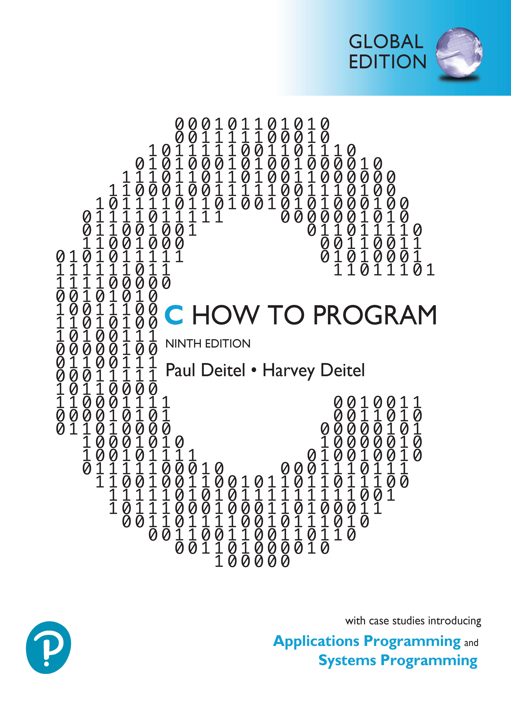

C How to Program
Ninth Edition, Global Edition
Chapter 7
Pointers
Copyright © 2023 Pearson Education Ltd. All Rights Reserved.
Notes:
If this PowerPoint presentation contains mathematical equations, you may need to check that your computer has the following installed:
1) MathType Plugin
2) Math Player (free versions available)
3) NVDA Reader (free versions available)

Slide 2
Objectives
Use pointers and pointer operators.
Pass arguments to functions by reference using pointers.
Understand the const qualifier’s various placements and how they affect what operations you can perform on a variable.
Use the sizeof operator with variables and types.
Use pointer arithmetic to process array elements.
Understand the close relationships among pointers, arrays and strings.
Define and use arrays of strings.
Use function pointers.
Learn about secure C programming with pointers.

Slide 3
Outline (1 of 3)
7.1 Introduction
7.2 Pointer Variable Definitions and Initialization
7.3 Pointer Operators
7.4 Passing Arguments to Functions by Reference
7.5 Using the const Qualifier with Pointers
7.5.1 Converting a String to Uppercase Using a Non-Constant Pointer to Non-Constant Data
7.5.2 Printing a String One Character at a Time Using a Non-Constant Pointer to Constant Data
7.5.3 Attempting to Modify a Constant Pointer to Non-Constant Data
7.5.4 Attempting to Modify a Constant Pointer to Constant Data
7.6 Bubble Sort Using Pass-By-Reference
7.7 sizeof Operator

Slide 4
Outline (2 of 3)
7.8 Pointer Expressions and Pointer Arithmetic
7.8.1 Pointer Arithmetic Operators
7.8.2 Aiming a Pointer at an Array
7.8.3 Adding an Integer to a Pointer
7.8.4 Subtracting an Integer from a Pointer
7.8.5 Incrementing and Decrementing a Pointer
7.8.6 Subtracting One Pointer from Another
7.8.7 Assigning Pointers to One Another
7.8.8 Pointer to void
7.8.9 Comparing Pointers

Slide 5
Outline (3 of 3)
7.9 Relationship between Pointers and Arrays
7.9.1 Pointer/Offset Notation
7.9.2 Pointer/Subscript Notation
7.9.3 Cannot Modify an Array Name with Pointer Arithmetic
7.9.4 Demonstrating Pointer Subscripting and Offsets
7.9.5 String Copying with Arrays and Pointers
7.10 Arrays of Pointers
7.11 Random-Number Simulation Case Study: Card Shuffling and Dealing
7.12 Function Pointers
7.12.1 Sorting in Ascending or Descending Order
7.12.2 Using Function Pointers to Create a Menu-Driven System
7.13 Secure C Programming

Slide 6
7.1 Introduction
In this chapter, we discuss one of C’s most powerful features—the pointer.
Pointers enable programs to
accomplish pass-by-reference,
pass functions between functions,
manipulate strings and arrays, and
create and manipulate dynamic data structures that grow and shrink at execution time, such as linked lists, queues, stacks and trees.

Slide 7
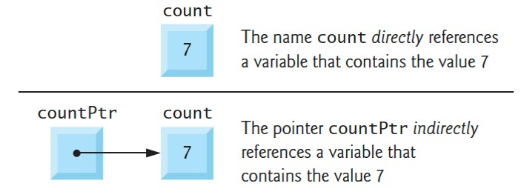
7.2 Pointer Variable Definitions and Initialization (1 of 3)
A pointer contains the address of another variable that contains a specific value
The pointer points to that variable
A variable name directly references a value
A pointer indirectly references a value
Referencing a value through a pointer is called indirection
Notes:
Part 1: A box contains a value 7 and is labeled count. The name count directly references a variable that contains the value 7. Part 2: A box labeled count P t r is to the left of the box labeled count that contains a value 7. An arrow from the left box points to the right box. The pointer count P t r indirectly references a variable that contains the value 7.

Slide 8
7.2 Pointer Variable Definitions and Initialization (2 of 3)
Declaring Pointers
Define countPtr as an int *—a pointer to an integer:
int *countPtr;
Read right-to-left, “countPtr is a pointer to int” or “countPtr points to an object of type int.”
* indicates that the variable is a pointer.
Pointer Variable Naming
Our convention – end each pointer variable name with Ptr
Other common naming conventions include starting the variable name with p (e.g., pCount) or p_ (e.g., p_count)

Slide 9
7.2 Pointer Variable Definitions and Initialization (3 of 3)
Define Variables in Separate Statements
The * does not distribute to each variable:
int *countPtr, count;
countPtr is a pointer to int, but count is just an int
Always write the preceding declaration as two statements to prevent ambiguity:
int *countPtr;
int count;
Initializing and Assigning Values to Pointers
Initialize pointers when they’re defined, or assign them a value
A pointer may be initialized to NULL, 0 or an address:
NULL points to nothing.
0 is equivalent to NULL. NULL is preferred.
Assigning a variable’s address to a pointer is discussed in Section 7.3

Slide 10
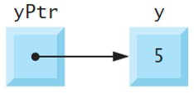
7.3 Pointer Operators (1 of 6)
Unary address operator (&) returns the address of its operand
int y = 5;
int *yPtr = &y;
initializes pointer variable yPtr with variable y’s address
yPtr is then said to “point to” y

Slide 11
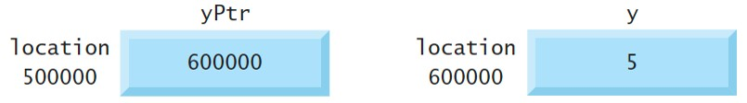
7.3 Pointer Operators (2 of 6)
The following diagram shows the preceding pointer’s representation in memory, assuming that integer variable y is stored at location 600000 and the pointer variable yPtr is stored at location 500000
Notes:
A pointer variable labeled y P t r is stored at memory location 500000 with a value 600000 in the memory block. An integer variable labeled y is stored at memory location 600000 with the value 5 in the memory block.

Slide 12
7.3 Pointer Operators (3 of 6)
Unary indirection operator (*), also called the dereferencing operator
Apply to a pointer operand to get the value of the object to which the pointer points—known as dereferencing a pointer
yPtr points to y, which is 5, so the following statement prints 5
printf("%d", *yPtr);
Dereferencing a pointer that has not been initialized with or assigned the address of another variable in memory is an error
Can cause a fatal execution-time error, accidentally modify data, produce incorrect results, or lead to a security breach

Slide 13
7.3 Pointer Operators (4 of 6)
Figure 7.1 demonstrates the pointer operators & and *
Conversion specification %p outputs a memory location as a hexadecimal integer on most platforms
The & and * operators are complements of one another
The addresses in the output will vary across systems that use different processor architectures, different compilers and even different compiler settings

Slide 14
7.3 Pointer Operators (5 of 6)
// fig07_01.c
// Using the & and * pointer operators.
#include <stdio.h>
int main(void) {
int a = 7;
int *aPtr = &a; // set aPtr to the address of a
printf("Address of a is %p\nValue of aPtr is %p\n\n", &a, aPtr);
printf("Value of a is %d\nValue of *aPtr is %d\n\n", a, *aPtr);
printf("Showing that * and & are complements of each other\n");
printf("&*aPtr = %p\n*&aPtr = %p\n", &*aPtr, *&aPtr);
}

Slide 15
7.3 Pointer Operators (6 of 6)
Address of a is 0x7fffe69386cc
Value of aPtr is 0x7fffe69386cc
Value of a is 7
Value of *aPtr is 7
Showing that * and & are complements of each other
&*aPtr = 0x7fffe69386cc
*&aPtr = 0x7fffe69386cc

Slide 16
7.4 Passing Arguments to Functions by Reference (1 of 18)
By default, arguments (other than arrays) are passed by value
Functions often need to modify variables in the caller or to receive a pointer to a large object to avoid the overhead of copying it (as in pass-by-value)
A return statement can return at most one value from a called function to its caller—pass-by-reference can enable a function to “return” multiple values by modifying the caller’s variables
Pointers and the indirection operator enable pass-by-reference
When calling a function with arguments that should be modified in the caller, you use & to pass each variable’s address
A function that receives the address of a variable in the caller can use the indirection operator (*) to modify the value at that location in the caller’s memory, thus effecting pass-by-reference

Slide 17
7.4 Passing Arguments to Functions by Reference (2 of 18)
Pass-By-Value
Line 11 of Figure 7.2 passes the variable number by value to function cubeByValue (lines 16–18), which cubes its argument and returns the new value
Line 11 assigns the new value to number in main, replacing number’s value

Slide 18
7.4 Passing Arguments to Functions by Reference (3 of 18)
// fig07_02.c
// Cube a variable using pass-by-value.
#include <stdio.h>
int cubeByValue(int n); // prototype
int main(void) {
int number = 5; // initialize number
printf("The original value of number is %d", number);
number = cubeByValue(number); // pass number by value to cubeByValue
printf("\nThe new value of number is %d\n", number);
}
// calculate and return cube of integer argument
int cubeByValue(int n) {
return n * n * n; // cube local variable n and return result
}

Slide 19
7.4 Passing Arguments to Functions by Reference (4 of 18)
The original value of number is 5
The new value of number is 125

Slide 20
7.4 Passing Arguments to Functions by Reference (5 of 18)
Line 12 of Figure 7.3 passes the variable number’s address to function cubeByReference (lines 17–19)
Passing the address enables pass-by-reference
The function’s parameter is a pointer to an int called nPtr (line 17).
The expression *nPtr dereferences the pointer
The function assigns the calculation result to *nPtr—which is really the variable number in main—thus changing number’s value in main
Use pass-by-value unless the caller explicitly requires the called function to modify the argument variable’s value in the caller
Prevents accidental modification of the caller’s arguments and is another example of the principle of least privilege

Slide 21
7.4 Passing Arguments to Functions by Reference (6 of 18)
// fig07_03.c
// Cube a variable using pass-by-reference with a pointer argument.
#include <stdio.h>
void cubeByReference(int *nPtr); // function prototype
int main(void) {
int number = 5; // initialize number
printf("The original value of number is %d", number);
cubeByReference(&number); // pass address of number to cubeByReference
printf("\nThe new value of number is %d\n", number);
}

Slide 22
7.4 Passing Arguments to Functions by Reference (7 of 18)
// calculate cube of *nPtr; actually modifies number in main
void cubeByReference(int *nPtr) {
*nPtr = *nPtr * *nPtr * *nPtr; // cube *nPtr
}

Slide 23
7.4 Passing Arguments to Functions by Reference (8 of 18)
The original value of number is 5
The new value of number is 125

Slide 24
7.4 Passing Arguments to Functions by Reference (9 of 18)
Use a Pointer Parameter to Receive an Address
A function receiving an address must use a pointer parameter
void cubeByReference(int *nPtr) {
Pointer Parameters in Function Prototypes
The function prototype for cubeByReference (Figure 7.3, line 6) specifies an int * parameter
It’s not necessary to include pointer names in function prototype
They’re ignored by the compiler
But it’s good practice to include them for documentation purposes

Slide 25
7.4 Passing Arguments to Functions by Reference (10 of 18)
Functions That Receive One-Dimensional Arrays
The compiler does not differentiate between a function that receives a pointer and one that receives a one-dimensional array
The function must “know” when it’s receiving an array versus. a single variable passed by reference
A parameter of the form int b[] is converted to int *b
The two forms are interchangeable

Slide 26
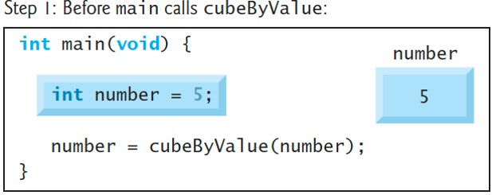
7.4 Passing Arguments to Functions by Reference (11 of 18)
Pass-By-Value Step-By-Step
Notes:
Before main calls cube By Value: The figure contains 4 lines of C code that reads as follows: Line 1 at indentation level 0, int main open parenthesis void close parenthesis open curly bracket. Line 2 at indentation level 1, int number equals 5 semicolon. Line 3 at indentation level 1, number equals cube By Value open parenthesis number close parenthesis semicolon. Line 4 at indentation level 0, close curly bracket. The integer number 5 passed as the value is depicted on the right side in a memory block.

Slide 27
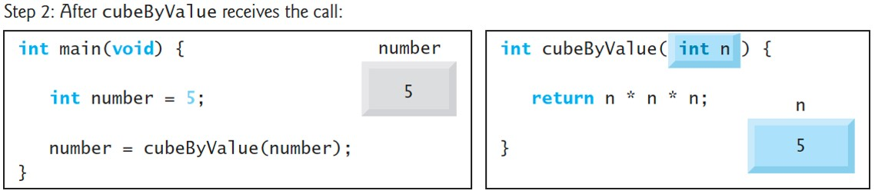
7.4 Passing Arguments to Functions by Reference (12 of 18)
Pass-By-Value Step-By-Step
Notes:
After cube By Value receives the call: Part 1 contains 4 lines of C code that reads as follows: Line 1 at indentation level 0, int main open parenthesis void close parenthesis open curly bracket. Line 2 at indentation level 1, int number equals 5 semicolon. Line 3 at indentation level 1, number equals cube By Value open parenthesis number close parenthesis semicolon. Line 4 at indentation level 0, close curly bracket. The integer number 5 passed as the value is depicted on the right side in a memory block. Part 2 contains 3 lines of C code that reads as follows: Line 1 at indentation level 0, int cube By Value open parenthesis int n close parenthesis open curly bracket. Line 2 at indentation level 1, return n asterisk n asterisk n semicolon. Line 3 at indentation level 0, close curly bracket. The integer number 5 received as n is depicted on the lower right side in a memory block.

Slide 28
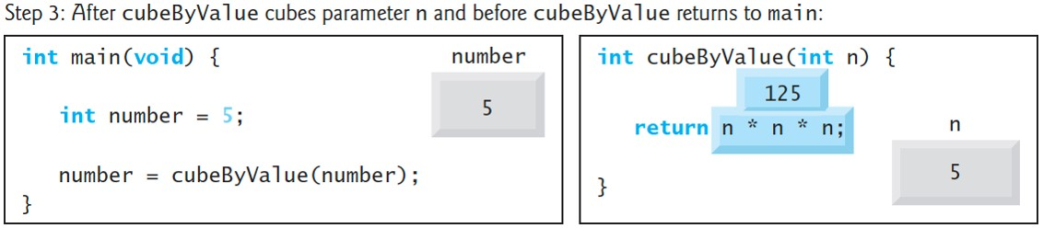
7.4 Passing Arguments to Functions by Reference (13 of 18)
Pass-By-Value Step-By-Step
Notes:
After cube By Value cubes parameter n and before cube By Value returns to main: Part 1 contains 4 lines of C code that reads as follows: Line 1 at indentation level 0, int main open parenthesis void close parenthesis open curly bracket. Line 2 at indentation level 1, int number equals 5 semicolon. Line 3 at indentation level 1, number equals cube By Value open parenthesis number close parenthesis semicolon. Line 4 at indentation level 0, close curly bracket. The integer number 5 passed as the value is depicted on the right side in a memory block. Part 2 contains 3 lines of C code that reads as follows: Line 1 at indentation level 0, int cube By Value open parenthesis int n close parenthesis open curly bracket. Line 2 at indentation level 1, return n asterisk n asterisk n semicolon. Line 3 at indentation level 0, close curly bracket. The integer number 5 received as n is depicted at the lower right in a memory block. The value of n asterisk n asterisk n is shown above Line 2 as 125.

Slide 29
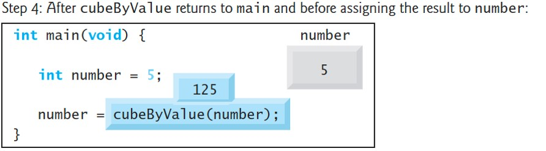
7.4 Passing Arguments to Functions by Reference (14 of 18)
Pass-By-Value Step-By-Step
Notes:
After cube By Value returns to main and before assigning the result to number: The figure contains 4 lines of C code that reads as follows: Line 1 at indentation level 0, int main open parenthesis void close parenthesis open curly bracket. Line 2 at indentation level 1, int number equals 5 semicolon. Line 3 at indentation level 1, number equals cube By Value open parenthesis number close parenthesis semicolon. Line 4 at indentation level 0, close curly bracket. The integer number 5 passed as the value is depicted on the right side in a memory block. The value 125 is shown above the function cube By Value.

Slide 30
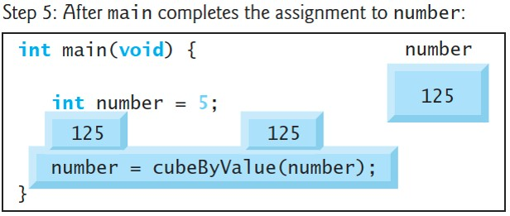
7.4 Passing Arguments to Functions by Reference (15 of 18)
Pass-By-Value Step-By-Step
Notes:
After main completes the assignment to number: The figure contains 4 lines of C code that reads as follows: Line 1 at indentation level 0, int main open parenthesis void close parenthesis open curly bracket. Line 2 at indentation level 1, int number equals 5 semicolon. Line 3 at indentation level 1, number equals cube By Value open parenthesis number close parenthesis semicolon. Line 4 at indentation level 0, close curly bracket. The new assigned value of 125 to the integer number is depicted on the right side in a memory block. The value 125 is shown above the function cube By Value and the number in line 3.

Slide 31
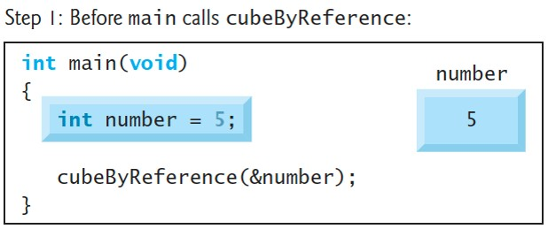
7.4 Passing Arguments to Functions by Reference (16 of 18)
Pass-By-Reference Step-By-Step
Notes:
Before main calls cube By Reference: The figure contains 4 lines of C code that reads as follows: Line 1 at indentation level 0, int main open parenthesis void close parenthesis open curly bracket. Line 2 at indentation level 1, int number equals 5 semicolon. Line 3 at indentation level 1, cube By Reference open parenthesis ampersand number close parenthesis semicolon. Line 4 at indentation level 0, close curly bracket. The integer number 5 passed as the reference is depicted on the right side in a memory block.

Slide 32
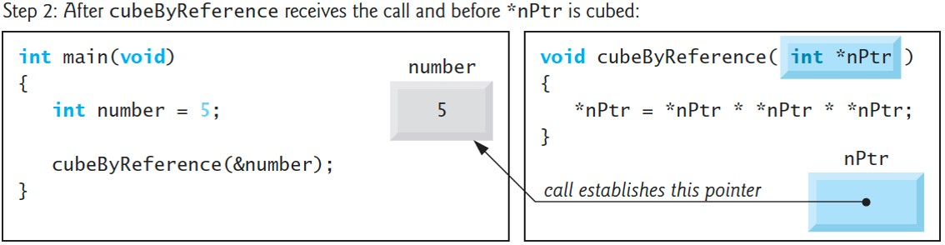
7.4 Passing Arguments to Functions by Reference (17 of 18)
Pass-By-Reference Step-By-Step
Notes:
After cube By Reference receives the call and before asterisk n P t r is cubed: Part 1 contains 4 lines of C code that reads as follows: Line 1 at indentation level 0, int main open parenthesis void close parenthesis open curly bracket. Line 2 at indentation level 1, int number equals 5 semicolon. Line 3 at indentation level 1, cube By Reference open parenthesis ampersand number close parenthesis semicolon. Line 4 at indentation level 0, close curly bracket. The integer number 5 passed as the reference is depicted on the right side in a memory block. Part 2 contains 4 lines of C code that reads as follows: Line 1 at indentation level 0, void cube By Reference open parenthesis int asterisk n P t r close parenthesis. Line 2 at indentation level 0, open curly bracket. Line 3 at indentation level 1, asterisk n P t r equals asterisk n P t r asterisk asterisk n P t r asterisk asterisk n P t r. Line 4 at indentation level 0, close curly bracket. A memory block labeled n P t r on the lower right side points to the memory block in part 1. The pointer arrow is labeled call establishes this pointer.

Slide 33
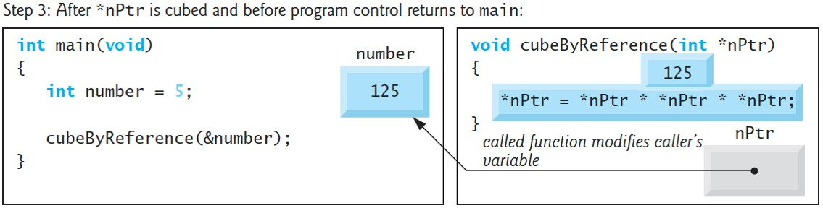
7.4 Passing Arguments to Functions by Reference (18 of 18)
Pass-By-Reference Step-By-Step
Notes:
After asterisk n P t r is cubed and before program control returns to main: Part 1 contains 4 lines of C code that reads as follows: Line 1 at indentation level 0, int main open parenthesis void close parenthesis open curly bracket. Line 2 at indentation level 1, int number equals 5 semicolon. Line 3 at indentation level 1, cube By Reference open parenthesis ampersand number close parenthesis semicolon. Line 4 at indentation level 0, close curly bracket. The integer number 125 returned to the main is depicted to the right side in a memory block. Part 2 contains 4 lines of C code that reads as follows: Line 1 at indentation level 0, Void cube By Reference open parenthesis int asterisk n P t r close parenthesis. Line 2 at indentation level 0, open curly bracket. Line 3 at indentation level 1, asterisk n P t r equals asterisk n P t r asterisk asterisk n P t r asterisk asterisk n P t r. Line 4 at indentation level 0, close curly bracket. A memory block labeled n P t r on the lower right side points to the memory block in part 1. The pointer arrow is labeled called function modifies caller’s variable. The value 125 is shown above line 3.

Slide 34
7.5 Using the const Qualifier with Pointers
const qualifier informs compiler that a variable should not be modified
Enforces the principle of least privilege
Reduces debugging time and prevents unintentional side effects
Four ways to pass to a function a pointer to data:
a non-constant pointer to non-constant data.
a constant pointer to non-constant data.
a non-constant pointer to constant data.
a constant pointer to constant data.
Each provides different access privileges
How do you choose?
Let the principle of least privilege be your guide
Always award a function enough access to the data in its parameters to accomplish its specified task, but absolutely no more

Slide 35
7.5.1 Converting a String to Uppercase Using a Non-Constant Pointer to Non-Constant Data (1 of 3)
Highest level of data access — non-constant pointer to non-constant data
Data can be modified through the dereferenced pointer
The pointer can be modified to point to other data items
A function might use such a pointer to receive a string argument, then process (and possibly modify) each character in the string
Function convertToUppercase in Figure 7.6 declares its parameter this way and uses it to convert lowercase characters to uppercase

Slide 36
7.5.1 Converting a String to Uppercase Using a Non-Constant Pointer to Non-Constant Data (2 of 3)
// fig07_06.c
// Converting a string to uppercase using a
// non-constant pointer to non-constant data.
#include <ctype.h>
#include <stdio.h>
void convertToUppercase(char *sPtr); // prototype
int main(void) {
char string[] = "cHaRaCters and $32.98"; // initialize char array
printf("The string before conversion is: %s\n", string);
convertToUppercase(string);
printf("The string after conversion is: %s\n", string);
}

Slide 37
7.5.1 Converting a String to Uppercase Using a Non-Constant Pointer to Non-Constant Data (3 of 3)
// convert string to uppercase letters
void convertToUppercase(char *sPtr) {
while (*sPtr != '\0') { // current character is not '\0'
*sPtr = toupper(*sPtr); // convert to uppercase
++sPtr; // make sPtr point to the next character
}
}
Output:
The string before conversion is: cHaRaCters and $32.98
The string after conversion is: CHARACTERS AND $32.98

Slide 38
7.5.2 Printing a String One Character at a Time Using a Non-Constant Pointer to Constant Data (1 of 7)
Non-constant pointer to constant data can be modified to point to any data item of the appropriate type, but the data to which it points cannot be modified
A function might receive such a pointer to process an array argument’s elements without modifying them
Function printCharacters (Figure 7.7) outputs each character in a string until it encounters a null character
After displaying each character, the loop increments pointer sPtr to point to the string’s next character

Slide 39
7.5.2 Printing a String One Character at a Time Using a Non-Constant Pointer to Constant Data (2 of 7)
// fig07_07.c
// Printing a string one character at a time using
// a non-constant pointer to constant data.
#include <stdio.h>
void printCharacters(const char *sPtr);
int main(void) {
// initialize char array
char string[] = "print characters of a string";
puts("The string is:");
printCharacters(string);
puts("");
}

Slide 40
7.5.2 Printing a String One Character at a Time Using a Non-Constant Pointer to Constant Data (3 of 7)
// sPtr cannot be used to modify the character to which it points,
// i.e., sPtr is a "read-only" pointer
void printCharacters(const char *sPtr) {
// loop through entire string
for (; *sPtr != '\0'; ++sPtr) { // no initialization
printf("%c", *sPtr);
}
}
Output:
The string is:
print characters of a string

Slide 41
7.5.2 Printing a String One Character at a Time Using a Non-Constant Pointer to Constant Data (4 of 7)
Trying to Modify Constant Data
Figure 7.8 shows the Visual C++ errors from compiling a function that receives a non-constant pointer to constant data and tries to use it to modify the data
The error message you receive is compiler-specific
Xcode’s L L V M compiler reports the error:
error: read-only variable is not assignable
G N U g c c compiler reports the error:
error: assignment of read-only location ‘*xPtr’

Slide 42
7.5.2 Printing a String One Character at a Time Using a Non-Constant Pointer to Constant Data (5 of 7)
// fig07_08.c
// Attempting to modify data through a
// non-constant pointer to constant data.
#include <stdio.h>
void f(const int *xPtr); // prototype
int main(void) {
int y = 7; // define y
f(&y); // f attempts illegal modification
}
// xPtr cannot be used to modify the
// value of the variable to which it points
void f(const int *xPtr) {
*xPtr = 100; // error: cannot modify a const object
}

Slide 43
7.5.2 Printing a String One Character at a Time Using a Non-Constant Pointer to Constant Data (6 of 7)
Error Output:
fig07_08.c(16,5): error C2166: l-value specifies const object

Slide 44
7.5.2 Printing a String One Character at a Time Using a Non-Constant Pointer to Constant Data (7 of 7)
Passing Structures versus Arrays
Arrays are aggregate types
Chapter 10 discusses another form of aggregate type called a structure (sometimes called a record or tuple in other languages), which can store related data items of the same or different types under one name
Structures are passed by value
Passing large objects such as structures by using pointers to constant data obtains the performance of pass-by-reference and the security of pass-by-value
If memory is low and execution efficiency is a concern, use pointers. If memory is in abundance and efficiency is not a major concern, pass data by value to enforce the principle of least privilege

Slide 45
7.5.3 Attempting to Modify a Constant Pointer to Non-Constant Data (1 of 3)
A constant pointer to non-constant data always points to the same location, but the data can be modified through the pointer
Default for an array name, which is a constant pointer to the array’s first element
Can be used to receive an array as an argument to a function that accesses array elements using array subscript notation
Pointers declared const must be initialized when they’re defined
Function parameters are initialized with arguments in a function call
Figure 7.9 attempts to modify a constant pointer
ptr is defined in line 11 to be of type int * const, which is read right-to-left as “ptr is a constant pointer to an integer”

Slide 46
7.5.3 Attempting to Modify a Constant Pointer to Non-Constant Data (2 of 3)
// fig07_09.c
// Attempting to modify a constant pointer to non-constant data.
#include <stdio.h>
int main(void) {
int x = 0; // define x
int y = 0; // define y
// ptr is a constant pointer to an integer that can be modified
// through ptr, but ptr always points to the same memory location
int * const ptr = &x;
*ptr = 7; // allowed: *ptr is not const
ptr = &y; // error: ptr is const; cannot assign new address
}

Slide 47
7.5.3 Attempting to Modify a Constant Pointer to Non-Constant Data (3 of 3)
Error Output:
fig07_09.c(14,4): error C2166: l-value specifies const object

Slide 48
7.5.4 Attempting to Modify a Constant Pointer to Constant Data (1 of 3)
The least access privilege is granted by a constant pointer to constant data
Such a pointer always points to the same memory location, and the data at that memory location cannot be modified
This is how an array should be passed to a function that looks at the elements using array subscript notation and does not modify them
Figure 7.10 defines ptr (line 12) to be of type const int *const
Read right-to-left as “ptr is a constant pointer to an integer constant.”
The output shows the error messages generated when we attempt to modify the data to which ptr points (line 15) and when we attempt to modify the address stored in the pointer variable (line 16)

Slide 49
7.5.4 Attempting to Modify a Constant Pointer to Constant Data (2 of 3)
// fig07_10.c
// Attempting to modify a constant pointer to constant data.
#include <stdio.h>
int main(void) {
int x = 5;
int y = 0;
// ptr is a constant pointer to a constant integer. ptr always
// points to the same location; the integer at that location
// cannot be modified
const int *const ptr = &x; // initialization is OK
printf("%d\n", *ptr);
*ptr = 7; // error: *ptr is const; cannot assign new value
ptr = &y; // error: ptr is const; cannot assign new address
}

Slide 50
7.5.4 Attempting to Modify a Constant Pointer to Constant Data (3 of 3)
Error Output:
fig07_10.c(15,5): error C2166: l-value specifies const object
fig07_10.c(16,4): error C2166: l-value specifies const object

Slide 51
7.6 Bubble Sort Using Pass-By-Reference (1 of 8)
Let’s improve the bubble-sort program of Figure 6.12 to use two functions—bubbleSort and swap (Figure 7.11)
Function bubbleSort sorts the array
It calls function swap (line 42) to exchange the array elements array[j] and array[j + 1].

Slide 52
7.6 Bubble Sort Using Pass-By-Reference (2 of 8)
// fig07_11.c
// Putting values into an array, sorting the values into
// ascending order and printing the resulting array.
#include <stdio.h>
#define SIZE 10
void bubbleSort(int * const array, size_t size); // prototype
int main(void) {
// initialize array a
int a[SIZE] = { 2, 6, 4, 8, 10, 12, 89, 68, 45, 37 };
puts("Data items in original order");
// loop through array a
for (size_t i = 0; i < SIZE; ++i) {
printf("%4d", a[i]);
}

Slide 53
7.6 Bubble Sort Using Pass-By-Reference (3 of 8)
bubbleSort(a, SIZE); // sort the array
puts("\nData items in ascending order");
// loop through array a
for (size_t i = 0; i < SIZE; ++i) {
printf("%4d", a[i]);
}
puts("");
}

Slide 54
7.6 Bubble Sort Using Pass-By-Reference (4 of 8)
// sort an array of integers using bubble sort algorithm
void bubbleSort(int * const array, size_t size) {
void swap(int *element1Ptr, int *element2Ptr); // prototype
// loop to control passes
for (int pass = 0; pass < size - 1; ++pass) {
// loop to control comparisons during each pass
for (size_t j = 0; j < size - 1; ++j) {
// swap adjacent elements if they’re out of order
if (array[j] > array[j + 1]) {
swap(&array[j], &array[j + 1]);
}
}
}
}

Slide 55
7.6 Bubble Sort Using Pass-By-Reference (5 of 8)
// swap values at memory locations to which element1Ptr and
// element2Ptr point
void swap(int *element1Ptr, int *element2Ptr) {
int hold = *element1Ptr;
*element1Ptr = *element2Ptr;
*element2Ptr = hold;
}
Output:
Data items in original order
2 6 4 8 10 12 89 68 45 37
Data items in ascending order
2 4 6 8 10 12 37 45 68 89

Slide 56
7.6 Bubble Sort Using Pass-By-Reference (6 of 8)
Function swap
C enforces information hiding between functions
swap does not have access to individual array elements in bubbleSort by default
bubbleSort wants swap to modify individual elements, so it passes each to swap by reference
swap(&array[j], &array[j + 1]);
swap uses the pointers it receives to exchange the values at the two memory locations

Slide 57
7.6 Bubble Sort Using Pass-By-Reference (7 of 8)
Function bubbleSort’s Array Parameter
The function header (line 33) declares its parameter as int * const array rather than int array[]
These notations are interchangeable; but array notation is preferred for readability.
Function swap’s Prototype in Function bubbleSort’s Body
The prototype for function swap (line 34) is included in bubbleSort’s body because only bubbleSort calls swap
Restricts proper swap calls to those made from bubbleSort (or any function that appears after swap in the source code)

Slide 58
7.6 Bubble Sort Using Pass-By-Reference (8 of 8)
Function bubbleSort’s size Parameter
When an array is passed to a function, the memory address of the array’s first element, of course, does not convey the number of array elements
Therefore, you must pass the array size to the function to know how many elements to sort
There are two main benefits to passing the array size to bubbleSort—software reusability and proper software engineering
By defining the function to receive the array size as an argument, we enable the function to be used by any program that sorts one-dimensional integer arrays of any size

Slide 59
7.7 sizeof Operator (1 of 8)
Operator sizeof determines an object’s or type’s size in bytes
Applied at compilation time unless its operand is a variable-length array (V L A; Section 6.12)
When applied to an array’s name as in Figure 7.12 (line 12), sizeof returns as a size_t value the array’s total number of bytes
sizeof is a compile-time operator, so it does not incur any execution-time overhead (except for V L A s).

Slide 60
7.7 sizeof Operator (2 of 8)
// fig07_12.c
// Applying sizeof to an array name returns
// the number of bytes in the array.
#include <stdio.h>
#define SIZE 20
size_t getSize(const float *ptr); // prototype
int main(void){
float array[SIZE]; // create array
printf("Number of bytes in the array is %zu\n", sizeof(array));
printf("Number of bytes returned by getSize is %zu\n", getSize(array));
}

Slide 61
7.7 sizeof Operator (3 of 8)
// return size of ptr
size_t getSize(const float *ptr) {
return sizeof(ptr);
}

Slide 62
7.7 sizeof Operator (4 of 8)
Output:
Number of bytes in the array is 80
Number of bytes returned by getSize is 8
Even though function getSize receives an array of 20 elements as an argument, the function’s parameter ptr is simply a pointer to the array’s first element. When you use sizeof with a pointer, it returns the pointer’s size, not the size of the item to which it points

Slide 63
7.7 sizeof Operator (5 of 8)
Determining the Sizes of the Standard Types, an Array and a Pointer
Figure 7.13 calculates the number of bytes used to store each of the standard types
The results of this program are implementation dependent
Often differ across platforms and sometimes across different compilers on the same platform
The output shows the results from our mac O S system using the Apple Xcode C++ compiler

Slide 64
7.7 sizeof Operator (6 of 8)
// fig07_13.c
// Using operator sizeof to determine standard type sizes.
#include <stdio.h>
int main(void) {
char c = '\0';
short s = 0;
int i = 0;
long l = 0;
long long ll = 0;
float f = 0.0F;
double d = 0.0;
long double ld = 0.0;
int array[20] = {0}; // create array of 20 int elements
int *ptr = array; // create pointer to array

Slide 65
7.7 sizeof Operator (7 of 8)
printf(" sizeof c = %2zu\t sizeof(char) = %2zu\n",
sizeof c, sizeof(char));
printf(" sizeof s = %2zu\t sizeof(short) = %2zu\n",
sizeof s, sizeof(short));
printf(" sizeof i = %2zu\t sizeof(int) = %2zu\n",
sizeof i, sizeof(int));
printf(" sizeof l = %2zu\t sizeof(long) = %2zu\n",
sizeof l, sizeof(long));
printf(" sizeof ll = %2zu\t sizeof(long long) = %2zu\n",
sizeof ll, sizeof(long long));
printf(" sizeof f = %2zu\t sizeof(float) = %2zu\n",
sizeof f, sizeof(float));
printf(" sizeof d = %2zu\t sizeof(double) = %2zu\n",
sizeof d, sizeof(double));
printf(" sizeof ld = %2zu\tsizeof(long double) = %2zu\n",
sizeof ld, sizeof(long double));
printf("sizeof array = %2zu\n sizeof ptr = %2zu\n",
sizeof array, sizeof ptr);
}

Slide 66
7.7 sizeof Operator (8 of 8)
sizeof c = 1 | sizeof(char) = 1
sizeof s = 2 | sizeof(short) = 2
sizeof i = 4 | sizeof(int) = 4
sizeof l = 8 | sizeof(long) = 8
sizeof ll = 8 | sizeof(long long) = 8
sizeof f = 4 | sizeof(float) = 4
sizeof d = 8 | sizeof(double) = 8
sizeof ld = 16 | sizeof(long double) = 16
sizeof array = 80 | Blank
sizeof ptr = 8 | Blank

Slide 67
7.8 Pointer Expressions and Pointer Arithmetic
Pointers are valid operands in arithmetic expressions, assignment expressions and comparison expressions
Not all arithmetic operators are valid with pointer variables
This section describes the operators that can have pointers as operands, and how these operators are used

Slide 68
7.8.1 Pointer Arithmetic Operators
The following arithmetic operations are allowed for pointers:
incrementing (++) or decrementing
adding an integer to a pointer (+ or +=),
subtracting an integer from a pointer
and
subtracting one pointer from another—meaningful only when both pointers point into the same array.
Pointer arithmetic on pointers that do not refer to array elements is a logic error.

Slide 69
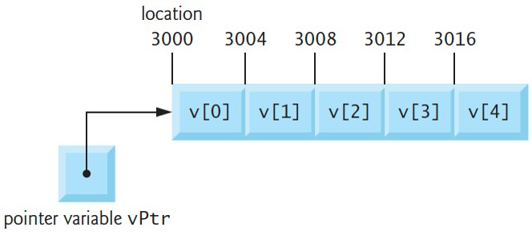
7.8.2 Aiming a Pointer at an Array
Assume int v[5] is defined, and its first element is at location 3000
Assume vPtr points to v[0]
The following diagram illustrates this scenario for a machine with four-byte integers
vPtr can be initialized to point to v with either of the statements
vPtr = v;
vPtr = &v[0];
Notes:
The array shown as boxes has a length of 5. The elements in each box of the array from left to right are v open square bracket 0 close square bracket to v open square bracket 4 close square bracket. The locations of the boxes from left to right are 3000, 3004, 3008, 3012, and 3016, respectively. An arrow from a box labeled pointer variable v P t r points to location 3000.

Slide 70
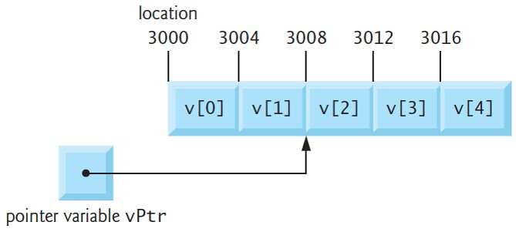
7.8.3 Adding an Integer to a Pointer
In arithmetic, 3000 + 2 yields the value 3002
Normally not the case with pointer arithmetic
Adding an integer to or subtracting one from a pointer increments or decrements by that integer times the size of the object to which the pointer refers
The diagram shows result of vPtr += 2; for 4-byte objects
Notes:
The array shown as boxes has a length of 5. The elements in each box of the array from left to right are v open square bracket 0 close square bracket to v open square bracket 4 close square bracket. The locations of the boxes from left to right are 3000, 3004, 3008, 3012, and 3016, respectively. An arrow from a box labeled pointer variable v P t r points to location 3008.

Slide 71
7.8.4 Subtracting an Integer From a Pointer
If vPtr contains 3016 (v[4]), the following statement would set vPtr back to 3000 (v[0])—the beginning of the array.
vPtr −= 4;
Using pointer arithmetic to adjust pointers to point outside an array’s bounds is a logic error that could lead to security problems.

Slide 72
7.8.5 Incrementing and Decrementing a Pointer
To increment or decrement a pointer by one, use the
increment (++) and decrement
operators
++vPtr;
vPtr++;
−−vPtr;
vPtr−−;

Slide 73
7.8.6 Subtracting One Pointer From Another
If vPtr contains the location 3000 and v2Ptr contains the address 3008, the following statement assigns to x the number of array elements between vPtr and v2Ptr, in this case, 2 (not 8).
x = v2Ptr - vPtr;
Pointer arithmetic is undefined unless performed on elements of the same array
We cannot assume that two variables of the same type are stored side-by-side in memory unless they’re adjacent elements of an array

Slide 74
7.8.7 Assigning Pointers to One Another
Pointers of the same type may be assigned to one another
This rule’s exception is a pointer to void (i.e., void *)—a generic pointer that can represent any pointer type
All pointer types can be assigned to a void *, and a void * can be assigned a pointer of any type (including another void *)
A cast operation is not required

Slide 75
7.8.8 Pointer to void
A pointer to void cannot be dereferenced
A void * contains a memory location for an unknown type
Number of bytes to which the pointer refers is not known
The compiler must know the type to determine the number of bytes that represent the referenced value
Dereferencing a void * pointer is a syntax error

Slide 76
7.8.9 Comparing Pointers
You can compare pointers using equality and relational operators
Meaningful only if the pointers point to elements of the same array
Otherwise, such comparisons are logic errors
A common use of pointer comparison is determining whether a pointer is NULL

Slide 77
7.9 Relationship Between Pointers and Arrays
Arrays and pointers often may be used interchangeably
Think of an array name as a constant pointer to the first element
Pointers can be used to do any operation involving array subscripting
int b[5]; int *bPtr;
The array name b is a pointer to the array’s first element
Can set bPtr to the address of the array b’s first element with the statement:
bPtr = b;
Equivalent to taking the address of array b’s first element:
bPtr = &b[0];

Slide 78
7.9.1 Pointer/Offset Notation
b[3] can alternatively be referenced with the pointer expression
*(bPtr + 3)
The 3 in the expression is the offset to the pointer
When bPtr points to the array’s first element, the offset indicates which array element to reference
Offset’s value is identical to the array subscript
Referred to as pointer/offset notation
Parentheses are required because the precedence of * is higher than that of +

Slide 79
7.9.2 Pointer/Subscript Notation
Pointers can be subscripted like arrays
If bPtr has the value b, the following expression refers to the array element b[1]
bPtr[1]
Referred to as pointer/subscript notation.

Slide 80
7.9.3 Cannot Modify an Array Name with Pointer Arithmetic
An array name always points to the beginning of the array
It’s like a constant pointer
b += 3
is invalid because it attempts to modify the array name’s value with pointer arithmetic
Attempting to modify the value of an array name with pointer arithmetic is a compilation error.

Slide 81
7.9.4 Demonstrating Pointer Subscripting and Offsets (1 of 6)
Figure 7.14 uses the four methods we’ve discussed for referring to array elements to print the four elements of the integer array b
array subscripting
pointer/offset with the array name as a pointer
pointer subscripting
pointer/offset with a pointer

Slide 82
7.9.4 Demonstrating Pointer Subscripting and Offsets (2 of 6)
// fig07_14.cpp
// Using subscripting and pointer notations with arrays.
#include <stdio.h>
#define ARRAY_SIZE 4
int main(void) {
int b[] = {10, 20, 30, 40}; // create and initialize array b
int *bPtr = b; // create bPtr and point it to array b
// output array b using array subscript notation
puts("Array b printed with:\nArray subscript notation");
// loop through array b
for (size_t i = 0; i < ARRAY_SIZE; ++i) {
printf("b[%zu] = %d\n", i, b[i]);
}

Slide 83
7.9.4 Demonstrating Pointer Subscripting and Offsets (3 of 6)
// output array b using array name and pointer/offset notation
puts("\nPointer/offset notation where the pointer is the array name");
// loop through array b
for (size_t offset = 0; offset < ARRAY_SIZE; ++offset) {
printf("*(b + %zu) = %d\n", offset, *(b + offset));
}
// output array b using bPtr and array subscript notation
puts("\nPointer subscript notation");
// loop through array b
for (size_t i = 0; i < ARRAY_SIZE; ++i) {
printf("bPtr[%zu] = %d\n", i, bPtr[i]);
}

Slide 84
7.9.4 Demonstrating Pointer Subscripting and Offsets (4 of 6)
// output array b using bPtr and pointer/offset notation
puts("\nPointer/offset notation");
// loop through array b
for (size_t offset = 0; offset < ARRAY_SIZE; ++offset) {
printf("*(bPtr + %zu) = %d\n", offset, *(bPtr + offset));
}
}

Slide 85
7.9.4 Demonstrating Pointer Subscripting and Offsets (5 of 6)
Array b printed with:
Array subscript notation
b[0] = 10
b[1] = 20
b[2] = 30
b[3] = 40
Pointer/offset notation where the pointer is the array name
*(b + 0) = 10
*(b + 1) = 20
*(b + 2) = 30
*(b + 3) = 40

Slide 86
7.9.4 Demonstrating Pointer Subscripting and Offsets (6 of 6)
Pointer subscript notation
bPtr[0] = 10
bPtr[1] = 20
bPtr[2] = 30
bPtr[3] = 40
Pointer/offset notation
*(bPtr + 0) = 10
*(bPtr + 1) = 20
*(bPtr + 2) = 30
*(bPtr + 3) = 40

Slide 87
7.9.5 String Copying with Arrays and Pointers (1 of 7)
To further illustrate array and pointer interchangeability, let’s look at two string-copying functions—copy1 and copy2—in Figure 7.15
Both functions copy a string into a character array, but they’re implemented differently

Slide 88
7.9.5 String Copying with Arrays and Pointers (2 of 7)
// fig07_15.c
// Copying a string using array notation and pointer notation.
#include <stdio.h>
#define SIZE 10
void copy1(char * const s1, const char * const s2); // prototype
void copy2(char *s1, const char *s2); // prototype
int main(void) {
char string1[SIZE]; // create array string1
char *string2 = "Hello"; // create a pointer to a string
copy1(string1, string2);
printf("string1 = %s\n", string1);

Slide 89
7.9.5 String Copying with Arrays and Pointers (3 of 7)
char string3[SIZE]; // create array string3
char string4[] = "Good Bye"; // create an array containing a string
copy2(string3, string4);
printf("string3 = %s\n", string3);
}

Slide 90
7.9.5 String Copying with Arrays and Pointers (4 of 7)
// copy s2 to s1 using array notation
void copy1(char * const s1, const char * const s2) {
// loop through strings
for (size_t i = 0; (s1[i] = s2[i]) != '\0'; ++i) {
; // do nothing in body
}
}
// copy s2 to s1 using pointer notation
void copy2(char *s1, const char *s2) {
// loop through strings
for (; (*s1 = *s2) != '\0'; ++s1, ++s2) {
; // do nothing in body
}
}

Slide 91
7.9.5 String Copying with Arrays and Pointers (5 of 7)
string1 = Hello
string3 = Good Bye

Slide 92
7.9.5 String Copying with Arrays and Pointers (6 of 7)
Copying with Array Subscript Notation
copy1 uses array subscript notation to copy the string in s2 to the character array s1.
The expression s1[i] = s2[i] copies one character from s2 to s1
When the null character is encountered in s2, it’s assigned to s1
Since the assignment’s value is what gets assigned to the left operand (s1), the loop terminates when an element of s1 receives the null character, which has the value 0 (false)
Copying with Pointers and Pointer Arithmetic
copy2 uses pointers and pointer arithmetic to copy s2 to the character array s1
*s1 = *s2 performs the copy by dereferencing s2 and assigning that character to the location s1
After the assignment, line 34 increments s1 and s2 to point to each string’s next character
When the assignment copies the null character into s1, the loop terminates.

Slide 93
7.9.5 String Copying with Arrays and Pointers (7 of 7)
Notes Regarding Functions copy1 and copy2
The first argument to both copy1 and copy2 must be an array large enough to hold the second argument’s string
Otherwise, a logic error may occur when an attempt is made to write into a memory location that’s not part of the array
In both functions, the second argument is copied into the first argument—characters are read from it one at a time, but the characters are never modified
The second parameter is declared to point to a constant so that the principle of least privilege is enforced

Slide 94
7.10 Arrays of Pointers (1 of 2)
Arrays may contain pointers
Commonly for array of strings, referred to simply as a string array
Each element in a C string is essentially a pointer to its first character
const char *suit[4] = {"Hearts", "Diamonds", "Clubs", "Spades"};
The char * indicates that each suit element is of type “pointer to char.”
const indicates that the string each element points to cannot be modified
"Hearts", "Diamonds", "Clubs" and "Spades" are placed into the array
Each is stored in memory as a null-terminated character string that’s one character longer than the number of characters in the quotes

Slide 95
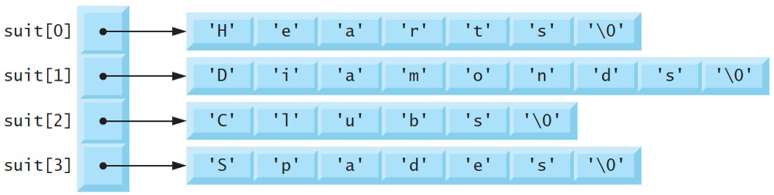
7.10 Arrays of Pointers (2 of 2)
Only pointers are actually stored in the array, as shown in the following diagram
Notes:
The array has four elements labeled suit open square bracket 0 close square bracket to suit open square bracket 3 close square bracket and is shown as a column to the left. Each of the elements points to the first element of an array each on the right. The elements in these arrays are each within open single quote and close single quote to depict that they are characters. Suit open square bracket 0 close square bracket points to an array of length 7 with values labeled 'H' 'e' 'a' 'r' 't' 's' 'backslash 0'. Suit open square bracket 1 close square bracket points to an array of length 9 with values labeled 'D' 'i' 'a' 'm' 'o' 'n' 'd' 's' 'backslash 0'. Suit open square bracket 2 close square bracket points to an array of length 6 with values labeled 'C' 'l' 'u' 'b' 's' 'backslash 0'. Suit open square bracket 3 close square bracket points to an array of length 7 with values labeled 'S' 'p' 'a' 'd' 'e' 's' 'backslash 0'.

Slide 96
7.11 Random-Number Simulation Case Study: Card Shuffling and Dealing (1 of 17)
Let’s use random number generation to develop a card shuffling and dealing simulation program, which can then be used to implement programs that play card games
To reveal some subtle performance problems, we’ve intentionally used suboptimal shuffling and dealing algorithms
In this chapter’s exercises and in Chapter 10, we develop more efficient algorithms.
Using the top-down, stepwise refinement approach, we develop a program that will shuffle a deck of 52 playing cards, then deal each card
The top-down approach is particularly useful in attacking more complex problems than you’ve seen in earlier chapters

Slide 97
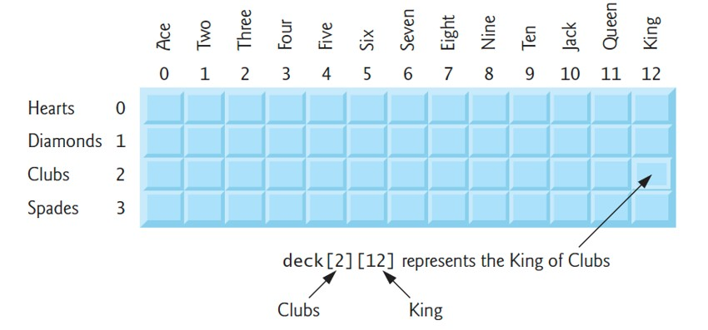
7.11 Random-Number Simulation Case Study: Card Shuffling and Dealing (2 of 17)
Representing a Deck of Cards as a Two-Dimensional Array
4-by-13 two-dimensional array deck represenst the deck of playing cards
rows correspond to the suits
columns correspond to the faces
We’ll load string array suit with character strings representing the four suits, and load string array face with character strings representing the 13 face values
Notes:
The array is represented as a 4-by-13 two-dimensional array. The rows from top to bottom are labeled 0 to 3 and the columns from left to right are labeled 0 to 12. The rows from 0 to 3 are labeled Hearts, Diamonds, Clubs, and Spades, respectively. The columns from 0 to 12 are labeled Ace, Two to Ten, Jack, Queen, and King, respectively. The cell at the third row last column represents the King of Clubs and is labeled deck open square bracket 2 close square bracket open square bracket 12 close square bracket. Index 2 indicates Clubs, and 12 indicates King.

Slide 98
7.11 Random-Number Simulation Case Study: Card Shuffling and Dealing (3 of 17)
Shuffling the Two-Dimensional Array
First, set all elements of deck to 0
Then, choose a row (0–3) and a column (0–12) at random
Place the number 1 in array element deck[row][column] to indicate that this card will be the first one dealt from the shuffled deck
Repeat this process for the numbers 2, 3, …, 52, randomly inserting each in the deck array to indicate which cards are to be dealt second, third, …, and fifty-second in the shuffled deck
As the deck array begins to fill with card numbers, a card may be selected again
Ignore and choose other random row and column values repeatedly until you find an unselected card

Slide 99
7.11 Random-Number Simulation Case Study: Card Shuffling and Dealing (4 of 17)
Possibility of Indefinite Postponement
This shuffling algorithm can execute indefinitely if cards that have already been shuffled are repeatedly selected at random—known as indefinite postponement
The exercises discuss a better shuffling algorithm
Seek algorithms that avoid indefinite postponement.

Slide 100
7.11 Random-Number Simulation Case Study: Card Shuffling and Dealing (5 of 17)
Dealing Cards from the Two-Dimensional Array
To deal the first card, search the array for deck[row][column] equal to 1 using nested for statements
What card does that element of the array correspond to?
The suit array has been preloaded with the four suits, so to get the card’s suit, we print the character string suit[row]
Similarly, to get the card’s face, we print the character string face[column].
We also print the character string " of ", as in "King of Clubs", "Ace of Diamonds" and so on

Slide 101
7.11 Random-Number Simulation Case Study: Card Shuffling and Dealing (6 of 17)
Developing the Program’s Logic with Top-Down, Stepwise Refinement
top
Shuffle and deal 52 cards
first refinement yields:
Initialize the suit array
Initialize the face array Initialize the deck array Shuffle the deck Deal 52 cards

Slide 102
7.11 Random-Number Simulation Case Study: Card Shuffling and Dealing (7 of 17)
Developing the Program’s Logic with Top-Down, Stepwise Refinement
“Shuffle the deck” may be refined as follows:
For each of the 52 cards
Place card number in a randomly selected unoccupied element of deck
“Deal 52 cards” may be refined as follows:
For each of the 52 cards
Find the card number in the deck array and print its face and suit

Slide 103
7.11 Random-Number Simulation Case Study: Card Shuffling and Dealing (8 of 17)
Developing the Program’s Logic with Top-Down, Stepwise Refinement
The complete second refinement is:
Initialize the suit array
Initialize the face array Initialize the deck array
For each of the 52 cards
Place card number in a randomly selected unoccupied slot of deck
For each of the 52 cards
Find the card number in the deck array and print the card’s face and suit

Slide 104
7.11 Random-Number Simulation Case Study: Card Shuffling and Dealing (9 of 17)
Developing the Program’s Logic with Top-Down, Stepwise Refinement
“Place card number in randomly selected unoccupied slot of deck” may be refined as:
Choose slot of deck randomly
While chosen slot of deck has been previously chosen
Choose slot of deck randomly
Place card number in chosen slot of deck
“Find the card number in the deck array and print its face and suit” may be refined as:
For each slot of the deck array
If slot contains card number Print the card’s face and suit

Slide 105
7.11 Random-Number Simulation Case Study: Card Shuffling and Dealing (10 of 17)
Developing the Program’s Logic with Top-Down, Stepwise Refinement
Incorporating these expansions yields our third refinement:
Initialize the suit array
Initialize the face array Initialize the deck array
For each of the 52 cards
Choose slot of deck randomly
While slot of deck has been previously chosen
Choose slot of deck randomly
Place card number in chosen slot of deck
For each of the 52 cards
For each slot of deck array If slot contains desired card number
Print the card’s face and suit

Slide 106
7.11 Random-Number Simulation Case Study: Card Shuffling and Dealing (11 of 17)
Implementing the Card Shuffling and Dealing Program
The card shuffling and dealing program and a sample execution are shown in Figure 7.16.
Conversion specification %s prints a pointer to char that points to a string or a char array that contains a string
Line 59’s format specification displays the card’s face right-aligned in a field of five characters followed by " of " and the card’s suit left-aligned in a field of eight characters
The minus sign in
indicates left-alignment

Slide 107
7.11 Random-Number Simulation Case Study: Card Shuffling and Dealing (12 of 17)
// fig07_16.c
// Card shuffling and dealing.
#include <stdio.h>
#include <stdlib.h>
#include <time.h>
#define SUITS 4
#define FACES 13
#define CARDS 52
// prototypes
void shuffle(int deck[][FACES]);
void deal(int deck[][FACES], const char *face[], const char *suit[]);

Slide 108
7.11 Random-Number Simulation Case Study: Card Shuffling and Dealing (13 of 17)
int main(void) {
// initialize deck array
int deck[SUITS][FACES] = {0};
srand(time(NULL)); // seed random-number generator
shuffle(deck); // shuffle the deck
// initialize suit array
const char *suit[SUITS] = {"Hearts", "Diamonds", "Clubs", "Spades"};
// initialize face array
const char *face[FACES] = {"Ace", "Deuce", "Three", "Four", "Five",
"Six", "Seven", "Eight", "Nine", "Ten", "Jack", "Queen", "King"};
deal(deck, face, suit); // deal the deck
}

Slide 109
7.11 Random-Number Simulation Case Study: Card Shuffling and Dealing (14 of 17)
// shuffle cards in deck
void shuffle(int deck[][FACES]) {
// for each of the cards, choose slot of deck randomly
for (size_t card = 1; card <= CARDS; ++card) {
size_t row = 0; // row number
size_t column = 0; // column number
// choose new random location until unoccupied slot found
do {
row = rand() % SUITS;
column = rand() % FACES;
} while(deck[row][column] != 0);
deck[row][column] = card; // place card number in chosen slot
}
}

Slide 110
7.11 Random-Number Simulation Case Study: Card Shuffling and Dealing (15 of 17)
// deal cards in deck
void deal(int deck[][FACES], const char *face[], const char *suit[]) {
// deal each of the cards
for (size_t card = 1; card <= CARDS; ++card) {
// loop through rows of deck
for (size_t row = 0; row < SUITS; ++row) {
// loop through columns of deck for current row
for (size_t column = 0; column < FACES; ++column) {
// if slot contains current card, display card
if (deck[row][column] == card) {
printf("%5s of %-8s %c", face[column], suit[row],
card % 4 == 0 ? '\n' : '\0'); // 2-column format
}
}
}
}
}

Slide 111
7.11 Random-Number Simulation Case Study: Card Shuffling and Dealing (16 of 17)
Ace of Hearts
Eight of Diamonds
Ace of Clubs
Seven of Clubs
Nine of Spades
Eight of Hearts
Jack of Spades
Four of Spades
Nine of Clubs
Four of Diamonds
Seven of Diamonds
Nine of Diamonds
Six of Clubs
Jack of Hearts
Three of Clubs
Deuce of Spades
Five of Hearts
Ace of Spades
Ten of Spades
Jack of Diamonds
Ten of Clubs
Six of Diamonds
Eight of Clubs
Three of Hearts
Three of Diamonds
Seven of Spades
Five of Clubs
Deuce of Hearts
Queen of Diamonds
Deuce of Clubs
Ace of Diamonds
Ten of Hearts
Three of Spades
King of Diamonds
Queen of Spades
Jack of Clubs
Five of Spades
Deuce of Diamonds
Five of Diamonds
King of Clubs
Four of Hearts
Six of Hearts
King of Hearts
Eight of Spades
Queen of Clubs
Four of Clubs
Six of Spades
King of Spades
Seven of Hearts
Nine of Hearts
Queen of Hearts
Ten of Diamonds

Slide 112
7.11 Random-Number Simulation Case Study: Card Shuffling and Dealing (17 of 17)
Improving the Dealing Algorithm
There’s a weakness in the dealing algorithm
Once a match is found, the two inner for statements continue searching deck’s remaining elements
We correct this deficiency in the exercises and in a Chapter 10 case study.
Related Exercises
Exercise 7.12 (Card Shuffling and Dealing: Dealing Poker Hands)
Exercise 7.13 (Project: Card Shuffling and Dealing—Which Poker Hand is Better?)
Exercise 7.14 (Project: Card Shuffling and Dealing—Simulating the Dealer)
Exercise 7.15 (Project: Card Shuffling and Dealing—Allowing Players to Draw Cards)

Slide 113
7.12 Function Pointers
A function’s name is really the starting address in memory of the code that performs the function’s task
A pointer to a function contains the address of the function in memory
Pointers to functions can be passed to functions, returned from functions, stored in arrays, assigned to other function pointers of the same type and compared with one another for equality or inequality

Slide 114
7.12.1 Sorting in Ascending or Descending Order (1 of 9)
To demonstrate pointers to functions, Figure 7.17 presents a modified version of Figure 7.11’s bubble-sort program
The new version consists of main and functions bubbleSort, swap, ascending and descending.
Function bubbleSort receives a pointer to a function as an argument—either function ascending or function descending—in addition to an int array and the array’s size
The user chooses whether to sort the array in ascending (1) or descending (2) order.
If the user enters 1, main passes ascending to bubbleSort
If the user enters 2, main passes descending to bubbleSort

Slide 115
7.12.1 Sorting in Ascending or Descending Order (2 of 9)
// fig07_17.c
// Multipurpose sorting program using function pointers.
#include <stdio.h>
#define SIZE 10
// prototypes
void bubbleSort(int work[], size_t size, int (*compare)(int a, int b));
int ascending(int a, int b);
int descending(int a, int b);

Slide 116
7.12.1 Sorting in Ascending or Descending Order (3 of 9)
int main(void) {
// initialize unordered array a
int a[SIZE] = { 2, 6, 4, 8, 10, 12, 89, 68, 45, 37 };
printf("%s", "Enter 1 to sort in ascending order,\n"
"Enter 2 to sort in descending order: ");
int order = 0;
scanf("%d", &order
);

Slide 117
7.12.1 Sorting in Ascending or Descending Order (4 of 9)
puts("\nData items in original order");
// output original array
for (size_t counter = 0; counter < SIZE; ++counter) {
printf("%5d", a[counter]);
}
// sort array in ascending order; pass function ascending as an
// argument to specify ascending sorting order
if (order == 1) {
bubbleSort(a, SIZE, ascending);
puts("\nData items in ascending order");
}
else { // pass function descending
bubbleSort(a, SIZE, descending);
puts("\nData items in descending order");
}

Slide 118
7.12.1 Sorting in Ascending or Descending Order (5 of 9)
// output sorted array
for (size_t counter = 0; counter < SIZE; ++counter) {
printf("%5d", a[counter]);
}
puts("\n");
}

Slide 119
7.12.1 Sorting in Ascending or Descending Order (6 of 9)
// multipurpose bubble sort; parameter compare is a pointer to
// the comparison function that determines sorting order
void bubbleSort(int work[], size_t size, int (*compare)(int a, int b)) {
void swap(int *element1Ptr, int *element2ptr); // prototype
// loop to control passes
for (int pass = 1; pass < size; ++pass) {
// loop to control number of comparisons per pass
for (size_t count = 0; count < size - 1; ++count) {
// if adjacent elements are out of order, swap them
if ((*compare)(work[count], work[count + 1])) {
swap(&work[count], &work[count + 1]);
}
}
}
}

Slide 120
7.12.1 Sorting in Ascending or Descending Order (7 of 9)
// swap values at memory locations to which element1Ptr and
// element2Ptr point
void swap(int *element1Ptr, int *element2Ptr) {
int hold = *element1Ptr;
*element1Ptr = *element2Ptr;
*element2Ptr = hold;
}
// determine whether elements are out of order for an ascending order sort
int ascending(int a, int b) {
return b < a; // should swap if b is less than a
}
// determine whether elements are out of order for a descending order sort
int descending(int a, int b) {
return b > a; // should swap if b is greater than a
}

Slide 121
7.12.1 Sorting in Ascending or Descending Order (8 of 9)
Enter 1 to sort in ascending order,
Enter 2 to sort in descending order: 1
Data items in original order
2 6 4 8 10 12 89 68 45 37
Data items in ascending order
2 4 6 8 10 12 37 45 68 89
Enter 1 to sort in ascending order,
Enter 2 to sort in descending order: 2
Data items in original order
2 6 4 8 10 12 89 68 45 37
Data items in descending order
89 68 45 37 12 10 8 6 4 2

Slide 122
7.12.1 Sorting in Ascending or Descending Order (9 of 9)
Function Pointer Parameter
int (*compare)(int a, int b)
Tells bubbleSort to expect a parameter (compare) that’s a pointer to a function, specifically for a function that receives two ints and returns an int result
The parentheses around *compare are required to group the * with compare and indicate that compare is a pointer
To call the function passed to bubbleSort via its function pointer, we deference it (line 56)
if ((*compare)(work[count], work[count + 1]))
The call to the function could have been made as
if (compare(work[count], work[count + 1]))
Uses the pointer directly as the function name

Slide 123
7.12.2 Using Function Pointers to Create a Menu-Driven System (1 of 5)
A common use of function pointers is in menu-driven systems
A program prompts a user to select an option from a menu (possibly from 0 to 2) by typing the menu item’s number
The program services each option with a different function stored in an array of function pointers
Figure 7.18 provides a generic example of the mechanics of defining and using an array of function pointers

Slide 124
7.12.2 Using Function Pointers to Create a Menu-Driven System (2 of 5)
// fig07_18.c
// Demonstrating an array of pointers to functions.
#include <stdio.h>
// prototypes
void function1(int a);
void function2(int b);
void function3(int c);
int main(void) {
// initialize array of 3 pointers to functions that each take an
// int argument and return void
void (*f[3])(int) = {function1, function2, function3};
printf("%s", "Enter a number between 0 and 2, 3 to end: ");
int choice = 0;
scanf("%d", &choice);

Slide 125
7.12.2 Using Function Pointers to Create a Menu-Driven System (3 of 5)
// process user's choice
while (choice >= 0 && choice < 3) {
// invoke function at location choice in array f and pass
// choice as an argument
(*f[choice])(choice);
printf("%s", "Enter a number between 0 and 2, 3 to end: ");
scanf("%d", &choice);
}
puts("Program execution completed.");
}

Slide 126
7.12.2 Using Function Pointers to Create a Menu-Driven System (4 of 5)
void function1(int a) {
printf("You entered %d so function1 was called\n\n", a);
}
void function2(int b) {
printf("You entered %d so function2 was called\n\n", b);
}
void function3(int c) {
printf("You entered %d so function3 was called\n\n", c);
}

Slide 127
7.12.2 Using Function Pointers to Create a Menu-Driven System (5 of 5)
Enter a number between 0 and 2, 3 to end: 0
You entered 0 so function1 was called
Enter a number between 0 and 2, 3 to end: 1
You entered 1 so function2 was called
Enter a number between 0 and 2, 3 to end: 2
You entered 2 so function3 was called
Enter a number between 0 and 2, 3 to end: 3
Program execution completed.

