Slide 1
Remote Car CNC 222 PROJECT
Mohamed Waleed Kamel 320210265
Ahmed Abdul Aziz Zahdy 320210266
Mohamed Omar Abdul Aziz 320210267
Zaghloul

Slide 2
01
components

Slide 3
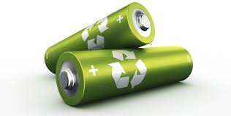
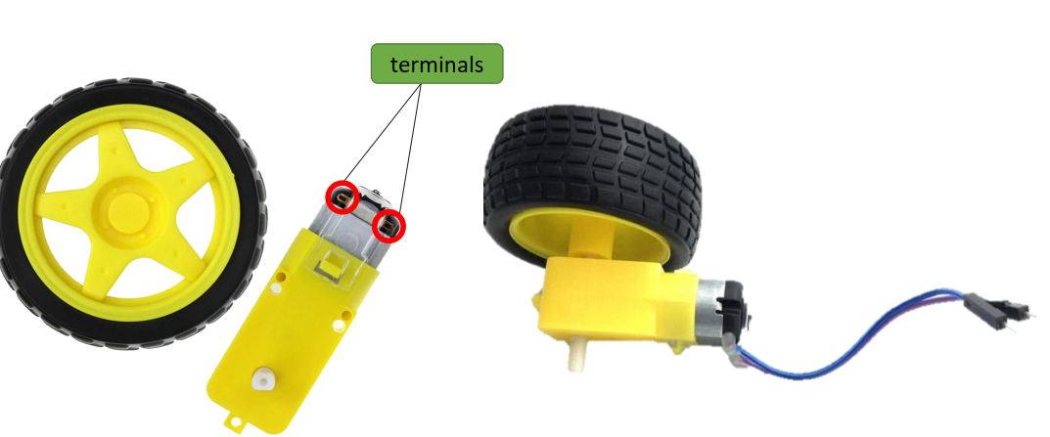
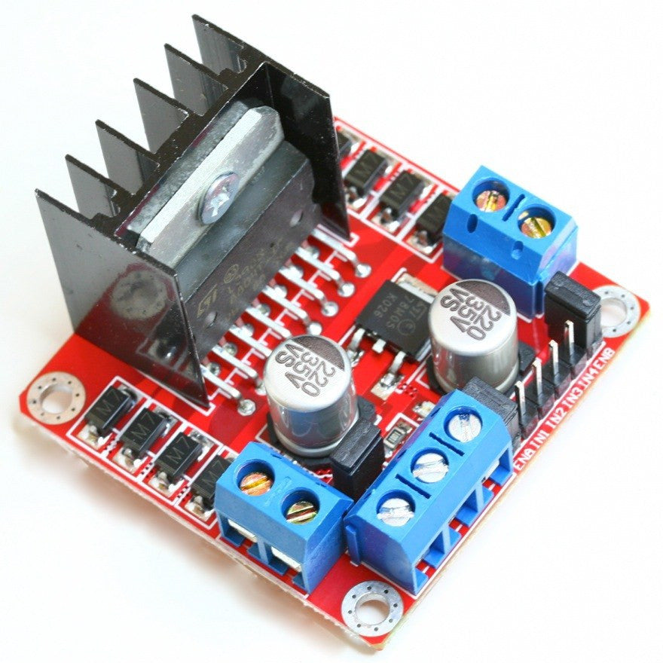
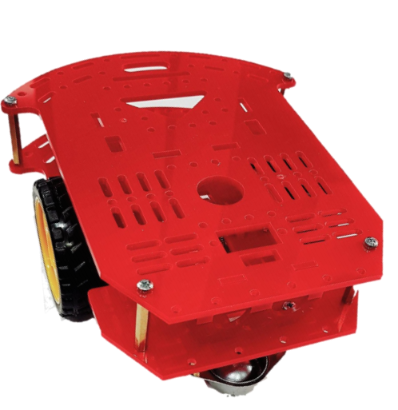
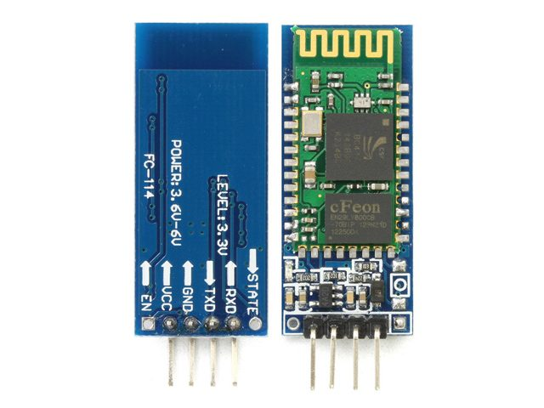
Battaries
components
DC MOTOR
Motor driver
BODY
Bluetooth chip

Slide 4
02
Connection

Slide 5
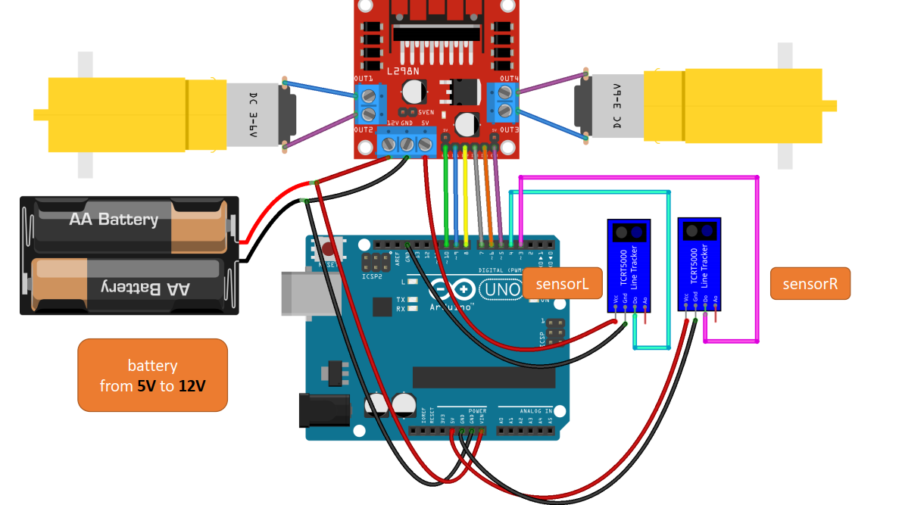
CONNECTION

Slide 6
03
CoDE

Slide 7
Code
#define speedl 6
#define speedr 3
String sound;
char reading ;
void setup() {
DDRD = 0b11111111;
Serial.begin(9600);
} void forward()
{
PORTD = 0b11011000 ;
analogWrite(speedl ,150);
analogWrite(speedr ,100);
}
void backward()
{
PORTD= 0b01101100;
}
void right()
{
PORTD= 0b11000000;
}
void left()
{
PORTD= 0b00011000;
}
void stopp()
PORTD= 0b00000000;
}
void loop() {
if(Serial.available()>0){
reading=Serial.read();
switch(reading){
case 'f' : forward();break;
case 'b' : backward();break;
case 'r' : right();break;
case 'l' : left();break;
case 's' : stopp();break;
}
}
}

Slide 8
THANK YOU

