Slide 1



WELCOME TO
EALPR SYSTEM

Slide 2


Our team
Mohamed Hanafy
Mahmoud Ali
Zeyad Ameen
Rashad Samir
Gamal Eldein Ayman
supervised by
Dr. Mohammed El-Said

Slide 3
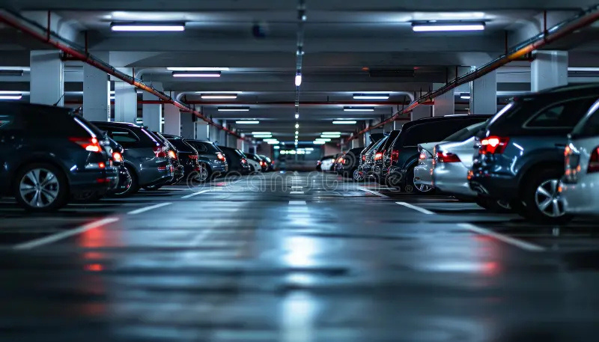
AGENDA
01 INTRODUCTION
02 PROBLEMS & MOTIVATION
03 PROJECT GOALS
04 CHALLENGES
05 SYSTEM OVERVIEW
06 IMPLEMENTATION WORKFLOW
07 USED TECHNOLOGIES
08 PROJECT FEATURES
09 USE CASES
10 FUTURE WORK

Slide 4

INTRODUCTION
Automates car plate recognition using AI and computer vision.
Captures live video, detects Egyptian license plates, extracts characters, and checks against a database.
Support security, traffic managment, and parking control

Slide 5
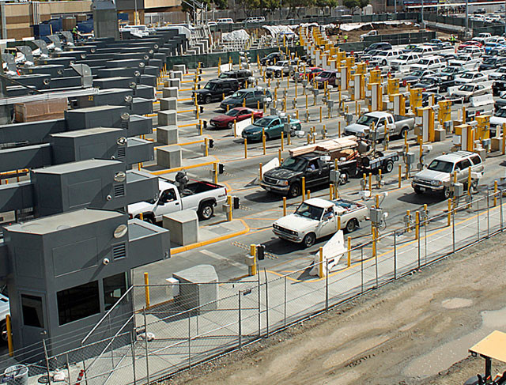

Problems & motivation
Problems
Motivation
Manual plate checks lead to delays and human errors
No real-time system to handle Egyptian plates
Security environments need faster, more accurate systems
Our system reduces human effort and improves access control using AI

Slide 6




Enhance traffic monitoring, parking management
Project Goals
Improve security and reduce manual effort
Create a reliable tool for future smart city applications

Slide 7


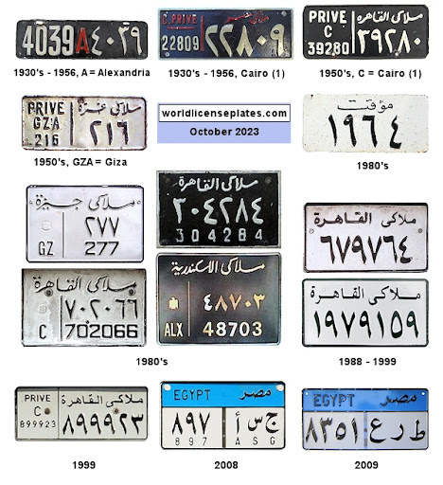
CHALLENGES
Recognizing Egyptian license plates that include both Arabic letters and numbers.
1
2
Handling Arabic text direction and reshaping characters for correct display.
Ensuring accurate plate detection and recognition in real-time video
3

Slide 8



Detection: Identifies license plate in video stream
01.
System Overview
Recognition: Uses OCR to extract and format Arabic text
02.
Database Check: Matches plate with local vehicle info
03.

Slide 9
Implementation workflow
1
2
3
4
5
6
VIDEO CAPTURE
LICENSE PLATE DETECTION
PLATE CROPPING
CHARACTER RECOGNITION
DATABASE LOOKUP
DISPLAY RESULTS

Slide 10
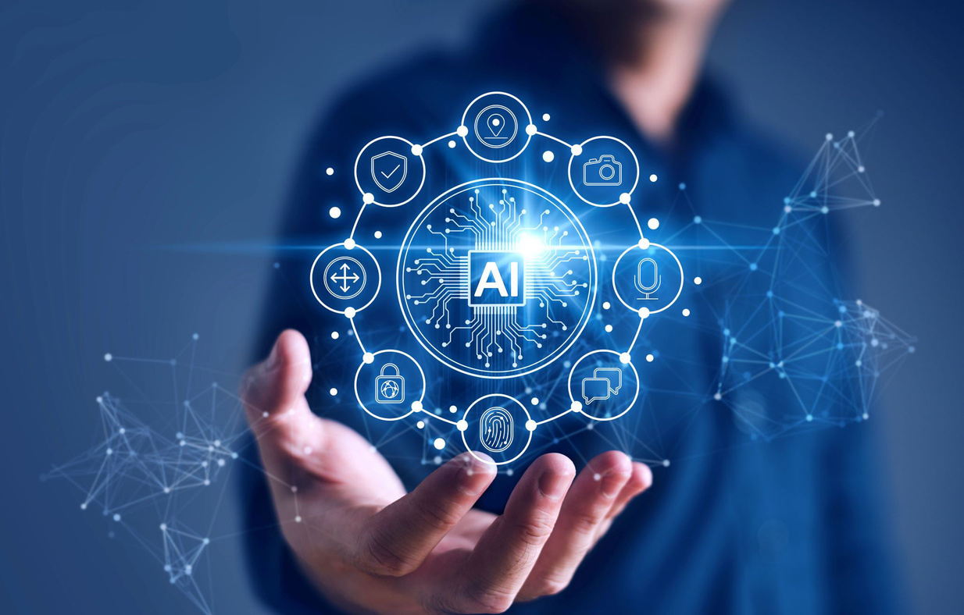
FRONT END
BACKEND
Used technologies
Flask
HTML / CSS
MongoDB
JavaScript
Bootstrap
jQuery
ML
OpenCV
PaddleOCR
EasyOCR
YOLO

Slide 11








Project Features
01
02
03
04
Real-time detection
Arabic plate recognition
Fast database search
authorized vehicle management

Slide 12
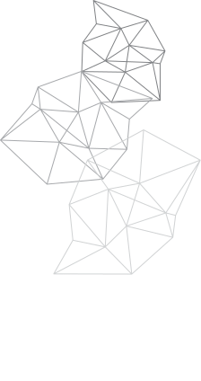
USE CASES
University gates
Residential communities
Parking lots
Corporate campuses

Slide 13
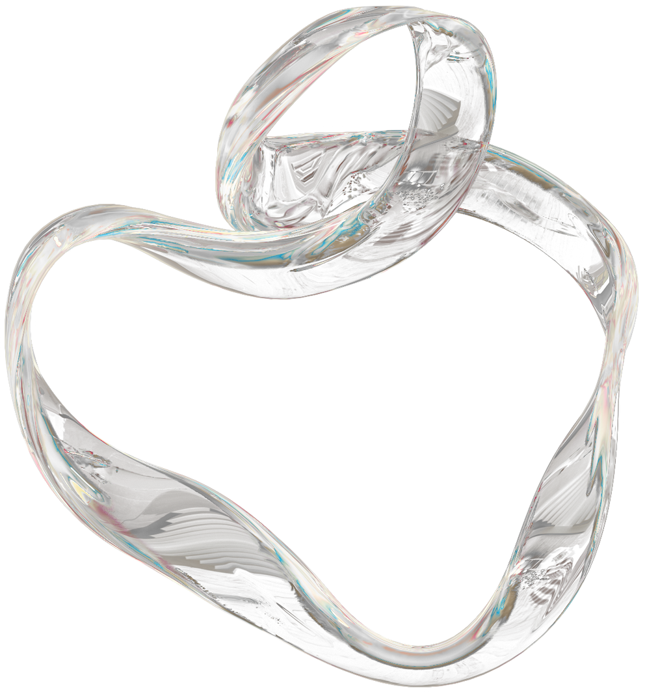

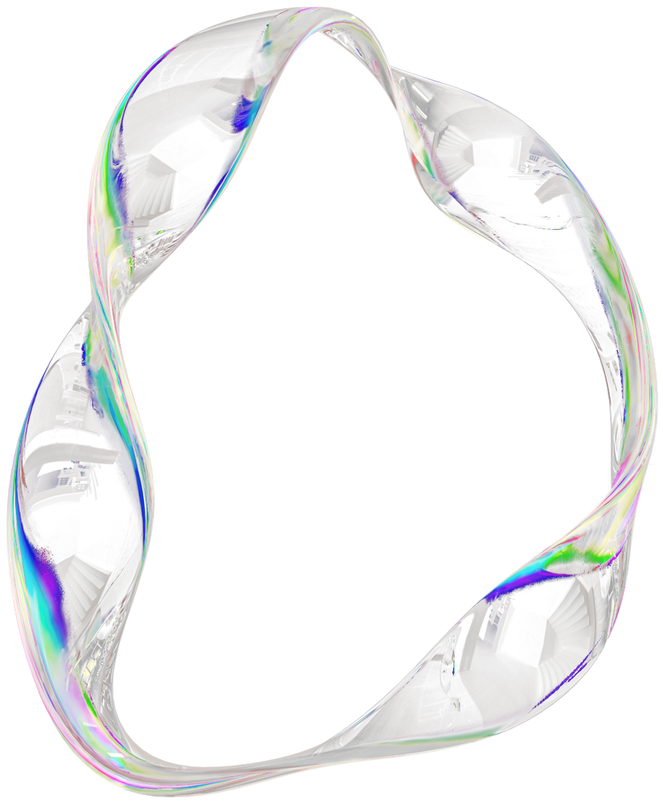
FUTURE WORK
Integration with smart gates and barriers for automated access control
Expansion to support multi-vehicle detection in crowded scenes
Enhanced model training for diverse lighting and weather conditions.
Mobile app for remote monitoring and alerts

Slide 14





Conclusion
Our project presents an intelligent system that detects and recognizes Egyptian car plates in real time using computer vision and OCR technologies. It accurately reads Arabic and numeric characters and retrieves related driver and vehicle information from a local database. offers a smooth user experience, and proves that artificial intelligence can enhance security, reduce human error, and automate vehicle identification processes efficiently

Slide 15
THANK YOU

