Slide 1
CYBERSECURITY | WINDOWS ADMINISTRATION | ACTIVE DIRECTORY
Windows Active Directory & Group Policy Home Lab
Building and Managing a Windows Domain Environment
Mohamed Ali Mohamed
Cybersecurity Graduate
linkedin.com/in/mohamed-ali-481a70387
mo5665ali@gmail.com

Slide 2
01 PROJECT INTRODUCTION
About the Project
This is a hands-on Windows infrastructure and cybersecurity home lab. I built it to simulate a small organization with a central domain, departments, users and managed workstations.
Windows Server 2025
Windows 11 Pro
Active Directory DS
DNS
The goal was practical experience managing a centralized Windows environment, not treating every PC as a separate island. The domain in my lab is test.local.
Organizational Units
Users
Security Groups
Group Policy
Everything in this deck comes from my own lab notes and screenshots. Where something was not documented, I say so.
Logon / startup scripts
Password policy
Domain-joined client

Slide 3
01 PROJECT INTRODUCTION
What I Wanted to Learn
How Active Directory works
What a Domain Controller does
Creating and managing users
Organizing users with OUs
Creating security groups
Joining computers to a domain
Why DNS matters for Active Directory
Creating and managing Group Policies
Applying policies per department
Managing Windows clients centrally
Running scripts through Group Policy
Applying password security controls
Troubleshooting a Windows domain

Slide 4
01 PROJECT INTRODUCTION
Project Journey
The deck follows the same order I built the lab in.
Requirements
Virtual machines
Server & network
AD DS & DNS
OUs, users, groups
Windows 11 domain join
Group Policy
Department policies
Scripts & password policy
Testing & lessons
Machine setup > Directory services > Policy management > Verification

Slide 5
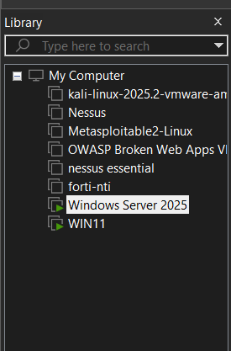
02 LAB REQUIREMENTS
Lab Requirements
1. Windows Server 2025
Role: Domain Controller. Hosts Active Directory Domain Services, DNS and Group Policy management. Computer name in my lab: ADMIN-Server.
2. Windows 11 Pro
Role: domain-joined client workstation used to receive users and policies. Additional Windows 11 machines could represent more users or departments.
Both machines run as virtual machines. The VM library on the right shows the two lab machines.
VM library: Windows Server 2025 and WIN11

Slide 6
02 LAB REQUIREMENTS
Lab Architecture
Windows Server 2025 - ADMIN-Server - 192.168.0.10
Active Directory Domain Services (test.local)
DNS
Windows 11 Pro client
PC-11 (domain: test.local)
DNS: 192.168.0.10
DNS, sign-in, policy
Organizational Units: IT, HR, Finance, Sales, Groups
Users and security groups
Only the two machines documented in my notes are shown. I did not add other servers or network devices.
Group Policy Objects

Slide 7
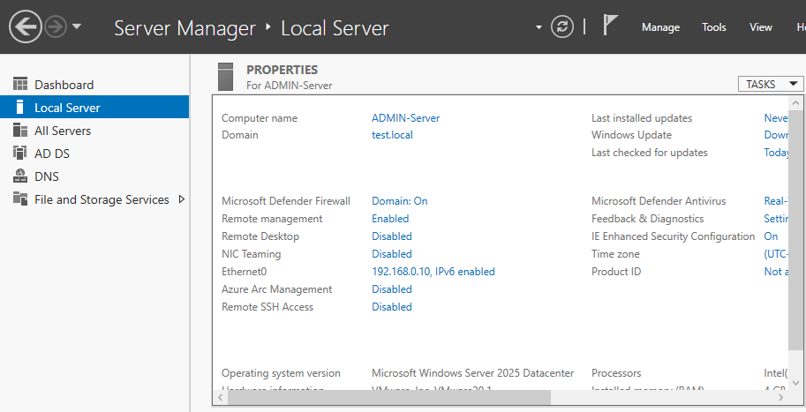
03 MACHINE PREPARATION
Windows Server Preparation
WHAT Installed Windows Server 2025 and gave the server the static IP 192.168.0.10.
HOW Set the Ethernet IP from the network adapter settings (ncpa.cpl is the tool in my command list). Server Manager then shows Ethernet0 as 192.168.0.10.
WHY A Domain Controller needs a predictable address. Clients and other services rely on it for DNS and for finding Active Directory, so it must not change.
RESULT A fixed, reachable server ready for the AD DS role. The server shows as ADMIN-Server in domain test.local.
Server Manager > Local Server (ADMIN-Server, test.local, Ethernet0 192.168.0.10, Windows Server 2025 Datacenter)
NOTE Subnet mask, gateway and server date/time steps are not explicitly documented in the original lab notes.

Slide 8
03 MACHINE PREPARATION
Windows 11 Client Preparation
WHAT Prepared the Windows 11 Pro machine before joining it to the domain.
HOW Installed Windows 11 Pro, changed the PC name, set the date and time, then assigned an IP in the 192.168.0.1X range with DNS 192.168.0.10.
WHY The client finds the domain through DNS. Pointing DNS at the Domain Controller lets it resolve test.local and locate Active Directory services.
RESULT The client can resolve the domain and is ready to join it.
Setting | Value in my lab
Operating system | Windows 11 Pro
Computer name | PC-11 (notes say PC11)
Client IP | 192.168.0.1X range
DNS server | 192.168.0.10
Date & time | Changed (value not recorded)
The exact client address and the PC11 vs PC-11 spelling are shown as documented: my notes say PC11, the screenshot shows PC-11.

Slide 9
04 ACTIVE DIRECTORY
Installing Active Directory Domain Services
WHAT Installed AD DS on the server and created the domain.
HOW Per my notes: set up Active Directory and assigned 192.168.0.10. Server Manager lists AD DS and DNS, and the domain is test.local.
WHY To get a central directory that can hold OUs, users, groups and GPOs.
RESULT Domain test.local running on ADMIN-Server.
What it is and why it matters
Active Directory Domain Services (AD DS) is the Windows directory service. It stores users, groups and computers in one place and handles authentication for the domain.
In an enterprise it replaces per-PC accounts with central identity and policy. That is why my project needs a Domain Controller: without one there is nothing to join, sign in to, or apply policy from.
NOTE Promotion wizard screens and functional levels are not explicitly documented in the original lab notes.

Slide 10
04 ACTIVE DIRECTORY
Domain Controller Configuration
Item | Value (from my screenshots)
Operating system | Windows Server 2025 Datacenter
Computer name | ADMIN-Server
Domain | test.local
IP address | 192.168.0.10 (Ethernet0)
Roles shown | AD DS, DNS, File and Storage Services
Platform | VMware virtual machine, 4 GB RAM visible
How a client reaches the directory
Client (PC-11)
DNS 192.168.0.10
Domain Controller
The client asks DNS where the domain is. DNS on the Domain Controller answers, and the client then talks to Active Directory.
Active Directory

Slide 11
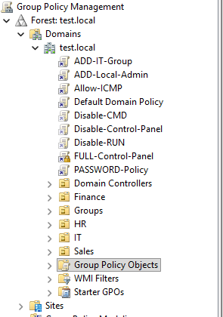
04 ACTIVE DIRECTORY
Organizational Units
WHAT Created OUs for the departments: IT, HR, Finance and Sales, plus a Groups OU for the security groups.
HOW In Active Directory Users and Computers (dsa.msc).
WHY An OU is a logical container for users and computers. Departmental OUs keep the directory tidy, let me apply different GPOs per department, and allow delegated administration.
RESULT Each department can be managed and policed separately. HR, Sales and Finance each carry their own GPOs.
GPMC tree: Finance, Groups, HR, IT, Sales

Slide 12
05 USERS & GROUPS
Creating Users
WHAT Created users for the departments (IT, HR, Finance, Sales) and an Admin group.
HOW Users are created in Active Directory Users and Computers (dsa.msc) inside the department OU.
WHY Separate departmental users let me test different policies on different people, and central accounts mean one place to manage sign-ins.
RESULT Domain users that can sign in on domain-joined PCs and receive the policies of their OU.
NOTE My screenshots do not show individual user account names, so I do not list any. Usernames and passwords are not recorded in the original notes.
Centralized user management means one account works across domain PCs and one change applies everywhere.

Slide 13
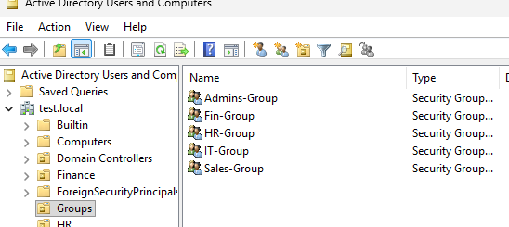
05 USERS & GROUPS
Security Groups
Group | Type | Matches
IT-Group | Security Group | IT
HR-Group | Security Group | HR
Fin-Group | Security Group | Finance
Sales-Group | Security Group | Sales
Admins-Group | Security Group | Admin
Active Directory Users and Computers: Groups OU
Why groups: assign access to a group instead of to each person.
With GPOs: groups can be used for filtering and for local admin rights (IT-Group is used that way).
Matches column: inferred from the group names.

Slide 14
06 WINDOWS 11 DOMAIN JOIN
Joining Windows 11 to the Domain
1
Configure the client IP
6
Choose Change > Domain: test.local
2
Set DNS to 192.168.0.10
7
Enter domain credentials
3
Confirm DNS points to the Domain Controller
8
Restart the computer
4
Change the computer name
9
Sign in with a domain account
5
Open System Properties (sysdm.cpl)
10
Check the computer in Active Directory
NOTE Teal steps are backed by my notes or screenshots. Steps 7 to 9 are the standard process and were not captured as screenshots.

Slide 15
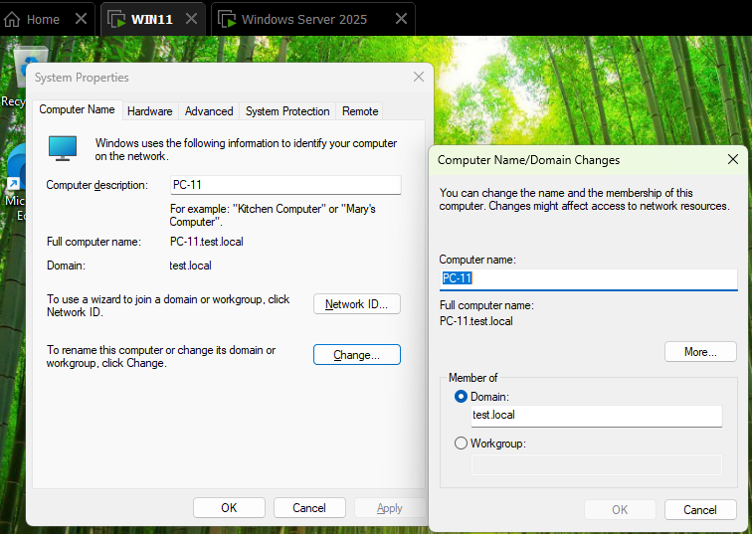
06 WINDOWS 11 DOMAIN JOIN
Domain Join in Practice
WHAT Joined the Windows 11 client to test.local.
HOW Set the DNS server to 192.168.0.10 first. Then in System Properties > Change, selected Domain and entered test.local. The screenshot shows the full name PC-11.test.local.
WHY Domain join looks up the domain through DNS. If DNS points elsewhere, the join fails.
RESULT The client became a member of test.local and could be managed by Group Policy.
Windows 11: System Properties > Change > Domain: test.local

Slide 16
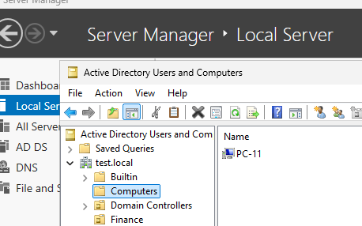
06 WINDOWS 11 DOMAIN JOIN
Domain Environment Verification
Joined: System Properties shows the domain test.local and full name PC-11.test.local.
Computer object: PC-11 appears in the Computers container in dsa.msc (screenshot).
Domain users sign in: sign in as a domain account on the client.
Policies reach the client: run gpupdate /force, then check the expected behavior of each GPO.
PC-11 listed in the Computers container
The first two items are shown in my screenshots. The last two are the checks I used in testing.

Slide 17
07 GROUP POLICY
Introduction to Group Policy
Group Policy lets an administrator centrally control settings for users and computers in a domain. Instead of changing each PC, I change a GPO once and it applies everywhere it is linked.
User Configuration
Computer Configuration
Settings that follow the person who signs in: desktop, Start menu, Control Panel and Task Manager access, and similar restrictions.
Many of my department restrictions belong here.
Settings that apply to the machine no matter who signs in: security settings, account policies, scripts at startup.
My PASSWORD-Policy is edited here (Computer Configuration > Windows Settings > Security Settings > Account Policies).

Slide 18
07 GROUP POLICY
Group Policy Structure
Domain test.local - GPOs linked at the domain
Default Domain Policy | FULL-Control-Panel (enforced) | ADD-Local-Admin | ADD-IT-Group | Allow-ICMP | PASSWORD-Policy
OU: HR
OU: Sales
OU: Finance
Remove-Clock, Disable-Properties, Disable-USB, Enable-Conrol_panel, Disable-Task-Manager, Creat-ShourtCut
Disable-USB, Disable-Task-Manager, Disable-Properties, Remove-Clock, Calc-ON
Calc-ON, Disable-Properties, Disable-USB, Remove-Clock, Disable-Task-Manager
Linked GPOs per OU are read from the Group Policy Inheritance tab in my screenshots. I have no policy screenshot for the IT OU, so I do not claim any.

Slide 19
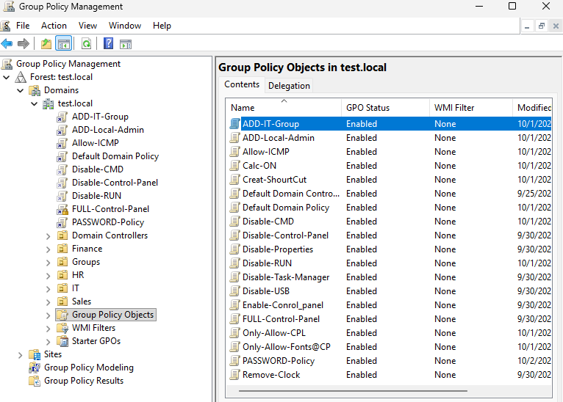
07 GROUP POLICY
Group Policy Objects in the Domain
Group | GPO names (as shown in console)
Restrictions | Disable-CMD, Disable-Control-Panel, Disable-Properties, Disable-RUN, Disable-Task-Manager, Disable-USB
Control Panel | Enable-Conrol_panel, FULL-Control-Panel, Only-Allow-CPL, Only-Allow-Fonts@CP
Desktop | Remove-Clock, Creat-ShourtCut, Calc-ON
Access | ADD-IT-Group, ADD-Local-Admin, Allow-ICMP
Security | PASSWORD-Policy
Defaults | Default Domain Policy, Default Domain Controllers Policy
Group Policy Objects in test.local: 19 GPOs, all Enabled
Names keep the exact spelling from the console, including my typos (Conrol, ShourtCut).

Slide 20
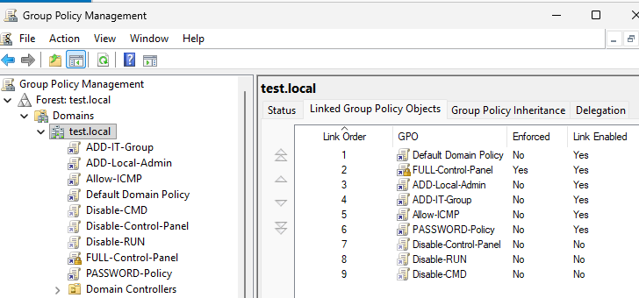
08 ALL USERS POLICY
All Users Group Policy (test.local)
Order | GPO | Enforced | Link
1 | Default Domain Policy | No | Yes
2 | FULL-Control-Panel | Yes | Yes
3 | ADD-Local-Admin | No | Yes
4 | ADD-IT-Group | No | Yes
5 | Allow-ICMP | No | Yes
6 | PASSWORD-Policy | No | Yes
7 | Disable-Control-Panel | No | No
8 | Disable-RUN | No | No
9 | Disable-CMD | No | No
Linked Group Policy Objects on test.local
Scope: every user and computer in test.local. Policies shown with Link = No exist but are not applied at the domain level.

Slide 21
08 ALL USERS POLICY
All Users: What Each Policy Does
GPO | What it does (by name / my notes) | What users see | How to test
FULL-Control-Panel (enforced) | Control Panel access rules; enforced so department GPOs cannot override it | Control Panel behaves per the policy on every OU | Open Control Panel as a user from each OU
ADD-Local-Admin | Runs the net user / net localgroup script to create a local admin | A local admin account exists on the PC | Check local users on the client after gpupdate /force
ADD-IT-Group | Adds IT-Group to local Administrators | IT-Group members have admin rights on the PC | Sign in as an IT-Group member and test admin tasks
Allow-ICMP | Allows ICMP (ping) through the client firewall | The PC answers ping | Ping the client from the server
PASSWORD-Policy | Domain password and lockout rules | Password rules apply at next change; lockout after failures | See the password policy slides
Exact setting contents are not visible in the screenshots. I describe each GPO from its name and from the commands in my notes.

Slide 22
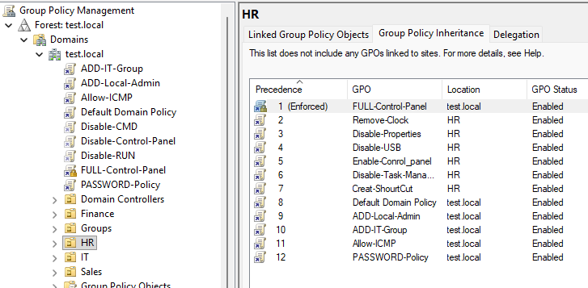
09 DEPARTMENT POLICIES
HR Group Policy
POLICY HR OU GPO set
PURPOSE Standard desktop restrictions for HR, plus a shortcut
CONFIGURATION 6 GPOs linked to the OU (next slide)
SCOPE Users and computers in the HR OU, plus inherited domain GPOs
RESULT Restricted desktop as listed next
VERIFY Sign in as a HR user, run gpupdate /force, test each item
HR OU: Group Policy Inheritance tab
Precedence 1 is FULL-Control-Panel (enforced, from test.local). HR GPOs are 2 to 7. Domain GPOs follow (8 to 12).

Slide 23
09 DEPARTMENT POLICIES
HR: Policy Details
GPO linked to HR | Purpose | Expected result | Verification
Remove-Clock | Removes the clock from the taskbar (by name) | Clock is gone from the taskbar | Check the taskbar after sign-in
Disable-Properties | Restricts Properties dialogs (by name; exact setting not visible) | Properties access is limited | Right-click an item and try Properties
Disable-USB | Blocks USB storage (by name) | USB drive cannot be used | Plug a USB drive into the client
Enable-Conrol_panel | Control Panel access for HR (by name; exact setting not visible) | Control Panel opens | Open Control Panel as an HR user
Disable-Task-Manager | Blocks Task Manager (name truncated in console) | Task Manager is blocked | Press Ctrl+Shift+Esc
Creat-ShourtCut | Creates a shortcut (by name; target not documented) | A shortcut is present at sign-in | Check the desktop after sign-in
Inherited from test.local: FULL-Control-Panel (enforced), Default Domain Policy, ADD-Local-Admin, ADD-IT-Group, Allow-ICMP, PASSWORD-Policy.

Slide 24
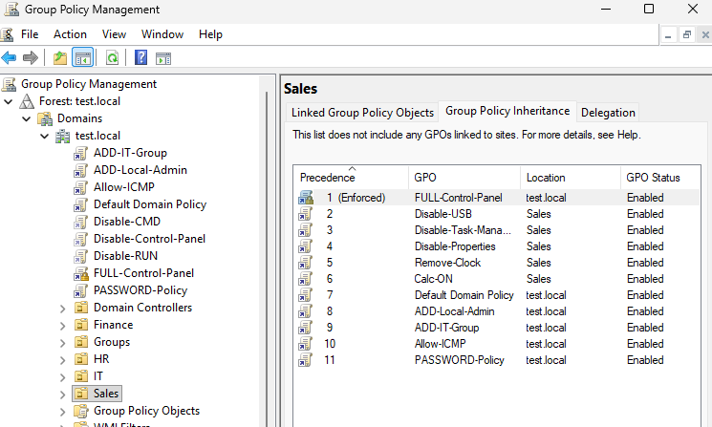
09 DEPARTMENT POLICIES
Sales Group Policy
POLICY Sales OU GPO set
PURPOSE Locked-down Sales desktop with Calculator auto-launch
CONFIGURATION 5 GPOs linked to the OU (next slide)
SCOPE Users and computers in the Sales OU, plus inherited domain GPOs
RESULT Restricted desktop as listed next
VERIFY Sign in as a Sales user, run gpupdate /force, test each item
Sales OU: Group Policy Inheritance tab
Precedence 1 is FULL-Control-Panel (enforced). Sales GPOs are 2 to 6. Domain GPOs follow (7 to 11).

Slide 25
09 DEPARTMENT POLICIES
Sales: Policy Details
GPO linked to Sales | Purpose | Expected result | Verification
Disable-USB | Blocks USB storage (by name) | USB drive cannot be used | Plug a USB drive into the client
Disable-Task-Manager | Blocks Task Manager (name truncated in console) | Task Manager is blocked | Press Ctrl+Shift+Esc
Disable-Properties | Restricts Properties dialogs (by name; exact setting not visible) | Properties access is limited | Right-click an item and try Properties
Remove-Clock | Removes the clock from the taskbar (by name) | Clock is gone from the taskbar | Check the taskbar after sign-in
Calc-ON | Auto-runs calc.exe (from my script notes) | Calculator opens at sign-in | Sign in and watch for Calculator
Inherited from test.local: FULL-Control-Panel (enforced), Default Domain Policy, ADD-Local-Admin, ADD-IT-Group, Allow-ICMP, PASSWORD-Policy.

Slide 26
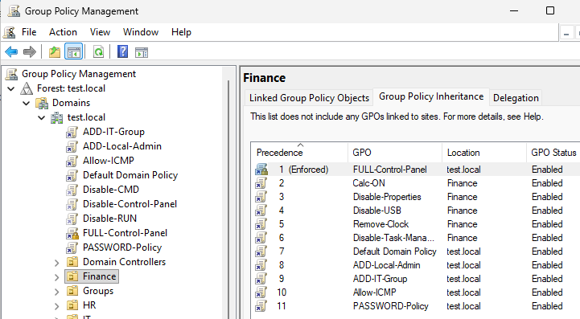
09 DEPARTMENT POLICIES
Finance Group Policy
POLICY Finance OU GPO set
PURPOSE Locked-down Finance desktop with Calculator auto-launch
CONFIGURATION 5 GPOs linked to the OU (next slide)
SCOPE Users and computers in the Finance OU, plus inherited domain GPOs
RESULT Restricted desktop as listed next
VERIFY Sign in as a Finance user, run gpupdate /force, test each item
Finance OU: Group Policy Inheritance tab
Precedence 1 is FULL-Control-Panel (enforced). Finance GPOs are 2 to 6. Domain GPOs follow (7 to 11).

Slide 27
09 DEPARTMENT POLICIES
Finance: Policy Details
GPO linked to Finance | Purpose | Expected result | Verification
Calc-ON | Auto-runs calc.exe (from my script notes) | Calculator opens at sign-in | Sign in and watch for Calculator
Disable-Properties | Restricts Properties dialogs (by name; exact setting not visible) | Properties access is limited | Right-click an item and try Properties
Disable-USB | Blocks USB storage (by name) | USB drive cannot be used | Plug a USB drive into the client
Remove-Clock | Removes the clock from the taskbar (by name) | Clock is gone from the taskbar | Check the taskbar after sign-in
Disable-Task-Manager | Blocks Task Manager (name truncated in console) | Task Manager is blocked | Press Ctrl+Shift+Esc
Inherited from test.local: FULL-Control-Panel (enforced), Default Domain Policy, ADD-Local-Admin, ADD-IT-Group, Allow-ICMP, PASSWORD-Policy.

Slide 28
10 TESTING
Testing Group Policies
Sign in as a user from the affected OU
Check whether the policy is applied
Update Group Policy on the client
Verify the expected behavior (USB, Task Manager, clock, Calculator)
Compare behavior before and after the policy
If it does not apply, check DNS, OU placement and link status
gpupdate
Refreshes policy that changed since the last refresh. Quick and normal for small edits.
gpupdate /force
Reapplies all policies, changed or not. I used it when a result looked wrong or I wanted a clean test.

Slide 29
11 SCRIPTS
Group Policy Scripts: Auto-run Calculator
Item | From my notes
Script | calc.exe
GPO | Calc-ON
Linked to | Sales and Finance OUs
WHAT Made Calculator open automatically for Sales and Finance users.
WHY It is a harmless way to prove that a GPO script really runs on the client.
RESULT Calculator launches when the script runs, which confirms scripts can automate actions.
Whether it ran as startup or logon was not explicitly documented in the original lab notes.

Slide 30
11 SCRIPTS
Creating a Local Admin Through Script
net user itadmin PASSWORD /add
net localgroup Administrators itadmin /add
Command 1: creates a local user called itadmin (PASSWORD is the placeholder from my notes).
Command 2: adds itadmin to the local Administrators group.
Linked via: the ADD-Local-Admin GPO, at the domain level.
LAB ONLY A plaintext password in a script is a lab shortcut. Scripts in SYSVOL can be read by authenticated domain users, and a domain-wide local admin account is a real risk. Do not do this in production.

Slide 31
11 SCRIPTS
Adding IT-Group to Local Administrators
net localgroup administrators IT-Group /add
What it does: adds the domain group IT-Group to the local Administrators group on each client.
Why groups: IT staff are managed by group membership, so adding or removing a person changes their rights everywhere at once.
GPO: ADD-IT-Group, linked at test.local.
LAB ONLY This gives IT-Group admin rights on every domain PC in scope. In production I would limit it by least privilege, for example admin only on the machines that need it, and review membership regularly.

Slide 32
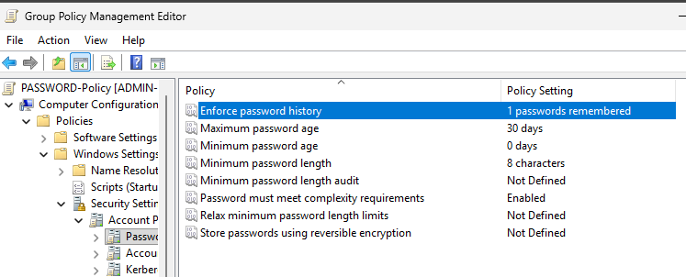
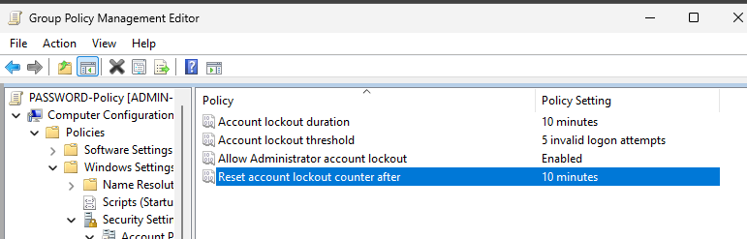
12 PASSWORD POLICY
Password Policy: As Configured
Group Policy Management Editor, PASSWORD-Policy: Computer Configuration > Windows Settings > Security Settings > Account Policies.
Password rules and lockout rules were both set in the same GPO, PASSWORD-Policy, linked to test.local.

Slide 33
12 PASSWORD POLICY
Password Policy: Values & Meaning
Setting | Value | What it controls
Enforce password history | 1 password remembered | How many old passwords cannot be reused
Maximum password age | 30 days | How long before a change is required
Minimum password age | 0 days | How soon a user may change again
Minimum password length | 8 characters | Shortest allowed password
Complexity requirements | Enabled | Mixed character types required
Account lockout threshold | 5 invalid attempts | Failed logons before lockout
Lockout duration | 10 minutes | How long the account stays locked
Reset lockout counter after | 10 minutes | When the failure count resets
Allow Administrator lockout | Enabled | Admin account can also lock out
My review
History of 1 and a minimum age of 0 days make reuse easy, and a 30-day maximum age forces frequent changes. Today I would favor longer passwords and breached-password checks. Also check that Default Domain Policy (link order 1) does not override these values.

Slide 34
13 ADMINISTRATIVE TOOLS
Windows Administrative Tools Used
Command | Purpose | Used for
ncpa.cpl | Network Connections | Change IP / DNS on the Ethernet adapter
sysdm.cpl | System Properties | Computer name and domain membership
dsa.msc | Active Directory Users and Computers | Manage users, groups, OUs, computers
gpedit.msc | Local Group Policy Editor | Local policy on one machine
gpmc.msc | Group Policy Management Console | Create and link domain GPOs
gpupdate | Update Group Policy | Apply policy that changed
gpupdate /force | Force policy refresh | Reapply all policies
My notes write the first command as cnpa.cpl. The correct Windows command is ncpa.cpl, and that is what this table uses.

Slide 35
14 TROUBLESHOOTING
Common Issues (1 of 2)
Problem | Possible cause | Check | Solution
Incorrect DNS | Client DNS is not the Domain Controller | ncpa.cpl: DNS should be 192.168.0.10 | Correct the DNS server
Incorrect IP configuration | Wrong address or range | ncpa.cpl on server and client | Use a free 192.168.0.x address; server stays 192.168.0.10
Client cannot join domain | DNS or connectivity problem | Can the client reach 192.168.0.10? | Fix DNS first, then retry in sysdm.cpl
User cannot authenticate | Wrong credentials, lockout, or password rule | Account status in dsa.msc | Reset password or wait out the 10-minute lockout
Common troubleshooting considerations. These are generic checks, not issues I claim to have hit.

Slide 36
14 TROUBLESHOOTING
Common Issues (2 of 2)
Problem | Possible cause | Check | Solution
Group Policy not applying | Wrong OU, link disabled, policy not refreshed | gpmc.msc: link status and OU | Enable the link, move the object, run gpupdate /force
Computer not in Active Directory | Join did not finish, or wrong container | dsa.msc: Computers container | Rejoin via sysdm.cpl, then move to the right OU
Policy change not visible | Policy not yet refreshed | Wait for refresh or sign out | Run gpupdate or gpupdate /force
Incorrect OU placement | Object created in the wrong OU | dsa.msc: object location | Move the user or computer to the right OU
Common troubleshooting considerations. These are generic checks, not issues I claim to have hit.

Slide 37
15 SECURITY
Security Considerations
Centralized identity
Least privilege
Group-based admin
Password security
One directory for all accounts
Admin rights only where needed
Manage people by group
History, length, complexity, lockout
Policy enforcement
Domain management
Department separation
Controlled admin access
Enforced GPOs the OU cannot override
Clients controlled from the server
OUs with their own GPOs
IT-Group and itadmin scope
NOTE Some of my lab choices need hardening for production (next slide).

Slide 38
15 SECURITY
From Lab Shortcut to Production Practice
What I did in the lab | Production practice
Plaintext password in a script (itadmin) | Never store passwords in scripts; use a managed solution
ADD-Local-Admin linked to the whole domain | Control local admin creation; avoid domain-wide admin accounts
IT-Group added to local Administrators everywhere | Least privilege: admin only where needed, reviewed regularly
Policies applied straight to departments | Test GPOs on a pilot OU before broad deployment
History of 1, minimum age 0, 30-day expiry | Review against current guidance, favor length and breach checks

Slide 39
16 WHAT I LEARNED
Skills Developed
Windows Server
Active Directory
DNS
Windows Server 2025, server configuration, network configuration
Domain Controllers, users, groups, OUs, domain management
DNS configuration, client DNS settings, DNS dependency for AD
Group Policy
Windows Clients
Automation
GPO creation and organization, user and department policies, testing, updates
Windows 11 configuration, domain joining, domain authentication
Windows commands, Group Policy scripts, basic administrative automation

Slide 40
16 WHAT I LEARNED
What This Project Taught Me
Before this lab I thought of each Windows PC as its own machine. Building it showed me that in a domain, the PCs are managed from one place. I change a policy once and it follows the user.
User
Group
OU
Group Policy
Windows client
Seeing a policy land on PC-11 after gpupdate /force made the idea concrete. I also saw how easy it is to over-grant access, which is why my security slides call out the weak spots.

Slide 41
17 NEXT STEPS
Future Improvements
FUTURE ideas only. None of these are part of the current lab.
Add more Windows clients
Add a dedicated file server
Implement more advanced GPOs
Configure Windows auditing
Enable centralized event logging
Integrate a SIEM (Wazuh)
Monitor Windows security events
Create attack-and-defense scenarios
Test common AD attacks in a controlled lab
Implement backup and recovery scenarios
Add PowerShell automation
Add endpoint security monitoring

Slide 42
PROJECT SUMMARY
Built
A Windows domain (test.local) with a Domain Controller, a Windows 11 client, OUs, groups and department GPOs.
Used
Windows Server 2025, Windows 11 Pro, AD DS, DNS, Group Policy, scripts, password policy.
Learned
How central identity, groups, OUs and policy work together, and where lab shortcuts need hardening.
Why it matters
Domain management is the core of most enterprise environments I would defend or support.
Mohamed Ali Mohamed
Cybersecurity Graduate
LinkedIn: https://www.linkedin.com/in/mohamed-ali-481a70387
Email: mo5665ali@gmail.com

