Slide 1
Machine Learning
Intro

Slide 3
What is Machine Learning?
“Learning is any process by which a system improves performance from experience.”
- Herbert Simon
Definition by Tom Mitchell (1998):
Machine Learning is the study of algorithms that
improve their performance P
at some task T
with experience E.
A well-defined learning task is given by <P, T, E>.
3

Slide 4
Traditional Programming
Data Program
Computer
Output
Machine Learning
Data Output
Computer
Program
4
Slide credit: Pedro Domingos

Slide 5
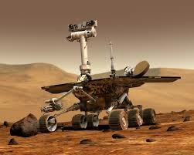
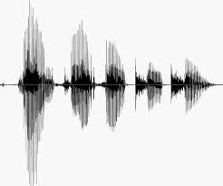
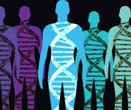
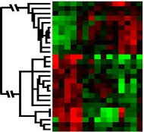
When Do We Use Machine Learning?
ML is used when:
Human expertise does not exist (navigating on Mars)
Humans can’t explain their expertise (speech recognition)
Models must be customized (personalized medicine)
Models are based on huge amounts of data (genomics)
Learning isn’t always useful:
There is no need to “learn” to calculate payroll
Based on slide by E. Alpaydin
5

Slide 6
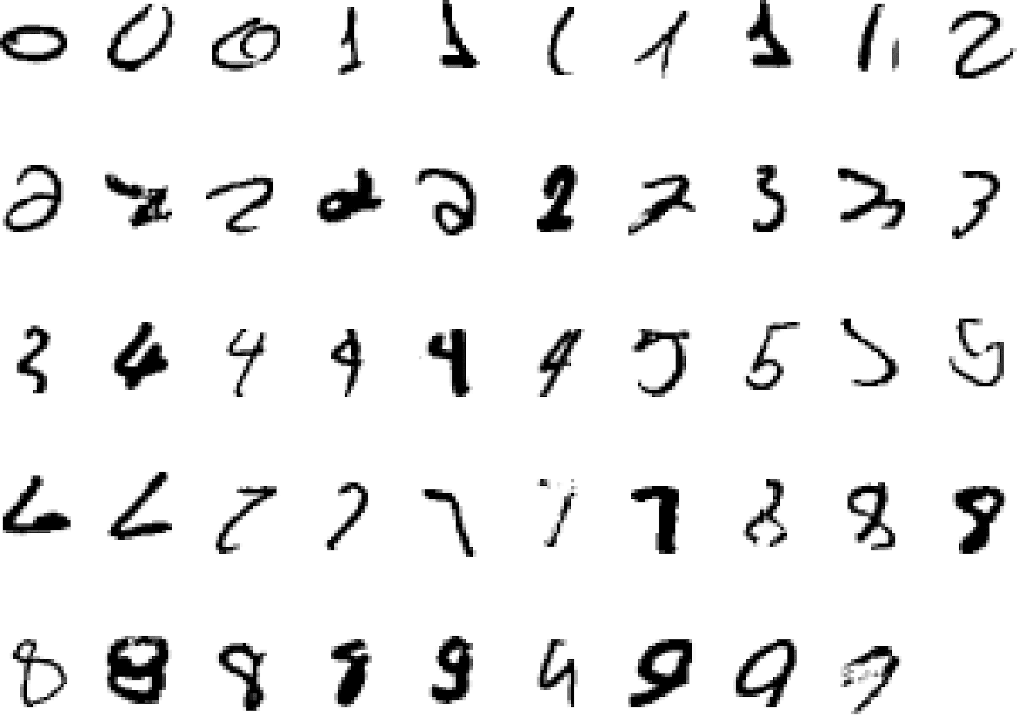
A classic example of a task that requires machine learning: It is very hard to say what makes a 2
6
Slide credit: Geoffrey Hinton

Slide 7
Some more examples of tasks that are best solved by using a learning algorithm
Recognizing patterns:
Facial identities or facial expressions
Handwritten or spoken words
Medical images
Generating patterns:
Generating images or motion sequences
Recognizing anomalies:
Unusual credit card transactions
Unusual patterns of sensor readings in a nuclear power plant
Prediction:
Future stock prices or currency exchange rates
7
Slide credit: Geoffrey Hinton

Slide 8
Sample Applications
Web search
Computational biology
Finance
E-commerce
Space exploration
Robotics
Information extraction
Social networks
Debugging software
Fashion retail
[Your favorite area]
8
Slide credit: Pedro Domingos

Slide 9
State of the Art Applications of Machine Learning
11

Slide 10
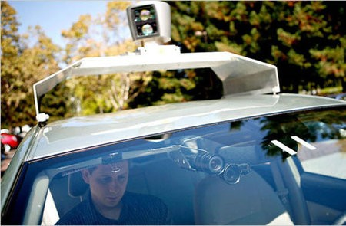
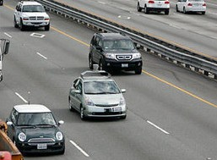
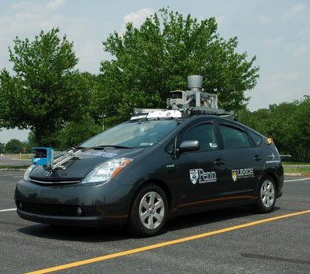
Autonomous Cars
Nevada made it legal for autonomous cars to drive on roads in June 2011
As of 2013, four states (Nevada, Florida, California, and Michigan) have legalized autonomous cars
12

Slide 11
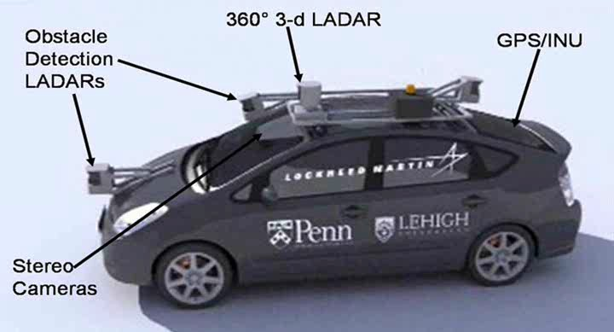
Autonomous Car Sensors
13

Slide 12
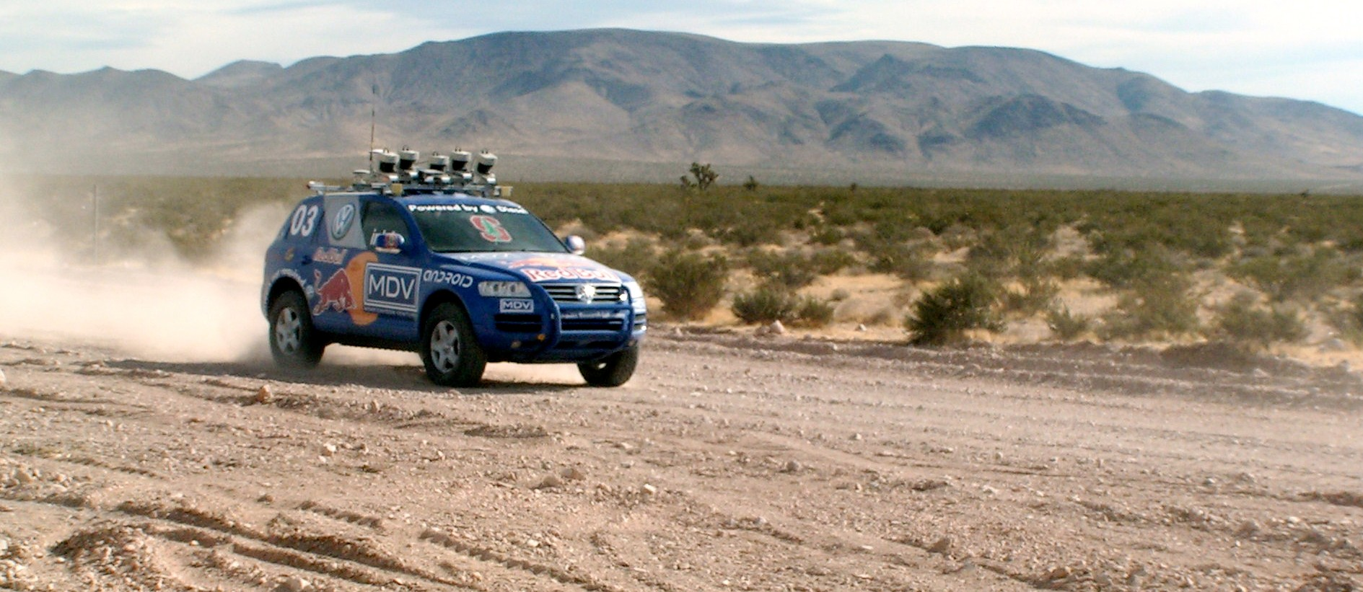
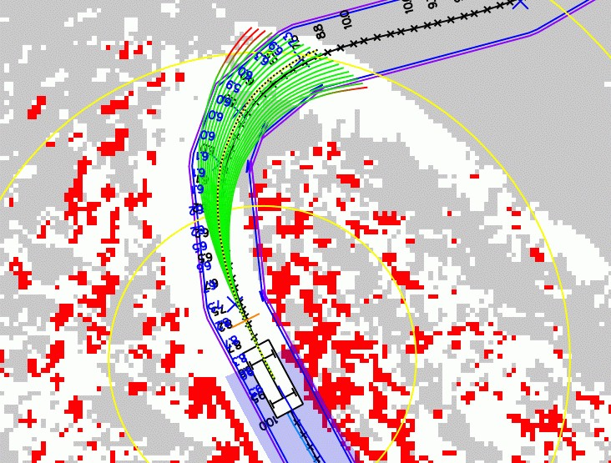
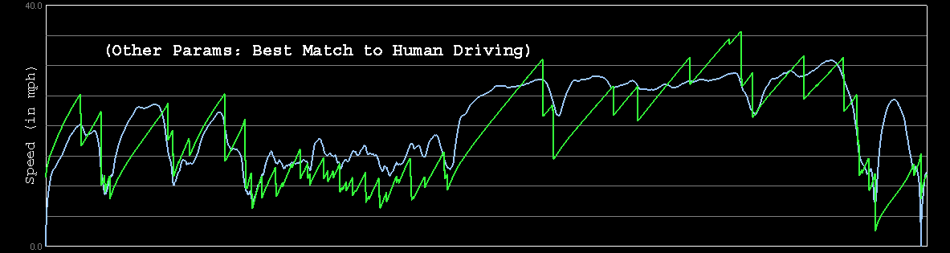

Autonomous Car Technology
Path Planning
Laser Terrain Mapping
Learning from Human Drivers
Sebastian
Adaptive Vision
Stanley
Images and movies taken from Sebastian Thrun’s multimedia w¹e⁴bsite.

Slide 13


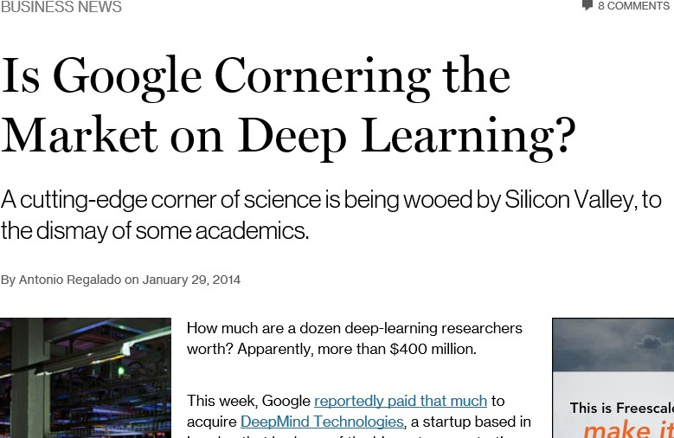
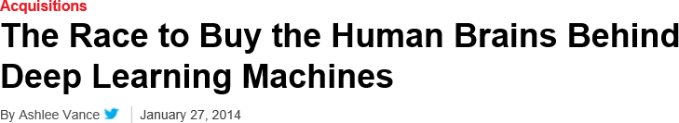
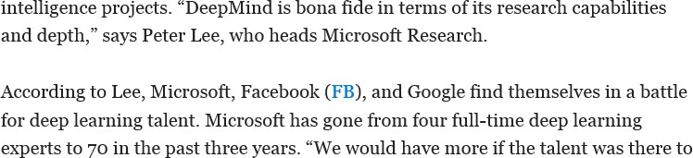
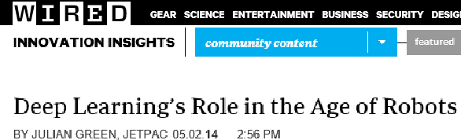
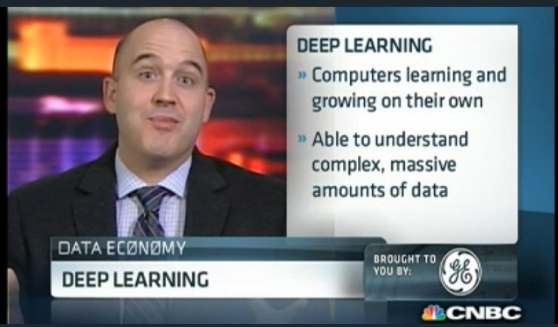
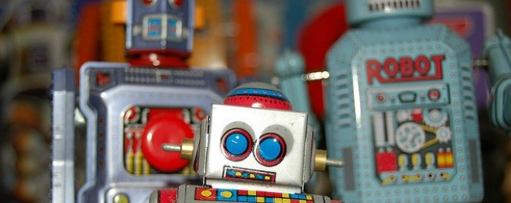
Deep Learning in the Headlines
15

Slide 14
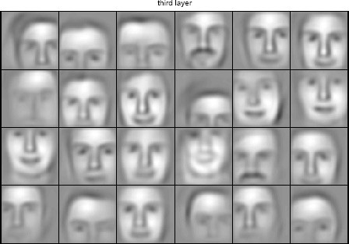
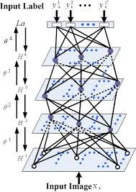

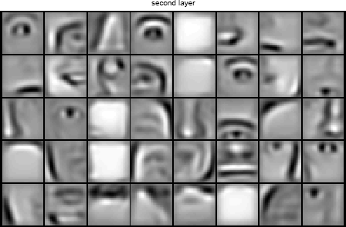


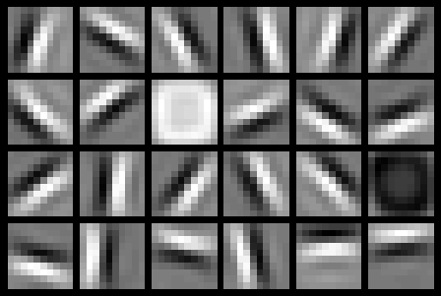




Deep Belief Net on Face Images
object models
object parts (combination of edges)
edges
pixels
Based on materials by Andrew Ng
16

Slide 15
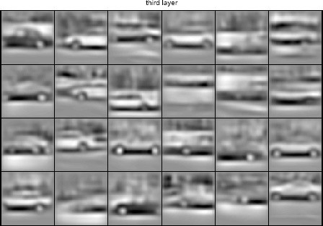
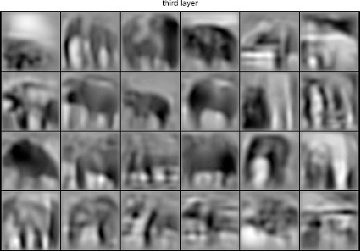
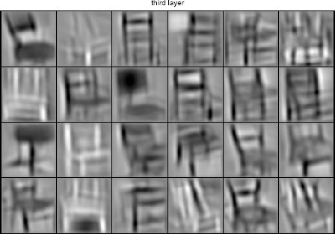
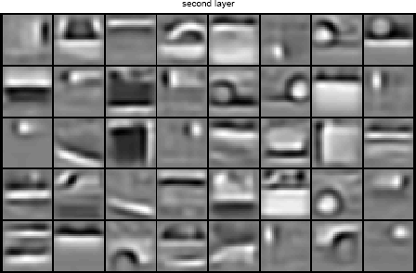
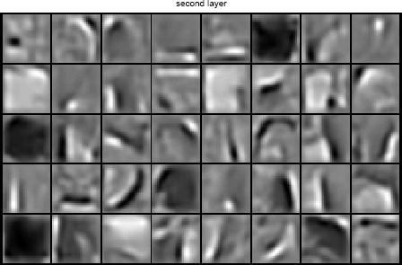
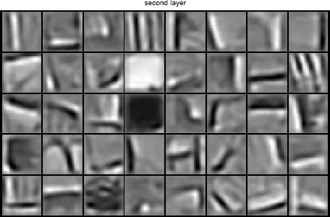
Learning of Object Parts
17
Slide credit: Andrew Ng

Slide 16
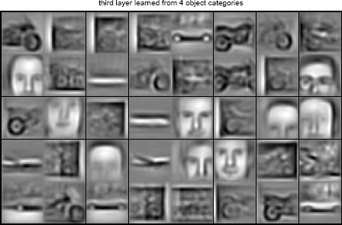
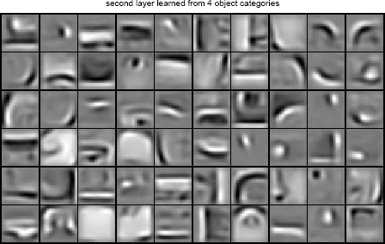
Training on Multiple Objects
Trained on 4 classes (cars, faces, motorbikes, airplanes).
Second layer: Shared-features and object-specific features.
Third layer: More specific features.
18
Slide credit: Andrew Ng

Slide 17
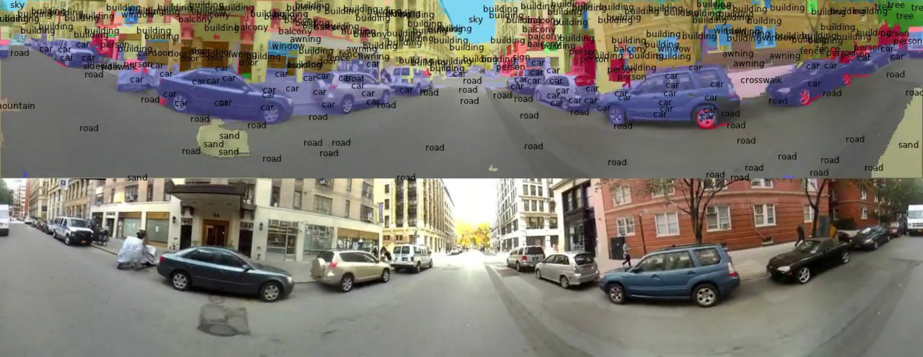
Scene Labeling via Deep Learning
[Farabet et al. ICML 2012, PAMI 2013]
19

Slide 18
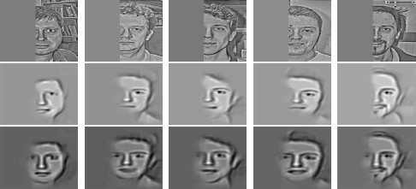
Inference from Deep Learned Models
Generating posterior samples from faces by “filling in” experiments
(cf. Lee and Mumford, 2003). Combine bottom-up and top-down inference.
Input images
Samples from feedforward Inference (control)
Samples fromFull posterior inference
20
Slide credit: Andrew Ng

Slide 19
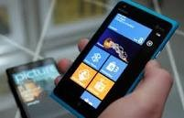
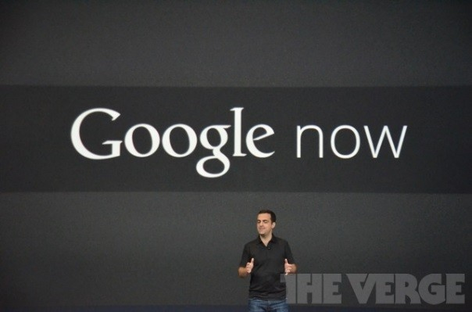
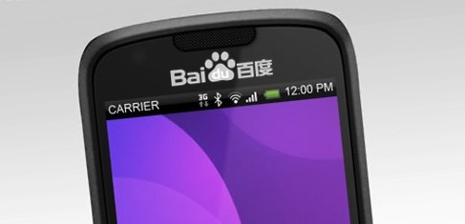
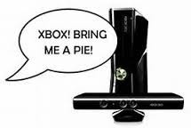



Impact of Deep Learning in Speech Technology
22
Slide credit: Li Deng, MS Research

Slide 20
Types of Learning
23

Slide 21
Types of Learning
Supervised (inductive) learning
Given: training data + desired outputs (labels)
Unsupervised learning
Given: training data (without desired outputs)
Semi-supervised learning
Given: training data + a few desired outputs
Reinforcement learning
Rewards from sequence of actions
24
Based on slide by Pedro Domingos

Slide 22




Supervised Learning: Regression
Given (x₁, y₁), (x₂, y₂), ..., (x_{n}, y_{n})
Learn a function f(x) to predict y given x
– y is real-valued == regression
9
8
7
6
5
4
3
2
1
0
1970 1980
September Arctic Sea Ice Extent (1,000,000 sq km)
1990 2000
2010
2020
Year
Data from G. Witt. Journal of Statistics Education, Volume 21, Number 1 (2013)
26

Slide 23










Supervised Learning: Classification
Given (x₁, y₁), (x₂, y₂), ..., (x_{n}, y_{n})
Learn a function f(x) to predict y given x
– y is categorical == classification
Breast Cancer (Malignant / Benign)
1(Malignant)
0(Benign)
Tumor Size
27
Based on example by Andrew Ng

Slide 24












Supervised Learning
x can be multi-dimensional
– Each dimension corresponds to an attribute
Clump Thickness
Uniformity of Cell Size
Uniformity of Cell Shape
…
Age
Tumor Size
30
Based on example by Andrew Ng

Slide 25















Unsupervised Learning
Given x₁, x₂, ..., x_{n} (without labels)
Output hidden structure behind the x’s
– E.g., clustering
31

Slide 26

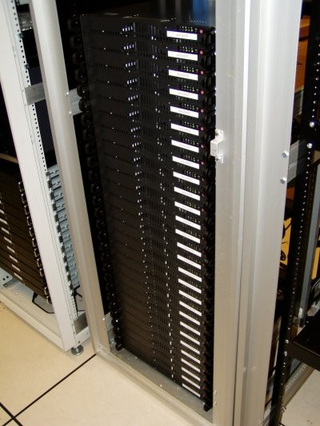
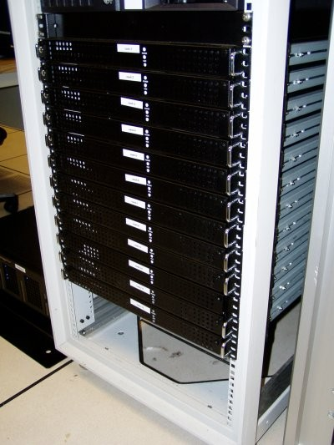




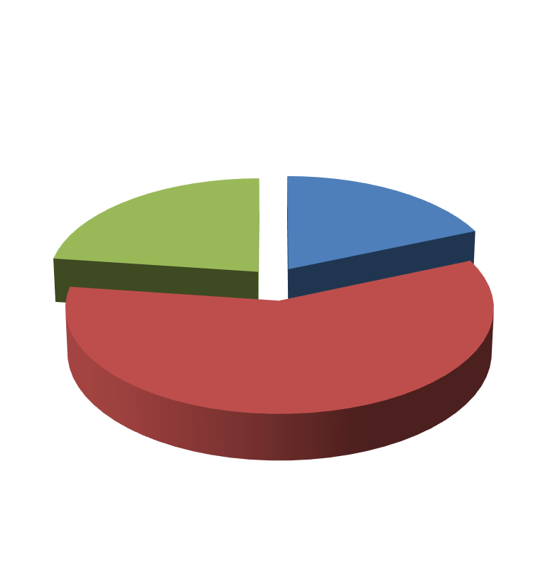

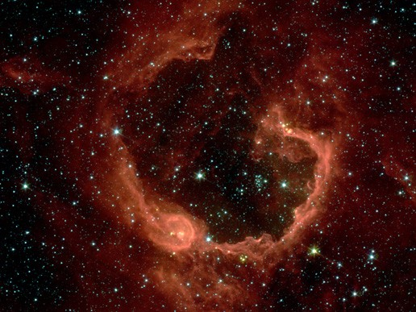


Unsupervised Learning
Organize computing clusters
Social network analysis
Market segmentation
Slide credit: Andrew Ng
Image credit: NASA/JPL-Caltech/E. Churchwell (Univ. of Wisconsin, Madison)
Astronomical data analysis
33

Slide 27
Framing a Learning Problem
40

Slide 28






Designing a Learning System
Choose the training experience
Choose exactly what is to be learned
– i.e. the target function
Choose how to represent the target function
Choose a learning algorithm to infer the target function from the experience
Training data
Learner
Environment/ Experience
Knowledge
Testing data
Performance Element
41
Based on slide by Ray Mooney

Slide 29
Training vs. Test Distribution
We generally assume that the training and test examples are independently drawn from the same overall distribution of data
– We call this “i.i.d” which stands for “independent and identically distributed”
If examples are not independent, requires
collective classification
If test distribution is different, requires
transfer learning
Slide credit: Ray Mooney
42

Slide 30
ML in a Nutshell
Tens of thousands of machine learning algorithms
Hundreds new every year
Every ML algorithm has three components:
Representation
Optimization
Evaluation
43
Slide credit: Pedro Domingos

Slide 31
Various Function Representations
Numerical functions
Linear regression
Neural networks
Support vector machines
Symbolic functions
Decision trees
Rules in propositional logic
Rules in first-order predicate logic
Instance-based functions
Nearest-neighbor
Case-based
Probabilistic Graphical Models
Naïve Bayes
Bayesian networks
Hidden-Markov Models (HMMs)
Probabilistic Context Free Grammars (PCFGs)
Markov networks
44
Slide credit: Ray Mooney

Slide 32
Various Search/Optimization Algorithms
Gradient descent
Perceptron
Backpropagation
Dynamic Programming
HMM Learning
PCFG Learning
Divide and Conquer
Decision tree induction
Rule learning
Evolutionary Computation
Genetic Algorithms (GAs)
Genetic Programming (GP)
Neuro-evolution
45
Slide credit: Ray Mooney

Slide 33
Evaluation
Accuracy
Precision and recall
F-score
Squared error
Likelihood
Posterior probability
Cost / Utility
Margin
Entropy
K-L divergence
etc.
47
Slide credit: Pedro Domingos

Slide 34


ML in Practice
Understand domain, prior knowledge, and goals
Data integration, selection, cleaning, pre-processing, etc.
Learn models
Interpret results
Consolidate and deploy discovered knowledge
Loop
48
Based on a slide by Pedro Domingos

Slide 35
Lessons Learned about Learning
Learning can be viewed as using direct or indirect experience to approximate a chosen target function.
Function approximation can be viewed as a search through a space of hypotheses (representations of functions) for one that best fits a set of training data.
Different learning methods assume different hypothesis spaces (representation languages) and/or employ different search techniques.
49
Slide credit: Ray Mooney

Slide 36
A Brief History of Machine Learning
50

Slide 37
History of Machine Learning
1950s
Samuel’s checker player
Selfridge’s Pandemonium
1960s:
Neural networks: Perceptron
Pattern recognition
Learning in the limit theory
Minsky and Papert prove limitations of Perceptron
1970s:
Symbolic concept induction
Winston’s arch learner
Expert systems and the knowledge acquisition bottleneck
Quinlan’s ID3
Michalski’s AQ and soybean diagnosis
Scientific discovery with BACON
Mathematical discovery with AM
51
Slide credit: Ray Mooney

Slide 38
History of Machine Learning (cont.)
1980s:
Advanced decision tree and rule learning
Explanation-based Learning (EBL)
Learning and planning and problem solving
Utility problem
Analogy
Cognitive architectures
Resurgence of neural networks (connectionism, backpropagation)
1990s
Data mining
Adaptive software agents and web applications
Text learning
Reinforcement learning (RL)
Inductive Logic Programming (ILP)
Ensembles: Bagging, Boosting, and Stacking
Bayes Net learning
52
Slide credit: Ray Mooney

Slide 39
History of Machine Learning (cont.)
2000s
Support vector machines & kernel methods
Graphical models
Statistical relational learning
Transfer learning
Sequence labeling
Collective classification and structured outputs
E-mail management
Learning in robotics and vision
2010s
Deep learning systems
Learning for big data
Bayesian methods
Applications to vision, speech, social networks, learning to read, etc.
53
Based on slide by Ray Mooney

Slide 40
What We’ll cover
Python overview
📖 Machine Learning with Python
Introduction to ML and Business cases
The difference between ML, Big data, Data analysis and Deep Learning
Regression problem
Linear Regression
Multi-linear regression
Polynomial regression
Regression Evaluation Metrics
Classification problem
Logistic Regression
K-nearest neighbour classifier
Decision tree classifier
Ensemble learning
Random Forest
Boosting
Classification Evaluation Metrics

Slide 41
Clustering Problems
k-nearest neighbors
K-means
Data preprocessing
Data acquisition
Data cleaning
Handling missing data
Data splitting
Feature scaling
📖 Introduction to Neural Networks. ( Preparation for the next course “ Deep Learning “ )
Introduction to Neural Networks.
Introduction to TensorFlow.
📖 Freelancing in Machine Learning.
Freelancing Projects to touch the field of work

Slide 42
📖 8 Projects. Your completed projects will become part of a career portfolio that will demonstrate to potential employers that you have skills in feature engineering, building machine learning algorithms, and model deployment.
☛Project 1: Predicting Housing Prices.
☛Project 2: predict patient length of stay in a hospital.
☛Project 3: predict sentiment in a product review dataset.
☛Project 4: Analyze financial data to predict loan defaults.
☛Project 5: predict the category of a dish's cuisine given a list of its ingredients.
☛Project 6: cluster Movies based on their synopsis.
☛Project 7: Email spam detection using Neural Networks.
☀Capstone Projects: Freelancing Projects to touch the field of work

