Slide 1


ADVANCED EMBEDDED SYSTEMS LAB · GROUP B
SmartFit Trainer
Rionela Kovaci · Christian Percival · Mohamed Abdo

Slide 2




PROJECT OVERVIEW
System Engineering
Block Diagram
Use Case
Hardware wiring → #define pins
Athlete features → firmware functions
Sequence
State Machine
Message timeline → loop() order
Connection logic → setup()/reconnect()
2

Slide 3
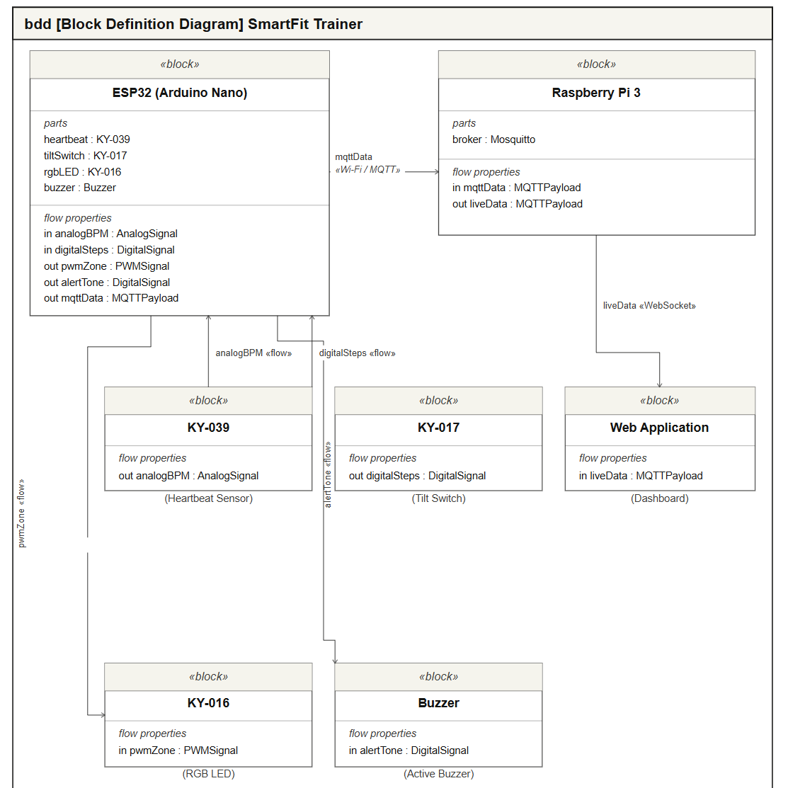




BLOCK DIAGRAM
Wiring → Pin Definitions
MAPS TO CODE
KY-039 heartbeat → A0
#define HEART_PIN A0
KY-017 tilt → D5
#define TILT_PIN 5
KY-016 RGB LED → D10–D12
LED_RED 12, LED_GREEN 11, LED_BLUE 10
Buzzer → D6
#define BUZZER_PIN 6
mqttData flow
client.publish("smartfit/...", ...)
SmartFit Trainer | Diagrams → Code
3

Slide 4
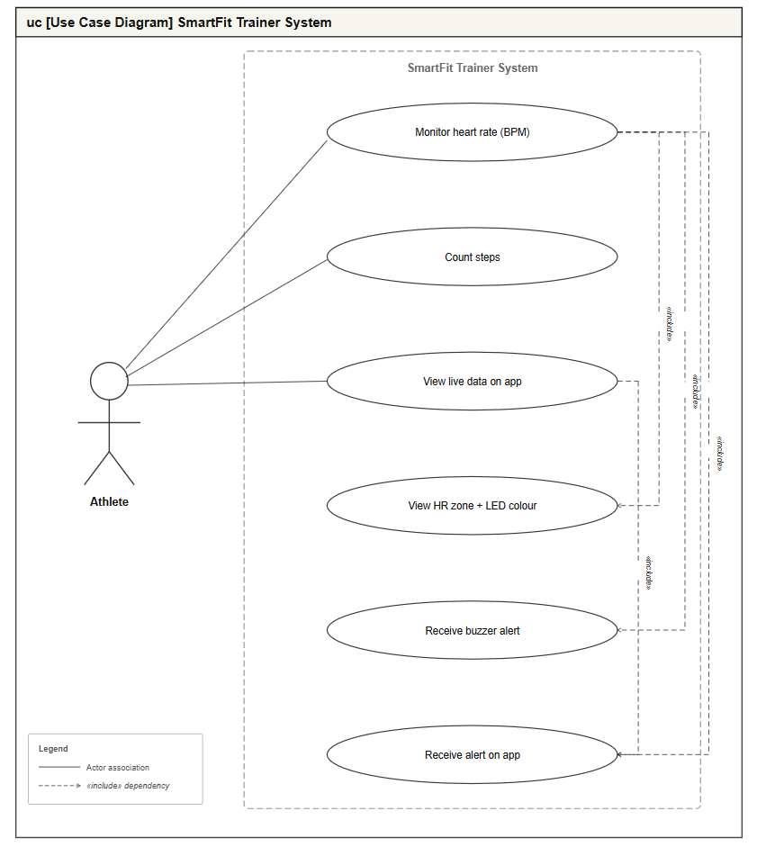

USE CASE DIAGRAM
Athlete Features → Functions
MAPS TO CODE
Monitor heart rate
heartbeatDetected() + getAverageBPM()
Count steps
readSteps()
View HR zone + LED
setHRZone() → setLEDColor()
Receive buzzer alert
digitalWrite(BUZZER_PIN, HIGH)
View live data / alert on app
client.on('message', ...) in index.html
SmartFit Trainer | Diagrams → Code
4

Slide 5
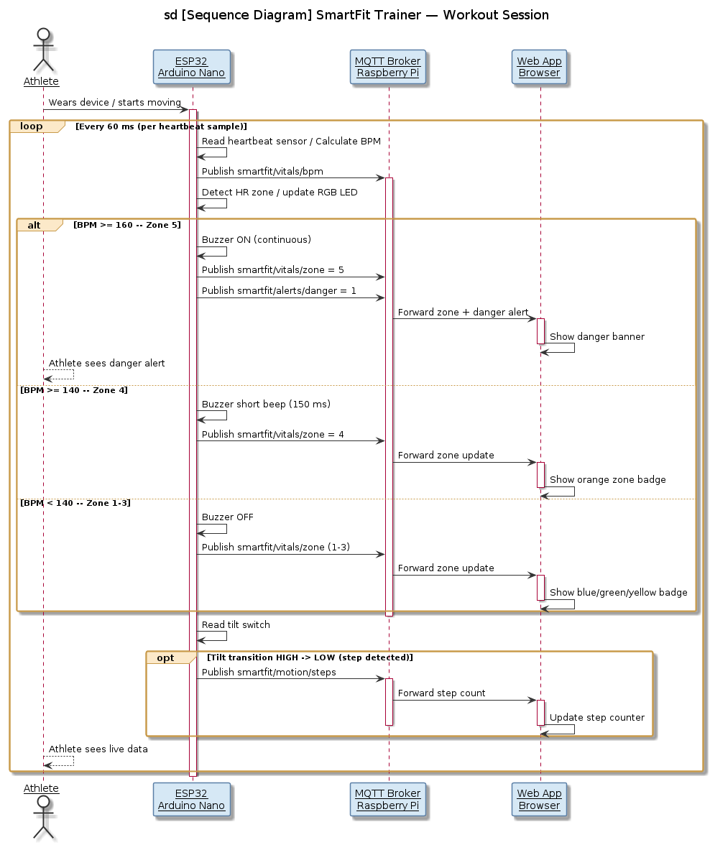
SEQUENCE DIAGRAM
Message Timeline → loop() Order
MAPS TO CODE
Read + calculate BPM
heartbeatDetected(HEART_PIN, delayMsec)
Publish BPM
client.publish("smartfit/vitals/bpm", ...)
Detect zone, drive LED/buzzer
setHRZone(avgBpm)
Read tilt, publish steps
readSteps()
SmartFit Trainer | Diagrams → Code
5

Slide 6
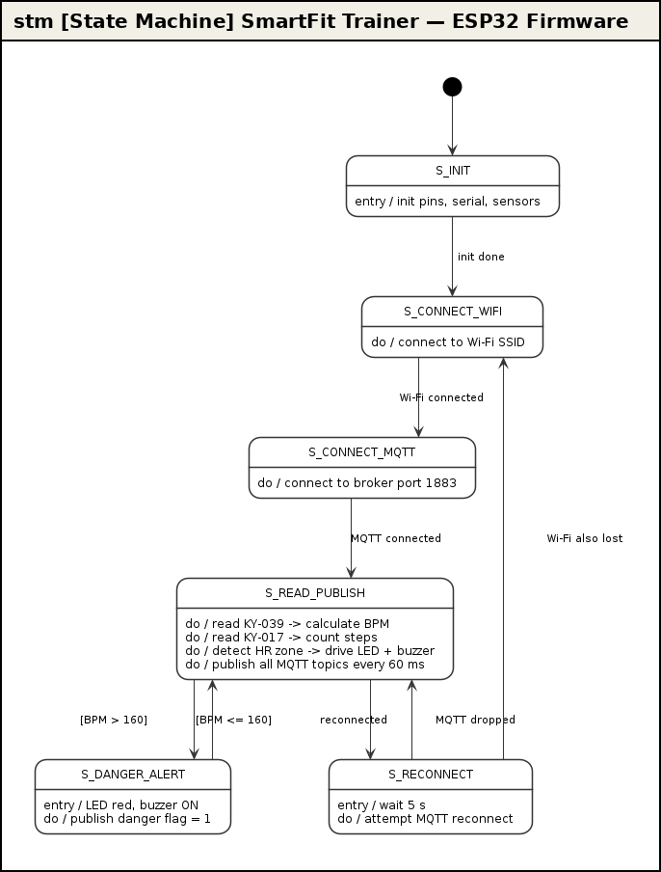




STATE MACHINE
Firmware States → setup() / loop()
MAPS TO CODE
S_INIT → S_CONNECT_WIFI
WiFi.begin(ssid, password) in setup()
S_CONNECT_MQTT
client.setServer(mqtt_server, 1883)
S_READ_PUBLISH
the main loop() body, every 60 ms
S_RECONNECT
reconnectMQTT() — retries every 5 s
"Wi-Fi also lost" has no code path yet — loop() never checks WiFi.status().
SmartFit Trainer | Diagrams → Code
6

Slide 7
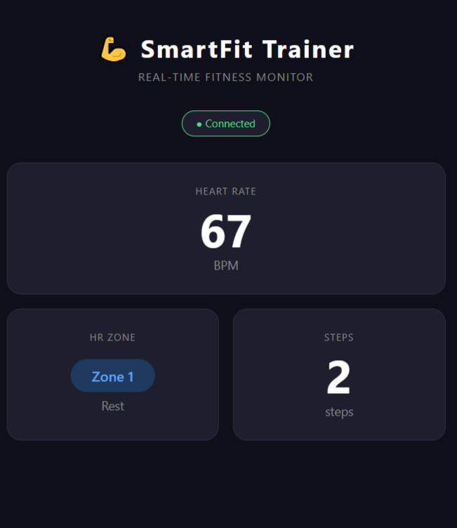

WEB DASHBOARD
index.html → Live MQTT Updates
MAPS TO CODE
Connect over WebSocket
mqtt.connect(`ws://${brokerIP}:9001`)
Subscribe to all topics
client.subscribe('smartfit/#')
Update BPM readout
if (topic === 'smartfit/vitals/bpm')
Update zone badge colour
badge.className = zoneColors[value]
Show danger banner
if (topic === 'smartfit/alerts/danger')
7

Slide 8
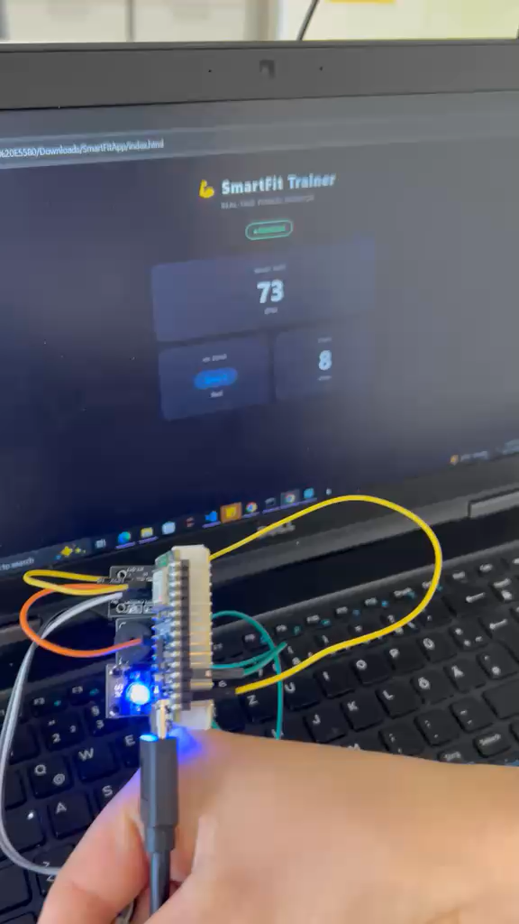
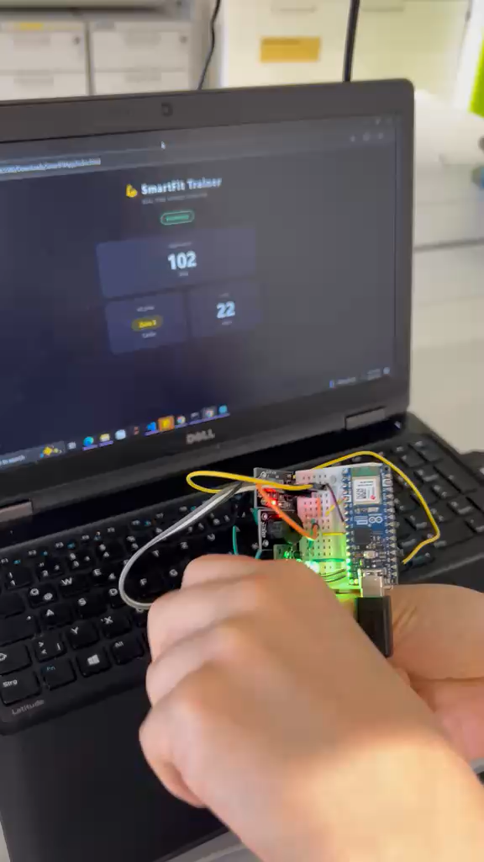
Demo Video
SmartFit Trainer — full workout session, hardware to dashboard

