Slide 1
Functional Safety in TMS
Team C
Maria Anthonyos
Mohamad Abdo
Jonathan Bahry
Hamm-Lippstadt University of Applied Sciences
Prof. Dr. –Ing. Ali Hayek
[15.01.2026]

Slide 2
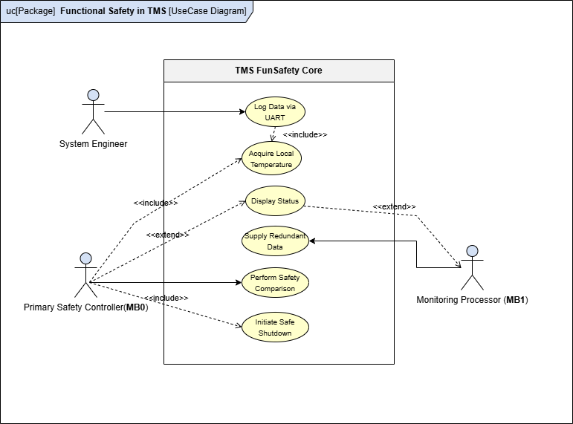
Intro
- FunSafe TMS Overview
❗ Prototype fig we had yesterday
- used Pmods figs

Slide 3
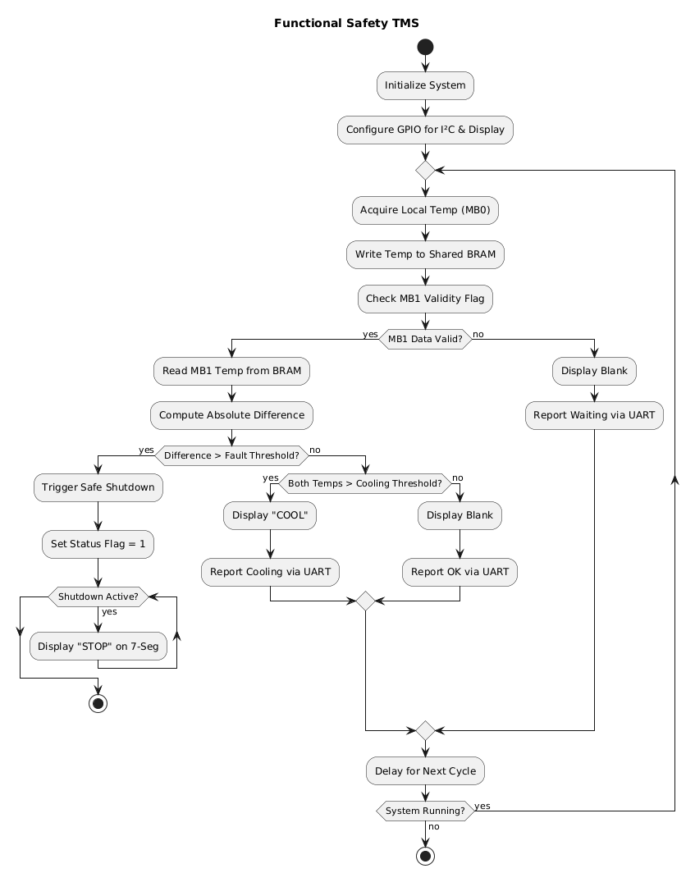
Activity Diagram
❗Image for COOL 7Seg
❗ Image for STOP 7Seg

Slide 4
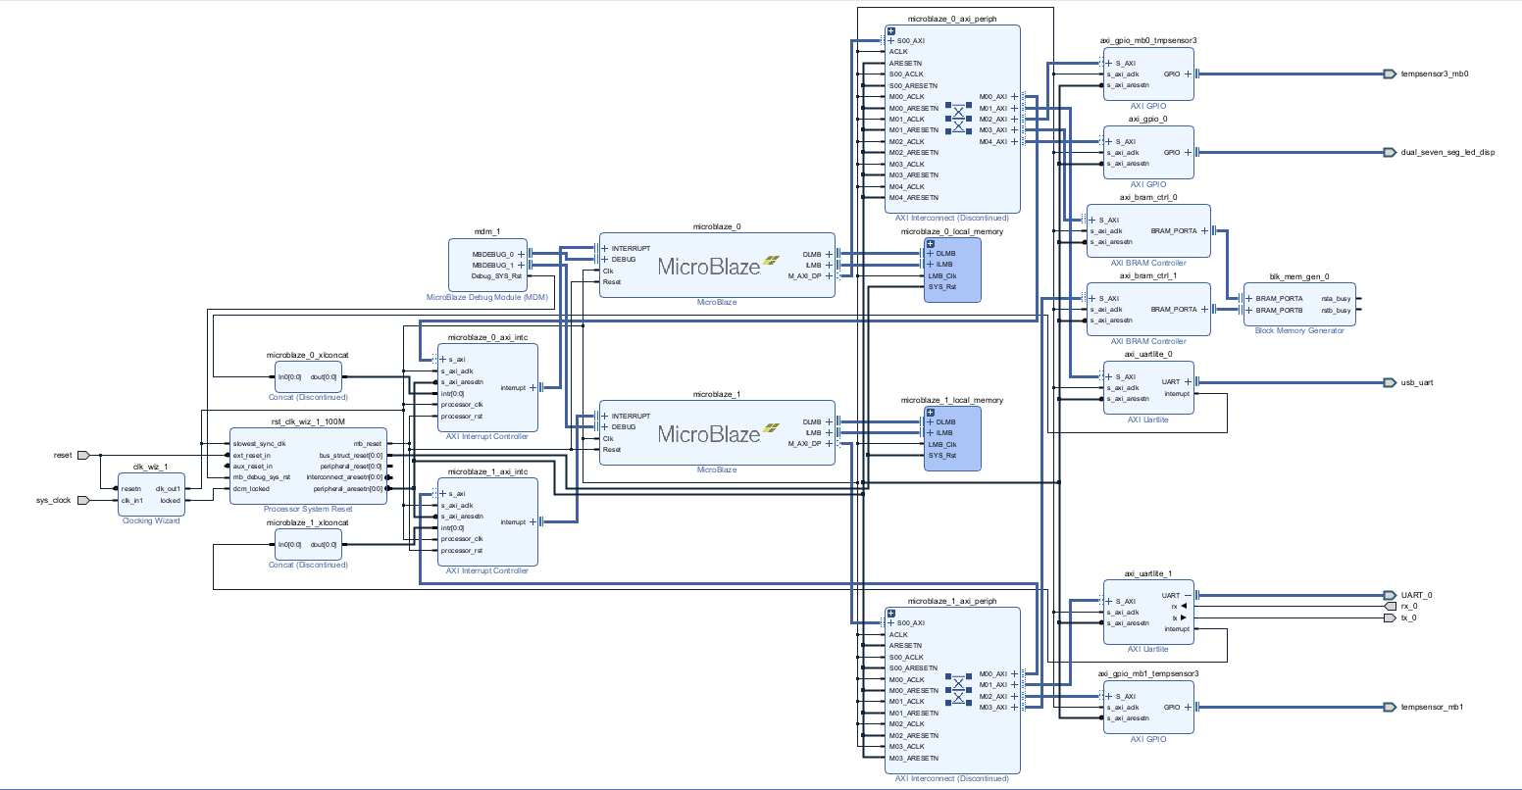
Vivado Block Diagram
2 Microblaze
2 Temp3 Pmods Ips
UART pmod

Slide 5
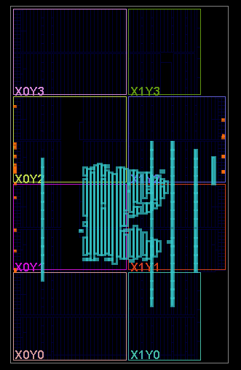
Comparator & 7Seg IPs

Slide 6
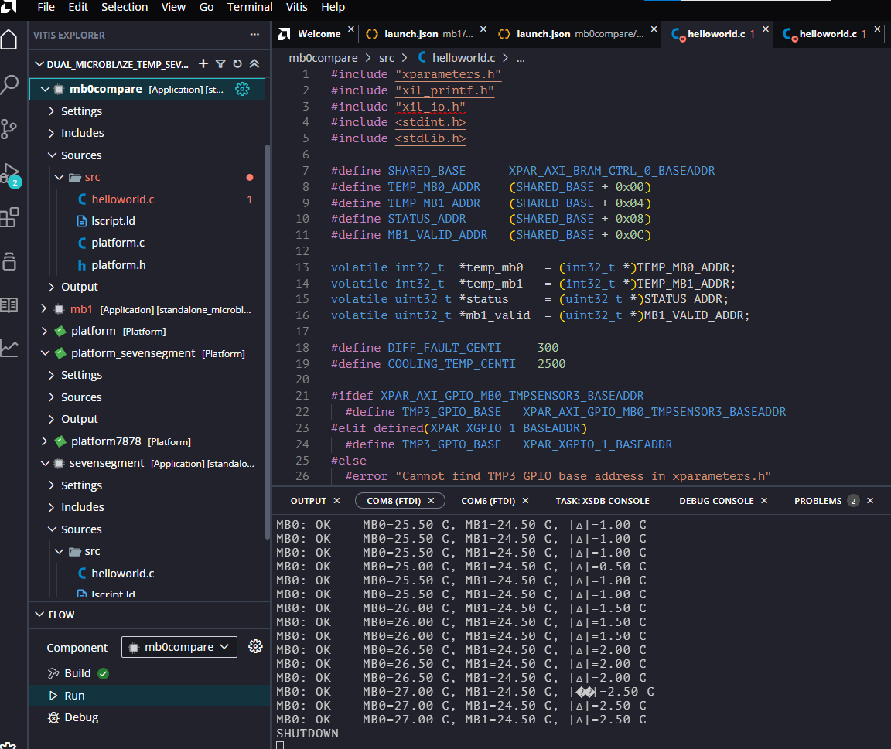
Vitis
1 Platform
2 Apps
2 Different Domains
2 UARTs
Challenges with: #include "xparameters.h“
- Search for XPAR
#include “xgpio.h“
- Used xil_io.h

Slide 7
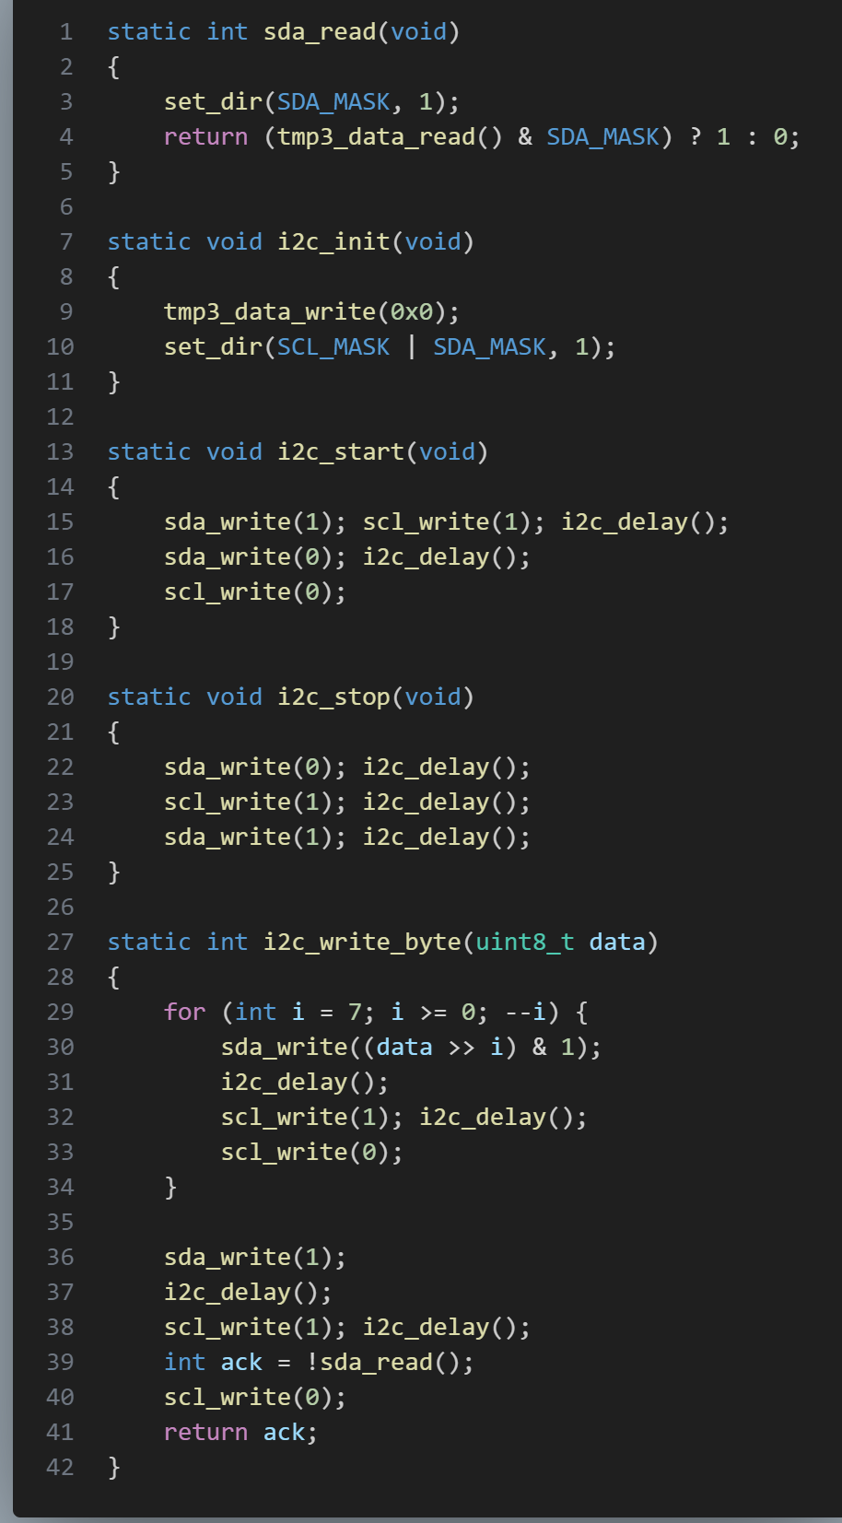
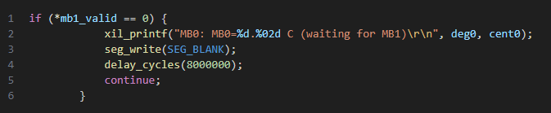
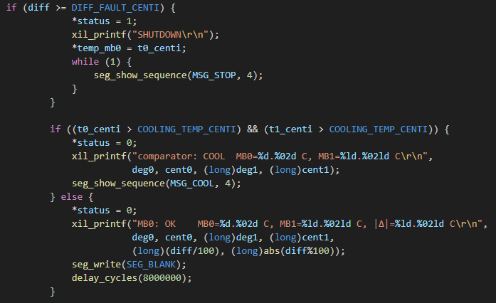
MicroBlaze_0 &1 Codes

Slide 8
Project Live Video

Slide 9
Thank you
Jump to the Lab

