Slide 1
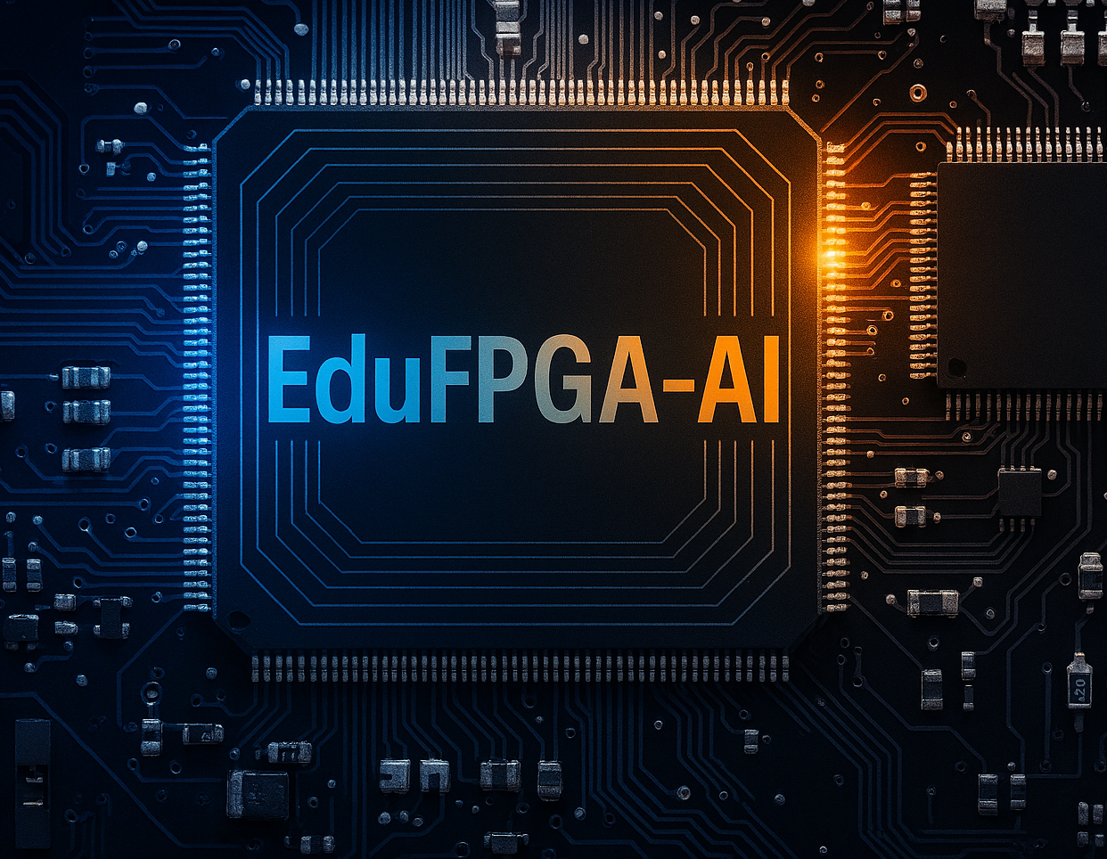
Educational Platforms for Learning AI on FPGA Hardware
Mohamed Abdo
Hamm-Lippstadt University of Applied Sciences
Prof
[Date]

Slide 2
Main headlines

Slide 3
THE FPGA-AI OPPORTUNITY
AI's Computational Demand:
• Exponential growth requiring specialized hardware
FPGA Advantages:
• Custom parallel architectures
• Ultra-low latency inference
• Energy efficiency for edge computing
The Educational Challenge:
• Traditional FPGA design requires HDL expertise
Solution:
• EduFPGA-AI platforms democratize hardware acceleration

Slide 4
TRADITIONAL FPGA COMPLEXITY
Traditional FPGA Workflow:
AI Model → HDL Coding → Synthesis → Place & Route → Bitstream
Barriers for Students:
• Hardware Description Languages (VHDL/Verilog)
• Complex vendor toolchains (Vivado/Quartus)
• Steep learning curve for AI-focused students
• Time-consuming design process

Slide 5
HIGH-LEVEL SYNTHESIS (HLS)
What is HLS?
• Converts C++/Python to hardware descriptions
• Abstracts away HDL complexity
• Enables algorithm-focused design
Educational Impact:
• Students describe behavior, not hardware
• Focus on AI algorithm optimization
• Faster prototyping and experimentation
• Bridges software-hardware gap

Slide 6
QUANTIZATION: KEY TO EFFICIENCY
Mathematical Foundation:
Q(x) = Δ · round(x/Δ)
Δ = 2 · max(|x|) / (2ᵇ - 1)
Three Approaches:
1. Post-Training Quantization (PTQ)
- Simple but less accurate
2. Quantization-Aware Training (QAT)
- Accurate but complex
3. Extreme Quantization (1-2 bit)
- Maximum efficiency, specialized

Slide 7
PLATFORM COMPARISON: ACCESSIBILITY FOCUS
AMD PYNQ:
• Python + Jupyter notebooks interface
• Zynq boards with ARM + FPGA
• Ideal for beginners
• Rapid prototyping
Vitis AI:
• Production-ready toolchain
• Automated quantization
• End-to-end deployment
• Industry standards
Educational Value: Lowering entry barriers

Slide 8
PLATFORM COMPARISON: DEPTH FOCUS
hls4ml (High-Energy Physics):
• Transparent model-to-hardware translation
• Fine-grained quantization control
• Educational focus: Understanding the process
FINN (Extreme Quantization):
• Binary/ternary neural networks
• Streaming dataflow architectures
• Maximum efficiency demonstrations
Educational Value: Conceptual depth and transparency

Slide 9
HANDS-ON WORKFLOW EXAMPLE
MNIST Classification on PYNQ-Z2:
1. Train & Quantize
- Keras/TensorFlow model
- Precision reduction experiments
2. Configure hls4ml
- Layer-specific bit-widths
- Resource constraints
3. Hardware Optimization
- Parallelism vs resources
- Reuse factor adjustment
4. Generate & Deploy
- HLS code generation
- Performance comparison
Learning Outcome: Complete hardware-software co-design understanding

Slide 10
EDUCATIONAL IMPACT
Democratization:
• Lowers barrier for CS/AI students
• No hardware expertise required initially
Conceptual Depth:
• Hands-on quantization experience
• Parallelism understanding
• Resource constraint awareness
Systems Thinking:
• Algorithm to silicon understanding
• Cross-layer optimization skills
Innovation Stimulation:
• Prototype novel accelerators
• Research exploration

Slide 11
IDENTIFIED CHALLENGES
Toolchain Complexity:
• Vendor tools remain difficult
• Installation and licensing issues
Resource Constraints:
• Limited educational hardware
• Overly simplified models required
Abstraction Leakage:
• Debugging requires hardware knowledge
• Cryptic error messages
Quantization Trade-offs:
• Accuracy vs efficiency decisions
• Numerical precision understanding
Curriculum Development:
• Significant instructor effort
• Balancing depth vs accessibility

Slide 12
RESEARCH DIRECTIONS
Cloud-Based Labs:
• Eliminate local installation issues
• Equitable access for all students
Enhanced Visualization:
• Model-to-hardware mapping tools
• Interactive debugging interfaces
Quantization Pedagogy:
• Real-time precision analysis
• Visual trade-off demonstrations
Broader Integration:
• Embedded systems curriculum
• Multi-platform comparisons
End-to-End Systems:
• Sensor-to-actuator intelligent edge
• Real-world application focus

Slide 13
INTRODUCING: EDUFLOW
A Proposed Educational Platform
Vision:
Progressive disclosure platform that grows with student expertise
Core Philosophy:
• Start simple, reveal complexity gradually
• Maintain conceptual transparency
• Integrate best practices from existing platforms
Target Gap:
Current platforms prioritize either accessibility OR depth
EduFlow delivers BOTH through progressive learning

Slide 14
PLATFORM ARCHITECTURE
EduFlow Architecture:
[Web Interface] ←→ [Educational API Layer] ←→ [Abstraction Engine]
↓
[Visual Debugger] ←→ [Hardware Abstraction] ←→ [Multi-Backend Support]
↓
[PYNQ] [hls4ml] [Vitis AI] [FINN]
Key Components:
• Unified Web Interface - Browser-based accessibility
• Educational API - Simplified commands for beginners
• Visualization Layer - Real-time hardware mapping
• Multi-Backend - Leverages existing platforms
• Progressive Mode - Reveals underlying commands

Slide 15
MULTI-LEVEL FEATURES
For Beginners:
• Drag-and-drop model building
• One-click deployment to FPGA
• Interactive quantization sliders
• Real-time performance feedback
For Intermediate Students:
• Exposed configuration parameters
• Comparative analysis tools
• Hardware resource visualization
• Step-by-step workflow inspection
For Advanced Students:
• Full backend tool access
• Custom optimization scripts
• Research experiment setup
• Performance profiling tools

Slide 16
INTERACTIVE QUANTIZATION LAB
Precision Exploration:
[FP32] ----[INT16]----[INT8]----[INT4]----[Binary]
Real-time Feedback:
Accuracy: 98% → 96% → 92% → 85% → 72%
Resources: 100% → 45% → 25% → 12% → 5%
Latency: 10ms → 4ms → 2ms → 1ms → 0.5ms
Educational Value:
• Immediate feedback on trade-offs
• Visual understanding of precision impact
• Encourages experimentation
• Builds intuition for hardware constraints

Slide 17
REAL-TIME VISUALIZATION
FPGA Mapping Display:
• Color-coded resource utilization
• Animated data flow through layers
• Parallelism visualization
• Bottleneck identification
Learning Impact:
• Concrete understanding of abstract concepts
• Debugging assistance through visualization
• Intuition development for hardware thinking
• Connects software decisions to hardware consequences
Visual Debugging:
• See why optimizations work or fail
• Understand resource constraints visually
• Learn hardware patterns through examples

Slide 18
DEVELOPMENT PHASES
Phase 1 (Months 1-6):
• Basic web interface and PYNQ integration
• Simple quantization visualization
• Beginner-level exercises
• Core educational API
Phase 2 (Months 7-12):
• Advanced visualization tools
• Multi-backend support (hls4ml, Vitis AI)
• Intermediate curriculum
• Comparative analysis features
Phase 3 (Months 13-18):
• Research-level features
• FINN integration for extreme quantization
• Custom optimization support
• Advanced learning paths
• Publication-ready results export

Slide 19
QUESTIONS & DISCUSSION
Thank You
Discussion Points:
• Your experience with existing EduFPGA-AI platforms?
• Challenges in hardware-software education?
• Interest in collaborative development?
• Suggestions for EduFlow features?
Let's build the future of FPGA-AI education together!

