Slide 1
PROFINET
IEC 61158 / IEC 61784
Protocol Explained
Industrial Ethernet for Factory Automation
#1
Team:
Rionela Kovaci
Christian Percival
Mohamed Abdo
Industrial Ethernet
in Europe
Supervisor: Prof. Dr.-Ing. Ali Hayek

Slide 2

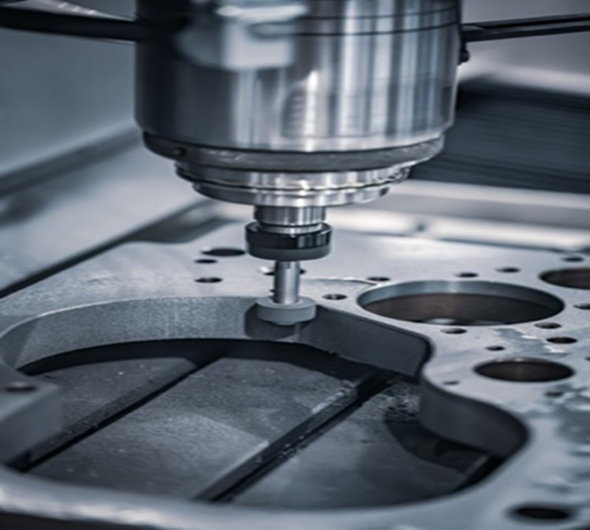
Motivation — Why PROFINET?
From home networks to factory-floor real-time communication
The Problem with Regular Ethernet in Factories:
Designed for best-effort delivery, no timing guarantees
100 ms delay is fine for streaming video, catastrophic for a robot arm
TCP/IP stack adds unpredictable latency
Why Factories Need Something Different:
Machines or CNC needs a response < 1 ms
One missed signal = broken part or safety risk
1000s of devices must be synchronized, not just connected

Slide 3
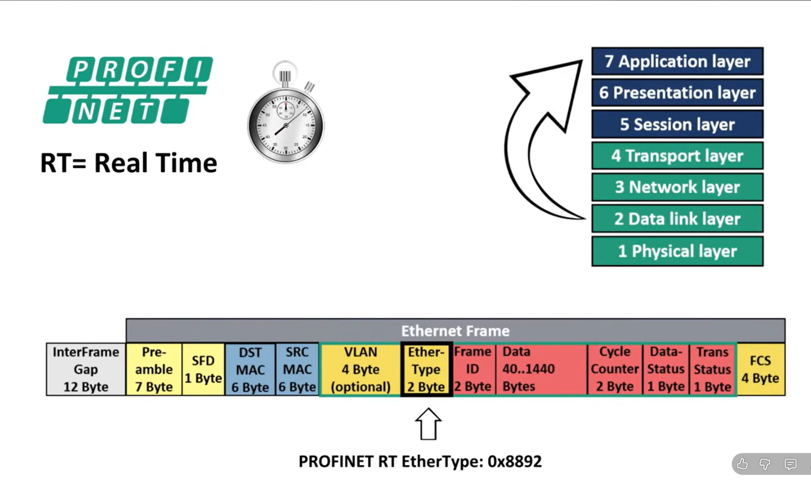
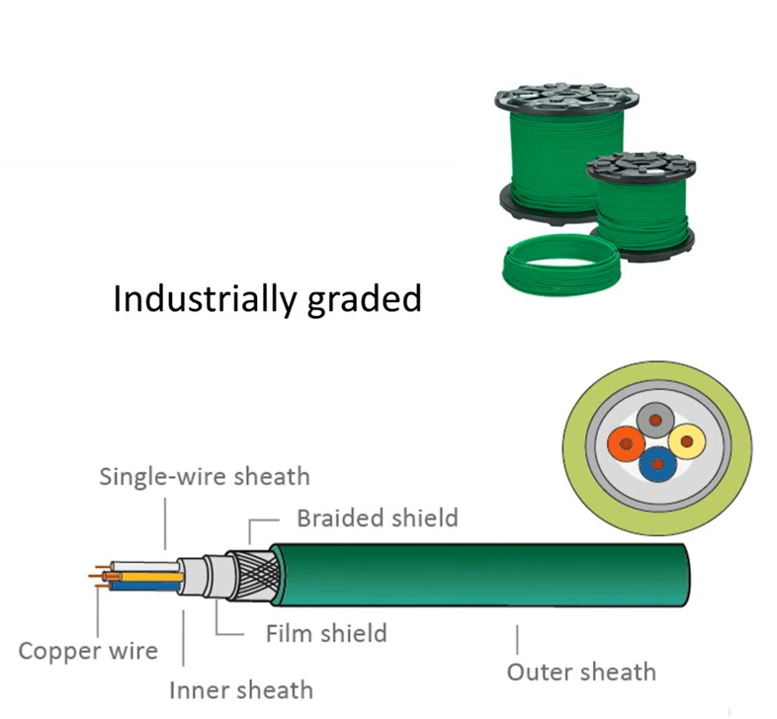
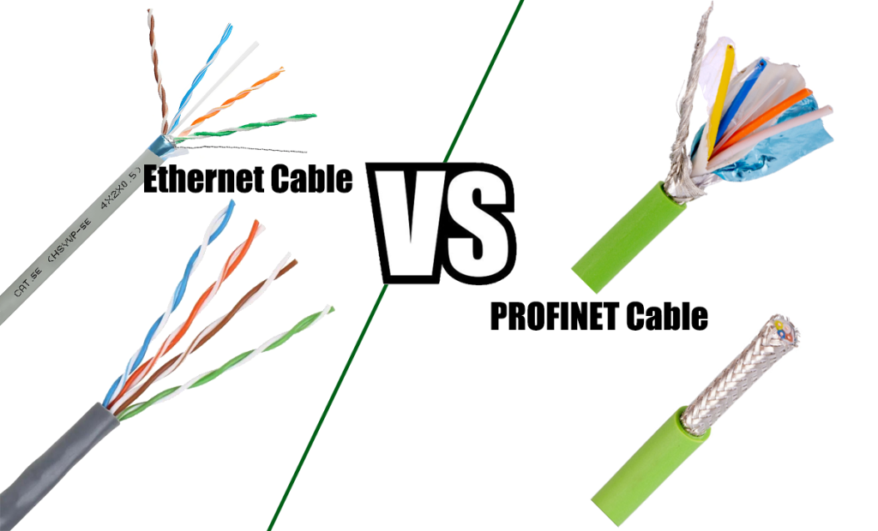
Motivation — Why PROFINET?
From home networks to factory-floor real-time communication
PROFINET solves this by:
Bypassing the TCP/IP stack entirely for time-critical data
Guaranteeing cycle times down to 125 µs
Running safety, motion, and Errors diagnostics on the same cable

Slide 4

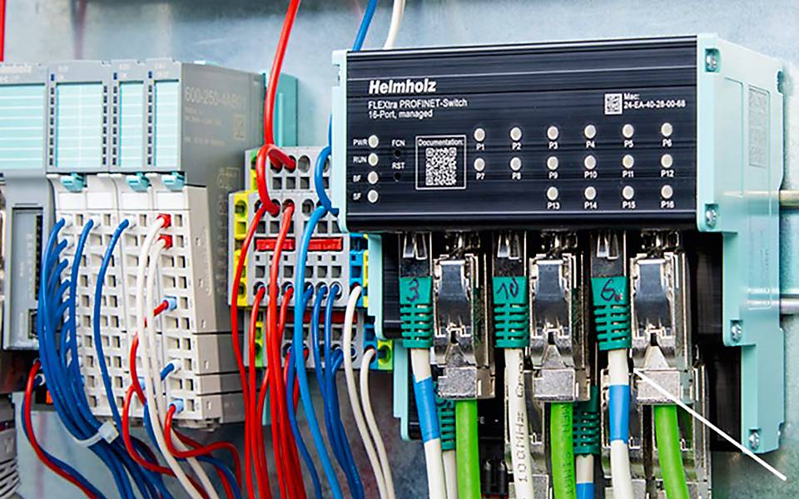
WHAT IS PROFINET?
PROFINET is an open Industrial Ethernet standard designed to exchange data between controllers and field devices in automation systems. standardized under IEC 61158 and IEC 61784, with support for real-time and isochronous real-time communication, integrated with PROFIsafe.
Source: Analysis of PROFINET IO Communication Protocol | IEEE Conference Publication | IEEE Xplore
SAFE

Slide 5
Can you build a PROFINET protocol prototype in the lab?

Slide 6
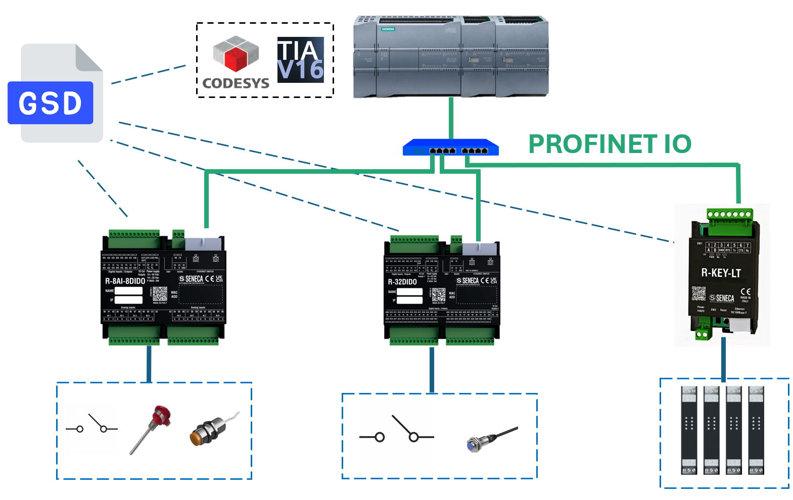
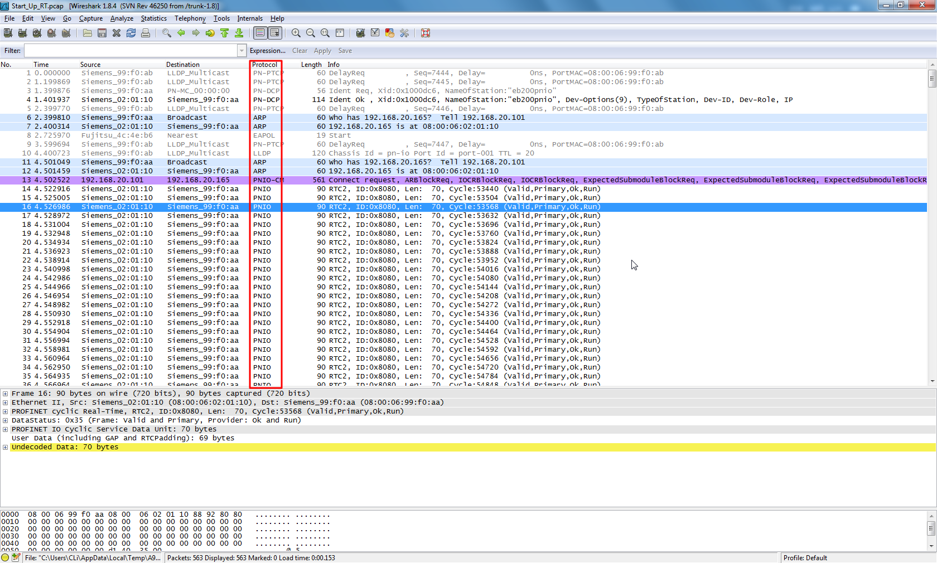
HOW PROFINET WORKS
PLC
(IO Controller)
Siemens S7-1500/1200, Beckhoff CX,
Rockwell 5380
Ethernet
Switch
Must support PROFINET DCP, LLDP & SNMP. RT
HMI
Human Machine Interface
(IO Supervisor)
Wireshark
PROFINET - Wireshark Wiki
Cyclic IO Data (RT frames, EtherType 0x8892)

Slide 7

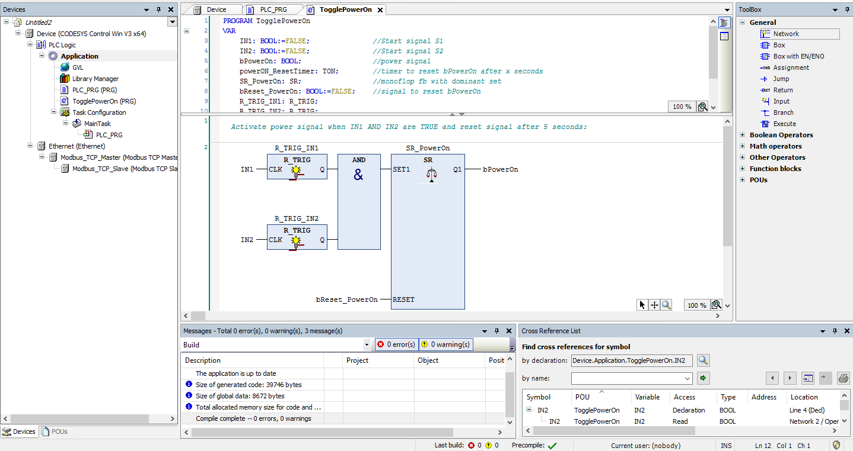
BUILDING A PROFINET NETWORK — 💻 SOFTWARE
Engineering Tool (PLC IDE)
Siemens TIA Portal (most common), CODESYS, Rockwell Studio 5000, Phoenix PLCnext Engineer. They are used to configure PROFINET network and program PLC logic
GSDML Files (per device)
XML-based General Station Description files, Which supplied by each device vendor. Import into the engineering tool to auto-configure IO data mappings and parameters

Slide 8
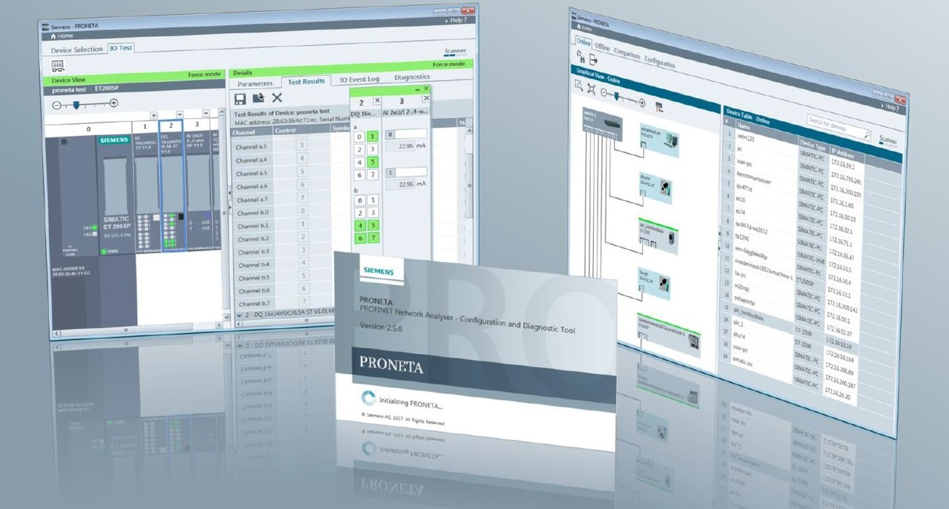
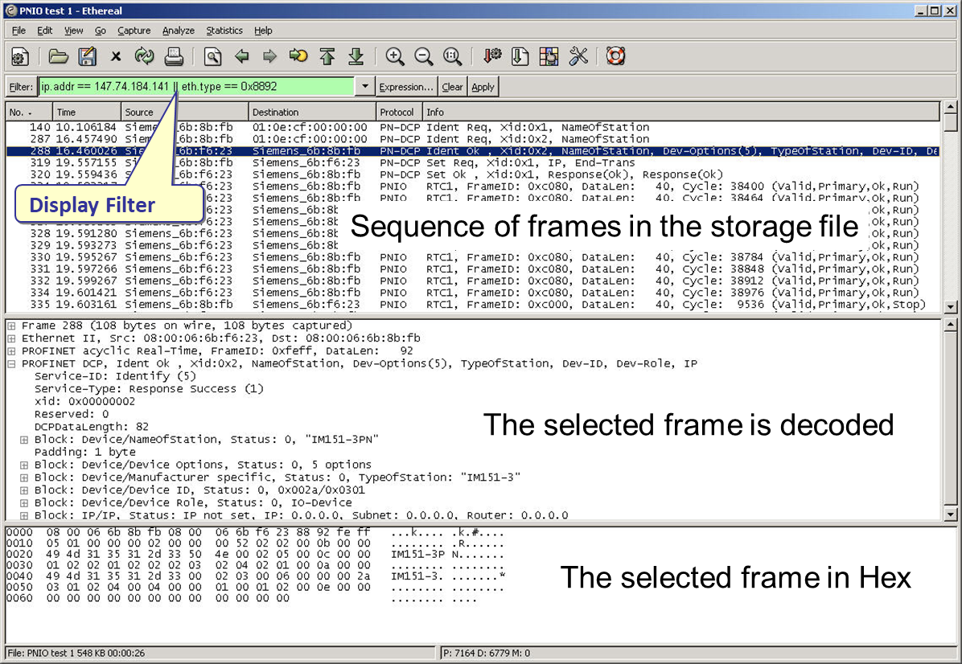
BUILDING A PROFINET NETWORK — 💻 SOFTWARE
Network Commissioning Tool
Siemens PRONETA (free), NetScan tools — scans the PROFINET network, assigns IP/device names, shows topology and device status without requiring a running PLC
Diagnostics Software
PROFINET-aware network analyzers (Wireshark + PROFINET dissector, Softing, Procentec ComBricks) for live frame capture, alarm analysis, and performance monitoring
Analysis of PROFINET IO Security Extensions on Wireshark | IEEE Conference Publication | IEEE Xplore

Slide 9

PROFINET raspberry pi Prototype

Slide 10
3 COMMUNICATION CHANNELS & types
TCP/IP
RT
IRT
Cycle: ~100 ms
Cycle: 1–10 ms
Cycle: < 1 ms
Non-Real-Time Channel
Real-Time Channel
Isochronous Real-Time
Used for configuration, parameterization, diagnostics, and IT integration. Travels through the full TCP/IP stack. Not suitable for time-critical tasks.
Cyclic IO data exchange using Layer 2 Ethernet frames (EtherType 0x8892). Bypasses the TCP/IP stack entirely for low latency.
Synchronized time-slot communication with hardware-level scheduling. Requires special IRT-capable switches. Reserved for demanding motion control.
▸ Device configuration
▸ Sensor/actuator IO
▸ CNC / servo drives
▸ SNMP diagnostics
▸ Valve & motor control
▸ Multi-axis coordination
▸ OPC UA, HTTP, MQTT coexistence
▸ Discrete IO monitoring
▸ High-speed robotics

Slide 11
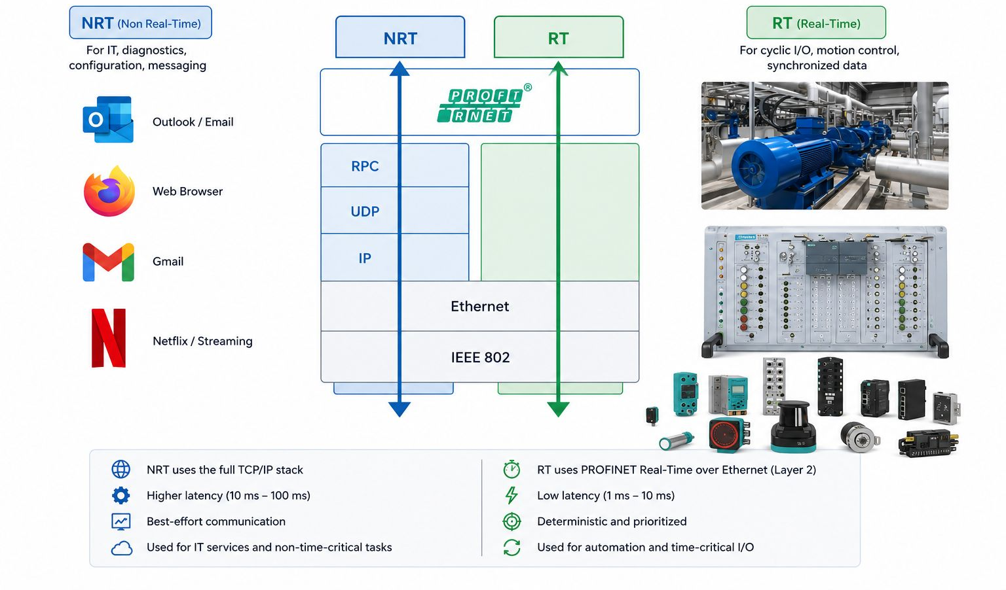
NRT vs RT

Slide 12
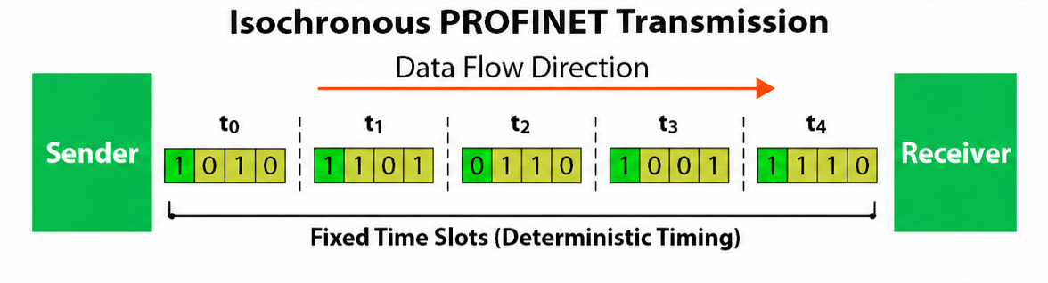
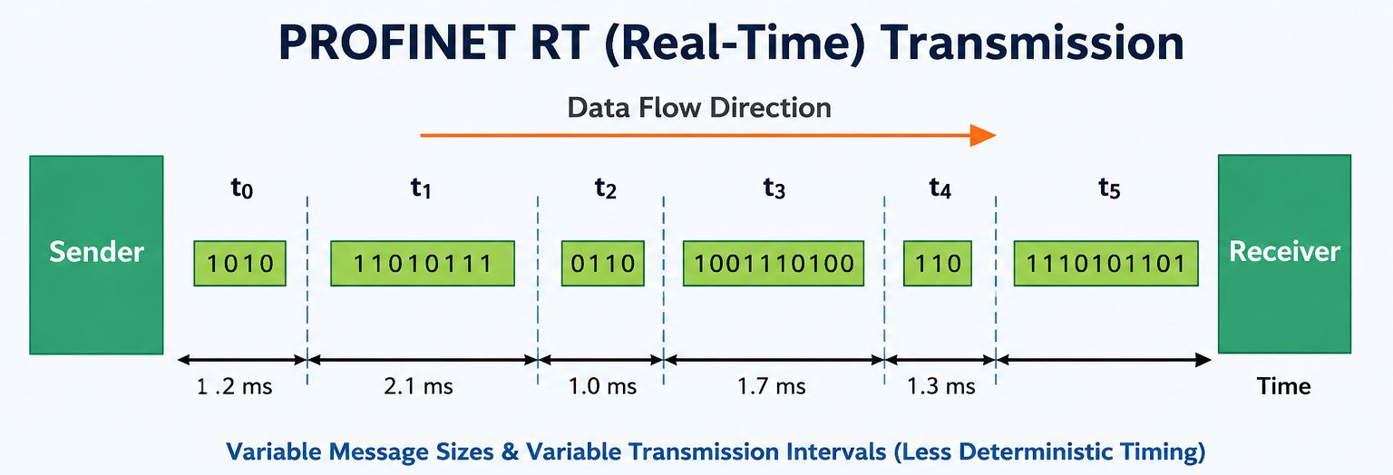
IRT (Isochronous Real Time)

Slide 13
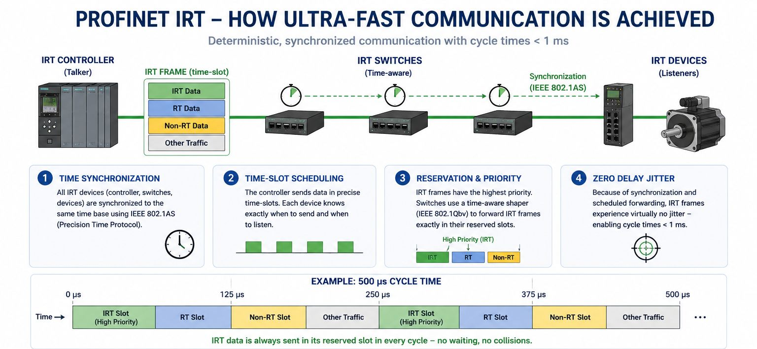
IRT (Isochronous Real Time)

Slide 14
PROFIsafe — FUNCTIONAL SAFETY OVER PROFINET
PROFIsafe is a safety communication profile (IEC 61784-3-3) built on top of PROFINET using the "Black Channel" principle — it adds its own error-detection layer above the standard network, so safety-critical signals (E-Stop, light curtains, safety doors) travel on the same cable as regular automation data without requiring separate wiring.
BLACK CHANNEL PRINCIPLE
Safety Level:
Up to SIL 3 (IEC 61508)
PL e / Cat 4 (ISO 13849)
Safety Function (F-CPU ↔ F-Device)
Certified By:
TÜV SÜD + IFA (Germany)
PROFIsafe Layer (CRC + Consecutive No.)
Standard:
IEC 61784-3-3 (since 2007)
PROFINET RT (Black Channel – untouched)
Key Mechanism:
CRC checksum + Consecutive Number + Watchdog Timer
Ethernet Physical (Cat 5e / Cat 6)
Use Cases:
E-Stop, light curtains, safety doors, safe speed monitoring
⚠ PROFIsafe does NOT replace a risk assessment — it provides the communication infrastructure for safety functions already designed per ISO 13849 / IEC 62061.

Slide 15
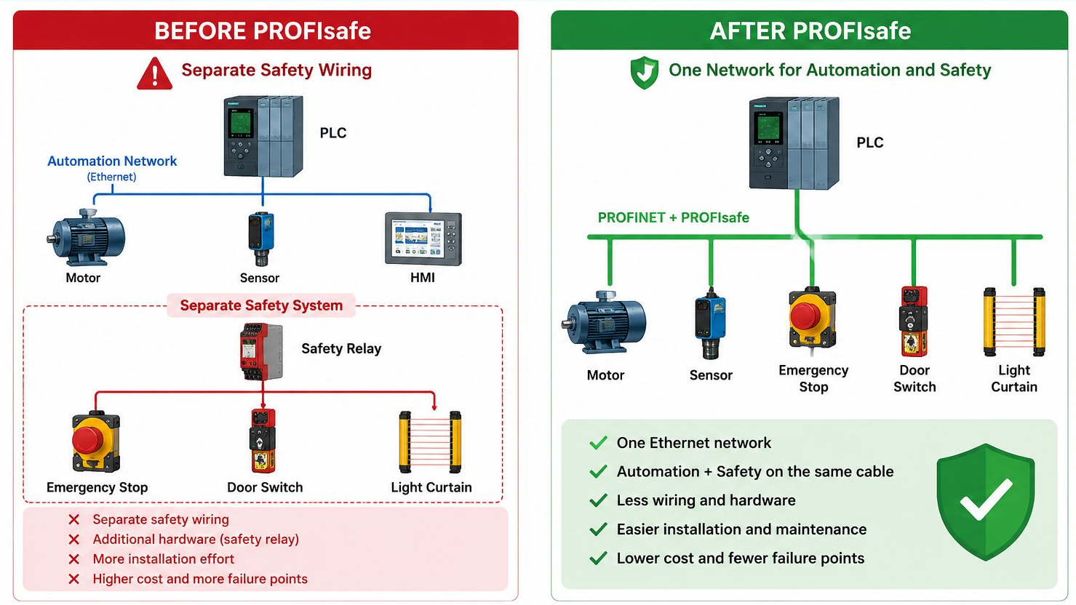
PROFIsafe

Slide 16
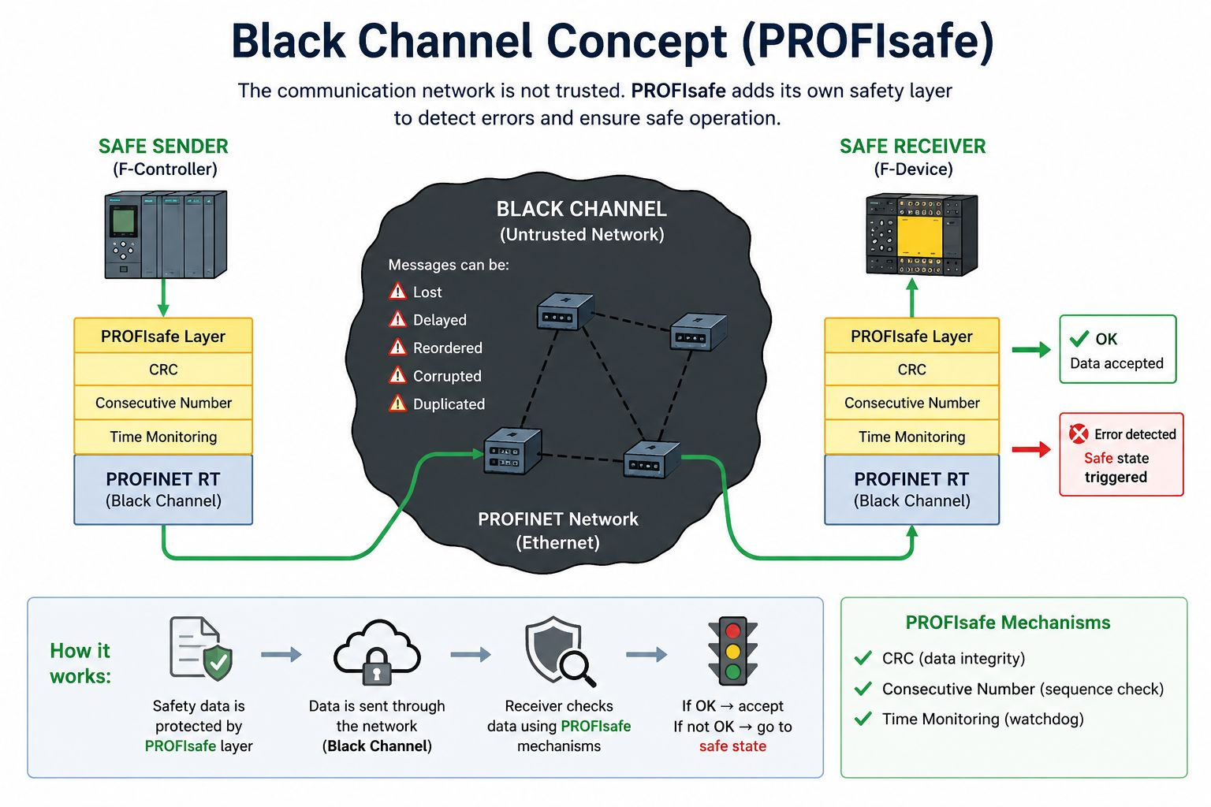
PROFIsafe – BLACK CHANNEL

Slide 17
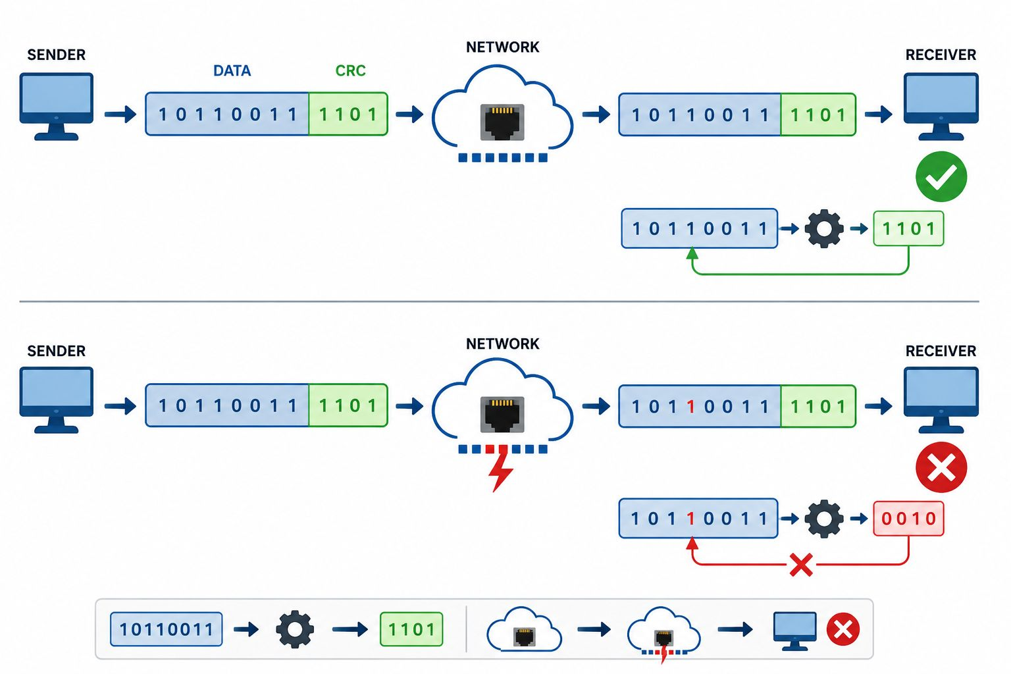
PROFIsafe - CRC (Check Sum)

Slide 18
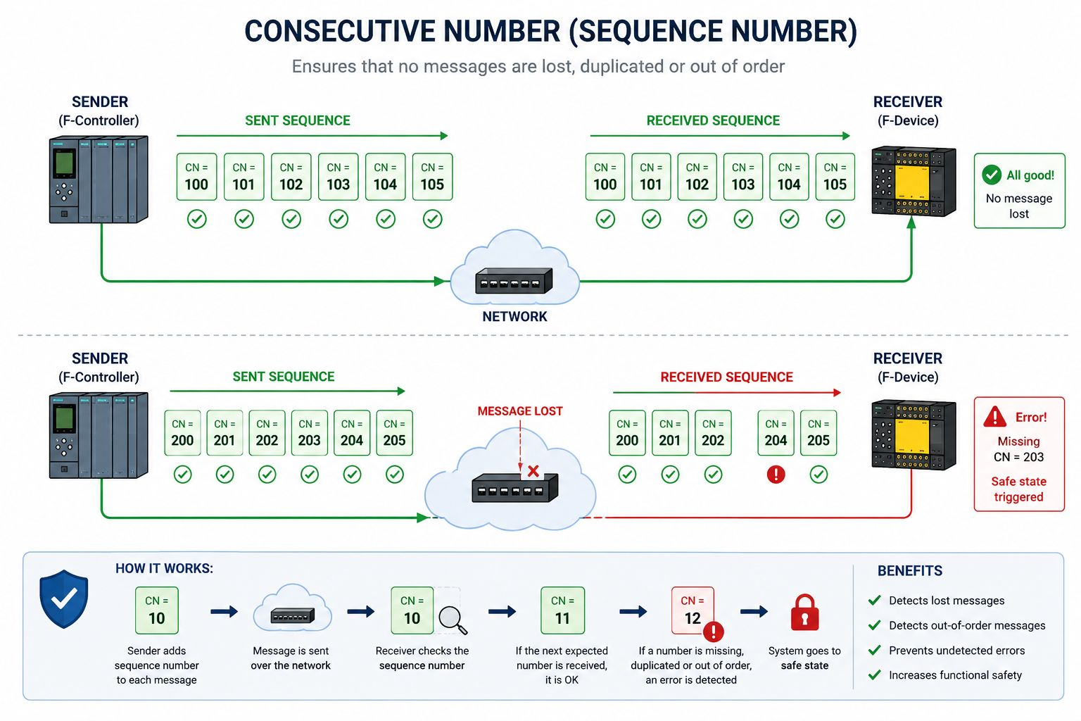
Consecutive Number (Sequence Number)

Slide 19
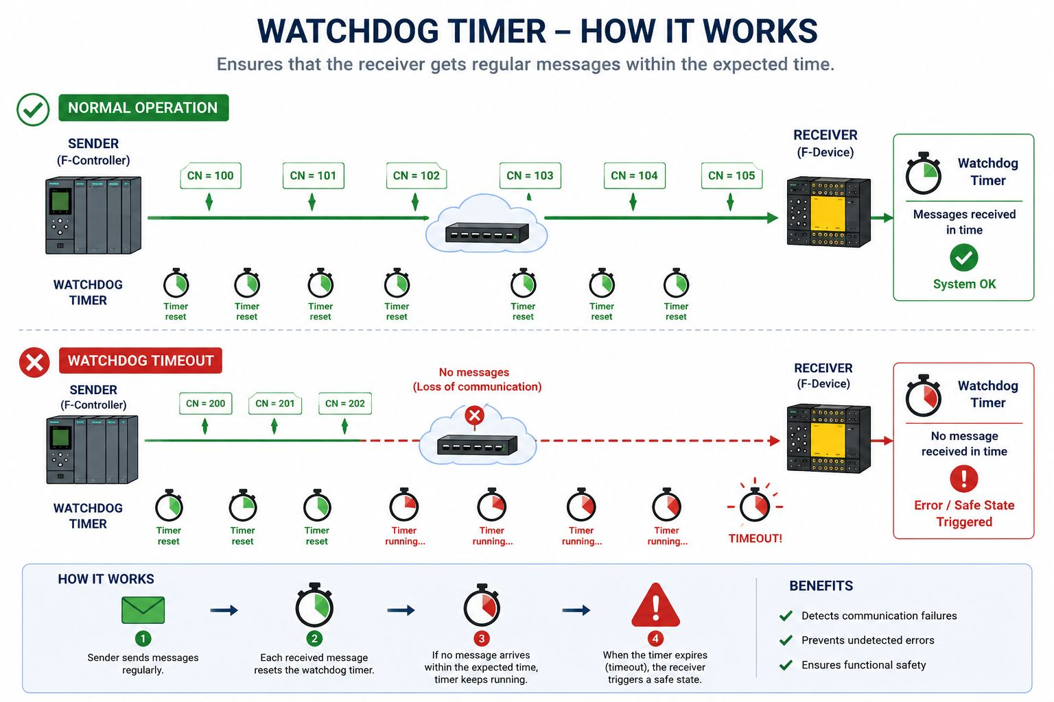
PROFIsafe – WATCHDOG TIMER

Slide 20
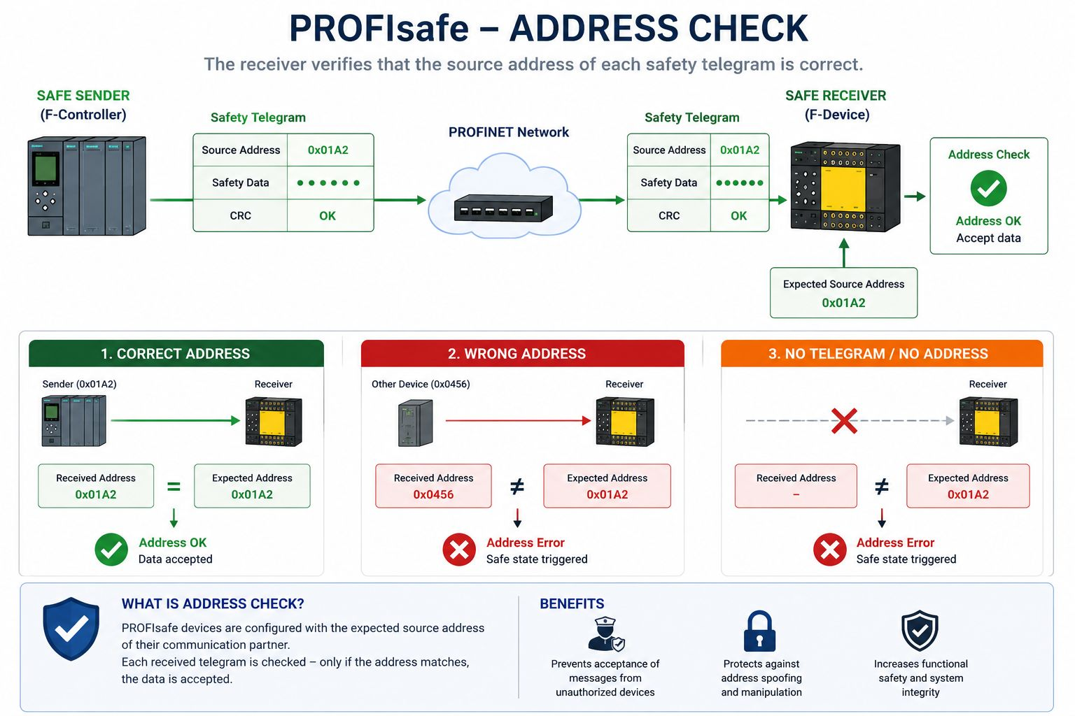
PROFIsafe – ADDRESS CHECK

Slide 21
PROFINET HARDWARE CHIPS
What makes these chips different? — Fast Timing in PROFINET
⚠ The Problem with Regular CPUs
✔ How PROFINET Chips Solve This
A standard Linux CPU handles Ethernet frames in software — through the OS scheduler, TCP/IP stack, and device drivers. This adds unpredictable delays of 1–10 ms and random jitter.
For a robot arm or CNC machine needing a new setpoint every 250 µs, that unpredictability is unacceptable — one late frame can cause a broken part or a safety stop.
Regular CPU cycle time: ~1–10 ms | Jitter: unpredictable
Dedicated PROFINET chips contain a hardware Ethernet engine that processes frames in silicon — completely bypassing the OS. A built-in hardware clock synchronizes all devices on the network.
The send window for each device is reserved in hardware — no OS scheduling, no congestion, no retransmit. Every frame goes out at exactly the right microsecond.
IRT chip cycle time: 250 µs | Jitter: < 1 µs

Slide 22
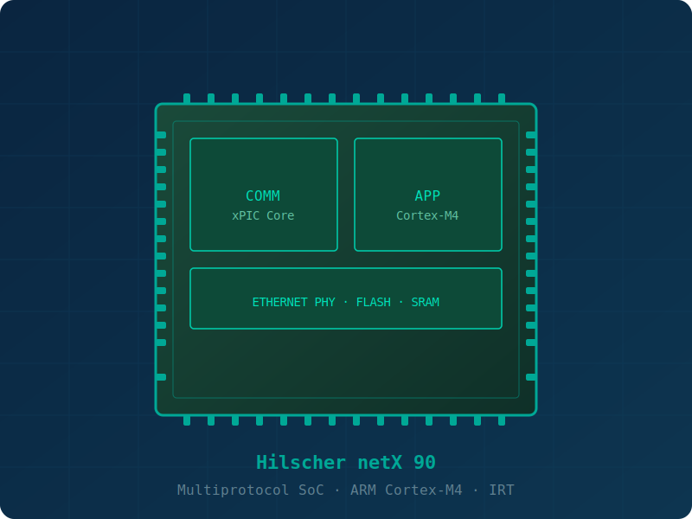
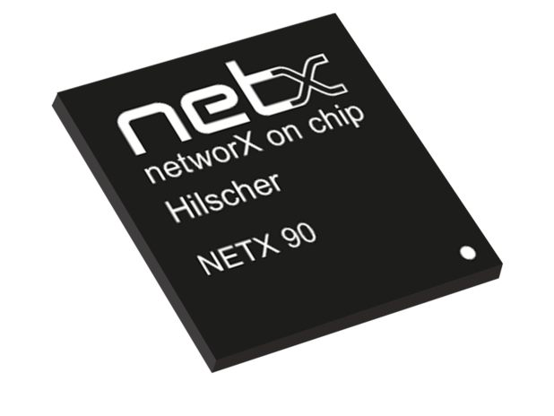
IMPLEMENTATION APPROACH 01 — Dedicated ASIC / SoC
01
Best performance. Smallest size. Fixed protocol.
Hilscher netX 90 — Multiprotocol SoC
What it is
A silicon chip purpose-built for PROFINET. It contains a dedicated real-time Ethernet engine in hardware — no OS, no software stack for the timing-critical path.
Advantages
Best RT/IRT performance
· Low CPU load
· Smallest footprint
· Low power
Limitations
Protocol is fixed in silicon
· High NRE cost
· Long design cycle
Examples: Siemens ERTEC 200P · Hilscher netX 90 · Renesas R-IN32M3
ARM Cortex-M4 · IRT capable · Multi-protocol · 2-port switch built-in

Slide 23
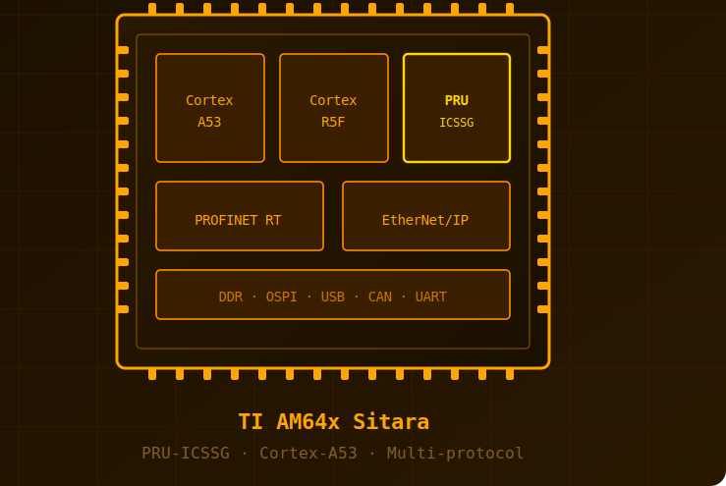
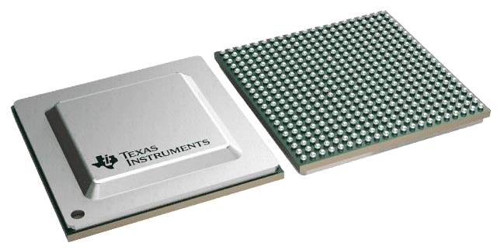
IMPLEMENTATION APPROACH 02 — General MCU + PRU / Soft-IP
02
Flexible & multi-protocol. No dedicated IRT ASIC needed.
Texas Instruments AM64x Sitara
What it is
A standard microcontroller that uses a dedicated sub-core called a PRU (Programmable Real-time Unit) to offload Ethernet frame handling from the main CPU.
✔ Advantages
Multi-protocol (PROFINET, EtherNet/IP, EtherCAT from same chip)
Lower BOM cost
Software-upgradeable
✖ Limitations
More software effort
Limited IRT support
Higher CPU overhead
Examples: TI AM64x (PRU-ICSSG) · TI AMIC110 · Renesas R-IN32M3
ARM Cortex-A53 + PRU-ICSSG · PROFINET RT · Multi-protocol · ~$4/unit

Slide 24
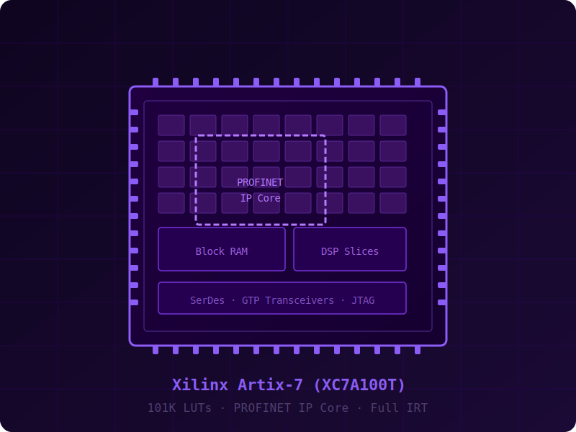
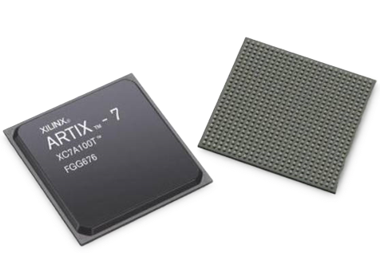
IMPLEMENTATION APPROACH 03 — FPGA-Based Implementation
03
Maximum flexibility. Full IRT. Highest cost.
Xilinx Artix-7 FPGA
What it is
A programmable logic chip (FPGA) loaded with a PROFINET IP core. The entire protocol stack is implemented as custom logic in the FPGA fabric, giving complete control over timing.
Advantages
Maximum flexibility
Full IRT capable
Custom logic possible ·
Multi-protocol
Limitations
Highest cost
Most complex design
Large power budget
Examples: Intel/Altera (EtherBrick) · Xilinx Artix-7 + 3rd-party IP core

Slide 25
WHICH APPROACH TO CHOOSE?
01
Dedicated ASIC
Choose when you need IRT (250 µs), lowest jitter, and smallest footprint. Best for compact sensors, actuators, and safety devices.
Hilscher netX 90
Siemens ERTEC 200P
02
MCU + PRU
Choose when you need multi-protocol flexibility and lower cost. RT class only — not IRT. Good for gateways, IIoT devices, PLC I/O cards.
TI AM64x (PRU-ICSSG)
Renesas R-IN32M3
03
FPGA
Choose when you need maximum control, custom logic, or a proprietary protocol alongside PROFINET. Highest cost and design effort.
Xilinx Artix-7
Intel/Altera EtherBrick
Conformance Class A (RT only) → MCU/ASIC · Class B (RT + topology) → ASIC · Class C (IRT, 250 µs) → ASIC or FPGA only

Slide 26
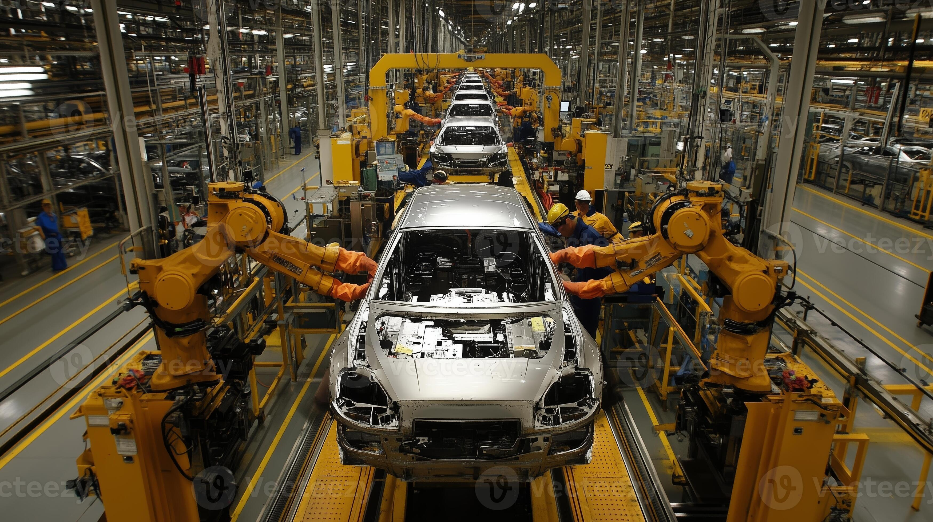
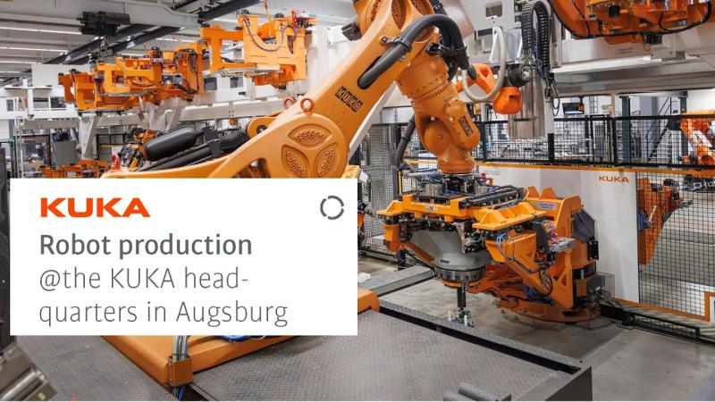
APPLICATION AREAS (1 / 2)
Automotive Manufacturing
Discrete Manufacturing & Robotics
PROFINET IRT synchronizes welding robots, paint robots, AGVs, and vision cameras across the assembly line with sub-millisecond precision.
~54% of automotive factories used PROFINET robotics by 2024 [5]
ABB, FANUC, and KUKA all support PROFINET IO natively. Robot cells publish data to MES/ERP via OPC UA, with PROFINET as the real-time transport layer [7].
~58% of industrial robots globally ran on PROFINET in 2024 [5]

Slide 27
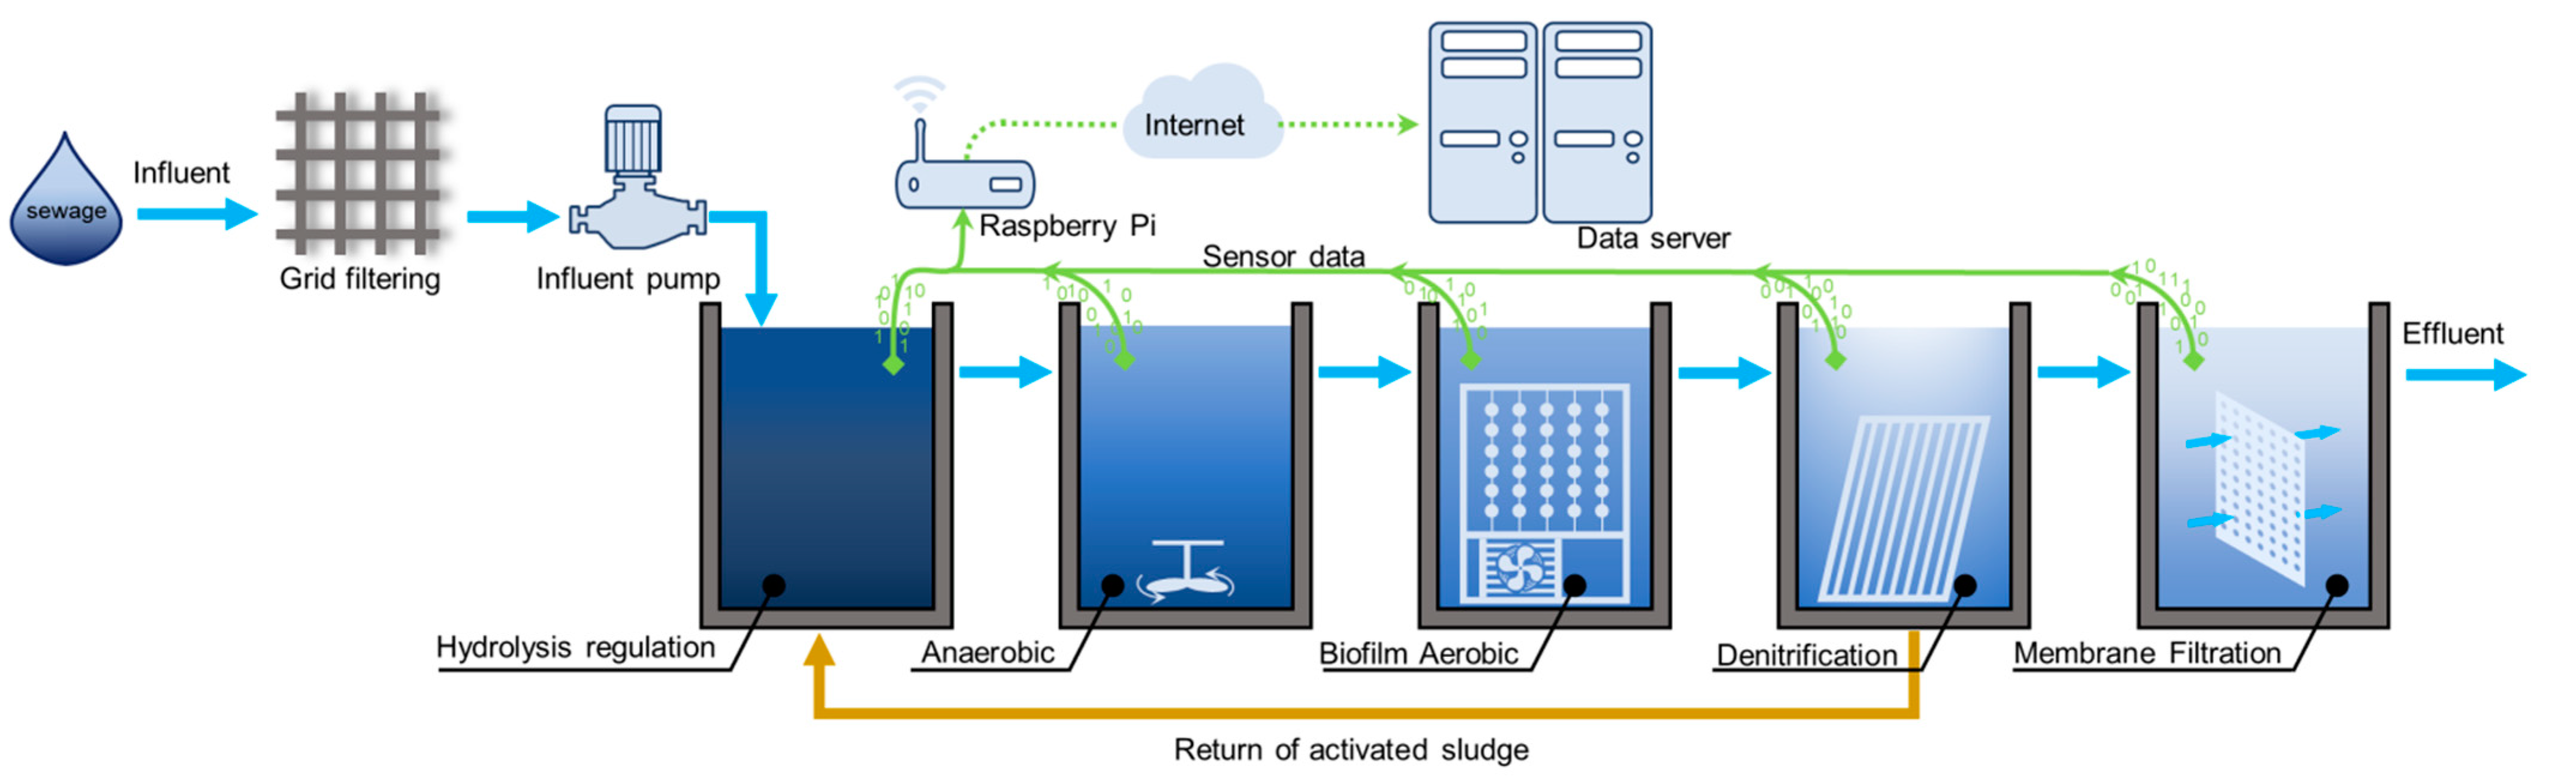
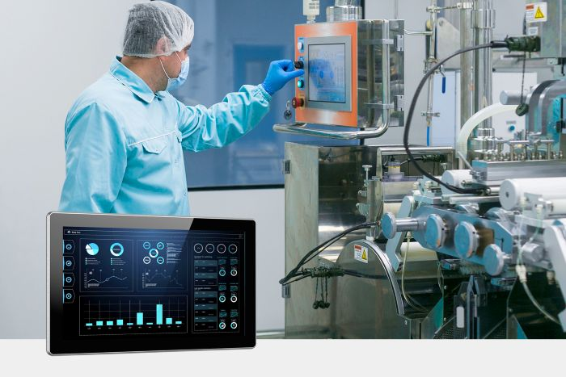

APPLICATION AREAS (2 / 2)
Process Automation
Pharma & Food
Energy & Utilities
Used in oil, gas, chemical, and water treatment plants. HART-over-PROFINET lets engineers remotely configure field instruments without stopping the control loop [5].
IP67/IP69K hardware for washdown environments. PROFIsafe handles SIL-rated safety interlocks on GMP lines. Diagnostic logging supports 21 CFR Part 11 audit trails [5].
Substations, wind turbines, and solar parks connect to SCADA via PROFINET. MRP ring redundancy auto-recovers from cable failure, critical for grid protection.

Slide 28
PROFINET vs. INDUSTRIAL ETHERNET STANDARDS
Feature
PROFINET
+PROFIsafe
EtherNet/IP
+CIP Safety
EtherCAT
+FSoE
Modbus TCP
CC-Link IE
POWERLINK
Standard
IEC 61158/61784
ODVA / IEC 61784
ETG / IEC 61158
Open / Modicon
CLPA / IEC 61784
Ethernet POWERLINK
Cycle Time
< 1 ms (IRT)
1–10 ms
< 0.1 ms
10–100 ms
< 1 ms
< 1 ms
Safety Profile
PROFIsafe SIL 3
CIP Safety SIL 3
FSoE SIL 3
✗ None
CC-Link Safety
openSAFETY SIL 3
Market Focus
Europe / Global
North America
Motion Control
Universal/Legacy
Asia (Mitsubishi)
European OEMs
Std. Ethernet HW
✔ Yes (RT)
✗ IRT needs special SW
✔ Yes
✗ Needs ASIC
✔ Yes
✔ Yes (1 Gbps)
✔ Yes
Topology
Star/Ring/Line
Star/Ring
Line/Ring
Star
Star/Ring/Line
Line/Ring
Vendor Lock
Open, PI governed
Open, ODVA governed
Open, ETG governed
Open, Modicon
Mitsubishi-led
Open, B&R/Ethernet

Slide 29
PROFINET STANDARDS References
IEC 61158
IEC 61784
Industrial communication networks – Fieldbus specifications. Defines PROFINET physical layer, data link layer, and application layer protocol.
Industrial communication networks – Profiles. Defines communication profiles including CPF 3 (PROFINET), specifying device behavior and interoperability.
IEC 61784-1
IEC 61784-2
IEC 61784-3-3
Communication Profiles
Real-Time Networks
PROFIsafe
Cyclic and acyclic data exchange profiles for industrial fieldbuses
RT and IRT performance requirements for industrial Ethernet
Functional safety communication profile (SIL 3 / PL e)
IEC 61784-5-3
IEEE 802.3
ISO 13849 / IEC 61508
Installation Guide
Ethernet Base
Safety Basis
Cabling, connectors, and infrastructure for PROFINET networks
Standard Ethernet physical/link layer PROFINET runs on top of
Functional safety standards PROFIsafe is built upon (PLe / SIL 3)

Slide 30
References
Thank you
[1]
S. Vitturi et al., "Ethernet-based real-time communications with PROFINET IO," IEEE IECON, 2009. DOI: 10.1109/IECON.2009.5414860
[2]
L. Dürkop et al., "Isochronous Real-Time in PROFINET," IEEE INDIN, 2014. DOI: 10.1109/INDIN.2014.6945612
[3]
P. Moraes et al., "Real-Time Ethernet in Industrial Automation," IEEE ETFA, 2010. DOI: 10.1109/ETFA.2010.5641343
Thank You
[4]
R. Pigan & M. Metter, Automating with PROFINET, 2nd ed. Publicis, 2008. ISBN 978-3-895-78348-1
[5]
PI (PROFIBUS & PROFINET Int.), "PROFINET System Description," Order No. 4.132, 2022. profibus.com
profinet.com
Refences
[6]
IEC 61158 — Industrial communication networks – Fieldbus specifications (PROFINET). IEC, Geneva.
profibus.com
ieeexplore.ieee.org
[7]
IEC 61784-3-3 — PROFIsafe: Functional Safety Fieldbuses, Ed. 3.0, 2021. IEC, Geneva.
hilscher.com/netx
[8]
Siemens AG, ERTEC 200P Product Brief, 6GK1184-0BB01, 2023. industry.siemens.com
renesas.com/r-in
ti.com/sitara
[9]
Hilscher GmbH, netX 90 Datasheet Rev. 2, 2019. hilscher.com
[10]
Texas Instruments, AM64x Sitara Processors Datasheet (SPRSP28), 2022. ti.com

