Slide 1
PROFINET
IEC 61158 / IEC 61784
Protocol Explained
Industrial Ethernet for Factory Automation
#1
Team:
Rionela Kovaci
Christian Percival
Mohamed Abdo
Industrial Ethernet
in Europe
Supervisor: Prof. Dr.-Ing. Ali Hayek

Slide 2

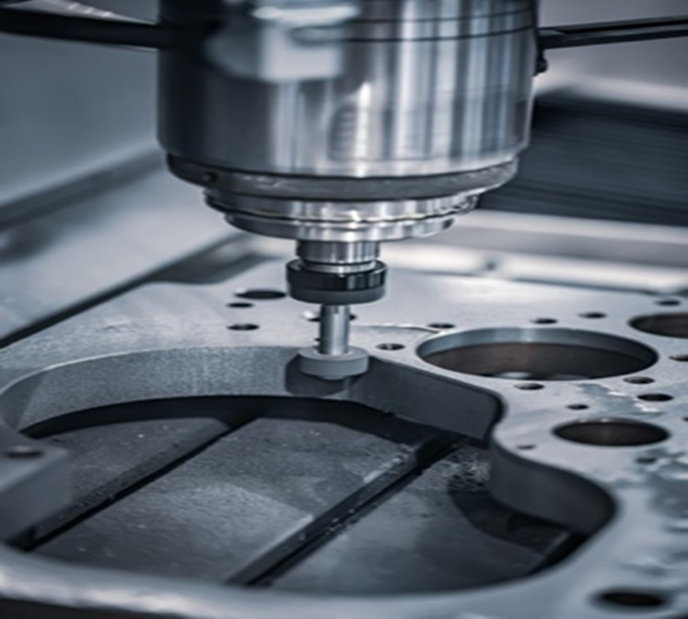
Motivation — Why PROFINET?
From home networks to factory-floor real-time communication
The Problem with Regular Ethernet in Factories:
Designed for best-effort delivery, no timing guarantees
100 ms delay is fine for streaming video, catastrophic for a robot arm
TCP/IP stack adds unpredictable latency
Why Factories Need Something Different:
Machines or CNC needs a response < 1 ms
One missed signal = broken part or safety risk
1000s of devices must be synchronized, not just connected

Slide 3
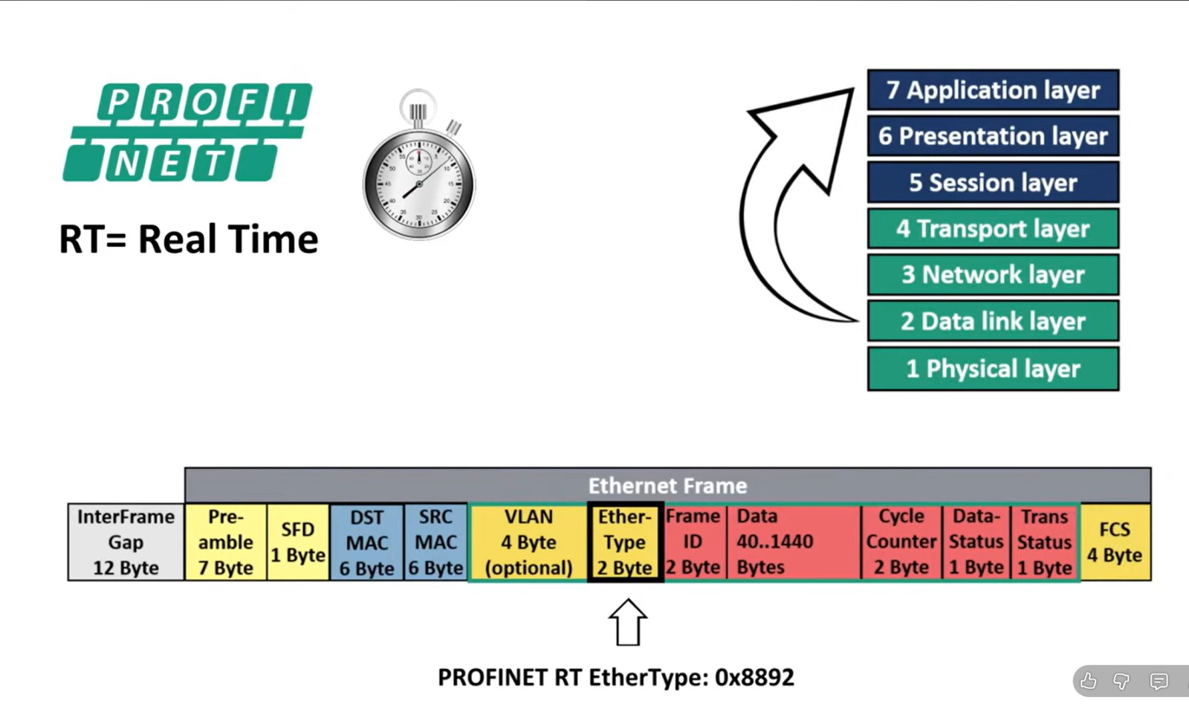
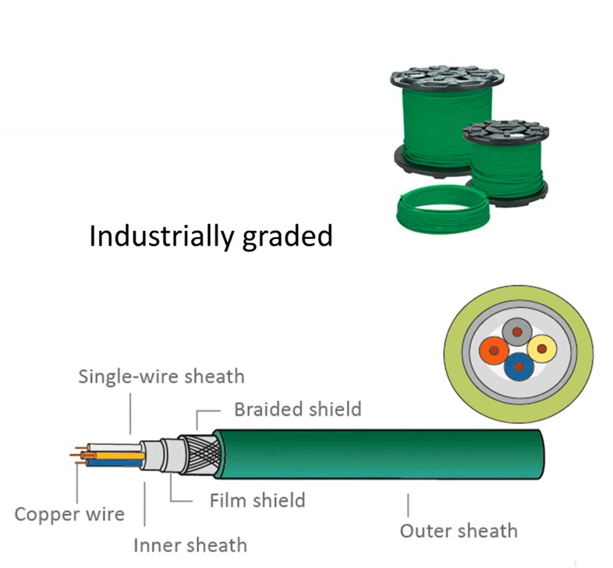
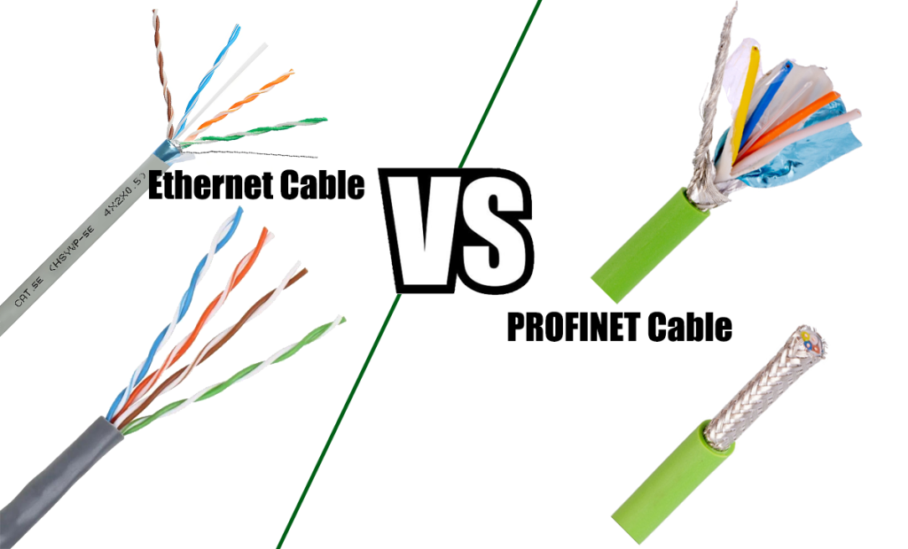
Motivation — Why PROFINET?
From home networks to factory-floor real-time communication
PROFINET solves this by:
Bypassing the TCP/IP stack entirely for time-critical data
Guaranteeing cycle times down to 125 µs
Running safety, motion, and Errors diagnostics on the same cable

Slide 4

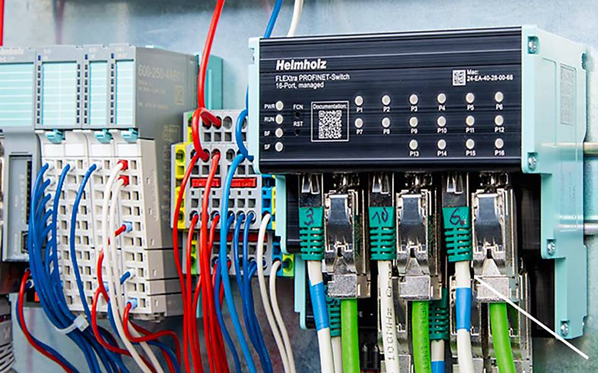
WHAT IS PROFINET?
PROFINET is an open Industrial Ethernet standard designed to exchange data between controllers and field devices in automation systems. standardized under IEC 61158 and IEC 61784, with support for real-time and isochronous real-time communication, integrated with PROFIsafe.
Source: Analysis of PROFINET IO Communication Protocol | IEEE Conference Publication | IEEE Xplore
SAFE

Slide 5
Can you build a PROFINET protocol prototype in the lab?

Slide 6
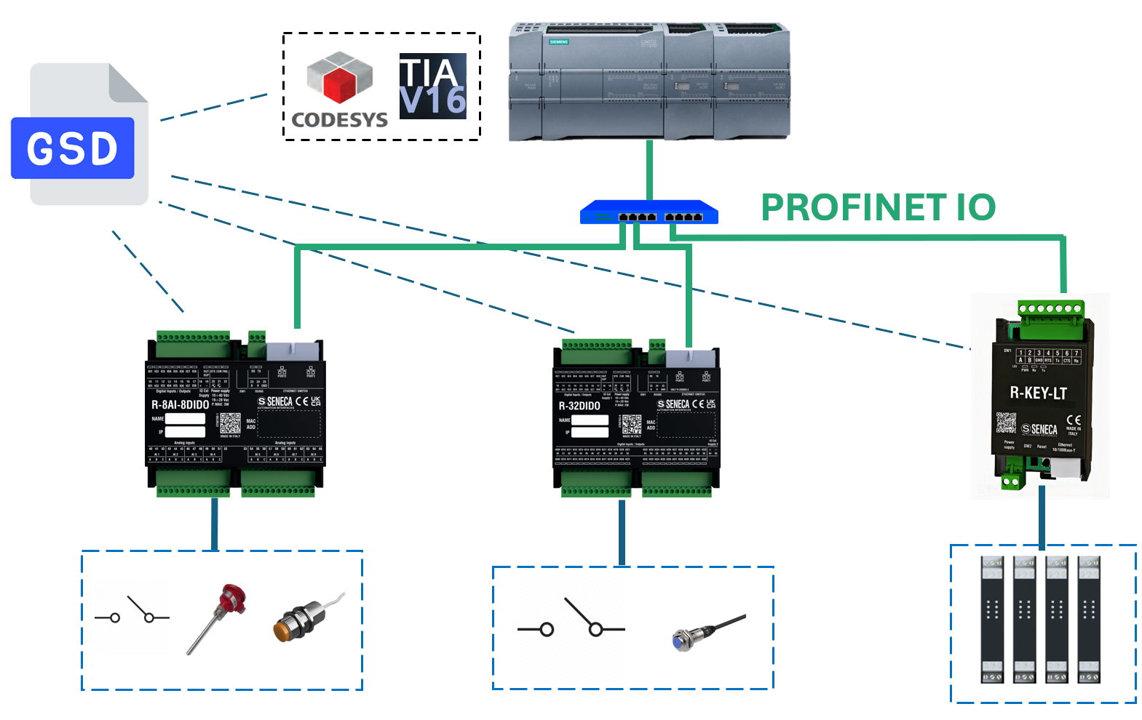
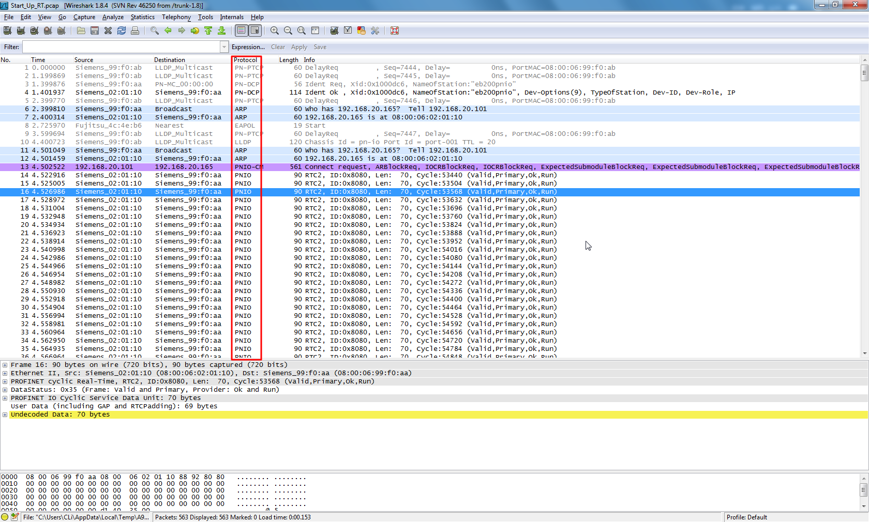
HOW PROFINET WORKS
PLC
(IO Controller)
Siemens S7-1500/1200, Beckhoff CX,
Rockwell 5380
Ethernet
Switch
Must support PROFINET DCP, LLDP & SNMP. RT
HMI
Human Machine Interface
(IO Supervisor)
shark wire
PROFINET - Wireshark Wiki
Cyclic IO Data (RT frames, EtherType 0x8892)

Slide 7

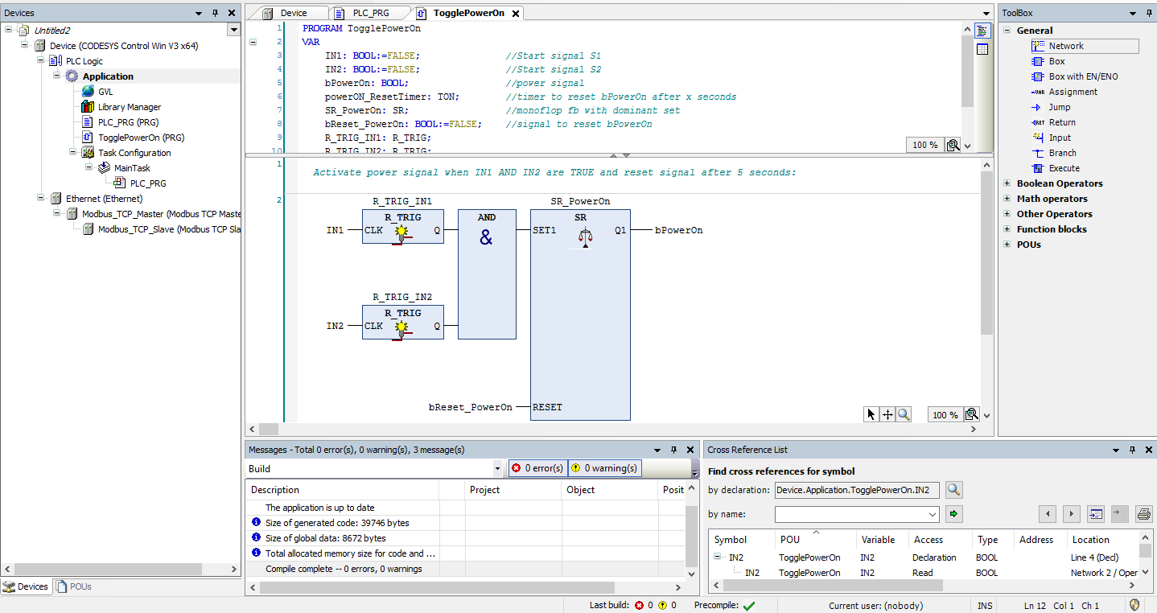
BUILDING A PROFINET NETWORK — 💻 SOFTWARE
Engineering Tool (PLC IDE)
Siemens TIA Portal (most common), CODESYS, Rockwell Studio 5000, Phoenix PLCnext Engineer — used to configure PROFINET network and program PLC logic
GSDML Files (per device)
XML-based General Station Description files — supplied by each device vendor. Import into the engineering tool to auto-configure IO data mappings and parameters

Slide 8
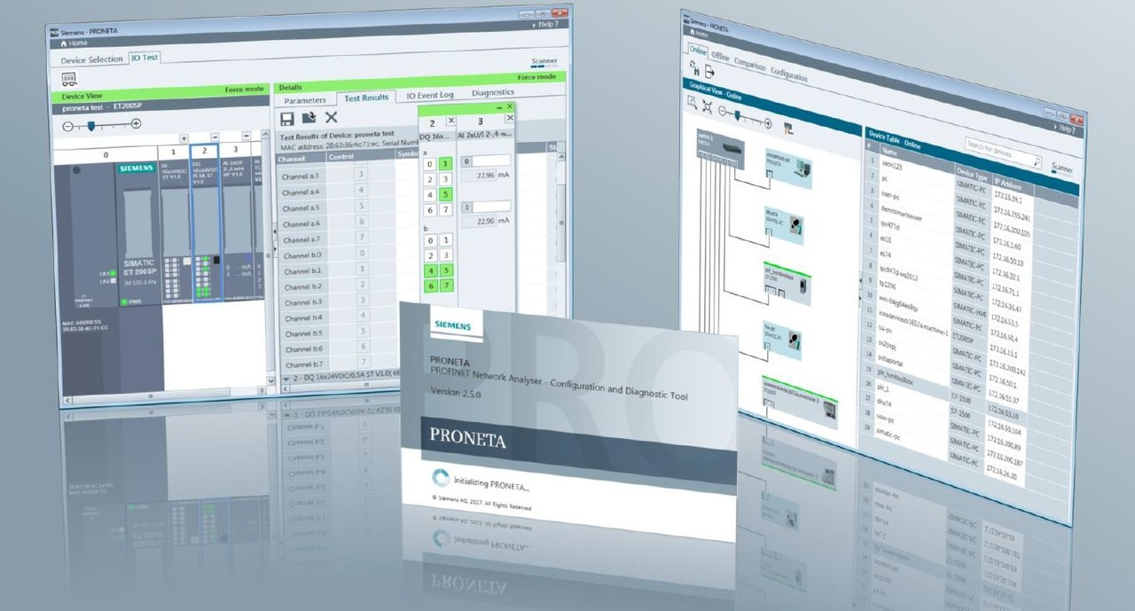
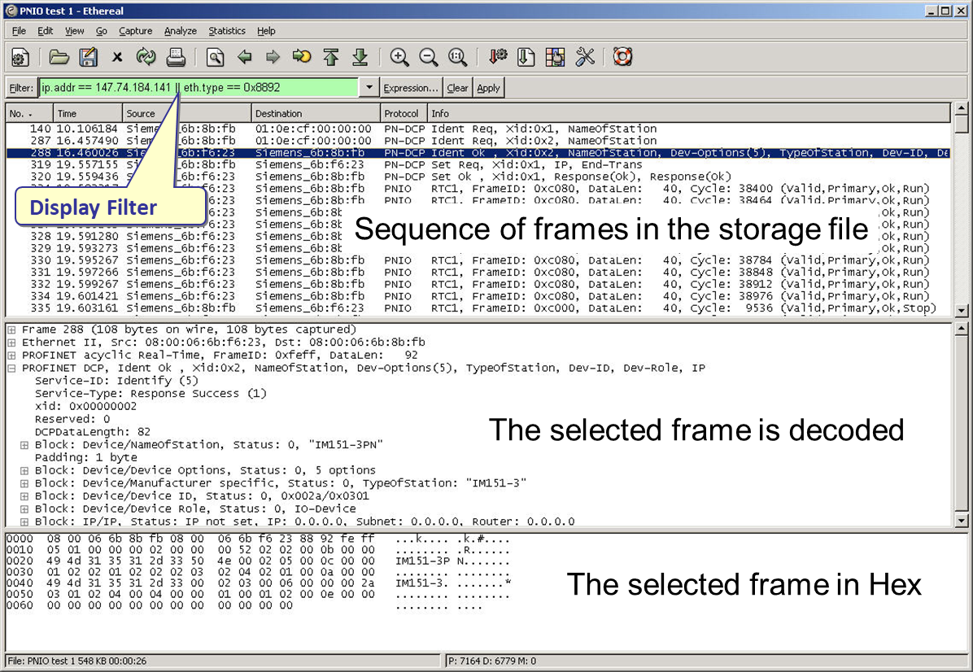
BUILDING A PROFINET NETWORK — 💻 SOFTWARE
Network Commissioning Tool
Siemens PRONETA (free), NetScan tools — scans the PROFINET network, assigns IP/device names, shows topology and device status without requiring a running PLC
Diagnostics Software
PROFINET-aware network analyzers (Wireshark + PROFINET dissector, Softing, Procentec ComBricks) for live frame capture, alarm analysis, and performance monitoring
Analysis of PROFINET IO Security Extensions on Wireshark | IEEE Conference Publication | IEEE Xplore

Slide 9

PROFINET raspberry pi Prototype

Slide 10
Christian‘s Part

Slide 11
3 COMMUNICATION CHANNELS & types
TCP/IP
RT
IRT
Cycle: ~100 ms
Cycle: 1–10 ms
Cycle: < 1 ms
Non-Real-Time Channel
Real-Time Channel
Isochronous Real-Time
Used for configuration, parameterization, diagnostics, and IT integration. Travels through the full TCP/IP stack. Not suitable for time-critical tasks.
Cyclic IO data exchange using Layer 2 Ethernet frames (EtherType 0x8892). Bypasses the TCP/IP stack entirely for low latency.
Synchronized time-slot communication with hardware-level scheduling. Requires special IRT-capable switches. Reserved for demanding motion control.
▸ Device configuration
▸ Sensor/actuator IO
▸ CNC / servo drives
▸ SNMP diagnostics
▸ Valve & motor control
▸ Multi-axis coordination
▸ OPC UA, HTTP, MQTT coexistence
▸ Discrete IO monitoring
▸ High-speed robotics

Slide 12
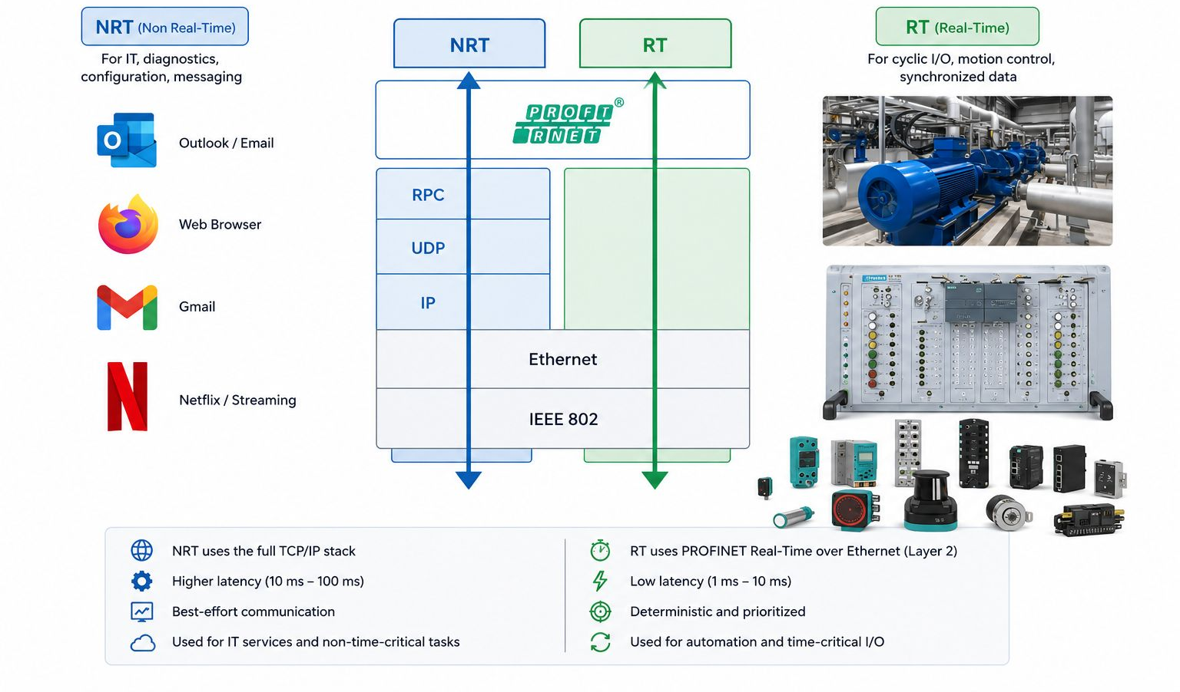
NRT vs RT

Slide 13
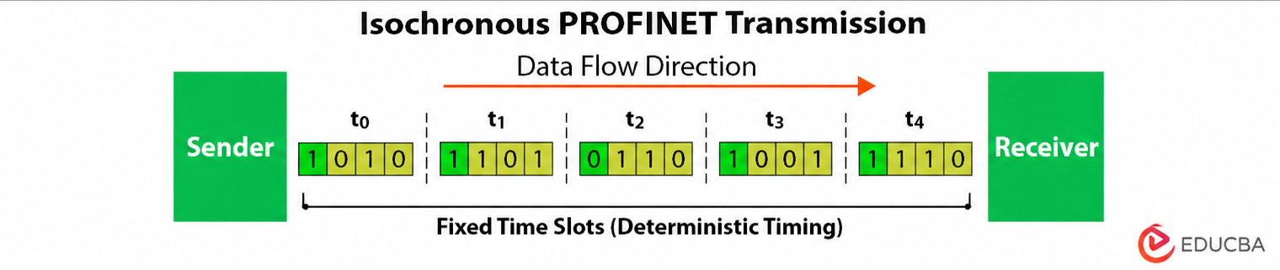
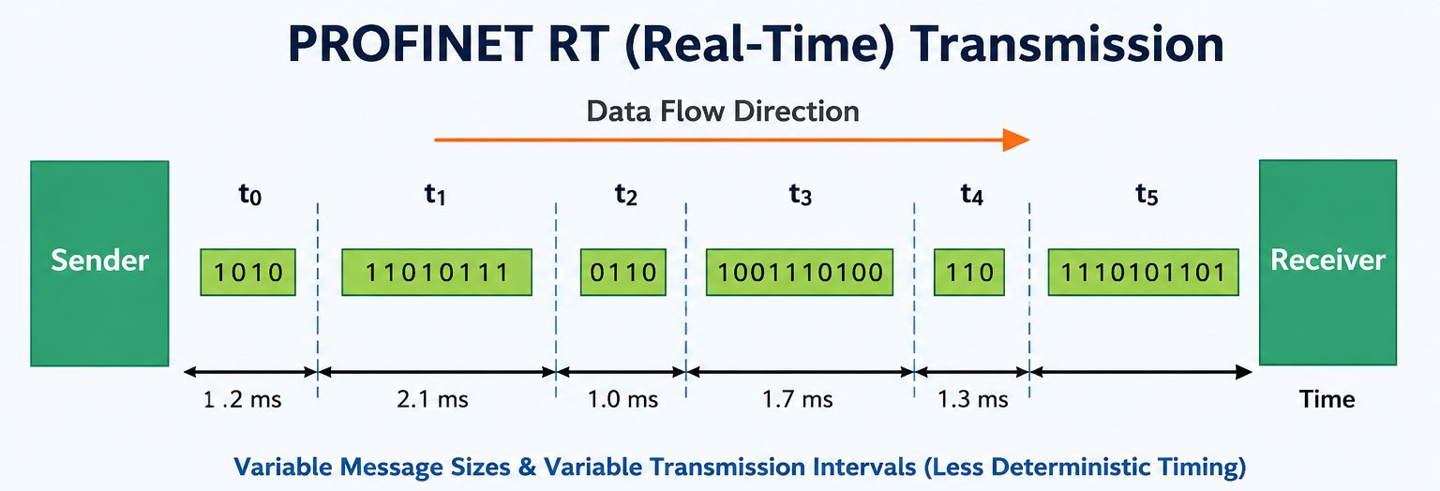
IRT (Isochronous Real Time)

Slide 14
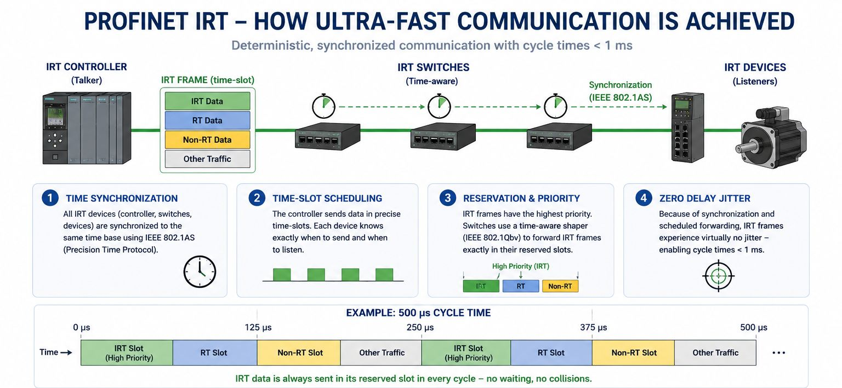
IRT (Isochronous Real Time)

Slide 15
PROFIsafe — FUNCTIONAL SAFETY OVER PROFINET
PROFIsafe is a safety communication profile (IEC 61784-3-3) built on top of PROFINET using the "Black Channel" principle — it adds its own error-detection layer above the standard network, so safety-critical signals (E-Stop, light curtains, safety doors) travel on the same cable as regular automation data without requiring separate wiring.
BLACK CHANNEL PRINCIPLE
Safety Level:
Up to SIL 3 (IEC 61508)
PL e / Cat 4 (ISO 13849)
Safety Function (F-CPU ↔ F-Device)
Certified By:
TÜV SÜD + IFA (Germany)
PROFIsafe Layer (CRC + Consecutive No.)
Standard:
IEC 61784-3-3 (since 2007)
PROFINET RT (Black Channel – untouched)
Key Mechanism:
CRC checksum + Consecutive Number + Watchdog Timer
Ethernet Physical (Cat 5e / Cat 6)
Use Cases:
E-Stop, light curtains, safety doors, safe speed monitoring
⚠ PROFIsafe does NOT replace a risk assessment — it provides the communication infrastructure for safety functions already designed per ISO 13849 / IEC 62061.

Slide 16
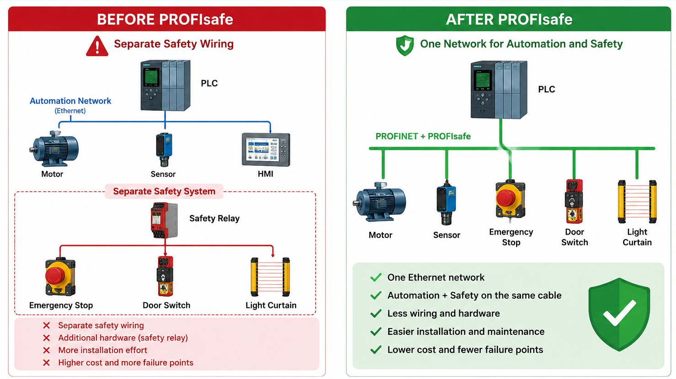
PROFIsafe

Slide 17
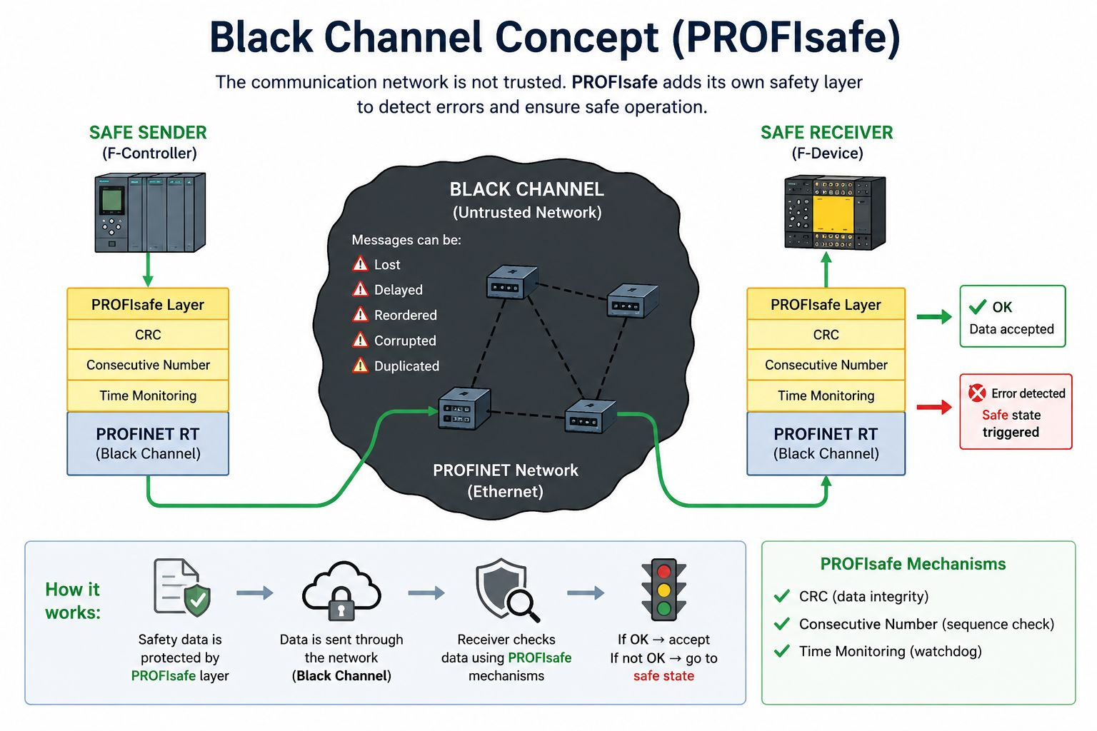
PROFIsafe – BLACK CHANNEL

Slide 18
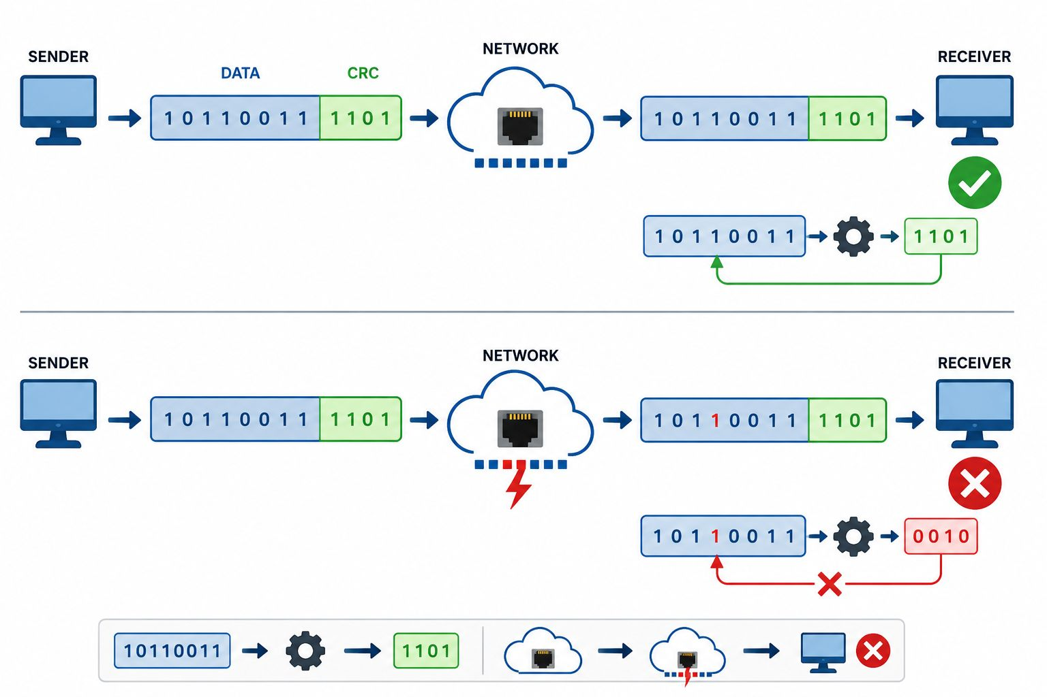
PROFIsafe - CRC (Check Sum)

Slide 19
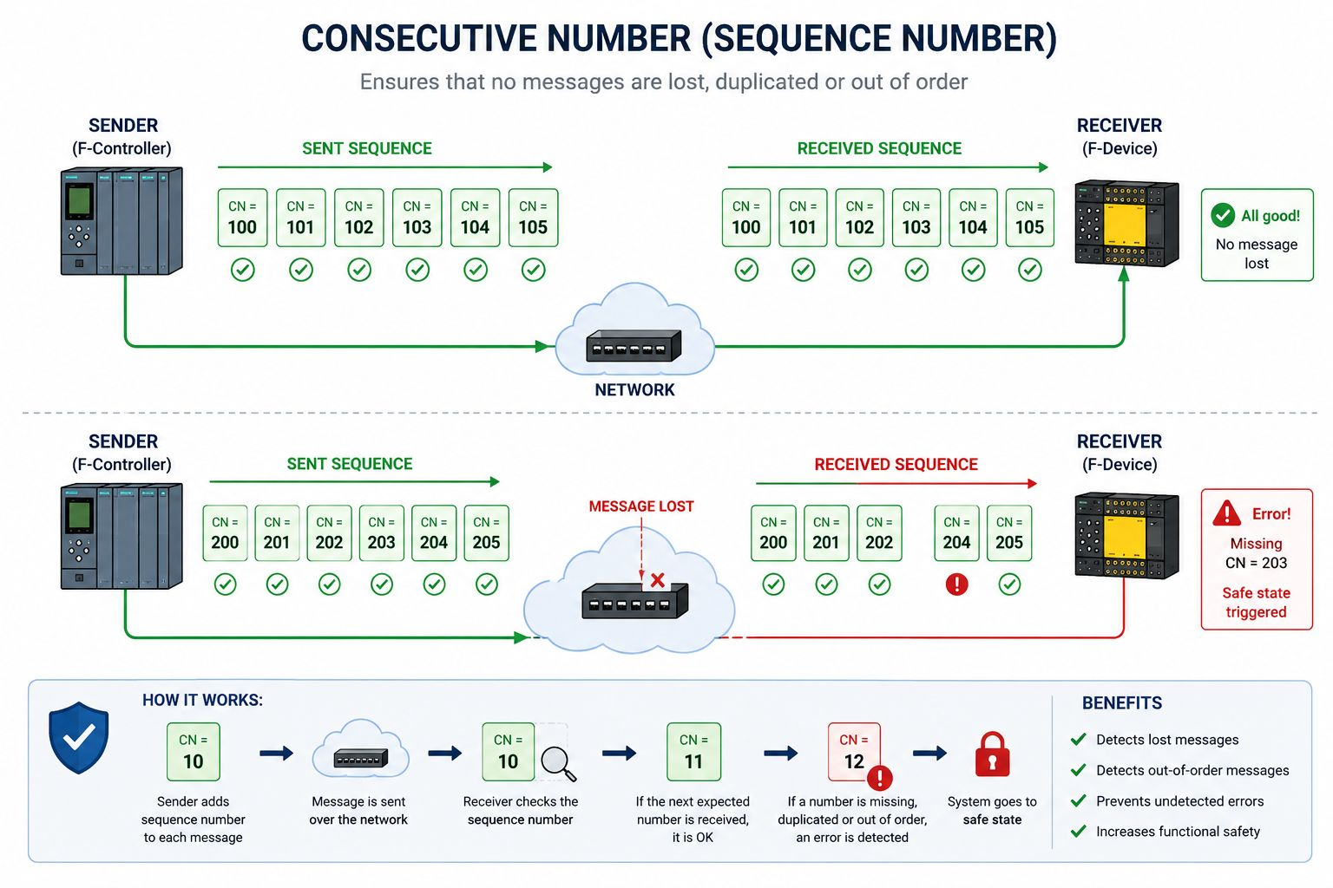
Consecutive Number (Sequence Number)

Slide 20
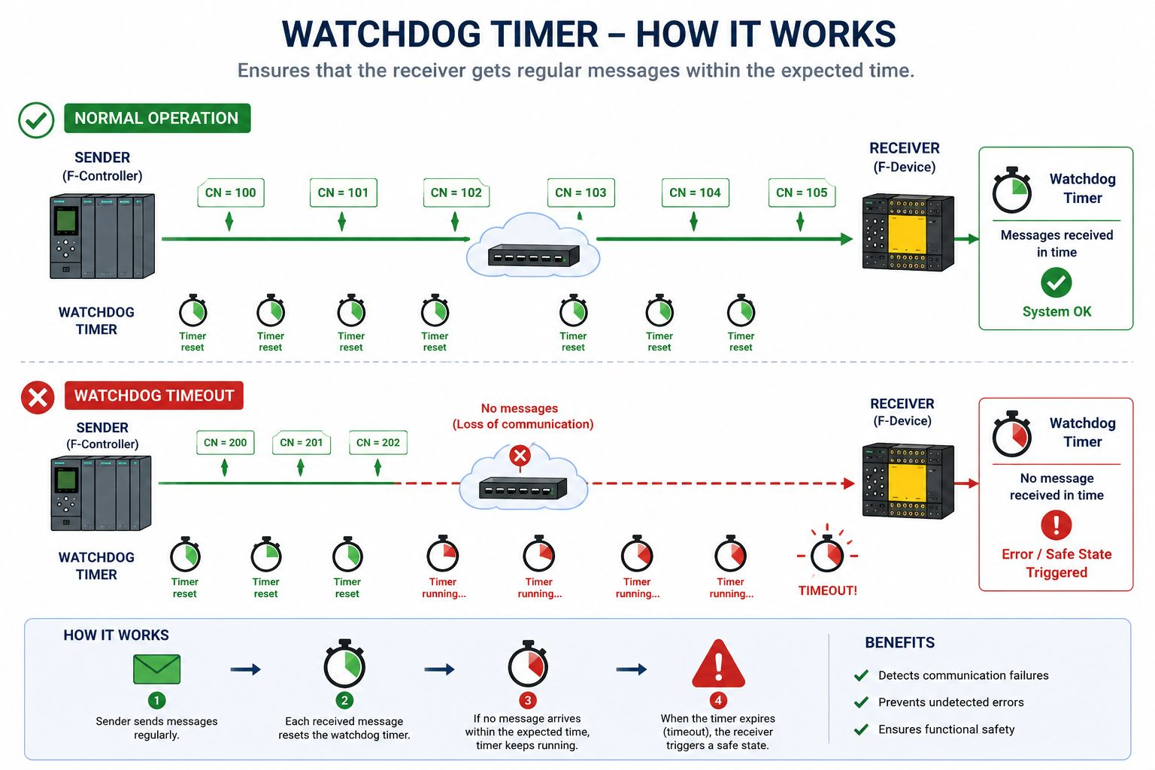
PROFIsafe – WATCHDOG TIMER

Slide 21
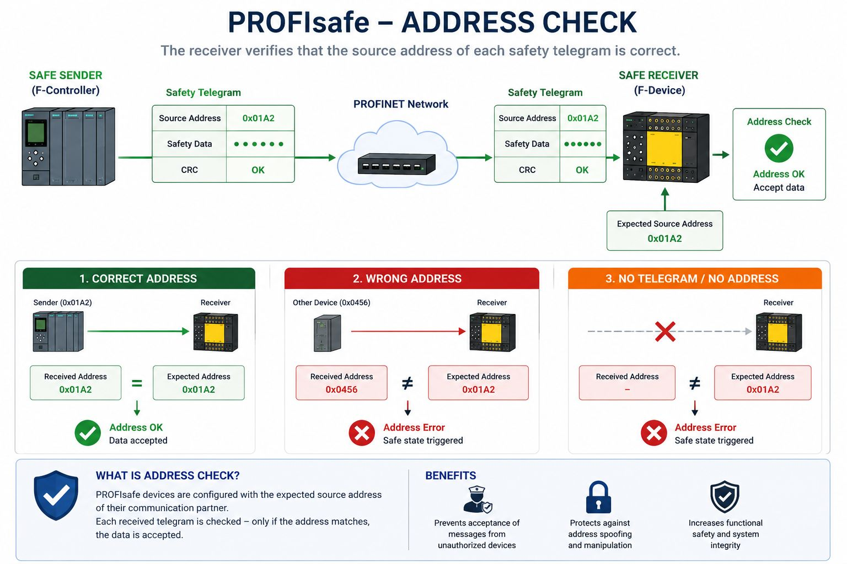
PROFIsafe – ADDRESS CHECK

Slide 22
PROFIsafe

Slide 23
Christian‘s Part

Slide 24
Rio‘s Part

Slide 25
PROFINET HARDWARE CHIPS — IMPLEMENTATION APPROACHES
Building a PROFINET IO Device requires dedicated hardware to handle real-time Ethernet frames. Three main implementation paths exist — each with different trade-offs in cost, performance, flexibility, and time-to-market.
01
Dedicated
ASIC / SoC
02
General MCU
+ PRU / Soft-IP
03
FPGA-based
Implementation
✔ Advantages
✔ Advantages
✔ Advantages
+ Best RT/IRT performance
+ Multi-protocol capable
+ Maximum flexibility
+ Low CPU load
+ Lower BOM cost
+ IRT capable
+ Smallest footprint
+ Software-upgradeable
+ Custom logic possible
+ Low power
+ Large ecosystem
+ Multi-protocol
✖ Limitations
✖ Limitations
✖ Limitations
– Fixed protocol
– More SW effort
– Highest cost
– High NRE cost
– Limited IRT support
– Complex design
Siemens ERTEC 200P
Hilscher netX 90
Renesas R-IN32M3
TI AM64x (PRU-ICSSG)
TI AMIC110
NXP i.MX RT
Intel/Altera (EtherBrick)
Xilinx Artix-7
(with 3rd-party IP cores)
– Long design cycle
– Higher CPU overhead
– Large power budget
Note: 'Conformance Classes' A (RT only), B (RT+topology), C (IRT) determine which chip category is required.

Slide 26
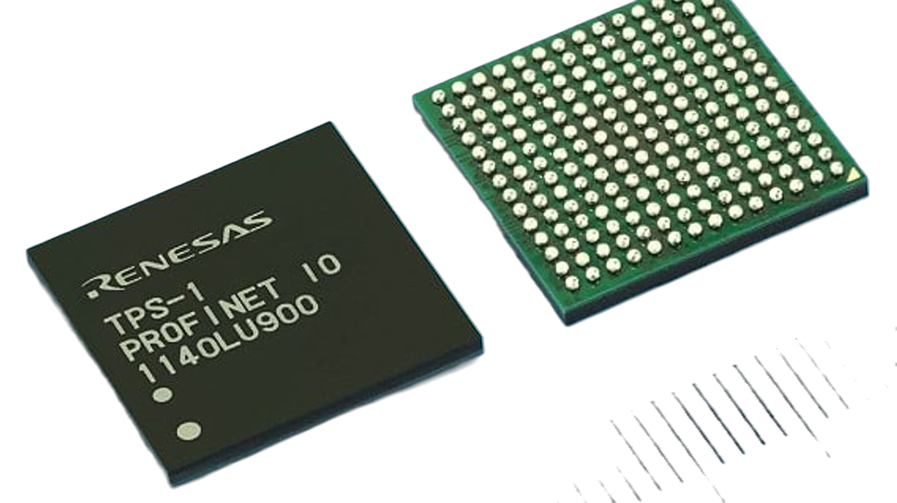
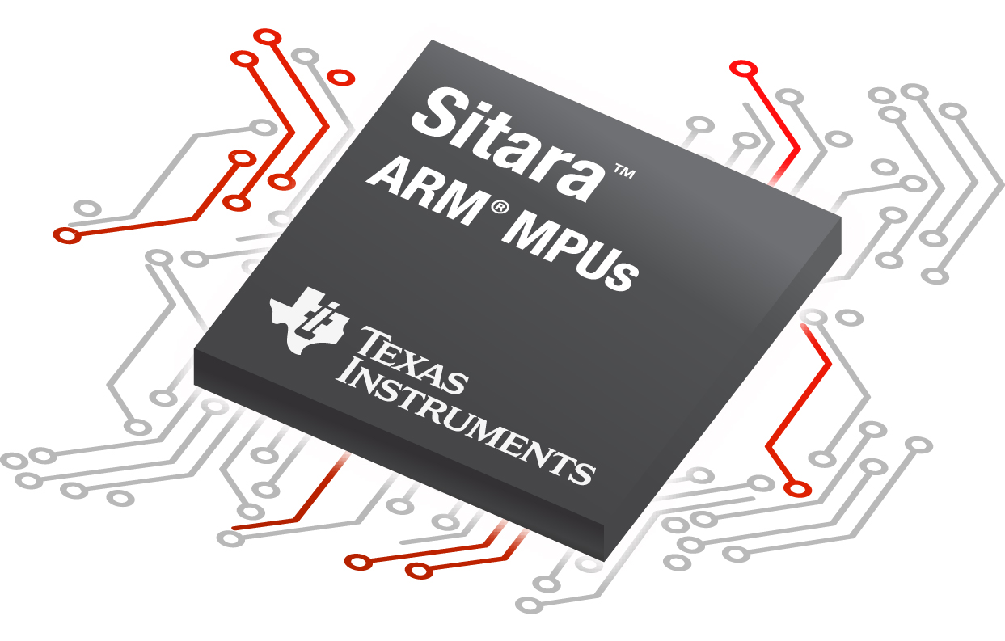
MCU-BASED APPROACHES — Renesas R-IN32 & Texas Instruments Sitara
🇯🇵 RENESAS — R-IN32 Family
🇺🇸 TEXAS INSTRUMENTS — Sitara / PRU-ICSS
R-IN32M3
AMIC110 (Sitara)
ARM Cortex-M3 + R-IN Engine
PROFINET RT, EtherNet/IP, EtherCAT
2-port 100 Mbps switch, multiprotocol
ARM Cortex-A8, ~$4/unit
PRU-ICSS subsystem for protocol offload
PROFINET RT, EtherNet/IP, EtherCAT from same HW

Slide 27
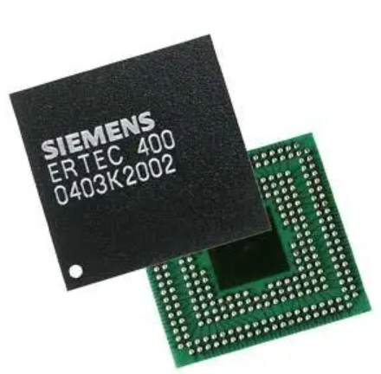
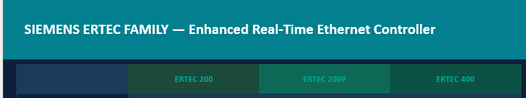
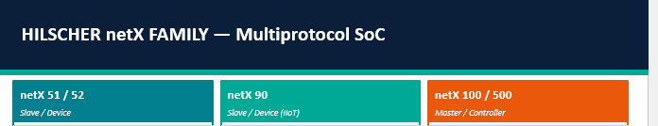
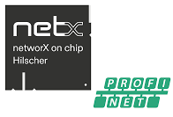
MCU-BASED APPROACHES — Renesas R-IN32 & Texas Instruments Sitara
🇯🇵 RENESAS — R-IN32 Family

Slide 28
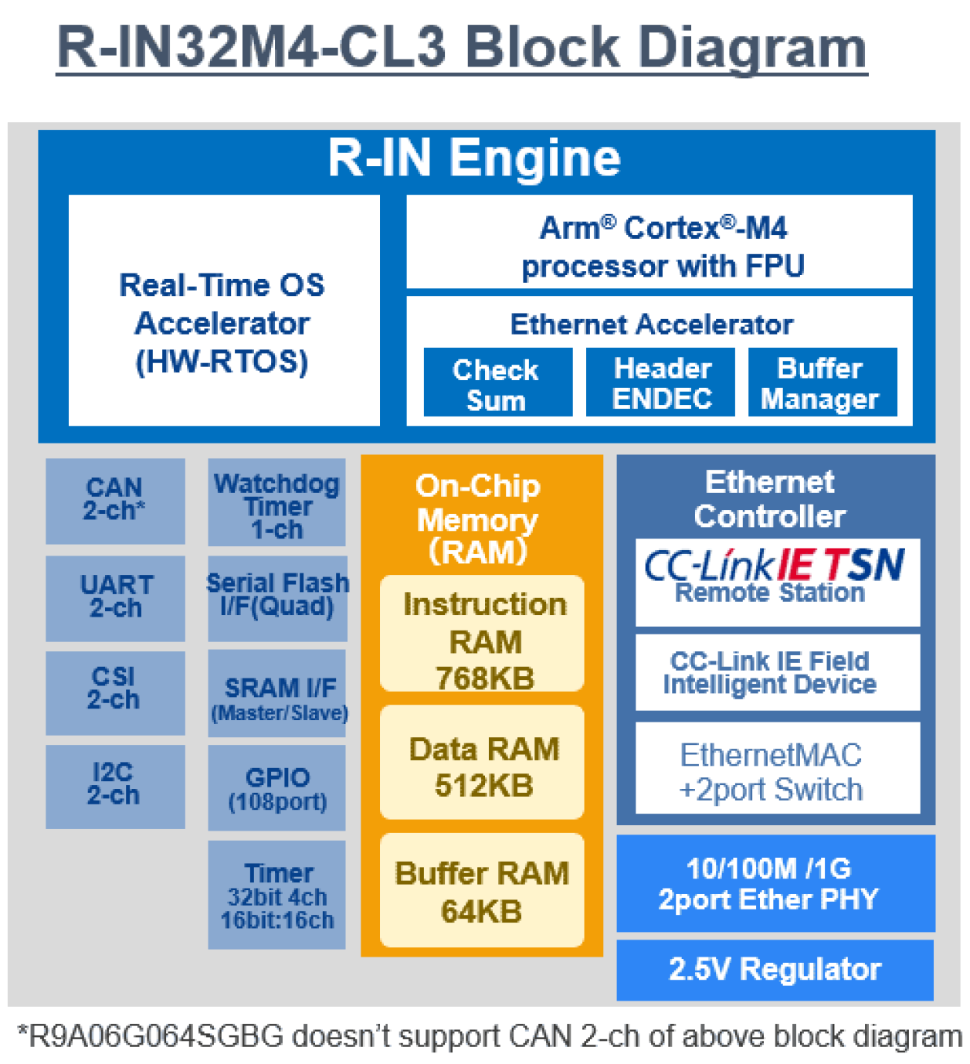
What makes these Chips different in profinet fast timming?

Slide 29
PROFINET APPLICATION AREAS
🏭
Discrete Manufacturing
⚙️
Machine Tools / CNC
Assembly lines, conveyor systems, pick-and-place, welding cells
Multi-axis servo coordination via PROFIdrive, <1 ms IRT cycles
🤖
Robotics
🏗️
Automotive
ABB, FANUC, KUKA — all support PROFINET natively for arm control
Body-in-white, paint, powertrain assembly; 100% PROFINET lines at VW, BMW
💊
Pharma & Food
🌊
Water / Oil & Gas
PROFIsafe ensures SIL-rated interlocks for FDA/GMP-compliant lines
Remote pump/valve control over long distances; PROFIBUS proxy integration
🔋
Energy / Utilities
🏢
Building Automation
Substation automation, wind turbines, solar plant SCADA networks
HVAC, access control, fire suppression with OPC UA coexistence

Slide 30
PROFINET vs. INDUSTRIAL ETHERNET STANDARDS
Feature
PROFINET
+PROFIsafe
EtherNet/IP
+CIP Safety
EtherCAT
+FSoE
Modbus TCP
CC-Link IE
POWERLINK
Standard
IEC 61158/61784
ODVA / IEC 61784
ETG / IEC 61158
Open / Modicon
CLPA / IEC 61784
Ethernet POWERLINK
Cycle Time
< 1 ms (IRT)
1–10 ms
< 0.1 ms
10–100 ms
< 1 ms
< 1 ms
Safety Profile
PROFIsafe SIL 3
CIP Safety SIL 3
FSoE SIL 3
✗ None
CC-Link Safety
openSAFETY SIL 3
Market Focus
Europe / Global
North America
Motion Control
Universal/Legacy
Asia (Mitsubishi)
European OEMs
Std. Ethernet HW
✔ Yes (RT)
✗ IRT needs special SW
✔ Yes
✗ Needs ASIC
✔ Yes
✔ Yes (1 Gbps)
✔ Yes
Topology
Star/Ring/Line
Star/Ring
Line/Ring
Star
Star/Ring/Line
Line/Ring
Vendor Lock
Open, PI governed
Open, ODVA governed
Open, ETG governed
Open, Modicon
Mitsubishi-led
Open, B&R/Ethernet

Slide 31
Rio‘s Part

Slide 32
Christian‘s Part

Slide 33
PROFINET STANDARDS refrences
IEC 61158
IEC 61784
Industrial communication networks – Fieldbus specifications. Defines PROFINET physical layer, data link layer, and application layer protocol.
Industrial communication networks – Profiles. Defines communication profiles including CPF 3 (PROFINET), specifying device behavior and interoperability.
IEC 61784-1
IEC 61784-2
IEC 61784-3-3
Communication Profiles
Real-Time Networks
PROFIsafe
Cyclic and acyclic data exchange profiles for industrial fieldbuses
RT and IRT performance requirements for industrial Ethernet
Functional safety communication profile (SIL 3 / PL e)
IEC 61784-5-3
IEEE 802.3
ISO 13849 / IEC 61508
Installation Guide
Ethernet Base
Safety Basis
Cabling, connectors, and infrastructure for PROFINET networks
Standard Ethernet physical/link layer PROFINET runs on top of
Functional safety standards PROFIsafe is built upon (PLe / SIL 3)

Slide 34
References
Thank you
PROFINET
[1]
S. Vitturi et al., "Ethernet-based real-time communications with PROFINET IO," IEEE IECON, 2009. DOI: 10.1109/IECON.2009.5414860
[2]
L. Dürkop et al., "Isochronous Real-Time in PROFINET," IEEE INDIN, 2014. DOI: 10.1109/INDIN.2014.6945612
Protocol Explained
[3]
P. Moraes et al., "Real-Time Ethernet in Industrial Automation," IEEE ETFA, 2010. DOI: 10.1109/ETFA.2010.5641343
[4]
R. Pigan & M. Metter, Automating with PROFINET, 2nd ed. Publicis, 2008. ISBN 978-3-895-78348-1
Thank You
[5]
PI (PROFIBUS & PROFINET Int.), "PROFINET System Description," Order No. 4.132, 2022. profibus.com
Refences
[6]
IEC 61158 — Industrial communication networks – Fieldbus specifications (PROFINET). IEC, Geneva.
profinet.com
[7]
IEC 61784-3-3 — PROFIsafe: Functional Safety Fieldbuses, Ed. 3.0, 2021. IEC, Geneva.
profibus.com
[8]
Siemens AG, ERTEC 200P Product Brief, 6GK1184-0BB01, 2023. industry.siemens.com
ieeexplore.ieee.org
hilscher.com/netx
[9]
Hilscher GmbH, netX 90 Datasheet Rev. 2, 2019. hilscher.com
renesas.com/r-in
[10]
Texas Instruments, AM64x Sitara Processors Datasheet (SPRSP28), 2022. ti.com
ti.com/sitara
Questions & Live Demo

