Slide 1

Team_A3
PCB Design Report
▸ Lattice FPGA iCE40UP5K-SG48I
▸ 4-Layer PCB Stack-up
▸ JLCPCB Manufacturing Standards
▸ 0 DRC Violations
▸ Serpentine Length Tuning
By:
Rionela Kovaci
Christian Percival
Mohamed Abdo

Slide 2
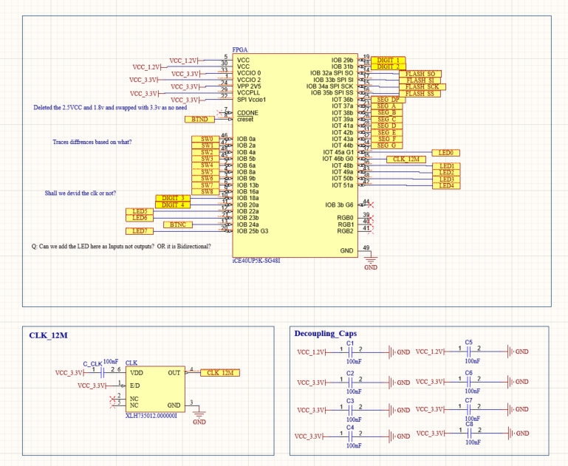
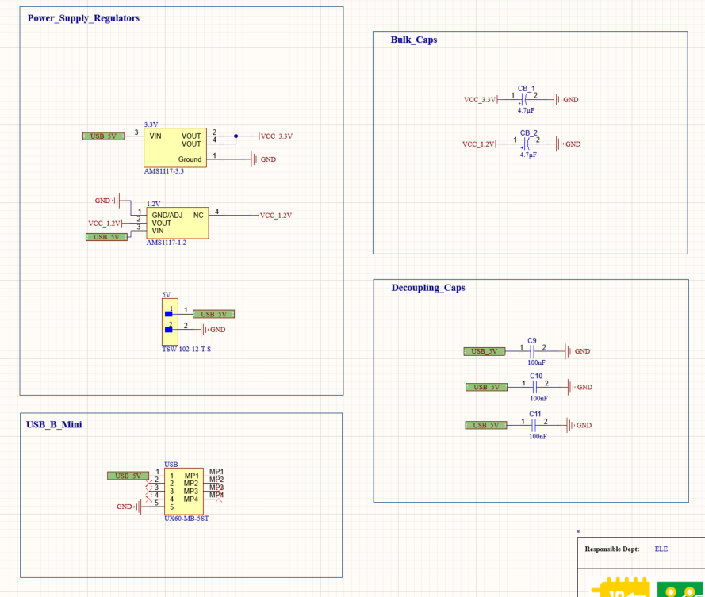
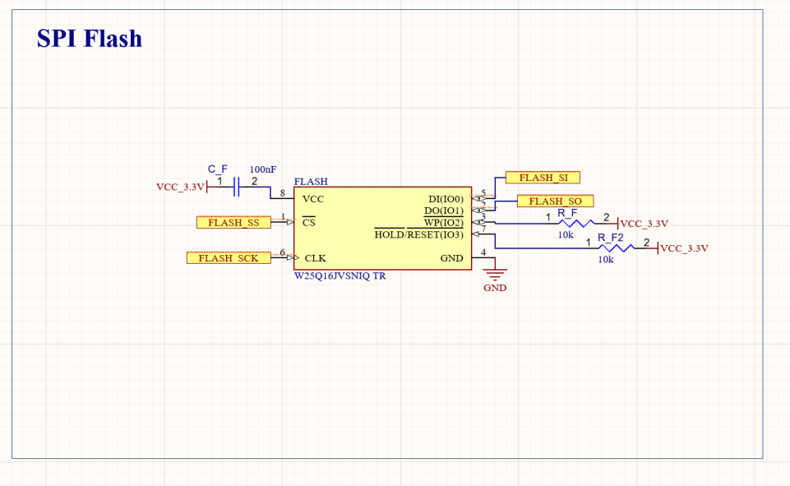
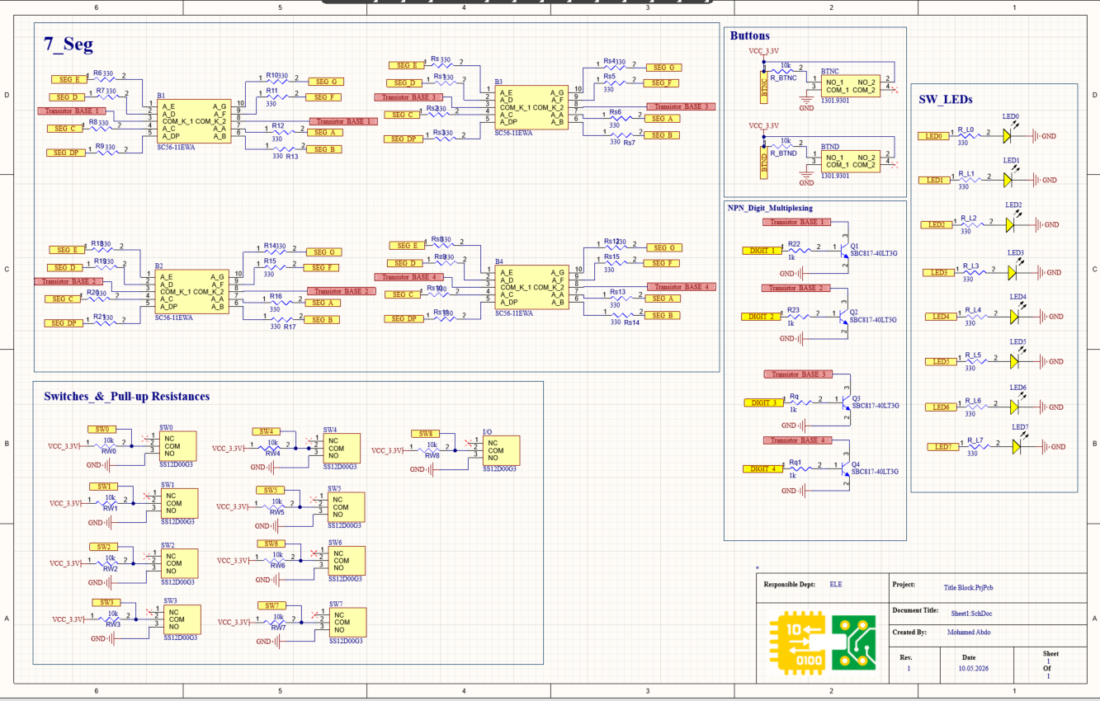
Schematic Overview
FPGA + Decoupling Caps
Power Supply (AMS1117 3.3V / 1.2V)
SPI Flash (W25Q16)
7-Seg, Switches & LEDs

Slide 3
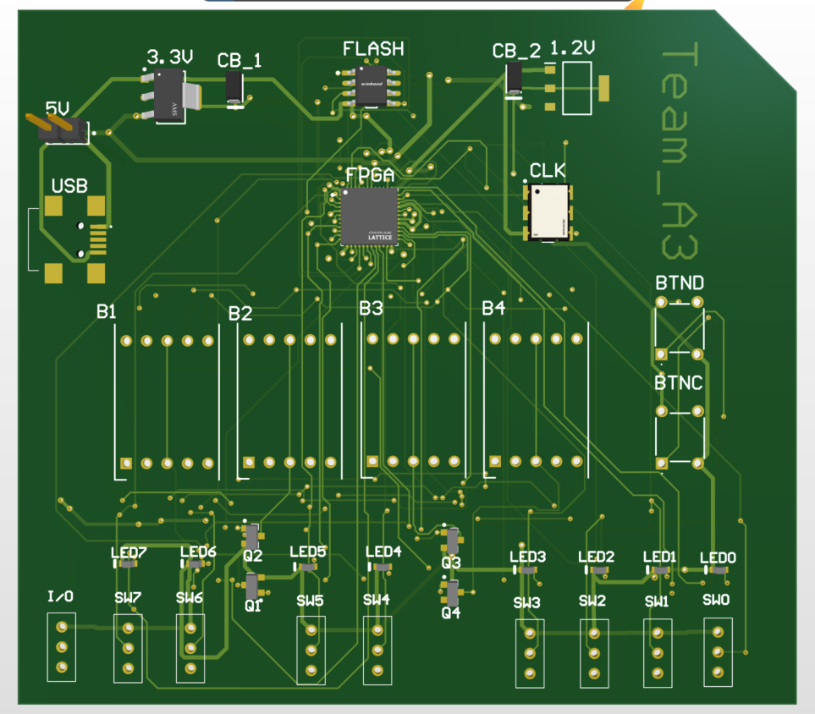
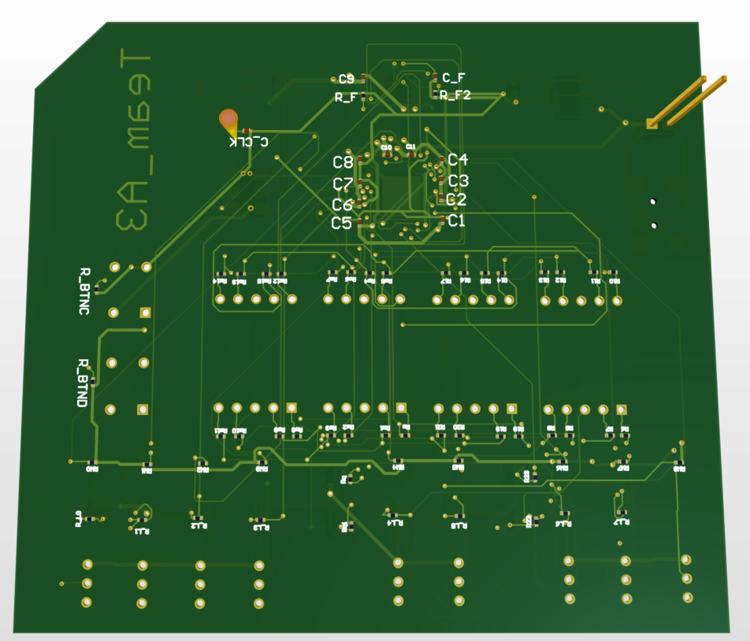
PCB Overview
TOP VIEW
BOTTOM VIEW
Decoupling caps C1–C11 placed on bottom layer directly under FPGA power pins

Slide 4
Decoupling Capacitors Strategy
Bottom View — Caps visible
Cap Placement Logic
C1–C8
100nF
FPGA VCC_3.3V & VCC_1.2V decoupling
C9–C11
100nF
USB_5V input line filtering
CB_1, CB_2
4.7µF
Bulk caps on 3.3V and 1.2V rails
C_F
100nF
SPI Flash VCC bypass capacitor
All caps placed within 2mm of FPGA power pins for minimum parasitic inductance

Slide 5
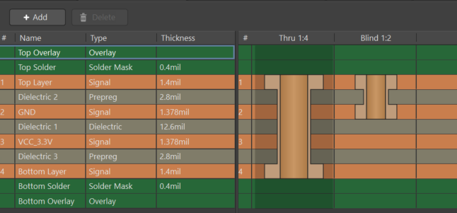
4-Layer Stack-up
Layer Details
L1 Top Layer
1.4 mil • Signals + components
L2 GND Plane
1.378 mil • Solid GND — EMI shield
L3 VCC_3.3V
1.378 mil • Power distribution plane
L4 Bottom Layer
1.4 mil • Signals + decoupling caps

Slide 6
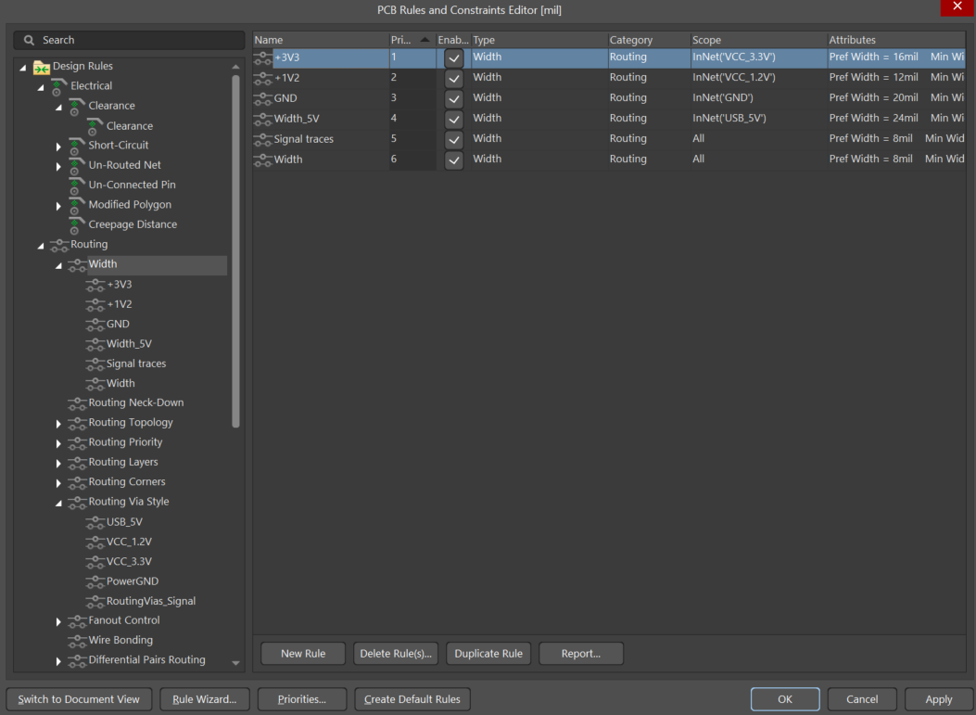
Trace Width Design Rules
Net | JLCPCB Min | Industry Std | Our Design
GND | 5 mil | 15–25 mil | 20 mil ✓
USB 5V | 5 mil | 20–30 mil | 24 mil ✓
VCC 3.3V | 5 mil | 12–20 mil | 16 mil ✓
VCC 1.2V | 5 mil | 10–15 mil | 12 mil ✓
Signals | 5 mil | 6–10 mil | 8 mil ✓
Min used | 5 mil | 5 mil | 5 mil ✓
All traces exceed JLCPCB minimum of 5mil (0.127mm)
Reference: jlcpcb.com/capabilities/pcb-capabilities

Slide 7
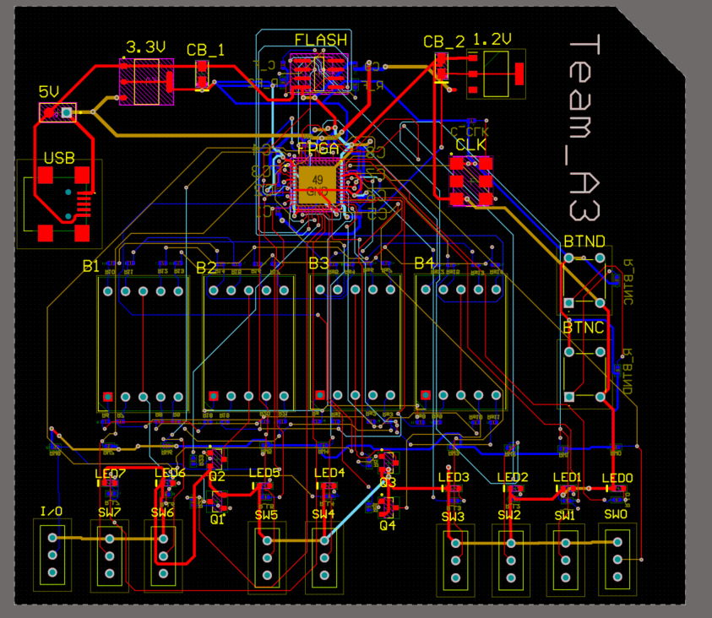
Routing & Layer Usage
Layer Color Key
Top Layer (L1)
FPGA signals, power
Bottom Layer (L4)
Return signals, decoupling
VCC_3.3V (L3)
Power distribution
GND Plane (L2)
Solid ground reference
Situs Autorouter — Default Multi Layer
Clearance: 6mil | Strategy: Shortest Path

Slide 8
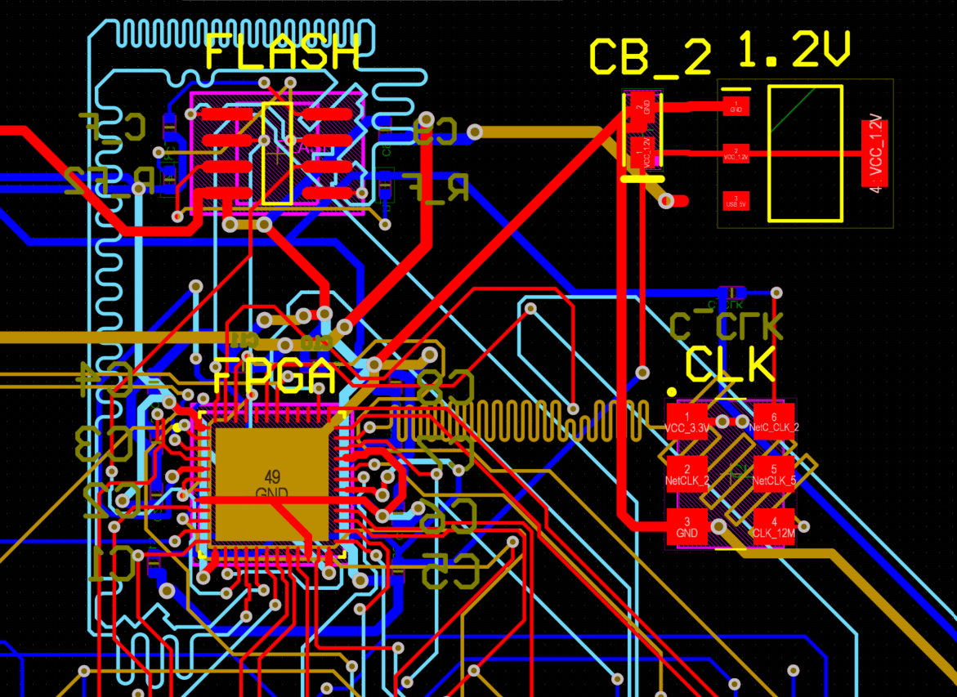
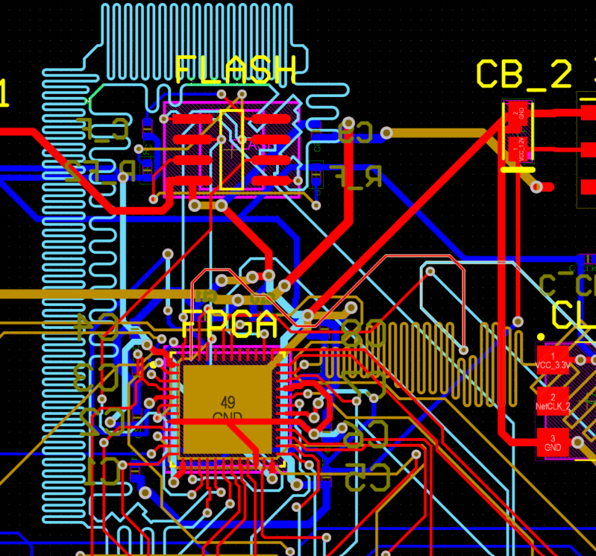
Serpentine Length Tuning
CLK + FLASH Serpentines
CLK Serpentine Detail
What & Why
CLK_12M
Serpentine traces match signal arrival times across parallel buses — critical for timing integrity
Applied between FPGA and CLK oscillator — compact tight meander, minimal area used
SPI Flash Lines:
FLASH_SCK, FLASH_SI, FLASH_SO length-matched using Altium Interactive Length Tuning (Shift+A)
Settings Used:
Amplitude: 0.3–0.5mm | Gap: 0.15mm | Corner: Rounded | 0 DRC violations after tuning

Slide 9
Via Design Strategy
Via Type | JLCPCB Min | Industry Std | Our Design | Net
Signal Vias | Hole≥0.3mm Pad≥0.5mm | Hole 0.3mm Pad 0.6mm | Hole 12mil Pad 24mil ✓ | All signals
VCC 3.3V | Hole≥0.3mm Pad≥0.5mm | Hole 0.4mm Pad 0.8mm | Hole 16mil Pad 28mil ✓ | VCC_3.3V
Power GND | Hole≥0.3mm Pad≥0.5mm | Hole 0.45mm Pad 0.9mm | Hole 18mil Pad 32mil ✓ | GND
USB 5V | Hole≥0.3mm Pad≥0.5mm | Hole 0.45mm Pad 0.9mm | Hole 18mil Pad 32mil ✓ | USB_5V
Annular Ring | ≥0.1mm (3.94mil) | ≥0.15mm | 6mil (0.15mm) ✓ | All
All vias exceed JLCPCB minimums and industry standards | 5 net-specific via rules applied

Slide 10
JLCPCB Manufacturing Compliance
Parameter | JLCPCB Min | Industry Std | Our Design | Status
Min Trace Width | 5 mil (0.127mm) | 6–8 mil typical | 8 mil signals | ✓ Pass
Min Clearance | 5 mil (0.127mm) | 6 mil typical | 6 mil | ✓ Pass
Via Hole (signal) | 0.3mm (11.8mil) | 0.3mm typical | 12 mil (0.305mm) | ✓ Pass
Via Pad (signal) | 0.5mm (19.7mil) | 0.6mm typical | 24 mil (0.61mm) | ✓ Pass
Annular Ring | 0.1mm (3.94mil) | 0.15mm typical | 6 mil (0.15mm) | ✓ Pass
Power Trace (3.3V) | 5 mil min | 12–20 mil | 16 mil | ✓ Pass
Power Trace (GND) | 5 mil min | 15–25 mil | 20 mil | ✓ Pass
Hole-to-Hole | 0.5mm edge | 0.5mm edge | Verified DRC | ✓ Pass
Layer Count | Standard 4-layer | 4-layer typical | 4 layers | ✓ Pass
Reference: jlcpcb.com/capabilities/pcb-capabilities

Slide 11
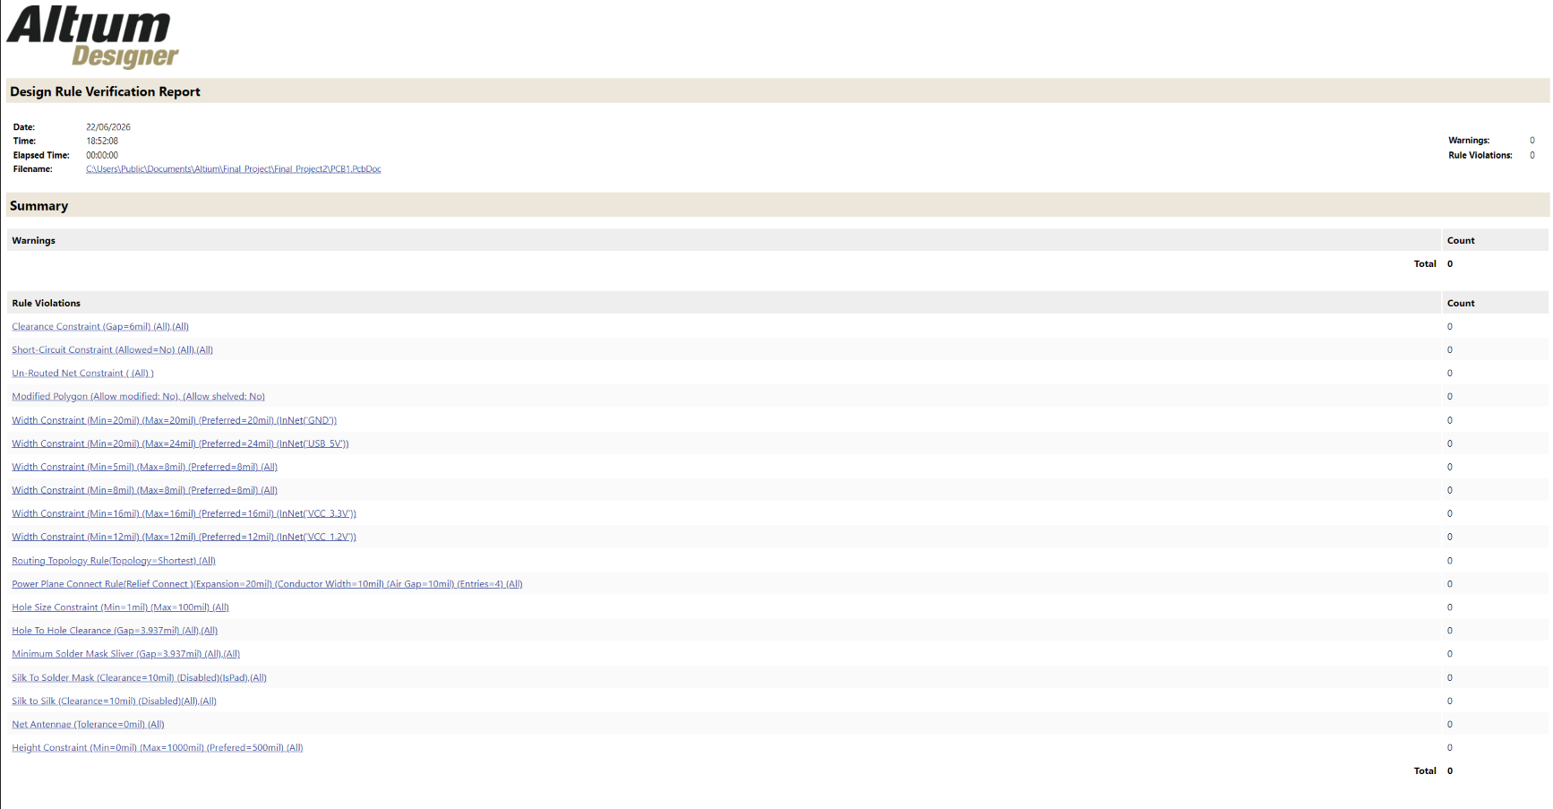
Design Rule Check — 0 Violations
0
VIOLATIONS
Clearance ✓
Short-Circuit ✓
Un-Routed ✓
Net Antennae ✓
Hole-to-Hole ✓

