Slide 1

Hardware Engineering Lab · Summer Term 2026
Hardware Engineering Project
Team A3
Part 1 — VHDL Soft-Core CPU
Part 2 — Custom PCB Design
8-bit register CPU · ADD / SUB / MUL / DIV · 5-State FSM · 4-Layer PCB · iCE40UP5K · 0 DRC Violations
Rionela Kovaci · Christian Percival · Mohamed Abdo
Supervisor: Prof. Dr.-Ing. Ali Hayek

Slide 2
Project Overview
Two-part hardware engineering project
Simulate
›
Prototype on dev-board
›
Tape-out to PCB
Part 1
Part 2
VHDL soft-core CPU
Custom PCB design
4
4
4
0
bit CPU
registers
PCB layers
DRC violations
5
4
12
11
FSM states
ALU ops
MHz clock
decoupling caps
Nexys A7 — Artix-7 XC7A100T
Lattice iCE40UP5K-SG48I FPGA
ADD · SUB · MUL · DIV
AMS1117 LDO — 3.3 V / 1.2 V rails
5-state FSM control unit
Winbond W25Q16 SPI NOR Flash
Signed decimal 7-segment display
Serpentine length tuning on SPI lines
Synthesised in Vivado 2024.x
JLCPCB manufacturing ready
Hardware Engineering Lab · Summer Term 2026 · Team A3

Slide 3
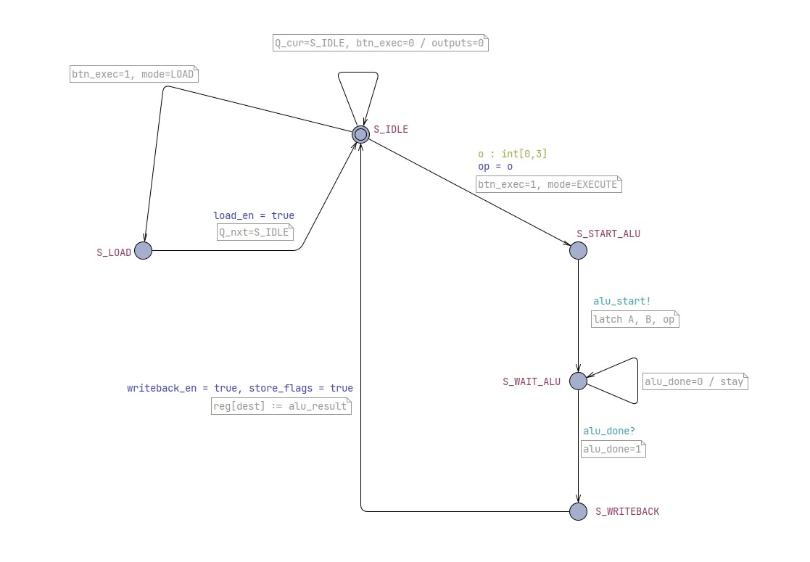
CPU Finite-State Machine (FSM)
Five-state clocked FSM — asynchronous reset on btn_rst
S_IDLE
Waits for btn_exec↑. Routes to S_LOAD or S_START_ALU based on SW[8].
S_LOAD
Writes signed value into reg_file[SW[5:4]]. Returns to S_IDLE.
S_START_ALU
Latches A, B, op. Pulses alu_start one clock cycle.
S_WAIT_ALU
Holds while alu_done=0. Advances when alu_done=1.
S_WRITEBACK
Writes alu_result to reg[dest]. Captures flags. Returns to S_IDLE.

Slide 4
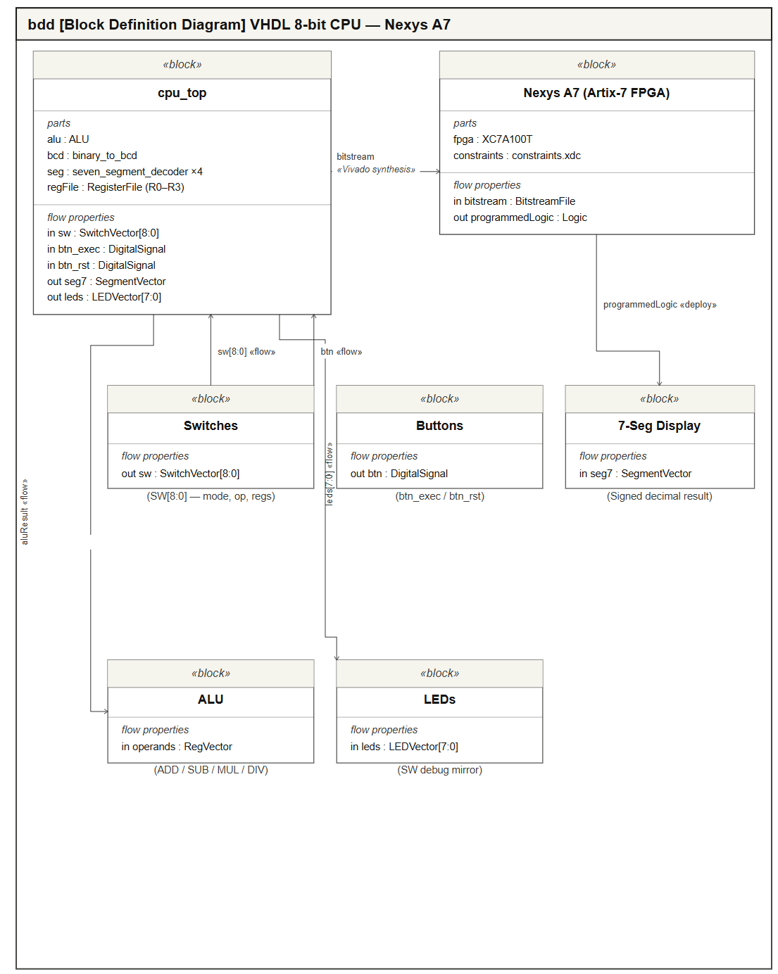
Part 1 — VHDL CPU Architecture
Project Source Files
cpu_top.vhd — top-level entity, register file, switch decode, display control
alu.vhd — FSM-controlled ALU: ADD/SUB/MUL/DIV + carry/overflow/div_zero flags
binary_to_bcd.vhd — double-dabble BCD converter (hundreds/tens/ones)
seven_segment_decoder.vhd — combinational 4→7 seg encoder
constraints.xdc — Nexys A7 pin assignments

Slide 5
Switch Interface Encoding
SW[9:0] — sole user interface between operator and CPU
Mode | Switch | Function
Both | SW[8] | 0 = Load mode · 1 = Execute mode
Load | SW[7] | Sign bit: 0 = positive, 1 = negative (two's complement applied)
Load | SW[3:0] | 4-bit magnitude (0 – 15)
Load | SW[5:4] | Destination register R0 – R3
Execute | SW[7:6] | Operation: 00 = ADD 01 = SUB 10 = MUL 11 = DIV
Execute | SW[1:0] | Source register A (R0 – R3)
Execute | SW[3:2] | Source register B (R0 – R3)
Execute | SW[5:4] | Destination register R0 – R3
btn_exec rising edge triggers action · btn_rst asynchronous reset clears all registers and FSM state to 0

Slide 6
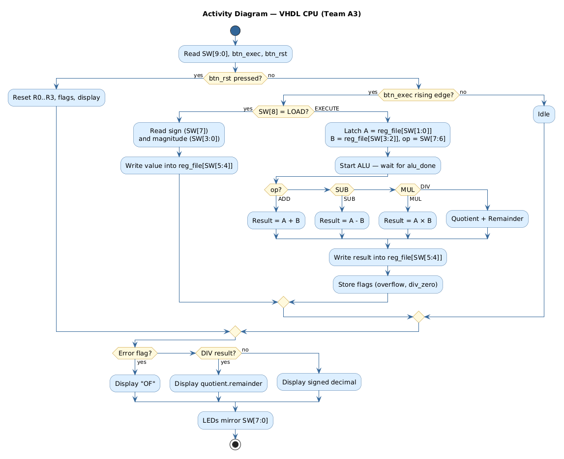
ALU Operations & Activity Flow
Four arithmetic operations and system activity diagram
op | Operation | Notes
00 | ADD | 8-bit signed — carry and overflow flags set
01 | SUB | ADD with two's complement of B
10 | MUL | 8-bit × 8-bit — lower 8 bits stored
11 | DIV | Quotient → result · Remainder → alu_remainder · div_zero on B=0
Normal Signed
Signed decimal, leading minus in
correct digit (ex. −128 fills all 4)
Division
Quotient.remainder with decimal pt
ex. 25÷4 → 6.1
Error OF
Overflow or divide-by-zero detected
displays OF (SEG_O + SEG_F)
Refresh: 50 kHz · Counter rolls at 49 999 cycles · 4 multiplexed digit positions

Slide 7
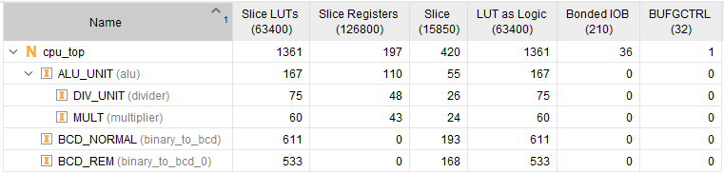
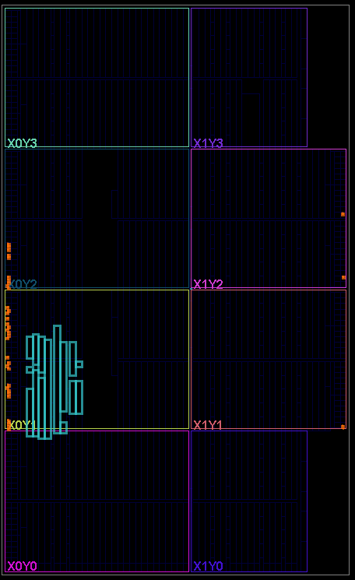
Vivado Synthesis Results
Artix-7 XC7A100T resource utilisation — well within device limits
1361
197
420
Slice LUTs
(2.1% of 63400)
Slice Regs
(0.16% of 126800)
Slices
(2.6% of 15850)
BCD modules dominate LUT usage (purely combinational, no registers) · ALU FSM uses only 167 LUTs · Logic concentrated in tile X0Y1
Netlist
Floorplan
36 of 210 IOBs used · 1 BUFGCTRL · Design fits with ample room for expansion

Slide 8
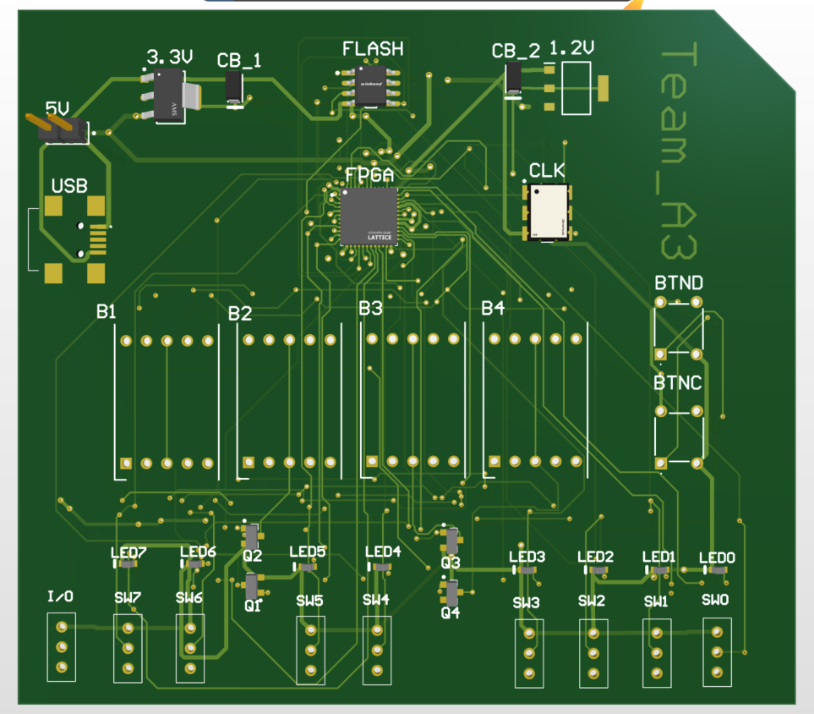
Part 2
Custom PCB Design
Lattice iCE40UP5K · 4-Layer Stack-up · JLCPCB Manufacturing · 0 DRC Violations

Slide 9
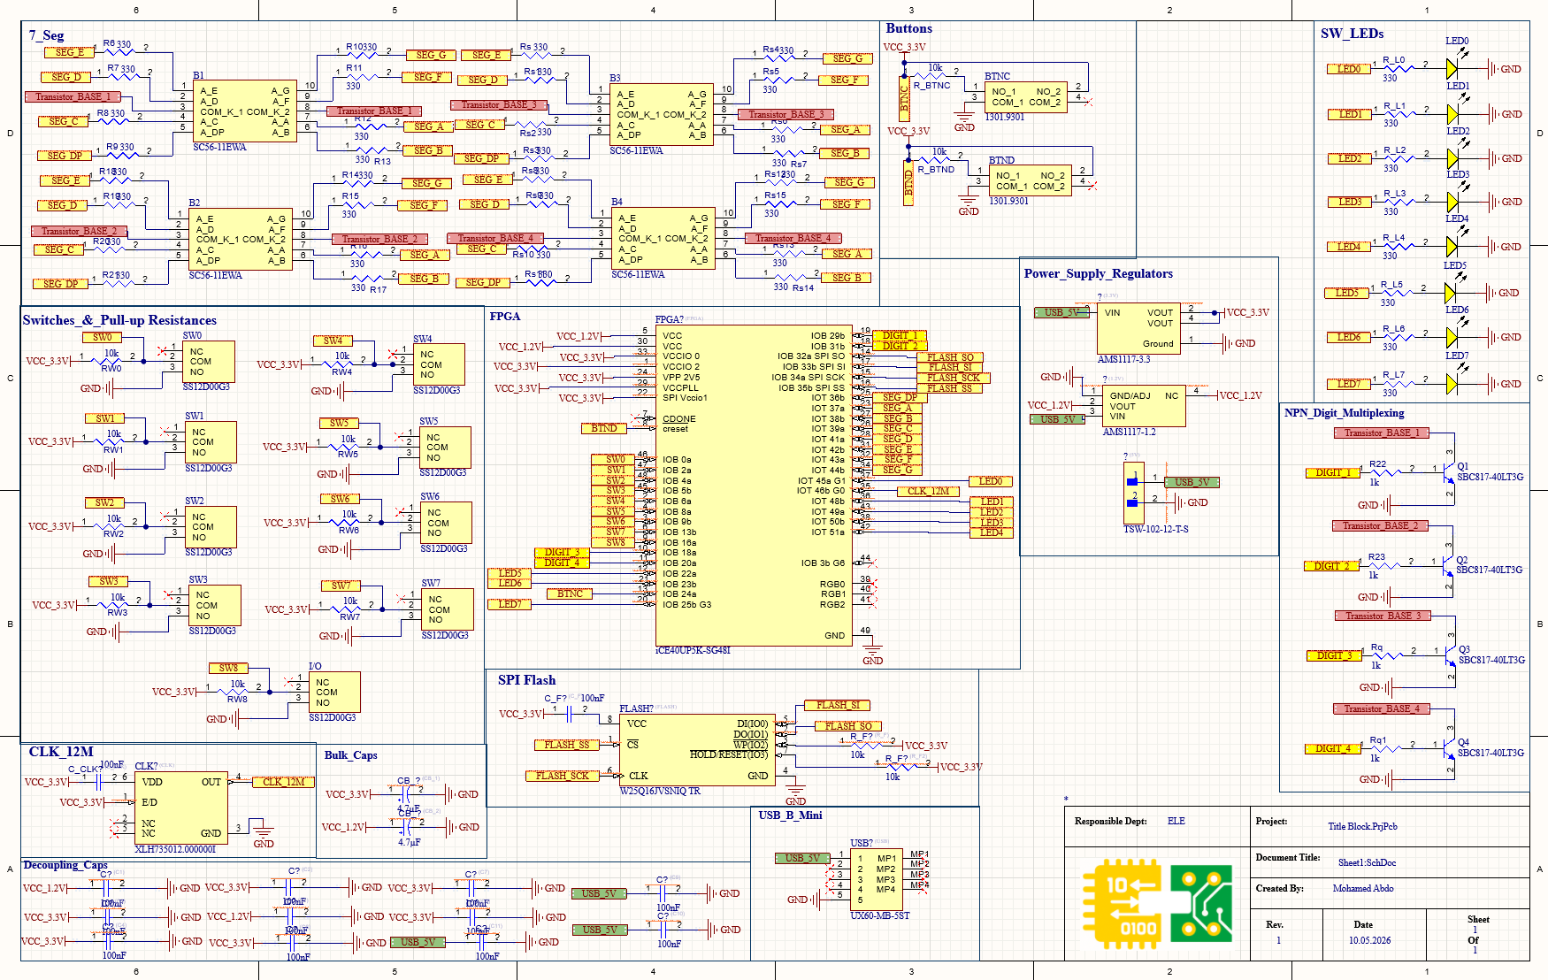
Full PCB Schematic
All functional blocks on one sheet — FPGA · Power · SPI Flash · CLK · 7-Seg · Switches · LEDs
Created by Mohamed Abdo · Rev 1 · 10.05.2026 · HSHL Hardware Engineering Lab

Slide 10
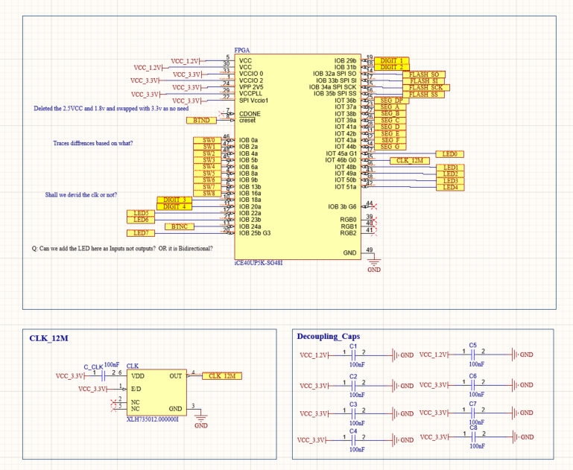
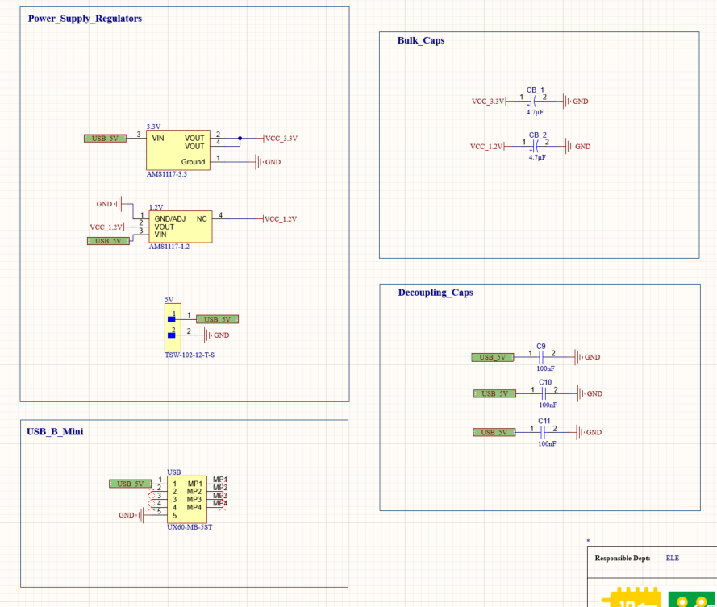
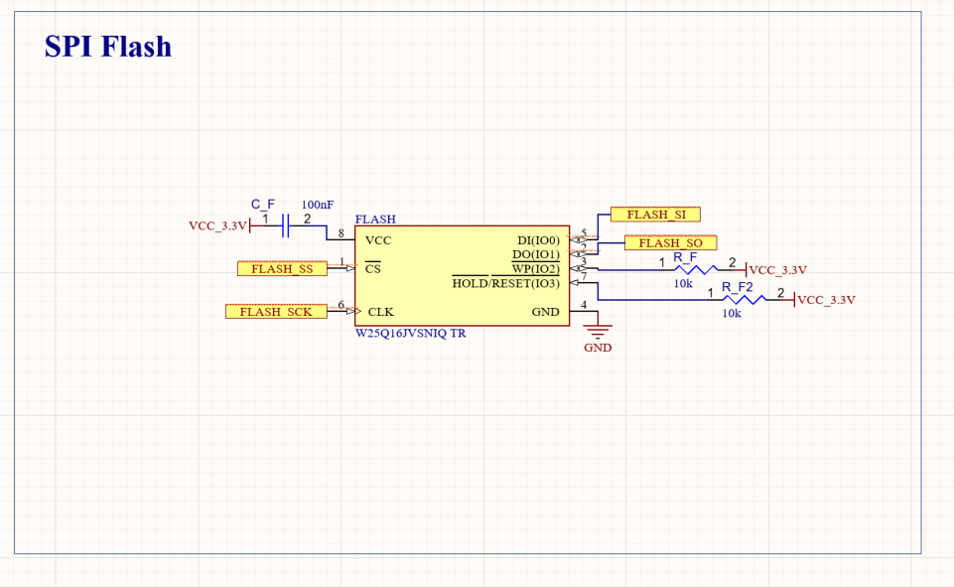
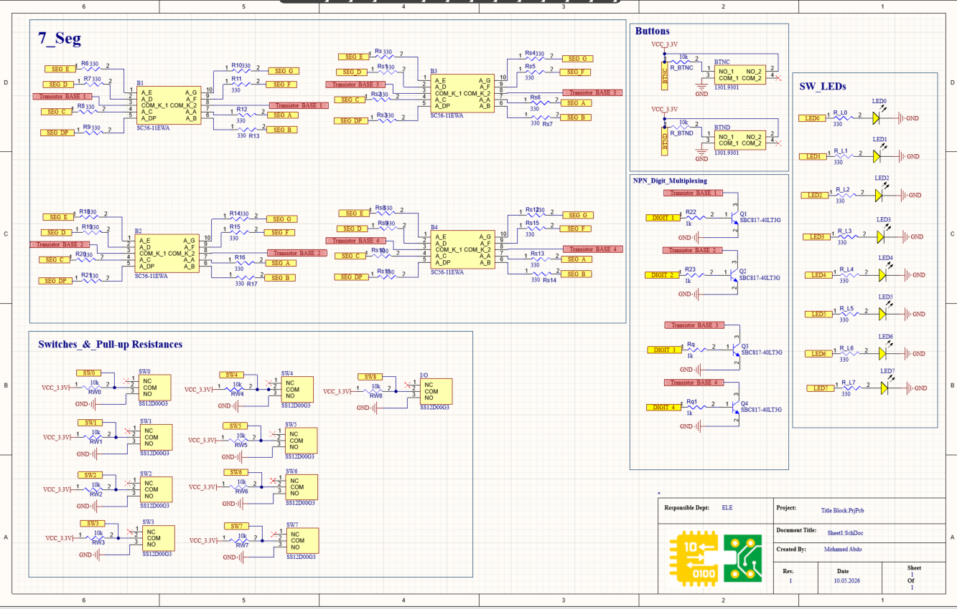
Schematic Overview
FPGA + Decoupling Caps
Power Supply (AMS1117 3.3V / 1.2V)
SPI Flash (W25Q16)
7-Seg, Switches & LEDs

Slide 11
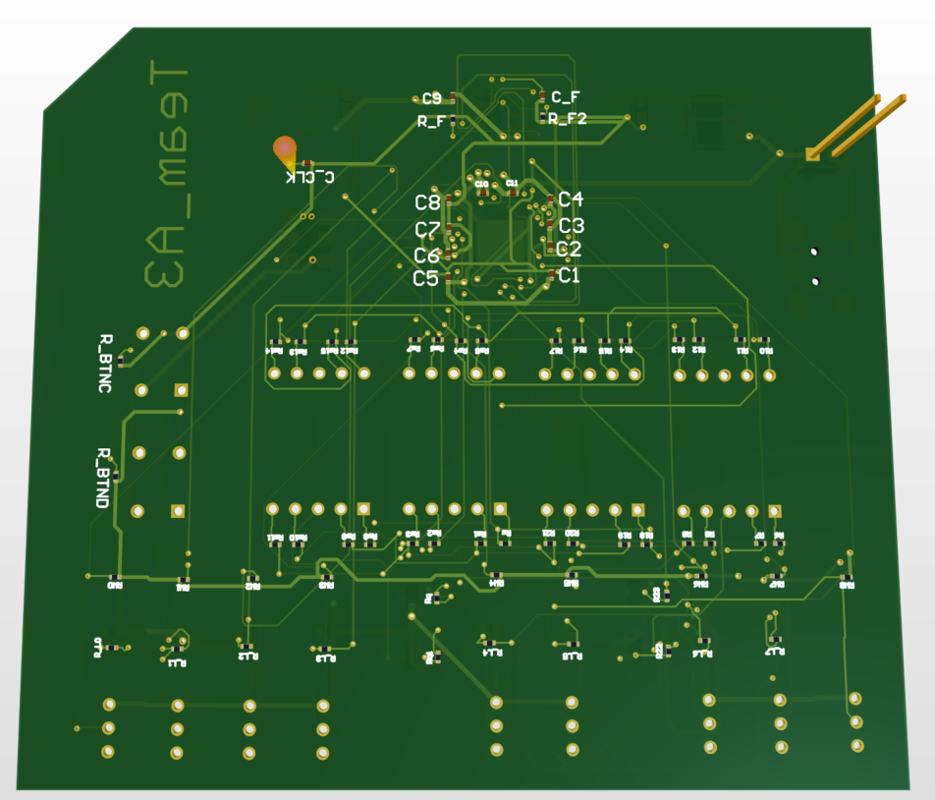
PCB Overview
TOP VIEW
BOTTOM VIEW
Decoupling caps C1–C11 placed on bottom layer directly under FPGA power pins

Slide 12
Decoupling Capacitors Strategy
Bottom View — Caps visible
Cap Placement Logic
C1–C8
100nF
FPGA VCC_3.3V & VCC_1.2V decoupling
C9–C11
100nF
USB_5V input line filtering
CB_1, CB_2
4.7µF
Bulk caps on 3.3V and 1.2V rails
C_F
100nF
SPI Flash VCC bypass capacitor
All caps placed within 2mm of FPGA power pins for minimum parasitic inductance

Slide 13
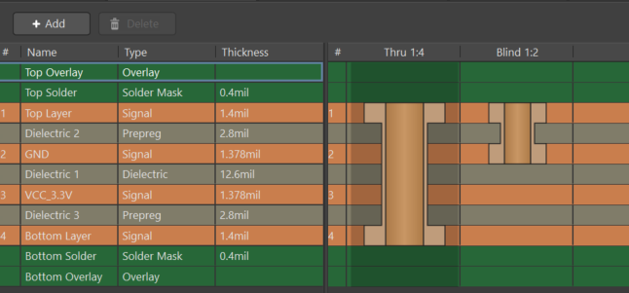
4-Layer Stack-up
Layer Details
L1 Top Layer
1.4 mil • Signals + components
L2 GND Plane
1.378 mil • Solid GND — EMI shield
L3 VCC_3.3V
1.378 mil • Power distribution plane
L4 Bottom Layer
1.4 mil • Signals + decoupling caps

Slide 14
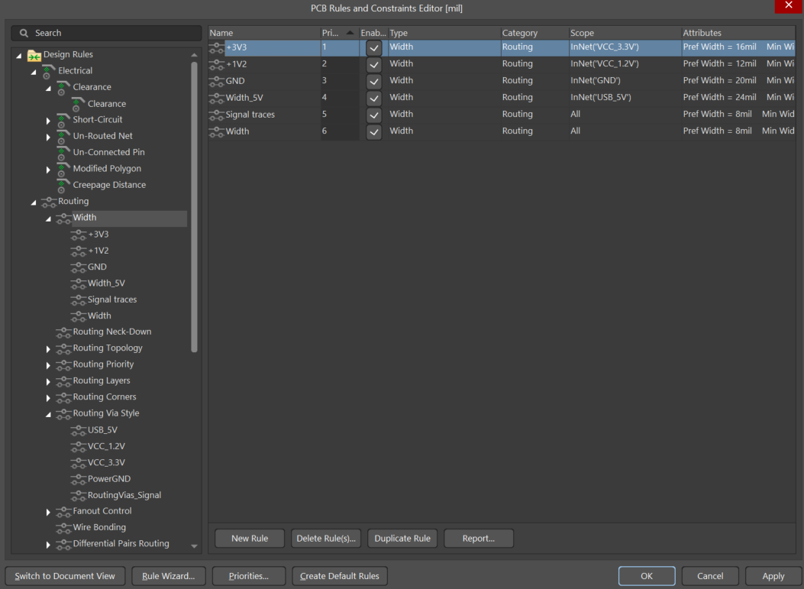
Trace Width Design Rules
Net | JLCPCB Min | Industry Std | Our Design
GND | 5 mil | 15–25 mil | 20 mil ✓
USB 5V | 5 mil | 20–30 mil | 24 mil ✓
VCC 3.3V | 5 mil | 12–20 mil | 16 mil ✓
VCC 1.2V | 5 mil | 10–15 mil | 12 mil ✓
Signals | 5 mil | 6–10 mil | 8 mil ✓
Min used | 5 mil | 5 mil | 5 mil ✓
All traces exceed JLCPCB minimum of 5mil (0.127mm)
Reference: jlcpcb.com/capabilities/pcb-capabilities

Slide 15
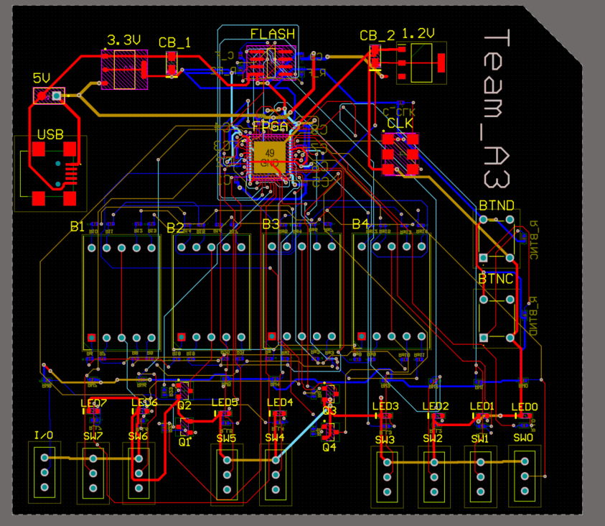
Routing & Layer Usage
Layer Color Key
Top Layer (L1)
FPGA signals, power
Bottom Layer (L4)
Return signals, decoupling
VCC_3.3V (L3)
Power distribution
GND Plane (L2)
Solid ground reference
Situs Autorouter — Default Multi Layer
Clearance: 6mil | Strategy: Shortest Path

Slide 16
Via Design Strategy
Via Type | JLCPCB Min | Industry Std | Our Design | Net
Signal Vias | Hole≥0.3mm Pad≥0.5mm | Hole 0.3mm Pad 0.6mm | Hole 12mil Pad 24mil ✓ | All signals
VCC 3.3V | Hole≥0.3mm Pad≥0.5mm | Hole 0.4mm Pad 0.8mm | Hole 16mil Pad 28mil ✓ | VCC_3.3V
Power GND | Hole≥0.3mm Pad≥0.5mm | Hole 0.45mm Pad 0.9mm | Hole 18mil Pad 32mil ✓ | GND
USB 5V | Hole≥0.3mm Pad≥0.5mm | Hole 0.45mm Pad 0.9mm | Hole 18mil Pad 32mil ✓ | USB_5V
Annular Ring | ≥0.1mm (3.94mil) | ≥0.15mm | 6mil (0.15mm) ✓ | All
All vias exceed JLCPCB minimums and industry standards | 5 net-specific via rules applied

Slide 17
JLCPCB Manufacturing Compliance
Parameter | JLCPCB Min | Industry Std | Our Design | Status
Min Trace Width | 5 mil (0.127mm) | 6–8 mil typical | 8 mil signals | ✓ Pass
Min Clearance | 5 mil (0.127mm) | 6 mil typical | 6 mil | ✓ Pass
Via Hole (signal) | 0.3mm (11.8mil) | 0.3mm typical | 12 mil (0.305mm) | ✓ Pass
Via Pad (signal) | 0.5mm (19.7mil) | 0.6mm typical | 24 mil (0.61mm) | ✓ Pass
Annular Ring | 0.1mm (3.94mil) | 0.15mm typical | 6 mil (0.15mm) | ✓ Pass
Power Trace (3.3V) | 5 mil min | 12–20 mil | 16 mil | ✓ Pass
Power Trace (GND) | 5 mil min | 15–25 mil | 20 mil | ✓ Pass
Hole-to-Hole | 0.5mm edge | 0.5mm edge | Verified DRC | ✓ Pass
Layer Count | Standard 4-layer | 4-layer typical | 4 layers | ✓ Pass
Reference: jlcpcb.com/capabilities/pcb-capabilities

Slide 18
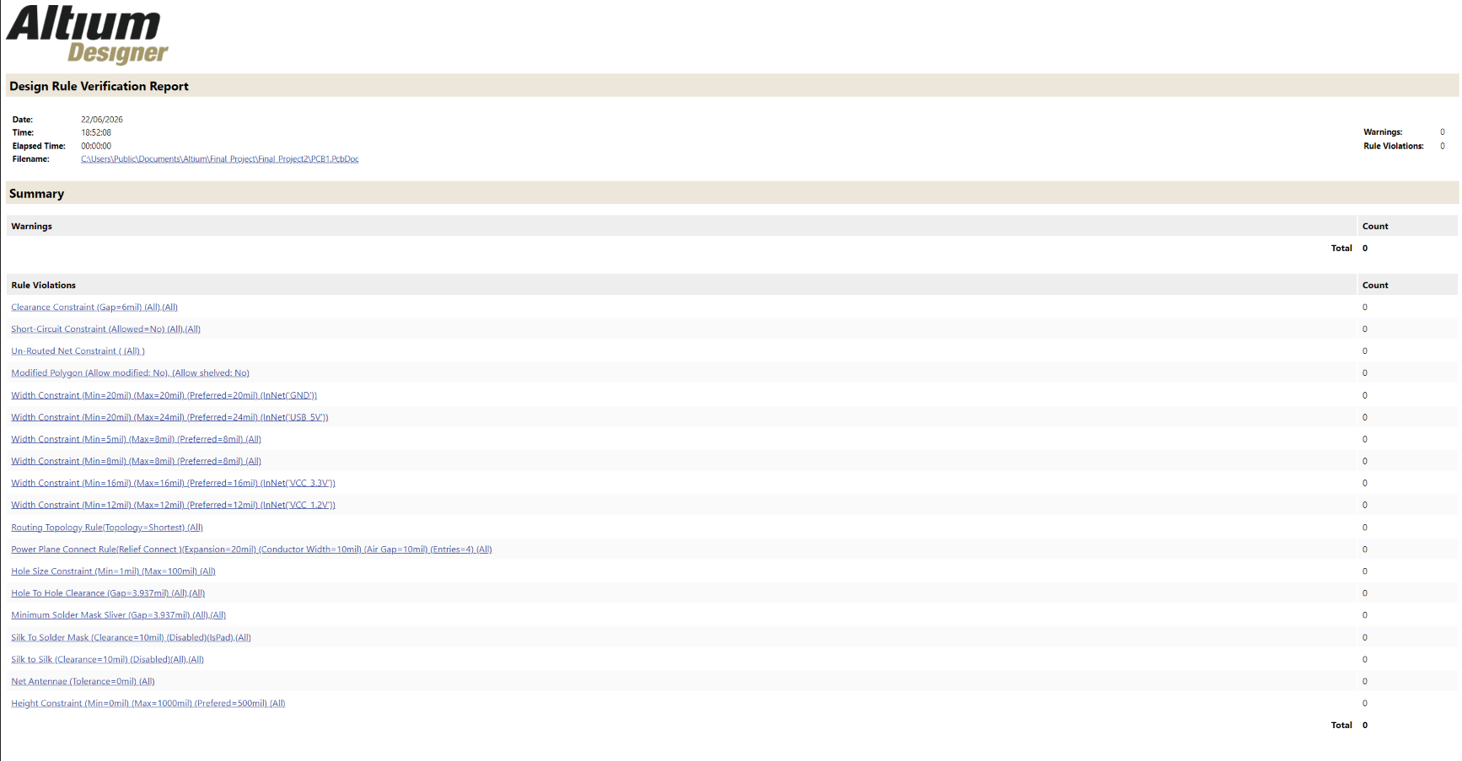
Design Rule Check — 0 Violations
0
VIOLATIONS
Clearance ✓
Short-Circuit ✓
Un-Routed ✓
Net Antennae ✓
Hole-to-Hole ✓

Slide 19
Live Demo

Slide 20
Conclusion
Hardware Engineering Lab · Summer Term 2026 · Team A3
2
5
4
0
Project Parts
VHDL + PCB
FSM States
CPU Control
PCB Layers
Stack-up
DRC
Violations
Rionela Kovaci · Christian Percival · Mohamed Abdo
github.com/MoAbdoHSHL/Hardware-Engineering-Gr_A3

