Slide 1

Linear Regression In House Price Prediction
Machine Learning – 2025
by: Mohamed Abdo
Email: mohamed-sayed.mohamed.abdo@stud.hshl.de

Slide 2





Motivation
Quickly estimate house prices using data
Compare properties based on key features
Help buyers make fair and confident offers
Assist sellers in setting accurate prices
Enable smarter, data-driven housing decisions

Slide 3
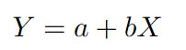
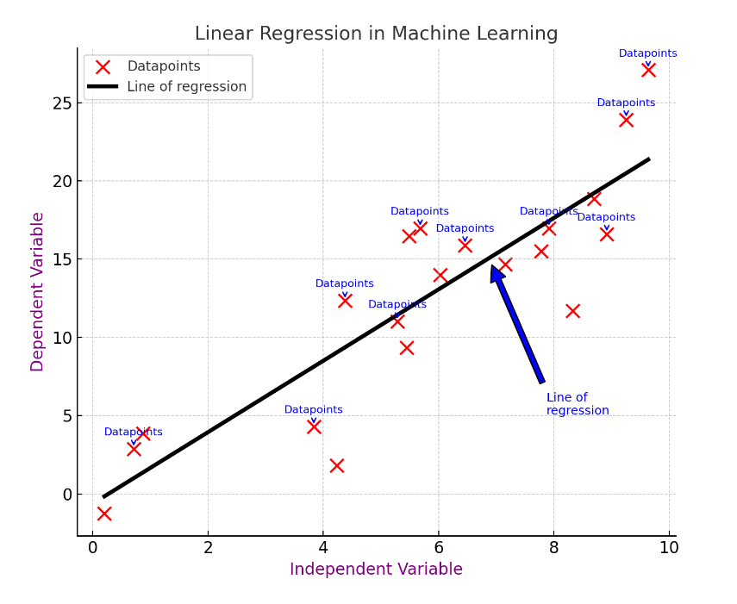
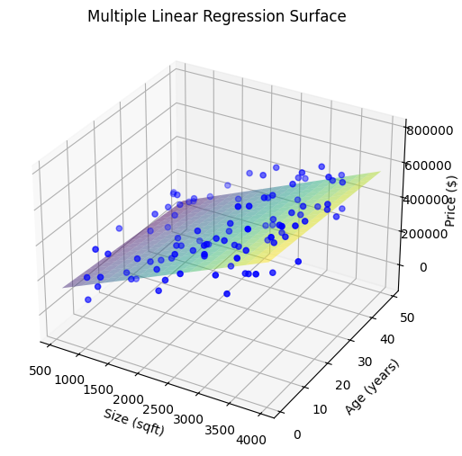
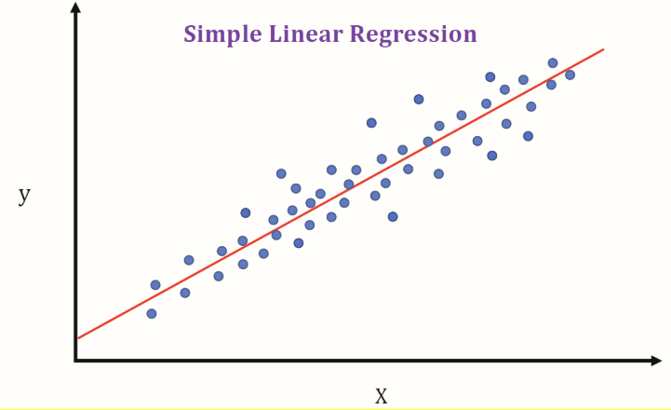
What is Linear Regression?
A statistical method to model the relationship between a dependent variable and one or more independent variables. [4]
VS.

Slide 4
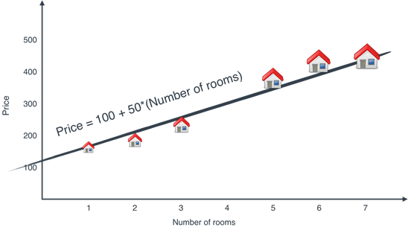
Why Use Linear Regression for House Prices?
Straightforward to implement and interpret results.
Helps identify the influence of each feature.
Effective when the relationship between features and price is linear.
Fast Training even on large datasets. Ex: California Dataset (20,641) entries.
Linear model: Price increases linearly with number of rooms [1]

Slide 5
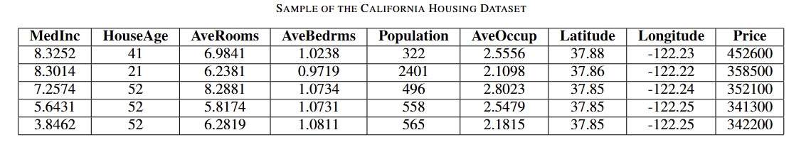
Key Features in House Price Prediction
MedInc: More income → higher prices
HouseAge: Older homes → usually cheaper
Rooms/Bedrooms: More rooms → higher price
Population/Density: Affects demand
Location: Strong impact on price
Price: What we want to predict

Slide 6
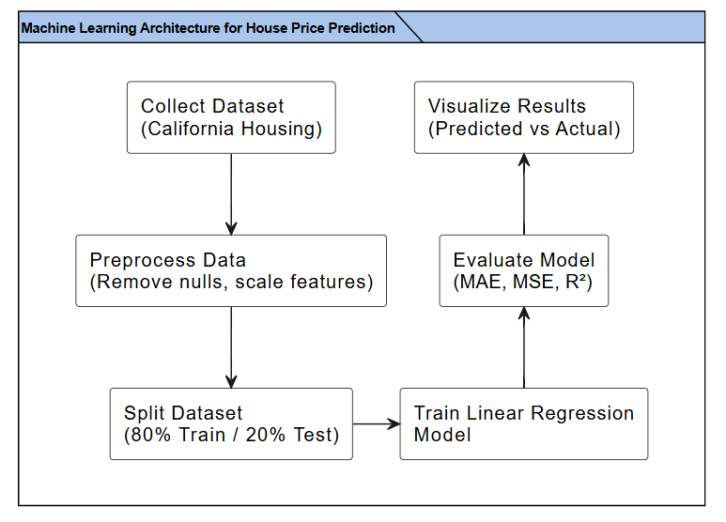
Building the Model
Load data: from sklearn.datasets import fetch_california_housing
Set X=data_feature, Y=target
Set feature_names into DataFrame
Feature Scaling
Data Splitting & Model Fitting
Prediction

Slide 7
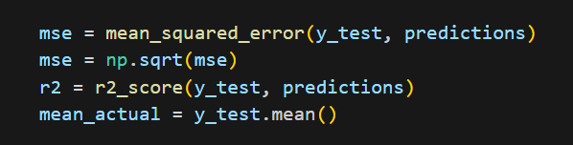
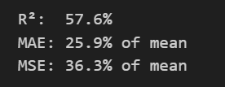
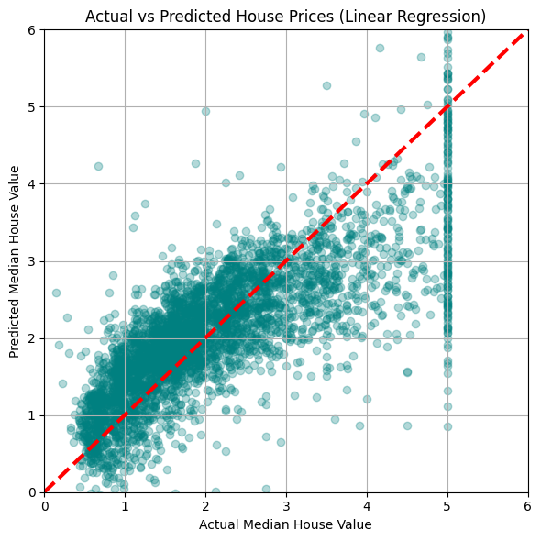
Evaluating the Model
Real-World Tabular Data, 58% accuracy is reasonable.
Non-Linearity of some data.
Real-world data contains inherent randomness

Slide 8
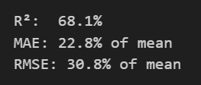
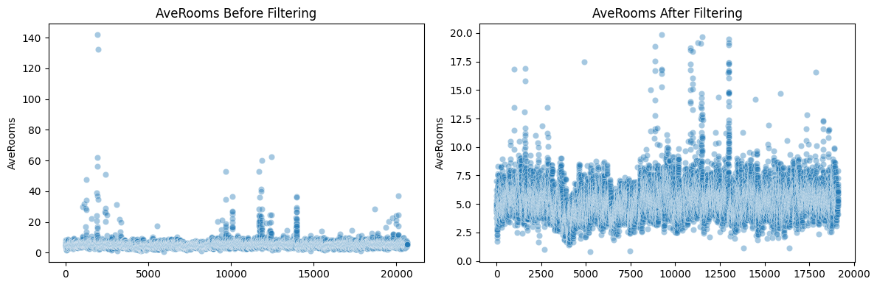
Challenges & Different Datasets
Model | R² (%) | MAE | RMSE
Linear Regression | 68.07 | 22.79 | 30.79
Ridge Regression | 68.07 | 22.79 | 30.79
Lasso Regression | 55.9 | 27.38 | 36.19
ElasticNet Regression | 59.47 | 26.15 | 34.69
Bayesian Ridge Regression | 68.07 | 22.79 | 30.79
Kaggle House price prediction Dataset[2]

Slide 9
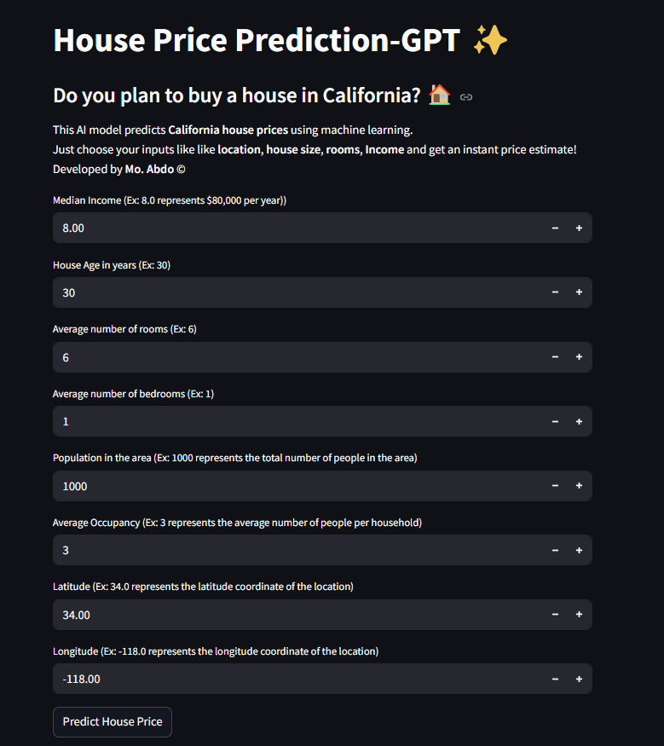
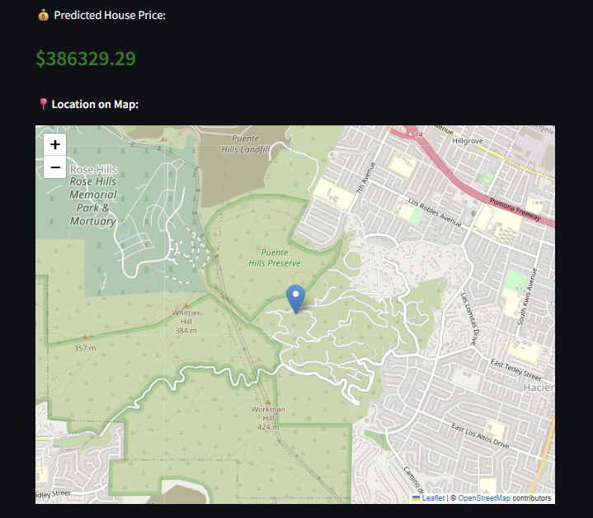
The final Model In GUI

Slide 10
Conclusion
Linear Regression provides a simple yet effective baseline model
It explains about 68% of house price variation
Works well with mostly linear data
Errors (MAE & RMSE) show room for improvement
Useful baseline before using more complex models

Slide 11
References
[1]: 3.1 The problem: We need to predict the price of a house - Grokking Machine Learning [2]: Kaggel_Dataset: House_price_predection
[3]: LinearRegression — scikit-learn 1.7.0 documentation
[4]: M. Sumeyra and K. Yildiz, “Linear regression is mainly used to predictused car prices,” International Journal of Computational and Experimen-tal Science and Engineering, vol. 9, no. 1, pp. 11–16, 2023
[5]: S. learn Developers, “California housing dataset,” Available at: https://scikit-learn.org/stable/datasets/real world.html#california-housing-dataset , accessed: 2025-05-22.
[6]: S. Rathore, M. A. Khan, S. Kumar, and C. Jain, “Machine learningapproaches for housing price prediction: A comparative study,” IEEETransactions, 2023

