Slide 1

Linear Regression In House Price Prediction
Machine Learning – 2025
by: Mohamed Abdo
Email: mohamed-sayed.mohamed.abdo@stud.hshl.de

Slide 2
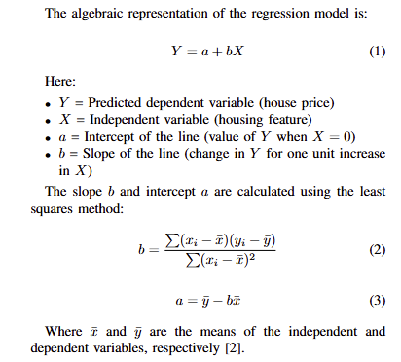
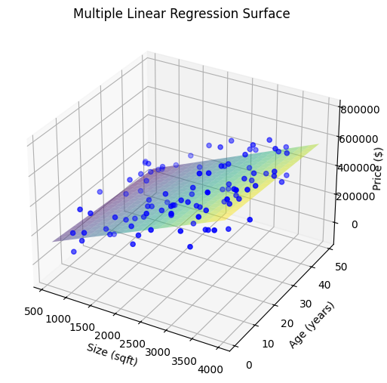
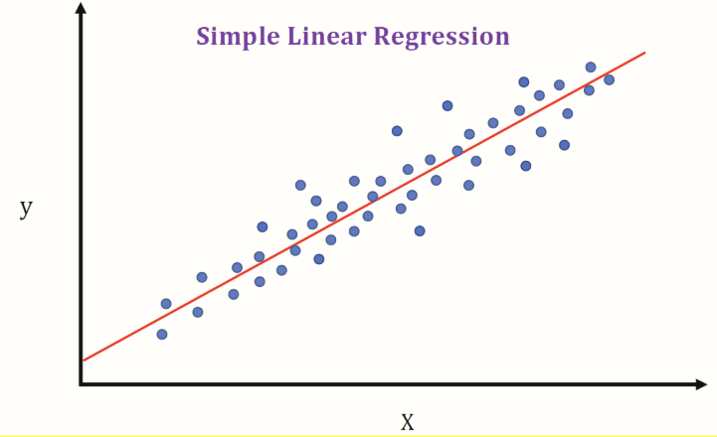
What is Linear Regression?
A statistical method to model the relationship between a dependent variable and one or more independent variables.
Simple vs. Multiple Linear Regression

Slide 3
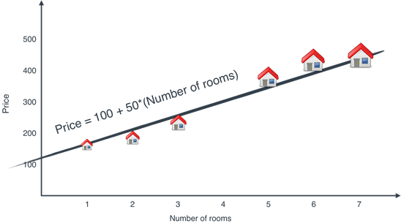
Why Use Linear Regression for House Prices?
Straightforward to implement and interpret results.
Helps identify the influence of each feature.
Effective when the relationship between features and price is linear.
Fast Training even on large datasets, making it ideal for initial modeling. Ex: California Dataset (20,641) cell.
Linear model: Price increases linearly with number of rooms [1]

Slide 4
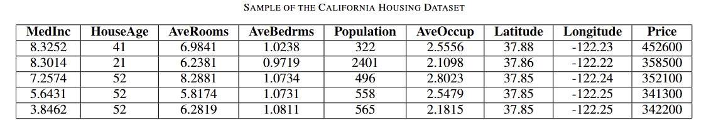
Key Features in House Price Prediction
MedInc: Income level in the neighborhood, higher income often means higher house prices.
HouseAge: Older houses may have lower prices unless they are in prime areas.
AveRooms & AveBedrms: Larger houses tend to have more rooms and higher prices.
Population & AveOccup: Indicate neighborhood density can affect demand.
Latitude & Longitude: Location has a major impact on pricing.
Price: The target we want to predict

Slide 5
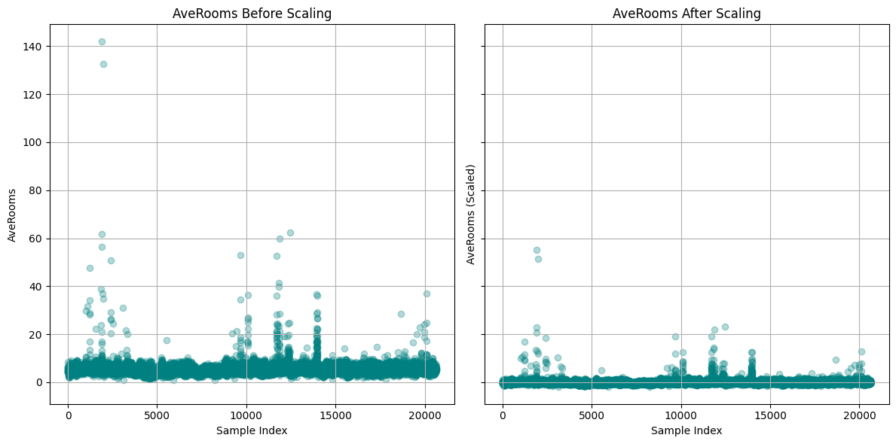
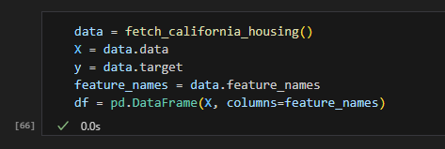
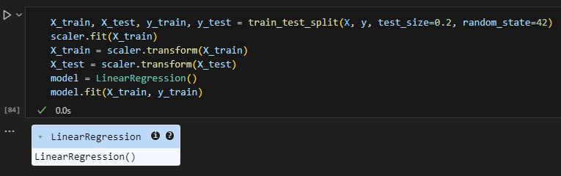
Building the Model
Load data: from sklearn.datasets import fetch_california_housing
Scaling features helps models perform better and more reliably when all input features have similar scales.
Split data into training/testing sets && Fitting the model using Linear regression

Slide 6
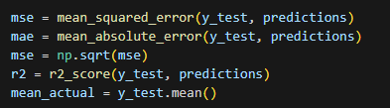

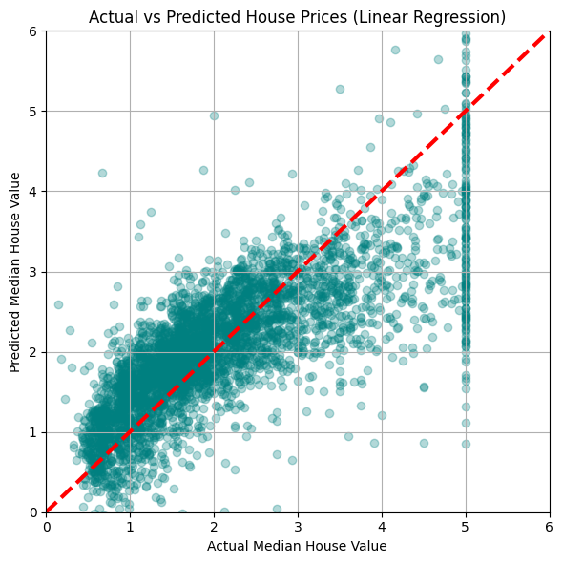
Evaluating the Model
For real-world tabular datasets, especially with simple linear regression, %58 is reasonable.
Data is not perfectly linear as relationships between income, location, etc., and house price are not perfectly straight lines.
Noise: There’s inherent randomness in real-world data

Slide 7

Thank you for your time
Appreciate Your Comments And Feeedback ☺

Slide 8
Refrences
[1]: 3.1 The problem: We need to predict the price of a house - Grokking Machine Learning

