Slide 1
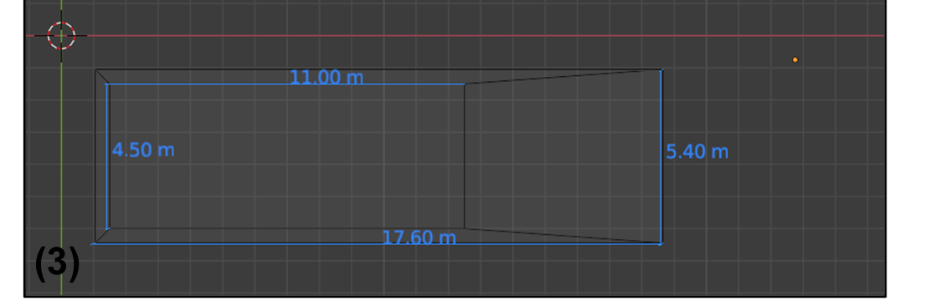
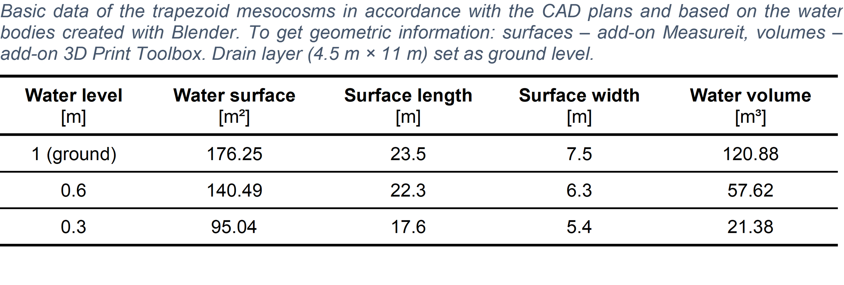
Geometry of the Floodplain Pond Mesocosms
Dimension at bed level
Dimension at the water surface for the regular fill height (water level) of 0.3 m

Slide 2
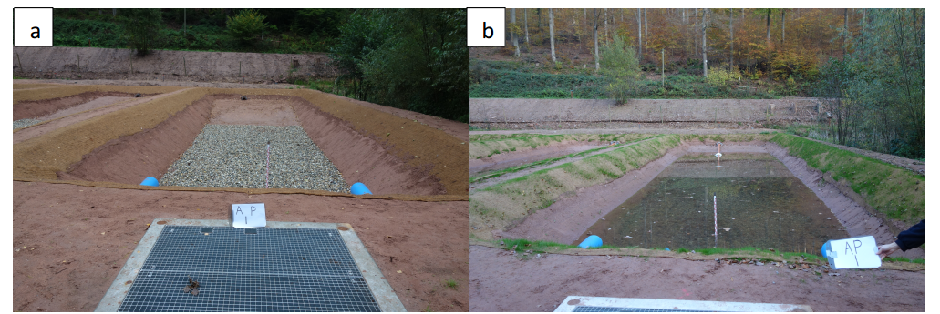
Geometry of the Floodplain Pond Mesocosms

