Slide 1
Chapter 4
Ipv4 IP Addresses:
Classful Addressing

Slide 2
CONTENTS
INTRODUCTION
CLASSFUL ADDRESSING
OTHER ISSUES
A SAMPLE INTERNET

Slide 3
4.1
INTRODUCTION

Slide 4

An IP address is a
32-bit
address.

Slide 5
The IP addresses
are
unique.

Slide 6
Address Space
…………..
…………..
addr1
addr15
addr2
…………..
…………..
…………..
addr41
addr226
addr31
…………..
…………..

Slide 7
RULE:
…………..
…………..
If a protocol uses N bits to
define an address,
the address space is 2^{N}
because each bit can have two
different values (0 and 1)
and N bits can have 2^{N} values.
addr1
addr15
addr2
…………..
…………..
…………..
addr41
addr226
addr31
…………..
…………..

Slide 8
The address space of IPv4 is
2³²
or
4,294,967,296.

Slide 9
Binary Notation
01110101 10010101 00011101 11101010

Slide 10
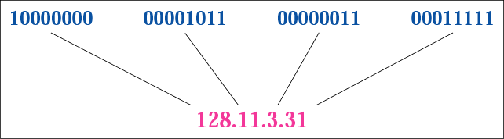
Figure 4-1
Dotted-decimal notation

Slide 11
Hexadecimal Notation
0111 0101 1001 0101 0001 1101 1110 1010
75 95 1D EA
0x75951DEA

Slide 12
The binary, decimal, and
hexadecimal number
systems are reviewed in
Appendix B.

Slide 13
Example 1
Change the following IP address from binary notation to dotted-decimal notation.
10000001 00001011 00001011 11101111
Solution
129.11.11.239

Slide 14
Example 2
Change the following IP address from dotted-decimal notation to binary notation.
111.56.45.78
Solution
01101111 00111000 00101101 01001110

Slide 15
Example 3
Find the error, if any, in the following IP address:
111.56.045.78
Solution
There are no leading zeroes in
dotted-decimal notation (045).

Slide 16
Example 3 (continued)
Find the error, if any, in the following IP address:
75.45.301.14
Solution
In dotted-decimal notation,
each number is less than or
equal to 255; 301 is outside this range.

Slide 17
Example 4
Change the following IP addresses from binary notation to hexadecimal notation.
10000001 00001011 00001011 11101111
Solution
0X810B0BEF or 810B0BEF₁₆

Slide 18
4.2
CLASSFUL
ADDRESSING

Slide 19
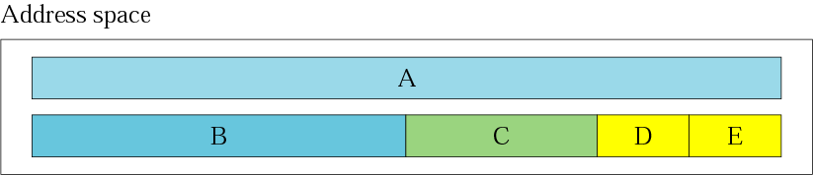
Figure 4-2
Occupation of the address space

Slide 20
In classful addressing,
the address space is
divided into five classes:
A, B, C, D, and E.

Slide 21
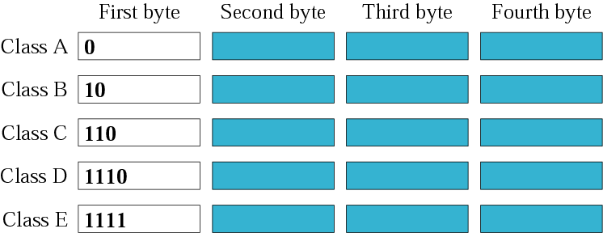
Figure 4-3
Finding the class in binary notation

Slide 22
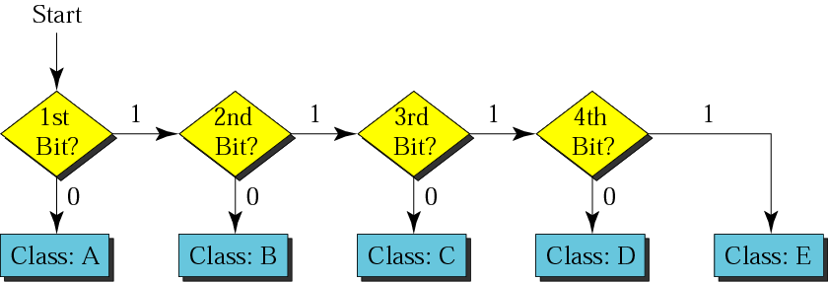
Figure 4-4
Finding the address class

Slide 23
Example 5
How can we prove that we have 2,147,483,648 addresses in class A?
Solution
In class A, only 1 bit defines the class.
The remaining 31 bits are available
for the address. With 31 bits,
we can have 2³¹ or 2,147,483,648 addresses.

Slide 24
Example 6
Find the class of the address:
00000001 00001011 00001011 11101111
Solution
The first bit is 0. This is a class A address.

Slide 25
Example 6 (Continued)
Find the class of the address:
11000001 10000011 00011011 11111111
Solution
The first 2 bits are 1; the third bit is 0.
This is a class C address.

Slide 26

Figure 4-5
Finding the class in decimal notation

Slide 27
Example 7
Find the class of the address:
227.12.14.87
Solution
The first byte is 227 (between 224 and 239);
the class is D.

Slide 28
Example 7 (Continued)
Find the class of the address:
193.14.56.22
Solution
The first byte is 193 (between 192 and 223);
the class is C.

Slide 29
Example 8
In Example 4 we showed that class A has 2³¹ (2,147,483,648) addresses. How can we prove this same fact using dotted-decimal notation?
Solution
The addresses in class A range from 0.0.0.0 to
127.255.255.255. We notice that we are
dealing with base 256 numbers here.

Slide 30
Solution (Continued)
Each byte in the notation has a weight.
The weights are as follows:
256³ , 256², 256¹, 256⁰
Last address: 127 × 256³ + 255 × 256² +
255 × 256¹ + 255 × 256⁰ = 2,147,483,647
First address: = 0
If we subtract the first from the
last and add 1, we get 2,147,483,648.

Slide 31
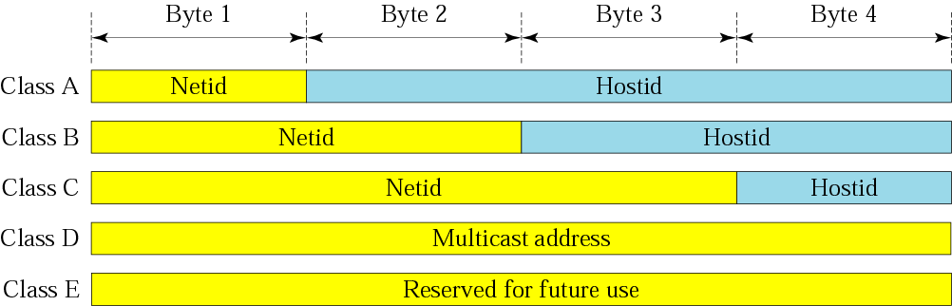
Figure 4-6
Netid and hostid

Slide 32
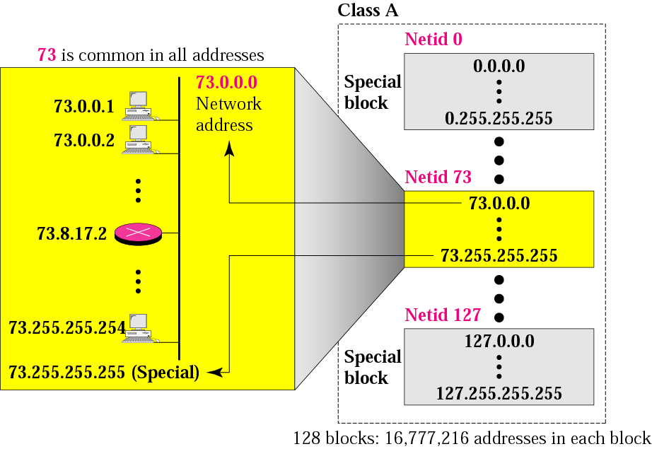
Figure 4-7
Blocks in class A

Slide 33
Millions of class A addresses
are wasted.

Slide 34
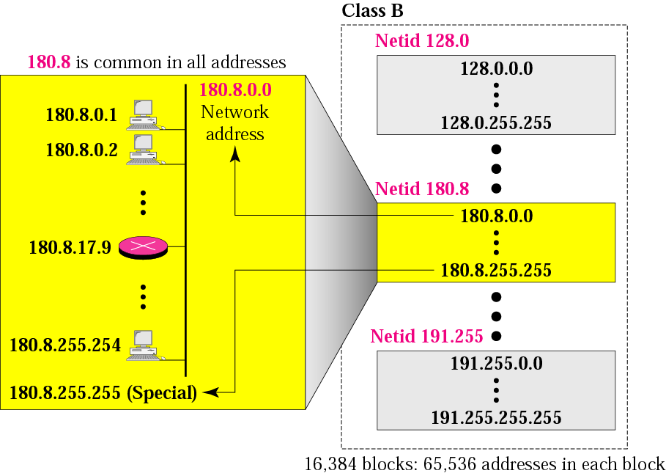
Figure 4-8
Blocks in class B

Slide 35
Many class B addresses
are wasted.

Slide 36
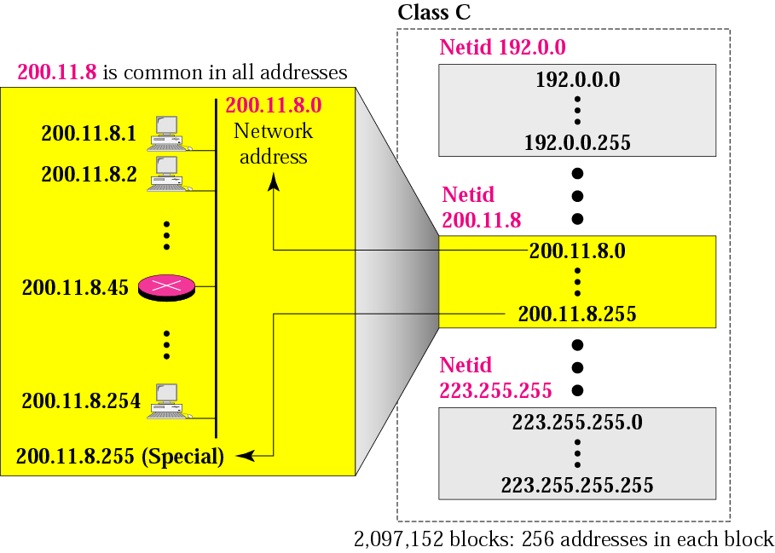
Figure 4-9
Blocks in class C

Slide 37
The number of addresses in
a class C block
is smaller than
the needs of most organizations.

Slide 38
Class D addresses
are used for multicasting;
there is only
one block in this class.

Slide 39
Class E addresses are reserved
for special purposes;
most of the block is wasted.

Slide 40
Network Addresses
The network address is the first address.
The network address defines the network to the rest of the Internet.
Given the network address, we can find the class of the address, the block, and the range of the addresses in the block

Slide 41
In classful addressing,
the network address
(the first address in the block)
is the one that is assigned
to the organization.

Slide 42
Example 9
Given the network address 17.0.0.0, find the class, the block, and the range of the addresses.
Solution
The class is A because the first byte is between
0 and 127. The block has a netid of 17.
The addresses range from 17.0.0.0 to
17.255.255.255.

Slide 43
Example 10
Given the network address 132.21.0.0, find the class, the block, and the range of the addresses.
Solution
The class is B because the first byte is between
128 and 191. The block has a netid of
132.21. The addresses range from
132.21.0.0 to 132.21.255.255.

Slide 44
Example 11
Given the network address 220.34.76.0, find the class, the block, and the range of the addresses.
Solution
The class is C because the first byte is between
192 and 223. The block has a netid of 220.34.76.
The addresses range from 220.34.76.0
to 220.34.76.255.

Slide 45
Mask
A mask is a 32-bit binary number that gives the first address in the block (the network address) when bitwise ANDed with an address in the block.

Slide 46
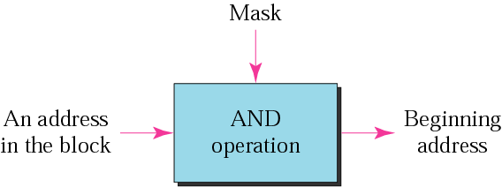
Figure 4-10
Masking concept

Slide 47
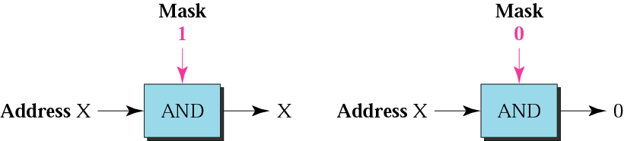
Figure 4-11
AND operation

Slide 48
The network address is the
beginning address of each block.
It can be found by applying
the default mask to
any of the addresses in the block
(including itself).
It retains the netid of the block
and sets the hostid to zero.

Slide 49
Example 12
Given the address 23.56.7.91 and the default class A mask, find the beginning address (network address).
Solution
The default mask is 255.0.0.0, which means
that only the first byte is preserved
and the other 3 bytes are set to 0s.
The network address is 23.0.0.0.

Slide 50
Example 13
Given the address 132.6.17.85 and the default class B mask, find the beginning address (network address).
Solution
The default mask is 255.255.0.0, which means
that the first 2 bytes are preserved
and the other 2 bytes are set to 0s.
The network address is 132.6.0.0.

Slide 51
Example 14
Given the address 201.180.56.5 and the class C default mask, find the beginning address (network address).
Solution
The default mask is 255.255.255.0,
which means that the first 3 bytes are
preserved and the last byte is set to 0.
The network address is 201.180.56.0.

Slide 52
We must not
apply the default mask
of one class to
an address belonging
to another class.

Slide 53
4.13
OTHER
ISSUES

Slide 54
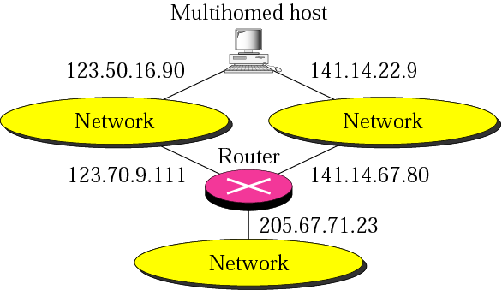
Figure 4-12
Multihomed devices

Slide 55
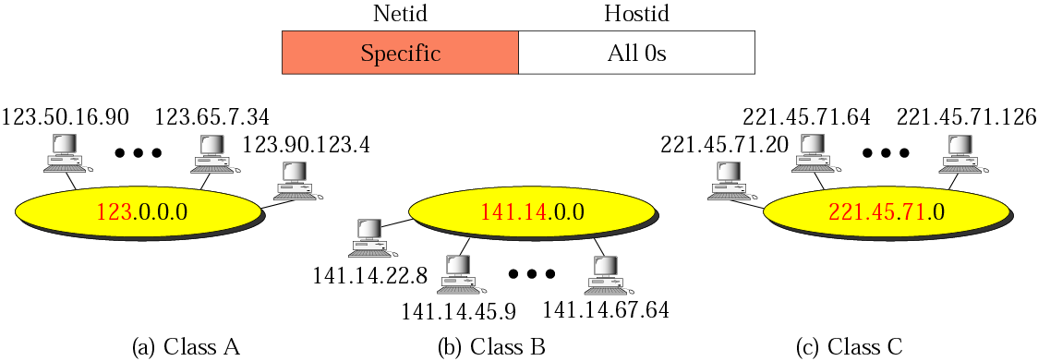
Figure 4-13
Network addresses

Slide 56
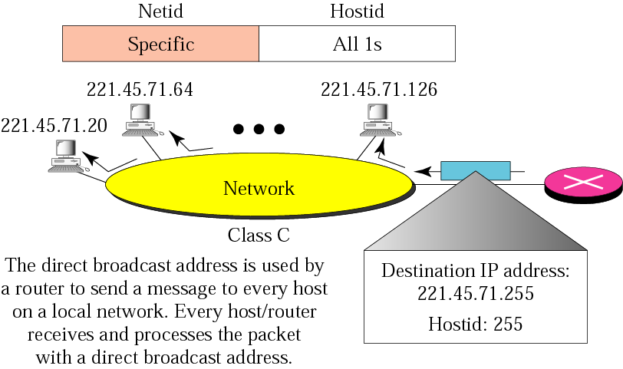
Figure 4-14
Example of direct broadcast address

Slide 57
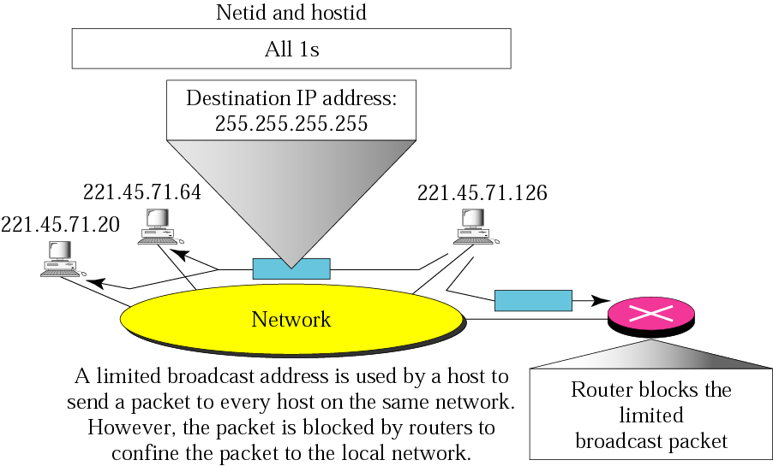
Figure 4-15
Example of limited broadcast address

Slide 58
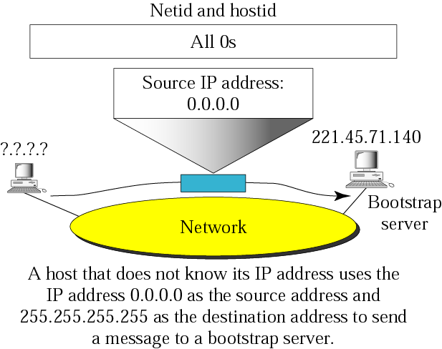
Figure 4-16
Example of this host on this address

Slide 59
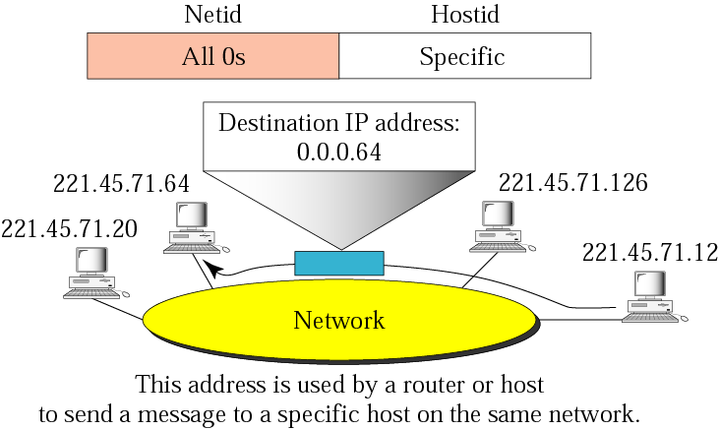
Figure 4-17
Example of specific host on this network

Slide 60
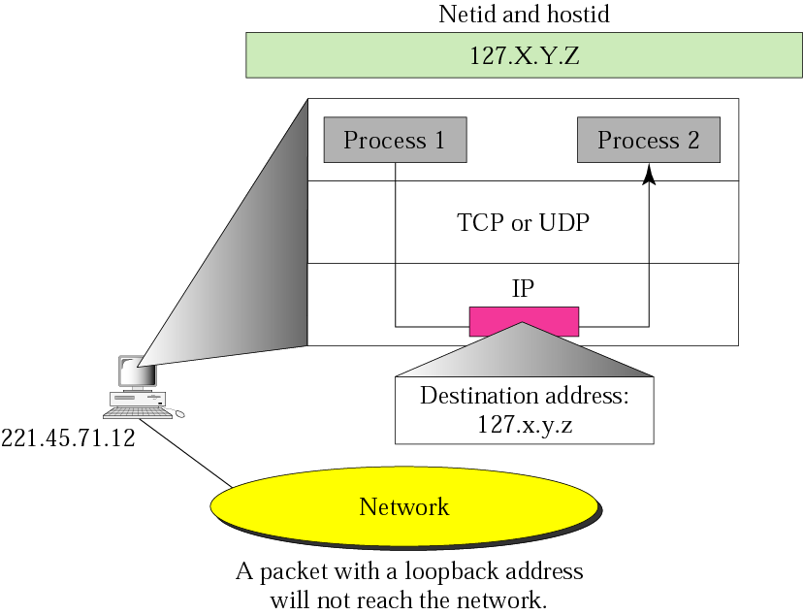
Figure 4-18
Example of loopback address

Slide 61
Private Addresses
A number of blocks in each class are assigned for private use. They are not recognized globally. These blocks are depicted in Table 4.4

Slide 62
Unicast, Multicast, and Broadcast Addresses
Unicast communication is one-to-one.
Multicast communication is one-to-many.
Broadcast communication is one-to-all.

Slide 63
Multicast delivery will be
discussed in depth in
Chapter 14.

Slide 64
4.4
A SAMPLE
INTERNET
WITH
CLASSFUL
ADDRESSES

Slide 65
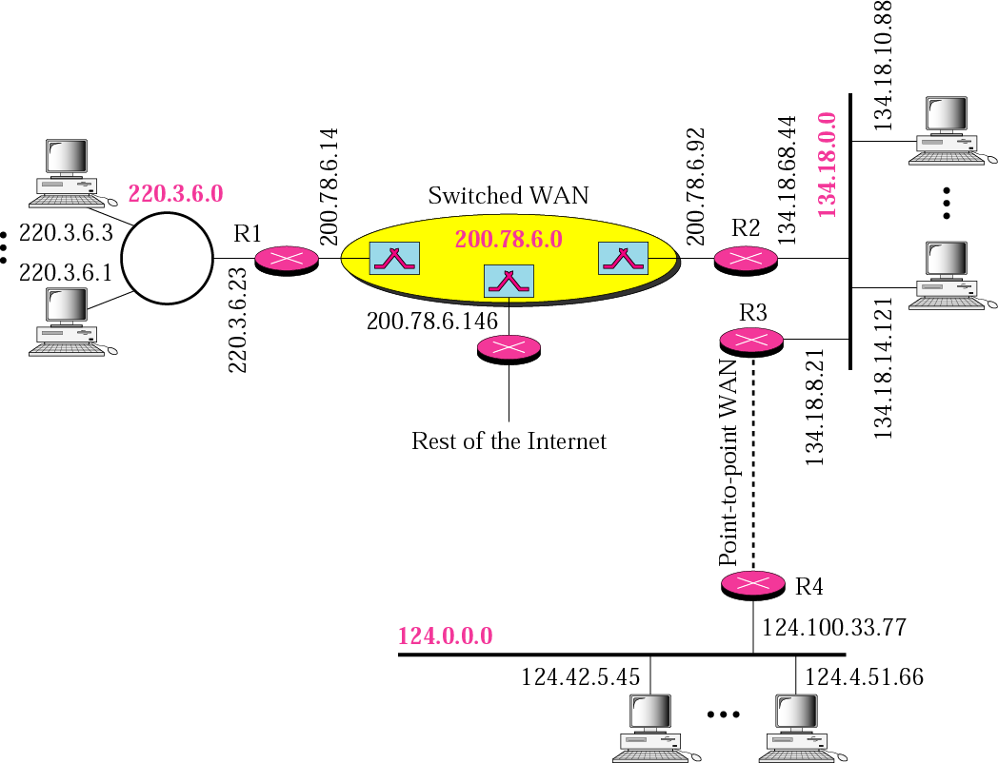
Figure 4-19
Sample internet

