Slide 1
Chapter 5
Subnetting/Supernetting
and
Classless Addressing

Slide 2
CONTENTS
SUBNETTING
SUPERNETTING
CLASSLESS ADDRSSING

Slide 3
5.1
SUBNETTING

Slide 4

IP addresses are designed with
two levels of hierarchy.

Slide 5
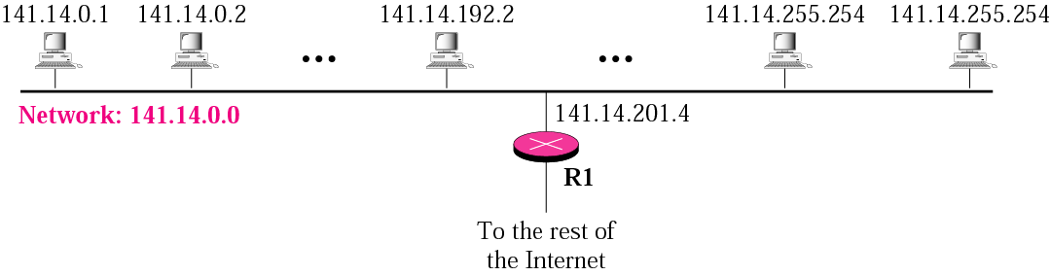
Figure 5-1
A network with two levels of
hierarchy (not subnetted)

Slide 6
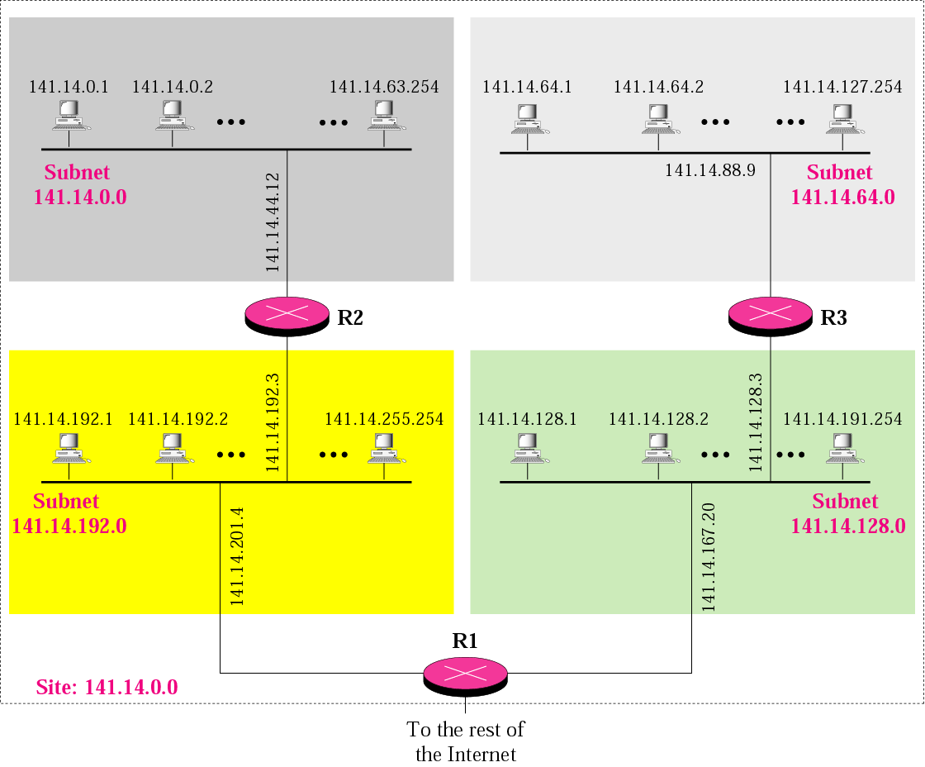
Figure 5-2
A network with three levels of
hierarchy (subnetted)

Slide 7
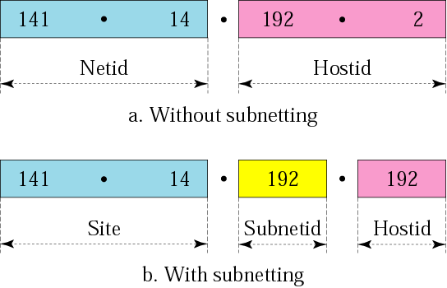
Figure 5-3
Addresses in a network with
and without subnetting

Slide 8

Figure 5-4
Hierarchy concept in a telephone number

Slide 9
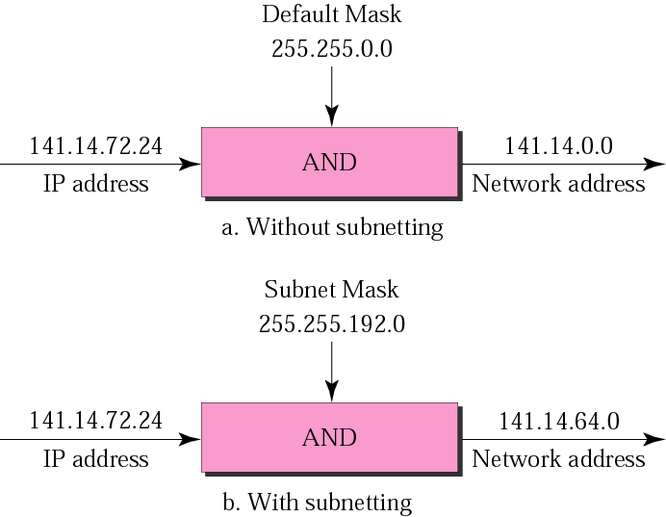
Figure 5-5
Default mask and subnet mask

Slide 10
Finding the Subnet Address
Given an IP address, we can find the subnet address the same way we found the network address in the previous chapter. We apply the mask to the address. We can do this in two ways: straight or short-cut.

Slide 11
Straight Method
In the straight method, we use binary notation for both the address and the mask and then apply the AND operation to find the subnet address.

Slide 12
Example 1
What is the subnetwork address if the destination address is 200.45.34.56 and the subnet mask is 255.255.240.0?

Slide 13
Solution
11001000 00101101 00100010 00111000
11111111 11111111 11110000 00000000
11001000 00101101 00100000 00000000
The subnetwork address is 200.45.32.0.

Slide 14
Short-Cut Method
    ** If the byte in the mask is 255, copy the byte in the address.
    ** If the byte in the mask is 0, replace the byte in the address with 0.
    ** If the byte in the mask is neither 255 nor 0, we write the mask and the address in binary and apply the AND operation.

Slide 15
Example 2
What is the subnetwork address if the destination address is 19.30.80.5 and the mask is 255.255.192.0?
Solution
See Figure 5.6

Slide 16
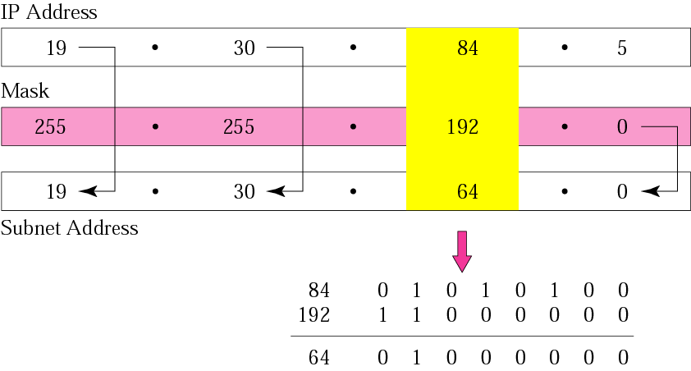
Figure 5-6
Example 2

Slide 17
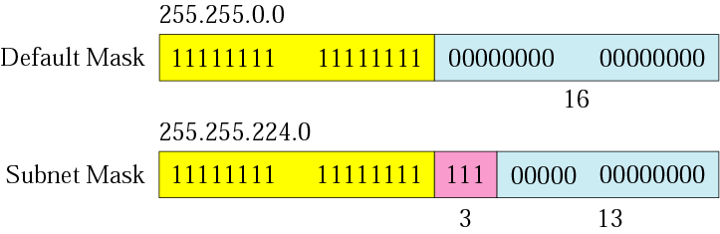
Figure 5-7
Comparison of a default mask and
a subnet mask

Slide 18
The number of subnets must be
a power of 2.

Slide 19
Example 3
A company is granted the site address 201.70.64.0 (class C). The company needs six subnets. Design the subnets.
Solution
The number of 1s in the default
mask is 24 (class C).

Slide 20
Solution (Continued)
The company needs six subnets. This number 6 is not a power of 2. The next number that is a power of 2 is 8 (2³). We need 3 more 1s in the subnet mask. The total number of 1s in the subnet mask is 27 (24 + 3).
The total number of 0s is 5 (32 − 27). The mask is

Slide 21
Solution (Continued)
11111111 11111111 11111111 11100000
or
255.255.255.224
    The number of subnets is 8.
    The number of addresses in each subnet is 2⁵ (5 is the number of 0s) or 32.
See Figure 5.8

Slide 22
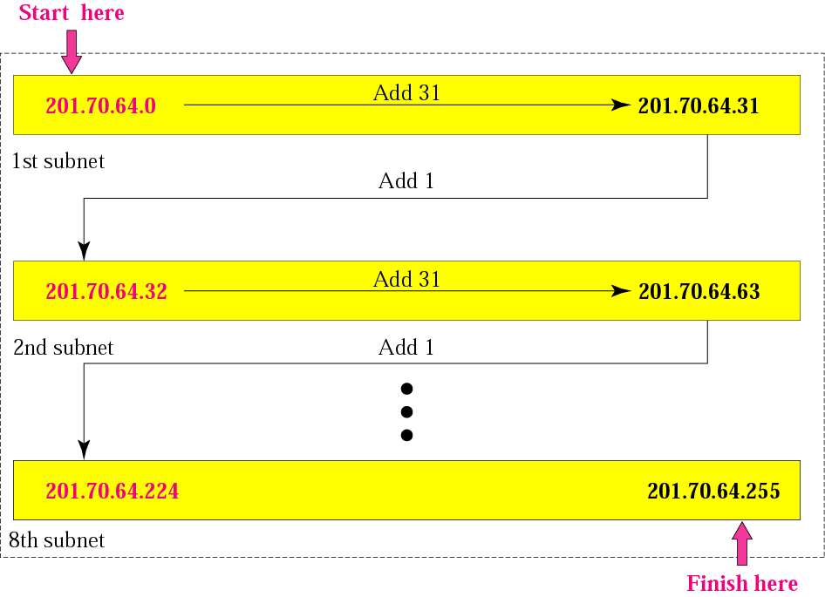
Figure 5-8
Example 3

Slide 23
Example 4
A company is granted the site address 181.56.0.0 (class B). The company needs 1000 subnets. Design the subnets.
Solution
The number of 1s in the default mask is 16 (class B).

Slide 24
Solution (Continued)
The company needs 1000 subnets. This number is not a power of 2. The next number that is a power of 2 is 1024 (2¹⁰). We need 10 more 1s in the subnet mask.
The total number of 1s in the subnet mask is 26 (16 + 10).
The total number of 0s is 6 (32 − 26).

Slide 25
Solution (Continued)
The mask is
11111111 11111111 11111111 11000000
or
255.255.255.192.
The number of subnets is 1024.
The number of addresses in each subnet is 2⁶ (6 is the number of 0s) or 64.
See Figure 5.9

Slide 26
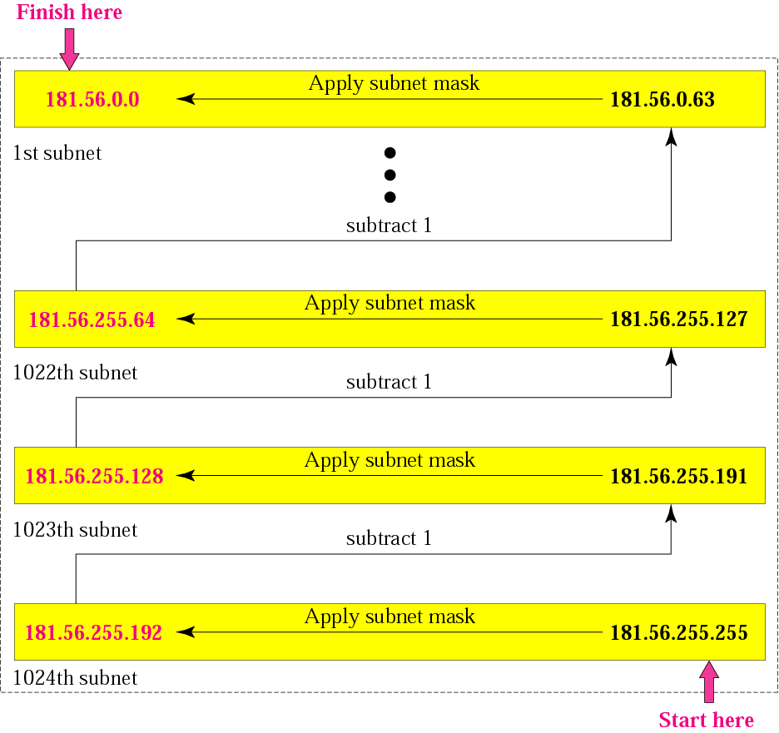
Figure 5-9
Example 4

Slide 27
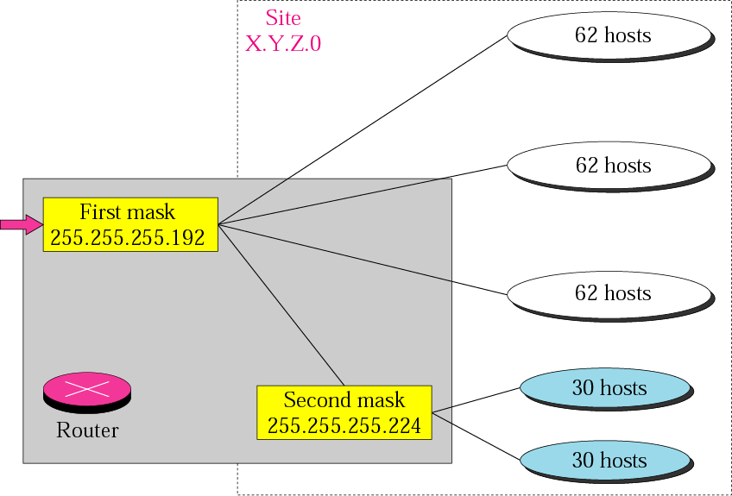
Figure 5-10
Variable-length subnetting

Slide 28
5.2
SUPERNETTING

Slide 29
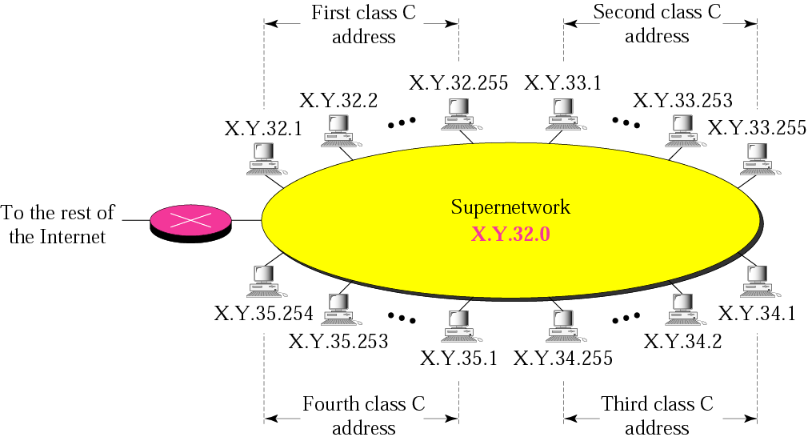
Figure 5-11
A supernetwork

Slide 30
Rules:
** The number of blocks must be a power of 2 (1, 2, 4, 8, 16, . . .).
** The blocks must be contiguous in the address space (no gaps between the blocks).
** The third byte of the first address in the superblock must be evenly divisible by the number of blocks. In other words, if the number of blocks is N, the third byte must be divisible by N.

Slide 31
Example 5
A company needs 600 addresses. Which of the following set of class C blocks can be used to form a supernet for this company?
198.47.32.0 198.47.33.0 198.47.34.0
198.47.32.0 198.47.42.0 198.47.52.0 198.47.62.0
198.47.31.0 198.47.32.0 198.47.33.0 198.47.52.0
198.47.32.0 198.47.33.0 198.47.34.0 198.47.35.0

Slide 32
Solution
1: No, there are only three blocks.
2: No, the blocks are not contiguous.
3: No, 31 in the first block is not divisible by 4.
4: Yes, all three requirements are fulfilled.

Slide 33
In subnetting,
we need the first address of the
subnet and the subnet mask to
define the range of addresses.

Slide 34
In supernetting,
we need the first address of
the supernet
and the supernet mask to
define the range of addresses.

Slide 35
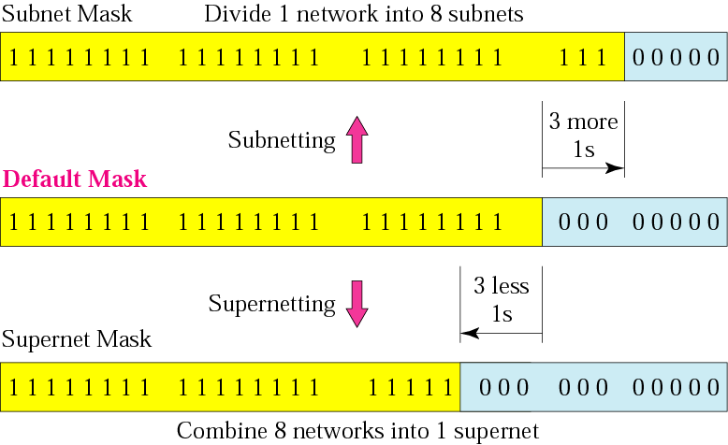
Figure 5-12
Comparison of subnet, default,
and supernet masks

Slide 36
Example 6
We need to make a supernetwork out of 16 class C blocks. What is the supernet mask?
Solution
We need 16 blocks. For 16 blocks we need to change four 1s to 0s in the default mask. So the mask is
11111111 11111111 11110000 00000000
or
255.255.240.0

Slide 37
Example 7
A supernet has a first address of 205.16.32.0 and a supernet mask of 255.255.248.0. A router receives three packets with the following destination addresses:
    205.16.37.44
    205.16.42.56
    205.17.33.76
Which packet belongs to the supernet?

Slide 38
Solution
We apply the supernet mask to see if we can find the beginning address.
205.16.37.44 AND 255.255.248.0 ➔  205.16.32.0
205.16.42.56 AND 255.255.248.0 ➔  205.16.40.0
205.17.33.76 AND 255.255.248.0 ➔  205.17.32.0
Only the first address belongs to this supernet.

Slide 39
Example 8
A supernet has a first address of 205.16.32.0 and a supernet mask of 255.255.248.0. How many blocks are in this supernet and what is the range of addresses?
Solution
The supernet has 21 1s. The default mask has 24 1s. Since the difference is 3, there are 2³ or 8 blocks in this supernet. The blocks are 205.16.32.0 to 205.16.39.0. The first address is 205.16.32.0. The last address is 205.16.39.255.

Slide 40
5.3
CLASSLESS
ADDRESSING

Slide 41
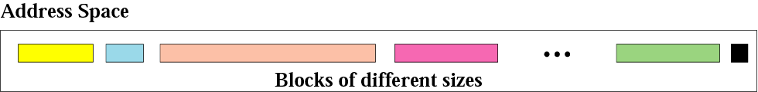
Figure 5-13
Variable-length blocks

Slide 42
Number of Addresses in a Block
There is only one condition on the number of addresses in a block; it must be a power of 2 (2, 4, 8, . . .). A household may be given a block of 2 addresses. A small business may be given 16 addresses. A large organization may be given 1024 addresses.

Slide 43
Beginning Address
The beginning address must be evenly divisible by the number of addresses. For example, if a block contains 4 addresses, the beginning address must be divisible by 4. If the block has less than 256 addresses, we need to check only the rightmost byte. If it has less than 65,536 addresses, we need to check only the two rightmost bytes, and so on.

Slide 44
Example 9
Which of the following can be the beginning address of a block that contains 16 addresses?
205.16.37.32
190.16.42.44
17.17.33.80
123.45.24.52
Solution
The address 205.16.37.32 is eligible because 32 is divisible by 16. The address 17.17.33.80 is eligible because 80 is divisible by 16.

Slide 45
Example 10
Which of the following can be the beginning address of a block that contains 1024 addresses?
205.16.37.32
190.16.42.0
17.17.32.0
123.45.24.52
Solution
To be divisible by 1024, the rightmost byte of an address should be 0 and the second rightmost byte must be divisible by 4. Only the address 17.17.32.0 meets this condition.

Slide 46

Figure 5-14
Slash notation

Slide 47
Slash notation is also called
CIDR
notation.

Slide 48
Example 11
A small organization is given a block with the beginning address and the prefix length 205.16.37.24/29 (in slash notation). What is the range of the block?
Solution
The beginning address is 205.16.37.24. To find the last address we keep the first 29 bits and change the last 3 bits to 1s.
Beginning:11001111 00010000 00100101 00011000
Ending : 11001111 00010000 00100101 00011111
There are only 8 addresses in this block.

Slide 49
Example 12
We can find the range of addresses in Example 11 by another method. We can argue that the length of the suffix is 32 − 29 or 3. So there are 2³ = 8 addresses in this block. If the first address is 205.16.37.24, the last address is 205.16.37.31 (24 + 7 = 31).

Slide 50
A block in classes A, B, and C
can easily be represented in slash
notation as
A.B.C.D/ n
where n is
either 8 (class A), 16 (class B), or
24 (class C).

Slide 51
Example 13
What is the network address if one of the addresses is 167.199.170.82/27?
Solution
The prefix length is 27, which means that we must keep the first 27 bits as is and change the remaining bits (5) to 0s. The 5 bits affect only the last byte. The last byte is 01010010. Changing the last 5 bits to 0s, we get 01000000 or 64. The network address is 167.199.170.64/27.

Slide 52
Example 14
An organization is granted the block 130.34.12.64/26. The organization needs to have four subnets. What are the subnet addresses and the range of addresses for each subnet?
Solution
The suffix length is 6. This means the total number of addresses in the block is 64 (2⁶). If we create four subnets, each subnet will have 16 addresses.

Slide 53
Solution (Continued)
Let us first find the subnet prefix (subnet mask). We need four subnets, which means we need to add two more 1s to the site prefix. The subnet prefix is then /28.
Subnet 1: 130.34.12.64/28 to 130.34.12.79/28.
Subnet 2: 130.34.12.80/28 to 130.34.12.95/28.
Subnet3:130.34.12.96/28 to 130.34.12.111/28.
Subnet 4: 130.34.12.112/28 to 130.34.12.127/28.
See Figure 5.15

Slide 54
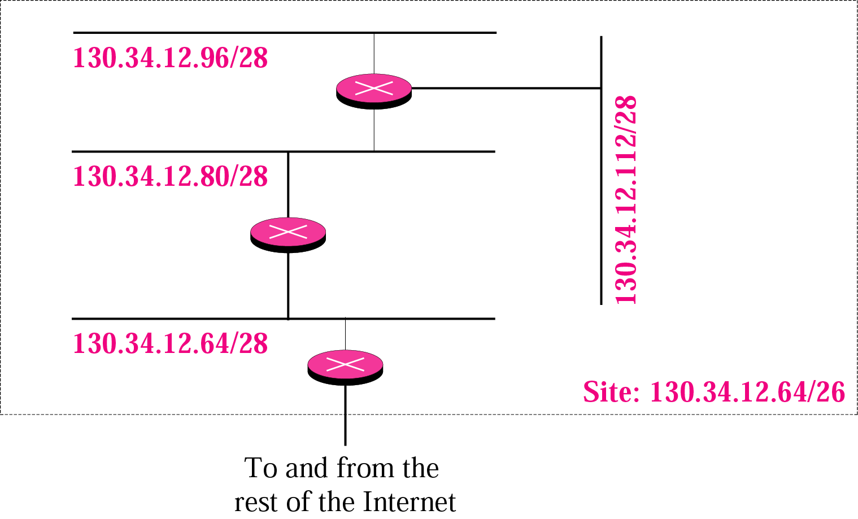
Figure 5-15
Example 14

Slide 55
Example 15
An ISP is granted a block of addresses starting with 190.100.0.0/16. The ISP needs to distribute these addresses to three groups of customers as follows:
1. The first group has 64 customers; each needs 256 addresses.
2. The second group has 128 customers; each needs 128 addresses.
3. The third group has 128 customers; each needs 64 addresses.
Design the subblocks and give the slash notation for each subblock. Find out how many addresses are still available after these allocations.

Slide 56
Solution
Group 1
For this group, each customer needs 256 addresses. This means the suffix length is 8 (2⁸ = 256). The prefix length is then 32 − 8 = 24.
01: 190.100.0.0/24  ➔190.100.0.255/24
02: 190.100.1.0/24 ➔190.100.1.255/24
…………………………………..
64: 190.100.63.0/24➔190.100.63.255/24
Total = 64 × 256 = 16,384

Slide 57
Solution (Continued)
Group 2
For this group, each customer needs 128 addresses. This means the suffix length is 7 (2⁷ = 128). The prefix length is then 32 − 7 = 25. The addresses are:
001:190.100.64.0/25 ➔190.100.64.127/25
002:190.100.64.128/25 ➔190.100.64.255/25
……………………………………..
128:190.100.127.128/25➔190.100.127.255/25
Total = 128 × 128 = 16,384

Slide 58
Solution (Continued)
Group 3
For this group, each customer needs 64 addresses. This means the suffix length is 6 (2⁶ = 64). The prefix length is then 32 − 6 = 26.
001:190.100.128.0/26 ➔190.100.128.63/26
002:190.100.128.64/26 ➔190.100.128.127/26
…………………………
128:190.100.159.192/26➔190.100.159.255/26
Total = 128 × 64 = 8,192

Slide 59
Solution (Continued)
Number of granted addresses: 65,536
Number of allocated addresses: 40,960
Number of available addresses: 24,576

