Slide 1


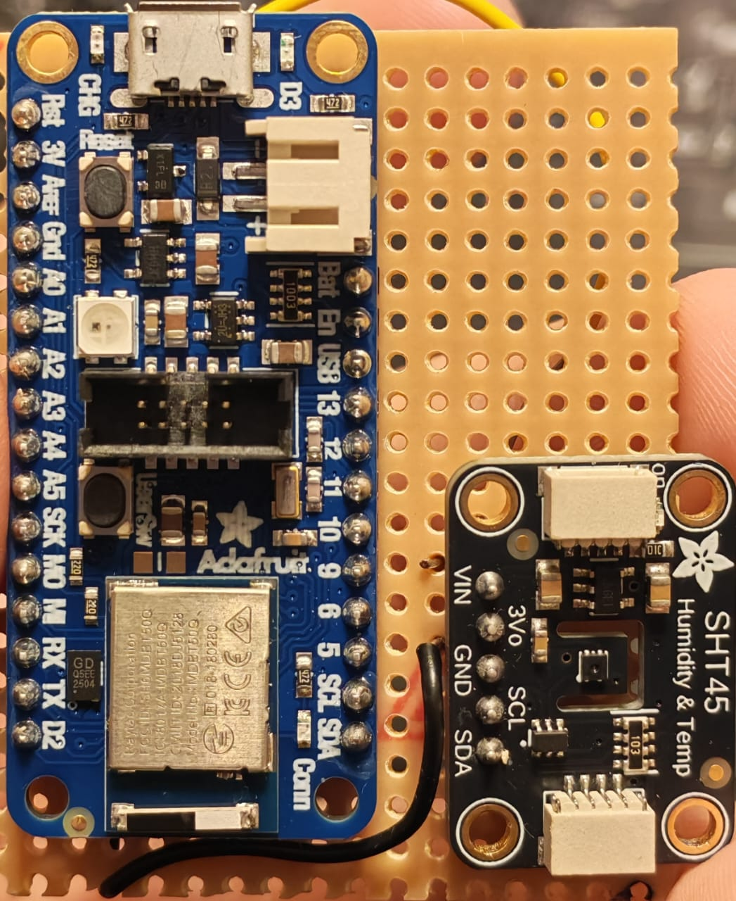
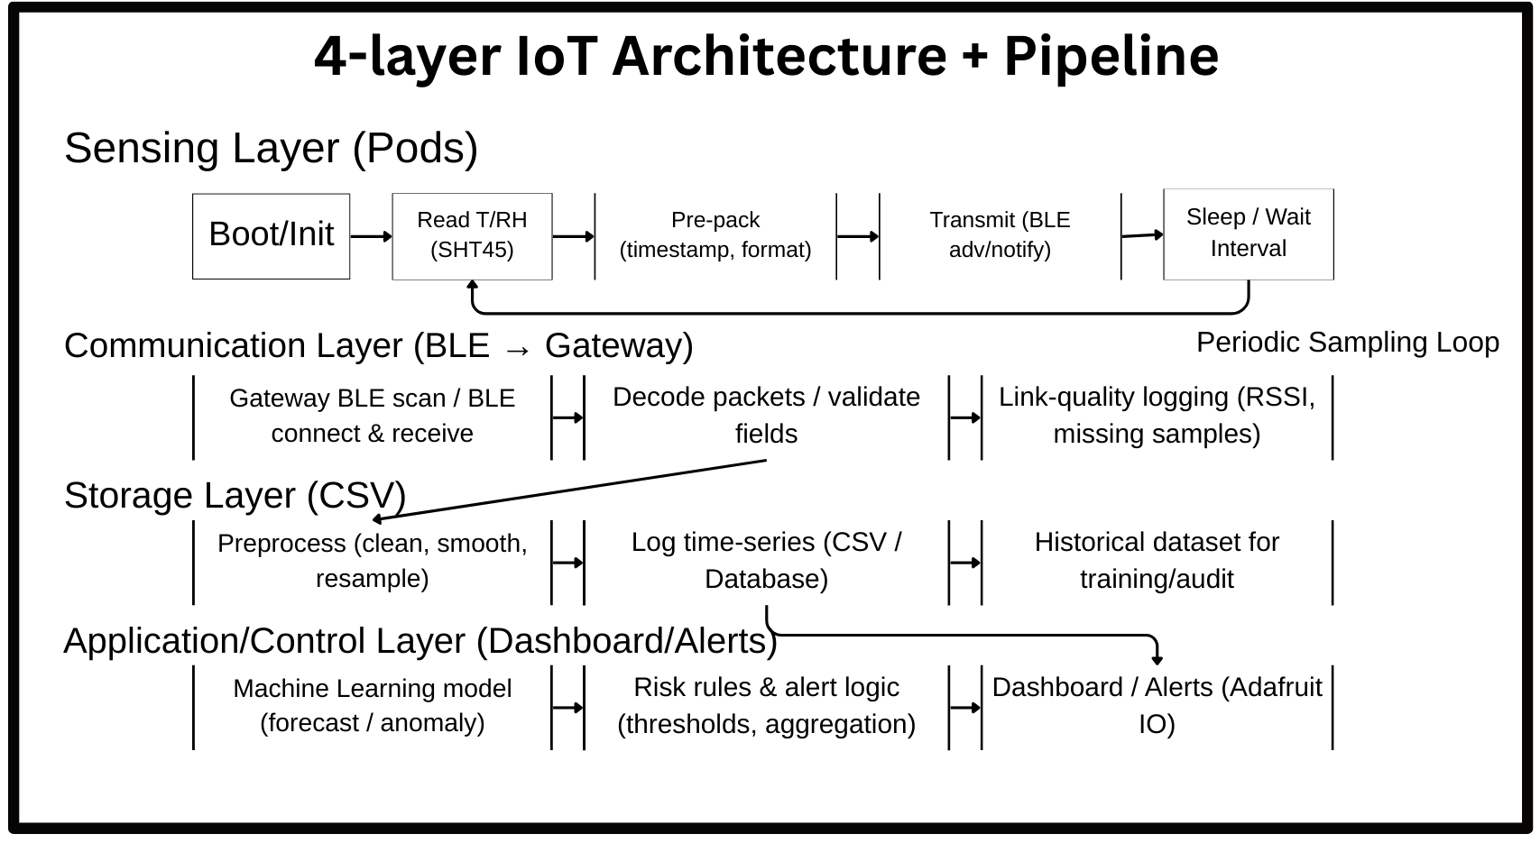
Research: Real-time monitoring is widely used in storage/transport to reduce food loss and waste, with temperature and humidity as the most common variables. (da Costa et al., 2022) Warehouse IoT systems demonstrate environmental monitoring/control, and recent work adds intelligent decision logic (e.g., fuzzy/learning) for improved responsiveness. (Parkhi et al., 2022; Zhang et al., 2025; Gowrishankar et al., 2023) For spices, moisture sorption and water-activity–temperature relationships can cause physical instability (e.g., caking), motivating early detection. (Voelker et al., 2020) Warehouse RF conditions can reduce BLE reliability (metal/multipath) and 2.4 GHz coexistence can add interference; scaling many peripherals also raises gateway scheduling/fairness issues.
UFCFXK-30-3: Digital Systems Project
Student name: Mohammad Faraj
Project Title: Predictive Spice-Stock Preservation System for Warehouse Environments
Abstract:
This project develops a predictive spice-stock preservation system for warehouses using distributed temperature/relative-humidity sensor pods and a gateway analytics pipeline. It detects short-horizon environmental risk by collecting multi-point data, running preprocessing plus forecasting/anomaly detection, and presenting actionable dashboards/alerts. Temperature and RH are used because they dominate real-time food monitoring and are strongly linked to moisture-driven quality deterioration in stored products.
(Ramires et al., 2024; Eltholth, 2023; Kim & Paek, 2025) Over time, concept drift can degrade static models, supporting logging and periodic re-validation. (Carnier et al., 2025)
Implementation Artifacts:
Board: Adafruit Feather nRF52840 Express (BLE, ARM Cortex-M4F, USB).
Sensor: Adafruit Sensirion SHT45 (high-accuracy digital T/RH, I²C).
Relevance: Supports low-power, reliable warehouse sensing pods.
Watch the demo video!
Functional Requirements:
Measure and timestamp T/RH at configurable intervals.
Transmit pod readings to a gateway reliably.
Log data locally (CSV) for evaluation/diagnosis.
Run forecasting/anomaly flags and generate alerts.
Provide a dashboard for status, trends, and alerts.
Non-functional Requirements:
Battery-aware pod operation (low duty cycle).
Robust under intermittent connectivity (gateway keeps logging).
Scales to multiple pods with predictable performance.
Low-noise alerting (avoid alert storms).
Testing includes: (a) sensor stability/sanity checks, (b) comms reliability tests (distance, obstruction, missing samples), and (c) forecasting evaluation using standard error metrics and baseline comparisons. Where possible, multi-pod trials will assess scaling and confirm that logging supports diagnosis and reproducible evaluation.
Aim: Build an energy-aware, multi-point warehouse monitoring system that predicts adverse T/RH conditions and communicates risk clearly.
Objectives:
Build a reliable T/RH sensor pod deployable across multiple zones.
Implement gateway ingestion, preprocessing, and timestamped CSV logging.
Implement forecasting/anomaly detection and evaluate against simple baselines.
Deliver a lightweight dashboard showing readings, trends, and alerts.
Document RF/missing-sample issues and deployment constraints.
Design, Implementation & Testing:
The system uses a layered pipeline: pods measure T/RH and forward readings to a gateway; the gateway validates and preprocesses data, runs forecasting/anomaly detection, and logs time-series for evaluation; the application layer visualises trends and alerts. The current artefact is a physical pod built from a BLE-capable board and a high-accuracy T/RH sensor. Next steps focus on stable gateway transfer, structured logging, and baseline analytics before extending models and alert logic.
Planning and Management:
Milestones: (1) hardware validation, (2) gateway ingestion + CSV logging, (3) baseline dashboard integration, (4) forecasting/anomaly evaluation, and (5) packaging/documentation/demo. Main risks are wireless reliability and time; mitigation is to deliver a minimal end-to-end pipeline first, then iterate once stability is proven.
State Diagram
References:
da Costa, T.P., Gillespie, J., Cama-Moncunill, X., Ward, S., Condell, J., Ramanathan, R. and Murphy, F. (2022) ‘A Systematic Review of Real-Time Monitoring Technologies and Its Potential Application to Reduce Food Loss and Waste: Key Elements of Food Supply Chains and IoT Technologies’, Sustainability, 15(1), p. 614. Available from: (Accessed: 11 January 2026).
Voelker, A.L., Sommer, A.A. and Mauer, L.J. (2020) ‘Moisture sorption behaviors, water activity-temperature relationships, and physical stability traits of spices, herbs, and seasoning blends containing crystalline and amorphous ingredients’, Food Research International, 136, p. 109608. (Accessed: 15 November 2025).
Parkhi, V., Chavhan, N., Chandak, S., Chaware, B. and Bongarde, P. (2022) ‘An IoT Based Environment Monitoring & Controlling System for Food Grain Warehouse’, in Lecture Notes in Networks and Systems. pp. 217–227.
Zhang, W., Zhang, X. and Zhou, X. (2025) ‘IoT-Based Multi-Sensor Environmental Monitoring and Intelligent Control in Automated Warehouses Using Fuzzy Logic and Deep Learning’, Informatica, 49(33). Available from: https://informatica.si/index.php/informatica/article/view/8257 (Accessed: 21 January 2026).
Gowrishankar, V., Veena, P., Ponmurugan, P., T, A.B., Vijayakumar, P. and Siva Ramkumar, M. (2023) Edge Computing Enabled Smart Warehouse Management System for Food Processing Industries. [Online]. (Accessed: 21 January 2026).
Ramires, M., Campaniço, A., Meneses, F. and Moreira, A. (2024) ‘Assessing BLE RSSI Fingerprinting for Product Tracking in a Warehouse’, [Online]. pp. 1–6. (Accessed: 2 December 2025).
Eltholth, A.A. (2023) ‘Improved Spectrum Coexistence in 2.4 GHz ISM Band Using Optimized Chaotic Frequency Hopping for Wi-Fi and Bluetooth Signals’, Sensors, 23(11), p. 5183. Available from: https://www.mdpi.com/1424-8220/23/11/5183 (Accessed: 21 January 2026).
Kim, M. and Paek, J. (2025) ‘Multi-Connection Scheduling with Fair Resource Management for Scalable Bluetooth Low Energy Networks’, IEEE Internet of Things Journal, pp. 1–1. Available from: https://ieeexplore.ieee.org/abstract/document/11275955 (Accessed: 4 January 2026).
Carnier, R.M., Lahesoo, L. and Fukuda, K. (2025) ‘Binary Anomaly Detection in Streaming IoT Traffic under Concept Drift’, arXiv. Available from: https://arxiv.org/abs/2510.27304 (Accessed: 21 January 2026).

