Slide 1


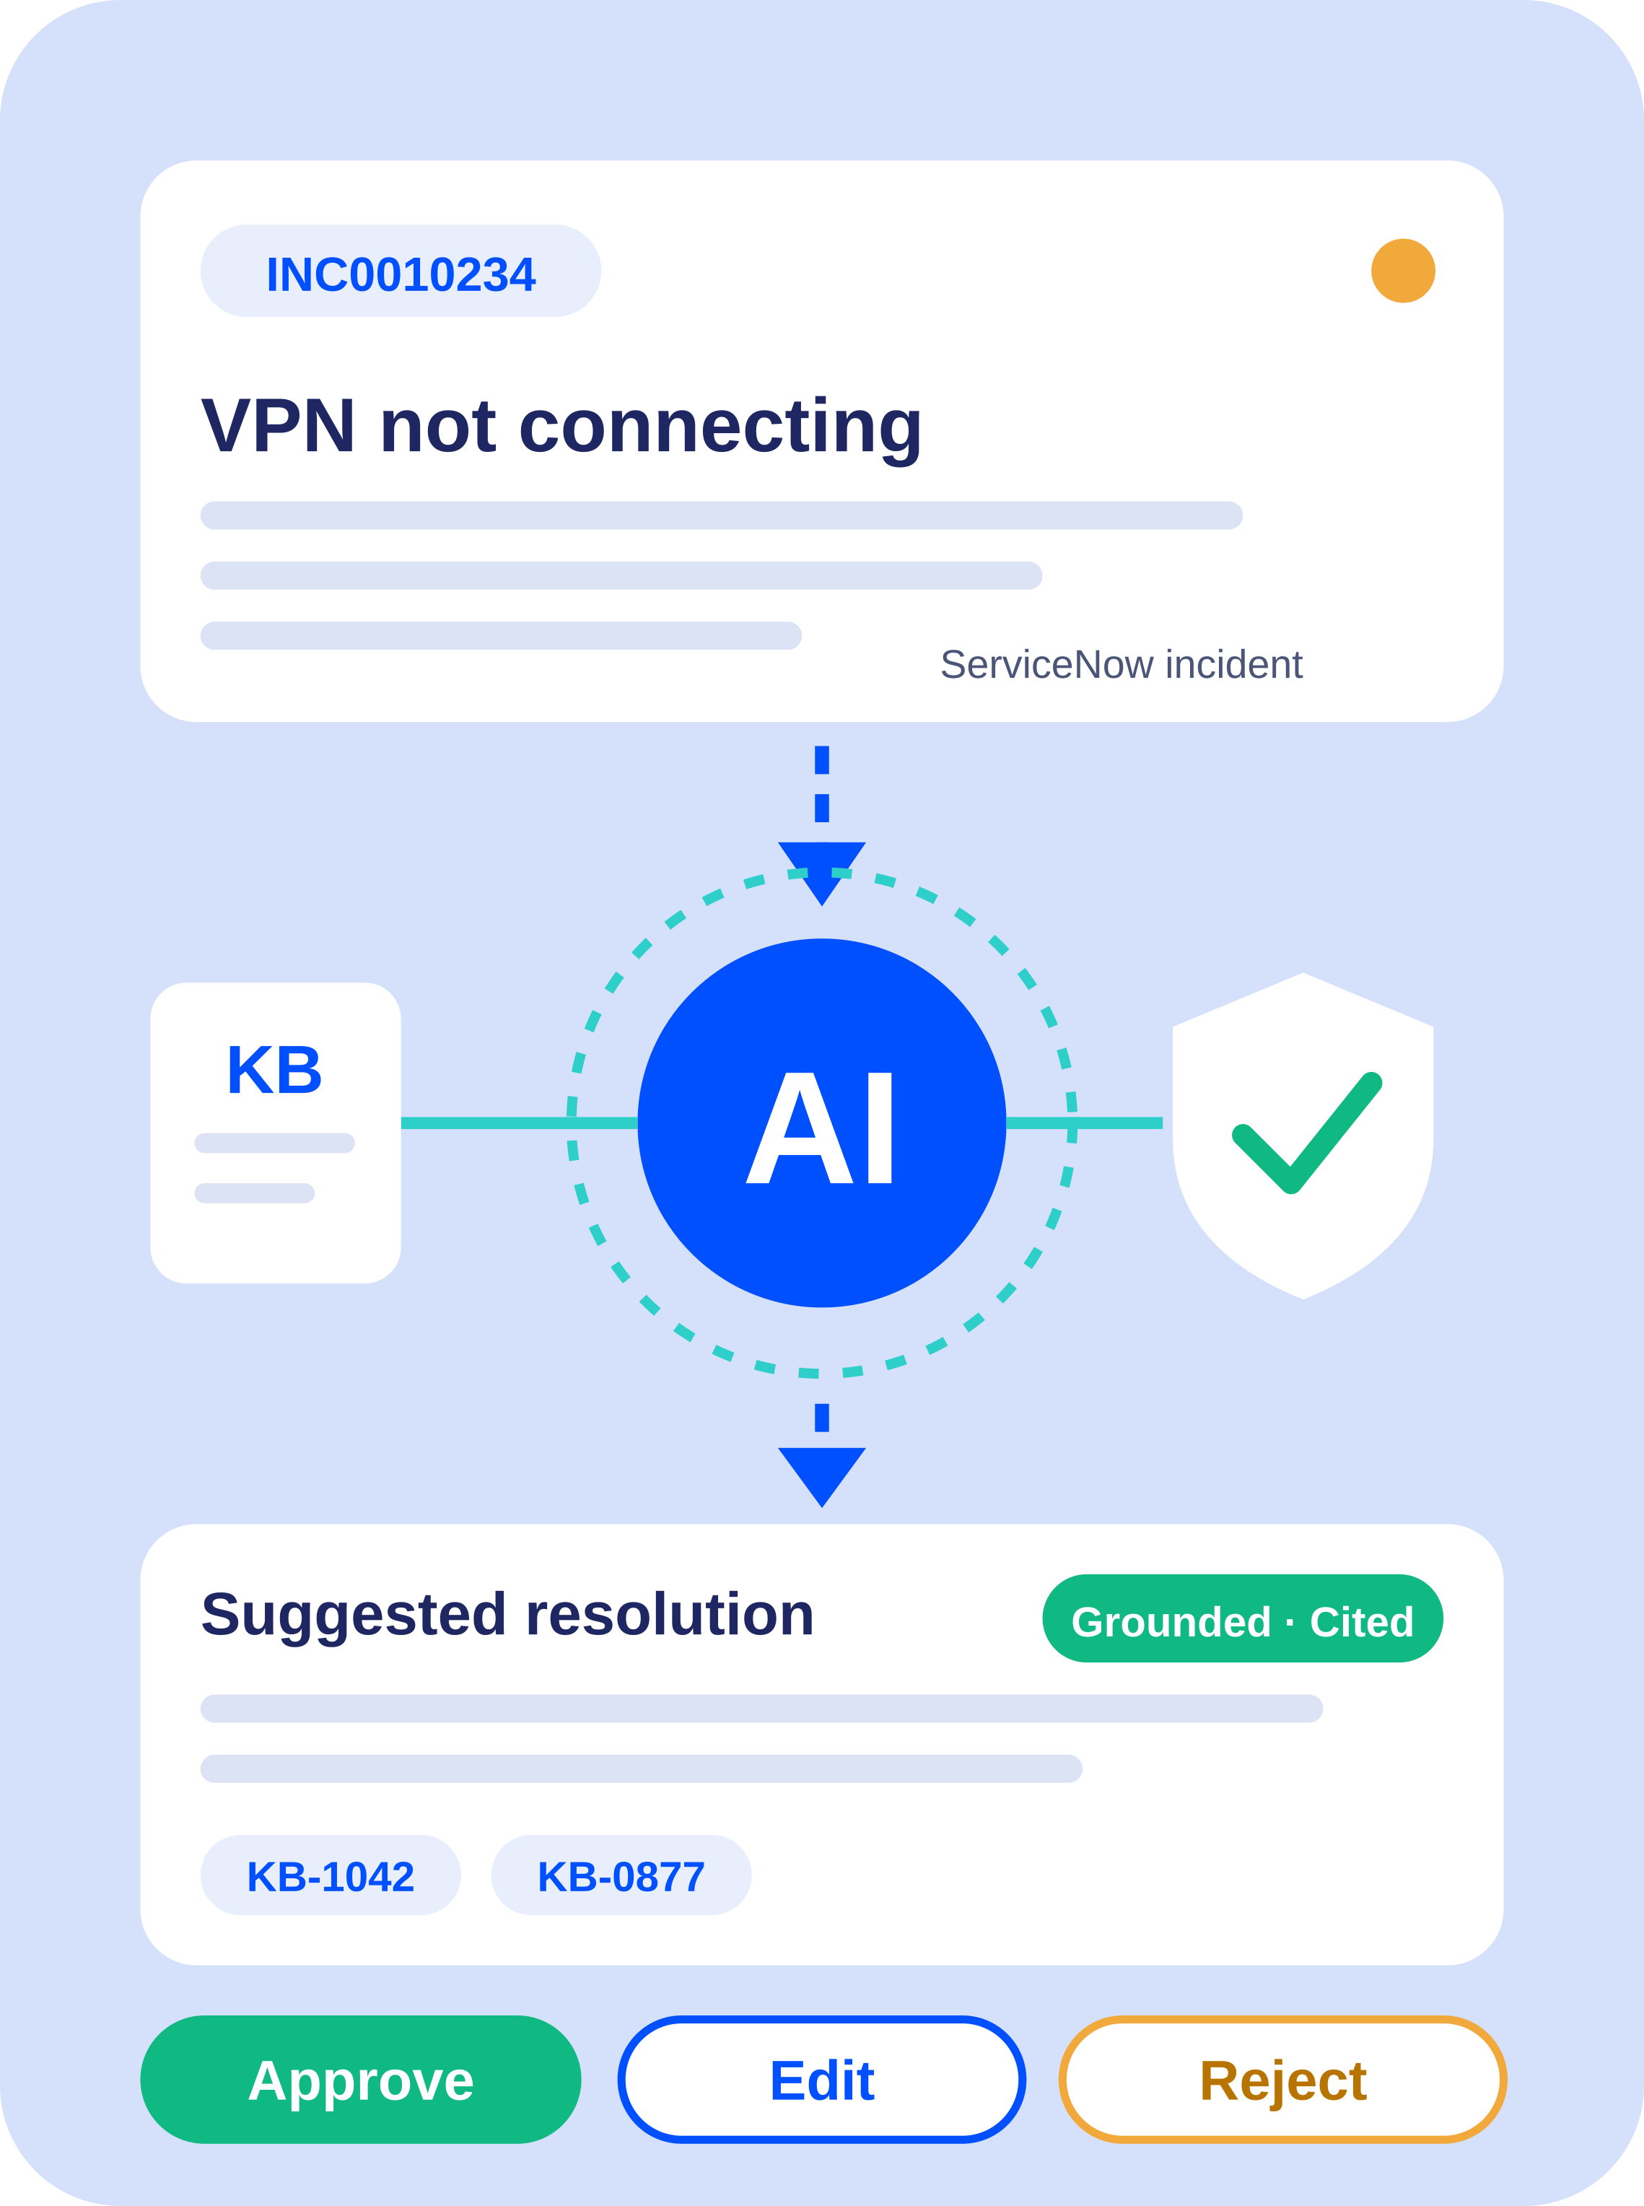
×
SPRINTS x BARQ · AI TRACK — GROUP 5 · 2026
AI ServiceNow
Support Assistant
Grounded AI. Automated Workflows. Human Control.
An AI-powered assistant for incident analysis and knowledge-grounded resolution suggestions.

Slide 2






OUR TEAM
Meet the Team
Ibrahim Abdelmottleb Abdellah
Sheref Ayman Serag
Abdullah Basyouni
[ServiceNow Platform & AI Retrieval Developer & RAG]
[AI Backend, RAG & ServiceNow Integration Developer]
[ServiceNow Integration & Backend Infrastructure Developer]
Mohaned Magdy
Malak Ashraf Hassan Elkayyal
Fatma Abdulfattah Ahmed
[Backend Security & Core Engine Developer]
[AI Agent, Security & Evaluation Engineer]
[AI Agent, Knowledge Base, Prompt Engineering & Evaluation Developer]
MM
MENTOR
Mariam Mohamed
Sprints x BARQ | AI Track — Group 5
02 / 14

Slide 3
THE PROBLEM
Challenges in Traditional IT Support
Manual knowledge-base searching
Time-consuming incident investigation
1
2
AI answers without sufficient supporting evidence
Risk of incorrect or uncontrolled record updates
3
4
OUR GOAL
Reduce repetitive work while keeping resolution decisions under human control.
Sprints x BARQ | AI Track — Group 5
03 / 14

Slide 4
OUR SOLUTION
From Incident to Human-Reviewed Suggestion
1
2
3
Receive the incident from ServiceNow
Validate the incoming event
Retrieve relevant knowledge-base articles
4
5
6
Generate an evidence-grounded suggestion
Validate the response
Write the suggestion back for human review
OUTCOME
Faster assistance with a controlled review workflow.
Sprints x BARQ | AI Track — Group 5
04 / 14

Slide 5
SYSTEM ARCHITECTURE
How the System Works
Event Ingestion
ServiceNow Business Rule → Signed Webhook → FastAPI
Background Processing
FastAPI → Redis → Celery Worker
AI Processing
Incident Context → ReAct Agent → Qdrant Knowledge Retrieval
Validation & Integration
Grounding Checks → ServiceNow Write-Back
Human Oversight
Suggested Resolution → Approve / Edit / Reject
Sprints x BARQ | AI Track — Group 5
05 / 14

Slide 6
KNOWLEDGE & AI
Knowledge Retrieval & AI Agent
RAG Pipeline
Agent Workflow
Parse and extract knowledge-base content
Split documents into manageable chunks
Generate vector embeddings
Retrieve relevant content from Qdrant
Use retrieved evidence to support the AI response
ReAct reasoning cycle
Restricted tools for knowledge search and workflow actions
Evidence validation before suggesting a resolution
Escalation when available evidence is insufficient
Sprints x BARQ | AI Track — Group 5
06 / 14

Slide 7
TRUST & SECURITY
Trust, Validation & Security
Request Protection
AI Response Validation
Controlled Write-Back
Webhook signature validation
Payload validation
Idempotency checks
Grounding and evidence checks
Prompt-injection detection
Handling insufficient evidence
Allow-listed ServiceNow fields
Input and confidence validation
Human review before final resolution
Sprints x BARQ | AI Track — Group 5
07 / 14

Slide 8
TOOLS & TECHNOLOGIES
Technology Stack
BACKEND & PROCESSING
AI & ORCHESTRATION
KNOWLEDGE RETRIEVAL
FastAPI · Celery · Redis · PostgreSQL · asyncpg
LangChain · ReAct Agent · LiteLLM · Gemini 2.5 Flash
Qdrant · BGE Embeddings · Docling
SERVICENOW INTEGRATION
TESTING & DEPLOYMENT
Business Rules · Table API · REST Integration · UI Actions
Pytest · Node Tests · Docker Compose
Sprints x BARQ | AI Track — Group 5
08 / 14

Slide 9
LIVE DEMO
Live Demo
SCENARIO 1
SCENARIO 2
SCENARIO 3
Knowledge-Supported Incident
Insufficient Evidence
Human Review
Receive an incident
Retrieve relevant knowledge
Generate a suggested response
Identify missing supporting evidence
Route the case for further human attention
Review the AI suggestion
Approve, edit, or reject it
Demo Evidence: [Insert Screenshots]

Slide 10
TESTING & RESULTS
Testing & Results
Automated Tests
Evaluation Metrics
Evidence
Unit Tests
Retrieval Hit Rate @3
Test Reports
208 Passed / 208 Total
92.4%
eval/reports/agent_report.md
Integration Tests
Processing Time
ServiceNow Screenshots
43 Tests
1.35 seconds
13 UI & Action Screenshots
Write-Back Tests
Tested Scenarios
End-to-End Evidence
98 Tests
17 Scenarios
Live ReAct Traces (.md)
Sprints x BARQ | AI Track — Group 5
10 / 14
Notes:
Final numbers will be added after verifying the actual test reports and distinguishing mocked tests from live integration tests.

Slide 11
CHALLENGES & LESSONS
Challenges & Lessons Learned
CHALLENGE | HOW WE SOLVED IT
Duplicate Events | Idempotency and duplicate-processing protection
Unreliable AI Responses | Grounding checks and evidence validation
ServiceNow API Failures | Error handling and retry mechanisms
Unsafe Record Updates | Field allow-lists and payload validation
Human Review Lifecycle | Explicit status management and review actions
Sprints x BARQ | AI Track — Group 5
11 / 14

Slide 12
INDIVIDUAL CONTRIBUTION · S3.6
Atomic Write-Back Client & Human Review Surface
ServiceNow Integration
Write-Back Safety
Human Review
ServiceNowWritebackClient (src/writeback/ servicenow_writeback.py)
Atomic operations: add_work_note(), suggest(), escalate()
Sync / Async adapter bridge
Strict 6-field allow-list (customer comments blocked)
Confidence clamped to [0.0, 1.0] with strict type validation
Exponential retry backoff on transient 503 errors
Approve / Edit / Reject UI Actions on the Incident form
Business Rules: AI_Confidence_Validation, AI_Lifecycle_Guard
UI Policy: AI fields read-only
Tests: 108 Passed in 0.81s
• 98 tests: test_writeback.py
• 10 tests: test_agent_adapter.py
• 100% pass rate (0 failures)
Evidence: 15 Verified Screenshots
• 13_live_suggest_servicenow.png (populated form)
• 04_review_actions_visible.png (UI buttons)
• 06_approve / 07_edit / 08_reject_result.png
Sprints x BARQ | AI Track — Group 5
12 / 14

Slide 13
FUTURE IMPROVEMENTS
Where We Go Next
AUTOMATION & DELIVERY
SCALABILITY & AVAILABILITY
Automated CI/CD & Continuous Testing
Enterprise Elastic Scaling & High Availability
Automate builds, deployments, and tests.
Scale with demand and minimize downtime.
MONITORING & OPTIMIZATION
AI QUALITY & SECURITY
Resource Monitoring & Infrastructure Optimization
Stronger prompt-injection defenses
Better confidence calibration
Improved grounding and abstention
Track resource usage and improve efficiency.
Sprints x BARQ | AI Track — Group 5
13 / 14

Slide 14
SPRINTS x BARQ · AI TRACK — GROUP 5
AI Drafts.
Evidence Grounds. Humans Decide.
Questions & Discussion
×
Sprints x BARQ | AI Track — Group 5

