Slide 1


BARQ SPRINTS · GROUP 3
AI ServiceNow
Support Assistant
An event-driven, RAG-powered assistant that drafts cited resolutions for IT service-desk fulfillers and keeps a human in charge of every decision.
[Presenter names] · [6th October 2026]
Notes:
About 15 seconds. Greet the judges, say the project name, then the one-line value proposition: an event-driven, RAG-powered Tier-1 assistant that drafts cited resolutions and keeps a human in charge. Stop there.

Slide 2


OUR TEAM
Who we are
Omar Ahmed
Ashar Sakr
Integration, tracing, benchmark harness
KB ingestion CLI, benchmark
Malak Rabie
Dana Hatem
Chunking, embedding, Celery worker
HMAC webhooks, S4.1 E2E verification
OUR MENTOR
Eng. Ahmed Taha
Aliaa Hasabou
[AI Engineer · Sprints]
Webhook receiver, retrieval gate
2
Notes:
About 30 seconds. We are Group 3 of the BARQ Sprints track, mentored by Eng. Ahmed Taha. Let each card speak for itself: say who owned which part in a few words, not a sentence per person.

Slide 3
PROBLEM STATEMENT
Tier-1 triage is slow and repetitive
Fulfillers spend minutes per ticket hunting through KB articles for answers that already exist.
Incidents keep repeating
The same network, software, hardware and inquiry issues
Why current options fall short: manual KB search is slow, and ungrounded AI answers are a risk in support.
Answers are hard to find
The fix is in a KB article, but searching costs minutes
~3 min
Ungrounded AI is risky
estimated manual KB search and drafting per ticket. Source: team estimate, not a measurement.
A wrong answer costs trust, so cite every answer
3
Notes:
About 1 minute. Start with the fulfiller who has the problem: Tier-1 incidents repeat, the answers already exist in KB articles, but finding them costs minutes per ticket. Ungrounded AI answers are not an acceptable fix in support. Say clearly that the ~3 minute figure is our estimate.

Slide 4

OUR SOLUTION
From ticket to cited suggestion
BARQ drafts a KB-cited answer for each incident; the fulfiller decides.
1
2
3
4
Incident created
Verified, queued
Grounded draft
Human decides
ServiceNow fires a signed webhook.
FastAPI checks the signature; Celery takes the job.
A LangGraph agent searches Qdrant and cites sources.
The fulfiller approves, edits or rejects.
What makes it different: the agent is read-only and every answer is cited; weak evidence escalates to a human.
4
Notes:
About 1 minute. Answer the problem directly: so we built BARQ. Walk the four steps left to right in one breath each: incident created, verified and queued, grounded draft, human decides. End on what makes it different: read-only agent, cited answers, escalation instead of guessing.

Slide 5


GOALS & USERS
What we aimed for, and for whom
WHAT WE SET OUT TO ACHIEVE
WHO IT'S FOR
Suggest within seconds of ticket creation
IT end users
A fast, consistent first response
Answer only from KB articles, with sources
Service-desk fulfillers
Keep a human in charge of every decision
A cited draft to review, not a blank form
Support engineers
Process every event once, and securely
Signed events, logs and a safe fallback
5
Notes:
About 45 seconds. We set out to suggest within seconds, answer only from the KB with sources, keep a human in charge, and process every event exactly once. Name the three user groups. Every goal here reappears on the Results slide.

Slide 6
HOW IT WORKS
How it works, end to end
INPUT
STEP 1
STEP 2
OUTPUT
New incident
Gateway
Agent
Cited suggestion
ServiceNow fires a signed webhook.
FastAPI verifies the signature, Redis dedupes, Celery queues.
LangGraph retrieves from Qdrant and applies a threshold gate.
Confidence, status and sources go back to the fulfiller.
FOUNDATION
Knowledge base in Qdrant (3072-dim vectors), built by an idempotent ingestion pipeline. Langfuse traces every agent run.
6
Notes:
About 1 minute 15 seconds. Walk the diagram left to right: it starts when ServiceNow fires a signed webhook; the gateway verifies, deduplicates and queues; the agent retrieves from Qdrant and applies a threshold gate; the fulfiller gets a cited suggestion. All of this runs on the ingested knowledge base, and Langfuse traces every run. Backup detail is in the appendix.

Slide 7






TOOLS & TECHNOLOGIES
What we built it with, and why
Event integration
API and queue
Agent
ServiceNow: signed webhooks
ngrok: dev tunnel to FastAPI
FastAPI: verifies, replies fast
Redis + Celery: async jobs
LangGraph: read-only tools
Gemini via LiteLLM: answers
Search
Ingestion
Trust and tracing
Qdrant: semantic search
Gemini embeddings: 3072 dims
Vision-LLM CLI: reads PDFs
Heading chunker by section
HMAC-SHA256: signed events
Langfuse: traces every run
7
Notes:
About 45 seconds. Do not read the list. Pick the one or two choices that mattered most, for example Redis plus Celery so the webhook can answer immediately, and Qdrant with provenance so every suggestion can cite its source.

Slide 8



LIVE DEMO
From incident to cited fix, live
Scene: a user reports Outlook disconnected from the server (incident INC0010116).
01
02
03
INC0010116 appears in ServiceNow, AI fields still empty.
Signed webhook, queue, agent and Qdrant search run, traced in Langfuse.
AI Triager shows confidence 0.9, KB sources and Approve / Edit / Reject.
Backup ready: live E2E screenshots and terminal log (appendix)
8
Notes:
About 2 minutes. Five-act story. Act 1 (1.5 min): a user reports Outlook disconnecting; show INC0010116 as it first appears. Act 2 (2 min): the Business Rule fires the outbound webhook to FastAPI; stress the HMAC-SHA256 signature and X-Signature check. Act 3 (3 min): the Celery task runs the LangGraph agent, which queries Qdrant and finds KB0010003; show the Langfuse traces. Act 4 (2 min): writeback of confidence 0.9, status Suggested, processed true, review required true, plus the diagnosis and citations. Act 5 (1.5 min): the Service Desk agent clicks Approve AI Suggestion. If anything fails, say let me show you the recording and use the evidence slide.

Slide 9

RESULTS & IMPACT
What changed because of our work
~20 s
0.9
144 = 144
Incident to cited suggestion
Agent confidence, 2 sources
Chunks = points after re-run
Measured: live E2E run on INC0010116, Oct 1, 2026 (one run)
Measured: same run. An LLM heuristic, not a calibrated probability
Measured: 50 sample articles ingested twice
“[A real quote from a user, client or tester]” — [Name, role]
9
Notes:
About 1 minute. Close the loop on the goals: about 20 seconds measured on a live run, a cited answer with two KB sources, idempotent ingestion. Be upfront: one live run so far, and the 3 minute baseline on the Problem slide is an estimate.

Slide 10
CHALLENGES & LESSONS
What we learned the hard way
Challenge | What we did | What we learned
Duplicate or replayed events | Signed webhooks, Redis dedupe and a claim status so each incident runs once | Make every step idempotent; assume events arrive twice
Weak evidence could become a confident guess | Threshold gate, fail-closed validation, escalate to a human | Confidence is a heuristic, so a human keeps the final call
A public tunnel is fragile for live use | ngrok in dev, plus a written fallback: manual triage and retry | Plan for failure early; hardened hosting comes next
10
Notes:
About 45 seconds. Pick the challenge with the best story and tell it in three beats: what happened, what we did, what we would do differently. Mention the others briefly.

Slide 11
NEXT STEPS
Where this goes next
Now
Next
Later
Harden hosting
Learn from fulfillers
Wider coverage
Move from ngrok to scalable cloud hosting
Capture approve, edit, reject as feedback
More incident categories and KB sources
Secure operations
Calibrate confidence
Quality dashboards
Managed data stores, vaulted secrets
Compare confidence with real outcomes
Acceptance rate and latency from traces
OUR ASK
Feedback from IT service-desk teams and a pilot environment to try BARQ on real tickets.
11
Notes:
About 30 seconds. Now: production readiness. Next: learn from approve, edit and reject decisions. Later: wider coverage. Then make the ask: feedback from service-desk teams and a pilot environment.

Slide 12


SUMMARY
BARQ G3: faster triage,
a human always in charge
~20 s to a cited draft
Idempotent ingestion
Human approves every call
Thank you — questions welcome
github.com/MoHatemTC/barq-sprints-ai-servicenow-support-assistant-group-3
12
Notes:
About 15 seconds. To sum up: faster triage with a human always in charge. Thank the judges, mentor and team, point to the QR code for the repo, and invite questions. Stay on this slide during Q&A. Repeat the question before answering and keep answers under 30 seconds.

Slide 13
APPENDIX · INCIDENT TO FEEDBACK (1 OF 2)
Trace: incident to queue
1
2
3
4
Incident created
Eligibility check
Sign and send
Verify, dedupe
Category network, software, hardware or inquiry. Must be active.
Skipped if already AI-processed or in progress, suggested or escalated.
Business Rule signs the payload (HMAC-SHA256) and POSTs via ngrok.
FastAPI verifies X-Signature; Redis drops duplicate events.
Result: only genuine, unprocessed, authenticated incidents reach the queue.
13
Notes:
Backup slide for Q&A on the first half of the trace.

Slide 14
APPENDIX · INCIDENT TO FEEDBACK (2 OF 2)
Trace: queue to fulfiller decision
5
6
7
8
9
Claim
Retrieve
Reason
Write back
Fulfiller decides
Celery worker sets ai_status = in_progress.
Qdrant search; threshold gate blocks weak matches.
LangGraph agent: max 5 iterations, read-only tools.
Resolution and confidence written; ai_status = suggested.
Approve, Edit or Reject: the human-feedback signal.
Note: confidence is an LLM heuristic, not a calibrated probability. Weak evidence escalates.
14
Notes:
Backup slide for Q&A on the second half of the trace.

Slide 15
APPENDIX · KNOWLEDGE INGESTION
Article ingestion: source to vector
1
2
3
4
5
Source
Chunk
Embed
Upsert
Searchable
PDFs via Vision-LLM CLI, or KB publish events.
Split HTML by headings: Problem, Resolution, Steps.
gemini-embedding-2, 3072 dims, cached for resume.
Batched into Qdrant with full provenance.
Threshold-gated retrieval at incident time.
50
144
3072
144 = 144
articles ingested
chunks stored
vector dimensions
points after re-run
Deterministic IDs make re-runs safe. Sprint 2 suite: 52 passed, 7 skipped.
15
Notes:
Backup slide for Q&A on ingestion and idempotency.

Slide 16




APPENDIX · GUARDRAILS
Security and trust at every hop
Signed events
Exactly once
Read-only agent
HMAC-SHA256 on every
webhook; bad ones rejected
Redis dedupe plus claim
status stop double runs
Scoped tools only; resolve,
close, reassign impossible
Grounded output
Secrets hygiene
Human decides
Threshold gate and fail-
closed answer validation
Keys in .env only; tracing
keys are masked
The fulfiller reviews every
suggestion before it is final
16
Notes:
Backup slide for Q&A on security and trade-offs.

Slide 17


APPENDIX · RESILIENCE
Fallback plan: a human catches the ticket
Webhook or tunnel fails
Queue worker crashes
Qdrant or LLM outage
WHAT BREAKS
WHAT BREAKS
WHAT BREAKS
AI backend never gets the event; AI fields stay unset.
FastAPI still accepts the event, but analysis waits in the queue.
Retrieval or generation fails (429, 500, timeout).
HOW WE RECOVER
HOW WE RECOVER
HOW WE RECOVER
Helpdesk triages manually. Support restarts ngrok and FastAPI, then retries.
/health flags the missing worker. It restarts and resumes from Redis.
Agent sets human_review_required = true; the incident returns to Tier 1.
17
Notes:
Backup slide: recovery procedures from the Sprint 4.1 fallback plan. Design principle: an AI failure never blocks the ticket; a human can always take it.

Slide 18
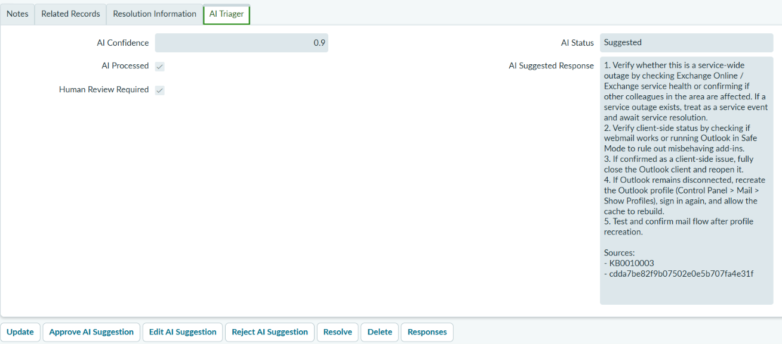
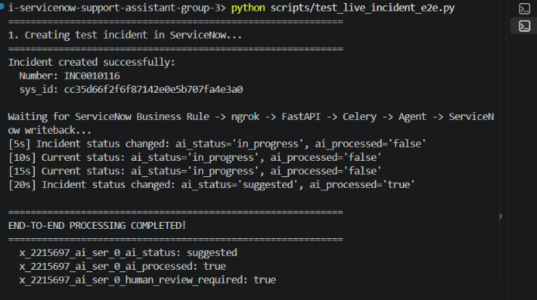
APPENDIX · LIVE EVIDENCE
Verified live: incident to cited suggestion
SERVICENOW: AI TRIAGER TAB
TERMINAL: E2E SCRIPT
0 s
Incident INC0010116 created
5 s
ai_status = in_progress
20 s
ai_status = suggested
Live test run on Oct 1, 2026 (Sprint 4.1 E2E verification). Evidence: docs/S4.1 in the repo.
18
Notes:
Backup evidence from the live Sprint 4.1 end-to-end test on October 1, 2026. Left: the AI Triager tab on INC0010116. Right: the test script polling until ai_status changed from in_progress to suggested, about 20 seconds after creation.

