Slide 1


Minor Project
EMERGENCE- AN INTELLIGENT CLASSROOM LEARNING SYSTEM
Presented by:
Mohit Kumar Yadav
B. Tech CSE AIML Batch-2
3rd Year
500122588
Guided by:
Dr. Anil Kumar
Cluster Head : AI
SoCS, UPES Dehradun

Slide 2
Content
Abstract
Introduction
Literature Review
Problem Statement
Objective
Methodology
Flowchart
Pert Chart
Conclusion
10. References

Slide 3
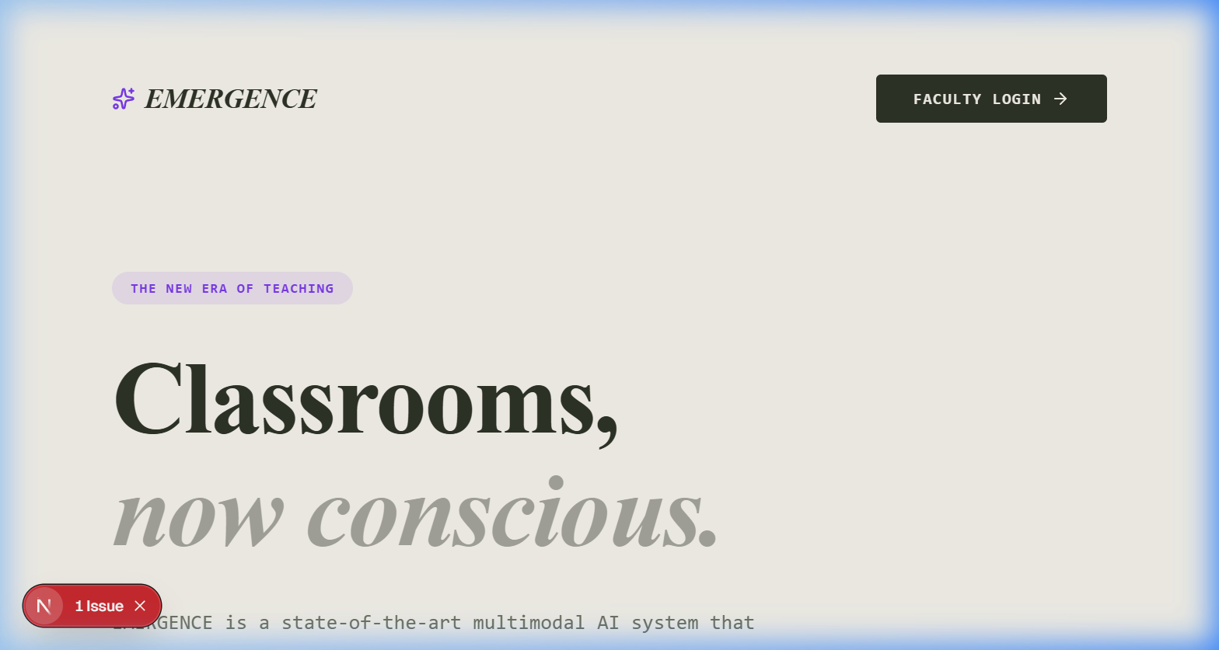
The New Era of Teaching: Predictive Intelligence
EMERGENCE utilizes state-of-the-art vision models to map out student behavior and engagement across the classroom, wrapped in a premium, accessible interface.

Slide 4
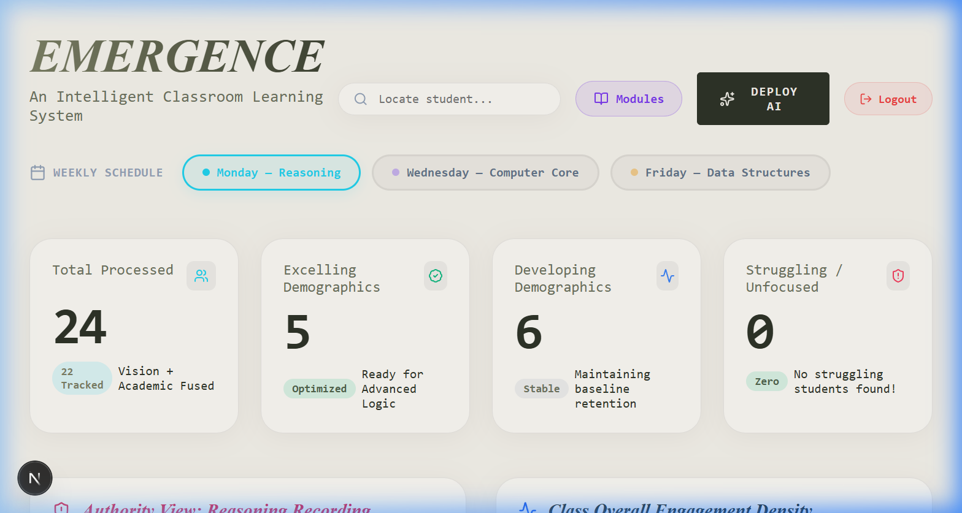
Automated Profiling & Leaderboards
The system calculates student profiling on a daily basis, fusing real-time vision metrics with academic test scores to dynamically categorize students into Excelling, Developing, and Struggling cohorts.

Slide 5
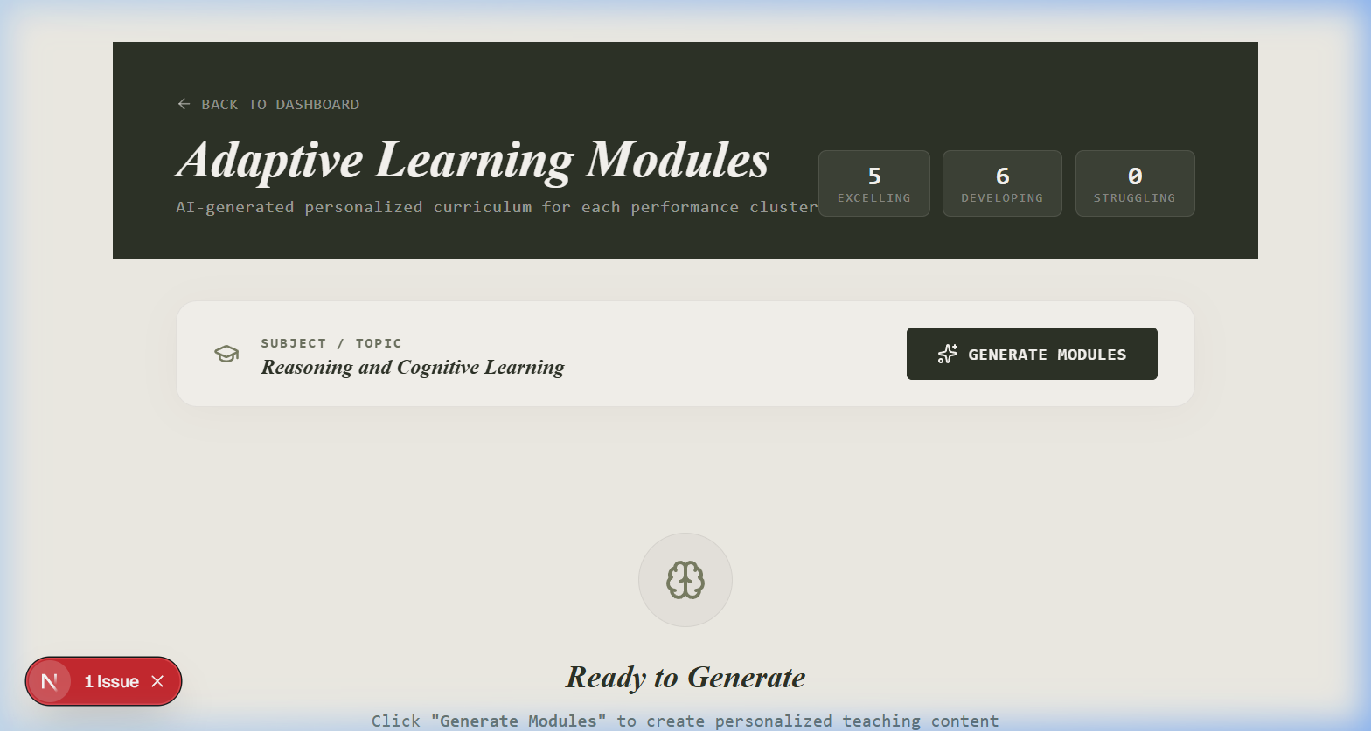
Adaptive Curriculum Generation
Powered by DeepSeek V3 and MiniMax M2.5, EMERGENCE autonomously generates hyper-personalized pedagogical interventions tailored to the specific needs of each performance cluster.

